Slide 1
ECEN 460, Spring 2026 Power System Operation and Control
Class 22: Dynamics Examples
Prof. Adam Birchfield
Dept. of Electrical and Computer Engineering
Texas A&M University
abirchfield@tamu.edu

Slide 2
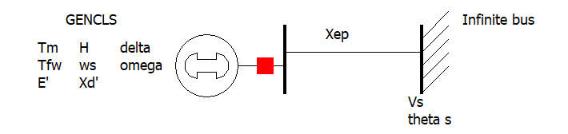
The Generator Dynamic Equations We Will Use
Example power system problem with differential algebraic equations (DAEs) is the classical synchronous generator connected to an infinite bus.
The two differential variables are $δ$ and $ω$; in practice dynamic models can have many more.
Generator Parameters
$H$ is the machine inertia constant (in seconds)
$ω_{s}$ is the synchronous frequency (2$π$60)
$T_{m}$ is the mechanical torque (power being supplied by the prime mover)
$E^{′}$ is the generator internal voltage, as controlled by the excitation system
$X_{d}^{′}$ is the generator transient impedance
$D$ damping constant of the generator
Infinite Bus / System
The infinite bus is defined by a Thevenin equivalent with voltage
$V_{s}∠θ_{vs}$
And reactance $X_{ep}$
These are the harder variables to get.
$\dot{δ} =ω$
$\frac{2H}{ω_{s}}\dot{ω}=T_{M}−\frac{E^{′}V_{s}}{X_{d}^{′}+X_{ep}}\sin\left(δ−θ_{vs}\right)−D⋅ω$

Slide 3
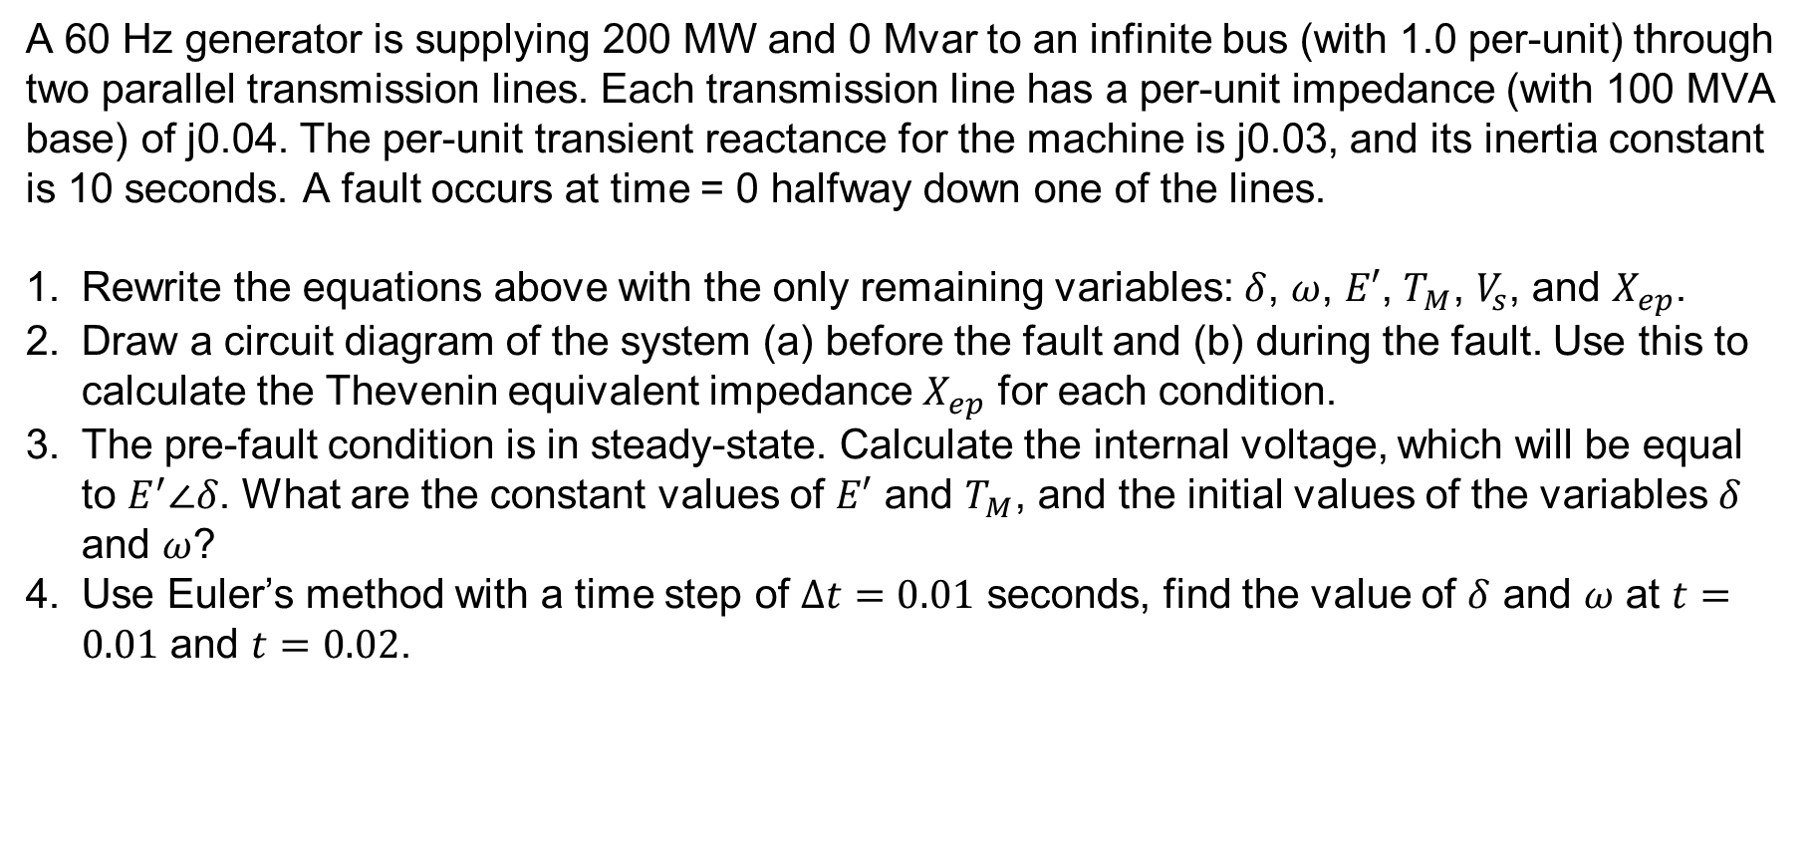
Handout Example
A 60 Hz generator is supplying 200 MW and 0 Mvar to an infinite bus (with 1.0 per-unit) through two parallel transmission lines. Each transmission line has a per-unit impedance (with 100 MVA base) of j0.04. The per-unit transient reactance for the machine is j0.03, and its inertia constant is 10 seconds. A fault occurs at time = 0 halfway down one of the lines.
Rewrite the equations above with the only remaining variables: $δ$, $ω$, $E′$, $T_{M}$, $V_{s}$, and $X_{ep}$.
Draw a circuit diagram of the system (a) before the fault and (b) during the fault. Use this to calculate the Thevenin equivalent impedance $X_{ep}$ for each condition.
The pre-fault condition is in steady-state. Calculate the internal voltage, which will be equal to $E^{′}∠δ$. What are the constant values of $E′$ and $T_{M}$, and the initial values of the variables $δ$ and $ω$?
Use Euler’s method with a time step of $Δt=0.01$ seconds, find the value of $δ$ and $ω$ at $t=0.01$ and $t=0.02$.

Slide 4
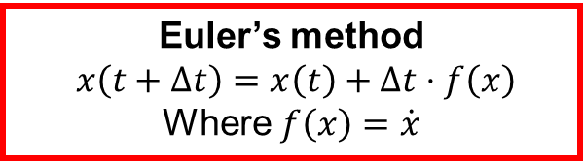
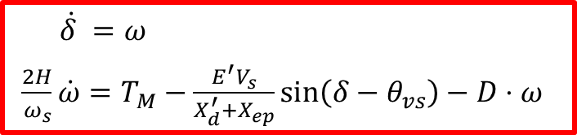
A 60 Hz generator is supplying 200 MW and 0 Mvar to an infinite bus (with 1.0 per-unit) through two parallel transmission lines. Each transmission line has a per-unit impedance (with 100 MVA base) of j0.04. The per-unit transient reactance for the machine is j0.03, and its inertia constant is 10 seconds. A fault occurs at time = 0 halfway down one of the lines.
$\dot{δ} =ω$
$\frac{2H}{ω_{s}}\dot{ω}=T_{M}−\frac{E^{′}V_{s}}{X_{d}^{′}+X_{ep}}\sin\left(δ−θ_{vs}\right)−D⋅ω$
Euler’s method
$$x\left(t+Δt\right)=x\left(t\right)+Δt⋅f\left(x\right)$$
Where $f\left(x\right)=\dot{x}$

Slide 5
Euler’s method
$$x\left(t+Δt\right)=x\left(t\right)+Δt⋅f\left(x\right)$$
Where $f\left(x\right)=\dot{x}$
$\dot{δ} =ω$
$\frac{2H}{ω_{s}}\dot{ω}=T_{M}−\frac{E^{′}V_{s}}{X_{d}^{′}+X_{ep}}\sin\left(δ−θ_{vs}\right)−D⋅ω$
A 60 Hz generator is supplying 200 MW and 0 Mvar to an infinite bus (with 1.0 per-unit) through two parallel transmission lines. Each transmission line has a per-unit impedance (with 100 MVA base) of j0.04. The per-unit transient reactance for the machine is j0.03, and its inertia constant is 10 seconds. A fault occurs at time = 0 halfway down one of the lines.

Slide 6
Blank for scratch work

Slide 7


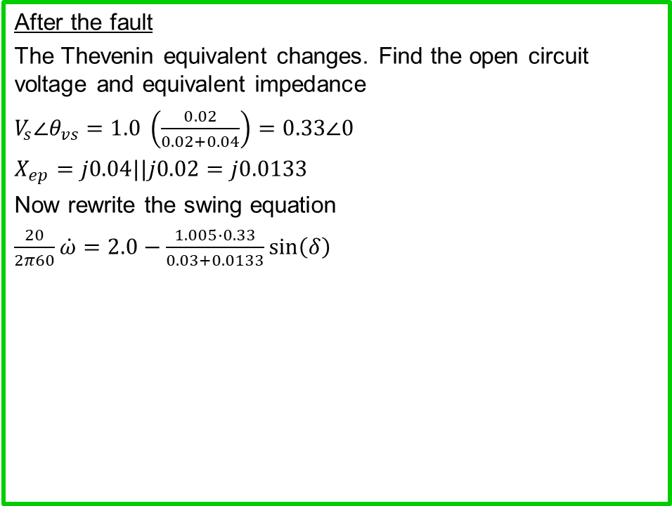
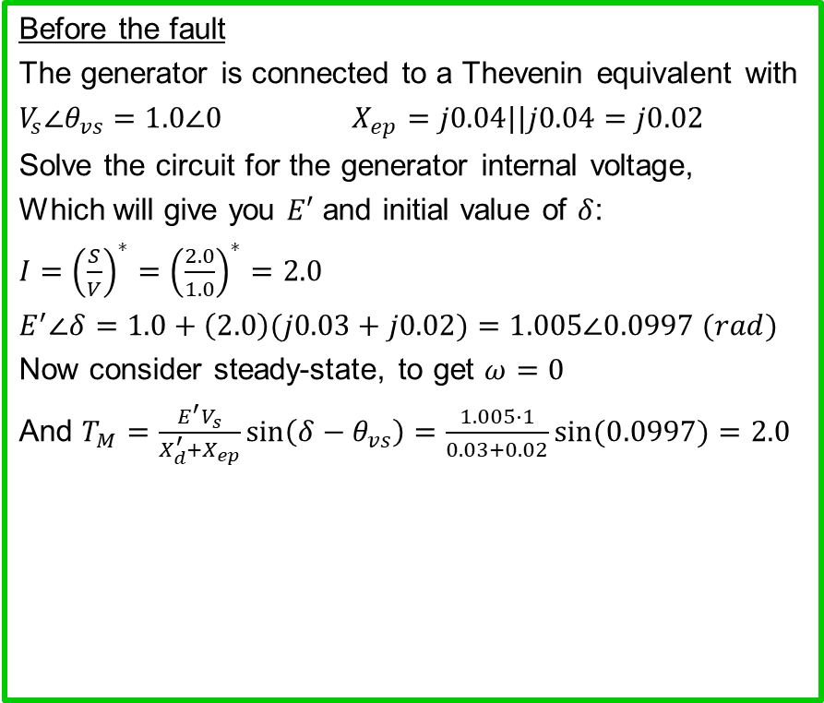
HW Solution
$\dot{δ} =ω$
$\frac{2H}{ω_{s}}\dot{ω}=T_{M}−\frac{E^{′}V_{s}}{X_{d}^{′}+X_{ep}}\sin\left(δ−θ_{vs}\right)−D⋅ω$
Euler’s method
$$x\left(t+Δt\right)=x\left(t\right)+Δt⋅f\left(x\right)$$
Where $f\left(x\right)=\dot{x}$
A 60 Hz generator is supplying 200 MW and 0 Mvar to an infinite bus (with 1.0 per-unit) through two parallel transmission lines. Each transmission line has a per-unit impedance (with 100 MVA base) of j0.04. The per-unit transient reactance for the machine is j0.03, and its inertia constant is 10 seconds. (No damping.) A fault occurs at time = 0 halfway down one of the lines.
Before the fault
The generator is connected to a Thevenin equivalent with
$V_{s}∠θ_{vs}=1.0∠0$ $X_{ep}=j0.04||j0.04=j0.02$
Solve the circuit for the generator internal voltage,
Which will give you $E′$ and initial value of $δ$:
$I={\left(\frac{S}{V}\right)}^{∗}={\left(\frac{2.0}{1.0}\right)}^{∗}=2.0$
$E^{′}∠δ=1.0+\left(2.0\right)(j0.03+j0.02)=1.005∠0.0997 (rad)$
Now consider steady-state, to get $ω=0$
And $T_{M}=\frac{E^{′}V_{s}}{X_{d}^{′}+X_{ep}}\sin\left(δ−θ_{vs}\right)=\frac{1.005⋅1}{0.03+0.02}\sin{(0.0997)}=2.0$
After the fault
The Thevenin equivalent changes. Find the open circuit voltage and equivalent impedance
$V_{s}∠θ_{vs}=1.0 \left(\frac{0.02}{0.02+0.04}\right)=0.33∠0$
$X_{ep}=j0.04||j0.02=j0.0133$
Now rewrite the swing equation
$\frac{20}{2π60}\dot{ω}=2.0−\frac{1.005⋅0.33}{0.03+0.0133}\sin\left(δ\right)$
Initial conditions:
$$δ\left(0\right)=0.0997$$
$$ω\left(0\right)=0$$
j0.04
j0.03
+
+
+
+
E$∠δ°$
1$∠0°$
_
_
E$∠δ°$
j0.04
1$∠0°$
_
_

Slide 8
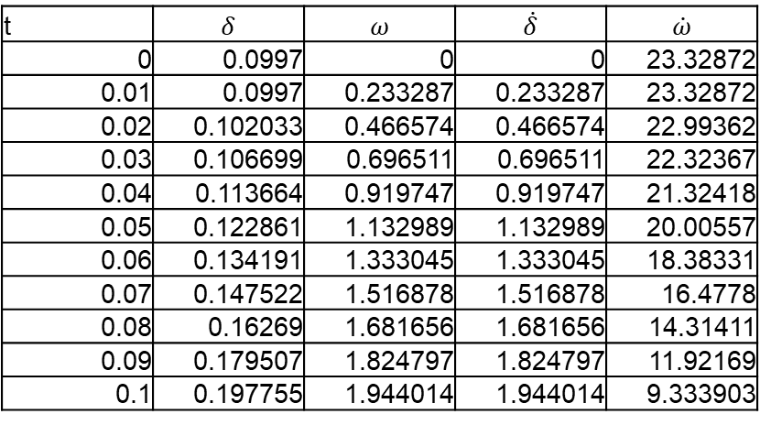
Handout from Last Class – Solution
t | $$δ$$ | $$ω$$ | $$\dot{δ}$$ | $$\dot{ω}$$
0 | 0.0997 | 0 | 0 | 23.32872
0.01 | 0.0997 | 0.233287 | 0.233287 | 23.32872
0.02 | 0.102033 | 0.466574 | 0.466574 | 22.99362
0.03 | 0.106699 | 0.696511 | 0.696511 | 22.32367
0.04 | 0.113664 | 0.919747 | 0.919747 | 21.32418
0.05 | 0.122861 | 1.132989 | 1.132989 | 20.00557
0.06 | 0.134191 | 1.333045 | 1.333045 | 18.38331
0.07 | 0.147522 | 1.516878 | 1.516878 | 16.4778
0.08 | 0.16269 | 1.681656 | 1.681656 | 14.31411
0.09 | 0.179507 | 1.824797 | 1.824797 | 11.92169
0.1 | 0.197755 | 1.944014 | 1.944014 | 9.333903

Slide 9
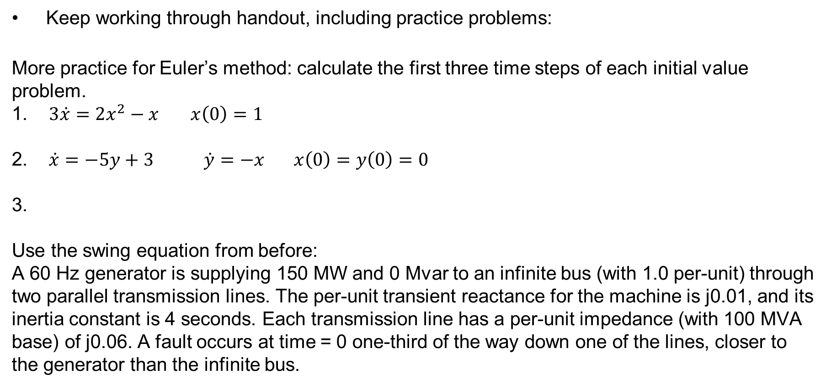
Homework
Keep working through handout, including practice problems:
More practice for Euler’s method: calculate the first three time steps of each initial value problem.
1. $3\dot{x}=2x^{2}−x$ $x\left(0\right)=1$
2. $\dot{x}=−5y+3 \dot{y}=−x x\left(0\right)=y\left(0\right)=0$
3.
Use the swing equation from before:
A 60 Hz generator is supplying 150 MW and 0 Mvar to an infinite bus (with 1.0 per-unit) through two parallel transmission lines. The per-unit transient reactance for the machine is j0.01, and its inertia constant is 4 seconds. Each transmission line has a per-unit impedance (with 100 MVA base) of j0.06. A fault occurs at time = 0 one-third of the way down one of the lines, closer to the generator than the infinite bus.

