Slide 1
ECEN 460, Spring 2026
Power System Operation and Control
Class 19: Power System Markets
Prof. Adam Birchfield
Dept. of Electrical and Computer Engineering
Texas A&M University
abirchfield@tamu.edu

Slide 2
Announcements
Exam 2 is Thursday, April 2nd in class
  Two note sheets, handwritten, 8.5”x11” front and back

Slide 3
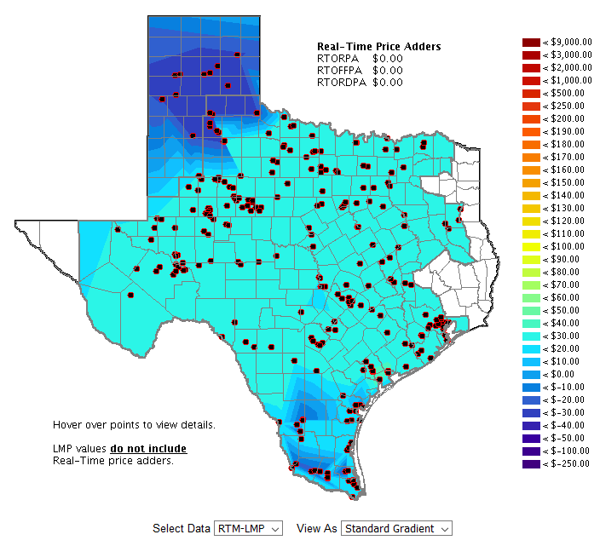
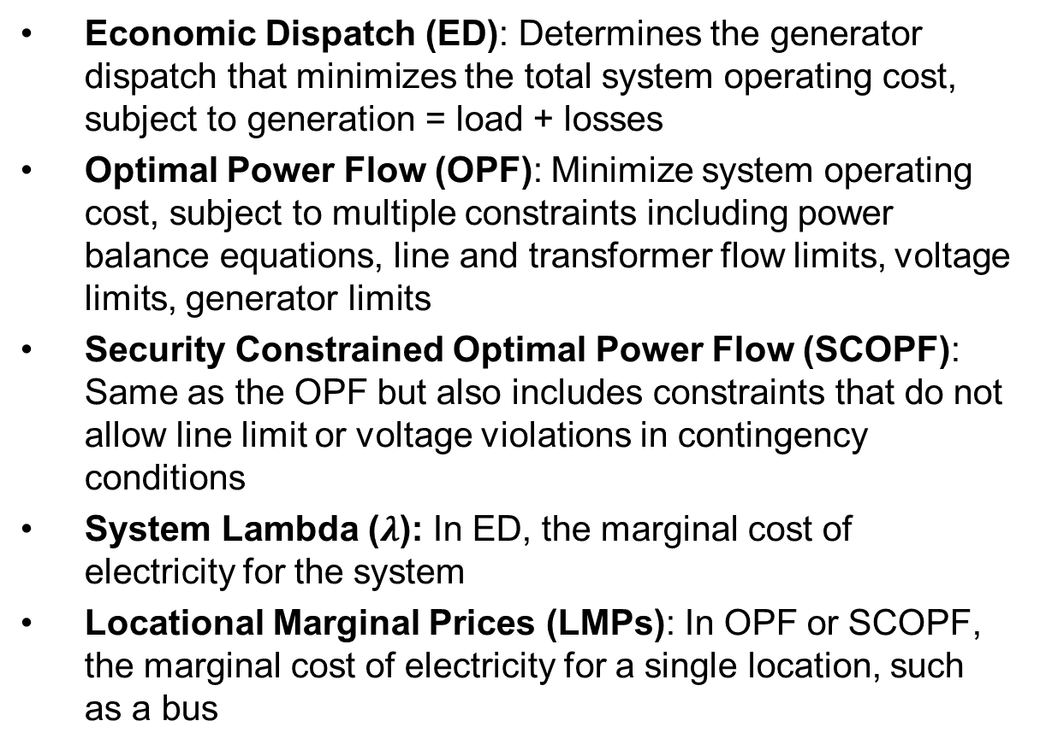
Key Terms
Economic Dispatch (ED): Determines the generator dispatch that minimizes the total system operating cost, subject to generation = load + losses
Optimal Power Flow (OPF): Minimize system operating cost, subject to multiple constraints including power balance equations, line and transformer flow limits, voltage limits, generator limits
Security Constrained Optimal Power Flow (SCOPF): Same as the OPF but also includes constraints that do not allow line limit or voltage violations in contingency conditions
System Lambda ($λ$): In ED, the marginal cost of electricity for the system
Locational Marginal Prices (LMPs): In OPF or SCOPF, the marginal cost of electricity for a single location, such as a bus
An LMP map from ERCOT

Slide 4
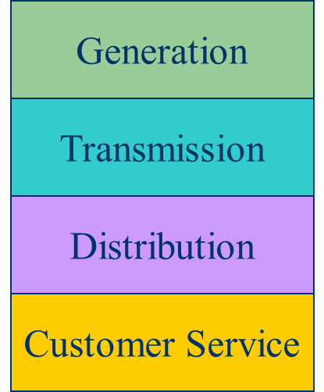
Electricity Markets Versus Centralized Planning
For decades electric utilities operated as vertical monopolies, with their rates set by state regulators. Utilities had an obligation to serve and customers had no choice.
Major change in US occurred in 1992 with the National Energy Policy Act that mandated utilities provide “nondiscriminatory” access to the high voltage grid
  Goal was to setup true competition in generation
With the vertically integrated utility, a small number of entities (typically utilities) did most of the planning
  For example, which new generators and lines to build
  Planning was coordinated and governed by regulators
  Regulators needed to know the utilities actual costs so they could provide them with a fixed rate of return
With markets the larger number of participants often make individual decisions in reaction to prices
  For example, whether to build new generation
  Generator owners in general to not need to reveal their true costs; rather they make offers into the market

Slide 5
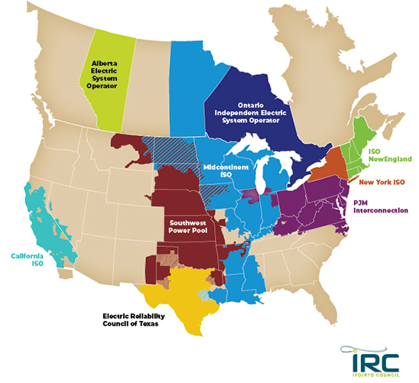
Electricity Markets Today
Starting in about 1995 electricity markets gradually started to develop, both in the US and elsewhere
In North America more than 60% of the load is supplied
via wholesale electricity markets
Markets differ but they all have certain common features
Image: https://isorto.org/#about-section

Slide 6
Market Design and Structure
What needs to be considered in designing an electricity market?
  How often do participants put in offers or bids to buy or sell electricity?
  What happens when actual demand doesn't match forecast?
  What about non-dispatchable generation like wind?
  Who's going to pay for transmission construction?
  Some generators are expensive to turn on and off and take a while to ramp their generation.
  Some generators support the grid with reactive power, transient inertia, or reserves, even though they are more expensive.
  What if participants attempt to manipulate the market?

Slide 7
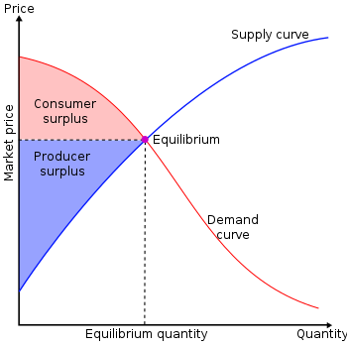
Overall Goal
Goal is to maximize the economic surplus (or total welfare), which is the sum of the consumer surplus and the producer surplus (i.e., their profit)
Generation owners have to decide their offer prices
If their price is too high, they are not selected to generate
At the wholesale level, the consumers often just see a price, though there can be price responsive load bids
Image Source: en.wikipedia.org/wiki/Economic_surplus#/media/File:Economic-surpluses.svg

Slide 8
Electricity Markets Common Features
Day ahead market – this is needed because time is required to make decisions about committing generators
  Generation owners submit offers for how much generation they can supply and at what price; accepted offers are binding
Real-time energy market – needed because day ahead forecasts are never perfect, and unexpected events can occur
Co-optimization with other “ancillary services” such as reserves
The source for much of this material “Analytic Research Foundations for the Next-Generation Electric Grid” (Chapter 2), The National Academies Press, 2016 (free download available)

Slide 9
Electricity Markets Common Features
Pricing is done using locational marginal prices, determined by an SCOPF
  Most markets include a marginal losses component
LMP markets are designed to send transparent price signal so people can make short and long-term decisions
  Generators are free to offer their electricity at whatever price they desire; they do not have to reveal their “true” costs
  Most of the times markets work as planned, and prices are competitive
  During times of shortages (scarcity) there are limits on LMPs; ERCOT’s is $9000/MWh
  Markets are run by independent system operators (ISOs)

Slide 10
LMP Energy Markets
In an LMP energy market the generation is paid the LMP at the bus, and the loads pay the LMP at the bus
  This is done in both the day ahead market and in the real-time market (which makes up the differences between actual and the day ahead)
The generator surplus (profit) is the difference between the LMP and the actual cost of generation
Generators that offer too high are not selected to run, and hence make no profit
A key decision for the generation owners is what values to offer

Slide 11
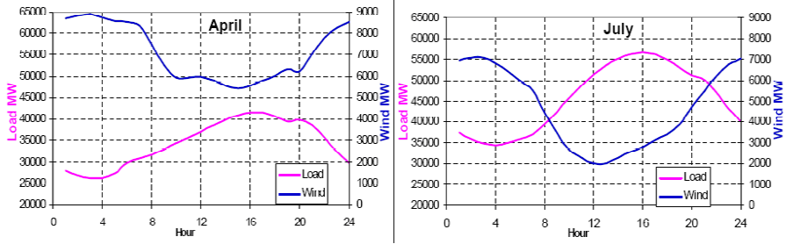
Wind Generation in ERCOT
Challenges: 1) intermittent, 2) wind and load patterns, 3) forecasting wind, 4) transmission system limitations
Source: www.ercot.com/content/wcm/training_courses/55/wind_operations_41111.pdf

Slide 12
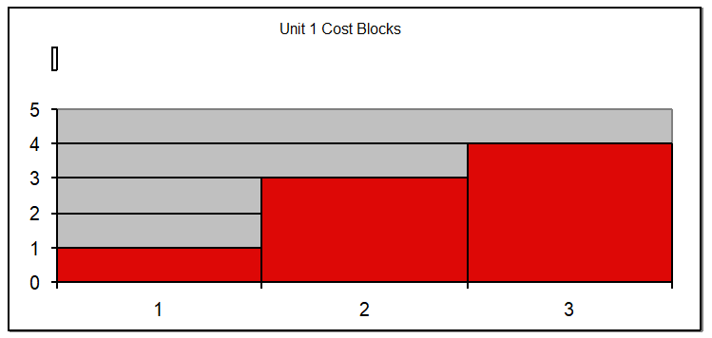
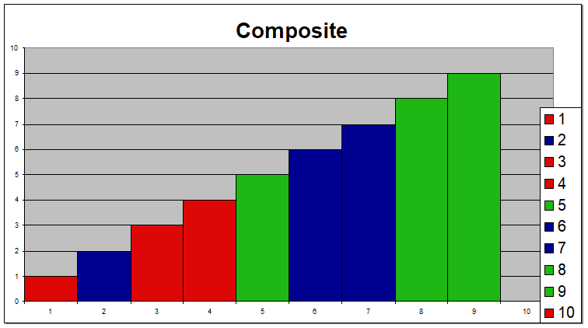
Generator Offers
Generator offers are given in piecewise linear curves; that is, a fixed $/MWh for so much power for a time period
In the absence of constraints (congestion) the ISO would just select the lowest offers to meet the anticipated load
Actual dispatch is determined using an SCOPF

Slide 13
General Guidelines
Generators with high fixed costs and low operating costs (e.g., wind, solar, nuclear) benefit from running many hours
  Usually they should submit offers close to their marginal costs
  Wind (and some others) receive a production tax credit (PTC) for their first ten years of operation
  Generators with low fixed costs and high operating cost can do fine operating fewer hours (at higher prices)

Slide 14
Trading Electricity Using Auctions
In its simplest form, an auction is a mechanism of allocating scarce goods based upon competition
  a seller wishes to obtain as much money as possible, and a buyer wants to pay as little as necessary.
An auction is usually considered efficient if resources accrue to those who value them most highly
Auctions can be either one-sided with a single monopolist seller/buyer or a double auction with multiple parties in each category
  bid to buy, offer to sell
Most people’s experience is with one-side auctions with one seller and multiple buyers

Slide 15
Auctions, cont.
Electricity markets can be one-sided, with the ISO functioning as a monopolist buyer, while multiple generating companies make offers to sell their generation, or two-sided with load participation
Auctions provide mechanisms for participants to reveal their true costs while satisfying their desires to buy low and/or sell high.
Auctions differ on the price participants receive and the information they see along the way

Slide 16
Types of Single-Sided Auctions with Multiple Buyers, One Seller
Simultaneous auctions
  English (ascending price to buy)
  Dutch (descending price to buy)
Sealed-bid auctions (all participants submit offers simultaneously)
  First price sealed bid (pay highest price if one, discriminatory prices if multiple)
  Vickrey (uniform second price) (pay the second highest price if one, all pay highest losing price if many); this approach gives people incentive to bid their true value

Slide 17
Uniform Price Auctions: Multiple Sellers, One Buyer
Uniform price auctions are sealed offer auctions in which sellers make simultaneous decisions (done when submitting offers).
Generators are paid the last accepted offer
Provides incentive to offer at marginal cost since higher values cause offers to be rejected
  reigning price should match marginal cost
Price caps are needed to prevent prices from rising up to infinity during shortages
Some generators offering above their marginal costs are needed to cover their fixed costs

Slide 18
What to Offer Example
Below example shows 3 generator case, in which the bus 2 generator can vary its offer to maximize profit
Note, this example makes the unrealistic assumption that the other generators do not vary their offers in response

Slide 19
Horizontal Market Power
One issue is whether a particular group of generators has market power
Market power is the antithesis of competition
    It is the ability of a particular group of sellers to maintain prices above competitive levels, usually by withholding supply
  The extreme case is a single supplier of a product (i.e., a monopoly)
  In the short run what a monopolistic producer can charge depends upon the price elasticity of the demand
  Sometimes market power can result in decreased prices in the long-term by quickening the entry of new players or new innovation

Slide 20
Market Power and Scarcity Rents
A generator owner exercises market power when it is unwilling to make energy available at a price that is equal to that unit’s variable cost of production, even thought there is currently unloaded generation capacity (i.e., there is no scarcity).
Scarcity rents occur when the level of electric demand is such that there is little, if any, unused capacity
Scarcity rents are used to recover fixed costs
No market power is required to earn scarcity rents
  a corn farmer earns scarcity rents when the price of corn exceeds the marginal cost of supply
High prices do not necessarily indicate market power; there may just be a scarcity

Slide 21
June 1998 Heat Storm: Two Constraints Caused a Price Spike
Price of electricity
in Central Illinois went
to $7500 per MWh!
Contoured areas could NOT sell into Midwest because of constraints on a line in Northern Wisconsin and on a transformer in Ohio

Slide 22
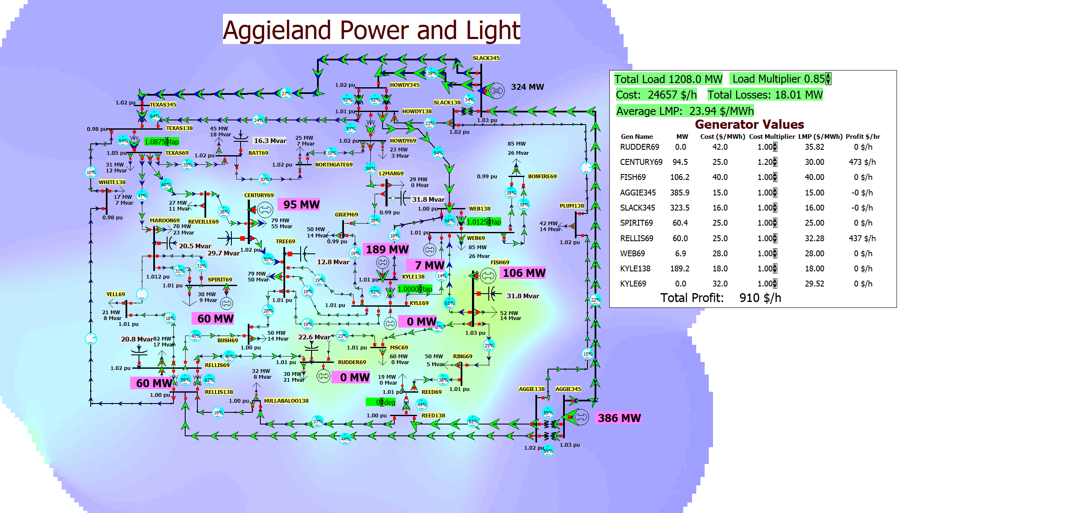
37 Bus Profit Maximization Example
To try maximizing profits, open the previous lab case and change the cost multiplier for one or more generators

Slide 23
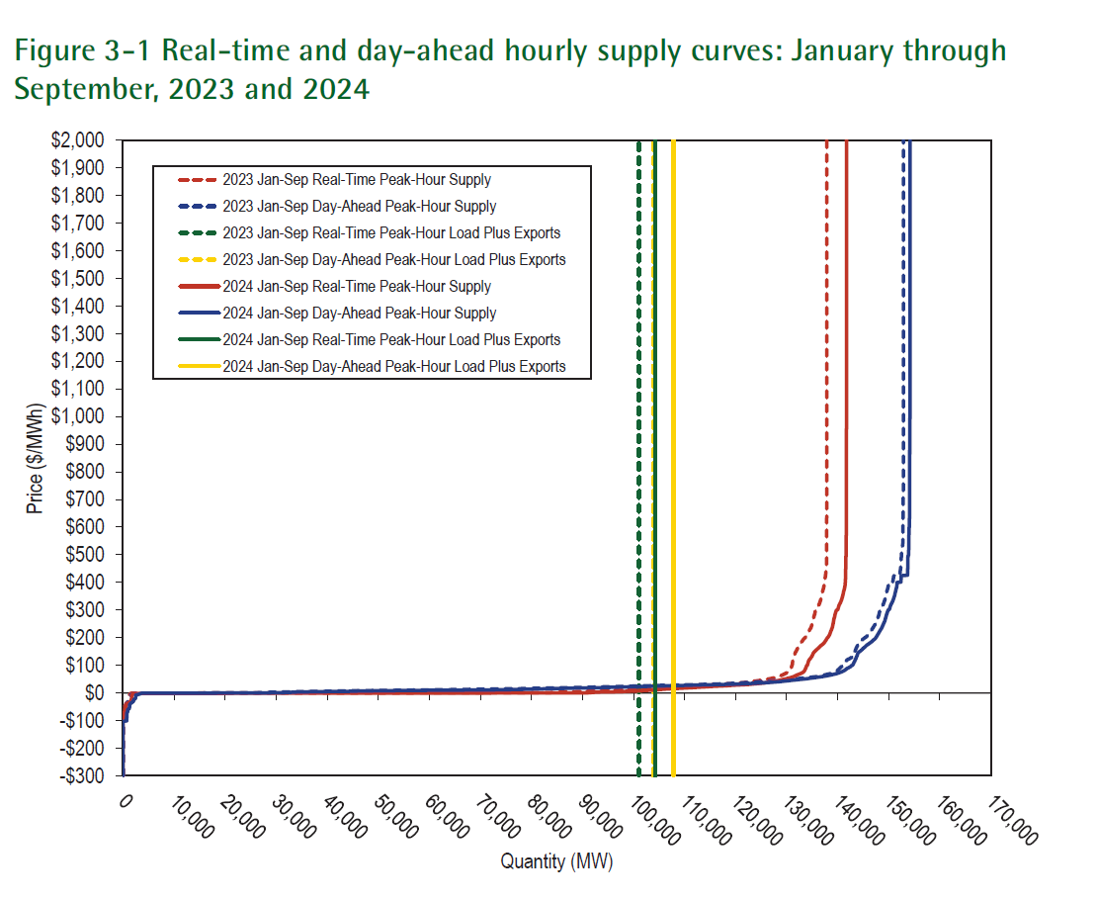
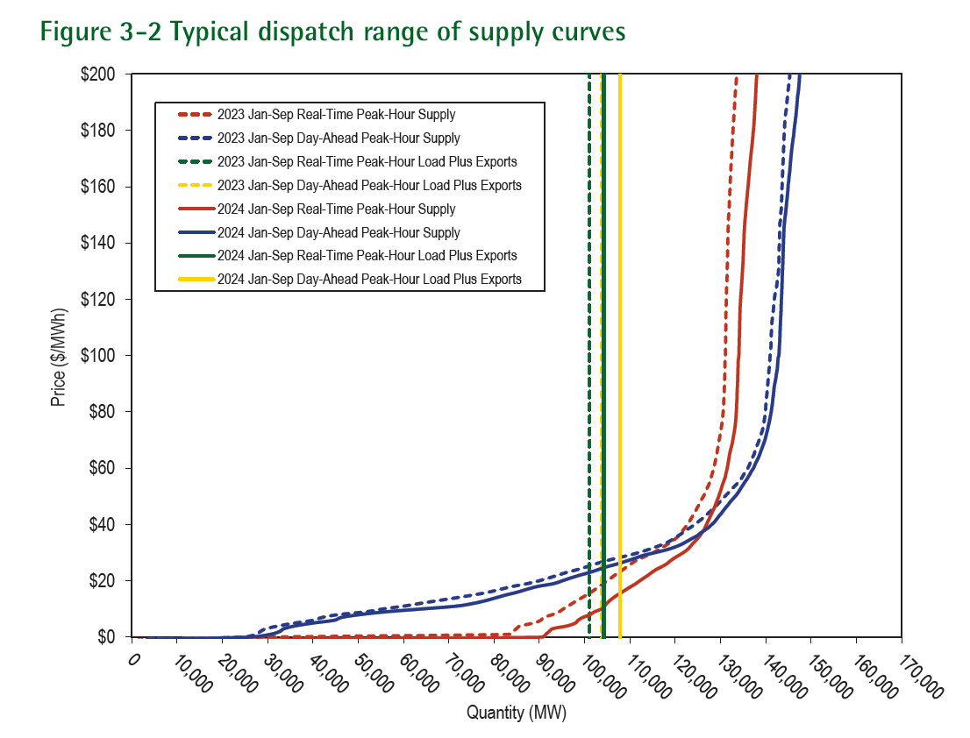
Example Generator Supply Curves
Image source: State of the Market Report for PJM, November 2024

Slide 24
ERCOT Congestion Revenue Rights
Congestion revenue rights (CRRs) are financial instruments that result in a charge or payment to the owner when the ERCOT transmission system is congested in the day ahead market
They are tradable financial instruments for hedging of transmission congestion charges
There is a payment to the owner (or perhaps payment from the owner) when there are LMP cost differences
  Options (only payments), Obligations (payments or charges)
Can be acquired by CRR auction, bilateral trades or allocation
Source: www.ercot.com/mktinfo/crr

Slide 25
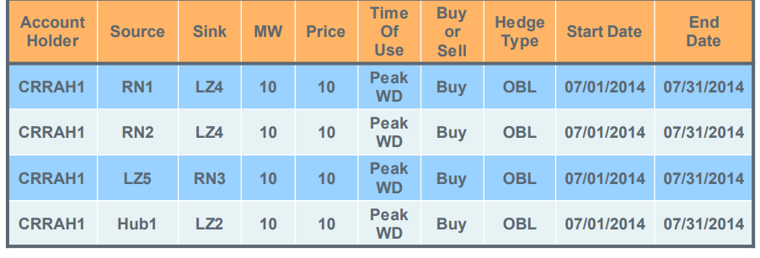
ERCOT Congestion Revenue Rights
Prior to auction ERCOT determines its system capacity
  Set on a monthly basis
  Modified based on pre-assigned CRRs (e.g., long-term supply)
They use a dc power flow model in the analysis
Auctioned or allocated in one month strips in time-of-use blocks (off-peak, peak weekday, peak weekend)
Source: www.ercot.com/content/wcm/training_courses/109553/CRR_2017_May.pdf

Slide 26
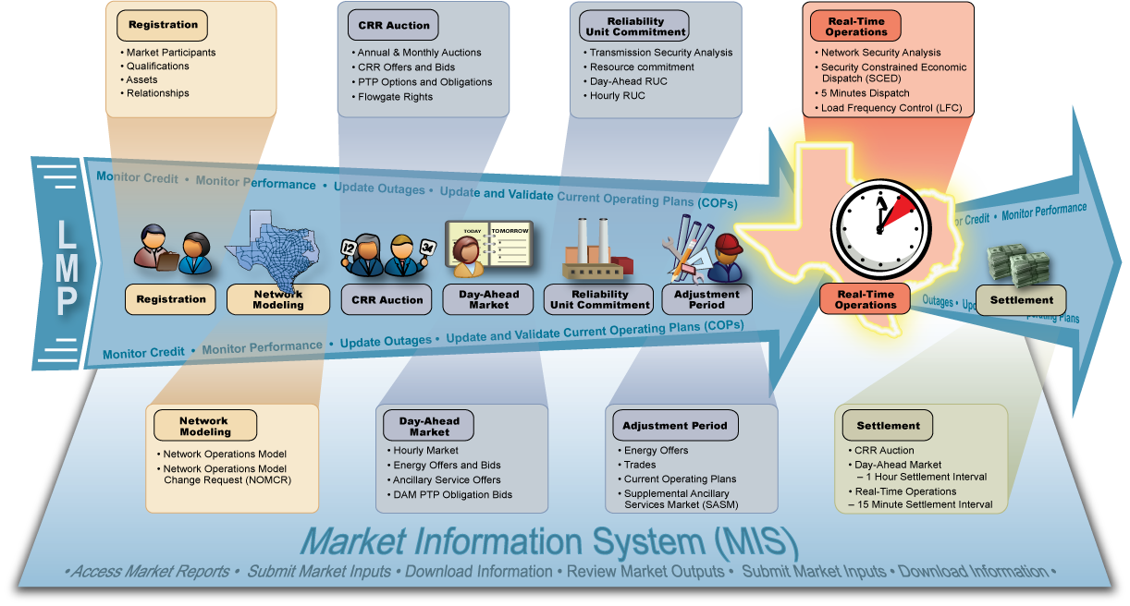
ERCOT Nodal Market Overview
Image source: ERCOT market education, transmission 101

Slide 27
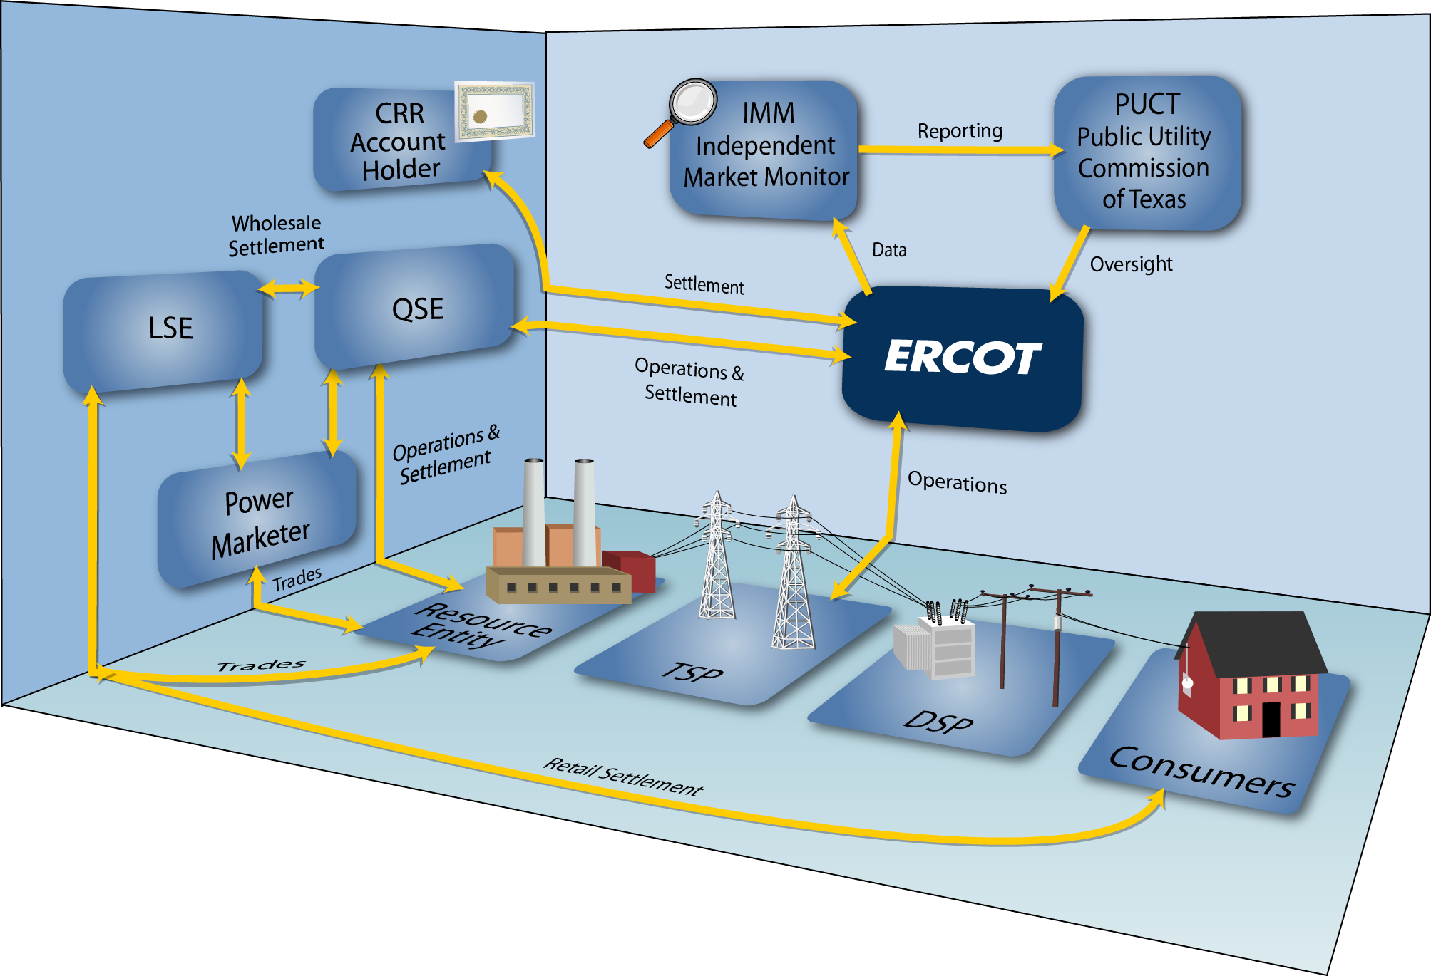
ERCOT Market Relationships
LSE is load
serving entity;
QSE is
qualified
scheduling
entity
Image source: ERCOT market education, transmission 101

