Slide 1
ECEN 460, Spring 2026 Power System Operation and Control
Class 17: Economic Dispatch Examples
Prof. Adam Birchfield
Dept. of Electrical and Computer Engineering
Texas A&M University
abirchfield@tamu.edu

Slide 2
Announcements
Homework #7: 6th edition book problems 6.62, 6.63, 6.65 or 7th edition book problems 7.1, 7.2, 7.4
Due Tuesday, March 24th

Slide 3

Economic Dispatch Summary
Minimize total generator cost, subject to serving total load
Each generator’s incremental cost curve is derivative of cost curve
Key necessary conditions for economic dispatch solution:
Total generated power must equal load + losses
Incremental cost for each generator (times penalty factor if losses are included) must be equal to the system $λ$.

Slide 4
System Lambda and Generator Limits
When the ED problem is solved, part of the solution is the incremental cost $λ$ in $/MWh. This would be the cost to serve one more MW of power. Higher $λ$ is typical for a more constrained or higher-load situation.
Generators have limits on the minimum and maximum amount of power they can produce
Often times the minimum limit is not zero. This represents a limit on the generator’s operation with the desired fuel type
Because of varying system economics usually many generators in a system are operated at their maximum MW limits.
Each generator has an incremental cost
If the generator's incremental cost is < $λ$, the generator should be operated at its maximum.
If the generator's incremental cost is > $λ$, it should be operated at its minimum.
Some generators may have their incremental cost = $λ$, these are the marginal units operated somewhere between minimum and maximum.

Slide 5
Penalty Factors
The losses on the transmission system are a function of the generation dispatch. In general, using generators closer to the load results in lower losses
This impact on losses should be included when doing the economic dispatch, and can be done by using what are known as penalty factors
A penalty factor is multiplied by the generator cost to represent the effect of losses: i.e. a generator that increases the losses by operating has a penalty factor > 1.0
For Lab 6 we are looking at the effect of penalty factors

Slide 6
Economic Dispatch Summary
Minimize total generator cost, subject to serving total load
Each generator’s incremental cost curve is derivative of cost curve
Key necessary conditions for economic dispatch solution:
Total generated power must equal load + losses
Incremental cost for each generator (times penalty factor if losses are included) must be equal to the system $λ$.

Slide 7
System Lambda and Generator Limits
When the ED problem is solved, part of the solution is the incremental cost $λ$ in $/MWh. This would be the cost to serve one more MW of power. Higher $λ$ is typical for a more constrained or higher-load situation.
Generators have limits on the minimum and maximum amount of power they can produce
Often times the minimum limit is not zero. This represents a limit on the generator’s operation with the desired fuel type
Because of varying system economics usually many generators in a system are operated at their maximum MW limits.
Each generator has an incremental cost
If the generator's incremental cost is < $λ$, the generator should be operated at its maximum.
If the generator's incremental cost is > $λ$, it should be operated at its minimum.
Some generators may have their incremental cost = $λ$, these are the marginal units operated somewhere between minimum and maximum.

Slide 8
Economic Dispatch Problem, Example 1
A system has two generators with the following cost curves.
$C_{1}$ and $C_{2}$ are the generator costs, in $/hr
$P_{1}$ and $P_{2}$ are the generator real power outputs, in MW
$$C_{1}\left(P_{1}\right)=5500+14 P_{1}+0.002 P_{1}^{2}$$
$$C_{2}\left(P_{2}\right)=2000+12 P_{2}+0.004 P_{2}^{2}$$
Each generator must be dispatched within the following limits
$$10 \text{MW}≤P_{1}≤200 \text{MW}$$
$$50 \text{MW}≤P_{2}≤500 \text{MW}$$
If the total system load is 325 MW, what should be $P_{1}$ and $P_{2}$ to minimize the total system cost $C_{1}+C_{2}$?
Also, what is the incremental cost to supply 1 more MW? How does the solution change if the load goes up to 400 MW? Down to 250 MW? Up to 570 MW? Up to 750 MW?

Slide 9
Economic Dispatch Problem, Example 1
Fundamental principle: For generators within their limits, the incremental cost should be equal to the system marginal cost $λ$
So we basically have two equations: We need to meet the load
$$P_{1}+P_{2}=325$$
And we need the incremental cost (derivatives) to be equal
$$λ=\frac{dC_{1}}{dP_{1}}=\frac{dC_{2}}{dP_{2}}$$
Take the derivatives to find the incremental cost
$$λ=\frac{dC_{1}}{dP_{1}}=14+0.004 P_{1}$$
$$λ=\frac{dC_{2}}{dP_{2}}=12 +0.008 P_{2}$$
Solving, we get $P_{1}=50 \text{MW}, P_{2}=275 \text{MW}, λ=14.2\frac{\$}{MWh}$

Slide 10
Economic Dispatch Problem, Example 1
Now try with the other values of the load
For load of 400 MW, you get $P_{1}=100, P_{2}=300, λ=14.4 \$/MWh$
For load of 250 MW, you get $P_{1}=0, P_{2}=250, λ=14 \$/MWh$
For load of 570 MW, you get $P_{1}=213, P_{2}=357, λ=14.85 \$/MWh$
For load of 750 MW, you get $P_{1}=333, P_{2}=417, λ=15.33 \$/MWh$
But wait a minute, check the limits
In the first case, we are fine, no limit violations
In the second case, $P_{1}$ will be stuck at its min limit, $P_{1}=50$, $P_{2}=200$, $λ=13.6 \$/MWh$
In the third case, $P_{1}$ will be stuck at its max limit, $P_{1}=200$, $P_{2}=370$, $λ=14.96 \$/MWh$
In the fourth case, we have a problem!!
Note that lambda and the incremental cost are related in this way
$$\left\{\begin{matrix}IC<λ & if \text{Generator} \text{at} \text{max} \text{limit} \\ IC=λ & if \text{Generator} \text{not} \text{at} \text{limit} \\ IC>λ & if \text{Generator} \text{at} \text{min} \text{limit}\end{matrix}\right.$$

Slide 11
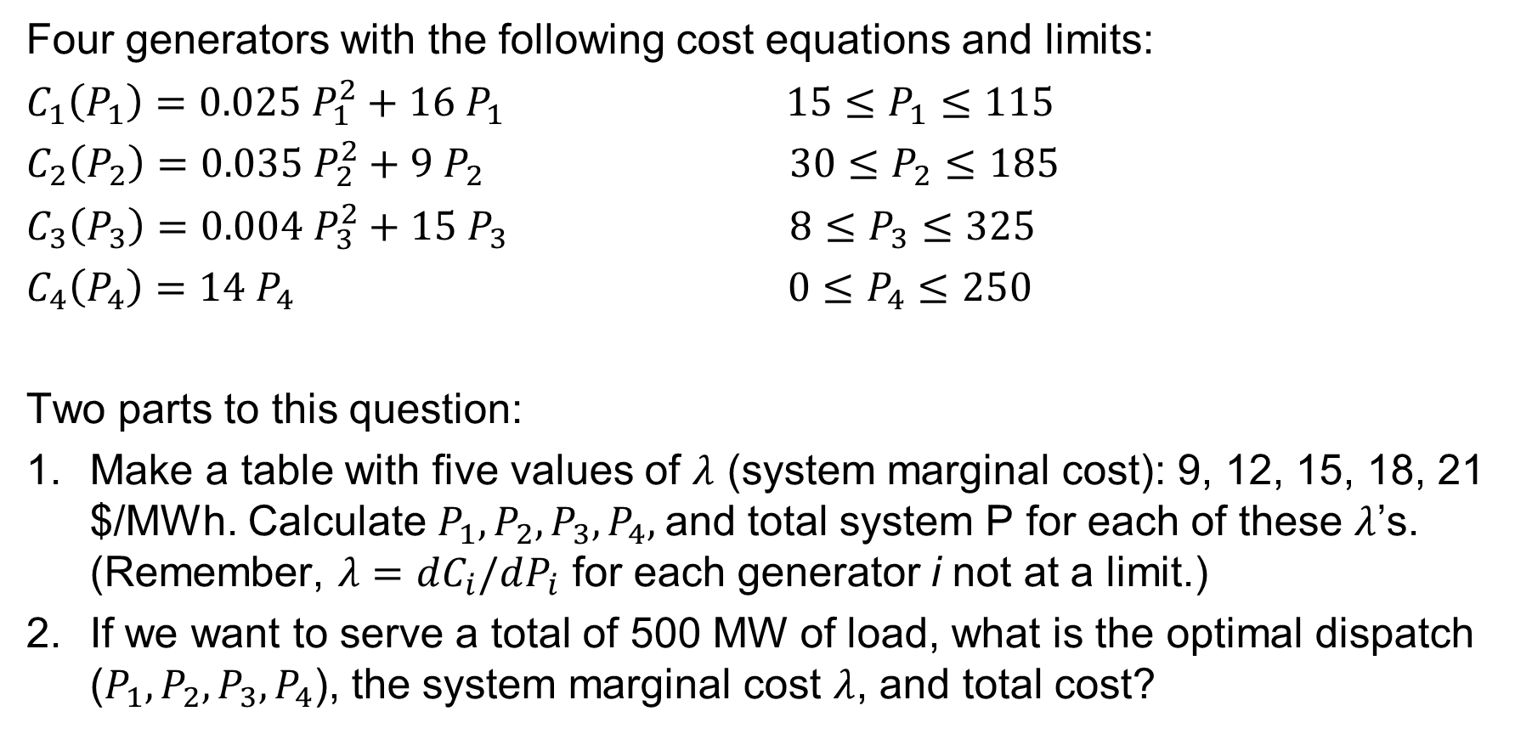
Worksheet -- Economic Dispatch, Exercise 2
Four generators with the following cost equations and limits:
$C_{1}\left(P_{1}\right)=0.025 P_{1}^{2}+16{ P}_{1}$ $15≤P_{1}≤115$
$C_{2}\left(P_{2}\right)=0.035 P_{2}^{2}+9 P_{2}$ $30≤P_{2}≤185$
$C_{3}\left(P_{3}\right)=0.004 P_{3}^{2}+15 P_{3}$ $8≤P_{3}≤325$
$C_{4}\left(P_{4}\right)=14 P_{4}$ $0≤P_{4}≤250$
Two parts to this question:
Make a table with five values of $λ$ (system marginal cost): 9, 12, 15, 18, 21 $/MWh. Calculate $P_{1}, P_{2}, P_{3},P_{4},$and total system P for each of these $λ$’s. (Remember, $λ=dC_{i}/dP_{i}$ for each generator i not at a limit.)
If we want to serve a total of 500 MW of load, what is the optimal dispatch ($P_{1}, P_{2}, P_{3},P_{4}$), the system marginal cost $λ$, and total cost?

Slide 12
Economic Dispatch, Exercise 2
$λ$ ($/MWh) | $$P_{1}$$ | $$P_{2}$$ | $$P_{3}$$ | $$P_{4}$$ | $$P_{total}$$
9
12
15
18
21

