Slide 1
ECEN 460, Spring 2026 Power System Operation and Control
Class 16: Power System Economic Modeling
Prof. Adam Birchfield
Dept. of Electrical and Computer Engineering
Texas A&M University
abirchfield@tamu.edu

Slide 2
Announcements
Homework #7: 6th edition book problems 6.62, 6.63, 6.65 or 7th edition book problems 7.1, 7.2, 7.4
Due Tuesday, March 24th

Slide 3
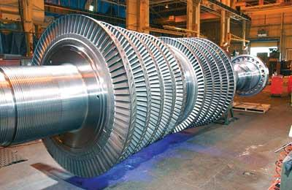
Introduction to Power System Economics
Today we're going to have introduce the economic side of power system operations
The key challenge is the economic dispatch (ED) problem, which asks how we can
Serve all of the load
Using the cheapest dispatch of generators
Subject to other reliability and efficiency constraints
The Optimal Power Flow problem (OPF), which we'll discuss later, combines ED with the Power Flow
Source: http://images.pennnet.com/articles/pe/cap/cap_gephoto.jpg

Slide 4
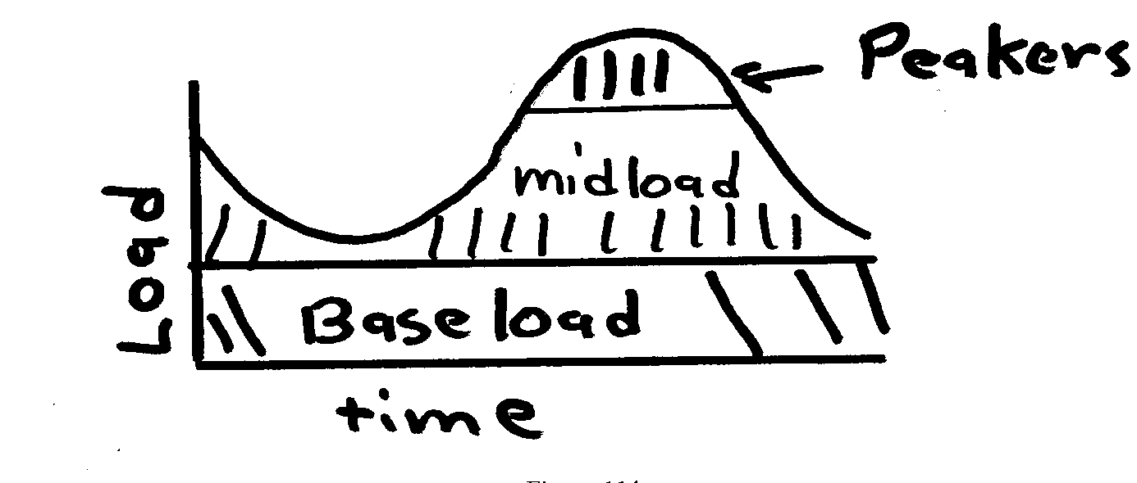
Generator Costs and Types
Generator costs depend on the fuel type, unit design, and system conditions
Traditionally there are three broad categories
Baseload: large coal and nuclear, operated 24/7 at maximum
Cycling or Midload: coal and gas plants that cycle on and off daily
Peakers: smaller gas, petroleum, hydro units that are mainly used during periods of high demand
Non-dispatchable sources such as wind and solar can be quite variable, but have a low incremental cost. Usually they are operated at the maximum available power.
For hydro the fuel (water) is free but there may be many constraints on operation: total water availability, reservoir level coordination, downstream flow for wildlife

Slide 5
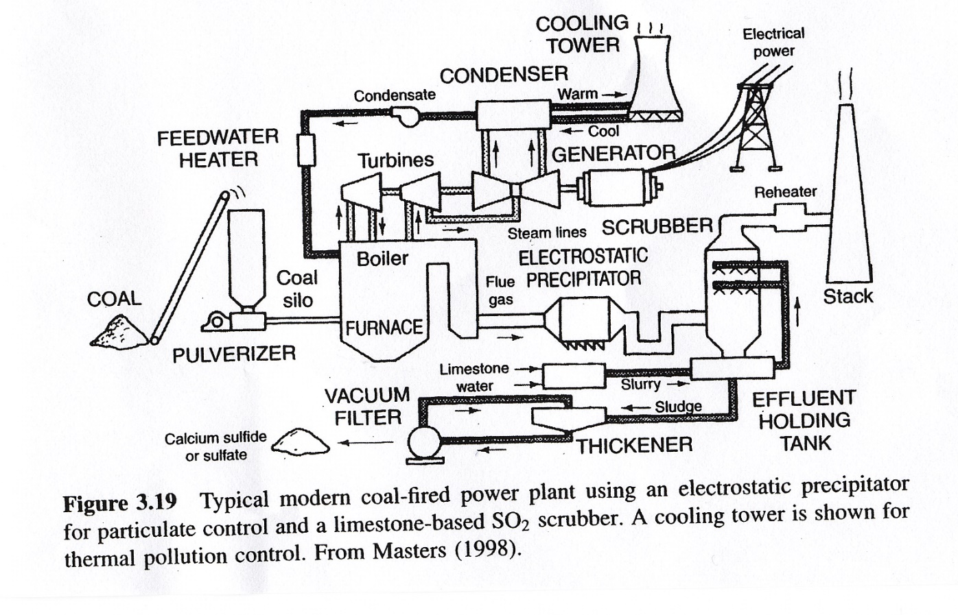
Steam Plant (Coal)
Source: Masters, Renewable and Efficient Electric Power Systems, 2004

Slide 6
Natural Gas Simple Cycle and Combined Cycle
Combined Cycle
Simple Cycle
Efficiencies of up to 60% can be achieved, with even higher values when the steam is used for heating. Fuel is usually natural gas
Typical efficiency is around 30 to 35%

Slide 7
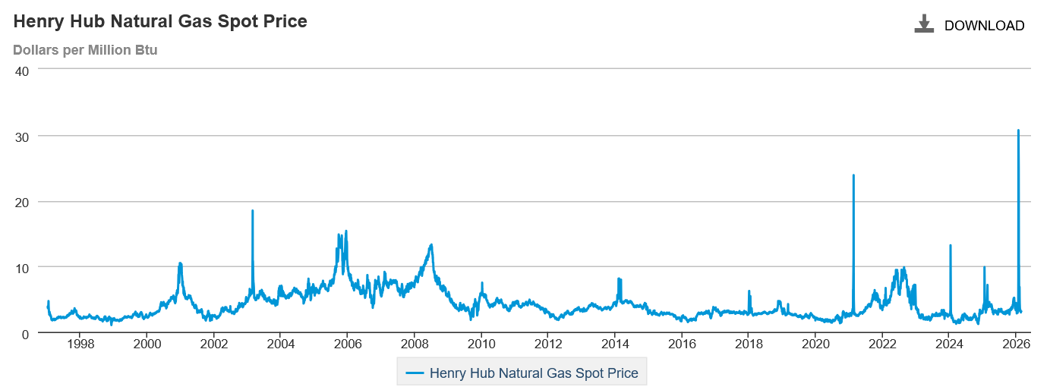
Variation in Natural Gas Prices
Our recent cold weather set a new record. Marginal cost for natural gas fired electricity price in $/MWh is about 7-10 times gas price.
Source: EIA

Slide 8
Generator Cost Curves
Generator costs are typically represented by up to four different curves
input/output (I/O) curve
fuel-cost curve
heat-rate curve
incremental cost curve
For reference
1 Btu (British thermal unit) = 1054 J
1 MBtu = 1x10⁶ Btu
1 MBtu = 0.293 MWh
3.41 Mbtu = 1 MWh

Slide 9
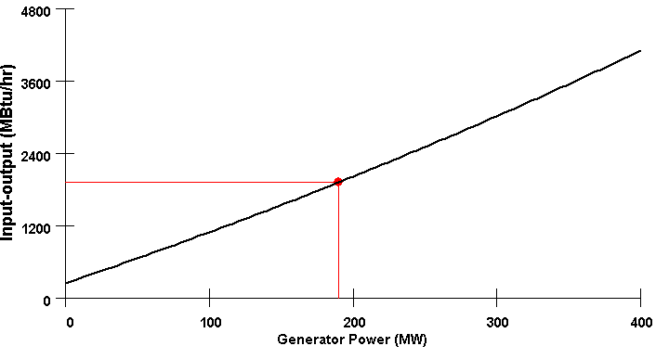
I/O Curve
The IO curve plots fuel input (in MBtu/hr) versus net MW output.

Slide 10
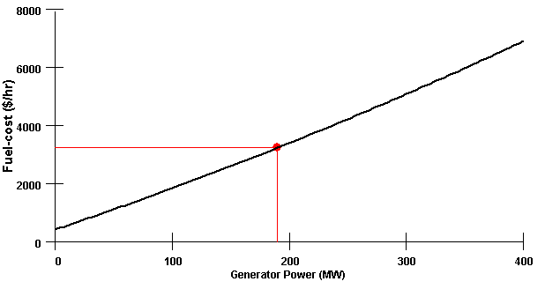
Fuel-cost Curve
The fuel-cost curve is the I/O curve scaled by fuel cost. Fuel costs vary (with the latest values in Chapter 4 of EIA’s Electricity Monthly)

Slide 11
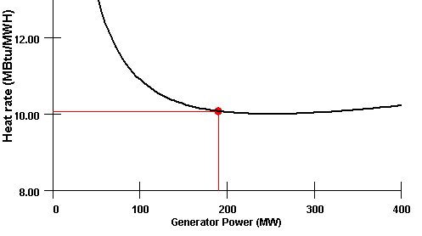
Heat-rate Curve
Plots the average number of MBtu/hr of fuel input needed per MW of output.
Heat-rate curve is the I/O curve scaled by MW; often heat rates are given in Btu/kWh, which is the Mbtu/MWh value multiplied by 1000
Coal and nuclear heat rates are around 10 (MBtu/MWh), and get down to 6.2 for highly efficient combined cycle plants

Slide 12
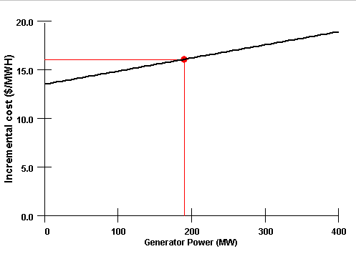
Incremental (Marginal) cost Curve
Plots the incremental $/MWh as a function of MW.
Found by differentiating the cost curve

Slide 13
Mathematical Formulation of Costs
Generator cost curves are usually not smooth. However the curves can usually be adequately approximated using piece-wise smooth, functions.
Two representations predominate
quadratic or cubic functions
piecewise linear functions
In 460 we’ll generally assume a quadratic representation
$$C_{i}(P_{Gi}) = α_{i}+βP_{Gi}+γP_{Gi}^{2} \text{\$/}\text{hr} (\text{fuel}\text{−}\text{cost}) \\ IC_{i}(P_{Gi}) = \frac{dC_{i}(P_{Gi})}{dP_{Gi}} =β+2γP_{Gi} \text{\$/}\text{MWh}$$

Slide 14
Incremental Cost Example
$\text{For} \text{a} \text{two} \text{generator} \text{system} \text{assume}$ $C_{1}(P_{G1}) = 1000+​20P_{G1}+0.01P_{G1}^{2} \$/hr$ $C_{2}(P_{G2}) = 400+​15P_{G2}+0.03P_{G2}^{2} \$/hr$
$\text{Then}$ $IC_{1}(P_{G1}) = \frac{dC_{1}(P_{G1})}{dP_{G1}} =20+0.02P_{G1} \text{\$/}\text{MWh}$ $IC_{2}(P_{G2}) = \frac{dC_{2}(P_{G2})}{dP_{G2}}=15+0.06P_{G2} \text{\$/}\text{MWh}$
$$\text{If} {\text{P}}_{\text{G}\text{1}}=250 \text{MW}$$
$$\text{and} {\text{P}}_{\text{G}\text{2}}=150 \text{MW}​$$
Then $$C_{1}(250) = 1000+​20×250+0.01×250^{2} =\text{\$ 6625/}\text{hr} \\ C_{2}(150) = 400+​15×150+0.03×150^{2} = \$6025\text{/}\text{hr} \\ \text{Then} \\ IC_{1}(250) = 20+0.02×250 =\$\text{ 25/}\text{MWh} \\ IC_{2}(150) = 15+0.06×150 =\$\text{ 24/}\text{MWh}$$

Slide 15
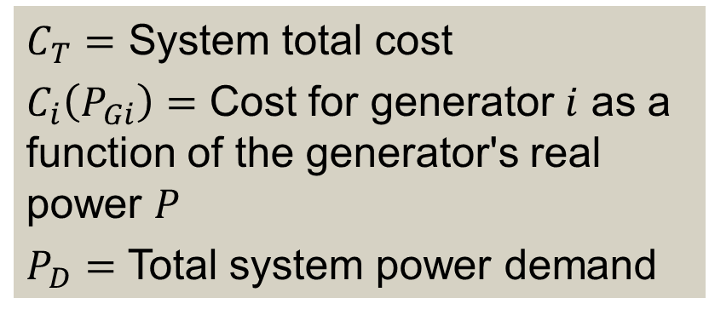
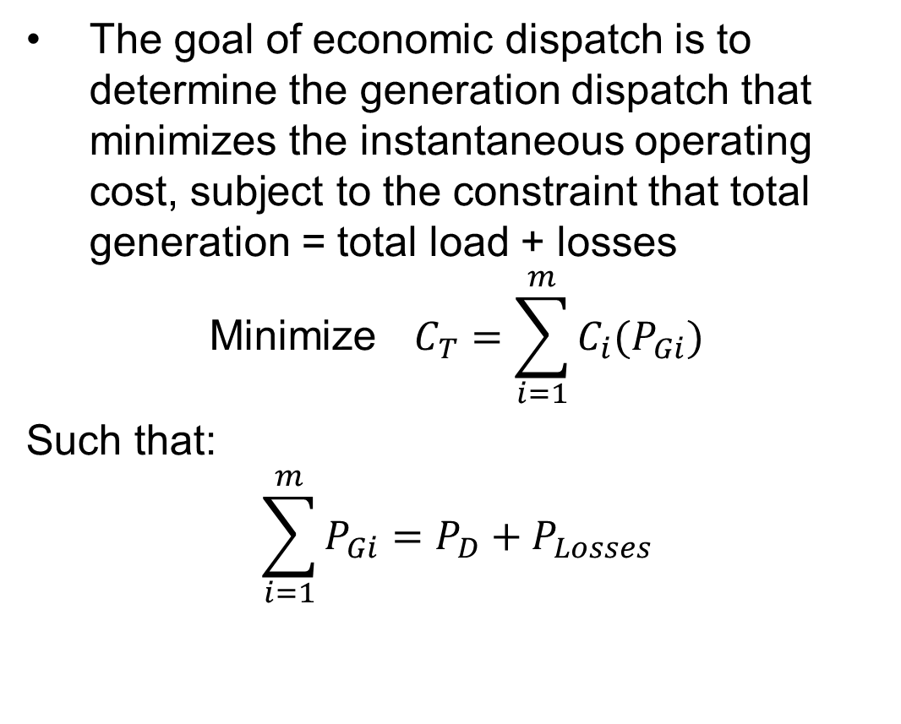
Economic Dispatch Problem
The goal of economic dispatch is to determine the generation dispatch that minimizes the instantaneous operating cost, subject to the constraint that total generation = total load + losses
$$\text{Minimize} C_{T}=\sum_{i=1}^{m}{C_{i}(P_{Gi})}$$
Such that:
$$\sum_{i=1}^{m}{P_{Gi}}=P_{D}+P_{Losses}$$
$C_{T}=$ System total cost
$C_{i}\left(P_{Gi}\right)=$ Cost for generator $i$ as a function of the generator's real power $P$
$P_{D}=$ Total system power demand

Slide 16
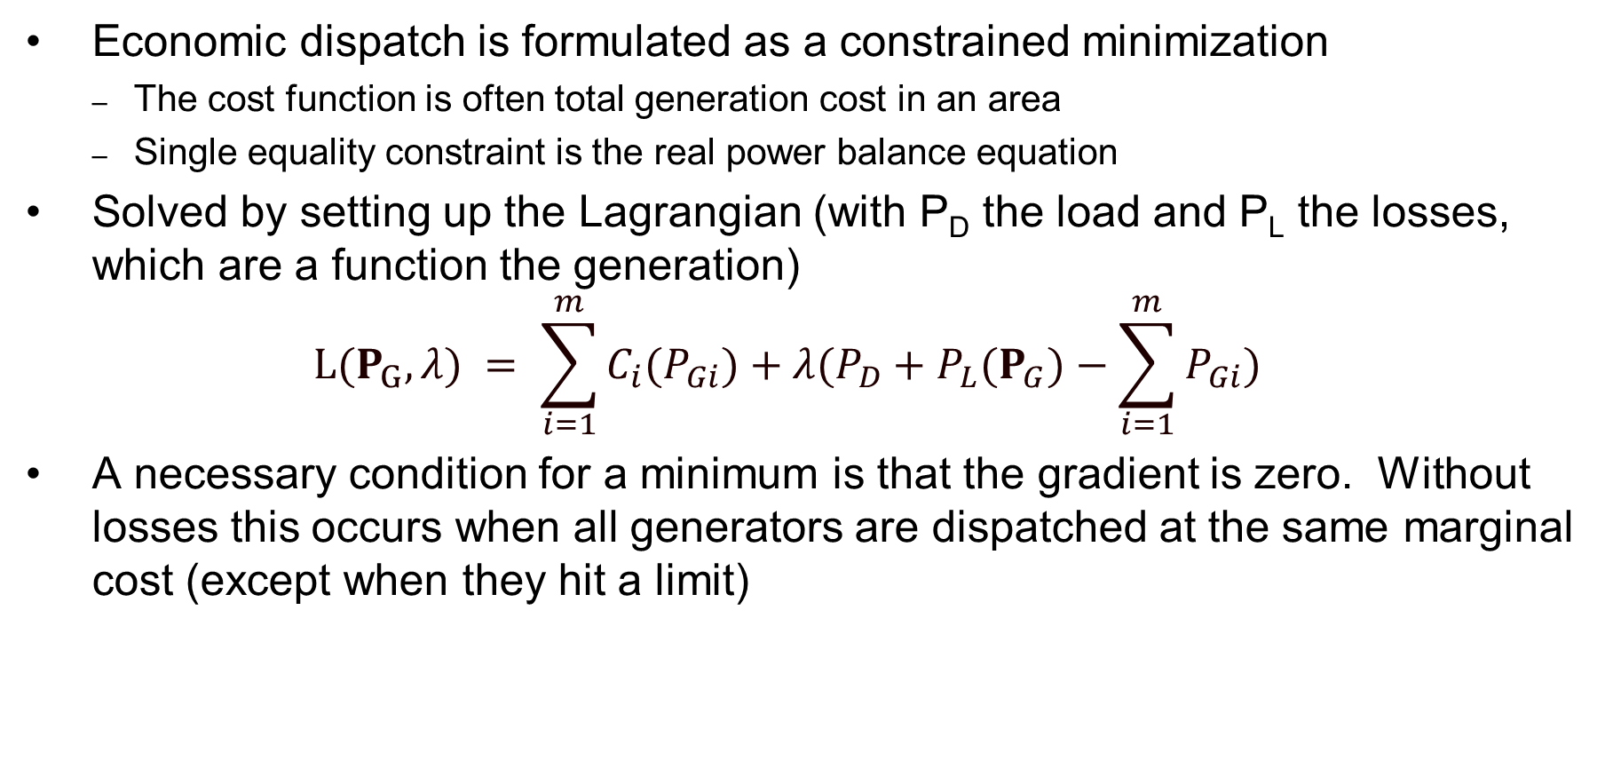
Solution to the Economic Dispatch Problem
Economic dispatch is formulated as a constrained minimization
The cost function is often total generation cost in an area
Single equality constraint is the real power balance equation
Solved by setting up the Lagrangian (with P_{D} the load and P_{L} the losses, which are a function the generation)
$$L(P_{G},λ) = \sum_{i=1}^{m}{C_{i}(P_{Gi})+λ(P_{D}+P_{L}(P_{G})−\sum_{i=1}^{m}{P_{Gi})}}$$
A necessary condition for a minimum is that the gradient is zero. Without losses this occurs when all generators are dispatched at the same marginal cost (except when they hit a limit)

Slide 17
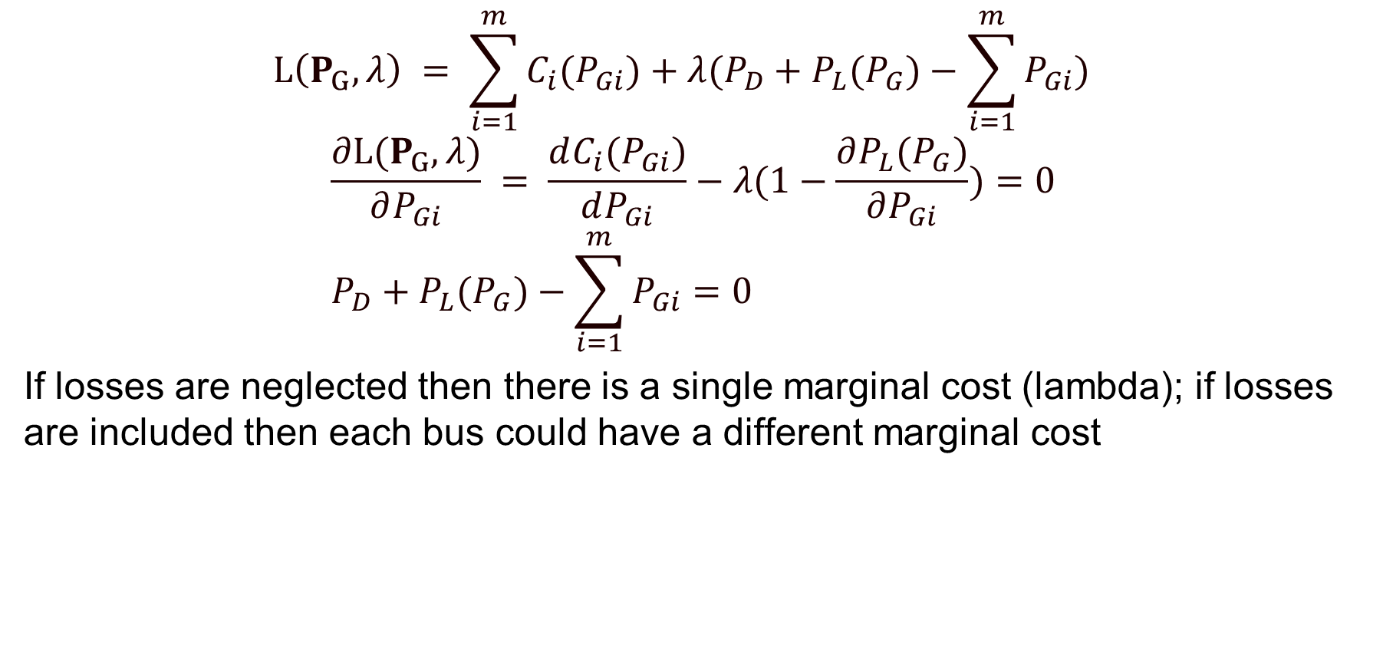
Solution to the Economic Dispatch Problem, cont.
$$L\left(P_{G},λ\right) = \sum_{i=1}^{m}{C_{i}(P_{Gi})+λ(P_{D}+P_{L}(P_{G})−\sum_{i=1}^{m}{P_{Gi})}}$$
$$\frac{∂L(P_{G},λ)}{∂P_{Gi}} = \frac{dC_{i}(P_{Gi})}{dP_{Gi}}−λ(1−\frac{∂P_{L}(P_{G})}{∂P_{Gi}})=0 \\ P_{D}+P_{L}(P_{G})−\sum_{i=1}^{m}{P_{Gi}=0}$$
If losses are neglected then there is a single marginal cost (lambda); if losses are included then each bus could have a different marginal cost

Slide 18
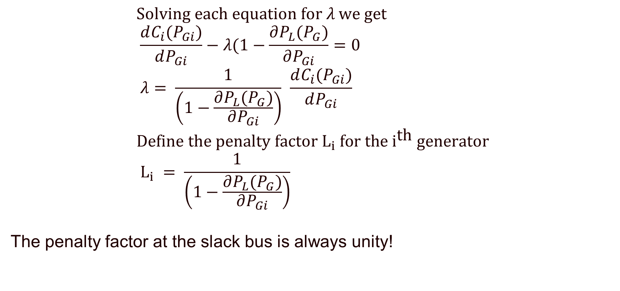
Economic Dispatch Penalty Factors
$$\text{Solving} \text{each} \text{equation} \text{for} λ \text{we} \text{get} \\ \frac{dC_{i}(P_{Gi})}{dP_{Gi}}−λ(1−\frac{∂P_{L}(P_{G})}{∂P_{Gi}}=0 \\ λ = \frac{1}{\left(1−\frac{∂P_{L}(P_{G})}{∂P_{Gi}}\right)} \frac{dC_{i}(P_{Gi})}{dP_{Gi}} \\ \text{Define} \text{the} \text{penalty} \text{factor} {\text{L}}_{i} \text{for} \text{the} {\text{i}}^{\text{th}} \text{generator} \\ L_{i} = \frac{1}{\left(1−\frac{∂P_{L}(P_{G})}{∂P_{Gi}}\right)}$$
The penalty factor at the slack bus is always unity!

Slide 19
Economic Dispatch Example
Case is Example7_3 from the book; use Power Flow Solution Options, Advanced Options to set penalty factor options

Slide 20
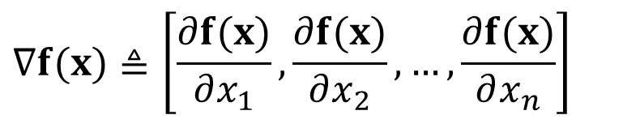

Unconstrained Minimization
Assume we have a function f(x) and wish to determine its minimum. This is an unconstrained minimization. A necessary (but not sufficient) condition for a minimum is the gradient of the function must be zero.
The gradient generalizes the first derivative for multi-variable problems:
This is not sufficient since the gradient is also zero at the maximum and at any saddle points
$$∇f(x)≜\left[\frac{∂f(x)}{∂x_{1}},\frac{∂f(x)}{∂x_{2}},…,\frac{∂f(x)}{∂x_{n}}\right]$$
$$∇f(x)=0$$

Slide 21

Minimization with Equality Constraint
When the minimization is constrained with one or more equality constraints we can solve the problem using the method of Lagrange Multipliers
Key idea is to modify a constrained minimization problem to be an unconstrained problem
$$\text{That} \text{is}\text{, }\text{for} \text{the} \text{general} \text{problem} \\ \text{minimize} f(x) \text{s}\text{.}\text{t}\text{. }g(x) = 0 \\ \text{We} \text{define} \text{the} \text{Lagrangian} \text{L}(x,λ)=f(x)+λ^{T}g(x) \\ \text{Then} \text{a} \text{necessary} \text{condition} \text{for} \text{a} \text{minimum} \text{is} \text{the} \\ ∇L_{x}(x,λ)=0 \text{and} ∇L_{λ}(x,λ)=0$$

Slide 22
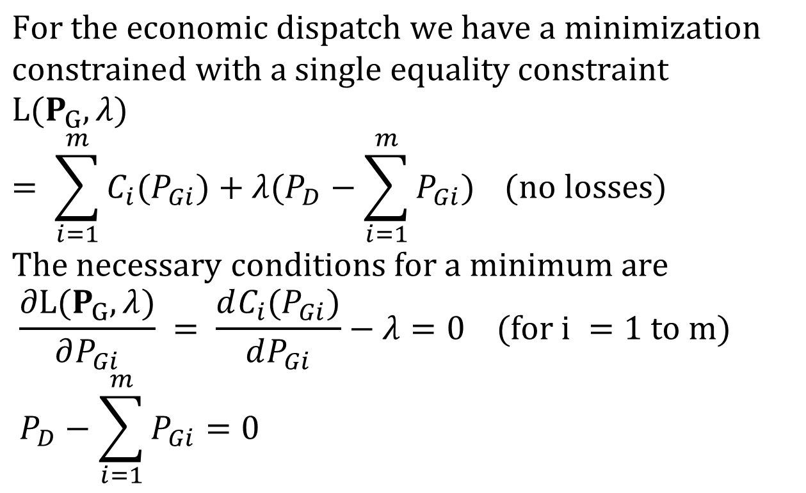
Economic Dispatch Lagrangian
$$\text{For} \text{the} \text{economic} \text{dispatch} \text{we} \text{have} \text{a} \text{minimization} \\ \text{constrained} \text{with} \text{a} \text{single} \text{equality} \text{constraint} \\ L(P_{G},λ) = \sum_{i=1}^{m}{C_{i}(P_{Gi})+λ(P_{D}−\sum_{i=1}^{m}{P_{Gi})}} (\text{no} \text{losses}) \\ \text{The} \text{necessary} \text{conditions} \text{for} \text{a} \text{minimum} \text{are} \\ \frac{∂L(P_{G},λ)}{∂P_{Gi}} = \frac{dC_{i}(P_{Gi})}{dP_{Gi}}−λ=0 (\text{for} \text{i} =\text{1 }\text{to} \text{m}) \\ P_{D}−\sum_{i=1}^{m}{P_{Gi}=0}$$

Slide 23
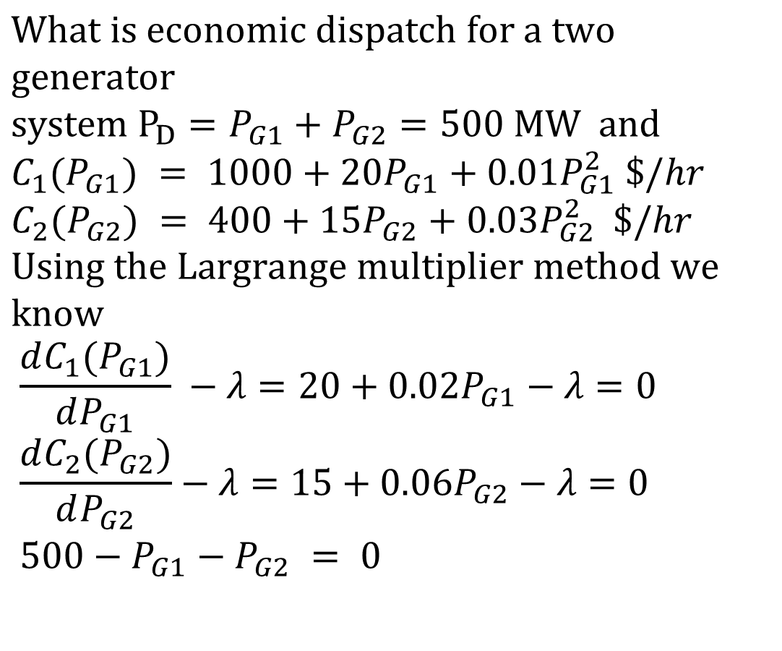
Economic Dispatch Example
$$\text{What} \text{is} \text{economic} \text{dispatch} \text{for} \text{a} \text{two} \text{generator} \\ \text{system} {\text{P}}_{D}=P_{G1}+P_{G2}=500 \text{MW} \text{and} \\ C_{1}(P_{G1}) = 1000+​20P_{G1}+0.01P_{G1}^{2} \$/hr \\ C_{2}(P_{G2}) = 400+​15P_{G2}+0.03P_{G2}^{2} \$/hr \\ \text{Using} \text{the} \text{Largrange} \text{multiplier} \text{method} \text{we} \text{know} \\ \frac{dC_{1}(P_{G1})}{dP_{G1}} −λ =20+0.02P_{G1}−λ =0 \\ \frac{dC_{2}(P_{G2})}{dP_{G2}}−λ =15+0.06P_{G2}−λ =0 \\ 500−P_{G1}−P_{G2} = 0$$

Slide 24
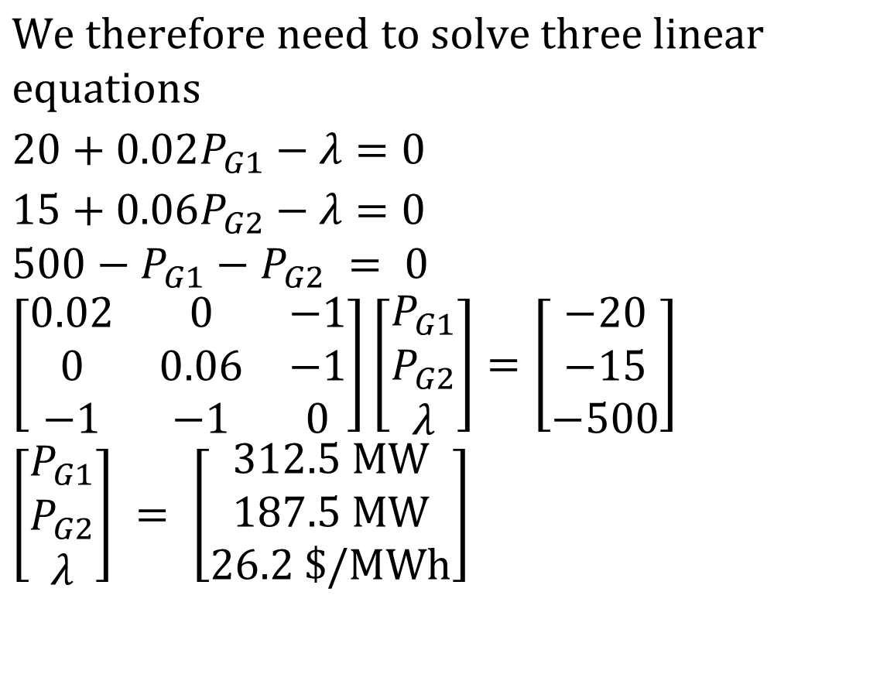
Economic Dispatch Example, cont’d
$$\text{We} \text{therefore} \text{need} \text{to} \text{solve} \text{three} \text{linear} \text{equations} \\ 20+0.02P_{G1}−λ =0 \\ 15+0.06P_{G2}−λ =0 \\ 500−P_{G1}−P_{G2} = 0 \\ \left[\begin{matrix}0.02 & 0 & −1 \\ 0 & 0.06 & −1 \\ −1 & −1 & 0\end{matrix}\right]\left[\begin{matrix}P_{G1} \\ P_{G2} \\ λ\end{matrix}\right]=\left[\begin{matrix}−20 \\ −15 \\ −500\end{matrix}\right] \\ \left[\begin{matrix}P_{G1} \\ P_{G2} \\ λ\end{matrix}\right] = \left[\begin{matrix}312.5 \text{MW} \\ 187.5 \text{MW} \\ 26.2\text{ \$/}\text{MWh}\end{matrix}\right]$$

Slide 25
Lambda-Iteration Solution Method
The direct solution only works well if the incremental cost curves are linear and no generators are at their limits
A more general method is known as the lambda-iteration
the method requires that there be a unique mapping between a value of lambda and each generator’s MW output
the method then starts with values of lambda below and above the optimal value, and then iteratively brackets the optimal value

Slide 26
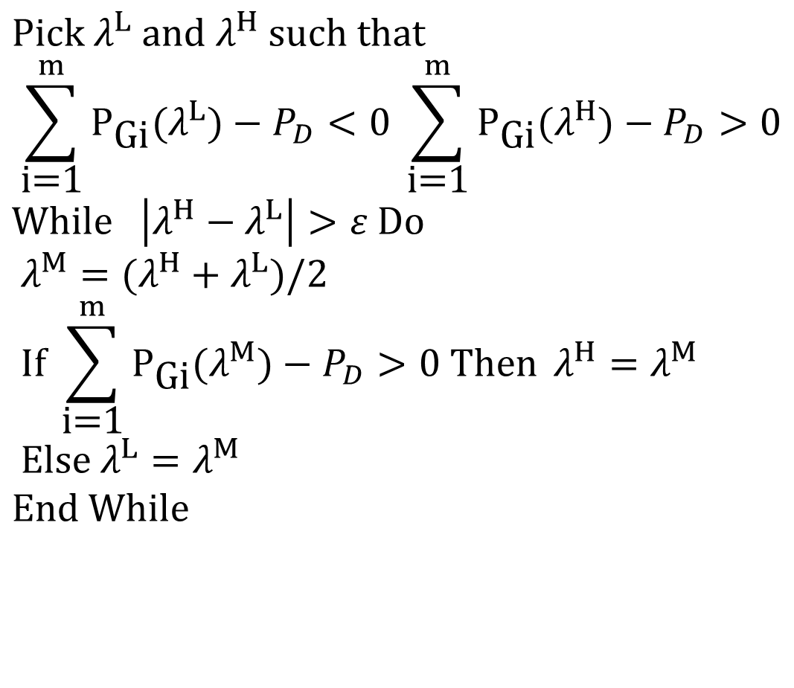
Lambda-Iteration Algorithm
$$\text{Pick} λ^{L} \text{and} λ^{H} \text{such} \text{that} \\ \sum_{\text{i}\text{=1}}^{m}{P_{\text{Gi}}(λ^{L})−P_{D}<0} \sum_{\text{i}\text{=1}}^{m}{P_{\text{Gi}}(λ^{H})−P_{D}>0} \\ \text{While} \left|λ^{H}−λ^{L}\right|>ε \text{Do} \\ λ^{M}=(λ^{H}+λ^{L})/2 \\ \text{If} \sum_{\text{i}\text{=1}}^{m}{P_{\text{Gi}}(λ^{M})−P_{D}>0 \text{Then} }λ^{H}=λ^{M} \\ \text{Else} λ^{L}=λ^{M} \\ \text{End} \text{While}$$

Slide 27
Lambda-Iteration: Graphical View
In the graph shown, for each value of lambda
there is a unique P_{Gi} for each generator. This
relationship is the P_{Gi}(λ) function.

Slide 28
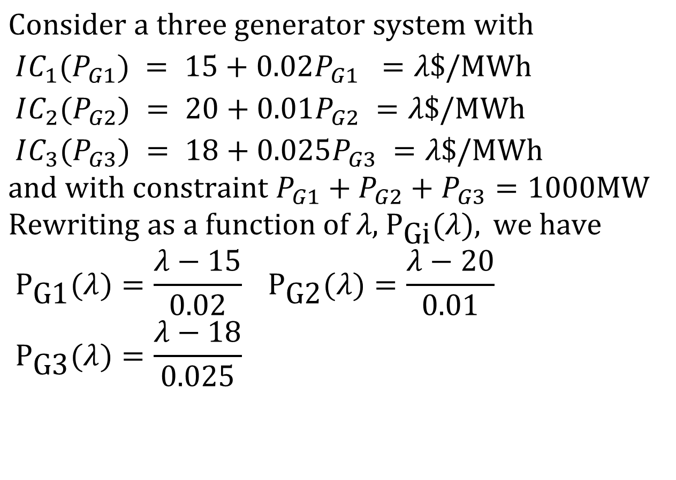
Lambda-Iteration Example
$$\text{Consider} \text{a} \text{three} \text{generator} \text{system} \text{with} \\ IC_{1}(P_{G1}) = 15+0.02P_{G1} =λ \text{\$/}\text{MWh} \\ IC_{2}(P_{G2}) = 20+0.01P_{G2} =λ \text{\$/}\text{MWh} \\ IC_{3}(P_{G3}) = 18+0.025P_{G3} =λ \text{\$/}\text{MWh} \\ \text{and} \text{with} \text{constraint} P_{G1}+P_{G2}+P_{G3}=1000\text{MW} \\ \text{Rewriting} \text{as} \text{a} \text{function} \text{of} λ\text{, }{\text{P}}_{\text{Gi}}(λ), \text{we} \text{have} \\ P_{\text{G}\text{1}}(λ)=\frac{λ−15}{0.02} P_{\text{G}\text{2}}(λ)=\frac{λ−20}{0.01} \\ P_{\text{G}\text{3}}(λ)=\frac{λ−18}{0.025}$$

Slide 29
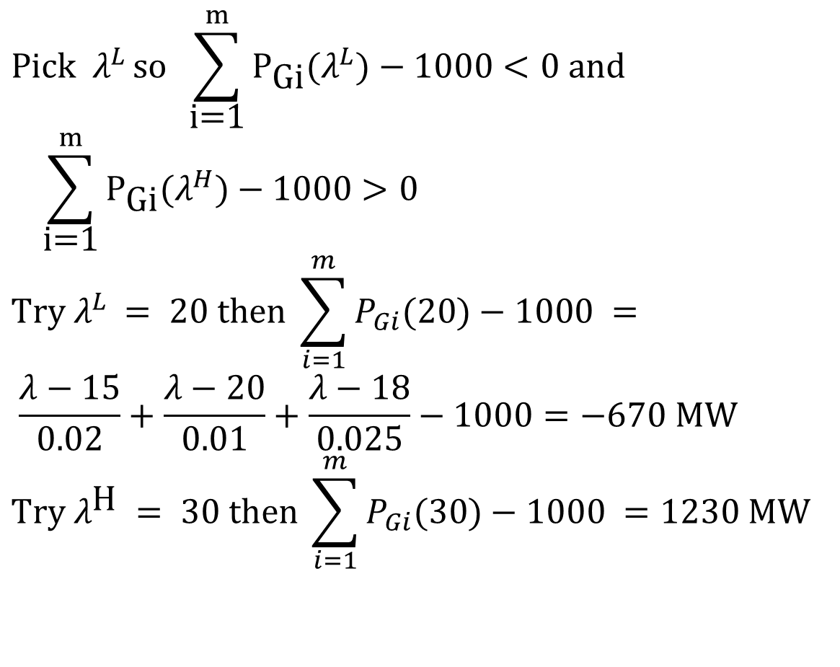
Lambda-Iteration Example, cont’d
$$\text{Pick} λ^{L }\text{so} \sum_{\text{i}\text{=1}}^{m}{P_{\text{Gi}}(λ^{L})}−1000<0 \text{and} \\ \sum_{\text{i}\text{=1}}^{m}{P_{\text{Gi}}(λ^{H})}−1000>0 \\ \text{Try} λ^{L }=\text{ 20 }\text{then} \sum_{i=1}^{m}{P_{Gi}(20)}−1000 = \\ \frac{λ−15}{0.02}+\frac{λ−20}{0.01}+\frac{λ−18}{0.025}−1000=−670 \text{MW} \\ \text{Try} λ^{\text{H} }=\text{ 30 }\text{then} \sum_{i=1}^{m}{P_{Gi}(30)}−1000 =1230 \text{MW}$$

Slide 30
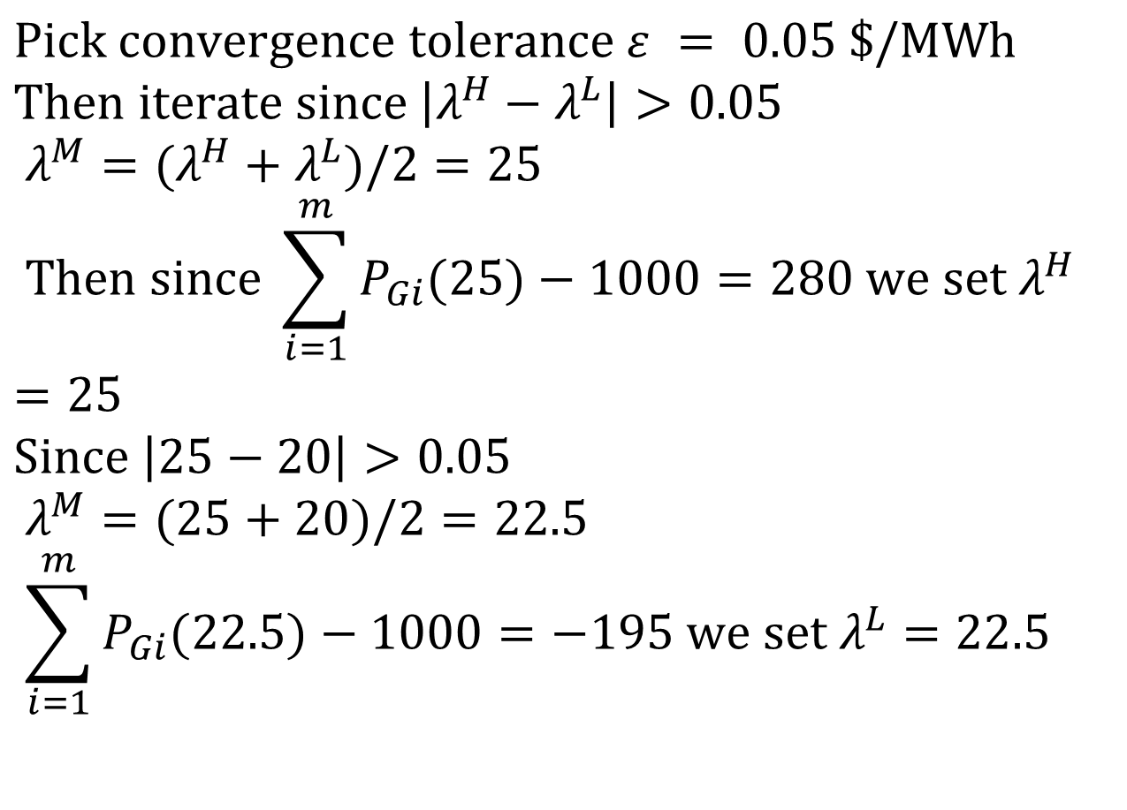
Lambda-Iteration Example, cont’d
$$\text{Pick} \text{convergence} \text{tolerance} ε = 0.05\text{ \$/}\text{MWh} \\ \text{Then} \text{iterate} \text{since} \left|λ^{H}−λ^{L}\right|>0.05 \\ λ^{M}=(λ^{H}+λ^{L})/2=25 \\ \text{Then} \text{since} \sum_{i=1}^{m}{P_{Gi}(25)}−1000=280 \text{we} \text{set} λ^{H}=25 \\ \text{Since} \left|25−20\right|>0.05 \\ λ^{M}=(25+20)/2=22.5 \\ \sum_{i=1}^{m}{P_{Gi}(22.5)}−1000=−195 \text{we} \text{set} λ^{L}=22.5$$

Slide 31
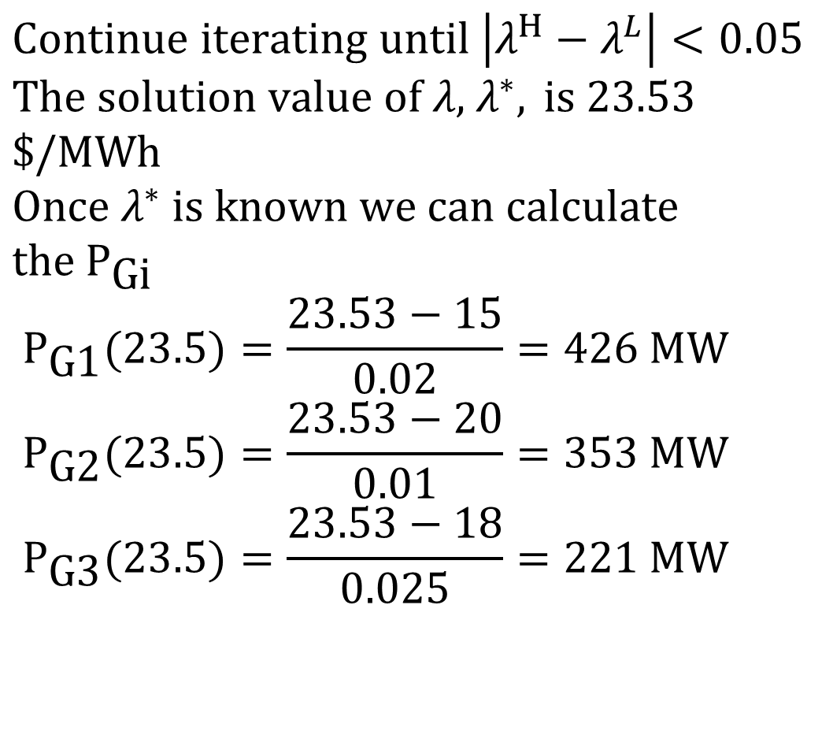
Lambda-Iteration Example, cont’d
$$\text{Continue} \text{iterating} \text{until} \left|λ^{H}−λ^{L}\right|<0.05 \\ \text{The} \text{solution} \text{value} \text{of} λ\text{, }λ^{∗}, \text{is}\text{ 23.53 \$/}\text{MWh} \\ \text{Once} λ^{∗} \text{is} \text{known} \text{we} \text{can} \text{calculate} \text{the} {\text{P}}_{\text{Gi}} \\ P_{\text{G}\text{1}}(23.5)=\frac{23.53−15}{0.02}=426 \text{MW} \\ P_{\text{G}\text{2}}(23.5)=\frac{23.53−20}{0.01}=353 \text{MW} \\ P_{\text{G}\text{3}}(23.5)=\frac{23.53−18}{0.025}=221 \text{MW}$$

Slide 32
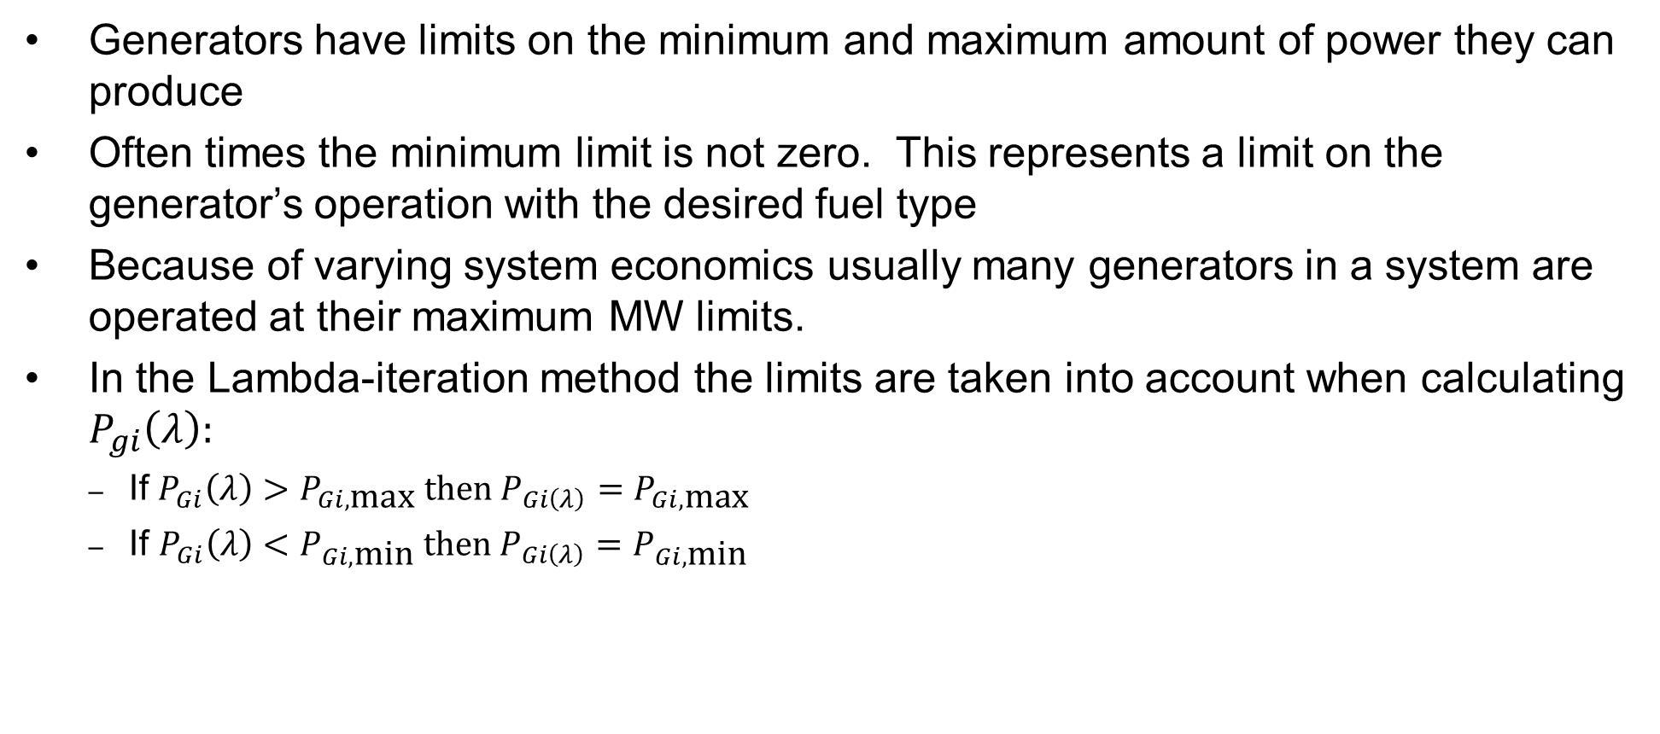
Generator MW Limits
Generators have limits on the minimum and maximum amount of power they can produce
Often times the minimum limit is not zero. This represents a limit on the generator’s operation with the desired fuel type
Because of varying system economics usually many generators in a system are operated at their maximum MW limits.
In the Lambda-iteration method the limits are taken into account when calculating $P_{gi}\left(λ\right):$
If $P_{Gi}\left(λ\right)>P_{Gi,\text{max}} \text{then} P_{Gi\left(λ\right)}=P_{Gi,\text{max}}$
$\text{If} P_{Gi}\left(λ\right)<P_{Gi,\text{m}\text{in}} \text{then} P_{Gi\left(λ\right)}=P_{Gi,\text{m}\text{in}}$

Slide 33
Area Supply Curve
The area supply curve shows how the marginal cost for an area (or the entire case) varies assuming an economic dispatch
The curves for an area or super area are available in their case information displays by right-clicking and selecting Plot then one of its options
This is a quick way to get an overall feel for a case
Texas2000 Supply Curve
PSC_37Bus Supply Curve

