Slide 1
ECEN 460, Spring 2026 Power System Operation and Control
Class 9: Power System Operations Fundamentals
Prof. Adam Birchfield
Dept. of Electrical and Computer Engineering
Texas A&M University
abirchfield@tamu.edu

Slide 2
Exam 1
Tuesday, Feb. 17th, 2026, in-class (75 minutes)
Closed-book, closed-notes, except you may use one 8.5”x11” handwritten note sheet, front and back
Main topics:
Three-phase AC circuit analysis
Power systems overview, structure, and history
Generators
Transformers and per-unit
Transmission lines
Power system operations and control topics (this week and in lab)
Make sure to study (1) quizzes (2) lecture notes (3) homework (4) labs (5) book Chapters 1-5.

Slide 3
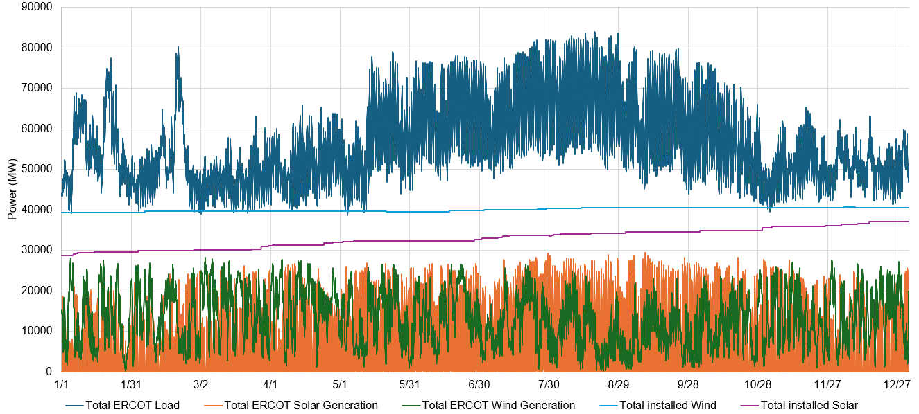
Operating the Grid 24/7 for a Year
ERCOT’s load, wind, and solar in 2025

Slide 4
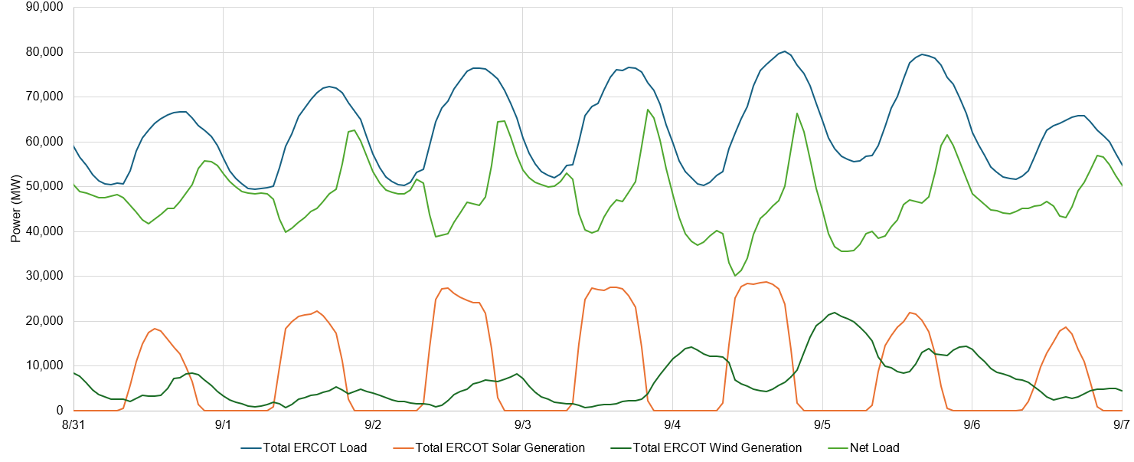
How about 24/7 for a Week?
Random Week in 2025
Over 50% Wind/Solar
Almost Zero Wind/Solar

Slide 5
Goals for Normal Power System Operations
Deliver electric power to customers while achieving
Safety to workers and the public
Security (physical and cyber)
Reliability
Affordability
Environmental responsibility
Quality – voltage levels, frequency, noise on signal

Slide 6
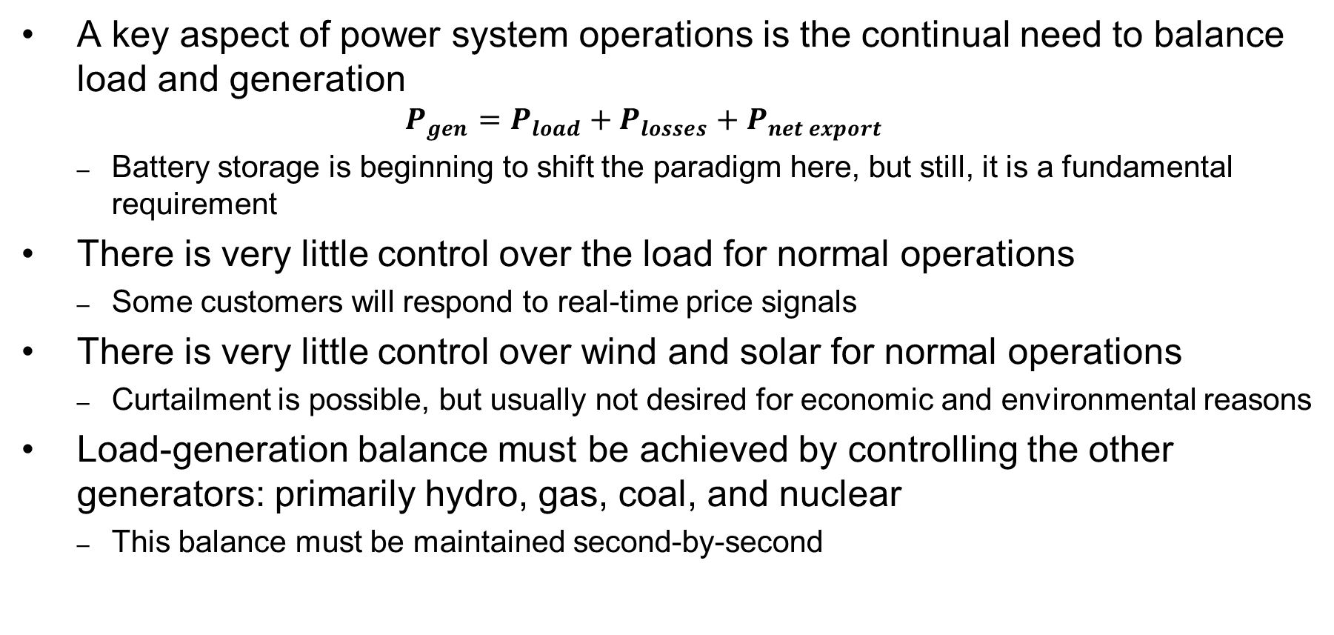
Normal Operations: Balancing Load and Generation
A key aspect of power system operations is the continual need to balance load and generation
$$P_{gen}=P_{load}+P_{losses}+P_{net export}$$
Battery storage is beginning to shift the paradigm here, but still, it is a fundamental requirement
There is very little control over the load for normal operations
Some customers will respond to real-time price signals
There is very little control over wind and solar for normal operations
Curtailment is possible, but usually not desired for economic and environmental reasons
Load-generation balance must be achieved by controlling the other generators: primarily hydro, gas, coal, and nuclear
This balance must be maintained second-by-second

Slide 7
Operational Strategy Decisions
Automatic Controls or Human Operators
Automatic controls operate quicker and can be less error-prone, but can have unintended consequences as not all situations can be anticipated in advance
Simple Procedures or More Complex
Complex controls could allow more flexibility and better utilization of resources, but again may have unintended consequences and reduce situational awareness of operators
Distributed or Centralized Controls
Centralized controls allow for decisions that are more coordinated and aware of overall system conditions, but are subject to disruption of the centralized controls, subject to communication breakdown, and have time delays associated with remote measurements
In practice, all of the above are used in various combinations as each situation requires

Slide 8
Steps to Maintain Load-Generation Balance
Situation: a 100 MW gas power plant has a problem and needs to trip offline immediately. How can we maintain load-generation balance?
Multi-Step Solution:
Inertial Response: Other synchronous machines (nearly) instantly and automatically supply additional power, taking it from their spinning kinetic energy. This causes system frequency to begin to decline. Physics-Based Response, 0-1 second.
Primary Frequency Response: Generators detect declining frequency and have localized controls called governors to increase fuel output and stabilize frequency. Local Automatic Control at the Plant, 1-30 seconds.
Secondary Frequency Response: Control center detects frequency deviating from 60 Hz and generators off scheduled amount. It sends updated generator schedules to match measured load and losses. Centralized Automatic Control, 30 s – 5 minutes
Real-Time Dispatch, Possibly from Market: Periodically, operators implement real-time dispatch to use most economic set of generators to match load. Centralized Human Operator Control, 5-15 minutes.

Slide 9
Unit Commitment
Many generators take quite some time to start up
Some are relatively quick (less than 30 minutes) such as gas turbine plants
Gas steam, combined cycle, and coal plants can take several hours (up to 12 in some cases)
Nuclear can take 24 hours in some cases
There’s a difference between “hot start” where a unit shuts down and then quickly starts up again, and “cold start” where it has not been operated for some time
Due to this, advanced planning is needed to ensure enough generators are available to meet the forecasted load. This problem is called “unit commitment”

Slide 10
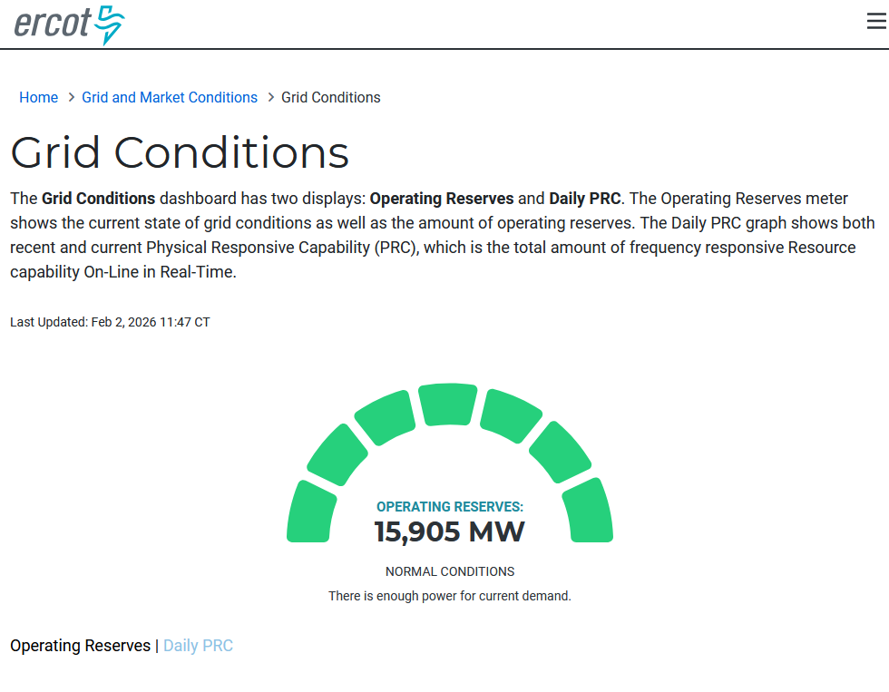
Reserves
“Reserves” in MW specifies how much additional generation is available. There are different types, for example
Online, spinning reserves: these are generators currently producing power, that could still produce more up to their physical limits
Even these may have some delay due to ramping restrictions
Fast-start reserves: these are offline generators that could start relatively quickly (30 minutes or so)
Non-spinning reserves: generators that would take longer to start up
ERCOT publishes its live operating reserves

Slide 11

Transmission Constraints
Transmission lines and transformers have power flow limits that must be maintained in good operations
As we discussed when studying transmission lines, these limits occur from several factors, such as thermal constraints, angle limits, and stability
For transformers the limits are thermal and saturation based
Buses have a minimum and maximum voltage magnitude limit that must be maintained in good operations
North American Electric Reliability Corporation (NERC) has legal authority to enforce reliability standards (and there are lots of them). See www.nerc.com/pa/stand/pages/reliabilitystandards.aspx

Slide 12
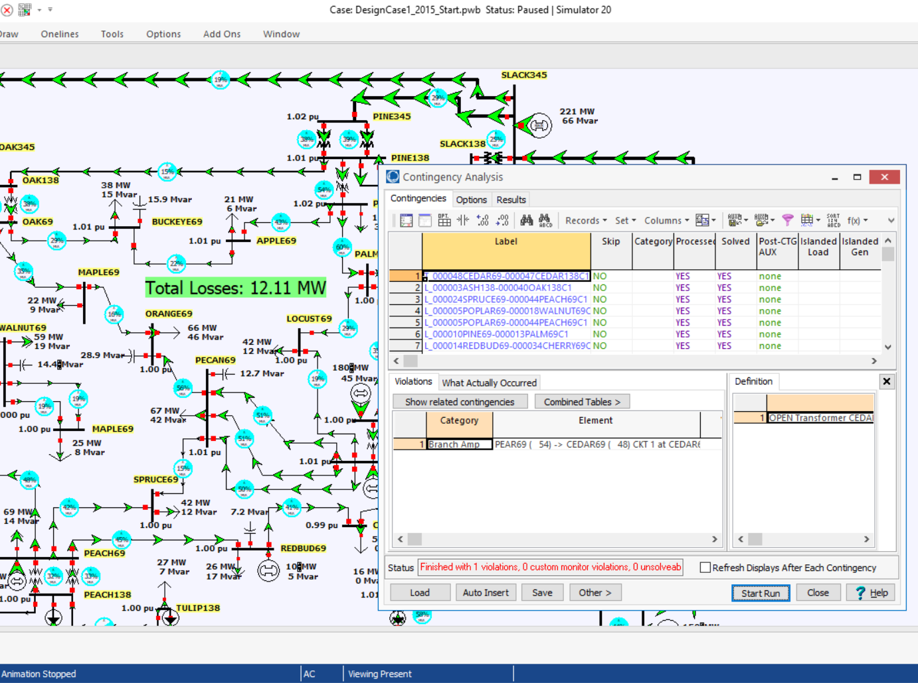
Contingency Preparedness
In normal operations, power systems are designed to be operated with N-1 security, that is, they would stay within limits after losing any single generator, line, or transformer.
Contingency analysis provides an automatic way of looking at all the statistically likely contingencies. In this example the contingency set is all the single line/transformer outages

Slide 13
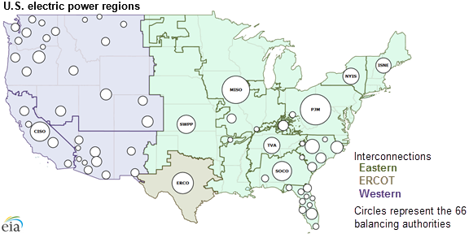
Multi-Area Operations
Transmission interconnects are divided into various areas that monitor the total load, generation, losses, and interchange with other areas.
These have been trending larger
An area schedules imports and exports with other areas
Area control error (ACE) measures the difference between scheduled and actual net exports
Ideally the ACE should always be zero.
Image Source: www.eia.gov/todayinenergy/detail.php?id=27152

Slide 14
Automatic Generator Control (AGC)
This works in step 3 (Secondary Frequency Response) of the steps to maintain load-generation balance
Automatically change generation to keep the ACE close to zero
Usually ACE is calculated based upon tie-line flows; then the AGC module sends control signals out to the generators every few seconds.

Slide 15
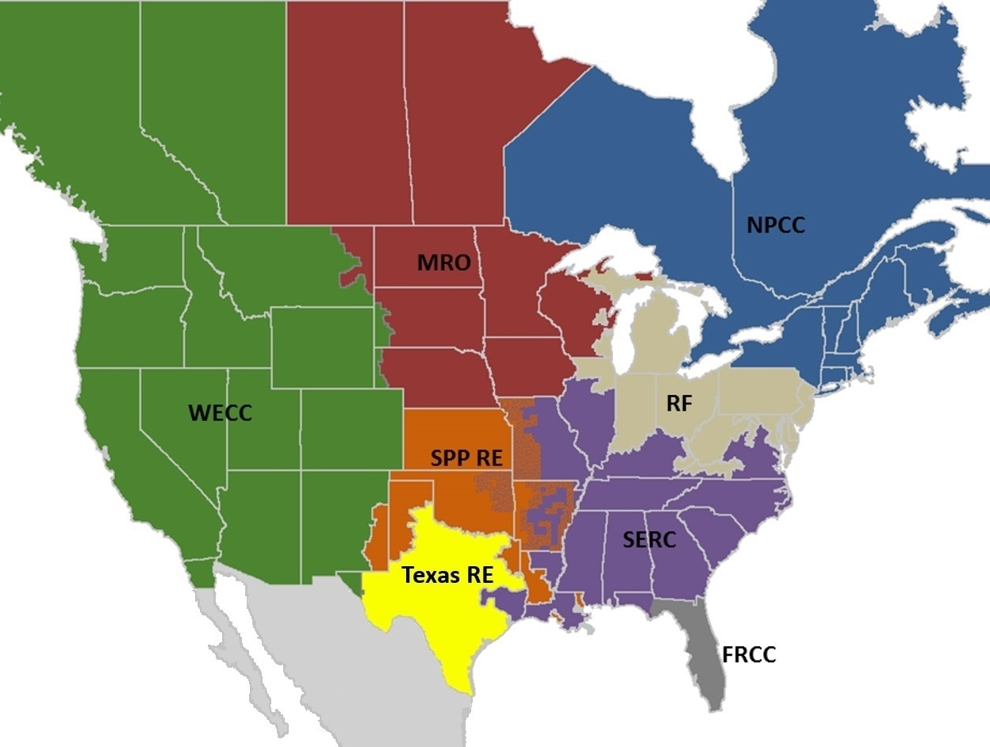
NERC Regional Reliability Councils
NERC is the North American Electric Reliability Council
Image: www.nerc.com/AboutNERC/keyplayers/PublishingImages/2017_NERC_Regions_May2017.jpg

Slide 16
Abnormal Operations
What we have described so far is “Normal State”
“Alert State” is when grid is getting close to not meeting requirements in certain contingency conditions
“Emergency State” is when operational limits are violated
“Restorative State” is when partial or full blackout has occurred
Normal State
Alert State
Restorative State
Emergency State

Slide 17
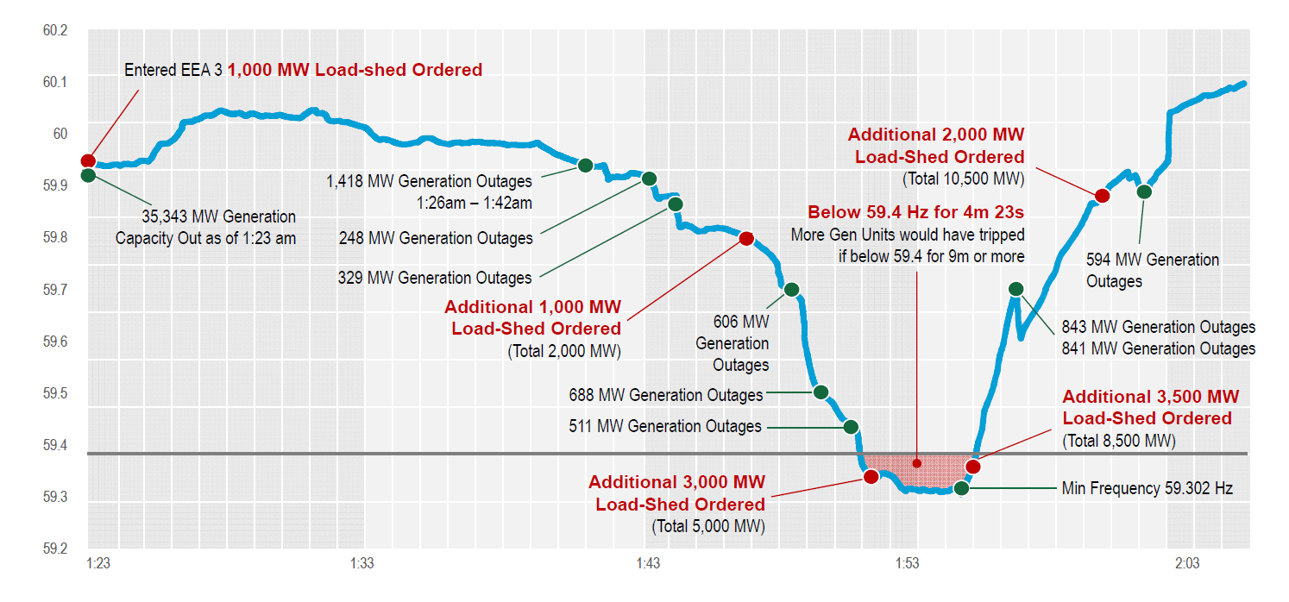
Winter Storm Uri – February 2021
Source: ERCOT

Slide 18
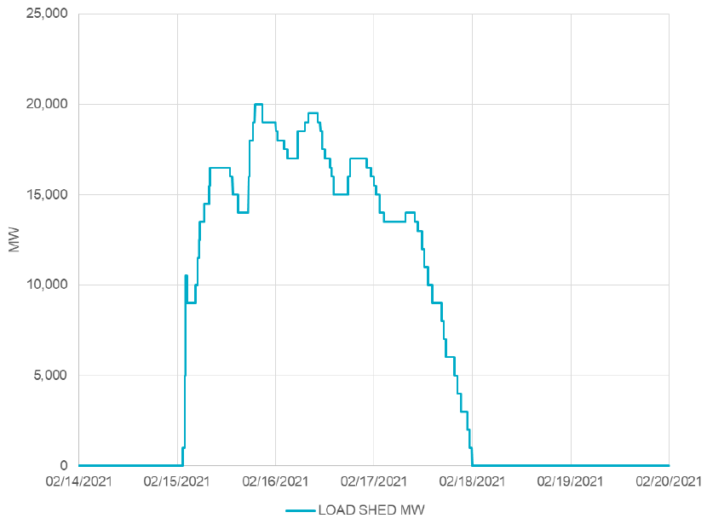
Winter Storm Uri – February 2021
Extreme winter weather, record-setting low temperatures across Texas and neighboring states
Generation supply lost
Controlled load outages for 3 days up to 20,000 MW
Far more than had been done historically, restricting proper rotation
System operators avoided an uncontrolled blackout, but did involve load restoration
Source: ERCOT

Slide 19
Winter Storm Uri – February 2021
Pre-Event Conditions
Significant number of natural gas units unavailable because of restrictions on gas supply system
Many wind turbines unavailable because of icing buildup
Very high demand predicted, customers requested to reduce usage
Event Sequence
New winter peak demand 7-8 PM Feb. 14: 69,222 MW. The demand stayed high through the night.
Around 11pm Feb. 14, multiple thermal units, such as natural gas, rapidly tripped offline due to cold weather. At highest point, total of 34,000 MW generation forced offline.
Due to diminishing reserves, emergency operation plan was implemented (energy emergency alert plan, EEA).
By 1:25 am Feb. 15, ERCOT entered highest level of emergency alert, EEA 3, which includes controlled outages.
Each transmission owner is instructed by ERCOT to reduce demand by a certain amount proportional to size.
In this case, total load reduction maximum was 16,500 MW on Monday morning.
Procedure is to rotate outages and avoid critical loads like hospitals and emergency services.
The magnitude of the outages meant that usual outage duration of 15-45 minutes could not be maintained. Many blackouts lasted much longer.
Blackouts longer and larger than any in the past.
Mid-morning on Feb. 19, ERCOT finally ended emergency conditions and was no longer instructing transmission owners to reduce load
Any remaining outages are localized issues
Source: ERCOT, 2/15/21 media call, news releases

Slide 20
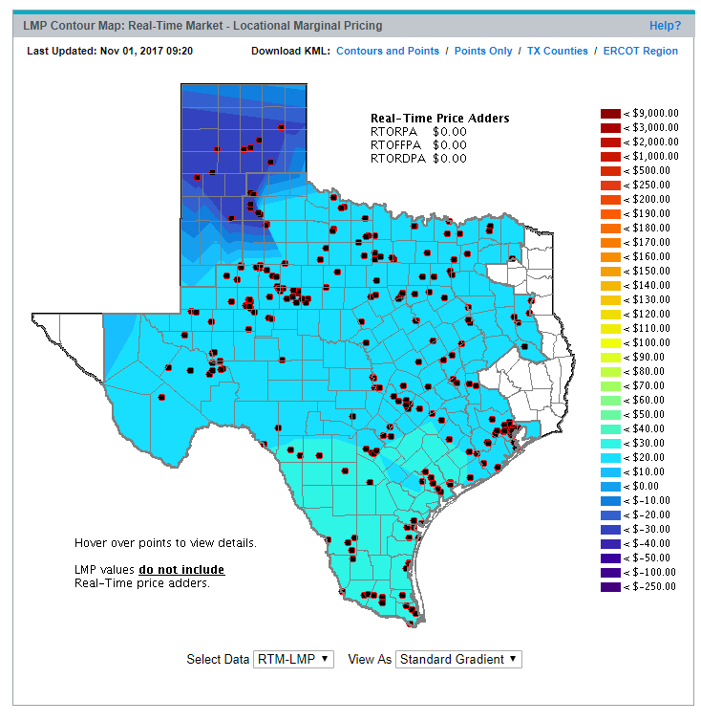
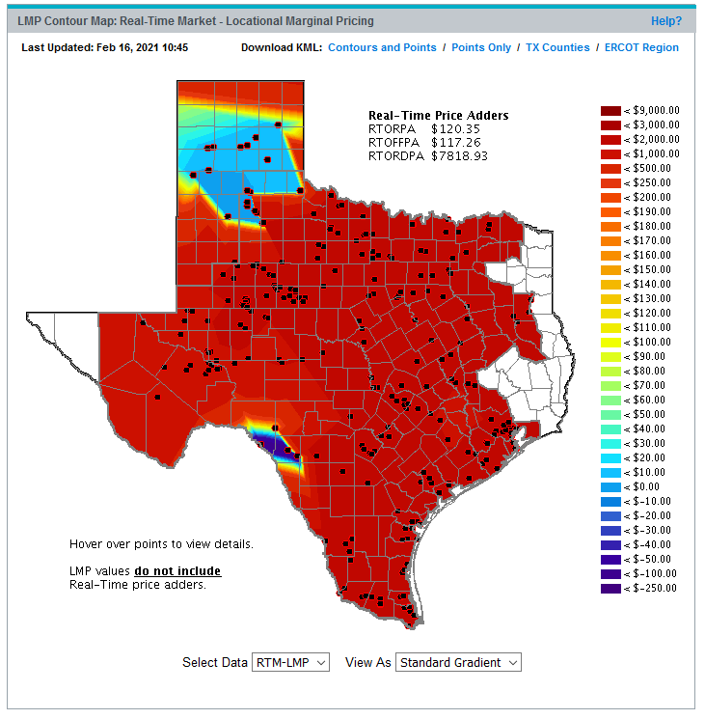
Texas Electric Market Prices Exceed $9000/MWh
Extreme Event Pricing Map
Typical Pricing Map
http://www.ercot.com/content/cdr/contours/rtmLmp.html

Slide 21
Comparing to Prior Controlled Outages in TX
Dec. 22-23, 1989 event was a similar extreme cold weather scenario, resulting in first-ever ERCOT interruption to customers. After 7 units tripped in rapid succession, 500 MW of load was shed at 10:21 am, restored within about 30 minutes.
Apr. 17, 2006 event was due to a spring heat wave that resulted in underestimating in the load forecast. 14,500 MW of generation unavailable due to planned maintenance. Around 4:00 PM multiple units trip offline. Rolling blackouts of up to 1000 MW are implemented from 4:13 pm to 6:10 pm.
Feb. 2, 2011 event was another winter storm, resulting in up to 4000 MW load shed from 5:43 am to 1:07 pm.
Feb 14-16, 2021 event: at maximum, 10,600 MW of load shed, rolling controlled blackouts from 1:25 am Feb. 15, still in-progress as of noon Feb. 16.
Source: ERCOT reports

