Slide 1
ECEN 460, Spring 2026 Power System Operation and Control
Class 7: Transmission Lines, Part 1
Prof. Adam Birchfield
Dept. of Electrical and Computer Engineering
Texas A&M University
abirchfield@tamu.edu

Slide 2
Homework 4 Due Next Week
No homework on generators. Make sure you understand the lecture notes and labs 2 and 3.
Homework 3 on transformers: book problems 3.4, 3.5, 3.23, due Feb. 3rd.
Homework 4 on transmission lines: book regular problems 4.10, 4.11, 4.20, and 4.41, 5.14 (a,b), 5.38, and 5.41 (a,b), due Feb. 10th.

Slide 3
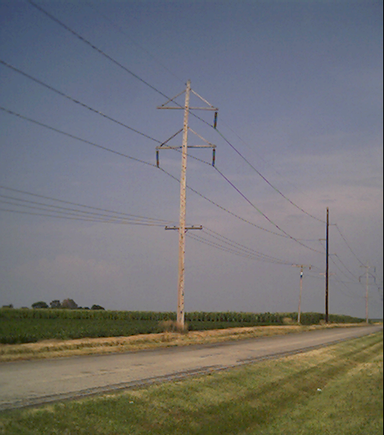
Transmission Lines
In this class, we give an overview of line and transformer modeling
More detailed coverage of some models is in ECEN 459
Our focus is on how to use the models to study power systems
Primary methods for long distance electric power transfer
Overhead ac
Underground ac
HVDC – overhead or underground

Slide 4
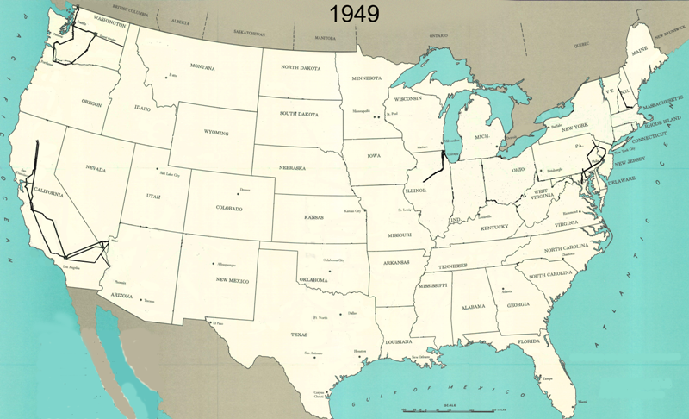
345 kV+ Transmission Growth at a Glance

Slide 5
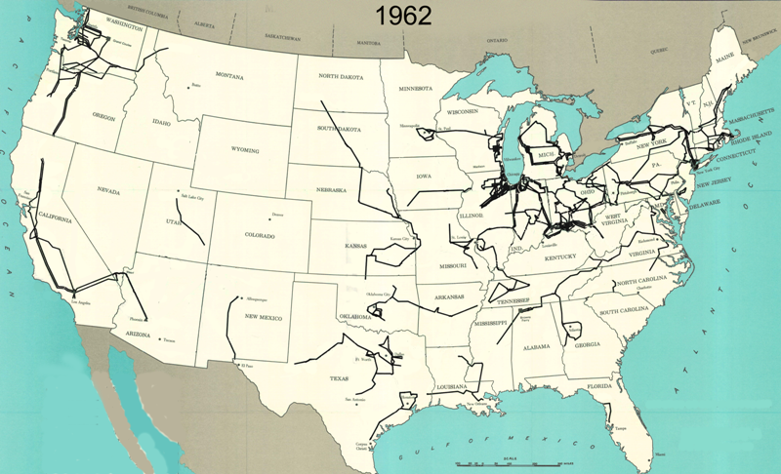
345 kV+ Transmission Growth at a Glance

Slide 6
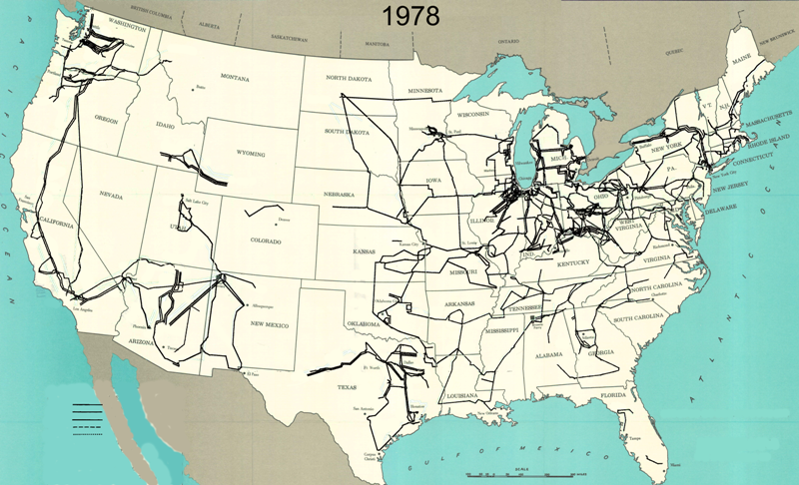
345 kV+ Transmission Growth at a Glance

Slide 7
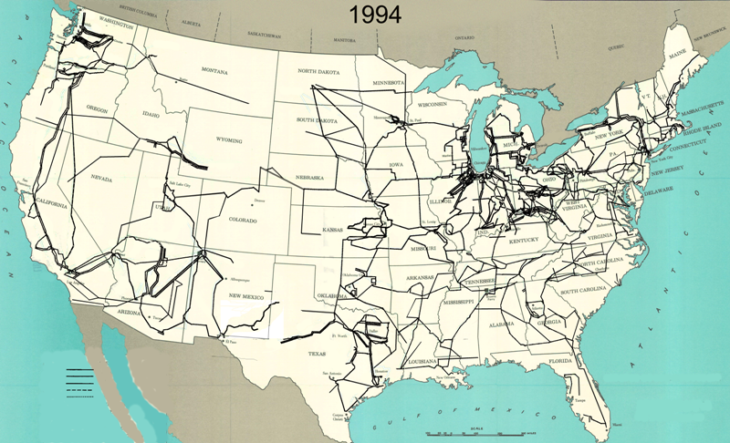
345 kV+ Transmission Growth at a Glance

Slide 8
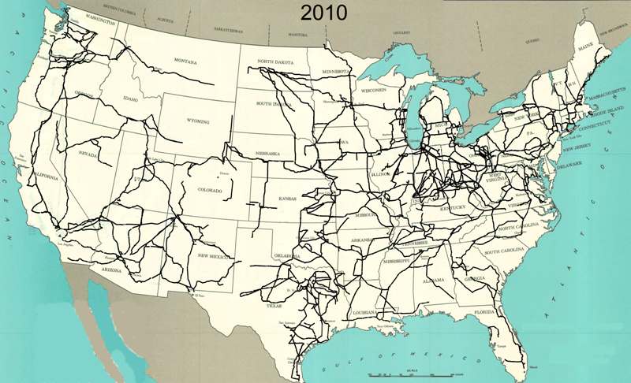
345 kV+ Transmission Growth at a Glance

Slide 9
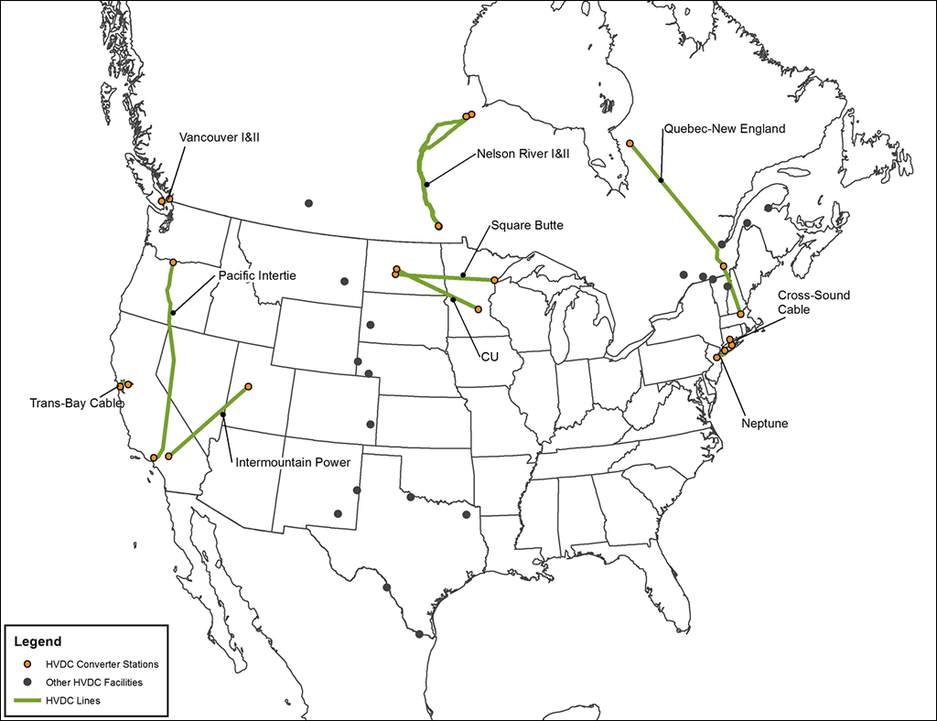
HVDC Lines in North America
http://www.grainbeltexpresscleanline.com/site/page/history_of_hvdc_transmission

Slide 10
Line Conductors
Typical transmission lines use multi-strand conductors
ACSR (aluminum conductor steel reinforced) conductors are most common. A typical Al. to St. ratio is about 4 to 1.
AAC (all aluminum conductors) are lighter but have less strength; used in urban areas with shorter spans
Copper is heavier, but has better conductance; used in cables where weight is not an issue

Slide 11
Line Conductors, cont’d
Total conductor area is given in circular mils. One circular mil is the area of a circle with a diameter of 0.001 = π × 0.0005² square inches
Example: what is the the area of a solid, 1” diameter circular wire? Answer: 1000 kcmil (kilo circular mils)
Because conductors are stranded, the equivalent radius must be provided by the manufacturer. In tables this value is known as the GMR and is usually expressed in feet.

Slide 12
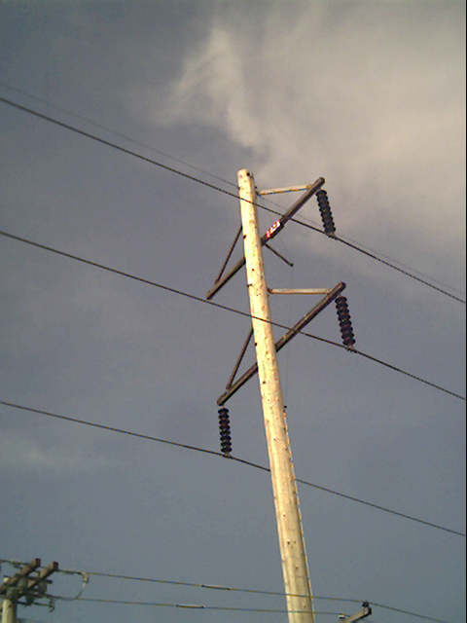
Transmission Line Parameters
We'll discuss how to calculate transmission line parameters, which will then form part of the input to our power system model, such as in PowerWorld:
Resistance
Inductance
Capacitance
Ampacity

Slide 13
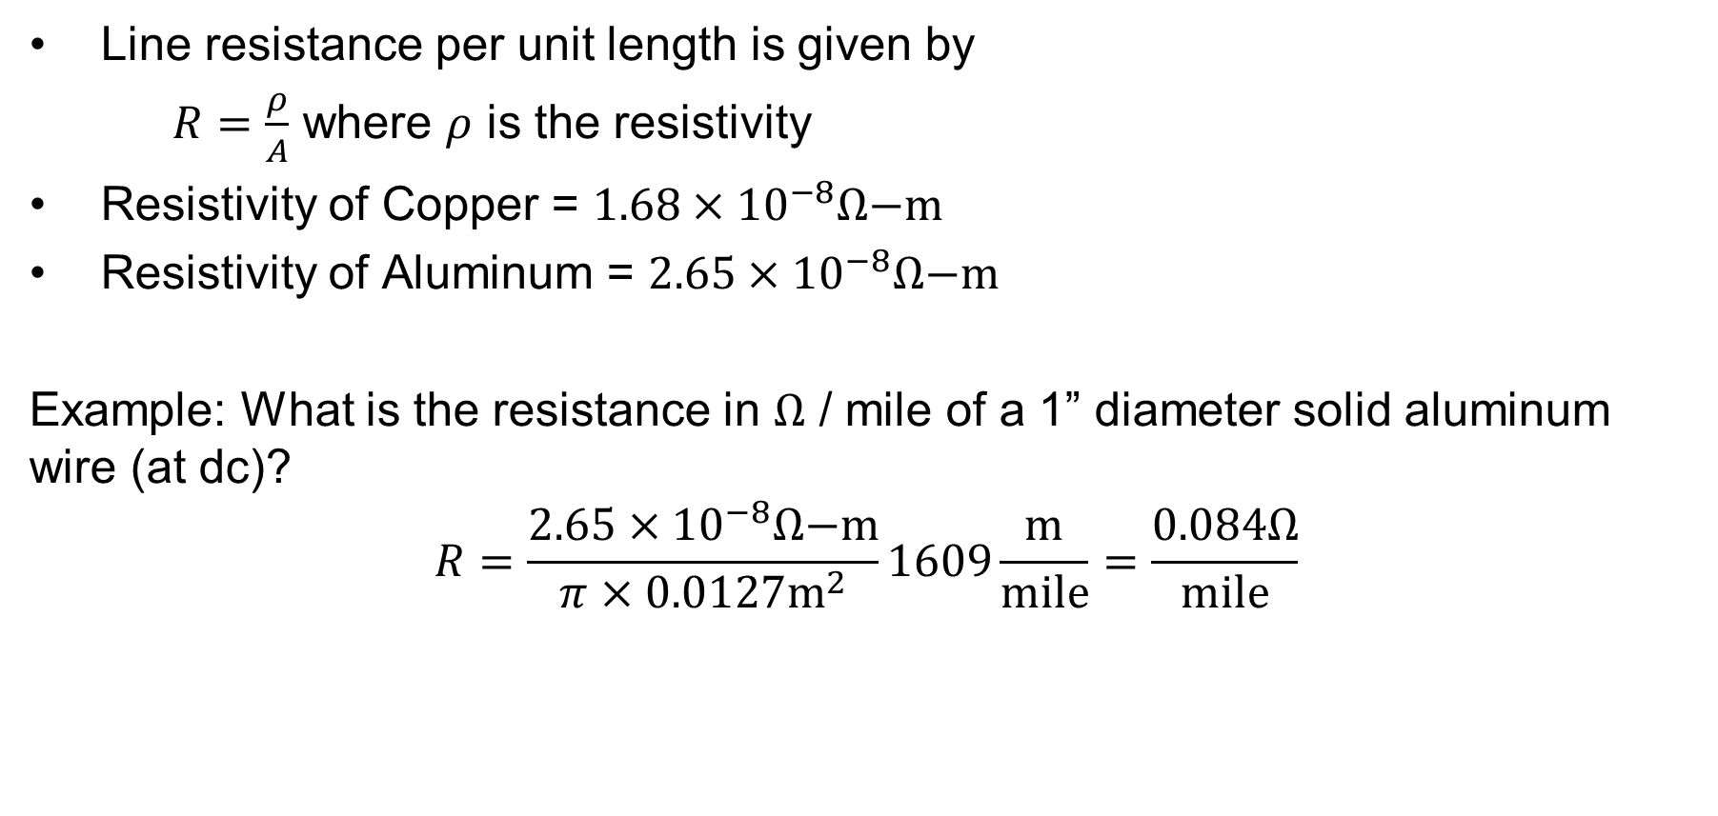
Line Resistance
Line resistance per unit length is given by
$R=\frac{ρ}{A}$ where $ρ$ is the resistivity
Resistivity of Copper = $1.68×{10}^{−8}Ω\text{−}\text{m}$
Resistivity of Aluminum = $2.65×{10}^{−8}Ω\text{−}\text{m}$
Example: What is the resistance in $Ω$ / mile of a 1” diameter solid aluminum wire (at dc)?
$$R=\frac{2.65×{10}^{−8}Ω\text{−}\text{m}}{π×0.0127{\text{m}}^{2}}1609\frac{\text{m}}{\text{mile}}=\frac{0.084Ω}{\text{mile}}$$

Slide 14
Line Resistance, cont’d
Because ac current tends to flow towards the surface of a conductor, the resistance of a line at 60 Hz is slightly higher than at dc.
Resistivity and hence line resistance increase linearly as conductor temperature increases (changes is about 0.4% per degree C)
In some locations conductor temperatures can vary by up to 100° C!
Because ACSR conductors are stranded, actual resistance, inductance and capacitance needs to be determined from tables.

Slide 15
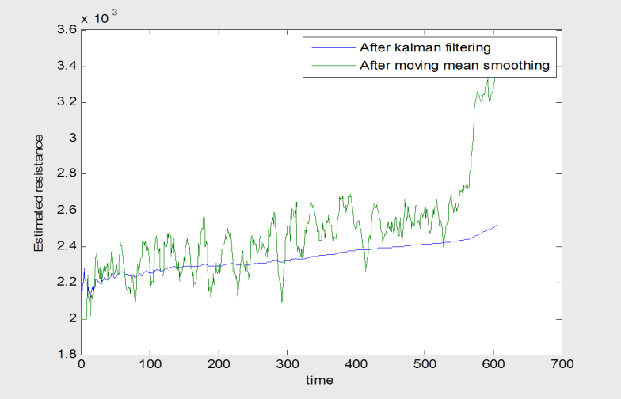
Variation in Line Resistance Example
Time is in minutes. Input was 30 second ICCP data. Conductor resistance increased by about 50%, indicating a 50/0.4 = 125 degree C rise in temperature.

Slide 16

High Voltage Transmission Line Worker
Source: www.youtube.com/watch?v=LIjC7DjoVe8

Slide 17
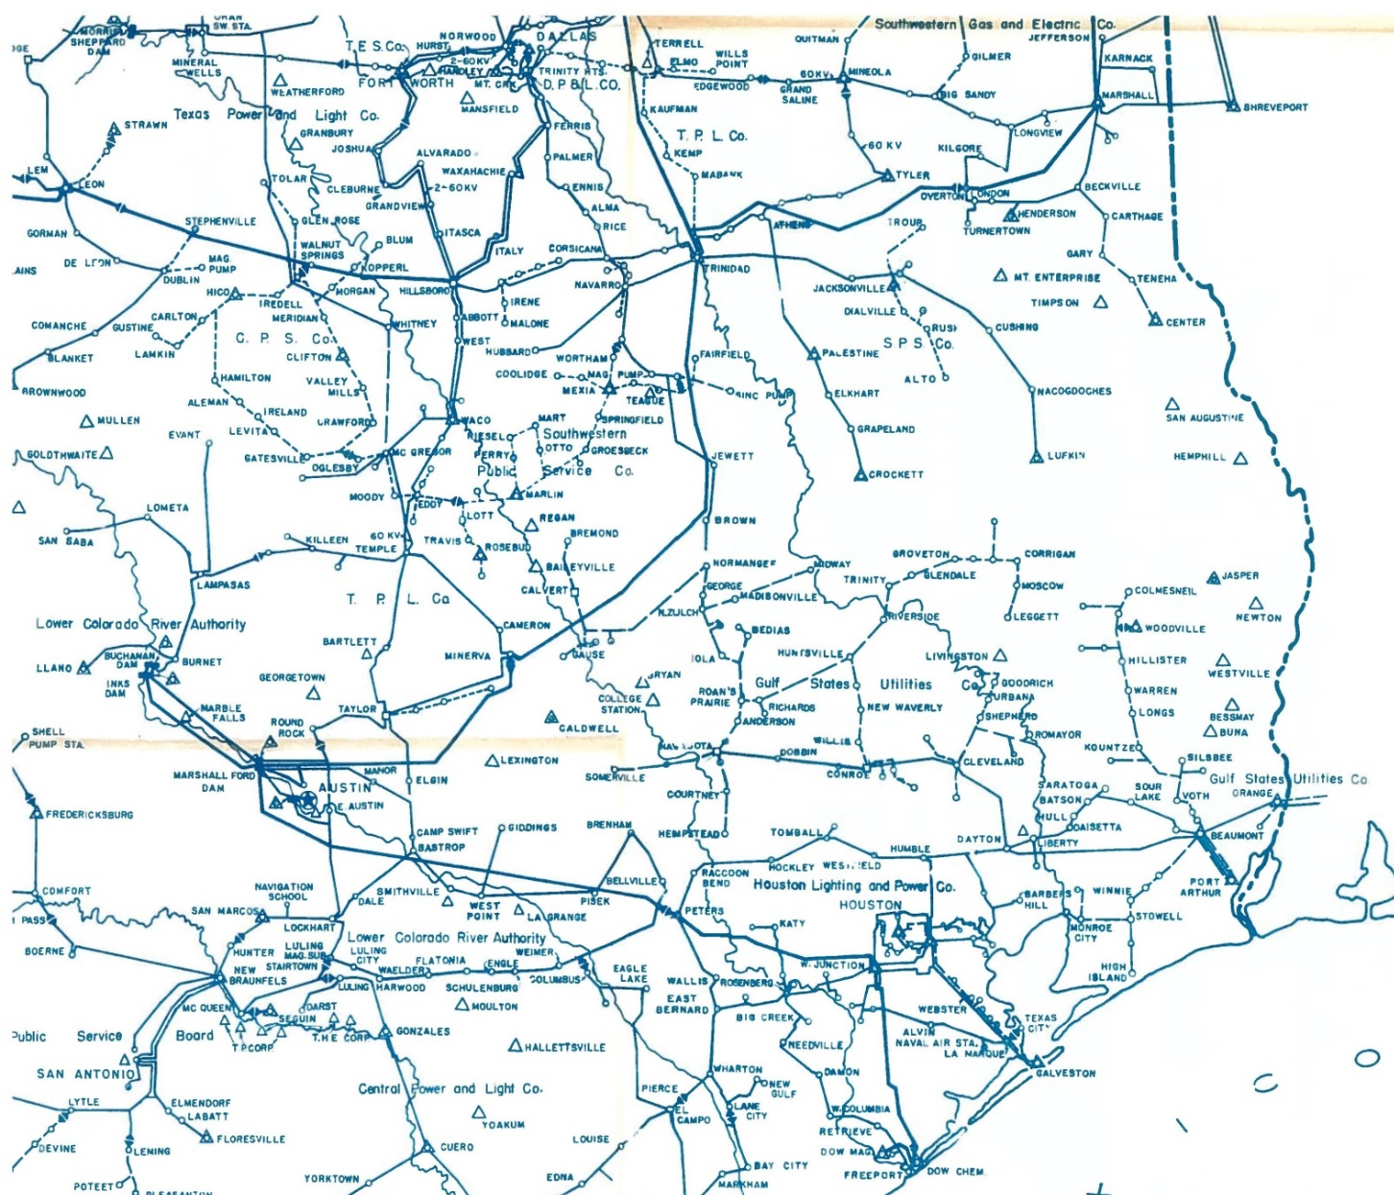

Texas Grid, 1943

Slide 18
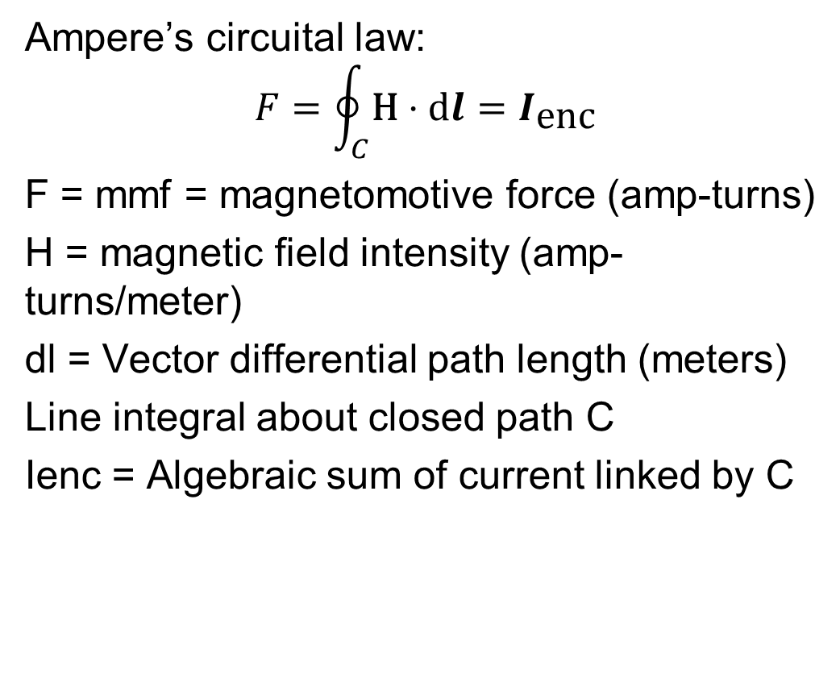
Magnetics Review
Ampere’s circuital law:
$$F=\oint_{C}^{ }{\text{H}⋅\text{d}l}=I_{\text{enc}}$$
F = mmf = magnetomotive force (amp-turns)
H = magnetic field intensity (amp-turns/meter)
dl = Vector differential path length (meters)
Line integral about closed path C
Ienc = Algebraic sum of current linked by C
Line integrals are a generalization of traditional integration
Integrate along X-axis
Integrate along a general path,
which may be closed.
Ampere’s law is most useful in cases of symmetry, such as with an infinitely long line

Slide 19
Magnetic Flux Density
Magnetic fields are usually measured in terms of flux density
$$B = \text{flux} \text{density} (\text{Tesla} [T] \text{or} \text{Gauss} [G]) \\ (\text{1}\text{T} = \text{10,000}\text{G}) \\ \text{For} \text{a} \text{linear} \text{a} \text{linear} \text{magnetic} \text{material} \\ B = μH \text{where} μ \text{is} \text{the} \text{called} \text{the} \text{permeability} \\ μ = μ_{0}μ_{r} \\ μ_{0} = \text{permeability} \text{of} \text{freespace}\text{ = 4}π×\text{1}{\text{0}}^{\text{−7}}\frac{H}{m} \\ μ_{r} = \text{relative} \text{permeability} ≈\text{ 1 }\text{for} \text{air}$$

Slide 20
Magnetic Flux
Total flux passing through a surface A is
$$φ=\int_{A}^{ }{B⋅da}$$
$da$ = vector with direction normal to surface
If flux density B is uniform and perpendicular to an area A then
$$φ=BA$$

Slide 21
Magnetic Fields from Single Wire
Assume we have an infinitely long wire with current of 1000A. How much magnetic flux passes through a 1 meter square, located between 4 and 5 meters from the wire?
Direction of H is given by the “Right-hand” Rule
Easiest way to solve the problem is to take advantage of symmetry. For an integration path we’ll choose a circle with a radius of x.

Slide 22
Two Conductor Line Inductance
Key problem with the previous derivation is we assumed no return path for the current. Now consider the case of two wires, each carrying the same current I, but in opposite directions; assume the wires are separated by distance R.
R
To determine the inductance of each conductor we integrate as before. However now we get some field cancellation
Creates counter-
clockwise field
Creates a
clockwise field

Slide 23
Two Conductor Case, cont’d
R
R
Key Point: As we integrate for the left line, at distance 2R from
the left line the net flux linked due to the Right line is zero!
Use superposition to get total flux linkage.
Rp
Direction of integration
Left Current
Right Current
$$\text{For} \text{distance} \text{Rp}\text{, }\text{greater} \text{than}\text{ 2}\text{R}\text{, }\text{from} \text{left} \text{line} \\ λ_{\text{left}}=\frac{μ_{0}}{2π}I\ln{\frac{Rp}{r′}}−\frac{μ_{0}}{2π}I\ln\left(\frac{Rp−R}{R}\right)$$

Slide 24
Two Conductor Inductance
$$\text{Simplifying} (\text{with} \text{equal} \text{and} \text{opposite} \text{currents}) \\ λ_{\text{left}} =\frac{μ_{0}}{2π}I\left(\ln{\frac{Rp}{r′}}−\ln\left(\frac{Rp−R}{R}\right)\right) \\ =\frac{μ_{0}}{2π}I\left(\ln{R}p−\ln{r}′−\ln{(}Rp−R)+\ln{R}\right) \\ =\frac{μ_{0}}{2π}I\left(\ln{\frac{R}{r′}}+\ln{\frac{Rp}{Rp−R}}\right) \\ =\frac{μ_{0}}{2π}I\left(\ln{\frac{R}{r′}}\right) \text{as} \text{Rp}→∞ \\ L_{left} =\frac{μ_{0}}{2π}\left(\ln{\frac{R}{r′}}\right) \text{H}\text{/}\text{m}$$

Slide 25
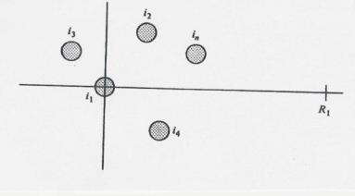
Many-Conductor Case
Now assume we now have k conductors, each with current i_{k}, arranged in some specified geometry. We’d like to find flux linkages of each conductor.
Each conductor’s flux linkage, l_{k}, depends upon its own current and the current in all the other conductors.
To derive l₁ we’ll be integrating from conductor 1 (at origin) to the right along the x-axis.

Slide 26
Many-Conductor Case, cont’d
$$\text{Therefore}\text{,} \text{if} \sum_{j=1}^{n}{i_{j}}=0,$$
which is true in a balanced three phase system, then the second term is zero and $$λ_{1} = \frac{μ_{0}}{2π}\left[i_{1}\ln{\frac{1}{r_{1}^{′}}}+i_{2}\ln{\frac{1}{d_{12}}}+⋯+i_{n}\ln{\frac{1}{d_{1n}}}\right] \\ λ_{1} = L_{11}i_{1}+L_{12}i_{2}⋯+L_{1n}i_{n}$$ System has self and mutual inductance. However, the mutual inductance can be canceled for balanced 3ϕ systems with symmetry.

Slide 27
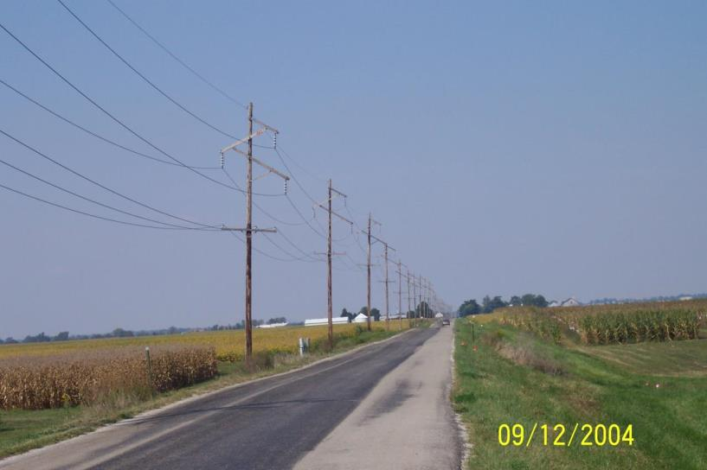
Symmetric Line Spacing – 69 kV

Slide 28

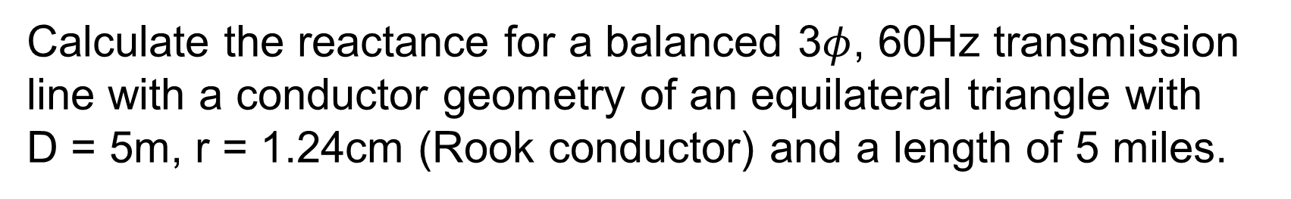
Line Inductance Example
Calculate the reactance for a balanced 3$φ$, 60Hz transmission line with a conductor geometry of an equilateral triangle with D = 5m, r = 1.24cm (Rook conductor) and a length of 5 miles.
$$\text{Since} \text{system} \text{is} \text{assumed} \text{balanced} \\ i_{a} = −i_{b}−i_{c}$$
$$λ_{a} = \frac{μ_{0}}{2π}\left[i_{a}\ln{(}\frac{1}{r′})+i_{b}\ln{(}\frac{1}{D})+i_{c}\ln{(}\frac{1}{D})\right]$$

Slide 29
Line Inductance Example, cont’d
$$\text{Substituting} \\ i_{a} = −i_{b}−i_{c} \\ \text{Hence} \\ λ_{a} = \frac{μ_{0}}{2π}\left[i_{a}\ln\left(\frac{1}{r′}\right)−i_{a}\ln\left(\frac{1}{D}\right)\right] \\ = \frac{μ_{0}}{2π}i_{a}\ln\left(\frac{D}{r′}\right) \\ L_{a} = \frac{μ_{0}}{2π}\ln\left(\frac{D}{r′}\right)=\frac{4π×10^{−7}}{2π}\ln\left(\frac{5}{9.67×10^{−3}}\right) \\ = 1.25×10^{−6} \text{H}\text{/}\text{m}$$

Slide 30
Transmission Tower Configurations
The problem with the line analysis we’ve done so far is we have assumed a symmetrical tower configuration. Such a tower figuration is seldom practical.
Therefore, in general D_{ab} ≠ D_{ac} ≠ D_{bc}
Unless something was done this would result in unbalanced phases
Typical transmission tower configurations

Slide 31
Transposition
To keep system balanced, over the length of a transmission line the conductors are rotated so each phase occupies each position on tower for an equal distance. This is known as transposition.
In practice, not all lines are transposed, but it is a very common assumption for simplicity of calculation
Aerial or side view of conductor positions over the length of the transmission line.

Slide 32
Inductance of Transposed Line
$$\text{Define} \text{the} \text{geometric} \text{mean} \text{distance} (\text{GMD}) \\ D_{m} ≜ {\left(d_{12}d_{13}d_{23}\right)}^{\frac{1}{3}} \\ \text{Then} \text{for} \text{a} \text{balanced}\text{ 3}φ \text{system} (I_{a}=−I_{b}−I_{c}) \\ λ_{a} = \frac{μ_{0}}{2π}\left[I_{a}\ln{\frac{1}{r′}}−I_{a}\ln{\frac{1}{D_{m}}}\right]=\frac{μ_{0}}{2π}I_{a}\ln{\frac{D_{m}}{r′}} \\ \text{Hence} \\ L_{a} = \frac{μ_{0}}{2π}\ln{\frac{D_{m}}{r′}} = 2×10^{−7}\ln{\frac{D_{m}}{r′}} \text{H}\text{/}\text{m}$$

Slide 33
Conductor Bundling
To increase the capacity of high voltage transmission lines it is very common to use a number of conductors per phase. This is known as conductor bundling. Typical values are two conductors for 345 kV lines, three for 500 kV and four for 765 kV.

Slide 34
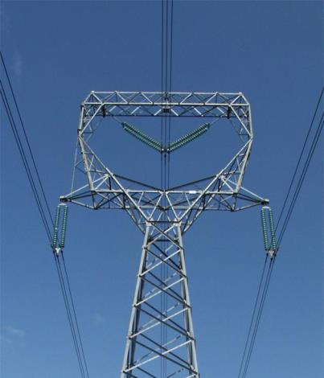
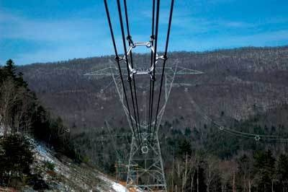
Bundled Conductor Pictures
The AEP Wyoming-Jackson Ferry 765 kV line uses 6-bundle conductors. Conductors in a bundle are at the same voltage!
Photo Source: BPA and American Electric Power

Slide 35
Inductance of Lines with Bundled Conductors
The per phase inductance is
$${\text{L}}_{a}= \frac{μ_{0}}{2π}\ln\left(\frac{D}{R_{b}}\right) \\ \text{where} \\ R_{b} ≜ \text{geometric} \text{mean} \text{radius} (\text{GMR}) \text{of} \text{bundle} \\ = (r′d_{12}…d_{1b})^{\frac{1}{b}} \text{in} \text{general}$$
The detailed derivation is given in ECEN 459
When calculating the per phase resistance of bundled lines, the total resistance is R per conductor divided by b, where b is the number of conductors in the bundle

Slide 36
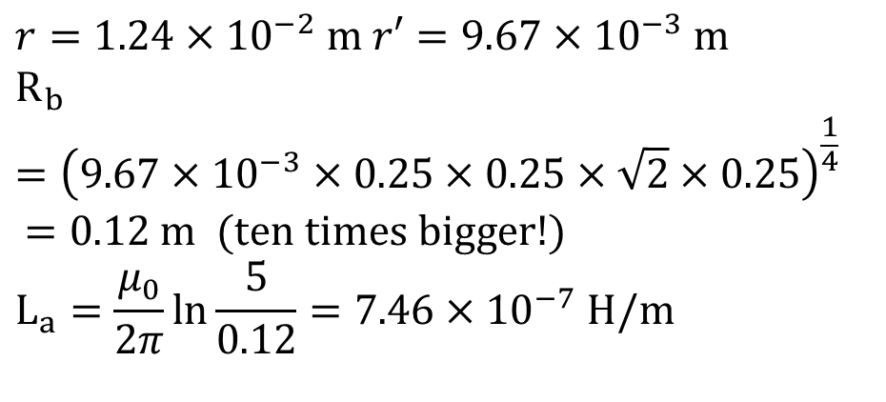
Bundle Inductance Example
Consider the previous example of the three phases symmetrically spaced 5 meters apart using wire with a radius of r = 1.24 cm. Except now assume each phase has 4 conductors in a square bundle, spaced 0.25 meters apart. What is the new inductance
per meter?
$$r=1.24×10^{−2} \text{m} r′=9.67×10^{−3} \text{m} \\ R_{b} ={\left(9.67×10^{−3}×0.25×0.25×\sqrt{2}×0.25\right)}^{\frac{1}{4}} \\ =0.12 \text{m} (\text{ten} \text{times} \text{bigger}\text{!}) \\ L_{a}=\frac{μ_{0}}{2π}\ln{\frac{5}{0.12}}=7.46×10^{−7} \text{H}\text{/}\text{m}$$
0.25 M
0.25 M
0.25 M

Slide 37
Inductance Example
Calculate the per phase inductance and reactance of a balanced 3φ, 60 Hz, line with horizontal phase spacing of 10m using three conductor bundling with a spacing between conductors in the bundle of 0.3m. Assume the line is uniformly transposed and the conductors have a 1cm radius.
Answer: D_{m} = 12.6 m, R_{b}= 0.0889 m Inductance = 9.9 x 10⁻⁷ H/m, Reactance = 0.6 Ω/Mile

Slide 38
Line Capacitance
High voltage transmission lines and cables can have significant capacitance
$$\text{For} \text{the} \text{case} \text{of} \text{uniformly} \text{transposed} \text{lines} \text{we} \\ \text{use} \text{the} \text{same} {\text{D}}_{m} \text{and} \text{a} \text{similar} \text{GMR} \text{as} \text{with} \text{inducance}\text{,} \\ C = \frac{2πε}{\ln{\frac{D_{m}}{R_{b}^{c}}}} \\ \text{where} D_{m} = {\left[d_{ab}d_{ac}d_{bc}\right]}^{\frac{1}{3}} \\ R_{b}^{c}=(rd_{12}⋯d_{1n})^{\frac{1}{n}} (\text{note} \text{r} \text{NOT} \text{r}\text{′}) \\ \text{ε} \text{in} \text{air} = ε_{o}=\text{ 8.854}×\text{1}{\text{0}}^{\text{−12}} \text{F}\text{/}\text{m}$$

Slide 39
Line Capacitance Example
Calculate the per phase capacitance and susceptance of a balanced 3φ, 60 Hz, transmission line with horizontal phase spacing of 10m using three conductor bundling with a spacing between conductors in the bundle of 0.3m. Assume the line is uniformly transposed and the conductors have a a 1cm radius.

Slide 40
Line Capacitance Example, cont’d
$$R_{b}^{c} = (0.01×0.3×0.3)^{\frac{1}{3}} = 0.0963 \text{m} \\ D_{m } = (10×10×20)^{\frac{1}{3}} = 12.6 \text{m} \\ C = \frac{2π×8.854×10^{−12}}{\ln{\frac{12.6}{0.0963}}} = 1.141×10^{−11}\text{F}\text{/}\text{m} \\ X_{c} = \frac{1}{ωC} = \frac{1}{2π60×1.141×10^{−11}\text{F}\text{/}\text{m}} \\ = 2.33×10^{8} Ω\text{−}\text{m} (\text{not} Ω/m)$$

Slide 41
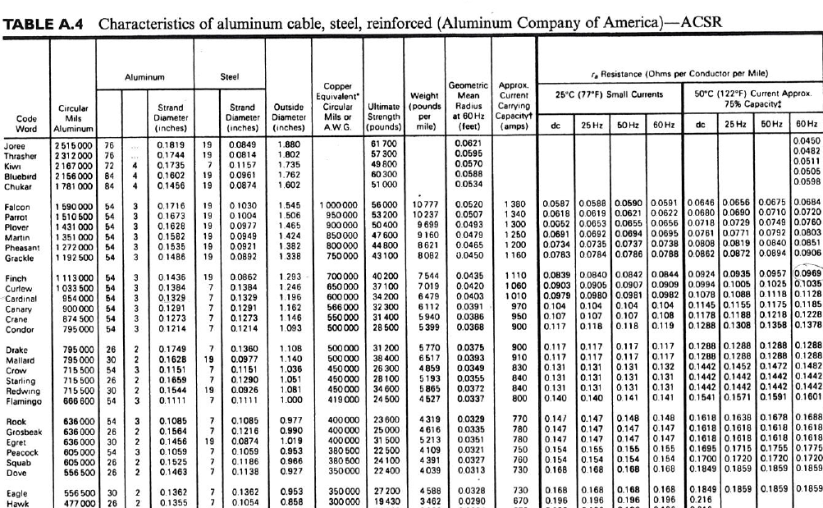
Conductor Table Example

