Slide 1
ECEN 460, Spring 2026 Power System Operation and Control
Class 15: Power Flow Approximations
Prof. Adam Birchfield
Dept. of Electrical and Computer Engineering
Texas A&M University
abirchfield@tamu.edu

Slide 2
Announcements
Homework #6: book problems 6.9, 6.12, 6.18, 6.25, 6.38, due Thursday, Mar 5, 2026

Slide 3
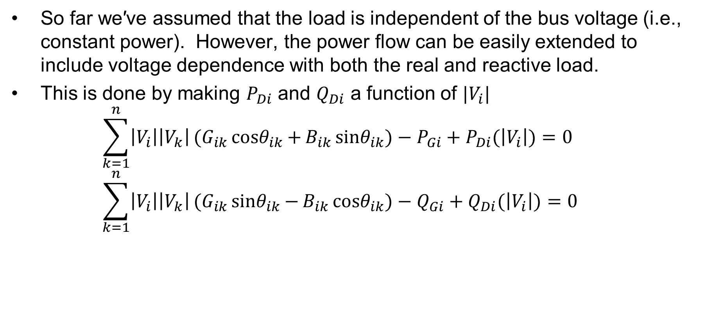
Modeling Voltage Dependent Load
So far we′ve assumed that the load is independent of the bus voltage (i.e., constant power). However, the power flow can be easily extended to include voltage dependence with both the real and reactive load.
This is done by making $P_{Di}$ and $Q_{Di}$ a function of $|V_{i}|$⁡ $\sum_{k=1}^{n}{\left|V_{i}\right|\left|V_{k}\right|}(G_{ik}{cosθ}_{ik}{+}B_{ik}{sinθ}_{ik}{)}−P_{Gi}+P_{Di}(\left|V_{i}\right|)=0$ $\sum_{k=1}^{n}{\left|V_{i}\right|\left|V_{k}\right|}(G_{ik}{sinθ}_{ik}{−}B_{ik}{cosθ}_{ik}{)}−Q_{Gi}+Q_{Di}(\left|V_{i}\right|)=0$

Slide 4
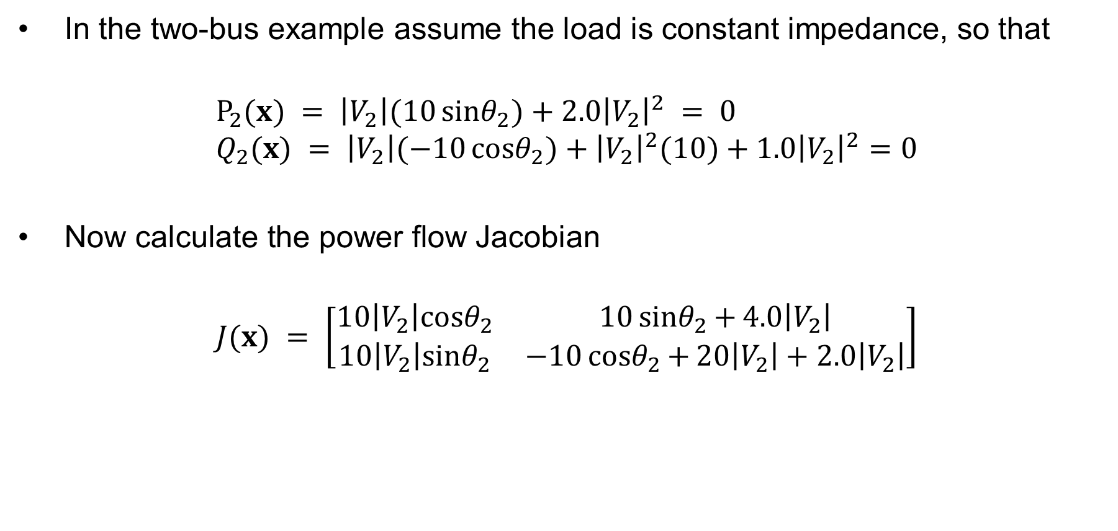
Voltage Dependent Load Example
In the two-bus example assume the load is constant impedance, so that
$$P_{2}(x) = \left|V_{2}\right|(10{sinθ}_{2}{)}+2.0{\left|V_{2}\right|}^{2} = 0 \\ Q_{2}(x) = \left|V_{2}\right|(−10{cosθ}_{2}{)}+{\left|V_{2}\right|}^{2}(10)+1.0{\left|V_{2}\right|}^{2}=0$$
$\text{Now} \text{calculate} \text{the} \text{power} \text{flow} \text{Jacobian}$
$$J(x) = \left[\begin{matrix}10\left|V_{2}\right|{cosθ}_{2} & 10{sinθ}_{2}{+}4.0\left|V_{2}\right| \\ 10\left|V_{2}\right|{sinθ}_{2} & −10{cosθ}_{2}{+}20\left|V_{2}\right|+2.0\left|V_{2}\right|\end{matrix}\right]$$

Slide 5
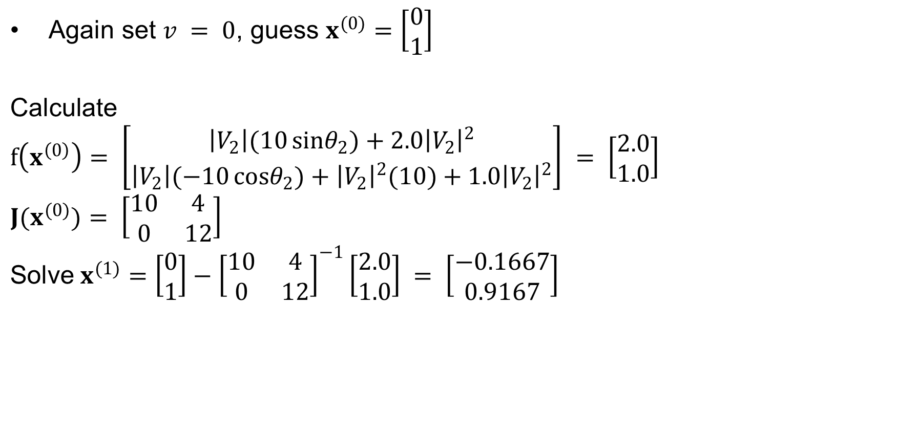
Voltage Dependent Load, cont'd
$\text{Again} \text{set} v = 0\text{, }\text{guess} x^{(0)}=\left[\begin{matrix}0 \\ 1\end{matrix}\right]$
$$\text{Calculate}$$
$$f\left(x^{\left(0\right)}\right)= \left[\begin{matrix}\left|V_{2}\right|(10{sinθ}_{2}{)}+2.0{\left|V_{2}\right|}^{2} \\ \left|V_{2}\right|(−10{cosθ}_{2}{)}+{\left|V_{2}\right|}^{2}(10)+1.0{\left|V_{2}\right|}^{2}\end{matrix}\right] = \left[\begin{matrix}2.0 \\ 1.0\end{matrix}\right]$$
$$J(x^{(0)})= \left[\begin{matrix}10 & 4 \\ 0 & 12\end{matrix}\right]$$
$$\text{Solve} x^{(1)}=\left[\begin{matrix}0 \\ 1\end{matrix}\right]−{\left[\begin{matrix}10 & 4 \\ 0 & 12\end{matrix}\right]}^{−1}\left[\begin{matrix}2.0 \\ 1.0\end{matrix}\right] = \left[\begin{matrix}−0.1667 \\ 0.9167\end{matrix}\right]$$

Slide 6
Voltage Dependent Load, cont’d
With constant impedance load the MW/Mvar load at bus 2 varies with the square of the bus 2 voltage magnitude. This if the voltage level is less than 1.0, the load is lower than 200/100 MW/Mvar

Slide 7
Speeding up the Power Flow
The most computationally complex part of power flow is building and inverting (or factorizing) the Jacobian, so most of the approximations are designed to speed it up by reducing that work

Slide 8
Power Flow Approximations
Methods used to approximate the power flow and potentially speed it up:
Dishonest Newton-Raphson: just keep the same Jacobian from the first iteration to use in all iterations. (Or only update occasionally.)
Decoupled Power Flow: Assume the off-diagonal Jacobian matrices are zero (they are usually quite small)
Fast Decoupled Power Flow: Same as decoupled but only build and invert the Jacobian once (like in the Dishonest Newton-Raphson method)
Linearized or "DC" power flow: ignore reactive power completely and assume all bus voltages are 1.0 per-unit.

Slide 9
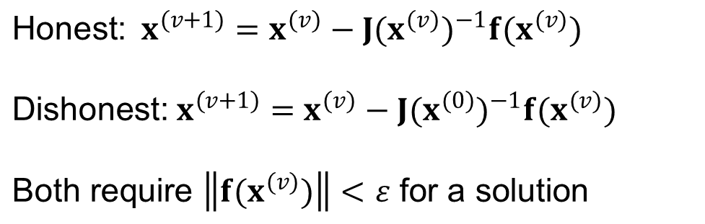
Dishonest Newton-Raphson
Since most of the time in the Newton-Raphson iteration is spend calculating the inverse of the Jacobian, one way to speed up the iterations is to only calculate/inverse the Jacobian occasionally
known as the “Dishonest” Newton-Raphson
an extreme example is to only calculate the Jacobian for the first iteration
$$\text{Honest}\text{:} x^{(v+1)}=x^{(v)}−J(x^{(v)})^{−1}f(x^{(v)})$$
$$\text{Dishonest}\text{:} x^{(v+1)}=x^{(v)}−J(x^{(0)})^{−1}f(x^{(v)})$$
$$\text{Both} \text{require} \left\|f(x^{(v)})\right\|<ε \text{for} \text{a} \text{solution}$$

Slide 10

Dishonest Newton-Raphson Example
$\text{Use} \text{the} \text{Dishonest} \text{Newton}\text{−}\text{Raphson} \text{to} \text{solve}$
$$f(x) = x^{2}−2=0 \\ Δx^{(v)} = −{\left[\frac{df(x^{(0)})}{dx}\right]}^{−1}f(x^{(v)}) \\ Δx^{(v)} = −\left[\frac{1}{2x^{(0)}}\right]((x^{(v)})^{2}−2) \\ x^{(v+1)} = x^{(v)}−\left[\frac{1}{2x^{(0)}}\right]((x^{(v)})^{2}−2)$$

Slide 11

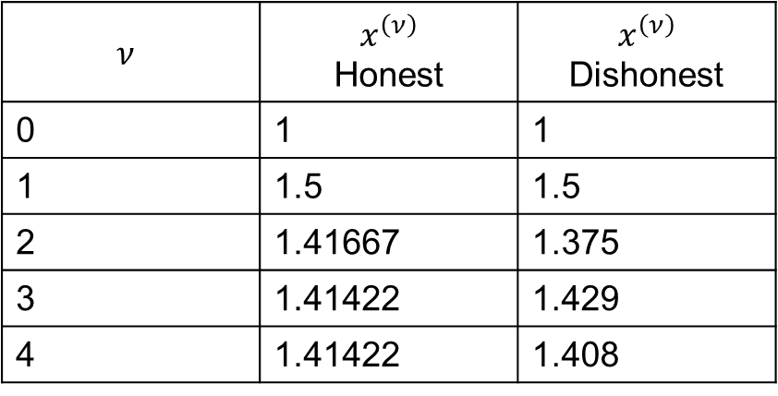
Dishonest N-R Example, cont’d
$x^{(v+1)} = x^{(v)}−\left[\frac{1}{2x^{(0)}}\right]((x^{(v)})^{2}−2)$
$$\text{Guess} {\text{x}}^{(0)}=1. \text{Iteratively} \text{solving} \text{we} \text{get}$$
$$ν$$ | $$x^{\left(ν\right)}$$ Honest | $$x^{\left(ν\right)}$$ Dishonest
0 | 1 | 1
1 | 1.5 | 1.5
2 | 1.41667 | 1.375
3 | 1.41422 | 1.429
4 | 1.41422 | 1.408
We pay a price
in increased
iterations, but
with decreased
computation
per iteration

Slide 12
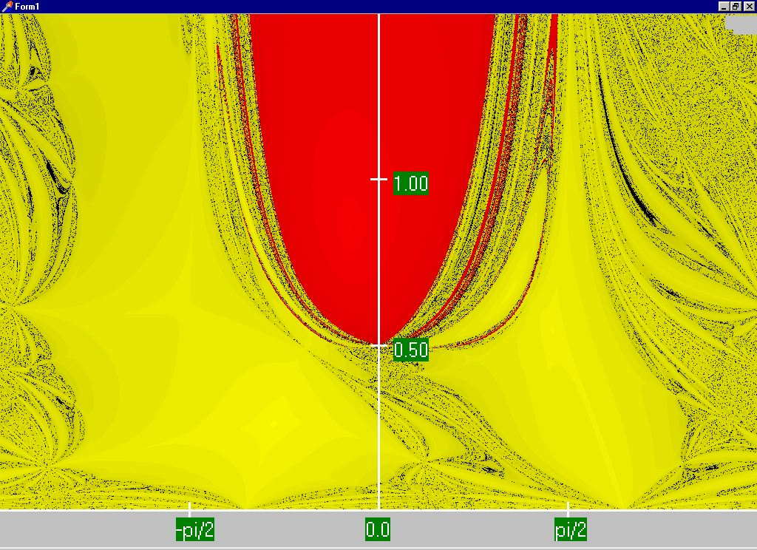
Regular Newton-Raphson Region of Convergence
For a two-bus system, this plot is graphing the initial guess: horizontal axis is theta and vertical axis is V.
Red region converges to the high voltage solution, while the yellow region converges to the low voltage solution
Maximum of 15 iterations

Slide 13
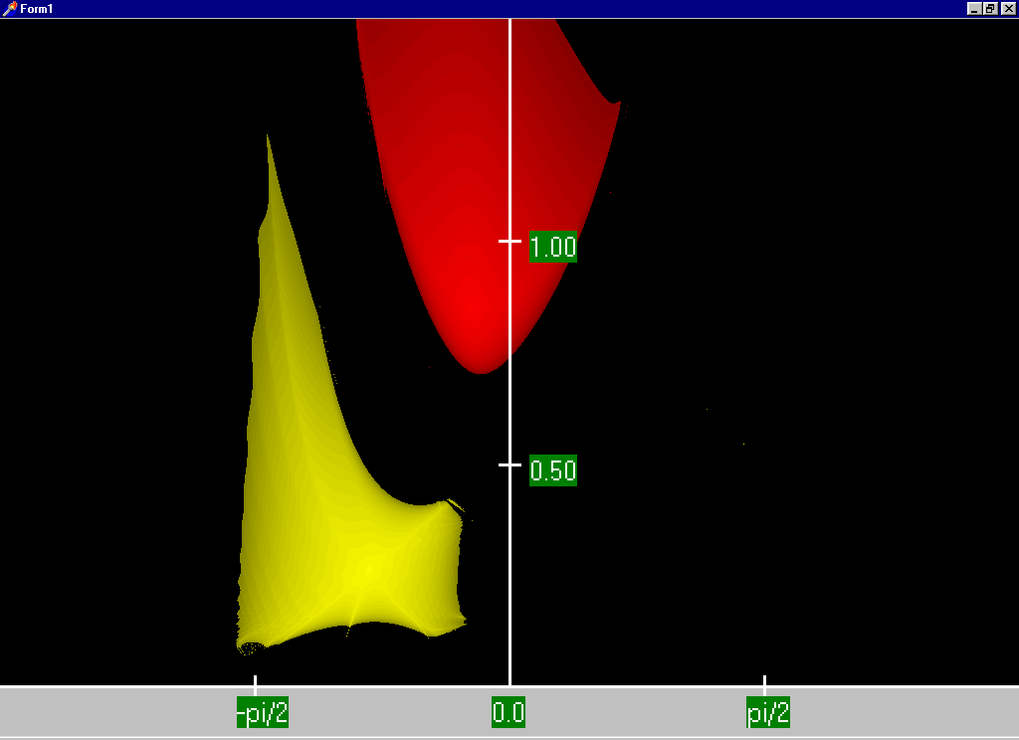
Dishonest Newton-Raphson Region of Convergence
For a two-bus system, this plot is graphing the initial guess: horizontal axis is theta and vertical axis is V.
Red region converges to the high voltage solution, while the yellow region converges to the low voltage solution
Maximum of 15 iterations

Slide 14
Decoupled Power Flow
The completely Dishonest Newton-Raphson is not used for power flow analysis. However several approximations of the Jacobian matrix are used.
One common method is the decoupled power flow. In this approach approximations are used to decouple the real and reactive power equations.

Slide 15
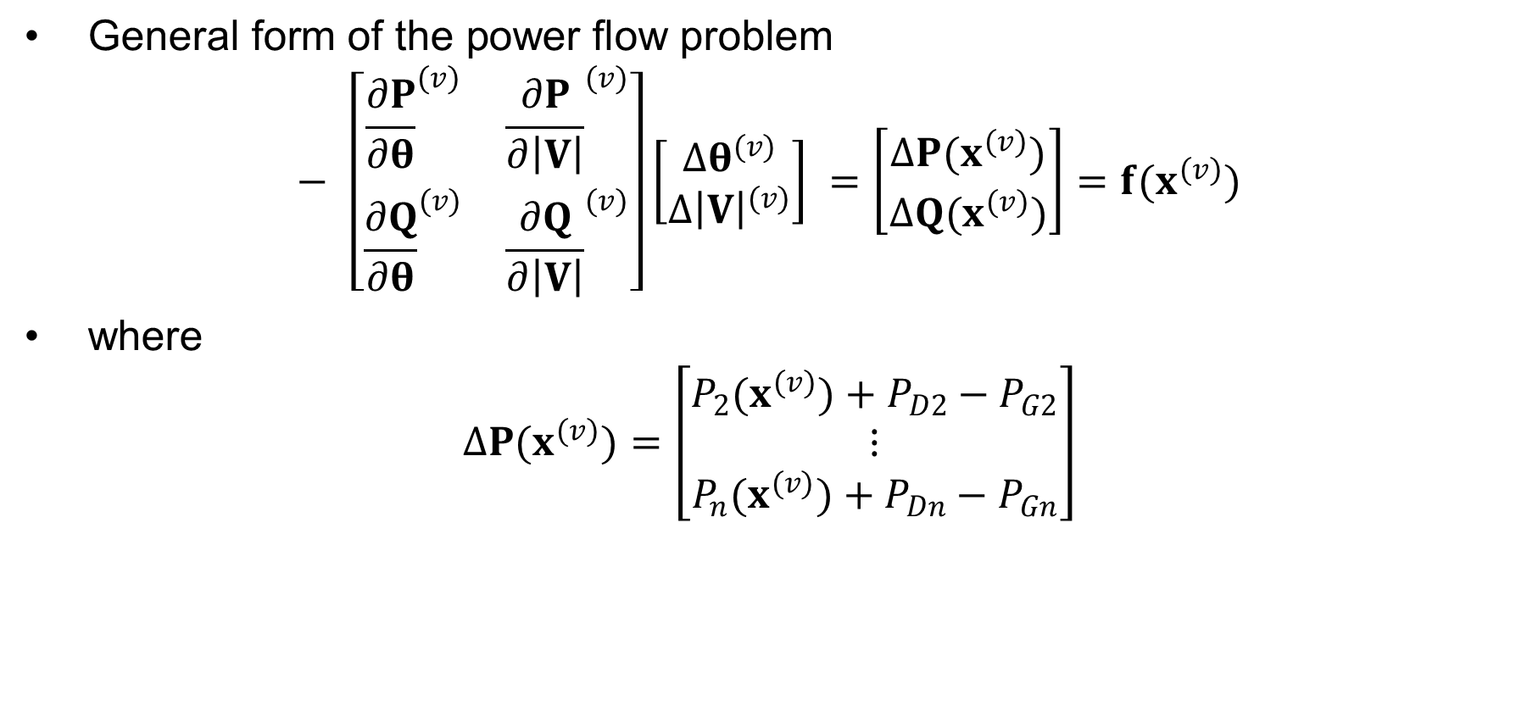
Decoupled Power Flow Formulation
$\text{General} \text{form} \text{of} \text{the} \text{power} \text{flow} \text{problem}$ $− \left[\begin{matrix}{\frac{∂P}{∂θ}}^{(v)} & {\frac{∂P}{∂\left|V\right|}}^{(v)} \\ {\frac{∂Q}{∂θ}}^{(v)} & {\frac{∂Q}{∂\left|V\right|}}^{(v)}\end{matrix}\right]\left[\begin{matrix}Δθ^{(v)} \\ Δ{\left|V\right|}^{(v)}\end{matrix}\right] =\left[\begin{matrix}ΔP(x^{(v)}) \\ ΔQ(x^{(v)})\end{matrix}\right]=f(x^{(v)})$
$\text{where}$ $ΔP(x^{(v)})=\left[\begin{matrix}P_{2}(x^{(v)})+P_{D2}−P_{G2} \\ ⋮ \\ P_{n}(x^{(v)})+P_{Dn}−P_{Gn}\end{matrix}\right]$

Slide 16
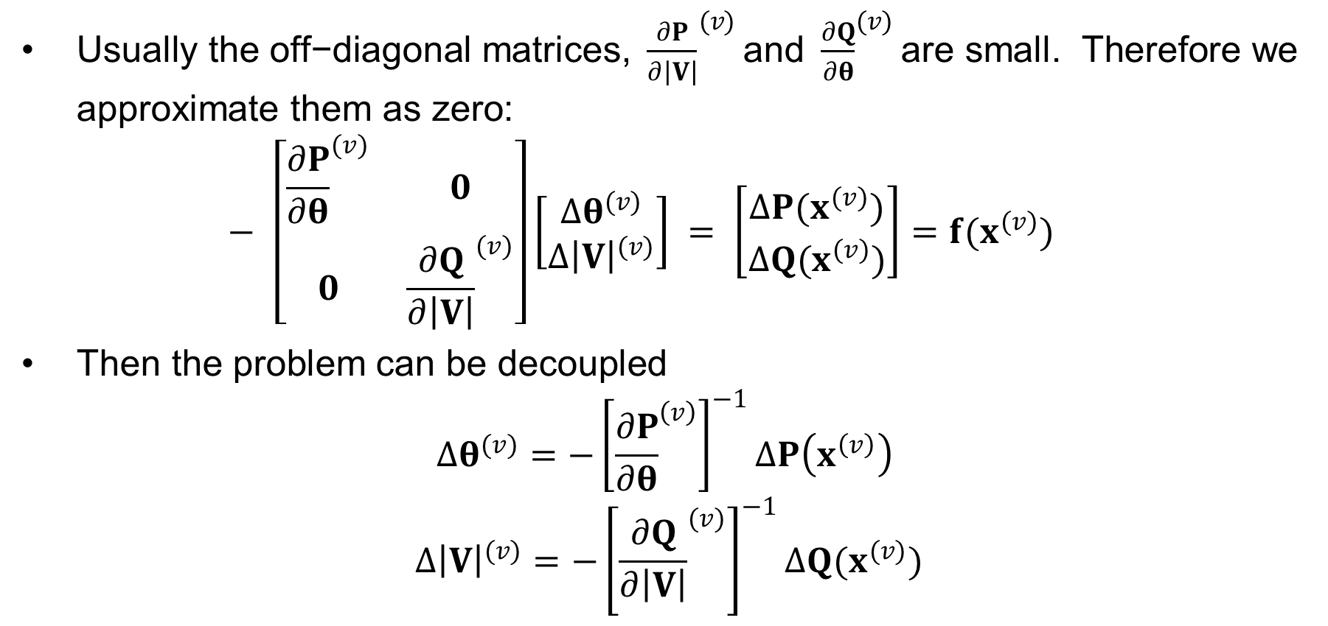
Decoupling Approximation
$\text{Usually} \text{the} \text{off}\text{−}\text{diagonal} \text{matrices}\text{, }{\frac{∂P}{∂\left|V\right|}}^{(v)}\text{and} {\frac{∂Q}{∂θ}}^{(v)}\text{are} \text{small}\text{. }\text{Therefore} \text{we} \text{approximate} \text{them} \text{as} \text{zero}\text{:}$ $− \left[\begin{matrix}{\frac{∂P}{∂θ}}^{(v)} & 0 \\ 0 & {\frac{∂Q}{∂\left|V\right|}}^{(v)}\end{matrix}\right]\left[\begin{matrix}Δθ^{(v)} \\ Δ{\left|V\right|}^{(v)}\end{matrix}\right] = \left[\begin{matrix}ΔP(x^{(v)}) \\ ΔQ(x^{(v)})\end{matrix}\right]=f(x^{(v)})$
$\text{Then} \text{the} \text{problem} \text{can} \text{be} \text{decoupled}$
$$Δθ^{(v)}=−{\left[{\frac{∂P}{∂θ}}^{\left(v\right)}\right]}^{−1}ΔP\left(x^{\left(v\right)}\right)$$
$$Δ{\left|V\right|}^{(v)}=−{\left[{\frac{∂Q}{∂\left|V\right|}}^{(v)}\right]}^{−1}ΔQ(x^{(v)})$$

Slide 17
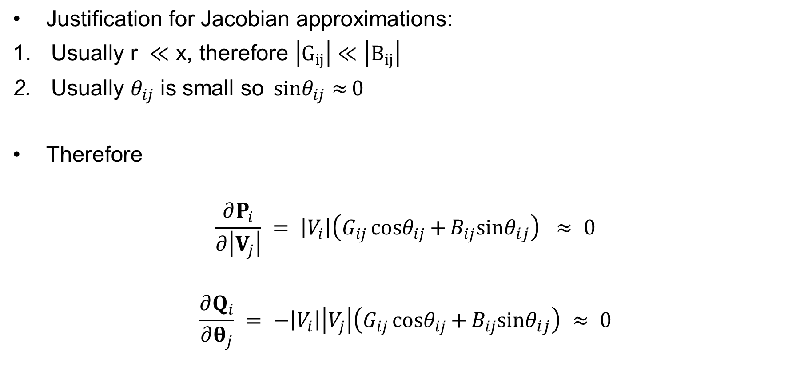
Off-diagonal Jacobian Terms
$\text{Justification} \text{for} \text{Jacobian} \text{approximations}\text{:}$
$\text{Usually} \text{r} ≪\text{x}\text{, }\text{therefore} \left|G_{ij}\right|≪\left|B_{ij}\right|$
$\text{Usually} θ_{ij} \text{is} \text{small} \text{so} {sinθ}_{ij}{≈}0$
$\text{Therefore}$
$$\frac{∂P_{i}}{∂\left|V_{j}\right|} = \left|V_{i}\right|\left(G_{ij}{cosθ}_{ij}{+}B_{ij}{sinθ}_{ij}\right) ≈ 0$$
$$\frac{∂Q_{i}}{∂θ_{j}} = −\left|V_{i}\right|\left|V_{j}\right|\left(G_{ij}{cosθ}_{ij}{+}B_{ij}{sinθ}_{ij}\right) ≈ 0$$

Slide 18
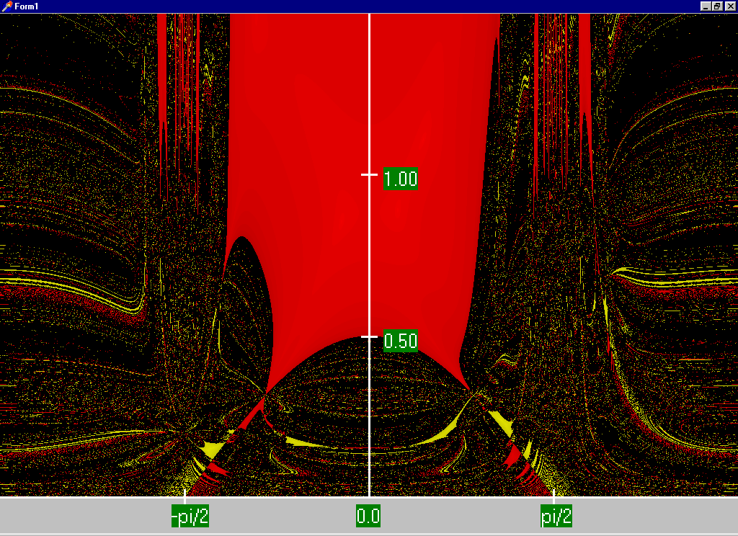
Decoupled Power Flow Region of Convergence
For a two-bus system, this plot is graphing the initial guess: horizontal axis is theta and vertical axis is V.
Red region converges to the high voltage solution, while the yellow region converges to the low voltage solution
Maximum of 15 iterations

Slide 19
Fast Decoupled Power Flow
By continuing with our Jacobian approximations we can actually obtain a reasonable approximation that is independent of the voltage magnitudes/angles.
The Jacobian need only be built/inverted once.
This approach is known as the fast decoupled power flow (FDPF)
FDPF uses the same mismatch equations as standard power flow so it should have same solution
The FDPF is sometimes used, particularly when we only need an approximate solution such as in contingency analysis

Slide 20

“DC” Power Flow
The “DC” power flow makes the most severe approximations:
completely ignore reactive power, assume all the voltages are always 1.0 per unit, ignore line conductance
This makes the power flow a linear set of equations, which can be solved directly
The advantage is it is fast, and it has a guaranteed solution. The disadvantage is the degree of approximation. However, it is used sometimes.
Note that even though it is called “DC” we are still solving an AC system. This is different from including HVDC lines in the power flow.
$$θ=B^{−1} P$$

Slide 21
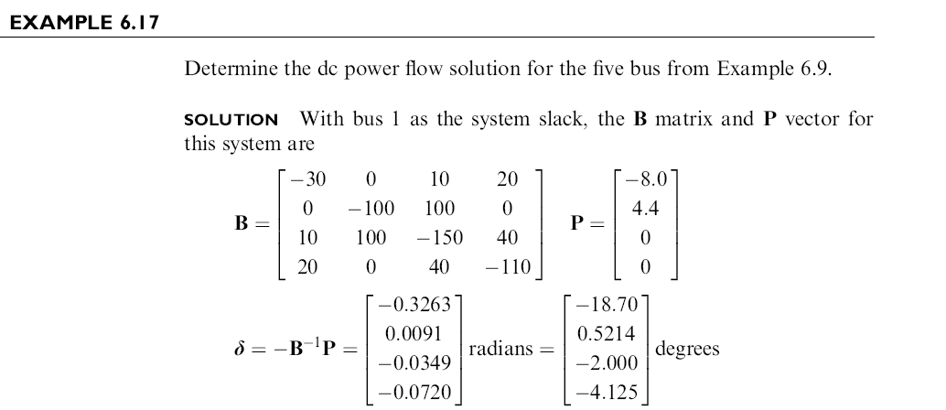
DC Power Flow Example
Notes:
21

Slide 22
DC Power Flow 5 Bus Example
Notice with the dc power flow all of the voltage magnitudes are 1 per unit.
Notes:
22

Slide 23
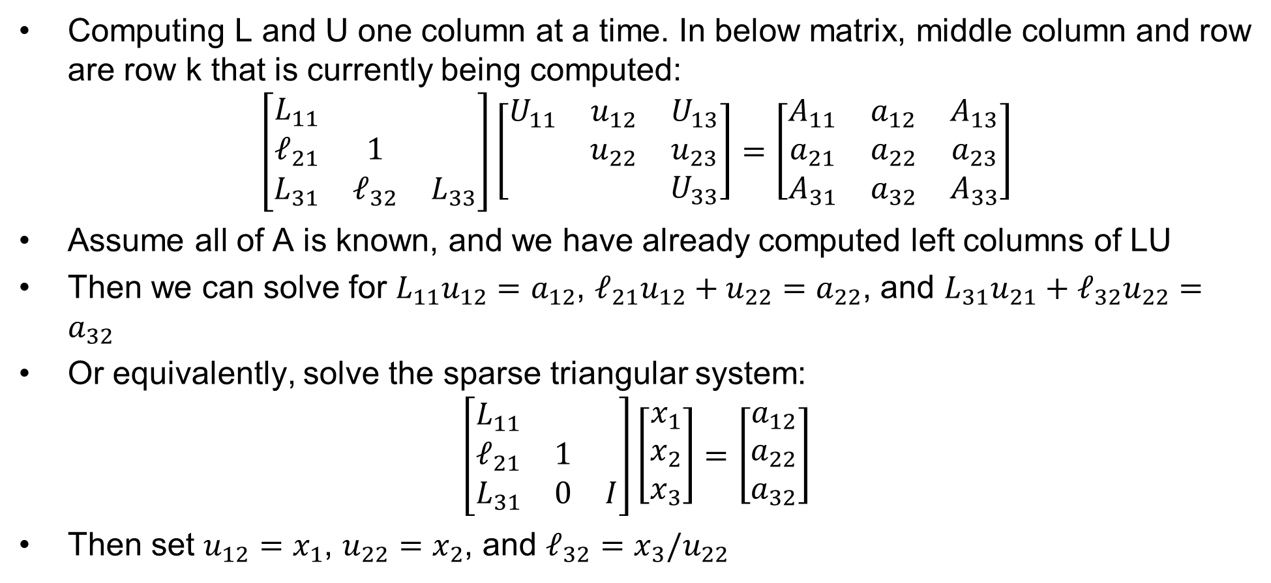
Example Algorithm: Left-looking LU Factorization
Computing L and U one column at a time. In below matrix, middle column and row are row k that is currently being computed:
$$\left[\begin{matrix}L_{11} & & \\ ℓ_{21} & 1 & \\ L_{31} & ℓ_{32} & L_{33}\end{matrix}\right]\left[\begin{matrix}U_{11} & u_{12} & U_{13} \\ & u_{22} & u_{23} \\ & & U_{33}\end{matrix}\right]=\left[\begin{matrix}A_{11} & a_{12} & A_{13} \\ a_{21} & a_{22} & a_{23} \\ A_{31} & a_{32} & A_{33}\end{matrix}\right]$$
Assume all of A is known, and we have already computed left columns of LU
Then we can solve for $L_{11}u_{12}=a_{12}$, $ℓ_{21}u_{12}+u_{22}=a_{22}$, and $L_{31}u_{21}+ℓ_{32}u_{22}=a_{32}$
Or equivalently, solve the sparse triangular system:
$$\left[\begin{matrix}L_{11} & & \\ ℓ_{21} & 1 & \\ L_{31} & 0 & I\end{matrix}\right]\left[\begin{matrix}x_{1} \\ x_{2} \\ x_{3}\end{matrix}\right]=\left[\begin{matrix}a_{12} \\ a_{22} \\ a_{32}\end{matrix}\right]$$
Then set $u_{12}=x_{1}$, $u_{22}=x_{2}$, and $ℓ_{32}=x_{3}/u_{22}$

Slide 24
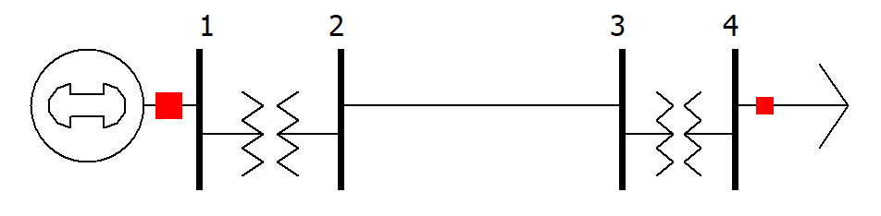
A DC Power Flow Example
$$θ=−B^{−1} P$$
Here were the impedances we found, in per-unit on the system base:
$Z_{xf12}=0.0186+j0.187$
$Z_{line23}=0.054+j0.1$
$Z_{xf34}=0.027+j0.216$
Note: we are modeling the generator as the slack bus (no impedance) and the load as constant power 20 MW and 10 Mvar
Solve the system with the DC power flow

Slide 25
A DC Power Flow Example, cont.
Make the y-bus matrix
$$Y_{bus}=\left[\begin{matrix}0.527−j5.30 & −0.527+j5.30 & 0 & 0 \\ −0.527+j5.30 & 4.71−j13.04 & −4.18+j7.74 & 0 \\ 0 & −4.18+j7.74 & 4.75−j12.30 & −0.570+j4.56 \\ 0 & 0 & −0.570+j4.56 & 0.570−j4.56\end{matrix}\right]$$
2. Find the B matrix as the imaginary part of Y without the slack bus row/column
$$B=\left[\begin{matrix}−13.04 & 7.74 & 0 \\ 7.74 & −12.30 & 4.56 \\ 0 & 4.56 & −4.56\end{matrix}\right]$$
3. Find the P-vector of power injections and solve $θ=−B^{−1} P$
$θ=−{\left[\begin{matrix}−13.04 & 7.74 & 0 \\ 7.74 & −12.30 & 4.56 \\ 0 & 4.56 & −4.56\end{matrix}\right]}^{−1}\left[\begin{matrix}0 \\ 0 \\ 0.2\end{matrix}\right]=\left[\begin{matrix}0.0377 \\ 0.0636 \\ 0.1074\end{matrix}\right]$
Solution:
$$V_{1}=1∠0°$$
$$V_{2}=1∠2.16°$$
$$V_{3}=1∠3.64°$$
$$V_{4}=1∠6.16°$$

Slide 26
Another Power Flow Example
For this four-bus power flow problem
Make the Y-bus matrix
Identify the bus type and known/unknown variables for each bus
Write the P and Q equations for bus 4
Write the last row ($Q_{4}$) of the Jacobian matrix
Solve the dc power flow for this problem
What is the approximate power flow on the line 1-2?
Bus 1
Bus 3
Bus 4
Bus 2
Bus 1: Generator with voltage setpoint of 1.00 pu
Bus 2: Generator with voltage setpoint of 1.02 pu and power setpoint of 75 MW
Bus 4: Load with 180 MW and 55 Mvar
Line 1-3: Z = j0.25
Line 1-2: Z = j0.05
Line 2-3: Z = j0.2
Line 3-4: Z = 0.04+j0.08

Slide 27
Another Power Flow Example, Cont.
$$θ=B^{−1} P$$
Y-bus matrix
$$\left[\begin{matrix}−j24 & j20 & j4 & 0 \\ j20 & −j25 & j5 & 0 \\ j4 & j5 & 5−j19 & −5+j10 \\ 0 & 0 & −5+j10 & 5−j10\end{matrix}\right]$$
Bus 1 is slack (unknown $P/Q$)
Bus 2 is PV (unknown $θ$/$Q$)
Buses 3&4 are PQ (unkn. $θ/V$)
$P_{4}=−1.8=V_{4}V_{3}\left(−5\cos{θ_{43}}+10\sin{θ_{43}}\right)+5V_{4}^{2}$
$Q_{4}=−0.55=V_{4}V_{3}\left(−5\sin{θ_{43}}−10\cos{θ_{43}}\right)−10V_{4}^{2}$
In last row of Jacobian: $\frac{∂Q_{4}}{∂θ_{3}}=V_{4}V_{3}\left(5\cos{θ_{43}}−10\sin{θ_{43}}\right);\frac{∂Q_{4}}{∂θ_{4}}=−\frac{∂Q_{4}}{∂θ_{3}}$
$\frac{∂Q_{4}}{∂V_{3}}=V_{4}\left(−5\sin{θ_{43}}−10\cos{θ_{43}}\right);\frac{∂Q_{4}}{∂V_{4}}=V_{3}\left(−5\sin{θ_{43}}−10\cos{θ_{43}}\right)−20V_{4}$
$$P_{i} = \sum_{k=1}^{n}{\left|V_{i}\right|\left|V_{k}\right|}(g_{ik}\cos{θ_{ik}}+b_{ik}\sin{θ_{ik}})=P_{Gi}−P_{Di} \\ Q_{i} = \sum_{k=1}^{n}{\left|V_{i}\right|\left|V_{k}\right|}(g_{ik}\sin{θ_{ik}}−b_{ik}\cos{θ_{ik}})=Q_{Gi}−Q_{Di}$$

Slide 28
Another Power Flow Example, dc part
$$θ=B^{−1} P$$
B matrix – imaginary part of y-bus without slack row and column
$$\left[\begin{matrix} & & & \\ & −25 & 5 & 0 \\ & 5 & −19 & 10 \\ & 0 & 10 & −10\end{matrix}\right]$$
P vector based on power leaving non-slack buses
$$P=\left[\begin{matrix}−0.75 \\ 0 \\ 1.8\end{matrix}\right]$$
Solve for theta (remember this is an approximation)
$$θ=B^{−1}P=\left[\begin{matrix}−0.01125 \\ −0.20625 \\ −0.38625\end{matrix}\right]$$
Get line flow based on dc assumptions
$P_{12}=(−B_{Line})\left(θ_{1}−θ_{2}\right)=20\left(0−−0.01125\right)=0.225$p.u. (or 22.5 MW)

Slide 29
Inverse of a Sparse Matrix
The inverse of a sparse matrix is NOT in general a sparse matrix
We never (or at least very, very, very seldom) explicitly invert a sparse matrix
Individual columns of the inverse of a sparse matrix can be obtained by solving x = A⁻¹b with b set to all zeros except for a single nonzero in the position of the desired column
If a few desired elements of A⁻¹ are desired (such as the diagonal values) they can usually be computed quite efficiently using sparse vector methods
We can’t invert a singular matrix (with sparse or not)

Slide 30
Brief Coverage of Sparse Matrices
A problem that occurs in many is fields is the solution of linear systems
Ax = b
where
A is an n by n matrix with elements a_{ij},
and x and b are n-vectors with elements x_{i} and b_{i} respectively
In power systems we are particularly interested in systems when n is relatively large and A is sparse
How large is large is changing
A matrix is sparse if a large percentage of its elements have zero values
Goal is to be aware of the computational issues (including complexity) associated with the solution of these systems

Slide 31
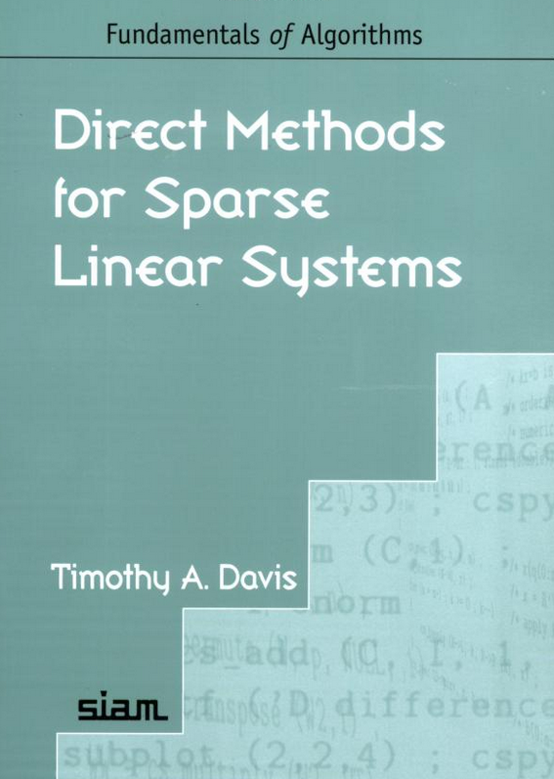
Brief Coverage of Sparse Matrices
Sparse matrices arise in many areas, and can have domain specific structures
Much of the early sparse matrix work was done in power!
Great book on modern methods for solving sparse matrices is by Texas A&M professor Tim Davis

