Slide 1
ECEN 460, Spring 2026 Power System Operation and Control
Class 14: More Power Flow Examples
Prof. Adam Birchfield
Dept. of Electrical and Computer Engineering
Texas A&M University
abirchfield@tamu.edu

Slide 2
Announcements
Homework #6: book problems 6.9, 6.12, 6.18, 6.25, 6.38, due Thursday, Mar 5, 2026

Slide 3
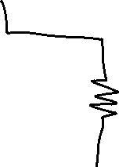






The Power Flow Problem
What we know:
Generator real power
Generator voltage magnitude
Load real and reactive power
What we don't know:
Bus voltage angles
Non-generator bus voltage magnitude
Generator reactive power
Current injections of generators or loads
Note that the problem is formulated with power values, not current, so we cannot use the Y-bus equations directly
Power flow problem is non-linear

Slide 4
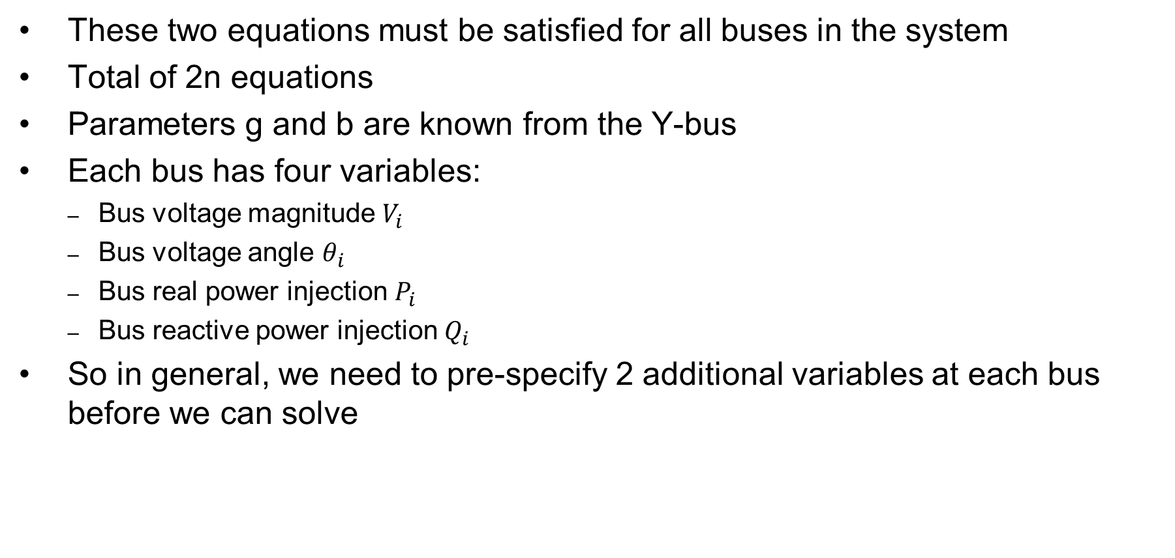
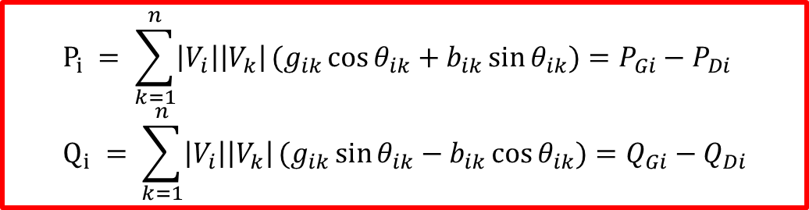
Power Flow Problem Variables
These two equations must be satisfied for all buses in the system
Total of 2n equations
Parameters g and b are known from the Y-bus
Each bus has four variables:
Bus voltage magnitude $V_{i}$
Bus voltage angle $θ_{i}$
Bus real power injection $P_{i}$
Bus reactive power injection $Q_{i}$
So in general, we need to pre-specify 2 additional variables at each bus before we can solve
$$P_{i} = \sum_{k=1}^{n}{\left|V_{i}\right|\left|V_{k}\right|}(g_{ik}\cos{θ_{ik}}+b_{ik}\sin{θ_{ik}})=P_{Gi}−P_{Di} \\ Q_{i} = \sum_{k=1}^{n}{\left|V_{i}\right|\left|V_{k}\right|}(g_{ik}\sin{θ_{ik}}−b_{ik}\cos{θ_{ik}})=Q_{Gi}−Q_{Di}$$

Slide 5
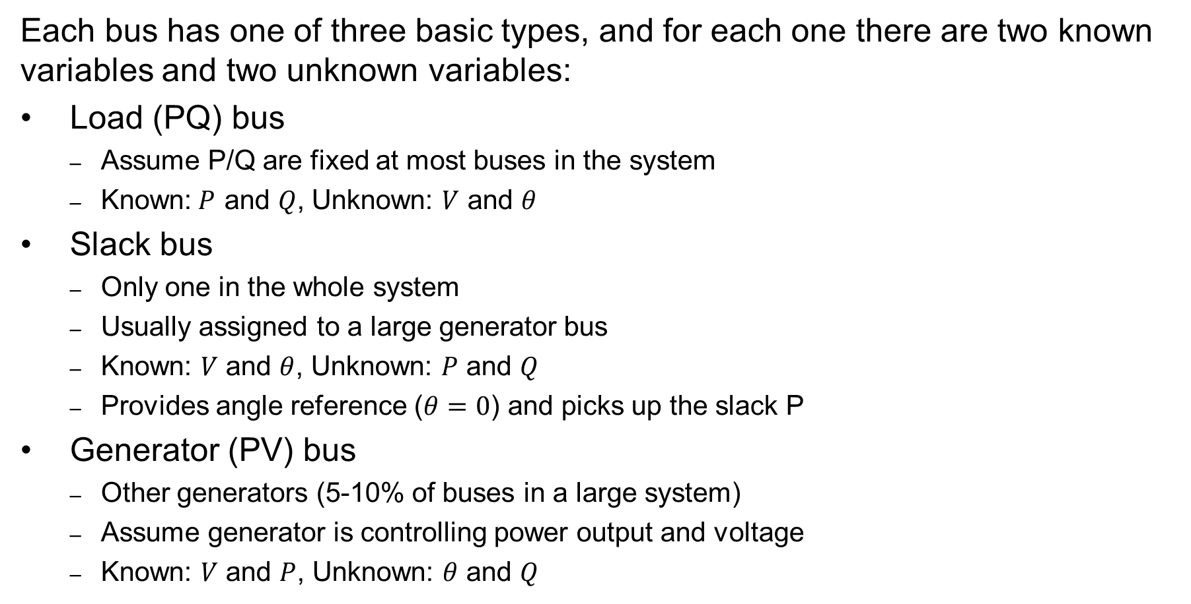
Power Flow Bus Types
Each bus has one of three basic types, and for each one there are two known variables and two unknown variables:
Load (PQ) bus
Assume P/Q are fixed at most buses in the system
Known:$P$ and $Q$, Unknown: $V$ and $θ$
Slack bus
Only one in the whole system
Usually assigned to a large generator bus
Known: $V$ and $θ$, Unknown: $P$ and $Q$
Provides angle reference ($θ=0$) and picks up the slack P
Generator (PV) bus
Other generators (5-10% of buses in a large system)
Assume generator is controlling power output and voltage
Known: $V$ and $P$, Unknown: $θ$ and $Q$

Slide 6
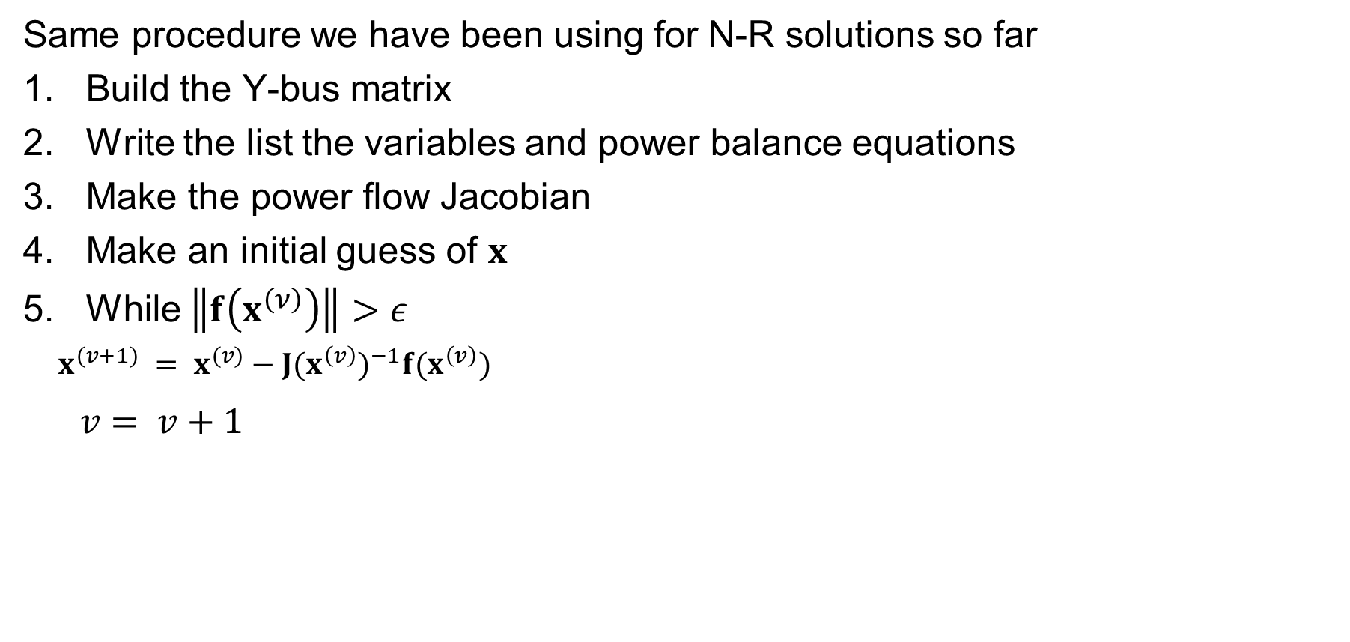
Newton-Raphson Power Flow Procedure
Same procedure we have been using for N-R solutions so far
Build the Y-bus matrix
Write the list the variables and power balance equations
Make the power flow Jacobian
Make an initial guess of $x$
While $\left\|f\left(x^{\left(ν\right)}\right)\right\|>ε$
$x^{(v+1)} = x^{(v)}−J(x^{\left(v\right)})^{−1}f(x^{\left(v\right)})$
$v = v+1$

Slide 7
Two Bus Solved Values
Once the voltage angle and magnitude at bus 2 are known we can calculate all the other system values, such as the line flows and the generator reactive power output

Slide 8
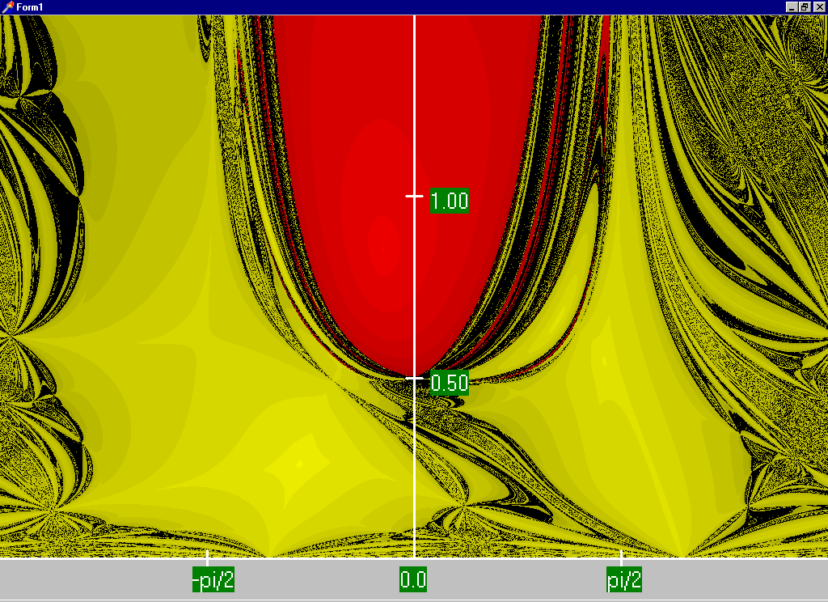

Low Voltage Solution!
$\text{This} \text{case} \text{actually} \text{has} \text{two} \text{solutions}\text{! }\text{The} \text{second}\text{ "}\text{low} \text{voltage}\text{"}​ \text{is} \text{found} \text{by} \text{using} \text{a} \text{low} \text{initial} \text{guess}\text{.}$ $\text{Set} v = 0\text{, }\text{guess} x^{(0)}=\left[\begin{matrix}0 \\ 0.25\end{matrix}\right]$
This shows the region of convergence for different initial guesses of bus 2 angle (x-axis) and magnitude (y-axis)
Red region converges to the high voltage solution, while the yellow region converges to the low voltage solution

Slide 9
Generator Reactive Power Limits
The reactive power output of generators varies to maintain the terminal voltage; on a real generator this is done by the exciter
To maintain higher voltages requires more reactive power
Generators have reactive power limits, which are dependent upon the generator's MW output
These limits must be considered during the power flow solution
During power flow, once a solution is obtained, check to make generator reactive power output is within its limits
If the reactive power is outside of the limits, fix Q at the max or min value, and resolve treating the generator as a PQ bus
this is know as "type-switching"
also need to check if a PQ generator can again regulate
Rule of thumb: to raise system voltage we need to supply more vars

Slide 10
Power Flow Example #2
Bus 1 contains a large generating unit operating at V=1.0 pu
Bus 2 has a load consuming 200 MW and 100 MVR
Bus 3 has a generator that is set to produce 30 MW and control its terminal voltage to 1.0 pu
Want to solve for all bus voltages and line flows

Slide 11
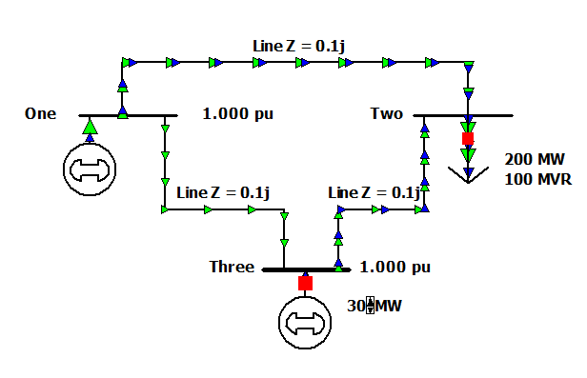
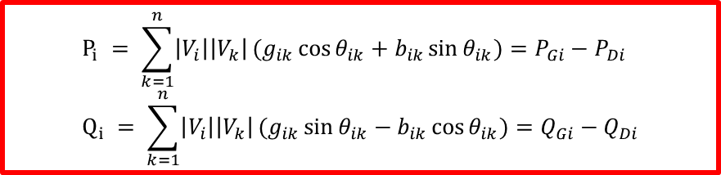
Power Flow Example #2
$$P_{i} = \sum_{k=1}^{n}{\left|V_{i}\right|\left|V_{k}\right|}(g_{ik}\cos{θ_{ik}}+b_{ik}\sin{θ_{ik}})=P_{Gi}−P_{Di} \\ Q_{i} = \sum_{k=1}^{n}{\left|V_{i}\right|\left|V_{k}\right|}(g_{ik}\sin{θ_{ik}}−b_{ik}\cos{θ_{ik}})=Q_{Gi}−Q_{Di}$$

Slide 12

Power Flow Example #2
$$P_{i} = \sum_{k=1}^{n}{\left|V_{i}\right|\left|V_{k}\right|}(g_{ik}\cos{θ_{ik}}+b_{ik}\sin{θ_{ik}})=P_{Gi}−P_{Di} \\ Q_{i} = \sum_{k=1}^{n}{\left|V_{i}\right|\left|V_{k}\right|}(g_{ik}\sin{θ_{ik}}−b_{ik}\cos{θ_{ik}})=Q_{Gi}−Q_{Di}$$

Slide 13
Power Flow Example #2

Slide 14
Power Flow Example #2

Slide 15
Power Flow Example #2

Slide 16
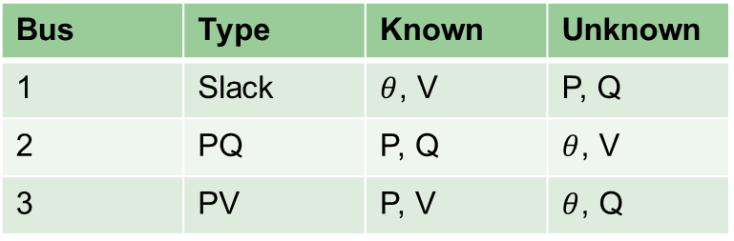

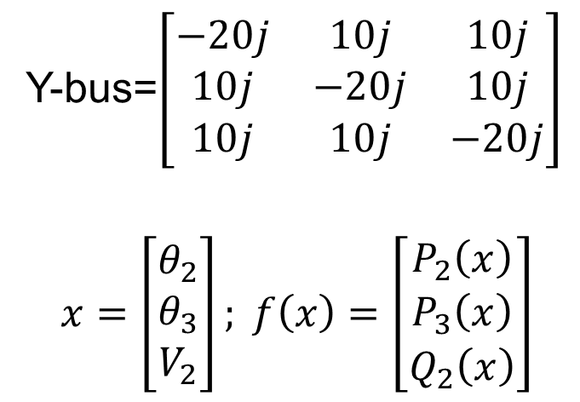
Power Flow Example #2, Solution
First, figure out bus types, knowns, and unknowns
Build Y-bus
Identify variables and equations (unknown $θ$, V and known P, Q)
Bus | Type | Known | Unknown
1 | Slack | $θ$, V | P, Q
2 | PQ | P, Q | $θ$, V
3 | PV | P, V | $θ$, Q
Y-bus=$\left[\begin{matrix}−20j & 10j & 10j \\ 10j & −20j & 10j \\ 10j & 10j & −20j\end{matrix}\right]$
$$x=\left[\begin{matrix}θ_{2} \\ θ_{3} \\ V_{2}\end{matrix}\right]; f\left(x\right)=\left[\begin{matrix}P_{2}\left(x\right) \\ P_{3}\left(x\right) \\ Q_{2}\left(x\right)\end{matrix}\right]$$

Slide 17
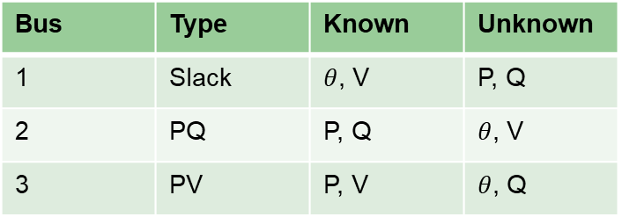
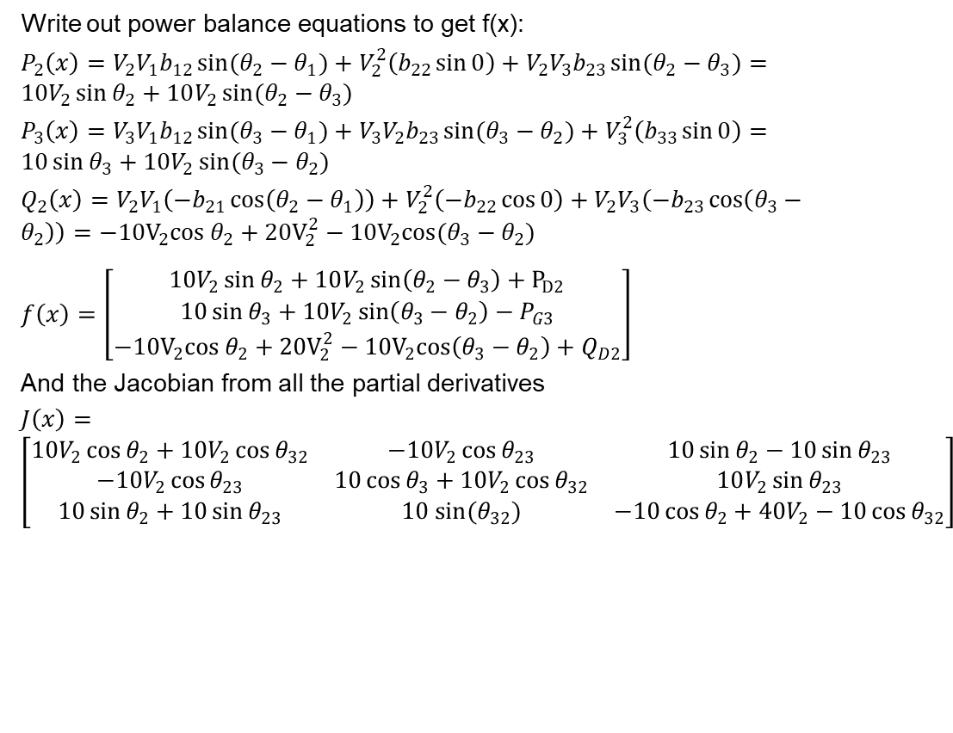
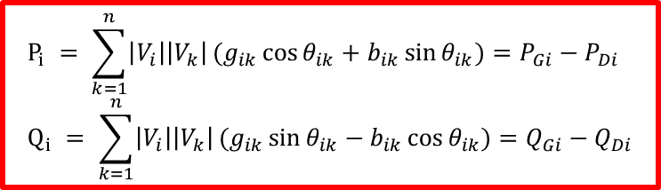
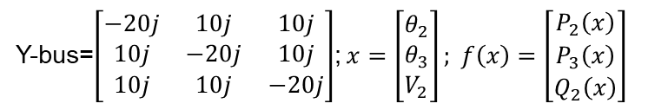
Power Flow Example #2, Solution
Write out power balance equations to get f(x):
$P_{2}\left(x\right)=V_{2}V_{1}b_{12}\sin{(θ_{2}−θ_{1})}+V_{2}^{2}\left(b_{22}\sin{0}\right)+V_{2}V_{3}b_{23}\sin{(θ_{2}−θ_{3})}=10V_{2}\sin{θ_{2}}+10V_{2}\sin{(θ_{2}−θ_{3})}$
$P_{3}\left(x\right)=V_{3}V_{1}b_{12}\sin{(θ_{3}−θ_{1})}+V_{3}V_{2}b_{23}\sin{(θ_{3}−θ_{2})}+V_{3}^{2}\left(b_{33}\sin{0}\right)=10\sin{θ_{3}}+10V_{2}\sin{(θ_{3}−θ_{2})}$
$Q_{2}\left(x\right)=V_{2}V_{1}\left(−b_{21}\cos\left(θ_{2}−θ_{1}\right)\right)+V_{2}^{2}\left(−b_{22}\cos{0}\right)+V_{2}V_{3}\left(−b_{23}\cos\left(θ_{3}−θ_{2}\right)\right)=−10V_{2}cos θ_{2}+{20V}_{2}^{2}−10V_{2}cos(θ_{3}−θ_{2})$
$f\left(x\right)=\left[\begin{matrix}10V_{2}\sin{θ_{2}}+10V_{2}\sin\left(θ_{2}−θ_{3}\right)+P_{D2} \\ 10\sin{θ_{3}}+10V_{2}\sin\left(θ_{3}−θ_{2}\right)−P_{G3} \\ −10V_{2}cos θ_{2}+{20V}_{2}^{2}−10V_{2}cos\left(θ_{3}−θ_{2}\right)+Q_{D2}\end{matrix}\right]$
And the Jacobian from all the partial derivatives
$J\left(x\right)=\left[\begin{matrix}10V_{2}\cos{θ_{2}}+10V_{2}\cos{θ_{32}} & −10V_{2}\cos{θ_{23}} & 10\sin{θ_{2}}−10\sin{θ_{23}} \\ −10V_{2}\cos{θ_{23}} & 10\cos{θ_{3}}+10V_{2}\cos{θ_{32}} & 10V_{2}\sin{θ_{23}} \\ 10\sin{θ_{2}}+10\sin{θ_{23}} & 10 sin(θ_{32}) & −10\cos{θ_{2}}+40V_{2}−10\cos{θ_{32}}\end{matrix}\right]$
Bus | Type | Known | Unknown
1 | Slack | $θ$, V | P, Q
2 | PQ | P, Q | $θ$, V
3 | PV | P, V | $θ$, Q
Y-bus=$\left[\begin{matrix}−20j & 10j & 10j \\ 10j & −20j & 10j \\ 10j & 10j & −20j\end{matrix}\right]$;$x=\left[\begin{matrix}θ_{2} \\ θ_{3} \\ V_{2}\end{matrix}\right]; f\left(x\right)=\left[\begin{matrix}P_{2}\left(x\right) \\ P_{3}\left(x\right) \\ Q_{2}\left(x\right)\end{matrix}\right]$
$$P_{i} = \sum_{k=1}^{n}{\left|V_{i}\right|\left|V_{k}\right|}(g_{ik}\cos{θ_{ik}}+b_{ik}\sin{θ_{ik}})=P_{Gi}−P_{Di} \\ Q_{i} = \sum_{k=1}^{n}{\left|V_{i}\right|\left|V_{k}\right|}(g_{ik}\sin{θ_{ik}}−b_{ik}\cos{θ_{ik}})=Q_{Gi}−Q_{Di}$$

Slide 18
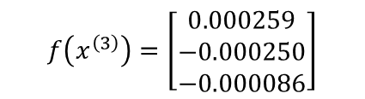
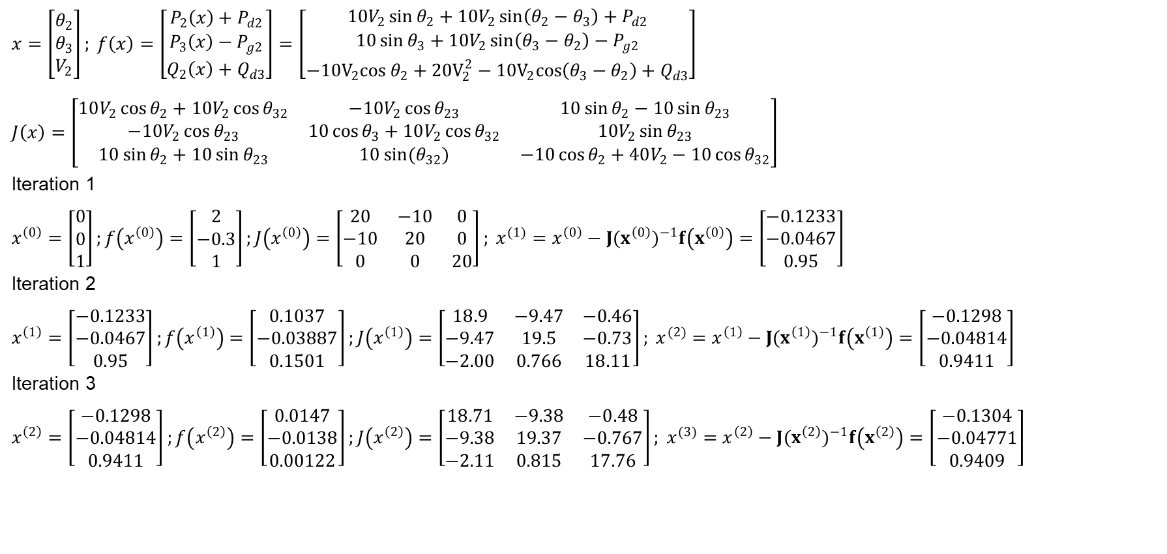
Power Flow Example #2, Solution
$x=\left[\begin{matrix}θ_{2} \\ θ_{3} \\ V_{2}\end{matrix}\right]; f\left(x\right)=\left[\begin{matrix}P_{2}\left(x\right)+P_{d2} \\ P_{3}\left(x\right)−P_{g2} \\ Q_{2}\left(x\right)+Q_{d3}\end{matrix}\right]=\left[\begin{matrix}10V_{2}\sin{θ_{2}}+10V_{2}\sin\left(θ_{2}−θ_{3}\right)+P_{d2} \\ 10\sin{θ_{3}}+10V_{2}\sin\left(θ_{3}−θ_{2}\right)−P_{g2} \\ −10V_{2}cos θ_{2}+{20V}_{2}^{2}−10V_{2}cos\left(θ_{3}−θ_{2}\right)+Q_{d3}\end{matrix}\right]$
$J\left(x\right)=\left[\begin{matrix}10V_{2}\cos{θ_{2}}+10V_{2}\cos{θ_{32}} & −10V_{2}\cos{θ_{23}} & 10\sin{θ_{2}}−10\sin{θ_{23}} \\ −10V_{2}\cos{θ_{23}} & 10\cos{θ_{3}}+10V_{2}\cos{θ_{32}} & 10V_{2}\sin{θ_{23}} \\ 10\sin{θ_{2}}+10\sin{θ_{23}} & 10 sin(θ_{32}) & −10\cos{θ_{2}}+40V_{2}−10\cos{θ_{32}}\end{matrix}\right]$
Iteration 1
$x^{\left(0\right)}=\left[\begin{matrix}0 \\ 0 \\ 1\end{matrix}\right];f\left(x^{\left(0\right)}\right)=\left[\begin{matrix}2 \\ −0.3 \\ 1\end{matrix}\right];J\left(x^{\left(0\right)}\right)=\left[\begin{matrix}20 & −10 & 0 \\ −10 & 20 & 0 \\ 0 & 0 & 20\end{matrix}\right]; x^{(1)}=x^{\left(0\right)}−J(x^{\left(0\right)})^{−1}f\left(x^{\left(0\right)}\right)=\left[\begin{matrix}−0.1233 \\ −0.0467 \\ 0.95\end{matrix}\right]$
Iteration 2
$x^{\left(1\right)}=\left[\begin{matrix}−0.1233 \\ −0.0467 \\ 0.95\end{matrix}\right];f\left(x^{\left(1\right)}\right)=\left[\begin{matrix}0.1037 \\ −0.03887 \\ 0.1501\end{matrix}\right];J\left(x^{\left(1\right)}\right)=\left[\begin{matrix}18.9 & −9.47 & −0.46 \\ −9.47 & 19.5 & −0.73 \\ −2.00 & 0.766 & 18.11\end{matrix}\right]; x^{(2)}=x^{\left(1\right)}−J(x^{\left(1\right)})^{−1}f\left(x^{\left(1\right)}\right)=\left[\begin{matrix}−0.1298 \\ −0.04814 \\ 0.9411\end{matrix}\right]$
Iteration 3
$x^{\left(2\right)}=\left[\begin{matrix}−0.1298 \\ −0.04814 \\ 0.9411\end{matrix}\right];f\left(x^{\left(2\right)}\right)=\left[\begin{matrix}0.0147 \\ −0.0138 \\ 0.00122\end{matrix}\right];J\left(x^{\left(2\right)}\right)=\left[\begin{matrix}18.71 & −9.38 & −0.48 \\ −9.38 & 19.37 & −0.767 \\ −2.11 & 0.815 & 17.76\end{matrix}\right]; x^{(3)}=x^{\left(2\right)}−J(x^{\left(2\right)})^{−1}f\left(x^{\left(2\right)}\right)=\left[\begin{matrix}−0.1304 \\ −0.04771 \\ 0.9409\end{matrix}\right]$
$$f\left(x^{\left(3\right)}\right)=\left[\begin{matrix}0.000259 \\ −0.000250 \\ −0.000086\end{matrix}\right]$$

Slide 19
The N-R Power Flow: 5-Bus Example
T2
800 MVA
345/15 kV
1
T1
5
4
3
520 MVA
Line 3 345 kV
50 mi
400 MVA
15 kV
800 MVA
15 kV
400 MVA
15/345 kV
345 kV 100 mi
345 kV 200 mi
40 Mvar
80 MW
Line 2
Line 1
2
280 Mvar
800 MW
Single-line diagram

Slide 20
The N-R Power Flow: 5-Bus Example
Bus | Type | V per unit | δ degrees | P_{G} per unit | Q_{G} per unit | P_{L} per unit | Q_{L} per unit | Q_{Gmax} per unit | Q_{Gmin} per unit
1 | Swing | 1.0 | 0 | ⎯ | ⎯ | 0 | 0 | ⎯ | ⎯
2 | Load | ⎯ | ⎯ | 0 | 0 | 8.0 | 2.8 | ⎯ | ⎯
3 | Constant voltage | 1.05 | ⎯ | 5.2 | ⎯ | 0.8 | 0.4 | 4.0 | -2.8
4 | Load | ⎯ | ⎯ | 0 | 0 | 0 | 0 | ⎯ | ⎯
5 | Load | ⎯ | ⎯ | 0 | 0 | 0 | 0 | ⎯ | ⎯
Table 1.
Bus input
data
Bus-to-Bus | R’ per unit | X’ per unit | G’ per unit | B’ per unit | Maximum MVA per unit
2-4 | 0.0090 | 0.100 | 0 | 1.72 | 12.0
2-5 | 0.0045 | 0.050 | 0 | 0.88 | 12.0
4-5 | 0.00225 | 0.025 | 0 | 0.44 | 12.0
Table 2.
Line input data
Notes:
20

Slide 21
The N-R Power Flow: 5-Bus Example
Bus-to-Bus | R per unit | X per unit | G_{c} per unit | B_{m} per unit | Maximum MVA per unit | Maximum TAP Setting per unit
1-5 | 0.00150 | 0.02 | 0 | 0 | 6.0 | —
3-4 | 0.00075 | 0.01 | 0 | 0 | 10.0 | —
Table 3.
Transformer
input data
Bus | Input Data | Unknowns
1 | V₁ = 1.0, δ₁ = 0 | P₁, Q₁
2 | P₂ = P_{G2}-P_{L2} = -8 Q₂ = Q_{G2}-Q_{L2} = -2.8 | V₂, δ₂
3 | V₃ = 1.05 P₃ = P_{G3}-P_{L3} = 4.4 | Q₃, δ₃
4 | P₄ = 0, Q₄ = 0 | V₄, δ₄
5 | P₅ = 0, Q₅ = 0 | V₅, δ₅
Table 4. Input data
and unknowns
Notes:
21

Slide 22
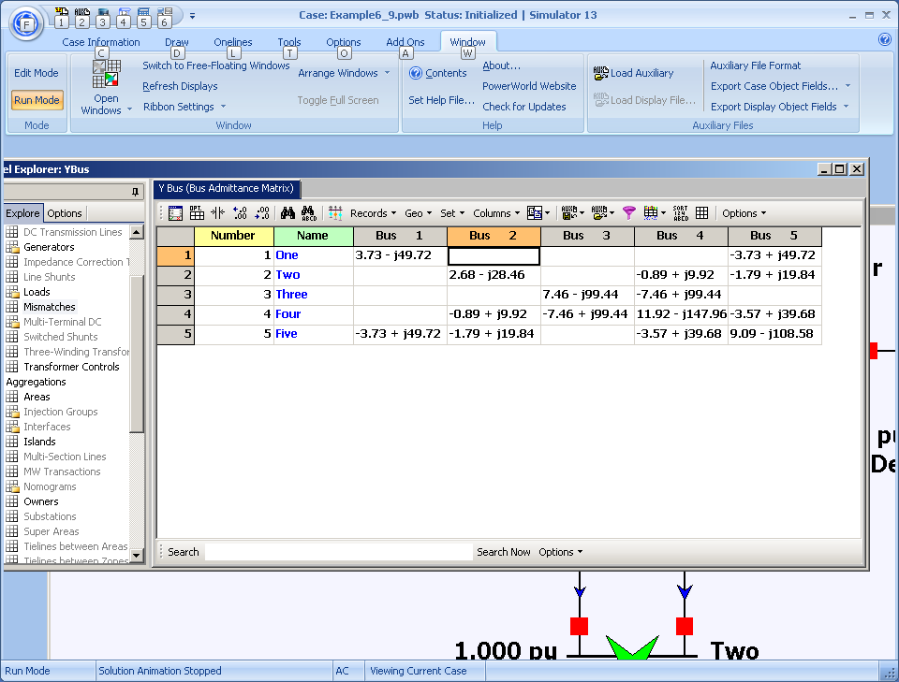
Time to Close the Hood: Let the Computer Do the Math! (Ybus Shown)
Notes:
22

Slide 23

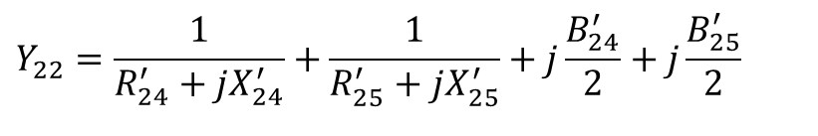
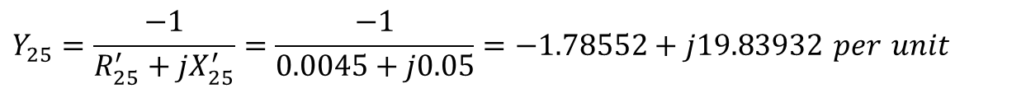
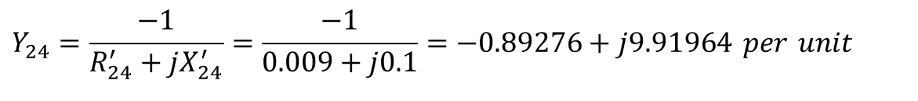
Ybus Details
Elements of Y_{bus} connected to bus 2
$$Y_{21}=Y_{23}=0$$
$$Y_{24}=\frac{−1}{R_{24}^{′}+jX_{24}^{′}}=\frac{−1}{0.009+j0.1}=−0.89276+j9.91964 per unit$$
$$Y_{25}=\frac{−1}{R_{25}^{′}+jX_{25}^{′}}=\frac{−1}{0.0045+j0.05}=−1.78552+j19.83932 per unit$$
$$Y_{22}=\frac{1}{R_{24}^{′}+jX_{24}^{′}}+\frac{1}{R_{25}^{′}+jX_{25}^{′}}+j\frac{B_{24}^{′}}{2}+j\frac{B_{25}^{′}}{2}$$
$$=(0.89276−j9.91964)+(1.78552−j19.83932)+j\frac{1.72}{2}+j\frac{0.88}{2}$$
$$=2.67828−j28.4590=28.5847∠−84.624° per unit$$
Notes:
23

Slide 24
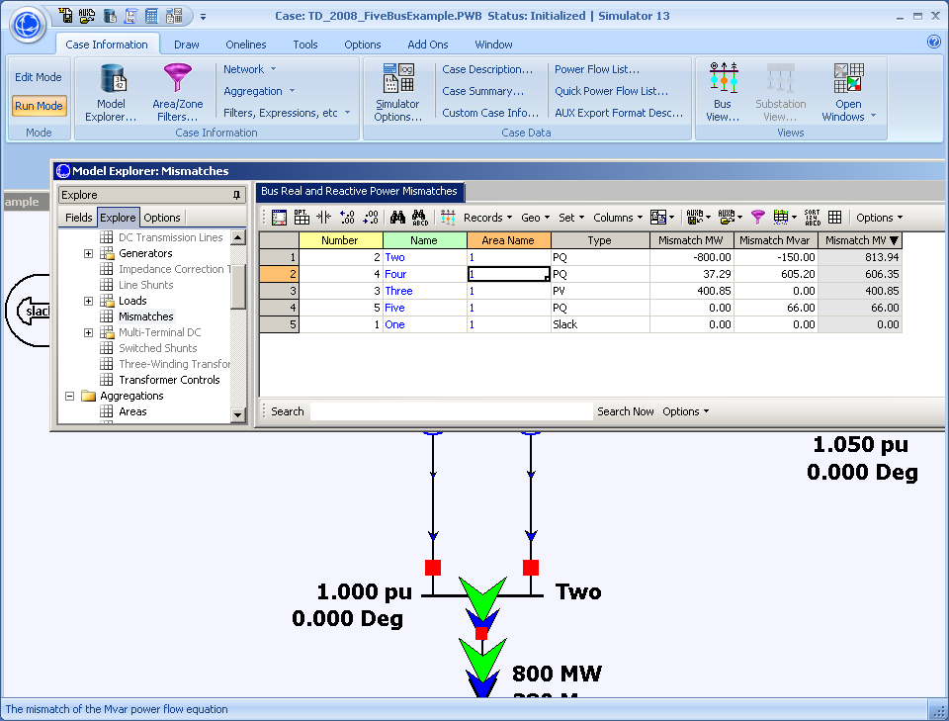
Here Are the Initial Bus Mismatches
Notes:
24

Slide 25
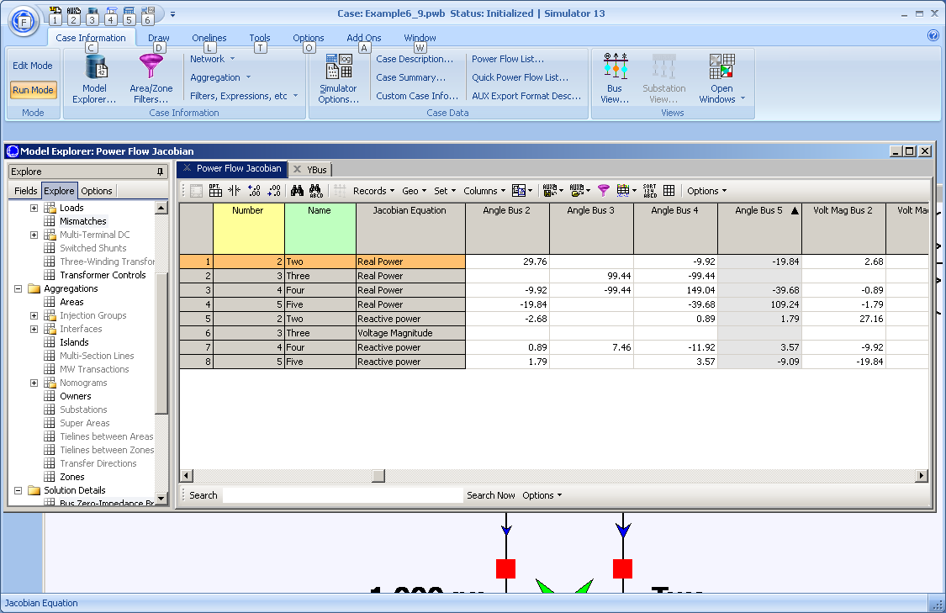
And the Initial Power Flow Jacobian
Notes:
25

Slide 26






And the Hand Calculation Details!
$$ΔP_{2}(0)=P_{2}−P_{2}(x)=P_{2}−V_{2}(0)\{Y_{21}V_{1}\cos{[}δ_{2}(0)−δ_{1}(0)−θ_{21}]$$
$$+Y_{22}V_{2}\cos{[}−θ_{22}]+Y_{23}V_{3}\cos{[}δ_{2}(0)−δ_{3}(0)−θ_{23}]$$
$$+Y_{24}V_{4}\cos{[}δ_{2}(0)−δ_{4}(0)−θ_{24}]$$
$$+Y_{25}V_{5}\cos{[}δ_{2}(0)−δ_{5}(0)−θ_{25}]\}$$
$$=−8.0−1.0\{28.5847(1.0)\cos{(}84.624°)$$
$$+9.95972(1.0)\cos{(}−95.143°)$$
$$+19.9159(1.0)\cos{(}−95.143°)\}$$
$$=−8.0−(−2.89×10^{−4})=−7.99972 per unit$$
$$J1_{24}(0)=V_{2}(0)Y_{24}V_{4}(0)\sin{[}δ_{2}(0)−δ_{4}(0)−θ_{24}]$$
$$=(1.0)(9.95972)(1.0)\sin{[}−95.143°]$$
$$=−9.91964 per unit$$
Notes:
26

Slide 27
Five Bus Power System Solved
Notes:
27

Slide 28
Five Bus System with Capacitor
A capacitor has been added at bus 2 to fix its low voltage

Slide 29
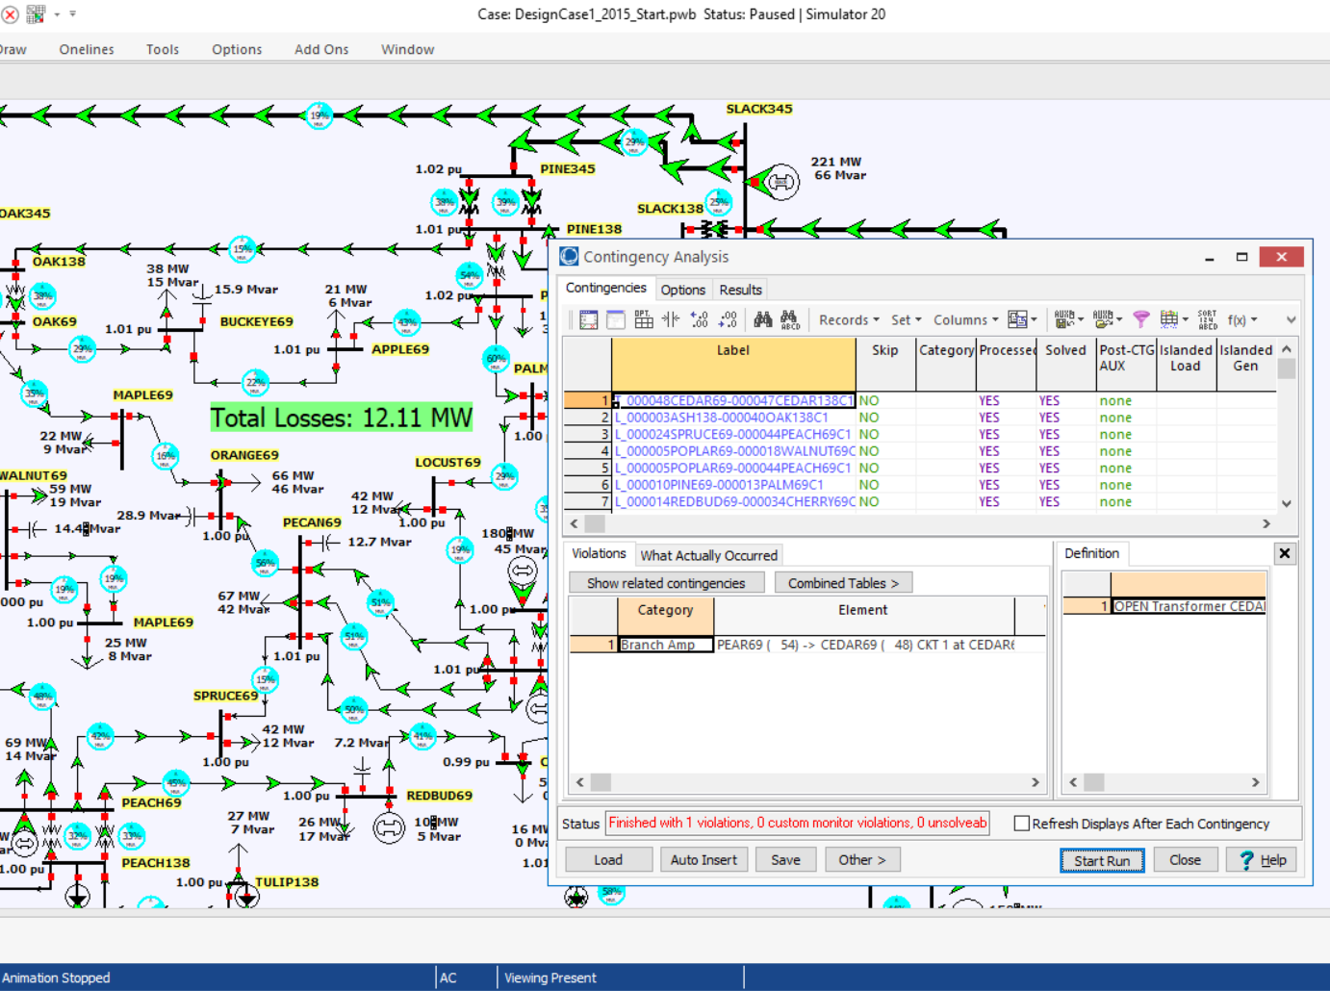
Contingency Analysis
Contingency analysis provides an automatic way of looking at all the statistically likely contingencies. In this example the contingency set is all the single line and transformer outages
Notes:
29

Slide 30
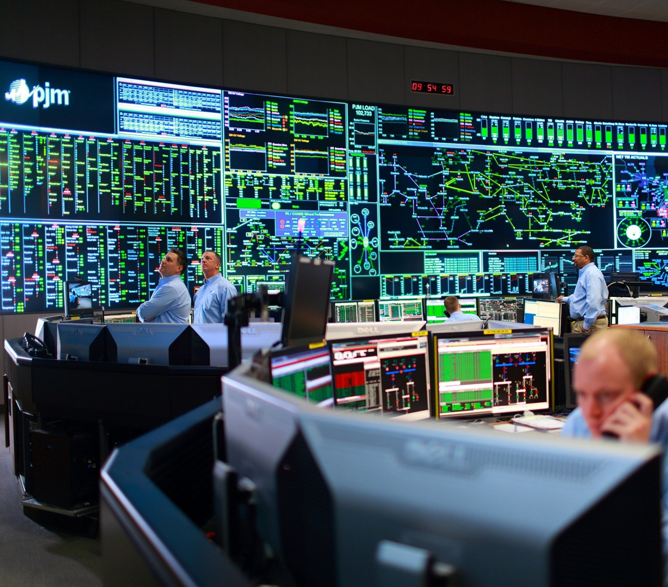
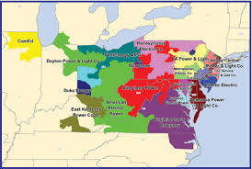
Power Flow Application - PJM Control Center

