Slide 1
ECEN 460, Spring 2026 Power System Operation and Control
Class 13: Newton-Raphson Solution Method for the Power Flow Problem
Prof. Adam Birchfield
Dept. of Electrical and Computer Engineering
Texas A&M University
abirchfield@tamu.edu

Slide 2
Announcements
Homework #5: book problems 6.30 and 6.31, due Thursday, Feb. 26, 2026
Homework #6: book problems 6.9, 6.12, 6.18, 6.25, 6.38, due Thursday, Mar 5, 2026

Slide 3

Recall, Transmission Line and Transformer Models
Transmission lines use the "pi" model
Transformer non-ideal model is simplified with the per-unit system (and neglecting shunt elements)
These devices reduce down to impedances

Slide 4

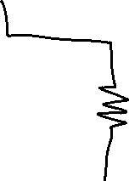
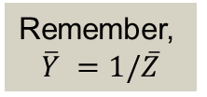


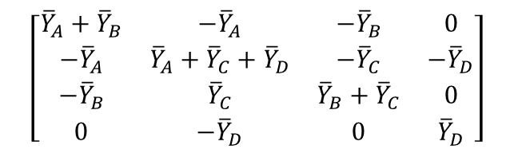
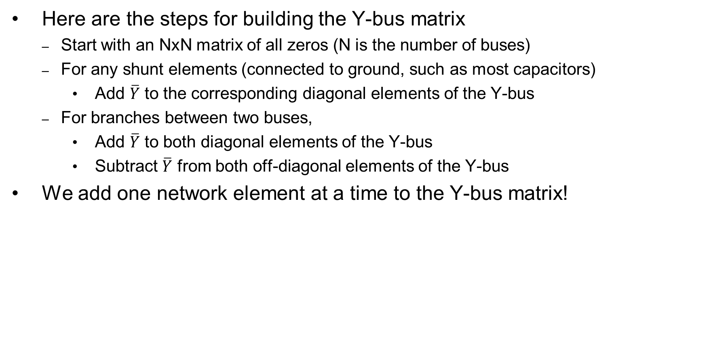



Recall, Building the Y-Bus Matrix
Here are the steps for building the Y-bus matrix
Start with an NxN matrix of all zeros (N is the number of buses)
For any shunt elements (connected to ground, such as most capacitors)
Add $\overline{Y}$ to the corresponding diagonal elements of the Y-bus
For branches between two buses,
Add $\overline{Y}$ to both diagonal elements of the Y-bus
Subtract $\overline{Y}$ from both off-diagonal elements of the Y-bus
We add one network element at a time to the Y-bus matrix!
Remember,
$$\overline{Y} =1/\overline{Z}$$
$$\left[\begin{matrix}{\overline{Y}}_{A}+{\overline{Y}}_{B} & −{\overline{Y}}_{A} & −{\overline{Y}}_{B} & 0 \\ −{\overline{Y}}_{A} & {\overline{Y}}_{A}+{\overline{Y}}_{C}+{\overline{Y}}_{D} & −{\overline{Y}}_{C} & −{\overline{Y}}_{D} \\ −{\overline{Y}}_{B} & {\overline{Y}}_{C} & {\overline{Y}}_{B}+{\overline{Y}}_{C} & 0 \\ 0 & −{\overline{Y}}_{D} & 0 & {\overline{Y}}_{D}\end{matrix}\right]$$

Slide 5
The Power Flow Problem
What we know:
Generator real power
Generator voltage magnitude
Load real and reactive power
What we don't know:
Bus voltage angles
Non-generator bus voltage magnitude
Generator reactive power
Current injections of generators or loads
Note that the problem is formulated with power values, not current, so we cannot use the Y-bus equations directly
Power flow problem is non-linear

Slide 6
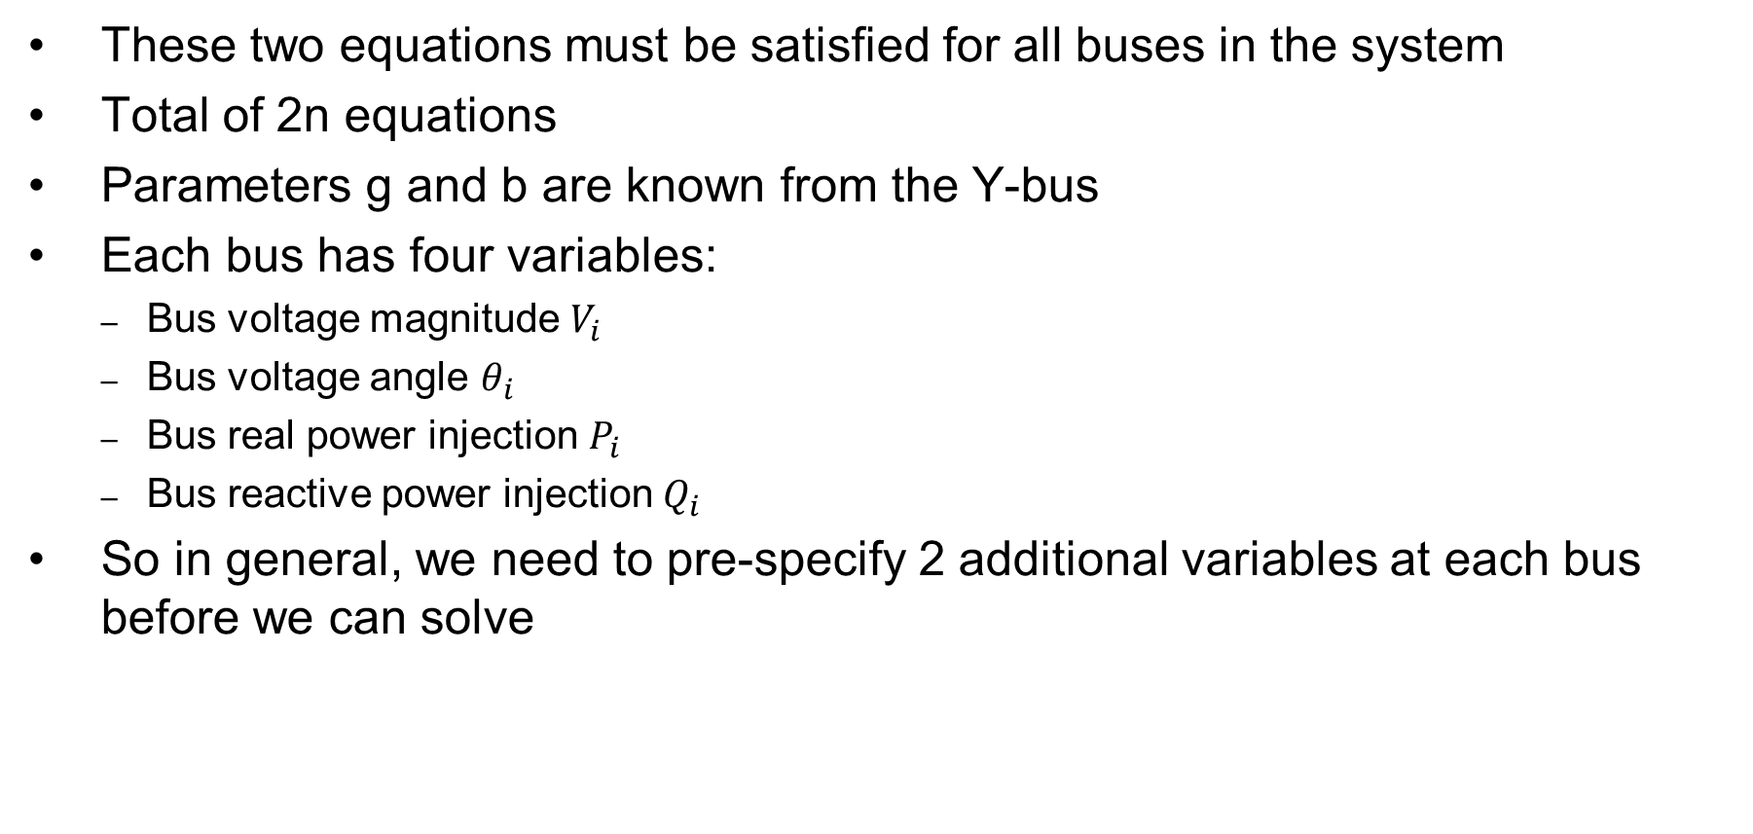
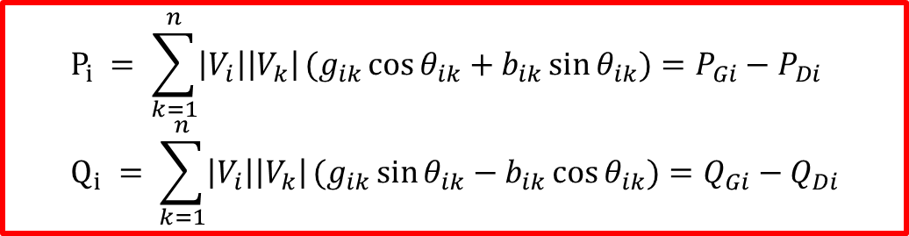
Power Flow Problem Variables
These two equations must be satisfied for all buses in the system
Total of 2n equations
Parameters g and b are known from the Y-bus
Each bus has four variables:
Bus voltage magnitude $V_{i}$
Bus voltage angle $θ_{i}$
Bus real power injection $P_{i}$
Bus reactive power injection $Q_{i}$
So in general, we need to pre-specify 2 additional variables at each bus before we can solve
$$P_{i} = \sum_{k=1}^{n}{\left|V_{i}\right|\left|V_{k}\right|}(g_{ik}\cos{θ_{ik}}+b_{ik}\sin{θ_{ik}})=P_{Gi}−P_{Di} \\ Q_{i} = \sum_{k=1}^{n}{\left|V_{i}\right|\left|V_{k}\right|}(g_{ik}\sin{θ_{ik}}−b_{ik}\cos{θ_{ik}})=Q_{Gi}−Q_{Di}$$

Slide 7
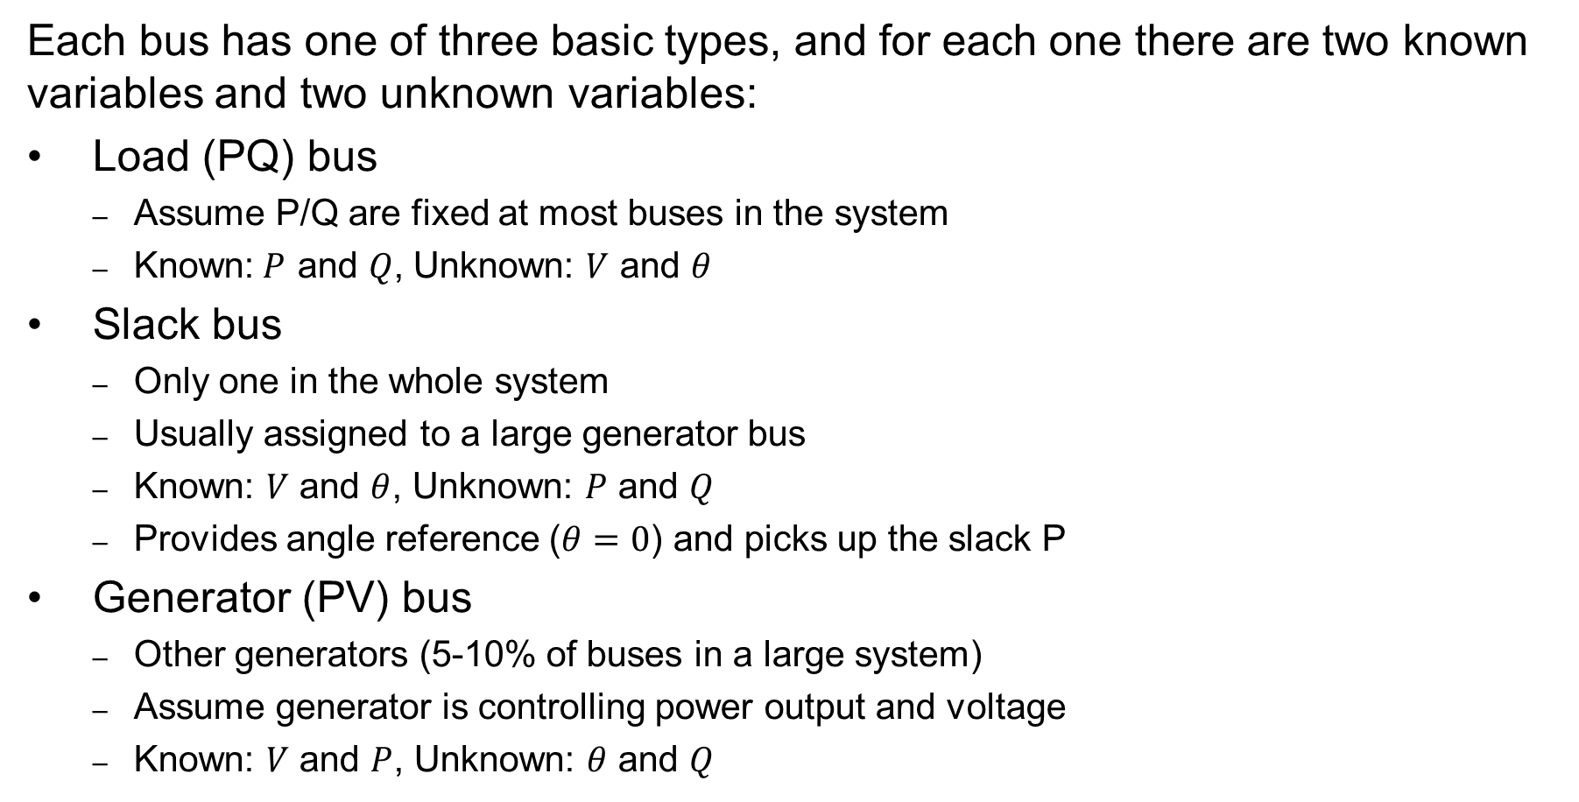
Power Flow Bus Types
Each bus has one of three basic types, and for each one there are two known variables and two unknown variables:
Load (PQ) bus
Assume P/Q are fixed at most buses in the system
Known:$P$ and $Q$, Unknown: $V$ and $θ$
Slack bus
Only one in the whole system
Usually assigned to a large generator bus
Known: $V$ and $θ$, Unknown: $P$ and $Q$
Provides angle reference ($θ=0$) and picks up the slack P
Generator (PV) bus
Other generators (5-10% of buses in a large system)
Assume generator is controlling power output and voltage
Known: $V$ and $P$, Unknown: $θ$ and $Q$

Slide 8
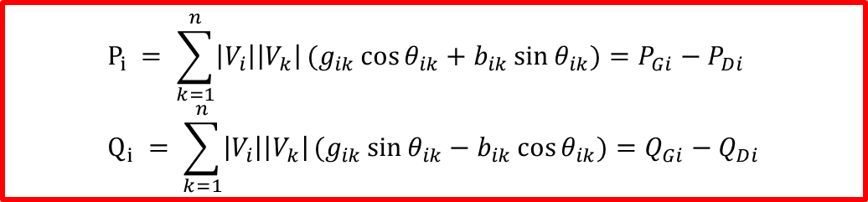
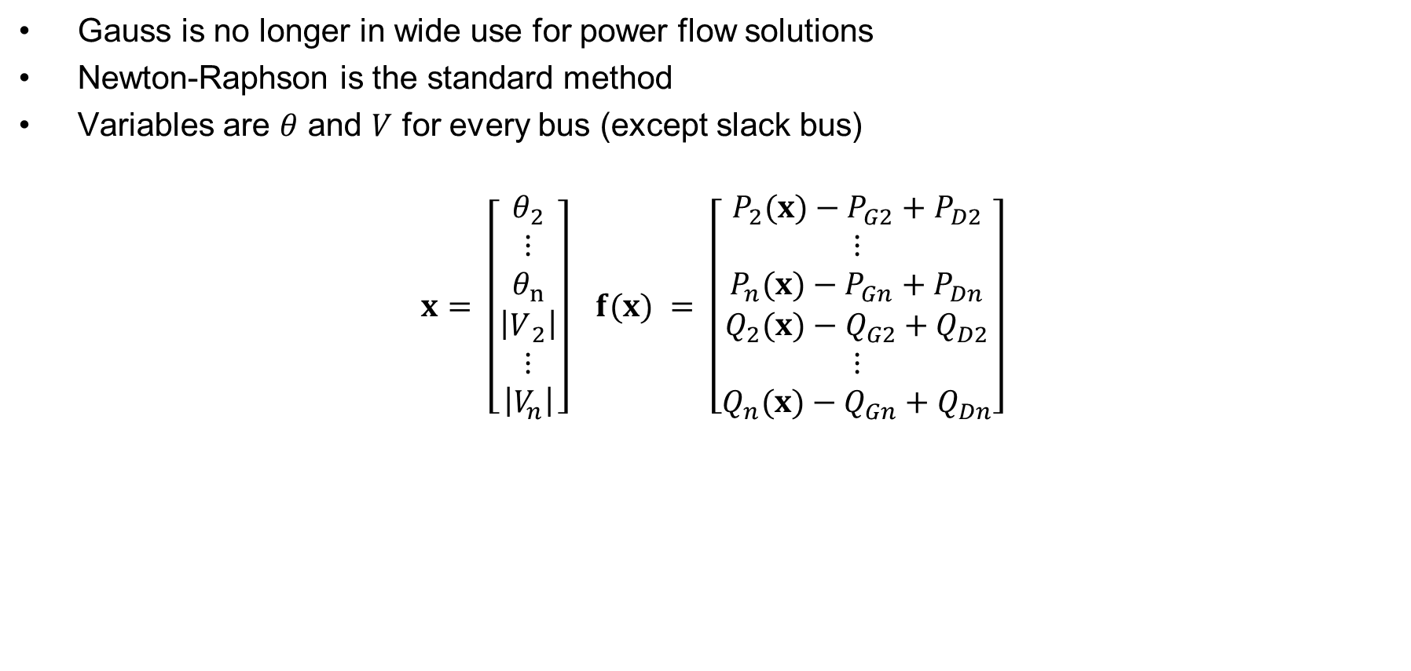
Using Newton-Raphson to Solve the Power Flow Problem
Gauss is no longer in wide use for power flow solutions
Newton-Raphson is the standard method
Variables are $θ$ and $V$ for every bus (except slack bus)
$$x = \left[\begin{matrix}θ_{2} \\ ⋮ \\ θ_{n} \\ \left|V​_{2}\right| \\ ⋮ \\ \left|V_{n}\right|\end{matrix}\right] f(x) = \left[\begin{matrix}P_{2}(x)−P_{G2}+P_{D2} \\ ⋮ \\ P_{n}(x)−P_{Gn}+P_{Dn} \\ Q_{2}(x)−Q_{G2}+Q_{D2} \\ ⋮ \\ Q_{n}(x)−Q_{Gn}+Q_{Dn}\end{matrix}\right]$$
$$P_{i} = \sum_{k=1}^{n}{\left|V_{i}\right|\left|V_{k}\right|}(g_{ik}\cos{θ_{ik}}+b_{ik}\sin{θ_{ik}})=P_{Gi}−P_{Di} \\ Q_{i} = \sum_{k=1}^{n}{\left|V_{i}\right|\left|V_{k}\right|}(g_{ik}\sin{θ_{ik}}−b_{ik}\cos{θ_{ik}})=Q_{Gi}−Q_{Di}$$

Slide 9
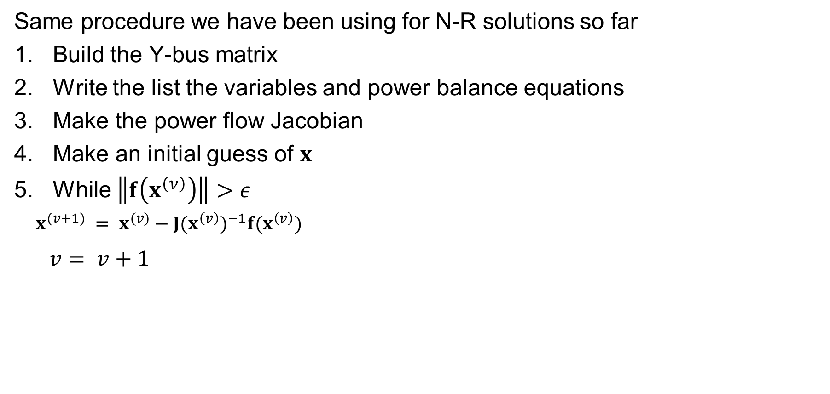
Newton-Raphson Power Flow Procedure
Same procedure we have been using for N-R solutions so far
Build the Y-bus matrix
Write the list the variables and power balance equations
Make the power flow Jacobian
Make an initial guess of $x$
While $\left\|f\left(x^{\left(ν\right)}\right)\right\|>ε$
$x^{(v+1)} = x^{(v)}−J(x^{\left(v\right)})^{−1}f(x^{\left(v\right)})$
$v = v+1$

Slide 10
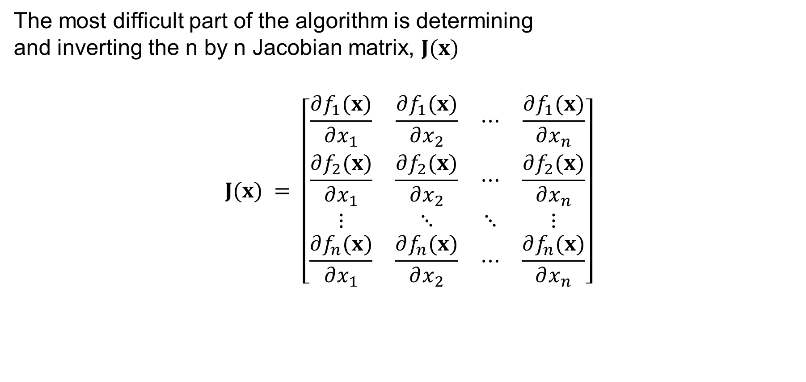
Power Flow Jacobian Matrix
The most difficult part of the algorithm is determining and inverting the n by n Jacobian matrix$\text{, }J(x)$
$$J(x) = \left[\begin{matrix}\frac{∂f_{1}(x)}{∂x_{1}} & \frac{∂f_{1}(x)}{∂x_{2}} & ⋯ & \frac{∂f_{1}(x)}{∂x_{n}} \\ \frac{∂f_{2}(x)}{∂x_{1}} & \frac{∂f_{2}(x)}{∂x_{2}} & ⋯ & \frac{∂f_{2}(x)}{∂x_{n}} \\ ⋮ & ⋱ & ⋱ & ⋮ \\ \frac{∂f_{n}(x)}{∂x_{1}} & \frac{∂f_{n}(x)}{∂x_{2}} & ⋯ & \frac{∂f_{n}(x)}{∂x_{n}}\end{matrix}\right]$$

Slide 11
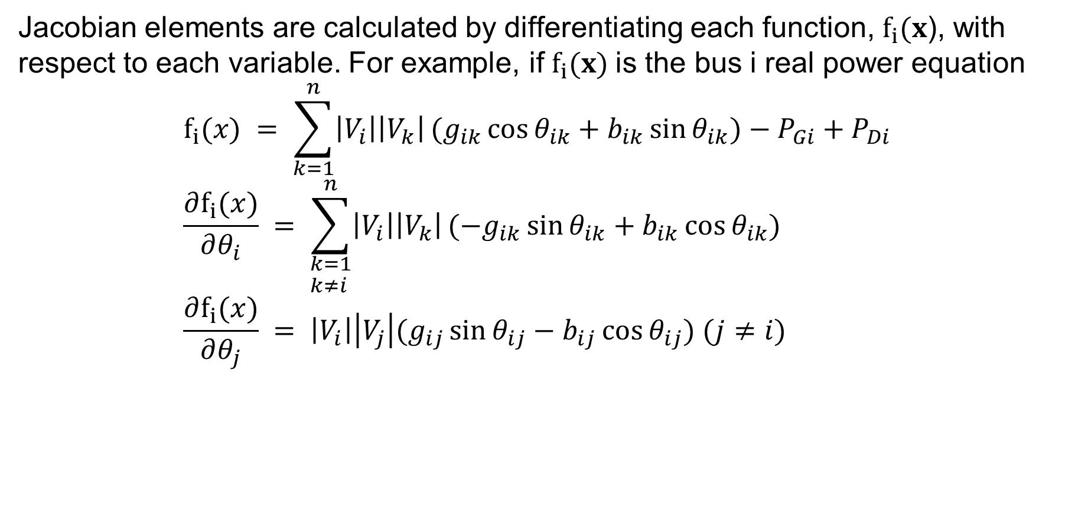
Power Flow Jacobian Matrix, Cont.
Jacobian elements are calculated by differentiating each function, ${\text{f}}_{i}(x$), with respect to each variable. For example, if ${\text{f}}_{i}(x)$is the bus i real power equation $$f_{i}(x) = \sum_{k=1}^{n}{\left|V_{i}\right|\left|V_{k}\right|}(g_{ik}\cos{θ_{ik}}+b_{ik}\sin{θ_{ik}})−P_{Gi}+P_{Di} \\ \frac{∂f_{i}(x)}{∂θ_{i}} = \sum_{\begin{aligned}&k=1 \\ &k≠i\end{aligned}}^{n}{\left|V_{i}\right|\left|V_{k}\right|}(−g_{ik}\sin{θ_{ik}}+b_{ik}\cos{θ_{ik}}) \\ \frac{∂f_{i}(x)}{∂θ_{j}} = \left|V_{i}\right|\left|V_{j}\right|(g_{ij}\sin{θ_{ij}}−b_{ij}\cos{θ_{ij}}) (j≠i)$$

Slide 12

Power Flow Example #1
For the two bus power system shown below, use the Newton-Raphson power flow to determine the voltage magnitude and angle at bus two. Assume that bus one is the slack and SBase = 100 MVA.
$$P_{i} = \sum_{k=1}^{n}{\left|V_{i}\right|\left|V_{k}\right|}(g_{ik}\cos{θ_{ik}}+b_{ik}\sin{θ_{ik}})=P_{Gi}−P_{Di} \\ Q_{i} = \sum_{k=1}^{n}{\left|V_{i}\right|\left|V_{k}\right|}(g_{ik}\sin{θ_{ik}}−b_{ik}\cos{θ_{ik}})=Q_{Gi}−Q_{Di}$$

Slide 13
Power Flow Example #1

Slide 14
Power Flow Example #1

Slide 15
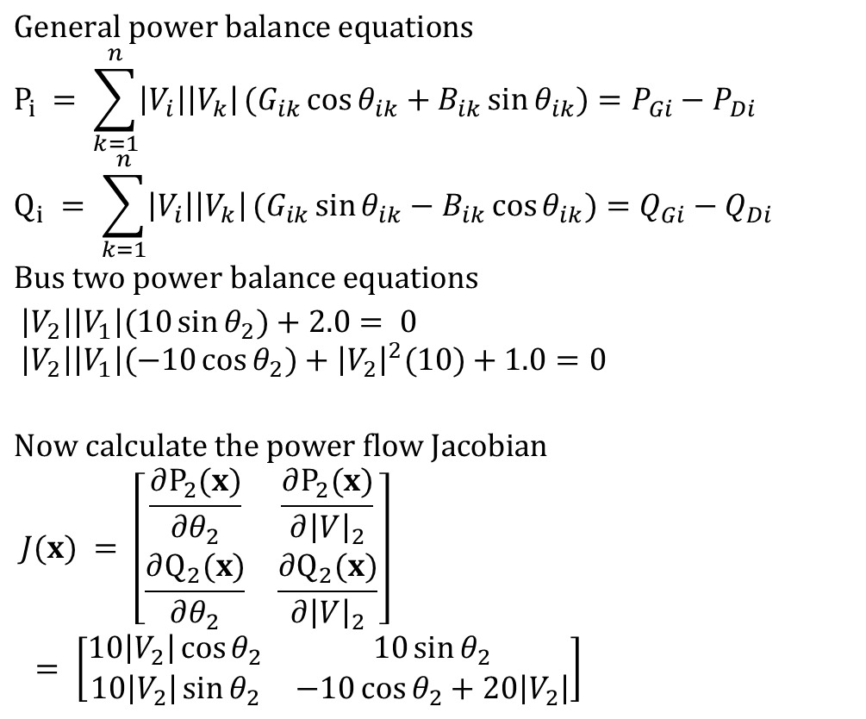
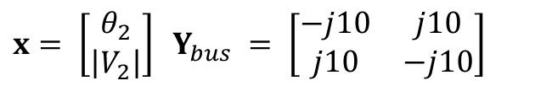
Power Flow Example #1, Solution
For the two bus power system shown below, use the Newton-Raphson power flow to determine the voltage magnitude and angle at bus two. Assume that bus one is the slack and SBase = 100 MVA.
$$\text{General} \text{power} \text{balance} \text{equations} \\ P_{i} = \sum_{k=1}^{n}{\left|V_{i}\right|\left|V_{k}\right|}(G_{ik}\cos{θ_{ik}}+B_{ik}\sin{θ_{ik}})=P_{Gi}−P_{Di} \\ Q_{i} = \sum_{k=1}^{n}{\left|V_{i}\right|\left|V_{k}\right|}(G_{ik}\sin{θ_{ik}}−B_{ik}\cos{θ_{ik}})=Q_{Gi}−Q_{Di} \\ \text{Bus} \text{two} \text{power} \text{balance} \text{equations} \\ \left|V_{2}\right|\left|V_{1}\right|(10\sin{θ_{2}})+2.0 = 0 \\ \left|V_{2}\right|\left|V_{1}\right|(−10\cos{θ_{2}})+{\left|V_{2}\right|}^{2}(10)+1.0=0$$
$$\text{Now} \text{calculate} \text{the} \text{power} \text{flow} \text{Jacobian} \\ J(x) = \left[\begin{matrix}\frac{∂P_{2}(x)}{∂θ_{2}} & \frac{∂P_{2}(x)}{∂{\left|V\right|}_{2}} \\ \frac{∂Q_{2}(x)}{∂θ_{2}} & \frac{∂Q_{2}(x)}{∂{\left|V\right|}_{2}}\end{matrix}\right] \\ = \left[\begin{matrix}10\left|V_{2}\right|\cos{θ_{2}} & 10\sin{θ_{2}} \\ 10\left|V_{2}\right|\sin{θ_{2}} & −10\cos{θ_{2}}+20\left|V_{2}\right|\end{matrix}\right]$$
$$x = \left[\begin{matrix}θ_{2} \\ \left|V_{2}\right|\end{matrix}\right] Y_{bus} = \left[\begin{matrix}−j10 & j10 \\ j10 & −j10\end{matrix}\right]$$

Slide 16
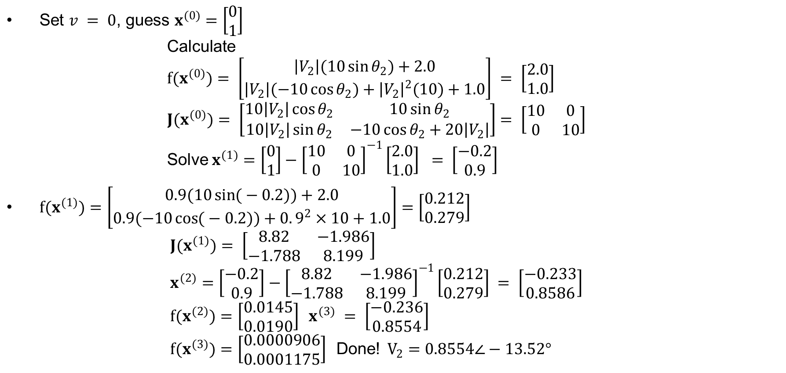
Power Flow Example #1, Solution Cont.
$\text{Set} v = 0\text{, }\text{guess} x^{(0)}=\left[\begin{matrix}0 \\ 1\end{matrix}\right]$ $\text{Calculate}$ $f(x^{(0)})= \left[\begin{matrix}\left|V_{2}\right|(10\sin{θ_{2}})+2.0 \\ \left|V_{2}\right|(−10\cos{θ_{2}})+{\left|V_{2}\right|}^{2}(10)+1.0\end{matrix}\right] = \left[\begin{matrix}2.0 \\ 1.0\end{matrix}\right]$ $J(x^{(0)})= \left[\begin{matrix}10\left|V_{2}\right|\cos{θ_{2}} & 10\sin{θ_{2}} \\ 10\left|V_{2}\right|\sin{θ_{2}} & −10\cos{θ_{2}}+20\left|V_{2}\right|\end{matrix}\right]= \left[\begin{matrix}10 & 0 \\ 0 & 10\end{matrix}\right]$ $\text{Solve} x^{(1)}=\left[\begin{matrix}0 \\ 1\end{matrix}\right]−{\left[\begin{matrix}10 & 0 \\ 0 & 10\end{matrix}\right]}^{−1}\left[\begin{matrix}2.0 \\ 1.0\end{matrix}\right] = \left[\begin{matrix}−0.2 \\ 0.9\end{matrix}\right]$
$f(x^{(1)})=\left[\begin{matrix}0.9(10\sin{(}−0.2))+2.0 \\ 0.9(−10\cos{(}−0.2))+0.9^{2}×10+1.0\end{matrix}\right]=\left[\begin{matrix}0.212 \\ 0.279\end{matrix}\right]$ $J(x^{(1)})= \left[\begin{matrix}8.82 & −1.986 \\ −1.788 & 8.199\end{matrix}\right]$ $x^{(2)}=\left[\begin{matrix}−0.2 \\ 0.9\end{matrix}\right]−{\left[\begin{matrix}8.82 & −1.986 \\ −1.788 & 8.199\end{matrix}\right]}^{−1}\left[\begin{matrix}0.212 \\ 0.279\end{matrix}\right] = \left[\begin{matrix}−0.233 \\ 0.8586\end{matrix}\right]$ $f(x^{(2)})=\left[\begin{matrix}0.0145 \\ 0.0190\end{matrix}\right] x^{(3)} = \left[\begin{matrix}−0.236 \\ 0.8554\end{matrix}\right]$ $f(x^{(3)})=\left[\begin{matrix}0.0000906 \\ 0.0001175\end{matrix}\right] \text{Done}\text{!} V_{2}=0.8554∠−13.52°$

