Slide 1
ECEN 460, Spring 2026
Power System Operation and Control
Class 10: Power System Control Principles
Prof. Adam Birchfield
Dept. of Electrical and Computer Engineering
Texas A&M University
abirchfield@tamu.edu

Slide 2
Exam 1
Tuesday, Feb. 17th, 2026, in-class (75 minutes)
Closed-book, closed-notes, except you may use one 8.5”x11” handwritten note sheet, front and back
Main topics:
  Three-phase AC circuit analysis
  Power systems overview, structure, and history
  Generators
  Transformers and per-unit
  Transmission lines
  Power system operations and control topics (this week and in lab)
Make sure to study (1) quizzes (2) lecture notes (3) homework (4) labs (5) book Chapters 1-5.

Slide 3

Control in a Power System
We’re going to focus on control of two things in the power system
  Real power flow through transmission lines
  Bus voltage

Slide 4
Direct Power Flow Control
The only direct way to control the power through a line is by opening and closing its associated circuit breakers
  This will cause the line flow to almost instantaneously change.
  There is no other way to directly control line flow – i.e. no "valves" as in piping.
  Note that opening a line because it is overloaded is usually a bad idea, because the flows will have to redistributed to other lines, potentially causing a cascade!

Slide 5
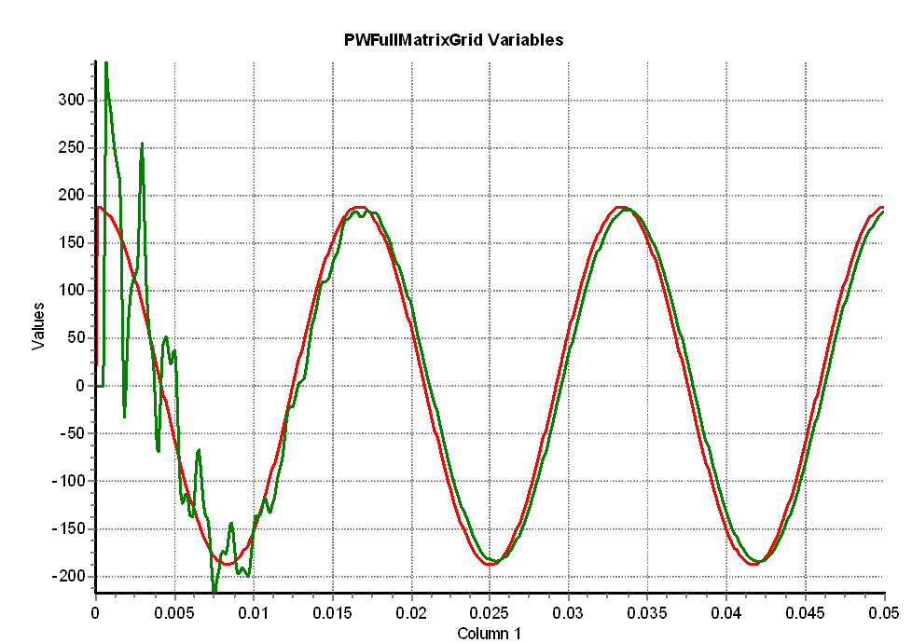
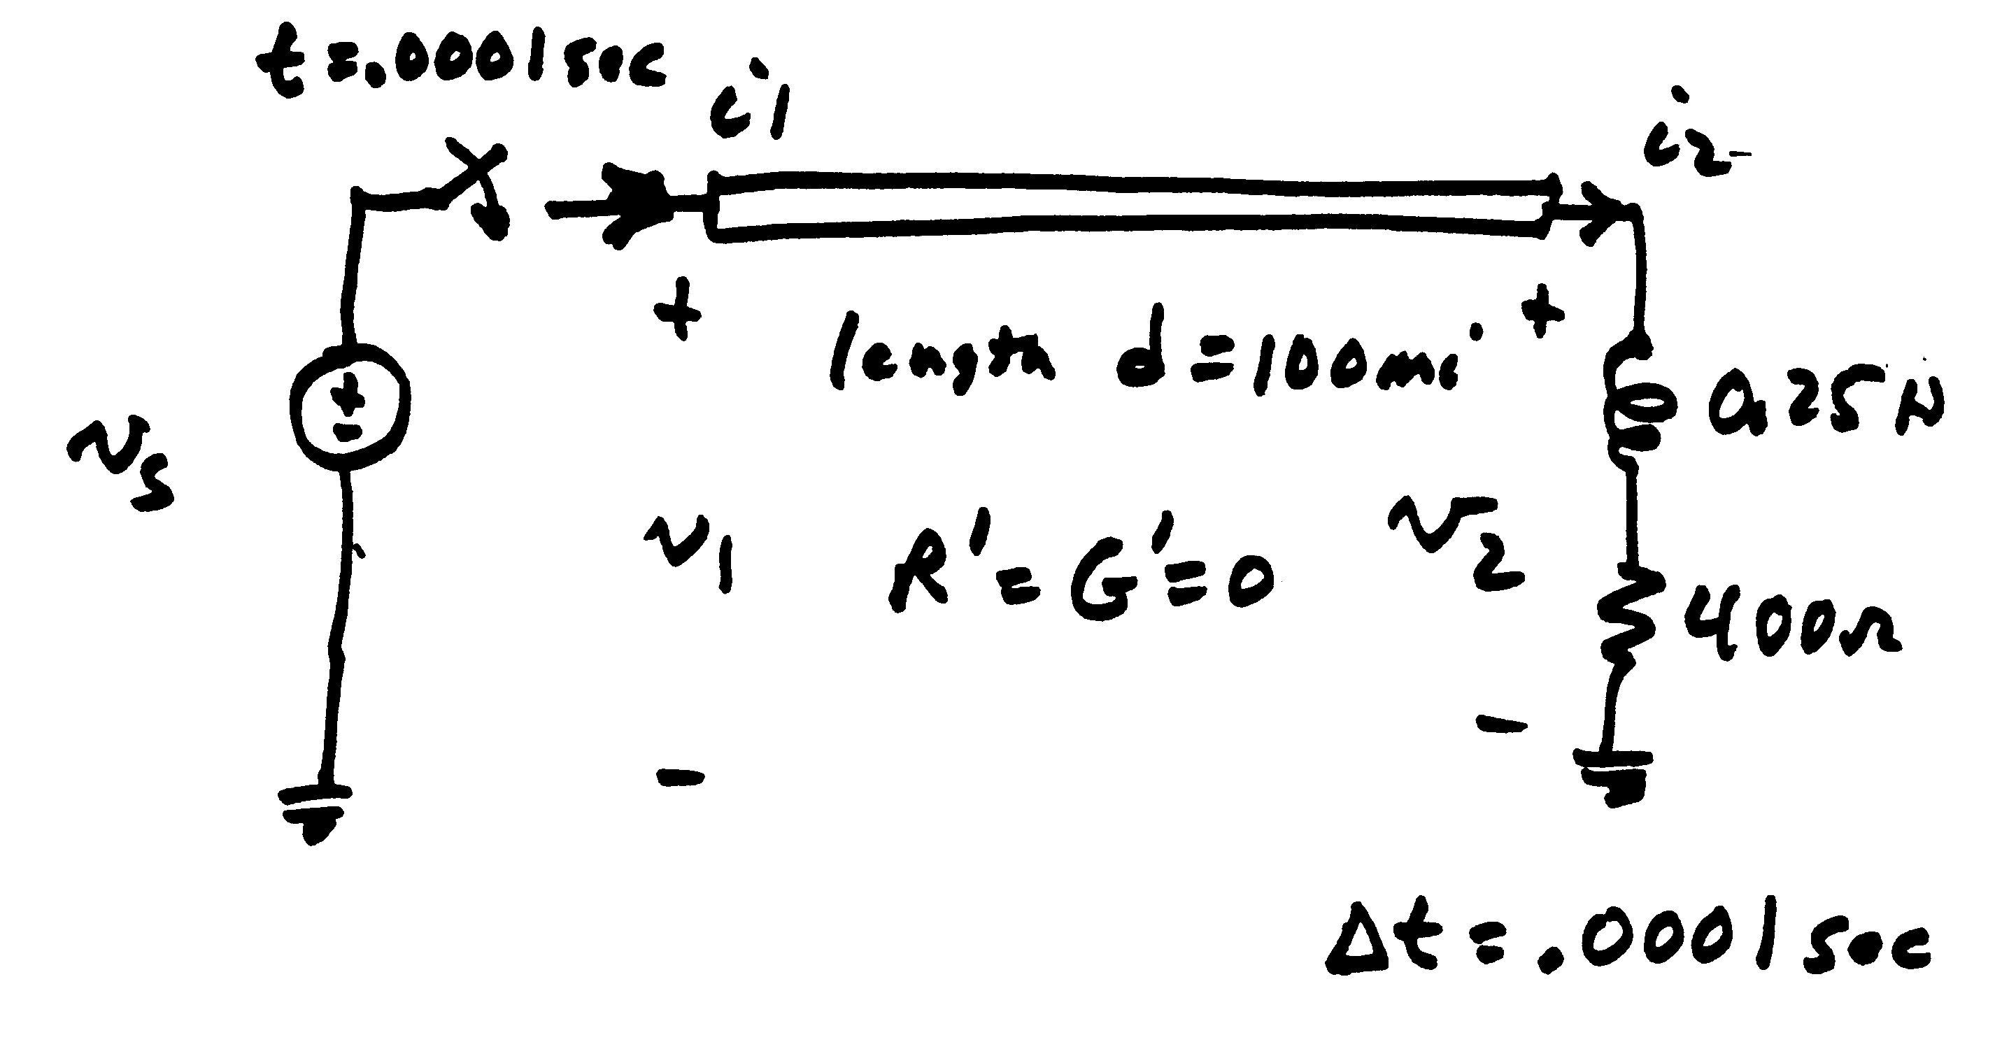
Modeling Consideration – Change is Not Really Instantaneous!
The change isn’t really instantaneous because of propagation delays, which are near the speed of light; there also wave reflection issues
  This is covered in chapters 5 and 13
Red is the v_{s} end, green the v₂ end

Slide 6
Indirect Transmission Flow Control
Indirect transmission flow control can be done by changing generator outputs.
Example of an overloaded transmission line. To fix this, indirectly change the flow by adjusting generator outputs.

Slide 7
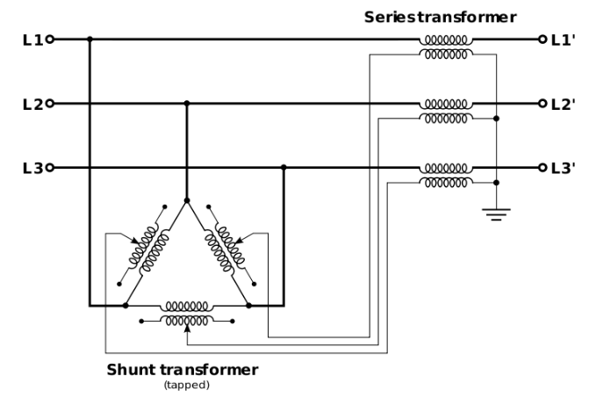
Adjusting Angles for Power Flow Control
Real power flow is closely tied with the phase angle of the bus voltage.
  We will see why when we write out the power flow equations
  A general rule of thumb is that real power will flow from larger angles to smaller angles
  This is also why phase angle regulating transformers can be used to help control real power flows indirectly.

Slide 8
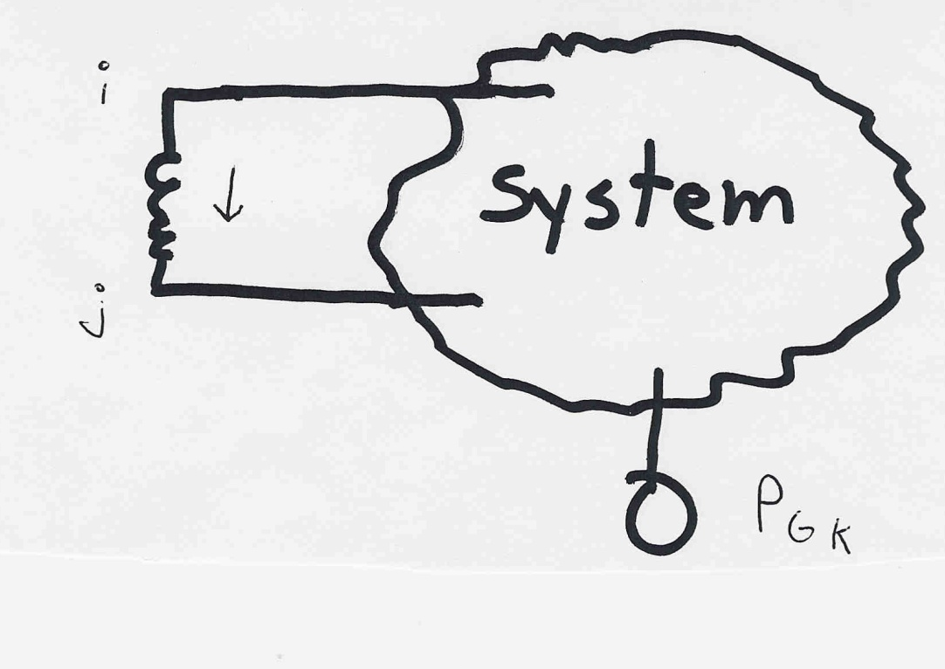
Sensitivities for Power Flow Control
Sensitivities can be helpful to explain how different power values are related to each other, to give insights into control.
The assumption is that the change in generation is absorbed by a “slack bus” which we will introduce later

Slide 9
Power Flow Simulation - Before
One way to determine the impact of a generator change is to compare a before/after power flow.
For example below is a three bus case with an overload

Slide 10
Power Flow Simulation - After
Increasing the generation at bus 3 by 95 MW (and hence decreasing it at bus 1 by a corresponding amount), results in a 30.3 MW drop in the MW flow on the line from bus 1 to 2, and a 64.7 MW drop on the flow from 1 to 3.
Expressed as a
percent, 30.3/95
=32% and
64.7/95=68%

Slide 11

Analytic Calculation of Sensitivities
Calculating control sensitivities by repeat power flow solutions is tedious and would require many power flow solutions. An alternative approach is to analytically calculate these values
We’ll return to this after we do power flow.
$$\text{The} \text{power} \text{flow} \text{from} \text{bus} \text{i} \text{to} \text{bus} \text{j} \text{is} \\ P_{ij}≈\frac{\left|V_{i}\right|\left|V_{j}\right|}{X_{ij}}\sin{(}θ_{i}−θ_{j})≈\frac{θ_{i}−θ_{j}}{X_{ij}} \\ \text{So} ΔP_{ij}≈ \frac{Δθ_{i}−Δθ_{j}}{X_{ij}} \text{We} \text{just} \text{need} \text{to} \text{get} \frac{Δθ_{ij}}{ΔP_{Gk}}$$

Slide 12
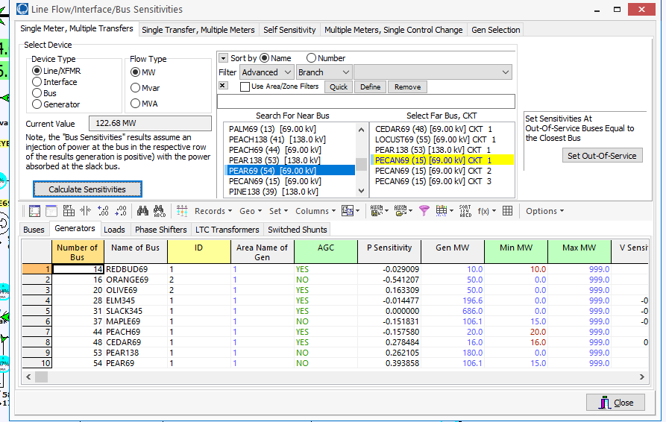
PowerWorld Analytic Sensitivities
Select Tools, Sensitivities, Flow and Voltage Sensitivities to see lots of sensitivities. The below image shows values for our example.

Slide 13
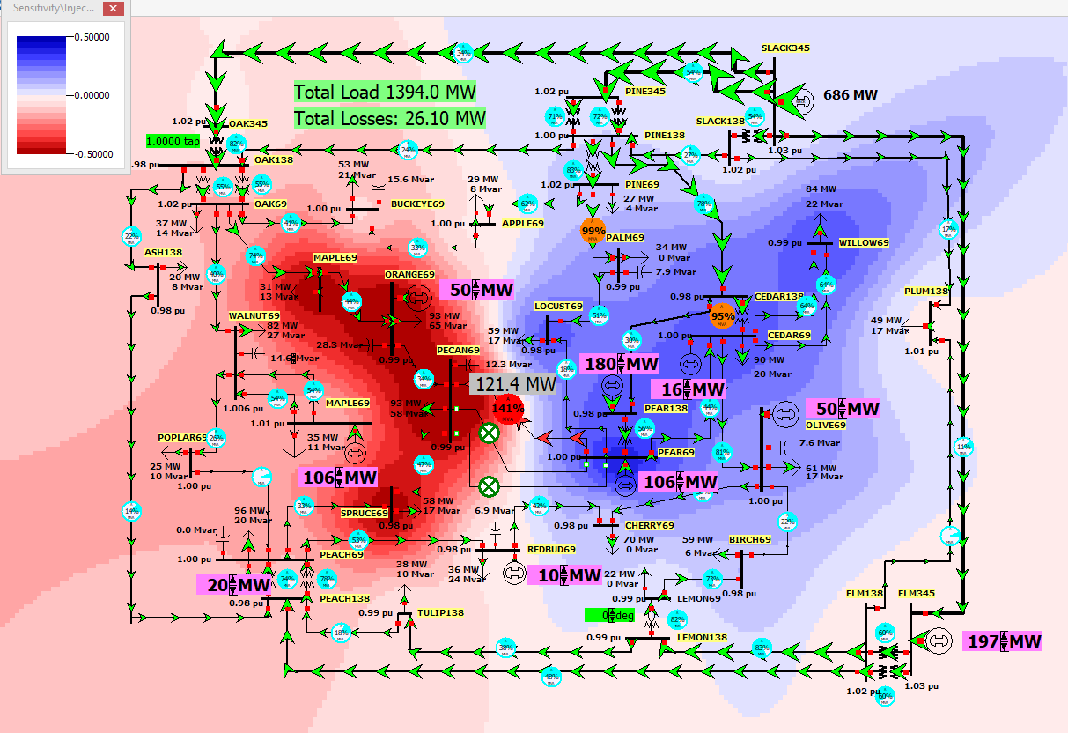
Contour of the Line Flow to Bus Injection Sensitivities
Image shows how a change in injection at a bus affects the
flow on the Pear69-Pecan69 line
This is a contour of the bus field: Sensitivity\Injection
Value dValue/dP

Slide 14
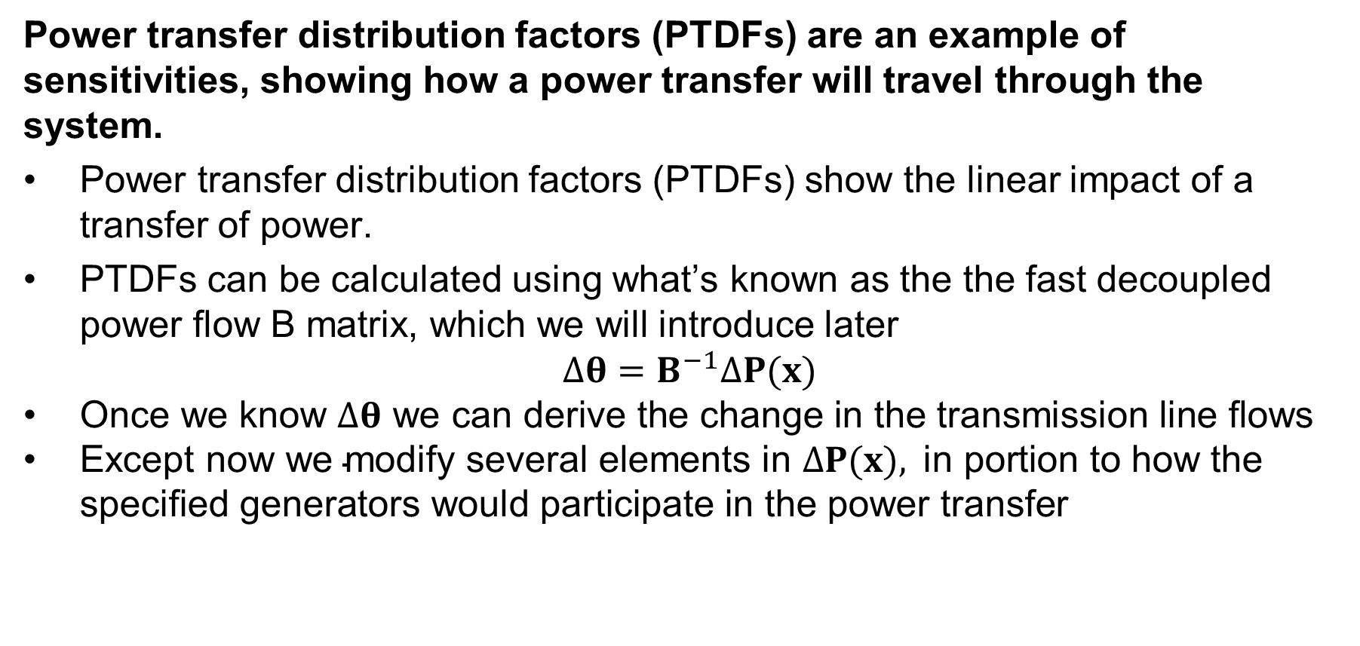
Power System Sensitivities
Power transfer distribution factors (PTDFs) are an example of sensitivities, showing how a power transfer will travel through the system.
Power transfer distribution factors (PTDFs) show the linear impact of a transfer of power.
PTDFs can be calculated using what’s known as the the fast decoupled power flow B matrix, which we will introduce later
$$Δθ=B^{−1}ΔP(x)$$
$\text{Once} \text{we} \text{know} Δθ \text{we} \text{can} \text{derive} \text{the} \text{change} \text{in} \text{the} \text{transmission} \text{line} \text{flows}$
$\text{Except} \text{now} \text{we} \text{modify} \text{several} \text{elements} \text{in} ΔP(x), \text{in} \text{portion} \text{to} \text{how} \text{the} \text{specified} \text{generators} \text{would} \text{participate} \text{in} \text{the} \text{power} \text{transfer}$

Slide 15
Nine Bus PTDF Example
Figure shows initial flows for a nine bus power system

Slide 16
Nine Bus PTDF Example, Cont'd
Figure now shows percentage PTDF flows from A to I

Slide 17
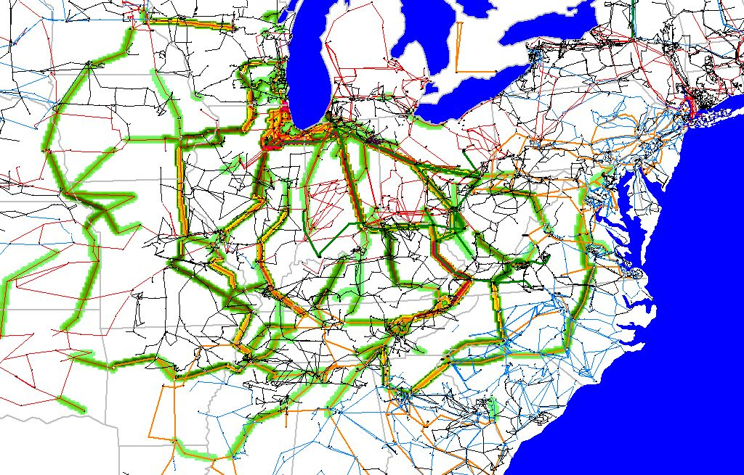
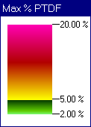
WE to TVA PTDFs

Slide 18
Controlling Power System Bus Voltages
Buses have a minimum and maximum voltage magnitude limit that must be maintained in good operations.
These are also covered by NERC standards. Typical limits would be 0.95 for a minimum limit and 1.08 for a maximum limit

Slide 19
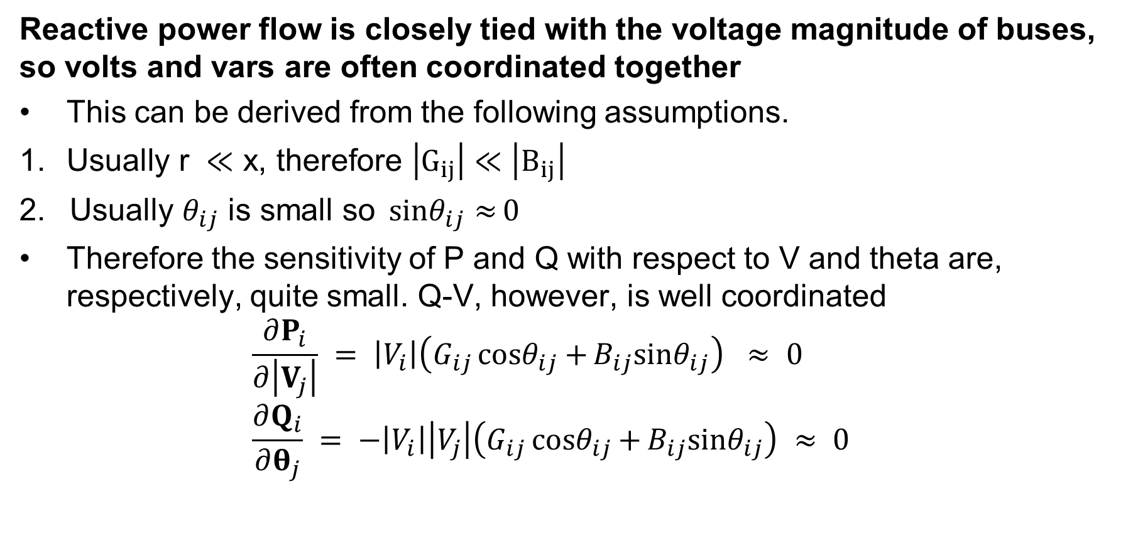
Volt-Var Control
Reactive power flow is closely tied with the voltage magnitude of buses, so volts and vars are often coordinated together
This can be derived from the following assumptions.
$\text{Usually} \text{r} ≪\text{x}\text{, }\text{therefore} \left|G_{ij}\right|≪\left|B_{ij}\right|$
2. $\text{Usually} θ_{ij} \text{is} \text{small} \text{so} {sinθ}_{ij}{≈}0$
Therefore the sensitivity of P and Q with respect to V and theta are, respectively, quite small. Q-V, however, is well coordinated
$\frac{∂P_{i}}{∂\left|V_{j}\right|} = \left|V_{i}\right|\left(G_{ij}{cosθ}_{ij}{+}B_{ij}{sinθ}_{ij}\right) ≈ 0$
$\frac{∂Q_{i}}{∂θ_{j}} = −\left|V_{i}\right|\left|V_{j}\right|\left(G_{ij}{cosθ}_{ij}{+}B_{ij}{sinθ}_{ij}\right) ≈ 0$

Slide 20
Generator Voltage Control
Generator voltage magnitudes are scheduled, with generators changing their reactive power output to control their voltage.
This is done with a device called an exciter, which changes the field winding voltage of a synchronous machine.

Slide 21
Zion Nuclear Power Plant
The Zion nuclear power plant, located on Lake Michigan, on the Illinois/Wisconsin border, use to be a 2000 MW generator, commissioned in 1973-74
In 1997 a control-room operator inserted control rods too far during a shut down, then withdrew them without following procedures
  NRC also said there were too many people in the control room
  ComEd ended up shutting down both units because it was too costly to fix the damage (estimated at $435 million!)
However, the plant was used for many years as a source of reactive power for North Illinois

Slide 22
Zion Nuclear Power Plant, cont.

Slide 23
Using Tap-Changing Transformers
Some transformers have variable tap ratios that can be used to control voltage.
However, we need to watch out for “circulating vars”
Also remember that the fundamental Q balance of the system is not affected by the taps, i.e. the taps themselves neither produce nor absorb Q

Slide 24
Using Q Resources
Reactive power resources, such a shunt capacitors, static VAR compensators, and synchronous condensers, are primarily used as voltage control devices.
Reactive power controllers include switched shunts, static var compensators (SVCs), LTC transformers, sometimes generator voltage setpoints
Goal is to maintain adequate system voltages and reduce losses
Reactive power control is much less linear than real power control; this is partially due to the much higher reactive power losses because for high voltage transmission lines X is usually much larger than R
  Losses are very nonlinear
Vars do not travel far

Slide 25
Effect of Loading on Voltage Control
Under-voltage is typically a problem in heavily loaded systems, needing more capacitor banks
Over-voltage can be a problem in lightly-loaded systems, needing more reactor banks
The pi model when current is low will produce a lot of reactive power
The pi model when current is high will consume a lot of reactive power
Recall, the surge impedance loading (SIL) is on the boundary

