Slide 1
ECEN 460, Spring 2026
Power System Operation and Control
Class 5: Transformers, Part 1
Prof. Adam Birchfield
Dept. of Electrical and Computer Engineering
Texas A&M University
abirchfield@tamu.edu

Slide 2

Reminder
PPE Needed for Machines Labs 2 and 3

Slide 3
Homework 3 and 4
No homework on generators. Make sure you understand the lecture notes and labs 2 and 3 (starting this week).
Homework 3 on transformers: book problems 3.4, 3.5, 3.23, due Feb. 3rd.
Homework 4 on transmission lines: book regular problems 4.10, 4.11, 4.20, and 4.41, 5.14 (a,b), 5.38, and 5.41 (a,b), due Feb. 10th.

Slide 4
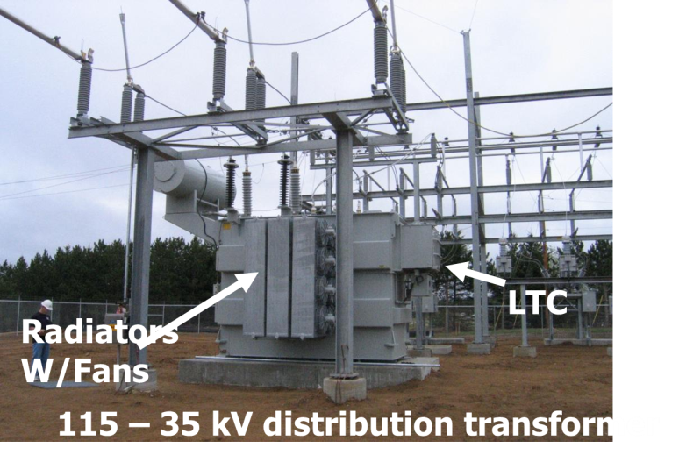
Transformers Overview
Power systems are characterized by many different voltage levels, ranging from 765 kV down to 240/120 volts.
Transformers are used to transfer power between different voltage levels.
The ability to inexpensively change voltage levels is a key advantage of ac systems over dc systems.
In this section we’ll development models for the transformer and discuss various ways of connecting three phase transformers.

Slide 5
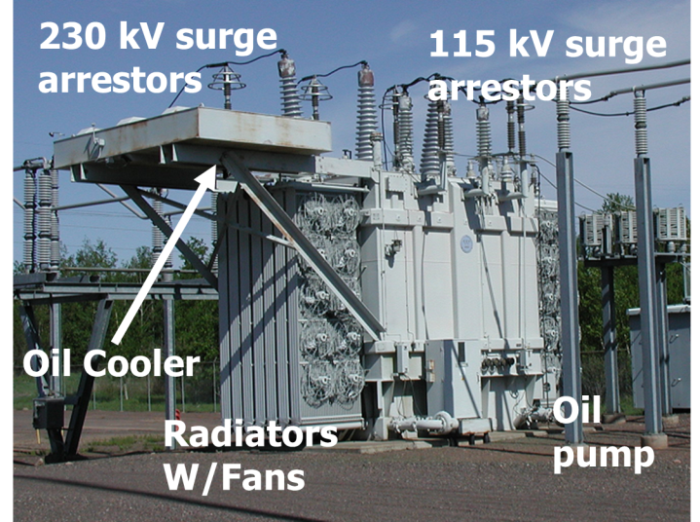
Transmission Level Transformer

Slide 6
Ideal Transformer
First, we review the voltage/current relationships for an ideal transformer
  no real power losses
  magnetic core has infinite permeability
  no leakage flux
We’ll define the “primary” side of the transformer as the side that usually takes power, and the secondary as the side that usually delivers power.
  primary is usually the side with the higher voltage but may be the low voltage side on a generator step-up transformer.

Slide 7
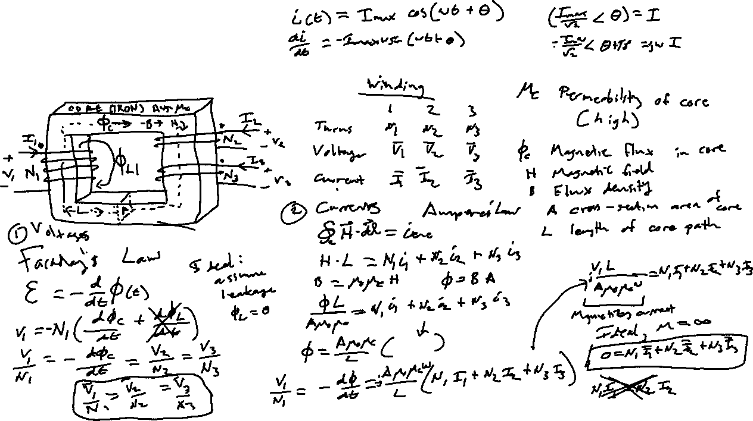
XF Theory

Slide 8

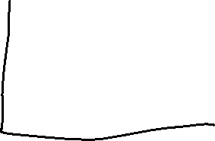
Ideal Transformer Relationships
$$\text{Assume} \text{we} \text{have} \text{flux} φ_{m} \text{in} \text{magnetic} \text{material}\text{. }\text{Then} \\ λ_{1} = N_{1}φ_{m} λ_{2} = N_{2}φ_{m} \\ v_{1} = \frac{dλ_{1}}{dt} = N_{1}\frac{dφ_{m}}{dt} {v_{2}}_{} = \frac{dλ_{2}}{dt} = N_{2}\frac{dφ_{m}}{dt} \\ \frac{dφ_{m}}{dt} = \frac{v_{1}}{N_{1}} = \frac{v_{2}}{N_{2}} → \frac{v_{1}}{v_{2}} = \frac{N_{1}}{N_{2}}=a\text{ = }\text{turns} \text{ratio}$$

Slide 9
Current and Voltage Relationships
$$\text{If} μ \text{is} \text{infinite} \text{then} 0=N_{1}i_{1}+N_{2}i_{2}^{′}. \text{Hence} \\ \frac{i_{1}}{i_{2}^{′}} = −\frac{N_{2}}{N_{1}} \text{or} \frac{i_{1}}{i_{2}} = \frac{N_{2}}{N_{1}}=\frac{1}{a} \\ \text{Then} \\ \left[\begin{matrix}v_{1} \\ i_{1}\end{matrix}\right] = \left[\begin{matrix}a & 0 \\ 0 & \frac{1}{a}\end{matrix}\right]\left[\begin{matrix}v_{2} \\ i_{2}\end{matrix}\right]$$

Slide 10
Impedance Transformation Example
Example: Calculate the primary voltage and current for an impedance load on the secondary
$$\left[\begin{matrix}v_{1} \\ i_{1}\end{matrix}\right] = \left[\begin{matrix}a & 0 \\ 0 & \frac{1}{a}\end{matrix}\right]\left[\begin{matrix}v_{2} \\ \frac{v_{2}}{Z}\end{matrix}\right]$$
$$v_{1} = av_{2} i_{1} = \frac{1}{a}\frac{v_{2}}{Z} \frac{v_{1}}{i_{1}} = a^{2}Z$$

Slide 11
Real Transformers
Real transformers
  have losses
  have leakage flux
  have finite permeability of magnetic core
Real power losses
  resistance in windings (i2 R)
  core losses due to eddy currents and hysteresis

Slide 12
Transformer Core Losses
Eddy currents arise because of changing flux in core.
Eddy currents are reduced by laminating the core
Hysteresis losses are proportional to area of BH curve and the frequency
These losses are reduced by using material with a thin BH curve
No lamination, high eddy current
With lamination, low eddy current

Slide 13
Simplified Equivalent Circuit
Often the shunt elements are assumed to have
such high impedance that they are ignored

Slide 14
Calculation of Model Parameters
The parameters of the model are determined based upon
  nameplate data: gives the rated voltages and power
  open circuit test: rated voltage is applied to primary with secondary open; measure the primary current and losses (the test may also be done applying the voltage to the secondary, calculating the values, then referring the values back to the primary side).
  short circuit test: with secondary shorted, apply voltage to primary to get rated current to flow; measure voltage and losses.

Slide 15
Transformer Example
Example: A single phase, 100 MVA, 200/80 kV transformer has the following test data:
open circuit: 20 amps, with 10 kW losses
short circuit: 30 kV, with 500 kW losses
Determine the model parameters.

Slide 16
Transformer Example, Cont’d
From the short circuit test
$$I_{sc}=\frac{100MVA}{200kV}=500 A, \left|R_{e}+jX_{e}\right|=\frac{30 kV}{500 A}=60 Ω \\ P_{\text{sc}}=R_{e}I_{sc}^{2}=500 \text{kW} →R_{e}=2 Ω, \\ \text{Hence} {\text{X}}_{e}=\sqrt{60^{2}−2^{2}}=60 Ω$$
From the open circuit test
$$R_{c}=\frac{200 kV^{2}}{10 kW}=4MΩ \\ \left|R_{e}+jX_{e}+jX_{m}\right|=\frac{200 kV}{20 A}=10,000 Ω X_{m}=10,000 Ω$$

Slide 17
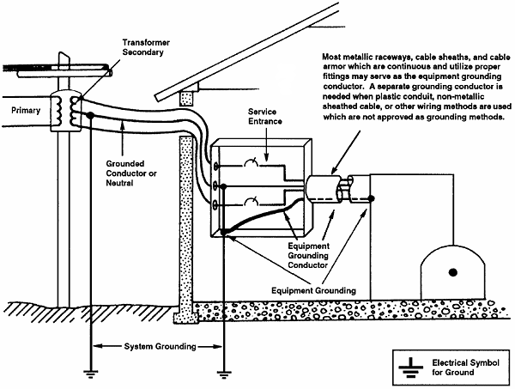




Residential Distribution Transformers
Single phase transformers are commonly used in residential distribution systems. Most distribution systems are 4 wire, with a multi-grounded, common neutral.
Image: www.osha.gov/dte/library/electrical/electrical_10.gif

Slide 18
How Do We Deal with Transformers on a Large System?
With many transformers, the equations of the form v1=a*v2 would be everywhere
The per-unit system was designed to make hand calculations and early computer calculations easier.
  Divide all numerical values by a "base" value, i.e., normalize them
  Instead of voltages in V, currents in A, impedance in Ohms, all are given in per-unit.
  Ideal transformers go away in the per-unit system
  Per-unit system has other advantages as well, and is extremely common in industry
  Next lecture we will discuss the per-unit system in detail

Slide 19
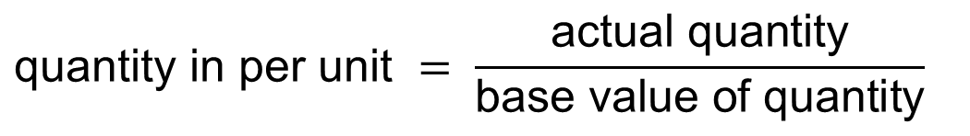
Per Unit Calculations
A key problem in analyzing power systems is the large number of transformers.
  It would be very difficult to continually have to refer impedances to the different sides of the transformers
This problem is avoided by a normalization of all variables.
This normalization is known as per unit analysis.
$$\text{quantity} \text{in} \text{per} \text{unit} = \frac{\text{actual} \text{quantity}}{\text{base} \text{value} \text{of} \text{quantity}}$$

Slide 20

Per Unit Conversion Procedure, Single-Phase
Pick a single-phase VA base for the entire system, $S_{b}$
Pick a voltage base for each different voltage level, $V_{b}$. Voltage bases are related by transformer turns ratios. Voltages are line to neutral.
Calculate the impedance base, $Z_{b}=V_{b}^{2}/S_{b}$
Calculate the current base, $I_{b}=S_{b}/V_{b}$
Convert actual values to per unit
Note, per unit conversion only affects magnitudes, not
the angles. Also, per unit quantities no longer have
units (i.e., a voltage is 1.0 p.u., not 1 p.u. volts)

Slide 21
Per Unit Solution Procedure
Convert to per unit (p.u.) (many problems are already in per unit)
Solve
Convert back to actual as necessary

Slide 22
Per Unit Example
Solve for the current, load voltage and load power in the circuit shown below using per unit analysis with an S_{B} of 100 MVA, and voltage bases of 8 kV, 80 kV and 16 kV.
Original Circuit

Slide 23
Per Unit Example, Cont’d
$$Z_{B}^{Left}=\frac{8kV^{2}}{100MVA}=0.64Ω \\ Z_{B}^{Middle}=\frac{80kV^{2}}{100MVA}=64Ω \\ Z_{B}^{Right}=\frac{16kV^{2}}{100MVA}=2.56Ω$$
Same circuit, with
values expressed
in per unit.

Slide 24
Per Unit Example, Cont’d 2
$$I = \frac{1.0∠0°}{3.91+j2.327}=0.22∠−30.8° \text{p}\text{.}\text{u}\text{. }(\text{not} \text{amps}) \\ V_{L} = 1.0∠0°−0.22∠−30.8°×2.327∠90° \\ = 0.859∠−30.8° \text{p}\text{.}\text{u}\text{.} \\ S_{L}= V_{L}I_{L}^{∗}=\frac{{\left|V_{L}\right|}^{2}}{Z}=0.189 \text{p}\text{.}\text{u}\text{.} \\ S_{G} = 1.0∠0°×0.22∠30.8°=0.22∠30.8° \text{p}\text{.}\text{u}\text{.}$$

Slide 25
Per Unit Example, Cont’d 3
To convert back to actual values just multiply the
per unit values by their per unit base
$$V_{L}^{\text{Actual}}= 0.859∠−30.8°×\text{16 }\text{kV}=13.7∠−30.8°\text{kV} \\ S_{L}^{\text{Actual}}=0.189∠0°×100 \text{MVA}=18.9∠0° \text{MVA} \\ S_{G}^{\text{Actual}}=0.22∠30.8°×100 \text{MVA}=22.0∠30.8° \text{MVA} \\ I_{B}^{\text{Middle}} = \frac{100 \text{MVA}}{\text{80 }\text{kV}}=1250 \text{Amps} \\ I_{\text{Middle}}^{\text{Actual}} = 0.22∠−30.8°×1250 \text{Amps} =275∠−30.8° Α$$

Slide 26

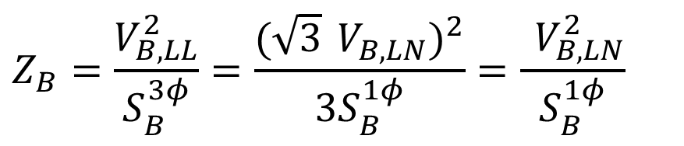
Three Phase Per-Unit
Procedure is very similar to 1 phase except we use a 3 phase VA base, and use line to line voltage bases
Pick a $3φ$ VA base for the entire system $S_{B}^{3φ}$
Pick a voltage base for each different voltage level, VB. Voltages are line to line.
Calculate the impedance base
$$Z_{B}=\frac{V_{B,LL}^{2}}{S_{B}^{3φ}}=\frac{(\sqrt{3} V_{B,LN})^{2}}{3S_{B}^{1φ}}=\frac{ V_{B,LN}^{2}}{S_{B}^{1φ}}$$
Exactly the same impedance bases as with single phase!

Slide 27

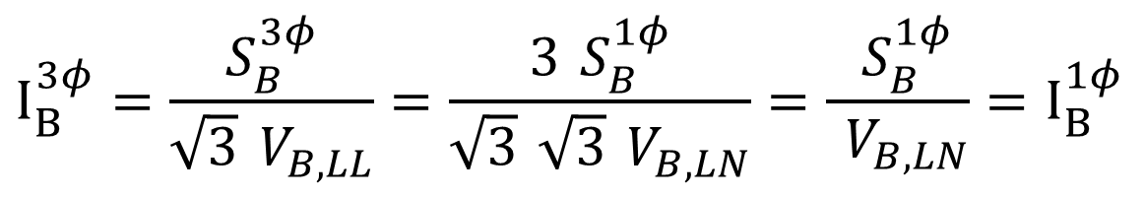
Three Phase Per-Unit, Cont'd
Calculate the current base, $I_{B}$
Convert actual values to per unit
$$I_{B}^{3φ}=\frac{S_{B}^{3φ}}{\sqrt{3} V_{B,LL}}=\frac{3 S_{B}^{1φ}}{\sqrt{3} \sqrt{3} V_{B,LN}}=\frac{ S_{B}^{1φ}}{ V_{B,LN}}=I_{B}^{1φ}$$
Exactly the same current bases as with single phase!
But, be careful in using 3ph bases to calculate it (need a root 3)

Slide 28
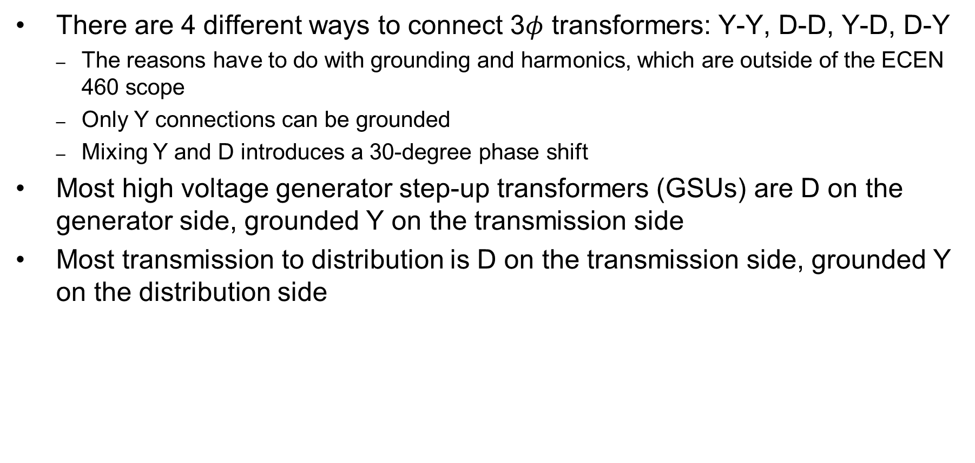
Three Phase Transformers
There are 4 different ways to connect 3$φ$ transformers: Y-Y, D-D, Y-D, D-Y
  The reasons have to do with grounding and harmonics, which are outside of the ECEN 460 scope
  Only Y connections can be grounded
  Mixing Y and D introduces a 30-degree phase shift
Most high voltage generator step-up transformers (GSUs) are D on the generator side, grounded Y on the transmission side
Most transmission to distribution is D on the transmission side, grounded Y on the distribution side

Slide 29
Autotransformers
Autotransformers are transformers in which the primary and secondary windings are coupled magnetically and electrically.
This results in lower cost, and smaller size and weight.
Most transmission level transformers are autotransformers, connected Y-Y with the low side grounded
The key disadvantage is loss of electrical isolation between the voltage levels; not used when a is large. For example, in stepping down 7160/240 V we do not ever want 7160 on the low side!

Slide 30
Three Winding Transformers
Many high voltage transformers have a third winding, called the tertiary winding; called three winding transformers
There are a number of benefits in having 3 windings
  Tertiary can be used to provide lower voltage electric service, including providing substation service for remote transmission substations; sometimes capacitors are connected to the tertiary
  Helps with fault protection by reducing the zero sequence current providing higher zero sequence currents (beyond ECEN 460 scope)
  When D-connected helps to reduce unbalanced and third harmonic issues (again beyond ECEN 460 scope)

Slide 31
Load Tap-Changing Transformers
LTC transformers have tap ratios that can be varied to regulate bus voltages
  Sometimes called on-load tap-changing transformers (OLTCs) or under-load tap-changing transformers (ULTCs)
The typical range of variation is ±10% from the nominal values, usually in 33 discrete steps (0.0625% per step).
Because tap changing is a mechanical process, LTC transformers usually have a time delay deadband to avoid repeated changes (e.g., 30 seconds)
Unbalanced tap positions can cause “circulating vars”

Slide 32
LTCs and Circulating Vars

Slide 33
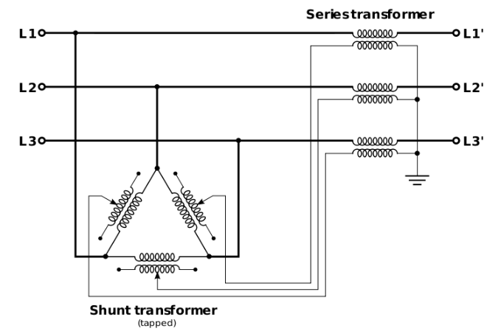
Phase Shifting Transformers
Phase shifting transformers are used to control the phase angle across the transformer
  Also called phase angle regulators (PARs) or quadrature booster transformers (British usage)
Since power flow through the transformer depends upon phase angle, this allows the transformer to regulate the power flow
through the transformer
Phase shifters can be used to
prevent inadvertent "loop
flow" and to prevent line overloads.
Image Source: en.wikipedia.org/wiki/Quadrature_booster#/media/File:Qb-3ph.svg

Slide 34
Phase Shifter Example 3.13

Slide 35
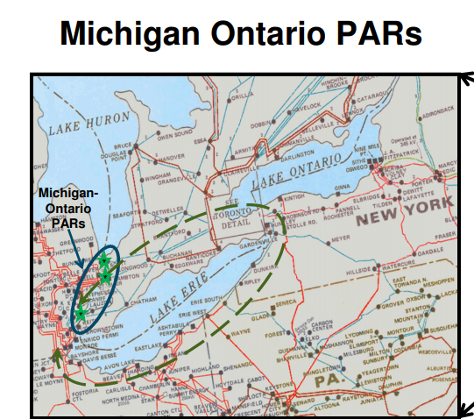
Phase Shifter Example: Lake Erie Loop Flow
There are five phase shifters (called phase angle regulators [PARs] here) at the border between Michigan and Ontario. They are used to control how much electricity travels between the US and Canada
By adjusting the PARs, the flow of electricity that “loops” around Lake Erie can be controlled
Source: MISO Board of Directors Market Committee Update, 9/30/13

