Slide 1
ECEN 460, Spring 2026
Power System Operation and Control
Class 3: Generators and Machines, Part 1
Prof. Adam Birchfield
Dept. of Electrical and Computer Engineering
Texas A&M University
abirchfield@tamu.edu

Slide 2

TPEC: Texas Power and Energy Conference
On campus at the MSC
February 8-10, 2026
Free for TAMU students
More info: tpec.engr.tamu.edu
It’s not too late to submit a poster
Bonus credit for 460 (extra 100 quiz)
  Attend at least 8 paper presentations
  (two paper sessions)
  Visit sponsor company booths
  Turn in one page of notes on what you did, observed, and learned to the TPEC registration desk, with your name, UIN, and “ECEN 460 Spring 2026 – Return to Dr. Birchfield” at the top.

Slide 3
The Next Three Weeks
How to model parts of the power system
Three main parts we will focus on
  Generation (this week Jan 20/22)
  Transformers (next week Jan 27/29)
  Transmission Lines (following week Feb 3/5)
When we're done with this, we'll have all we need to start modeling a full power system

Slide 4
Things to Remember About Modeling
Take a small, basic 1 Ohm resistor for a breadboard. 10,000 amps should give you 10,000 volts, right? V=IR? Don't try it. The circuit model is wrong.
Models are always only an approximation of reality, and are dependent upon the assumptions that are made in making that model
"All models are wrong, but some are useful." – George Box
The engineer's job in doing analysis is more than just putting numbers into a model and getting results.
  It is figuring out the appropriate model to use that will be useful (though still ultimately wrong), given the questions you're trying to answer.
  What range of currents and voltages are we talking about? What time frame? Microseconds? Years? How accurately do we need the answer? The model will change
  You should always be asking: What assumptions am I making and are they reasonable?
There are lots of different power system component models, for different purposes, and all of them are ultimately "wrong" i.e., incomplete

Slide 5
Generators
Sources of energy in the power system
  Nuclear
  Coal-fired steam
  Gas
    Gas turbine
    Steam turbine
    Combined Cycle
  Hydro
  Oil / Petroleum
  Wind
  Solar
  Other
Synchronous Machines (Today)
Power Electronics / Other (Thursday)

Slide 6
Machines: Generators and Motors
Electric machines are used to convert energy
  Generators: mechanical into electrical
  Motors: electrical into mechanical
  Many devices can operate in either mode, but are usually customized for one or the other
Majority of electricity is generated using synchronous generators and some is consumed using synchronous motors
Much literature on subject, and sometimes overly confusing with the use of different conventions and nomenclature

Slide 7
Stator and Rotor
Stator
  The part of the machine that does not move
  Contains sets of windings or “armature windings” surrounding the rotor
Rotor
  Internal part of the machine that rotates
  Separated from the stator by airgap
  Also has one or more windings or “field windings”
  There may be some electrical connection between the spinning rotor windings and the stator
  Occasionally the rotor is a permanent magnetic, but this limits control of the machine

Slide 8
Main Types of AC Machines
Synchronous
  Rotor windings have dc current powered separately
  Stator is connected to the machine terminals
  In steady state, rotor speed stays in-synch with the electrical frequency (i.e., some constant multiple)
Induction
  Rotor windings are shorted through an impedance
  Stator is connected to the machine terminals
  In steady state, the rotor speed may vary from the electrical frequency according to a “slip”
Both can be 1 phase or 3 phase

Slide 9
Three-phase Synchronous Machines
Our focus today is on three-phase synchronous machines.
The three stator windings have a three-phase voltage. In a motor or interconnected generator this voltage is supplied. In a stand-alone generator, it is induced.
The stator ac electrical currents are arranged to create a rotating magnetic field.
The rotor dc current creates a constant magnetic field which mechanically spins “in synch” with the stator field.

Slide 10
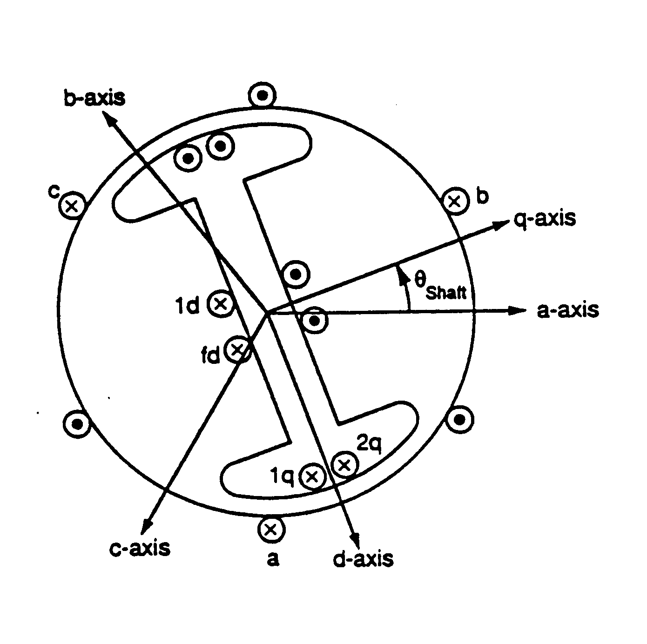
Diagram of Synchronous Machine
3φ bal. windings (a,b,c) – stator
Field winding (fd) on rotor
Damper in “d” axis
(1d) on rotor
2 dampers in “q” axis
(1q, 2q) on rotor

Slide 11
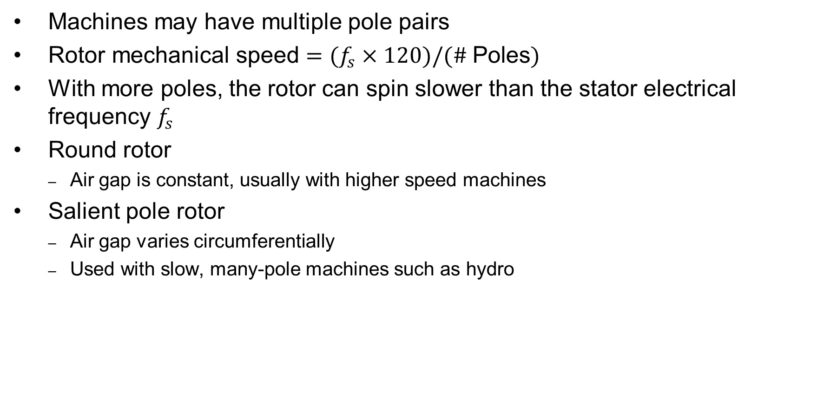
Round and Salient Pole Rotors
Machines may have multiple pole pairs
$\text{Rotor} \text{mechanical} \text{speed}=(f_{s}×120)/(\# \text{Poles})$
With more poles, the rotor can spin slower than the stator electrical frequency $f_{s}$
Round rotor
  Air gap is constant, usually with higher speed machines
Salient pole rotor
  Air gap varies circumferentially
  Used with slow, many-pole machines such as hydro

Slide 12
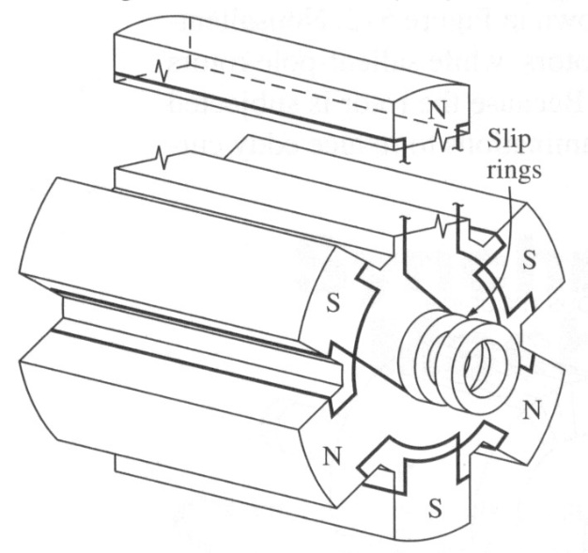
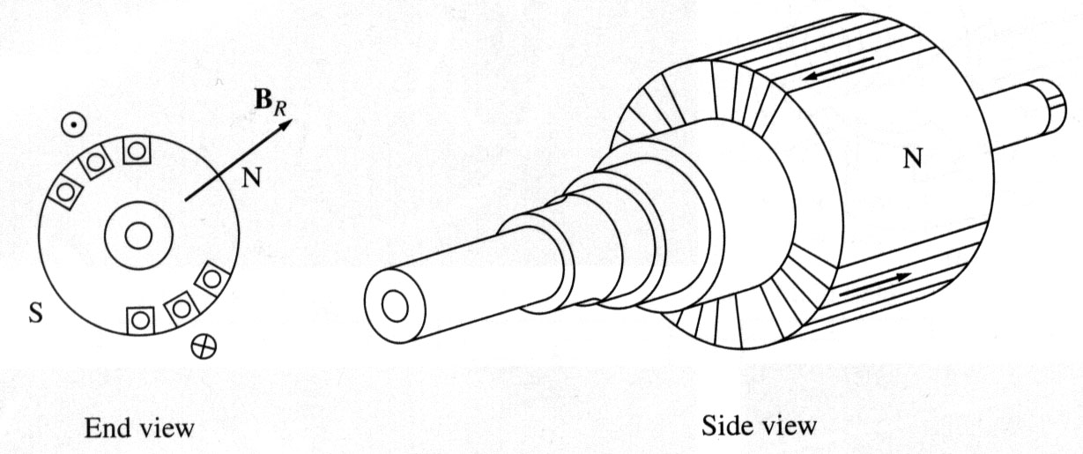
Rotor Examples
Rotors are essentially electromagnets
Two pole (P)
round rotor
Six pole salient
rotor
Image Source: Dr. Gleb Tcheslavski, ee.lamar.edu/gleb/teaching.htm

Slide 13
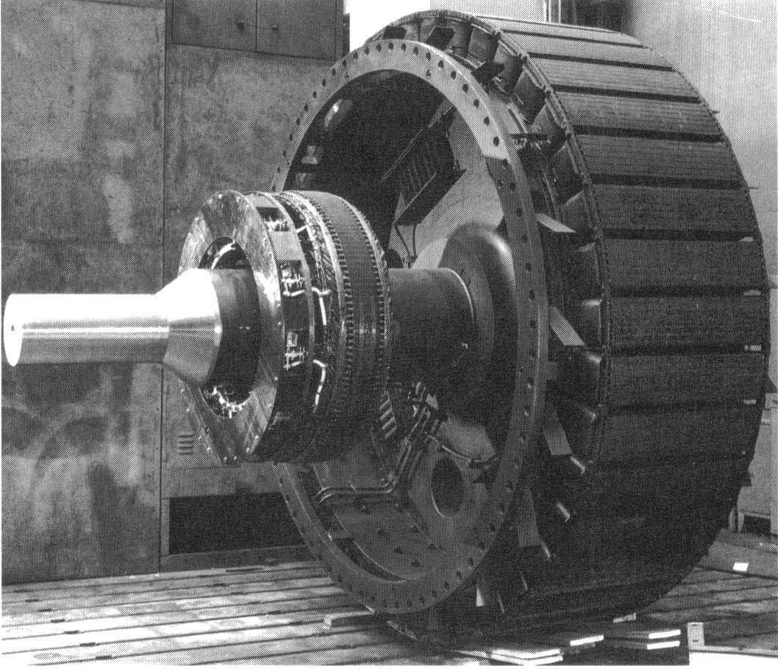
Large Salient Rotor Example
High pole
salient
rotor
Shaft
Part of exciter,
which is used
to control the
field current
Image Source: Dr. Gleb Tcheslavski, ee.lamar.edu/gleb/teaching.htm

Slide 14
Creating a Voltage in an Open-Circuited Generator
With zero stator current, the only magnetic flux is due to the field current
When the generator is at standstill, the flux linking each coil depends on its angle relative to the rotor’s position (and hence the field winding)
  The three phases are physically shifted by 120 degrees from each other
The maximum
flux depends on the field current

Slide 15

Creating a Voltage in an Open-Circuited Generator, 3
No voltage is generated at standstill
Now assume the rotor is spinning at a uniform rate, $ω$ = $2πf$ so

Slide 16
Creating a Voltage in an Open-Circuited Generator, 4
Then by Faraday’s law a voltage is induced

Slide 17
Creating a Voltage in an Open-Circuited Generator, 5
For a linear magnetic circuit, we can also write this as proportional to field current
The negative sign
could be removed
with a change in
the assumed
polarity

Slide 18
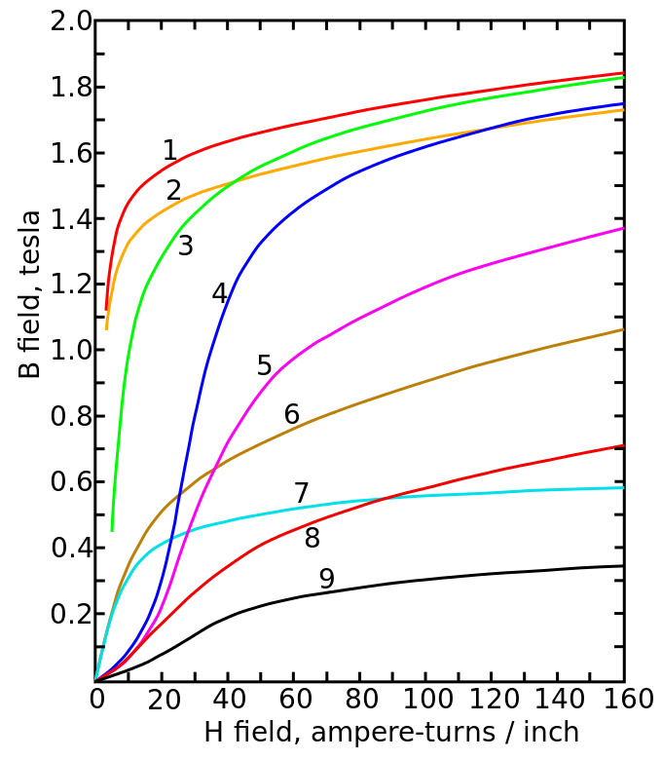
Magnetic Saturation and Hysteresis
A linear magnetic circuit assumes the flux density B is always proportional to current, but real magnetic materials saturate
Magnetization curves of 9 ferromagnetic materials, showing saturation. 1.Sheet steel, 2.Silicon steel, 3.Cast steel, 4.Tungsten steel, 5.Magnet steel, 6.Cast iron, 7.Nickel, 8.Cobalt, 9.Magnetite; highest saturation materials can get to around 2.2 or 2.3T
H is proportional to current
Image Source: en.wikipedia.org/wiki/Saturation_(magnetic)

Slide 19
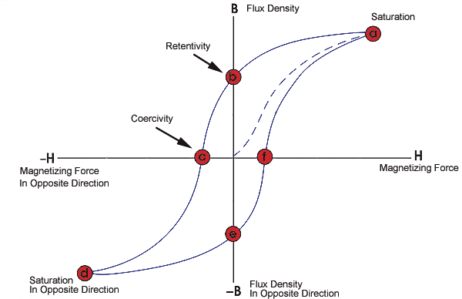
Magnetic Saturation and Hysteresis, 2
Magnetic materials also exhibit hysteresis, so there is some residual magnetism when the current goes to zero; design goal is to reduce the area enclosed by the hysteresis loop
To minimize the amount
of magnetic material,
and hence cost and
weight, electric machines
are designed to operate
close to saturation
Image source: www.nde-ed.org/EducationResources/CommunityCollege/MagParticle/Graphics/BHCurve.gif

Slide 20
Frequency Impacts
Assuming no saturation, the generated voltage is then proportional to frequency
To create the same voltage with less flux, we just need to increase the frequency; this is why aircraft operate at a higher frequency (e.g., 400 Hz)
When controlling motors with variable frequency, common control is to use constant volt/Hz, preventing saturation

Slide 21
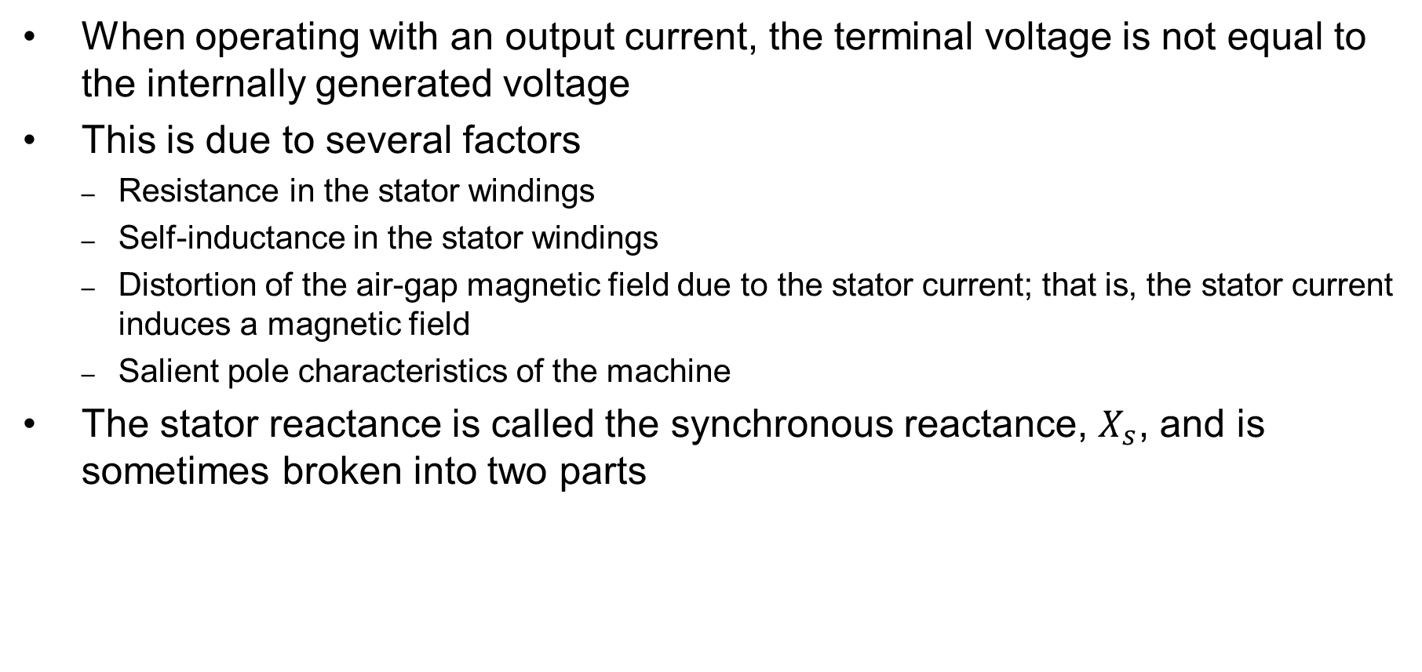

Synchronous Machines with Output Current
When operating with an output current, the terminal voltage is not equal to the internally generated voltage
This is due to several factors
  Resistance in the stator windings
  Self-inductance in the stator windings
  Distortion of the air-gap magnetic field due to the stator current; that is, the stator current induces a magnetic field
  Salient pole characteristics of the machine
The stator reactance is called the synchronous reactance, $X_{s}$, and is sometimes broken into two parts
$$X_{s}=X_{l}+X_{ls}$$
X_{l} is due to the winding
self inductance

Slide 22
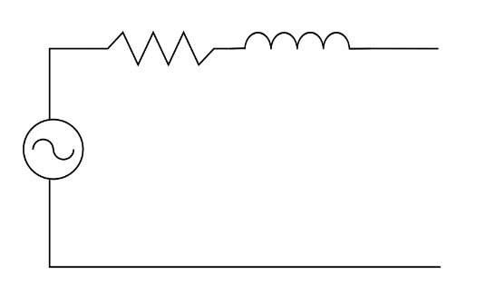


A Synchronous Machine Model
This gives us the following per phase model, which can be helpful in considering how the steady-state real and reactive output of the machine changes with changes in the field current
This model is not particularly good for saturation and understanding the generator’s dynamic response, something we’ll revisit later
$$R_{A}+jX_{S}$$
$$E_{A}$$

Slide 23
Synchronous Machine Testing to Determine its Parameters
These synchronous machine parameters can be determined from two tests
  Open-circuit test: measure the machine’s response when there is no load, and the field current is gradually changed
  Short-circuit test: measure the machine’s response when it is operated at rated speed and its terminals are short-circuited

Slide 24
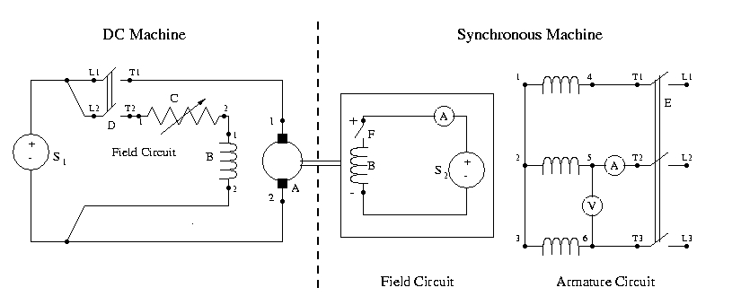
Lab 2 & 3 Setup
We use a DC machine (which is speed controllable) to drive a synchronous generator. In lab 3 we do open-circuit and short-circuit tests to determine its parameters
In the experiment you measure line-to-line values,
which are sqrt(3) times the line-to-neutral values

Slide 25
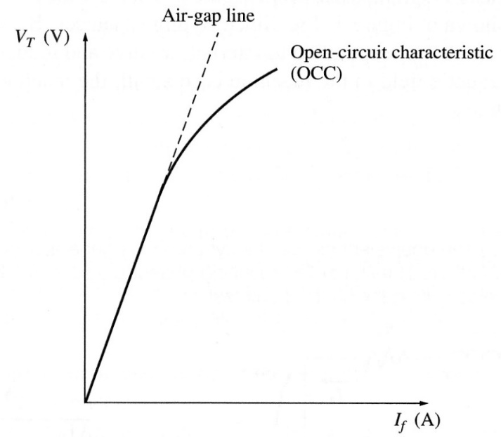
Open-Circuit Characteristic (OCC)
The open-circuit characteristic (OCC) can be derived by gradually
changing the field current
when operating at a fixed
frequency (e.g., synchronous
speed)
  Hysteresis needs to be
  considered when making
  field current adjustments
Because there is no stator current,
the internal voltage can be directly
measured at the terminals
We’ll be using phasor values here

Slide 26
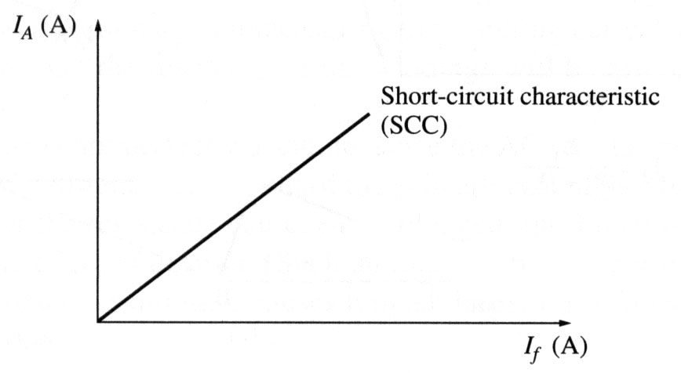


Short-Circuit Test
The short-circuit characteristic measures the relationship between the field current and the terminal current
With the model we get
Since usually XS >> RA, so
$$I_{A,SC}=\frac{E_{A}}{\sqrt{R_{A}^{2}+X_{S}^{2}}}$$
$$X_{S}≈\frac{E_{A}}{I_{A,SC}}$$
This curve is almost linear since there is little saturation because the fluxes in the machine tend to cancel.

Slide 27
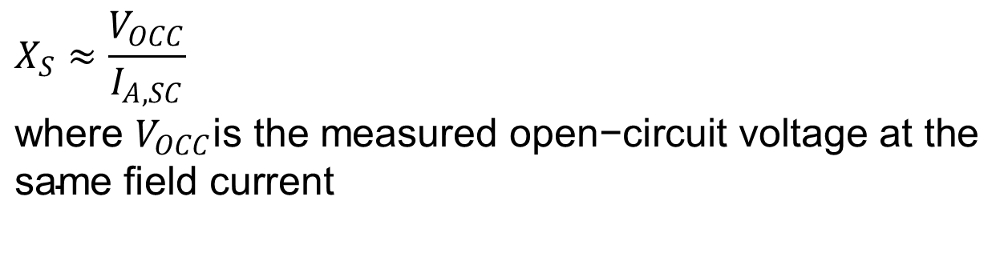
Short-Circuit Test, Cont.
However, in doing this test we cannot directly measure EA and of course the terminal voltage is now zero during the short-circuit.
One approach is to approximate it as
$$X_{S}≈\frac{V_{OCC}}{I_{A,SC}} \\ \text{where} V_{OCC}\text{is} \text{the} \text{measured} \text{open}\text{−}\text{circuit} \text{voltage} \text{at} \text{the} \\ \text{same} \text{field} \text{current}$$

Slide 28
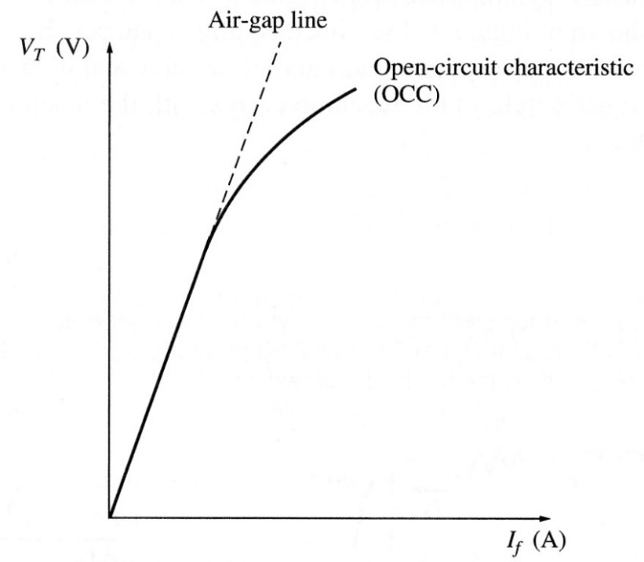

Short-Circuit Test, Cont., 2
This approach is accurate up to the point of saturation. An alternative approach is to substitute the equivalent air-gap voltage instead of the VOCC value.
  This is commonly called the unsaturated synchronous reactance, Xu
The amount of saturation depends
on loading; in
large generators
saturation is explicitly modeled
$$X_{u}=\frac{E_{a​​g​l}}{I_{A,SC}}$$

Slide 29
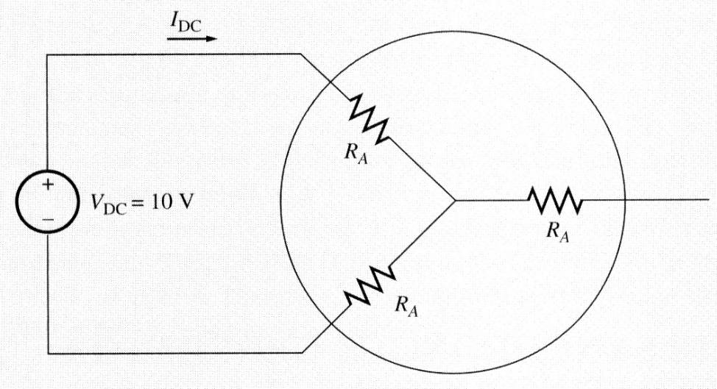
Measuring RA
The winding resistance can be calculated at standstill by applying a small dc voltage to two of the terminals, and then measuring the dc current
Or one could just use an
ohmmeter

Slide 30

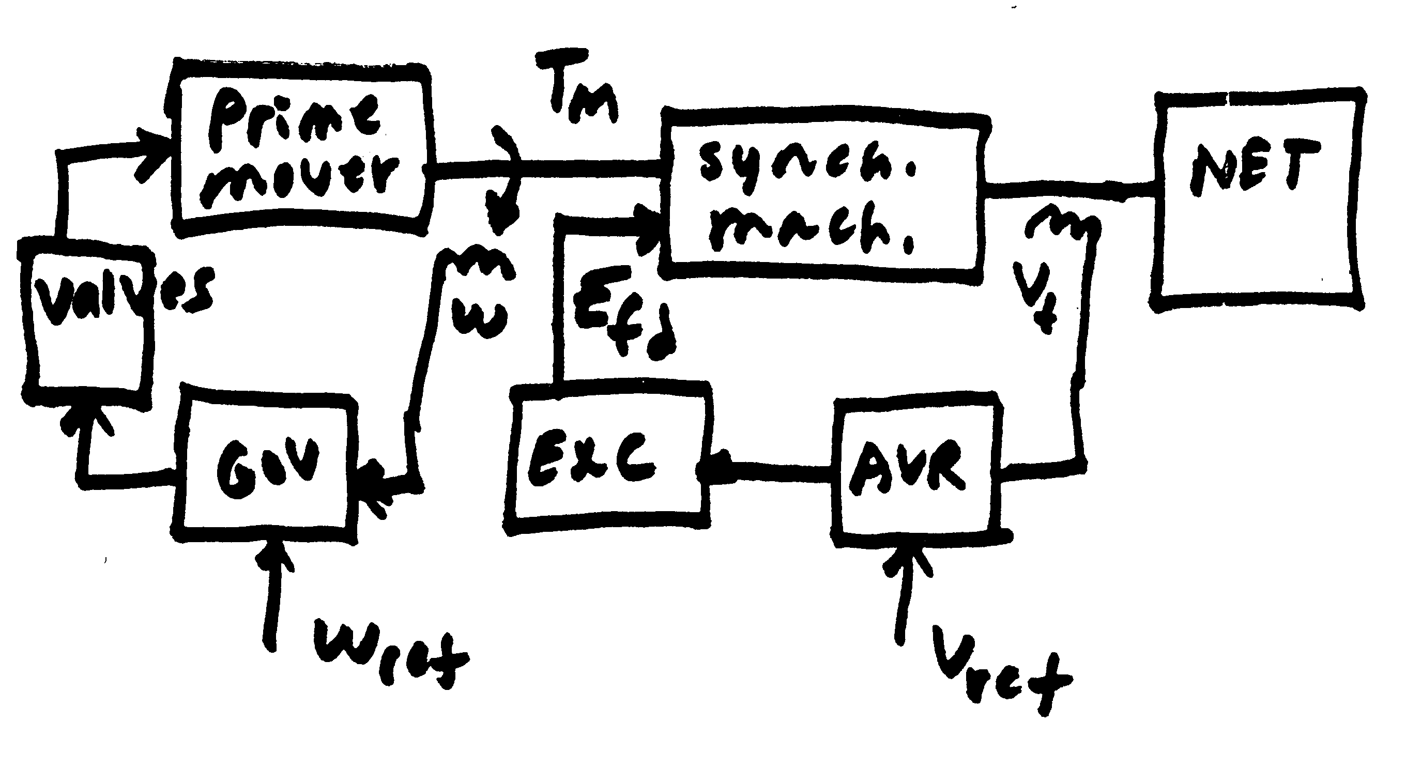

Operating Synchronous Machines Under Load
We’ve seen that the terminal voltage of a synchronous machine can be controlled by adjusting its field voltage (and hence field current)
Large generators have a number of automatic control systems, including one called an exciter to keep the terminal voltage or other
voltage at a specified value
Small machines might operate with a constant field current
$$R_{A}+jX_{S}$$
$$E_{A}$$

Slide 31


Operating Synchronous Machines Under Load with a Constant Field
If the field voltage and hence field current are assumed constant, and the speed is assumed constant (which in practice would be controlled by a governor), then the internal voltage can be assumed to be constant
How the voltage varies with loading is then given by
$$R_{A}+jX_{S}$$
$$E_{A}$$

Slide 32
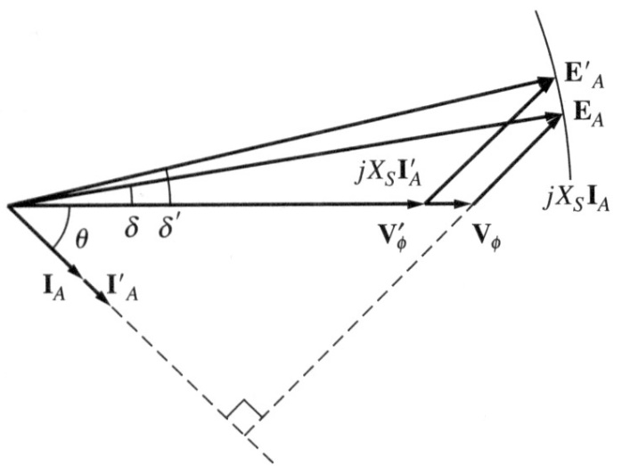
Operating Synchronous Machines Under Load with a Constant Field, 2
To help gain insight, we’ll neglect the usually small RA so then
  Arbitrarily we can set the angle of VT to zero
If the load has a lagging power
factor then internal voltage
magnitude is higher
If leading pf then internal voltage
is lower than the terminal voltage

Slide 33

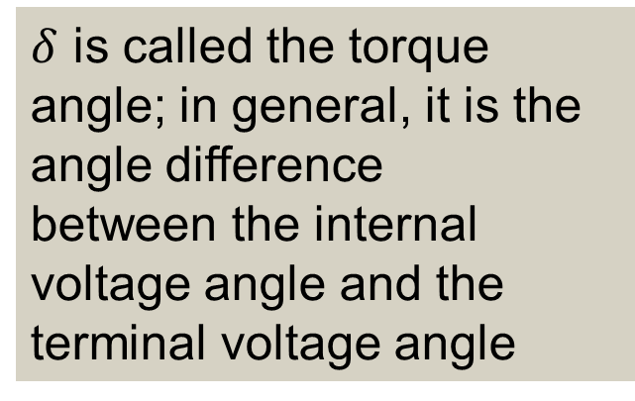

Operating Synchronous Machines Under Load with a Constant Field, 3
With $R_{A}$ neglected, the power out of the machine is given by
$${P\frac{V_{T,pu}E_{A,pu}}{X_{s,pu}}\sin{δ}}_{out,pu} \\ P_{3φ}=3\frac{V_{AN}E_{A}}{X_{s}}\sin{δ} \\ P_{3φ}=\sqrt{3}\frac{V_{LL}E_{A}}{X_{s}}\sin{δ}$$
$δ$ is called the torque angle; in general, it is the angle difference
between the internal voltage angle and the
terminal voltage angle

Slide 34
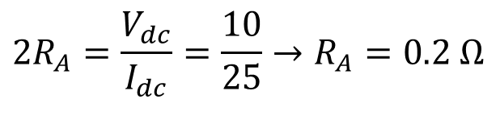
Example
A 200 kVA, 480 V (line-to-line), 60 Hz, Y-connected generator with a rated field voltage of 5A was tested with the following results
  VT,LL = 540 V at rated field current
  IA,SC = 300 A at rated field current
  When disconnected, a dc voltage of 10 V is applied to two of the terminals, giving a current of 25 A
  Find the model
$$2R_{A}=\frac{V_{dc}}{I_{dc}}=\frac{10}{25}→R_{A}=0.2 Ω$$

Slide 35
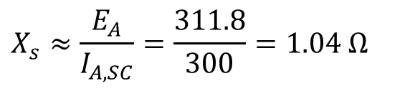
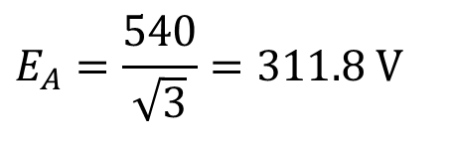
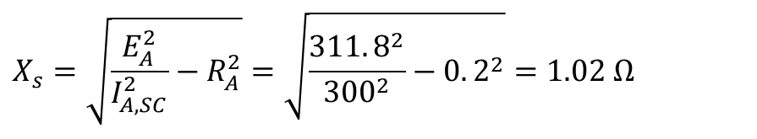
Example, Cont.
The internal, per phase voltage is
The synchronous reactance at the rated field current is
If we wished to include the impact of RA it would be
$$E_{A}=\frac{540}{\sqrt{3}}=311.8 \text{V}$$
$$X_{s}≈\frac{E_{A}}{I_{A,SC}}=\frac{311.8}{300}=1.04 Ω$$
$$X_{s}=\sqrt{\frac{E_{A}^{2}}{I_{A,SC}^{2}}−R_{A}^{2}}=\sqrt{\frac{311.8^{2}}{300^{2}}−0.2^{2}}=1.02 Ω$$

Slide 36
Example, Cont., 2
Now assume a three-phase, wye-connected load is attached to its terminal with Z = 4∠20° Ω. The field current is adjusted so the line-to-line terminal voltage is 480 V and the generator is operated at 60 Hz. What is the internal voltage, and what is the total power delivered to the load? Use XS = 1.04 Ω. Then repeat with Z = 4∠-20° Ω.

Slide 37
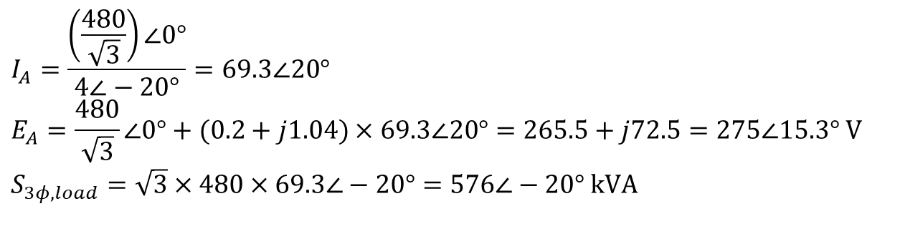
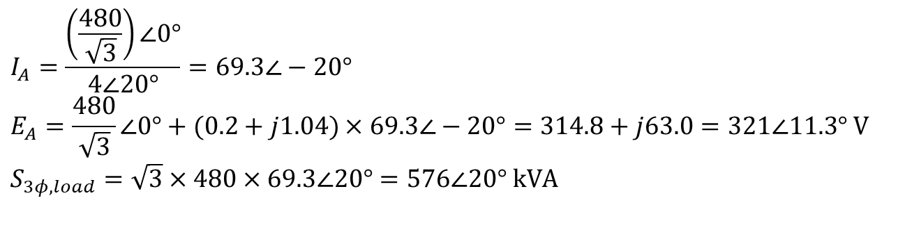
Example, Cont., 3
With Z = 4∠20° Ω
With Z = 4∠-20° Ω
$$I_{A}=\frac{\left(\frac{480}{\sqrt{3}}\right)∠0°}{4∠20°}=69.3∠−20° \\ E_{A}=\frac{480}{\sqrt{3}}∠0°+(0.2+j1.04)×69.3∠−20°=314.8+j63.0=321∠11.3° \text{V} \\ S_{3φ,load}=\sqrt{3}×480×69.3∠20°=576∠20° \text{kVA}$$
$$I_{A}=\frac{\left(\frac{480}{\sqrt{3}}\right)∠0°}{4∠−20°}=69.3∠20° \\ E_{A}=\frac{480}{\sqrt{3}}∠0°+(0.2+j1.04)×69.3∠20°=265.5+j72.5=275∠15.3° \text{V} \\ S_{3φ,load}=\sqrt{3}×480×69.3∠−20°=576∠−20° \text{kVA}$$

Slide 38
DC Machines
Prior to widespread use of machine drives, dc motors had an important advantage of easy speed control
  Example is a model railroad
On the stator a dc machine has either a permanent magnet or a single concentrated winding
  With winding field voltage is Vf and field current is If
Rotor (armature) currents are supplied through brushes and commutator

Slide 39
DC Machines, 2
If there is a field winding (i.e., not a permanent magnet machine) then the machine could be connected in the following ways
  Separately-excited: Field and armature windings are connected to separate power sources
    For an exciter, control is provided by varying the field current (which is stationary), which changes the armature voltage
  Series-excited: Field and armature windings are in series
  Shunt-excited: Field and armature windings are in parallel

Slide 40



DC Machines, 3
In a machine with a field winding the equations are
In steady-state these can be simplified to
In a shunt-connected machine, VT = VF so
$$V_{F}=I_{F}R_{F}+L_{F}\frac{dI_{F}}{dt} \\ V_{T}=I_{A}R_{A}+L_{A}\frac{dI_{A}}{dt}+Gω_{m}I_{A}$$
G is a machine constant,
w_{m} is its speed
$$V_{F}=I_{F}R_{F} \\ V_{T}=I_{A}R_{A}+Gω_{m}I_{F}$$
$$V_{T}=I_{A}R_{A}+Gω_{m}\frac{V_{T}}{R_{F}}$$

