Slide 1
ECEN 460, Spring 2026
Power System Operation and Control
Class 1: Three-Phase AC Power Calculations
Prof. Adam Birchfield
Dept. of Electrical and Computer Engineering
Texas A&M University
abirchfield@tamu.edu

Slide 2


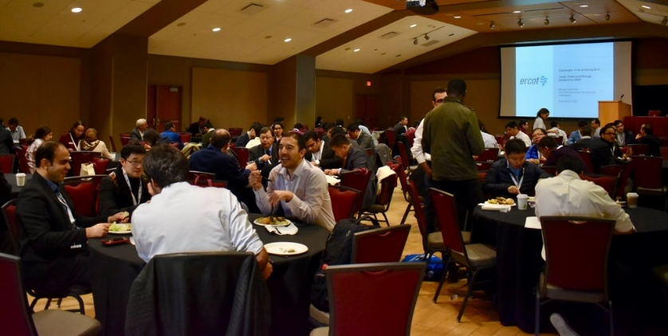
Energy and Power Group (EPG) at Texas A&M
Texas A&M is a leader in power and energy research!
14+ Faculty members in various expertise areas of power systems, power electronics, and electric machines
Get connected!
Smart Grid Research Facility
Texas Power and Energy Conference (Student Run!!)
EPG Spring 2025 Picnic at Dr. Overbye’s house

Slide 3
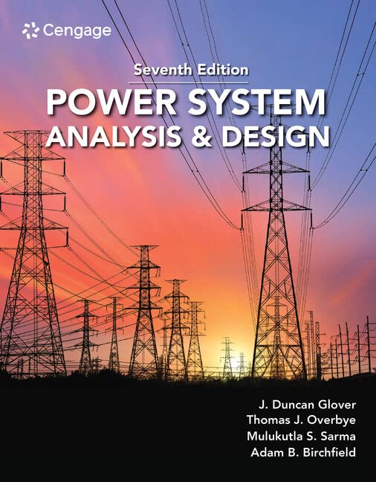
Welcome to ECEN 460!
Syllabus and other important information, including slides will be on the website: https://birchfield.engr.tamu.edu/460s26/
Canvas is used for lab reports and grades
Textbook: Power System Analysis and Design
Evaluation
  20% First Exam, Tentatively Feb 17
  20% Second Exam, Tentatively April 2
  20% Final, May 5
  20% In-class quizzes
  20% Lab – starts next week
If you need accommodation for a disability, please let me know as soon as you can

Slide 4
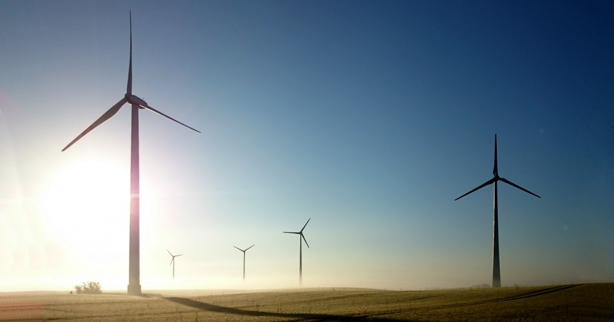

Motivation for this Class
Electrification has changed the world, and power systems are now critical to our way of life
  Lighting, HVAC, manufacturing
  Refrigeration, medical technology, agriculture
  Communications, computing, transportation
Now is a time of rapid transformation for electric grids worldwide
  Major additions of wind, solar, and batteries
  EVs and smart/efficient consumer devices
  Cyber and physical security concerns
  AI’s consumption of power and using AI for grid control
In 460, we want to develop future power engineers who can tackle difficult problems either directly or indirectly related to the grid

Slide 5
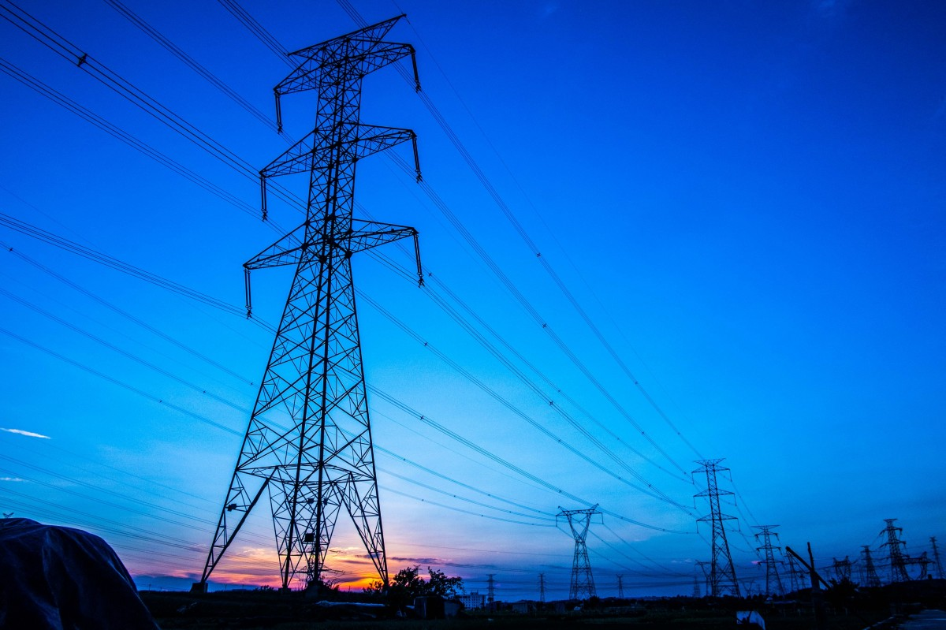
Some Things to Think About – For Next Class
What is energy? What is power?
Why is the bulk of the energy we use transmitted at some point by electricity?
Why is it important to have very high voltages in power systems?
Why do large electric power systems exclusively use AC at 50 or 60 Hz?
Why are large electric power systems exclusively three-phase?
Why are power grids connected across continents? What are the advantages or disadvantages of connecting to neighbors?

Slide 6
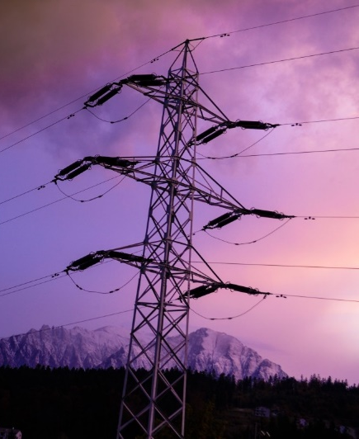
What this Class Will Cover
Review of three-phase AC power calculations (today)
Structure, history, and design of power systems
Generator and load modeling
Transmission line and transformer modeling
The power flow problem and solution methods
Economic power system operation
Dynamics and stability of power systems
Emerging topics

Slide 7
First Assignment – Review Three-Phase AC Power Calculations
Main topics you need to know
  Complex number math – by hand and calculator
  Phasors – representing AC voltage and current
  Impedance – for AC circuit solving
  Complex power – including power factor, reactive power
  Three phase – wye/delta, line-to-line/line-to-neutral voltage, per-phase analysis
Today we’re going to review these
Homework #1 and #2 are practice problems on these topics
  Homework #1 due next Tuesday (Jan 20) and Homework #2 due Tuesday Jan 27
Take advantage of the textbook, and office hours (me and TAs)
We’re going to have quizzes most classes to review.

Slide 8
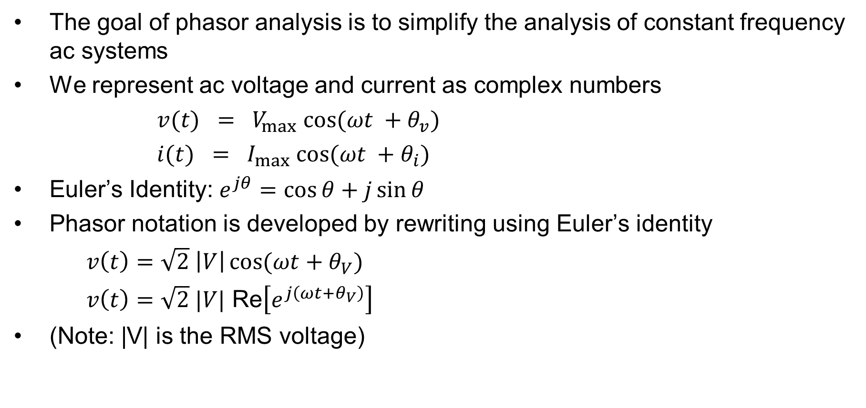
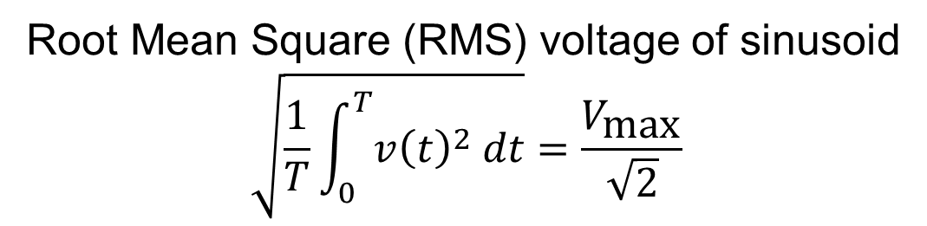
Review of Phasors – Representing AC Voltage and Current
The goal of phasor analysis is to simplify the analysis of constant frequency ac systems
We represent ac voltage and current as complex numbers
$v(t) = V_{max} cos⁡(ωt +θ_{v})$
$i(t) = I_{max} cos⁡(ωt +θ_{i})$
Euler’s Identity: $e^{jθ}=\cos{θ}+j\sin{θ}$
Phasor notation is developed by rewriting using Euler’s identity
$v\left(t\right)=\sqrt{2} \left|V\right|\cos{(ωt+θ_{V})}$
$v\left(t\right)=\sqrt{2} |V| \text{Re}\left[e^{j\left(ωt+θ_{V}\right)}\right]$
(Note: |V| is the RMS voltage)
Root Mean Square (RMS) voltage of sinusoid
$$\sqrt{\frac{1}{T}\int_{0}^{T}{v{\left(t\right)}^{2} dt}}=\frac{V_{\text{max}}}{\sqrt{2}}$$

Slide 9

Phasors, Cont.
The RMS, cosine-referenced voltage phasor is:
$V$ $=$ $\left|V\right|e^{jθ_{V}}=\left|V\right|∠θ_{V}$
$v\left(t\right)$ $=$ $\text{Re} [\sqrt{2} Ve^{jωt} e^{jθ_{V}}]$
$V$ $=$ $\left|V\right|\cos{θ_{V}}+j\left|V\right|\sin{θ_{V}}$
$I$ $=$ $\left|I\right|\cos{θ_{I}}+j\left|I\right|\sin{θ_{I}}$
(Note: Some texts use boldface type for complex numbers; some use overbars)

Slide 10
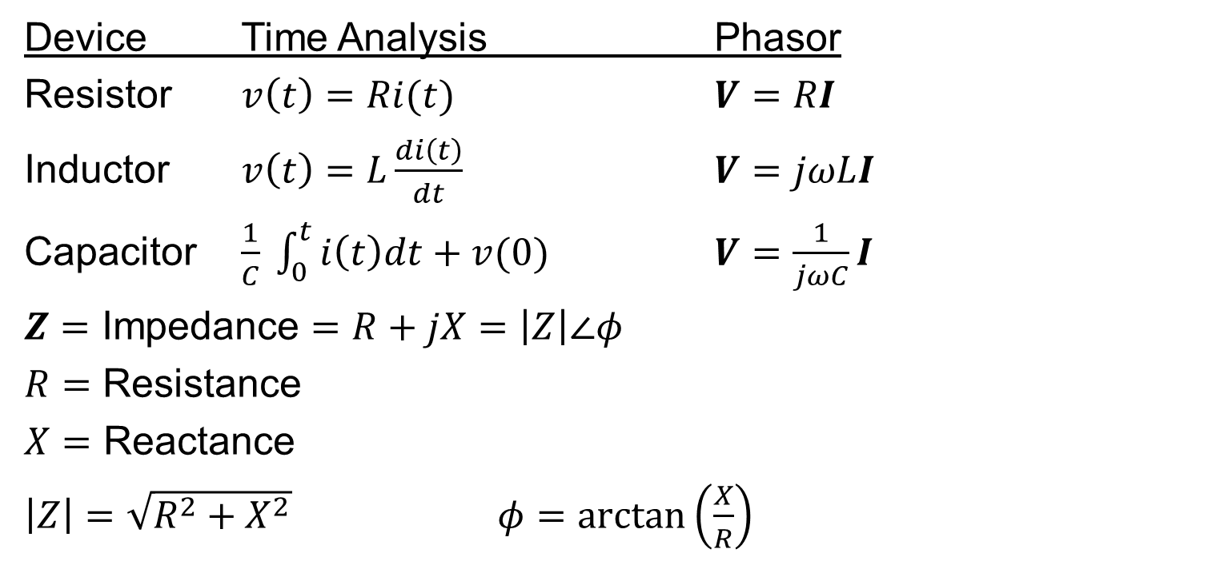
Impedance – For AC Circuit Solutions
Device Time Analysis Phasor
Resistor $v\left(t\right)=Ri(t)$ $V=RI$
Inductor $v\left(t\right)=L\frac{di\left(t\right)}{dt}$ $V=jωLI$
Capacitor $\frac{1}{C} \int_{0}^{t}{i\left(t\right)dt}+v(0)$ $V=\frac{1}{jωC}I$
$Z=\text{Impedance}=R+jX=\left|Z\right|∠φ$
$R=\text{Resistance}$
$X=\text{Reactance}$
$\left|Z\right|=\sqrt{R^{2}+X^{2}}$ $φ=\arctan\left(\frac{X}{R}\right)$
(Note: Z is a complex number but not a phasor)

Slide 11
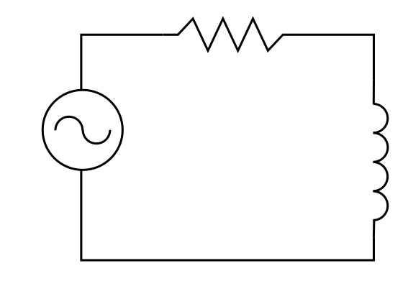




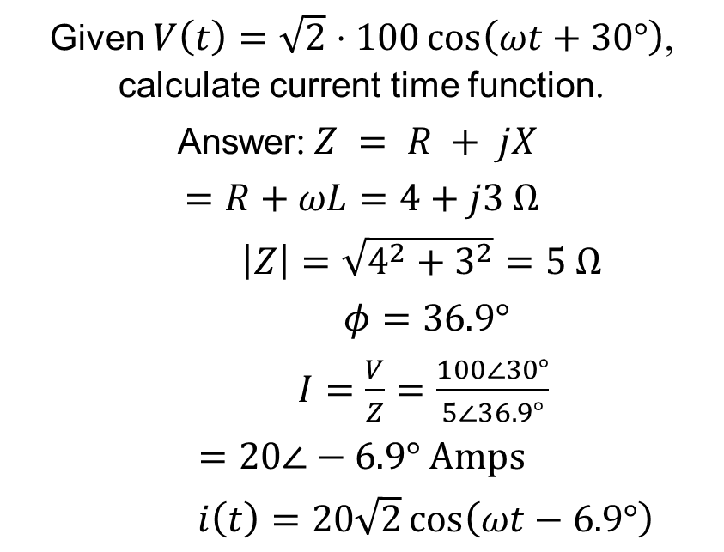

Impedance – RL Circuit Example
Given $V\left(t\right)=\sqrt{2}⋅100\cos\left(ωt+30°\right)$, calculate current time function.
Answer:$Z = R + jX$
$=R+ωL=4+j3 \text{Ω}$
$\left|Z\right|=\sqrt{4^{2}+3^{2}}=5 Ω$
$φ=36.9°$
$I=\frac{V}{Z}=\frac{100∠30°}{5∠36.9°}$
$=20∠−6.9° \text{Amps}$
$i\left(t\right)=20\sqrt{2}\cos\left(ωt−6.9°\right)$
$$f=60 \text{Hz}$$
$$4 Ω$$
$$i\left(t\right)→$$
$$V(t)$$
$$7.96 \text{mH}$$

Slide 12
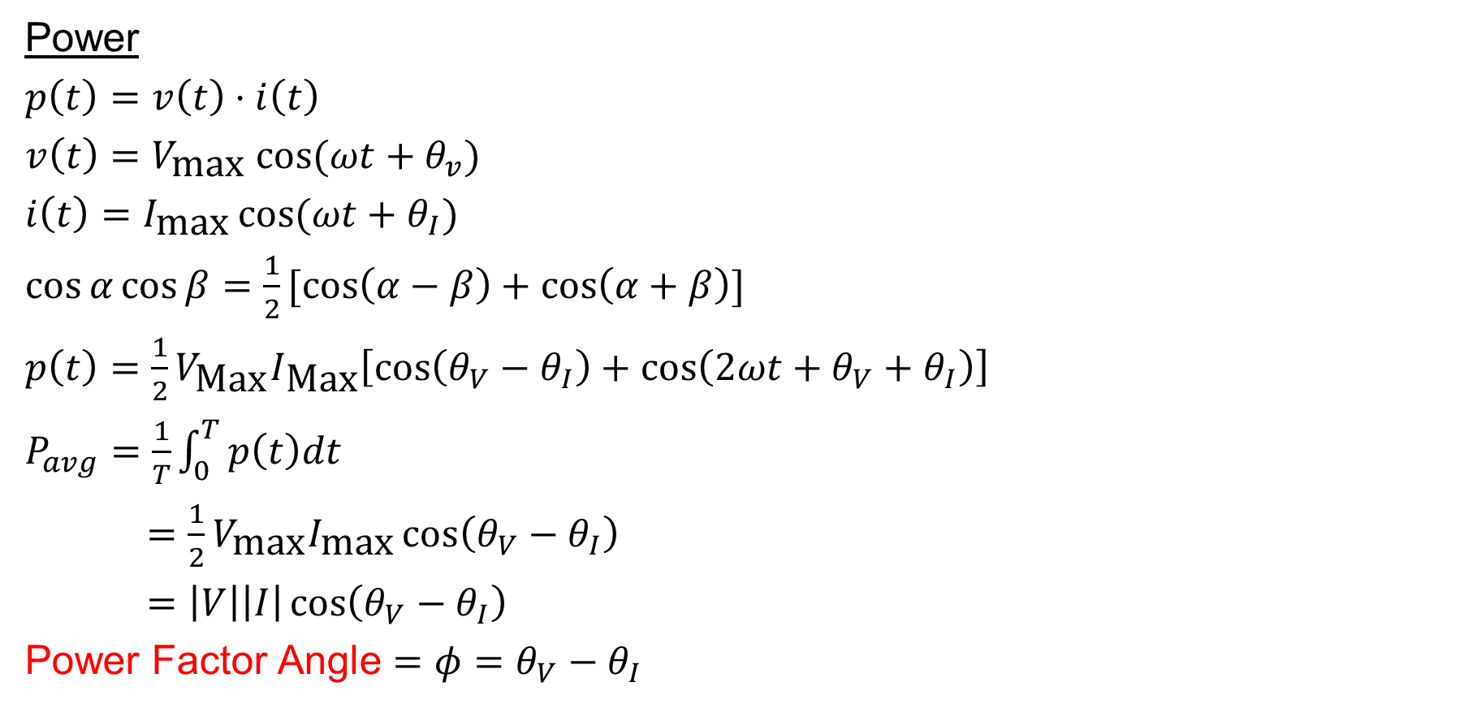
Complex Power
Power
$p\left(t\right)=v\left(t\right)⋅i\left(t\right)$
$v\left(t\right)=V_{\text{max}} cos⁡(ωt+θ_{v})$
$i\left(t\right)=I_{\text{max}}\cos{(ωt+θ_{I})}$
$\cos{α}\cos{β}=\frac{1}{2}[\cos\left(α−β\right)+\cos\left(α+β\right)]$
$p\left(t\right)=\frac{1}{2}V_{\text{Max}}I_{\text{Max}}\left[\cos\left(θ_{V}−θ_{I}\right)+\cos\left(2ωt+θ_{V}+θ_{I}\right)\right]$
$P_{avg}=\frac{1}{T}\int_{0}^{T}{p\left(t\right)dt}$
$=\frac{1}{2}V_{\text{max}}I_{\text{max}}\cos\left(θ_{V}−θ_{I}\right)$
$=\left|V\right|\left|I\right|\cos\left(θ_{V}−θ_{I}\right)$
Power Factor Angle $=φ=θ_{V}−θ_{I}$

Slide 13
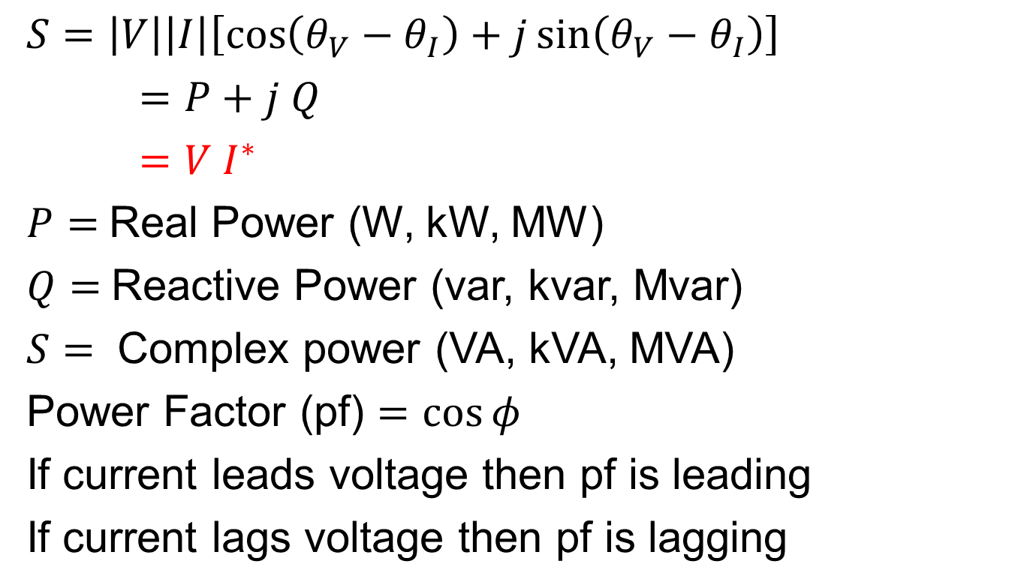
Complex Power, Cont’d
$S=\left|V\right|\left|I\right|\left[\cos\left(θ_{V}−θ_{I}\right)+j\sin\left(θ_{V}−θ_{I}\right)\right]$
$=P+j Q$
$=V I^{∗}$
$P=$Real Power (W, kW, MW)
$Q=$Reactive Power (var, kvar, Mvar)
$S=$ Complex power (VA, kVA, MVA)
Power Factor (pf) $=\cos{φ}$
If current leads voltage then pf is leading
If current lags voltage then pf is lagging
(Note: S is a complex number but not a phasor)

Slide 14
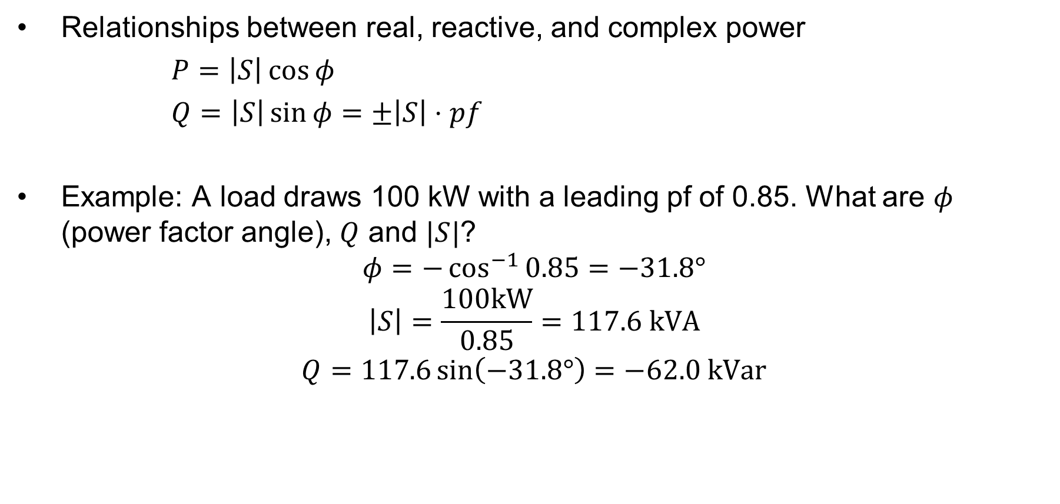
Complex Power, Cont’d 2
Relationships between real, reactive, and complex power
$P=\left|S\right|\cos{φ}$
$Q=\left|S\right|\sin{φ}=±\left|S\right|⋅pf$
Example: A load draws 100 kW with a leading pf of 0.85. What are $φ$ (power factor angle), $Q$ and $|S|$?
$$φ=−\cos^{−1}{0.85}=−31.8°$$
$$\left|S\right|=\frac{100\text{kW}}{0.85}=117.6 \text{kVA}$$
$$Q=117.6\sin\left(−31.8°\right)=−62.0 \text{kVar}$$

Slide 15
Conservation of Power
At every node (bus) in the system:
  Sum of real power into node must equal zero
  Sum of reactive power into node must equal zero
This is a direct consequence of Kirchhoff’s current law, which states that the total current into each node must equal zero.
  Conservation of power follows since S = VI*

Slide 16
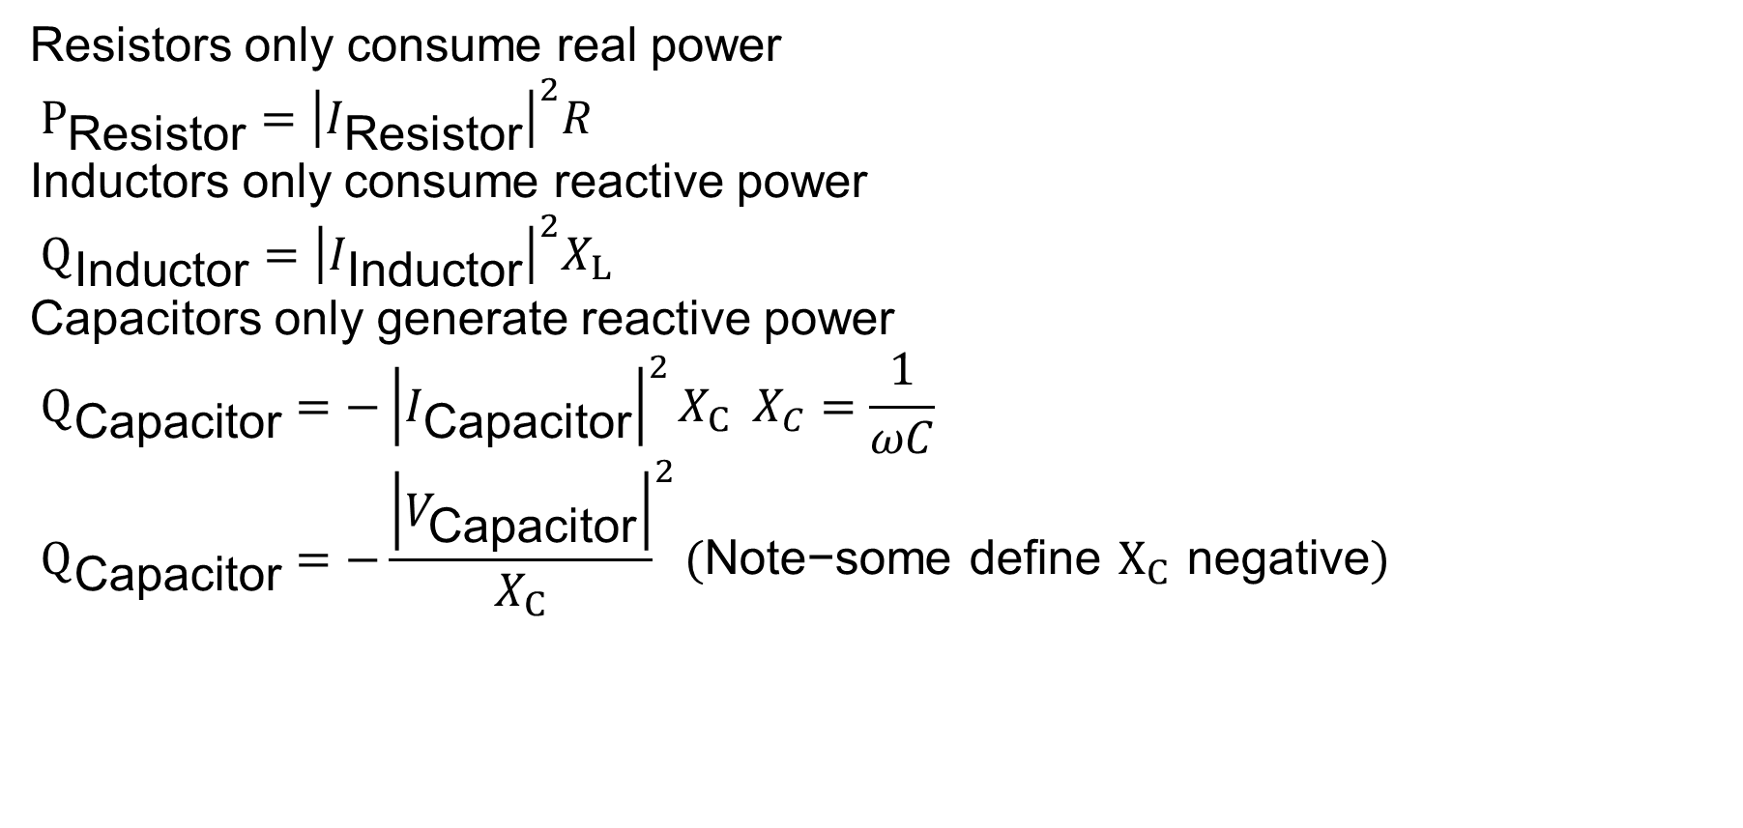
Power Consumption in Devices
Resistors only consume real power
$P_{\text{Resistor}}={\left|I_{\text{Resistor}}\right|}^{2}R$
Inductors only consume reactive power
$$Q_{\text{Inductor}}={\left|I_{\text{Inductor}}\right|}^{2}X_{L}$$
Capacitors only generate reactive power
$$Q_{\text{Capacitor}}=−{\left|I_{\text{Capacitor}}\right|}^{2}X_{C} X_{C}=\frac{1}{ωC} \\ Q_{\text{Capacitor}}=−{\frac{\left|V_{\text{Capacitor}}\right|}{X_{C}}}^{2}(\text{Note}\text{−}\text{some} \text{define} X_{C} \text{negative})$$

Slide 17
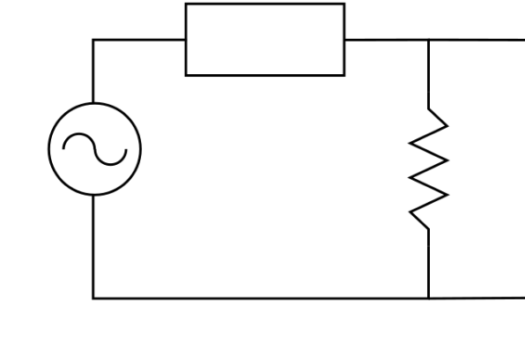
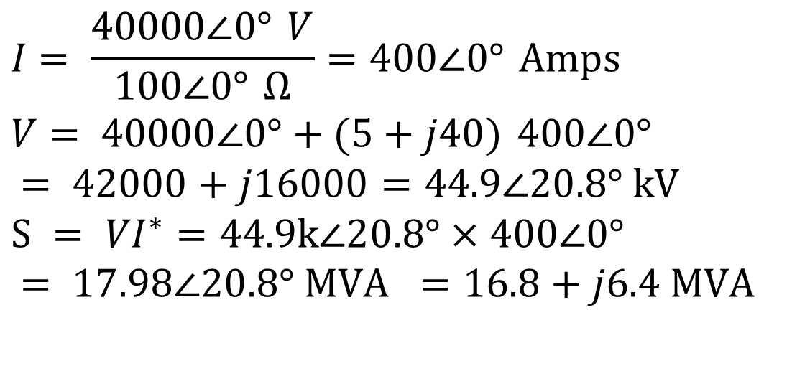
Example
$$5+j40 Ω$$
$$+$$
First solve
basic circuit
$$V_{s}$$
$$100 Ω$$
$$V_{l}=40,000 ∠0°$$
$$−$$
$$I = \frac{40000∠0° V}{100∠0° Ω}=400∠0° \text{Amps} \\ V = 40000∠0°+(5+j40) 400∠0° \\ = 42000+j16000=44.9∠20.8° \text{kV} \\ S = V​I^{∗}=44.9k∠20.8°×400∠0° \\ = 17.98∠20.8° \text{MVA} =16.8+j6.4 \text{MVA}$$

Slide 18
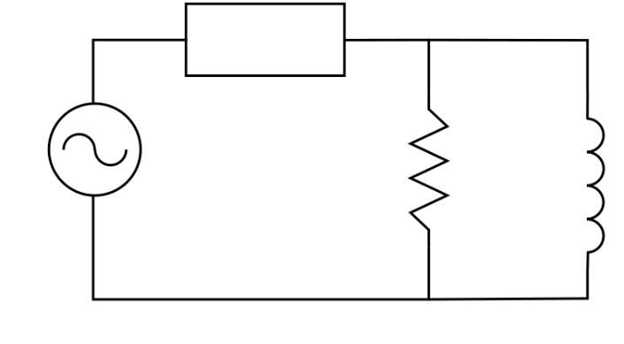

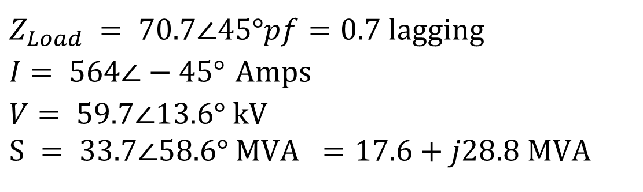






Example, Cont’d
$$5+j40 Ω$$
$$+$$
Now add additional
reactive power load
and resolve
$$V_{s}$$
$$100 Ω$$
$$j100 Ω$$
$$V_{l}=40,000 ∠0°$$
$$−$$
$$Z_{Load} = 70.7∠45° pf=0.7 \text{lagging} \\ I = 564∠−45° \text{Amps} \\ V = 59.7∠13.6° \text{kV} \\ S = 33.7∠58.6° \text{MVA} =17.6+j28.8 \text{MVA}$$

Slide 19
Power System Notation
Power system components are usually shown as
“one-line diagrams.” Previous circuit redrawn
Transmission lines are shown as a single line
Arrows are
used to
show loads
Generators are
shown as circles

Slide 20
Reactive Compensation
Key idea of reactive compensation is to supply reactive power locally. In the previous example this can be done by adding a 16 Mvar capacitor at the load
Reactive compensation decreased the line flow from 564 Amps to 400 Amps. This has advantages
  Lines losses, which are equal to I2 R decrease
  Lower current allows utility to use small wires, or alternatively, supply more load over the same wires
  Voltage drop on the line is less

Slide 21
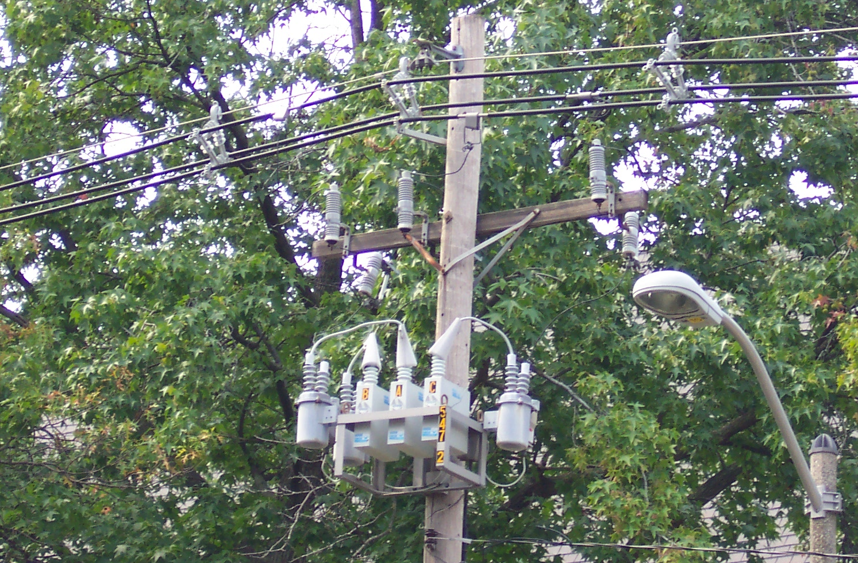
Reactive Compensation, Cont’d
Reactive compensation is used extensively by utilities
Capacitors can be used to “correct” a load’s power factor to an arbitrary value.
Distribution-level capacitor shown on right

Slide 22
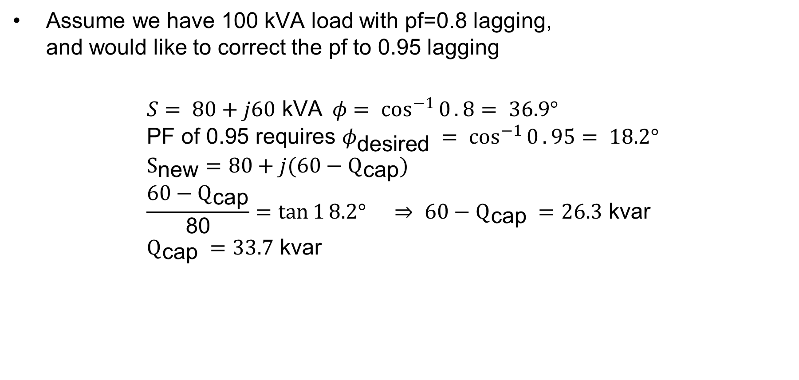
Power Factor Correction Example
Assume we have 100 kVA load with pf=0.8 lagging,
and would like to correct the pf to 0.95 lagging
$$S = 80+j60 \text{kVA} φ = \cos^{−1}{0}.8 = 36.9° \\ \text{PF} \text{of}\text{ 0.95 }\text{requires} φ_{\text{desired}} = \cos^{−1}{0}.95= 18.2° \\ S_{\text{new}}=80+j(60−Q_{\text{cap}}) \\ \frac{60−Q_{\text{cap}}}{\text{80}}=\tan{1}8.2° ⇒ 60−Q_{\text{cap}} =26.3 \text{kvar} \\ Q_{\text{cap}} =33.7 \text{kvar}$$
Similar example is given in video linked to website.

Slide 23
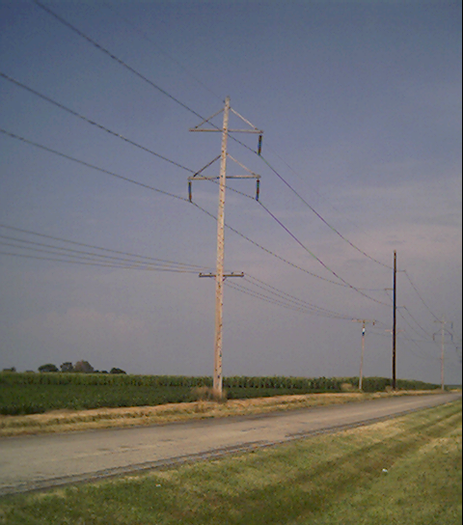
Balanced Three-Phase (φ) Systems
A balanced three-phase (φ) system has
  three voltage sources with equal magnitude, but with an angle shift of 120°
  equal loads on each phase
  equal impedance on the lines connecting the generators to the loads
Bulk power systems are almost exclusively 3φ
Single-phase is used primarily only in low voltage, low power settings, such as residential and some commercial
Advantages include transmitting more power for same amount of wire, and easier starting, better design, and constant torque for machines

Slide 24
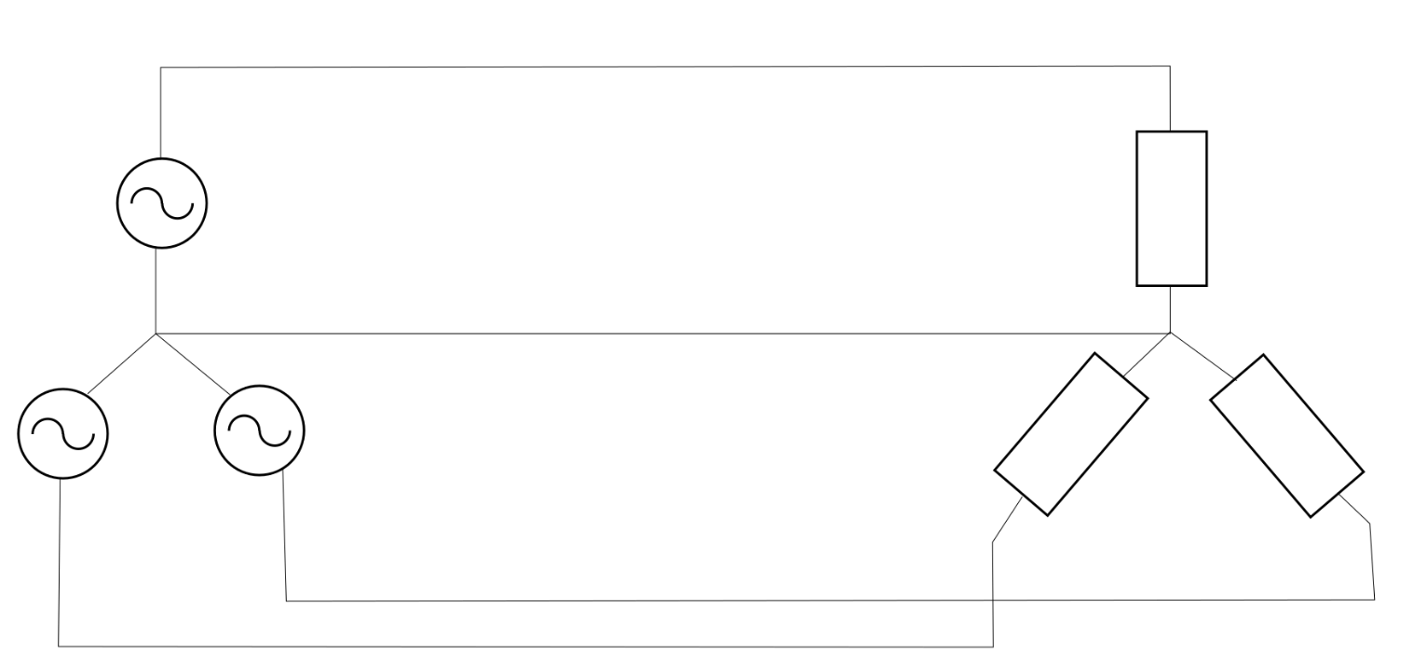

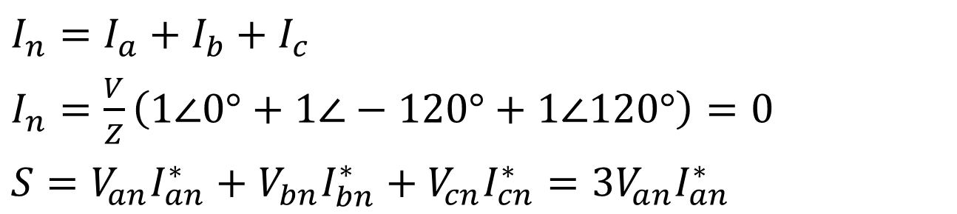
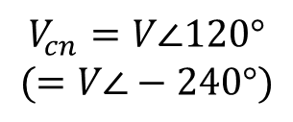








Balanced 3φ -- No Neutral Current
Phase “a”
$$I_{a} →$$
+
$$V_{an}=V∠0°$$
$$Z$$
–
Neutral “n”
$$←I_{n}$$
–
–
$$V_{cn}=V∠120°$$
$$(=V∠−240°)$$
$$V_{bn}=V∠−120°$$
$$Z$$
$$Z$$
+
+
Phase “b”
$$I_{b}→$$
Phase “c”
$$I_{c}→$$
$I_{n}=I_{a}+I_{b}+I_{c}$
$I_{n}=\frac{V}{Z}\left(1∠0°+1∠−120°+1∠120°\right)=0$
$S=V_{an}I_{an}^{∗}+V_{bn}I_{bn}^{∗}+V_{cn}I_{cn}^{∗}=3V_{an}I_{an}^{∗}$

Slide 25
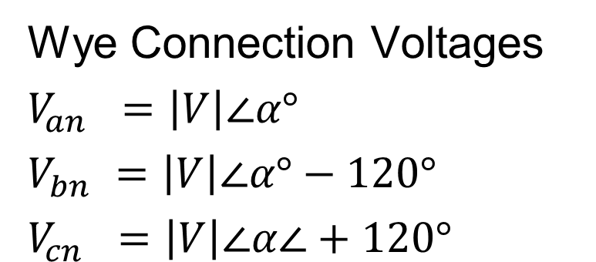
Three-Phase Wye Connection
There are two ways to connect 3φ systems
  Wye (Y)
  Delta (Δ)
Wye Connection Voltages
$V_{an} =\left|V\right|∠α°$
$V_{bn} =\left|V\right|∠α°−120°$
$V_{cn} =\left|V\right|∠α∠+120°$

Slide 26
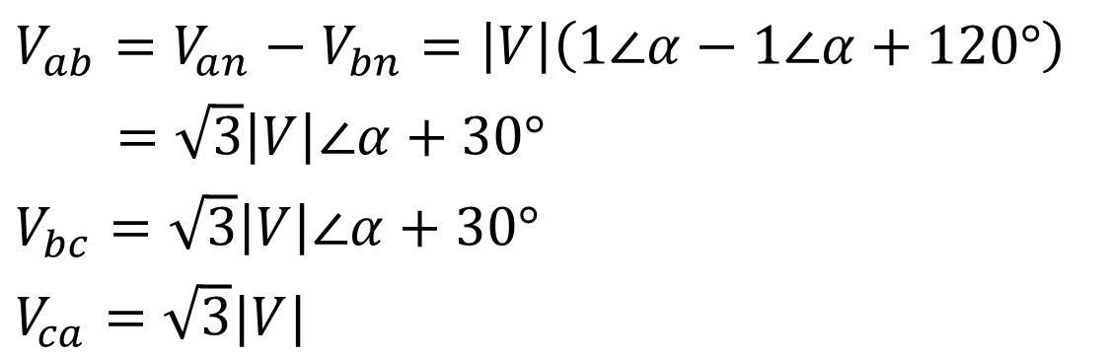
Wye Connection Line Voltages
V_{cn}
V_{ab}
V_{ca}
V_{an}
-V_{bn}
V_{bn}
V_{bc}
(α = 0 in this case)
$V_{ab}=V_{an}−V_{bn}=\left|V\right|\left(1∠α−1∠α+120°\right)$
$=\sqrt{3}\left|V\right|∠α+30°$
$V_{bc}=\sqrt{3}\left|V\right|∠α+30°$
$V_{ca}=\sqrt{3}|V|$
Line to line
voltages are
also balanced

Slide 27
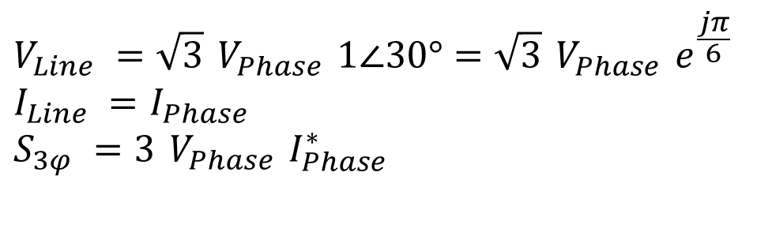
Wye Connection, cont’d
Phase voltage: across wye-connected device
Phase current: through wye-connected device
Line voltage: voltage from one line to another
Line current: current through a line
$$V_{Line} =\sqrt{3} V_{Phase} 1∠30°=\sqrt{3} V_{Phase} e^{\frac{jπ}{6}} \\ I_{Line} =I_{Phase} \\ S_{3φ} =3 V_{Phase} I_{Phase}^{∗}$$

Slide 28
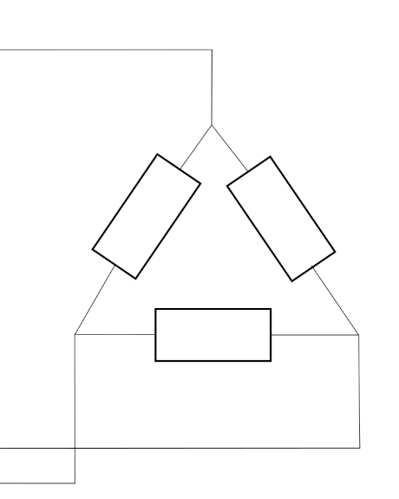
Delta Connection
$$I_{a}→$$
Phase “a”
$$I_{ca}→$$
$$I_{ab}→$$
$$Z$$
$$Z$$
Phase “c”
$$Z$$
Phase “b”
$$←I_{bc}$$
$$I_{b}→$$
$$I_{c}→$$
I_{ca}
I_{c}
I_{b}
I_{ab}
I_{bc}
I_{a}

Slide 29
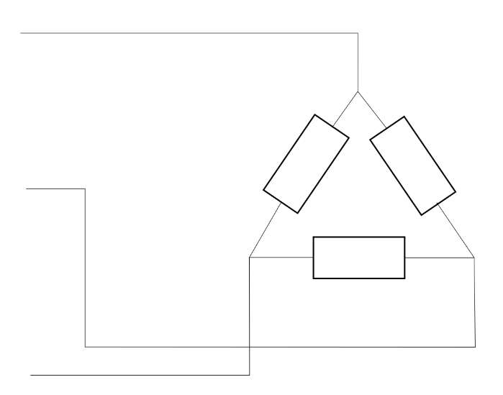
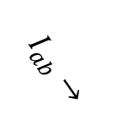

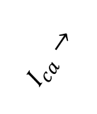




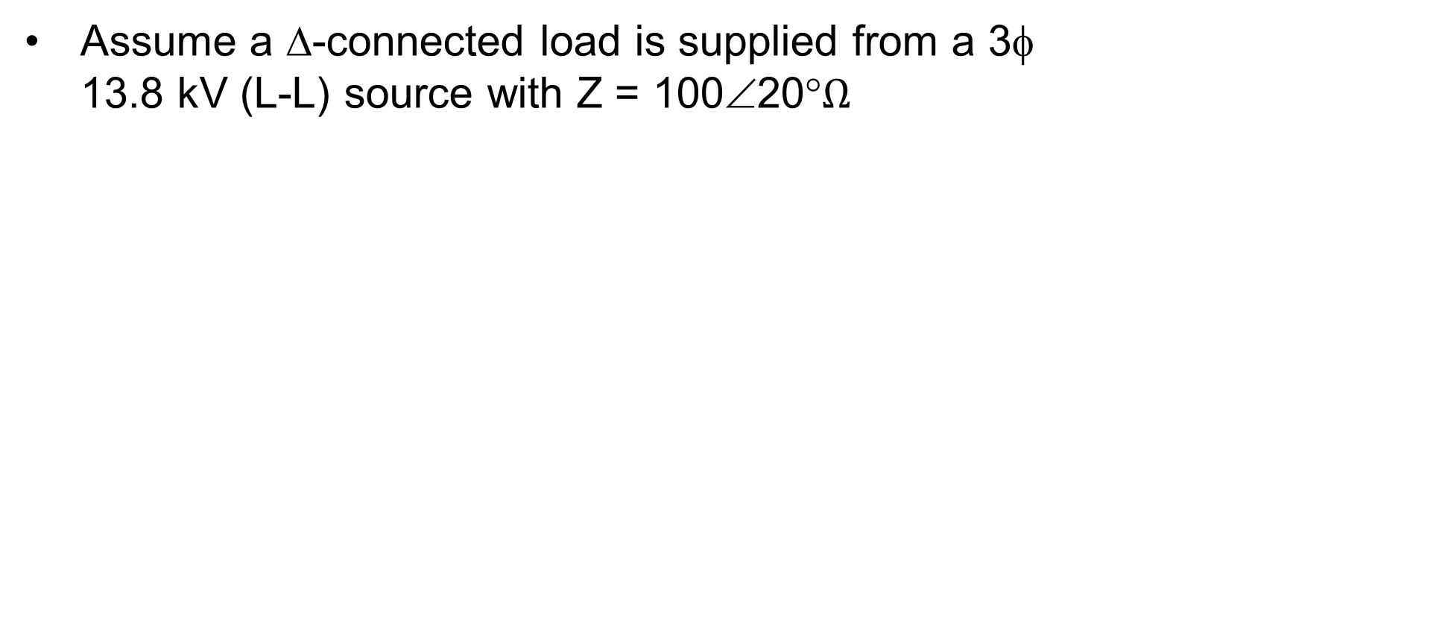


Three-Phase Example
Assume a Δ-connected load is supplied from a 3φ
13.8 kV (L-L) source with Z = 100∠20°$Ω$
Phase “a”
$$I_{a}→$$
$$I_{ca}→$$
$$I_{ab}→$$
$$Z$$
$$Z$$
Phase “b”
$$Z$$
$$I_{b}→$$
$$←I_{bc}$$
Phase “c”
$$I_{c}→$$

Slide 30
Three-Phase Example, cont’d

Slide 31
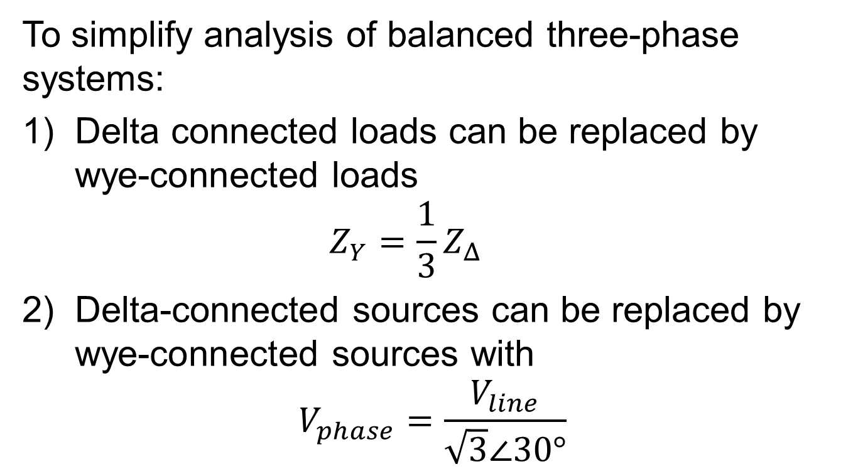
Delta-Wye Transformation
To simplify analysis of balanced three-phase systems:
Delta connected loads can be replaced by wye-connected loads
$Z_{Y}=\frac{1}{3}Z_{Δ}$
Delta-connected sources can be replaced by wye-connected sources with
$$V_{phase}=\frac{V_{line}}{\sqrt{3}∠30°}$$

Slide 32
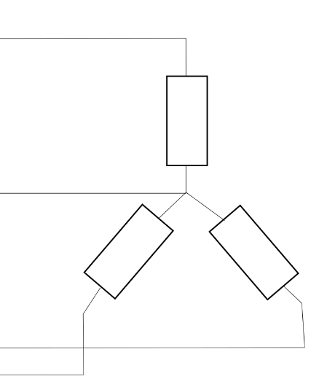
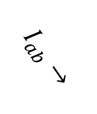

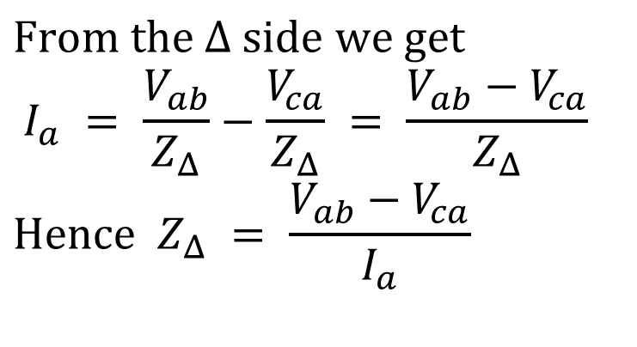

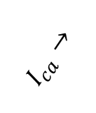

















Delta-Wye Transformation Proof
$$I_{a}→$$
$$I_{a}→$$
$$+ \\ V_{an} \\ −$$
$$− \\ V_{ca} \\ +$$
$$+ \\ V_{ab} \\ −$$
$$Z_{Y}$$
$$I_{ca}→$$
$$I_{ab}→$$
$$Z_{Δ}$$
$$Z_{Δ}$$
$$− \\ V_{cn} \\ +$$
$$− \\ V_{bn} \\ +$$
$$Z_{Δ}$$
$$Z_{Y}$$
$$Z_{Y}$$
$$←I_{bc}$$
$$I_{b}→$$
$$I_{b}→$$
$$I_{c}→$$
$$− V_{bc}+$$
$$I_{c}→$$
$$\text{From} \text{the} Δ \text{side} \text{we} \text{get} \\ I_{a} = \frac{V_{ab}}{Z_{Δ}}−\frac{V_{ca}}{Z_{Δ}} = \frac{V_{ab}−V_{ca}}{Z_{Δ}} \\ \text{Hence} Z_{Δ} = \frac{V_{ab}−V_{ca}}{I_{a}}$$

Slide 33
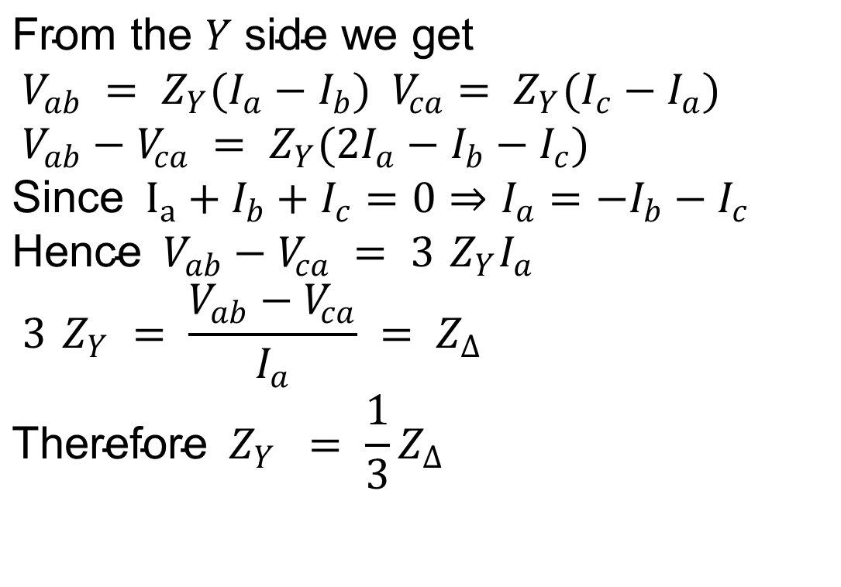
Delta-Wye Transformation, cont’d
$$\text{From} \text{the} Y \text{side} \text{we} \text{get} \\ V_{ab} = Z_{Y}(I_{a}−I_{b}) V_{ca}= Z_{Y}(I_{c}−I_{a}) \\ V_{ab}−V_{ca} = Z_{Y}(2I_{a}−I_{b}−I_{c}) \\ \text{Since} I_{a}+I_{b}+I_{c}=0⇒I_{a}=−I_{b}−I_{c} \\ \text{Hence} V_{ab}−V_{ca} = 3 Z_{Y}I_{a} \\ 3 Z_{Y} = \frac{V_{ab}−V_{ca}}{I_{a}} = Z_{Δ} \\ \text{Therefore} Z_{Y} = \frac{1}{3}Z_{Δ}$$

Slide 34
Per Phase Analysis
Per phase analysis allows analysis of balanced three-phase systems with the same effort as for a single phase system
Balanced Three-Phase Theorem: For a balanced three-phase system with
  All loads and sources Y connected
  No mutual Inductance between phases
Then
  All neutrals are at the same potential
  All phases are completely decoupled
  All system values are the same sequence as sources. The sequence order we’ve been using (phase b lags phase a and phase c lags phase a) is known as “positive” sequence (negative and zero sequence systems are mostly covered in ECEN 459)

Slide 35
Per Phase Analysis Procedure
To do per phase analysis
  Convert all Δ load/sources to equivalent Y’s
  Solve phase “a” independent of the other phases
  Total system power S = 3 Va Ia*
  If desired, phase “b” and “c” values can be determined by inspection (i.e., ±120° degree phase shifts)
  If necessary, go back to original circuit to determine line-line values or internal Δ values.

Slide 36
Per Phase Example
Assume a 3φ, Y-connected generator with Van = 1∠0° volts supplies a Δ-connected load with ZΔ = -jΩ through a transmission line with impedance of j0.1Ω per phase. The load is also connected to a
Δ-connected generator with Va”b” = 1∠0° through a second transmission line which also has an impedance of j0.1Ω per phase.
Find
1. The load voltage Va’b’
2. The total power supplied by each generator, SY and SΔ

Slide 37















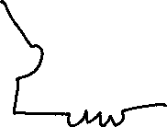



Per Phase Example, cont’d
$$\text{First} \text{convert} \text{the} \text{delta} \text{load} \text{and} \text{source} \text{to} \text{equivalent} \\ \text{Y} \text{values} \text{and} \text{draw} \text{just} \text{the}\text{ "}\text{a}\text{" }\text{phase} \text{circuit}$$

Slide 38

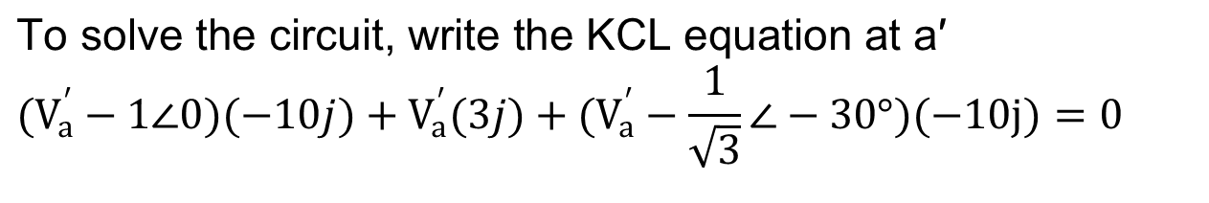

Per Phase Example, cont’d 2
$$\text{To} \text{solve} \text{the} \text{circuit}\text{, }\text{write} \text{the} \text{KCL} \text{equation} \text{at} \text{a}\text{′} \\ (V_{a}^{′}−1∠0)(−10j)+V_{a}^{′}(3j)+(V_{a}^{′}−\frac{1}{\sqrt{3}}∠−30°)(−10j)=0$$

Slide 39
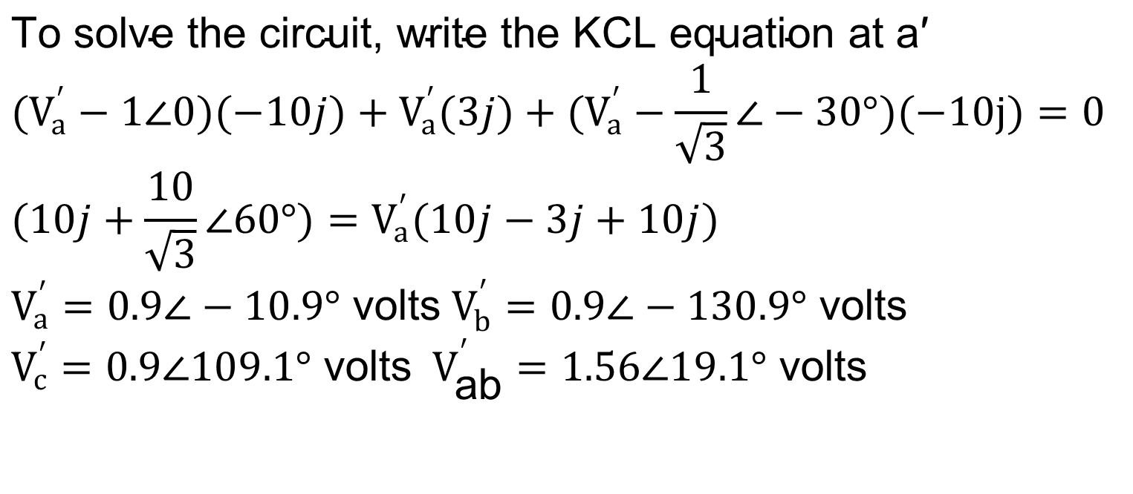
Per Phase Example, cont’d 3
$$\text{To} \text{solve} \text{the} \text{circuit}\text{, }\text{write} \text{the} \text{KCL} \text{equation} \text{at} \text{a}\text{′} \\ (V_{a}^{′}−1∠0)(−10j)+V_{a}^{′}(3j)+(V_{a}^{′}−\frac{1}{\sqrt{3}}∠−30°)(−10j)=0 \\ (10j+\frac{10}{\sqrt{3}}∠60°)=V_{a}^{′}(10j−3j+10j) \\ V_{a}^{′}=0.9∠−10.9° \text{volts} V_{b}^{′}=0.9∠−130.9° \text{volts} \\ V_{c}^{′}=0.9∠109.1° \text{volts} V_{\text{ab}}^{′}=1.56∠19.1° \text{volts}$$

Slide 40
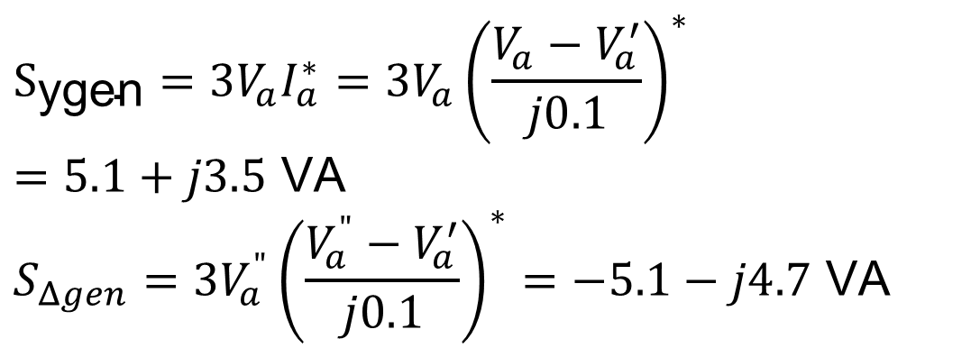
Per Phase Example, cont’d 4
$$S_{\text{ygen}}=3V_{a}I_{a}^{∗}=3V_{a}{\left(\frac{V_{a}−V_{a}^{′}}{j0.1}\right)}^{∗}=5.1+j3.5 \text{VA} \\ S_{Δgen}=3V_{a}^{"}{\left(\frac{V_{a}^{"}−V_{a}^{′}}{j0.1}\right)}^{∗}=−5.1−j4.7 \text{VA}$$

Slide 41
Reminders
Review these topics
  Complex number math – by hand and calculator
  Phasors – representing AC voltage and current
  Impedance – for AC circuit solving
  Complex power – including power factor, reactive power
  Three phase – wye/delta, line-to-line/line-to-neutral voltage, per-phase analysis
Homework #1 and #2 are practice problems on these topics
  Homework #1 due next Tuesday (Jan 20) and Homework #2 due Tuesday Jan 27
Take advantage of the textbook, and office hours (me and TAs)
We’re going to have quizzes most classes to review

Slide 42

Aggie Core Values and Aggie Honor Code
Aggie Core Values
  Respect
  Excellence
  Leadership
  Loyalty
  Integrity
  Selfless Service
Aggie Honor Code: An Aggie does not lie, cheat, or steal, or tolerate those who do.
Reveille and I hope you have a great semester!

