Slide 1
ECEN 616, Spring 2025
Electromagnetic Transients in Power Systems
Class 16: EMT, Control, and Stability
Prof. Adam Birchfield
Dept. of Electrical and Computer Engineering
Texas A&M University
abirchfield@tamu.edu

Slide 2
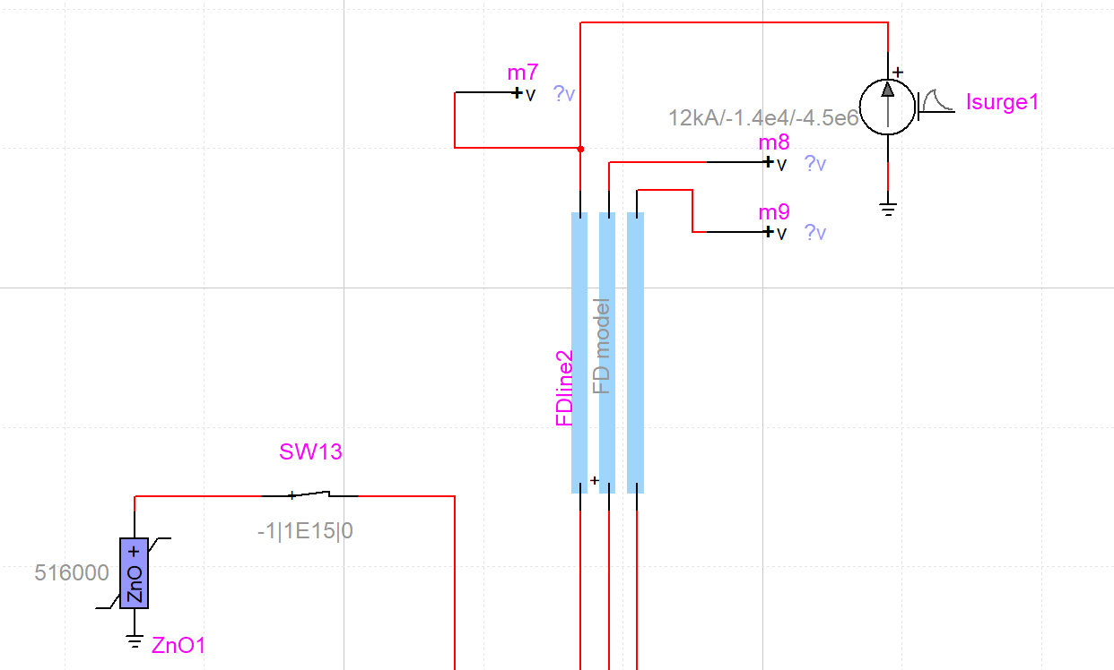
EMTP Example with Lightning and Surge Arrester

Slide 3
Grid Controls
Primarily we are speaking of generator controls
  Synchronous machine exciters
  Synchronous machine turbine-governors
  Synchronous machine stabilizers
  Inverter power-frequency control
  Inverter voltage control
Typically we use block diagrams to explain many of the controls
  Then to put them in simulation we need to convert to equations (first order differential)
u
y

Slide 4
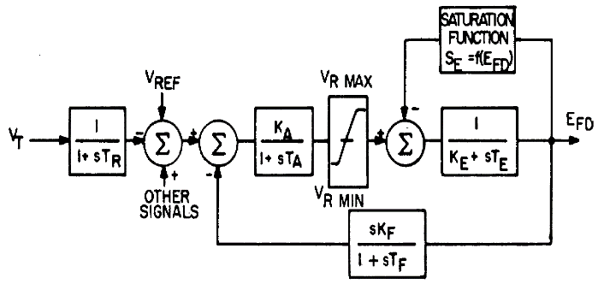
Exciter Example – IEEE T1
Voltage control
With limits
Physical excitation behavior
Voltage measurement
Feedback control

Slide 5
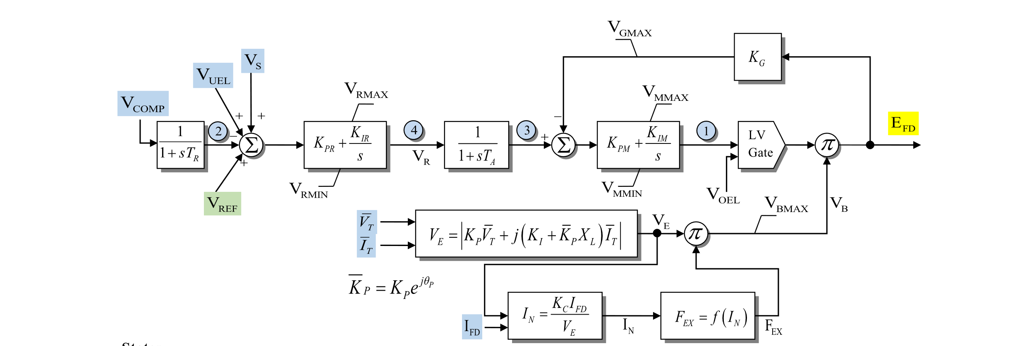
Another Exciter Example – ESST4B

Slide 6
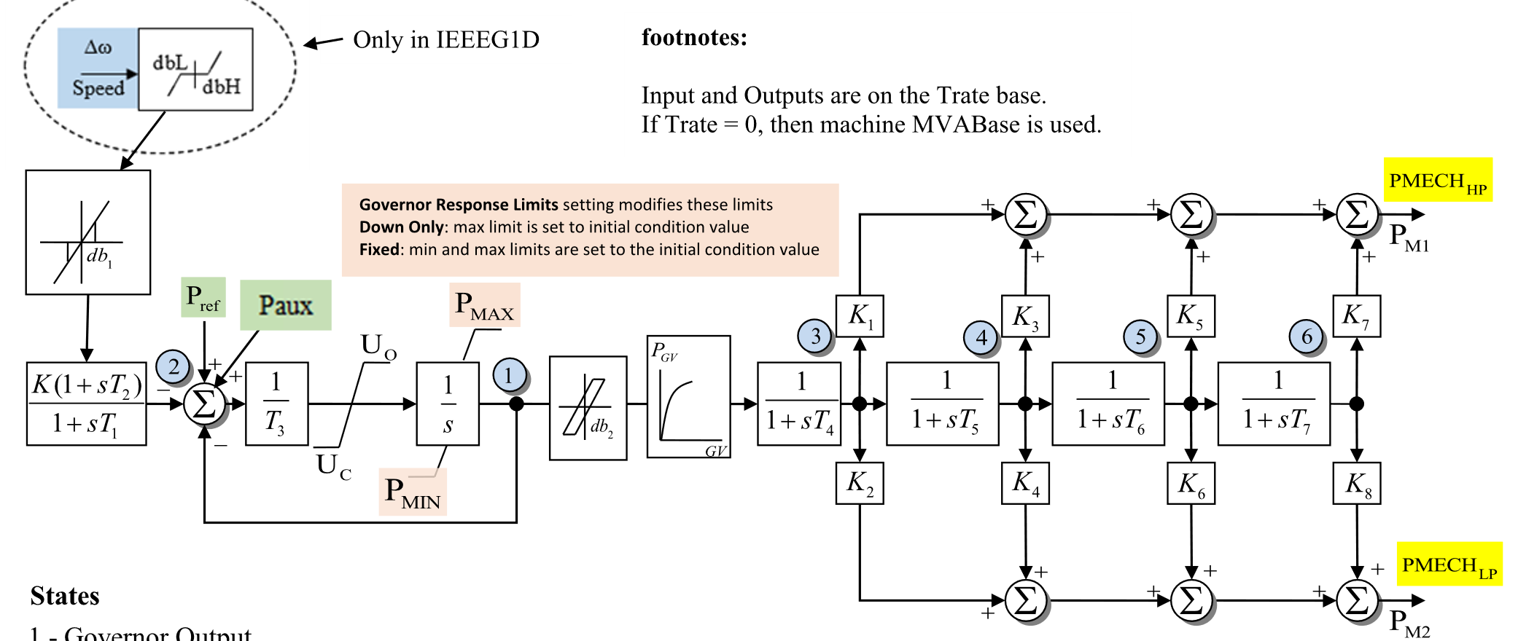
Governor Control – IEEEG1 for Steam Turbines

Slide 7
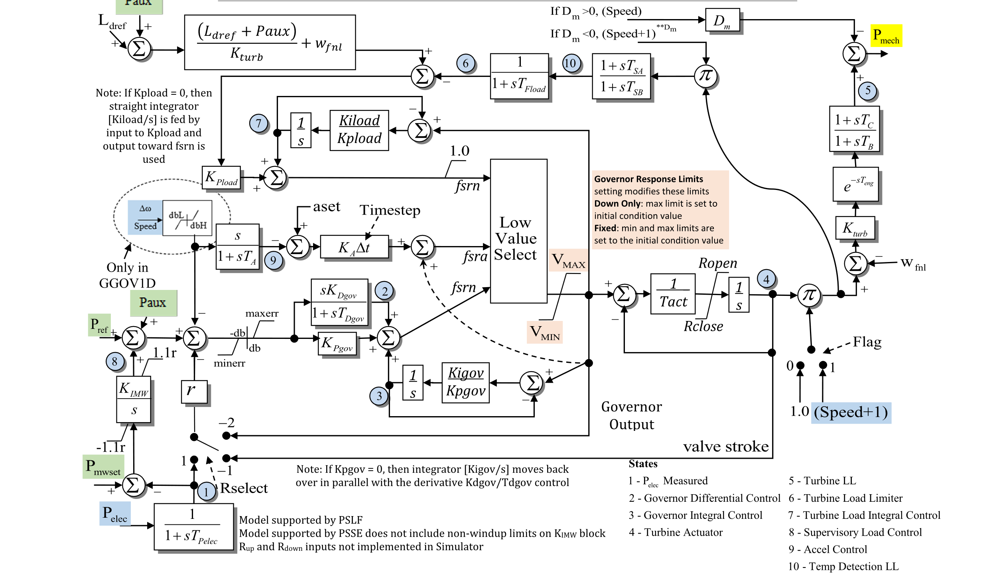
Governor Control – GGOV1 for Gas Turbines

Slide 8
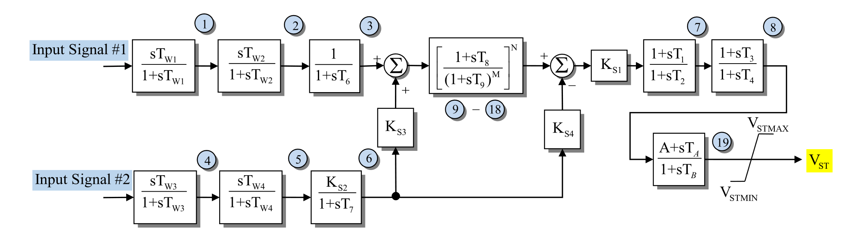
Stabilizers
Common inputs are machine speed, voltage, angle
Output adds to exciter input
Goal is to detect and counteract oscillations

Slide 9
Inverter Controls
Power-frequency control
  Real power must come from the DC side
  There is very little storage in the DC capacitor (compared to synchronous machines)
  Control capabilities depend on what is connected to the DC side
  Main control schemes
    Constant power – produce what is available on the DC side independent of frequency
    Frequency control – either synchronous machine emulation, droop control, or virtual synchronous oscillator
Voltage control
  Reactive power does not interact with DC side
  Capabilities depend on current carrying capacity of components
  Main control schemes: constant power factor (often zero) or voltage control, often via droop control

Slide 10
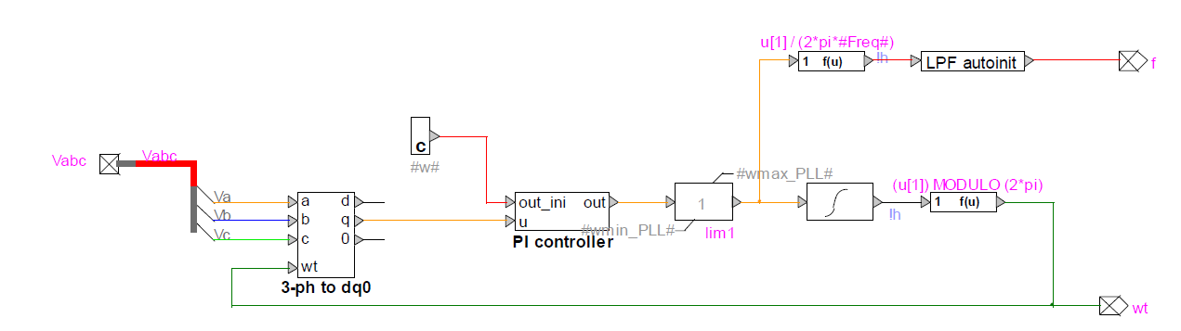
Phase-Locked Loop
One common way to control an inverter which is not contributing to frequency control is to use a phase-locked loop. EMTP diagram:
Find the angle and frequency at which the DQZ transformation gives you Vq=0.
Then control the inverter in this framework to ensure V&I line up with the grid.
Control schemes based on this are often called “grid-following”

Slide 11
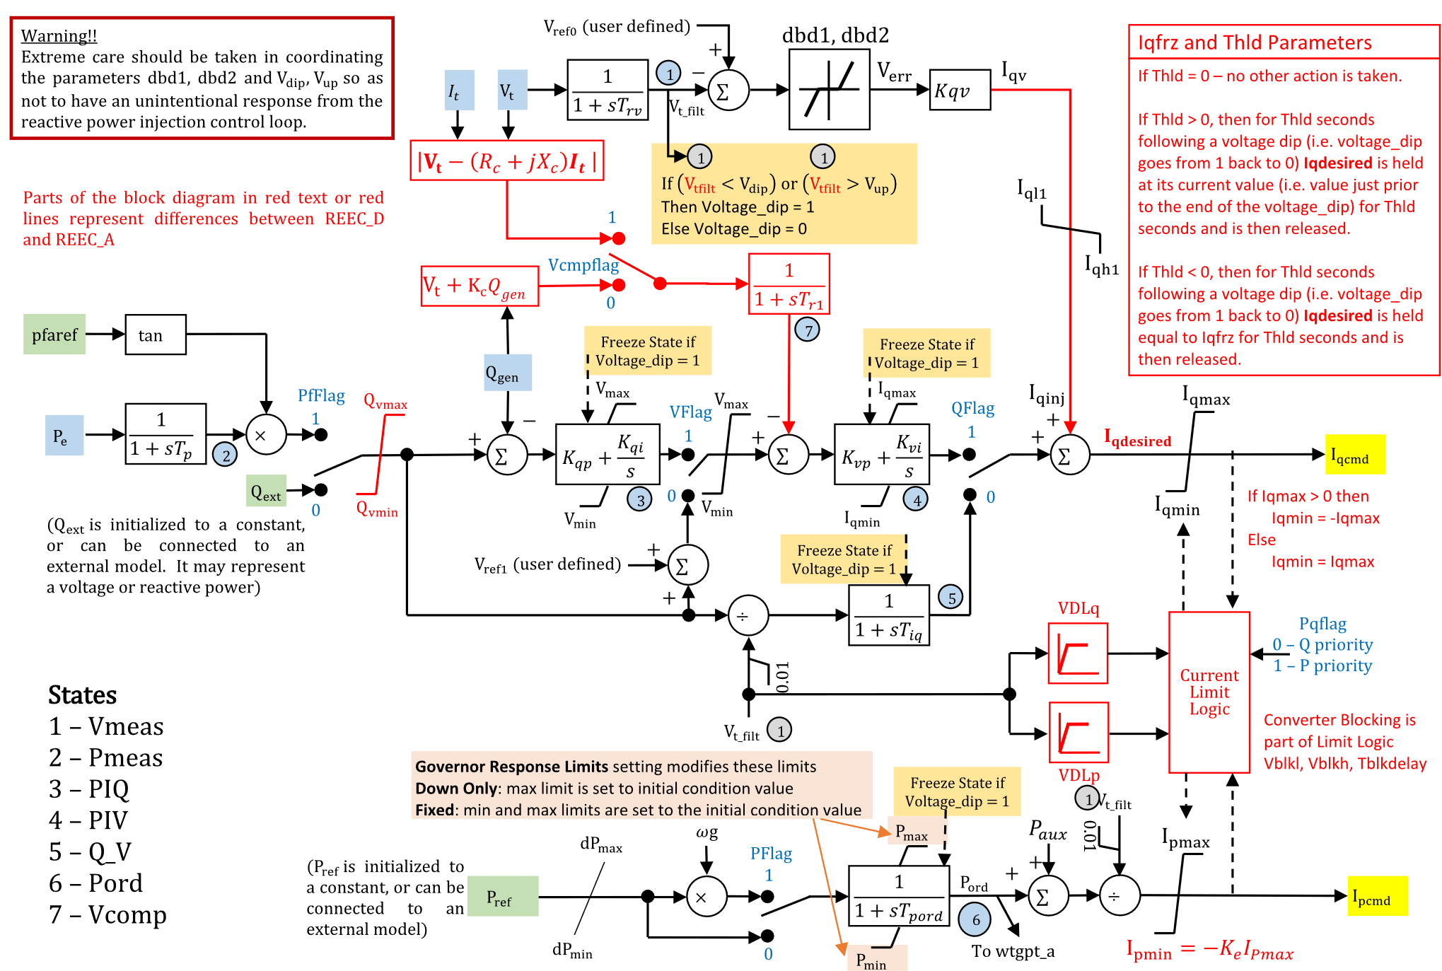
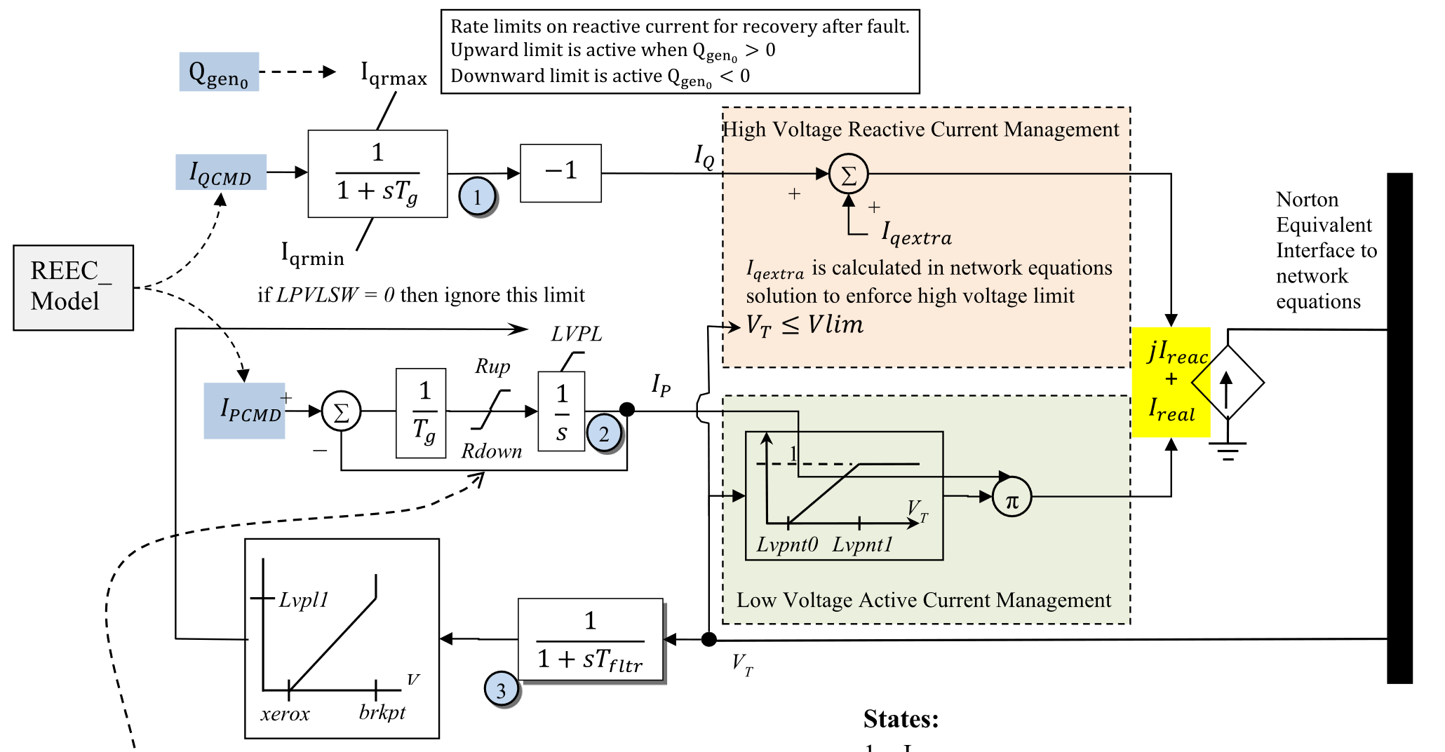
Renewable Energy Electrical Control (REEC)

Slide 12

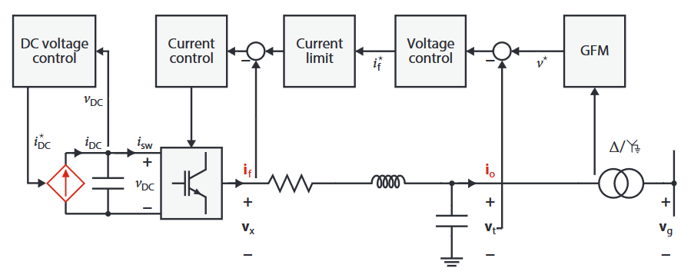

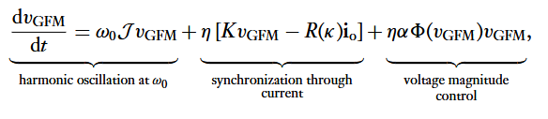
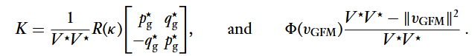
Grid Forming Inverter Control Schemes
Droop Control
Virtual Synchronous Generator
Dispatchable Virtual Harmonic Oscillator
F. Dorfler and D. Gross, “Control of Low-Inertia Power Systems,” Annual Review of Control, Robotics, and Autonomous Systems, 2023.

Slide 13
How To Assess Grid Stability
1. Modeling
  Create the best set of equations to represent the grid’s behavior
  “All models are wrong…”
  The grid is always changing, so the grid models must be always changing
  Varying levels of fidelity
2A. Analytical stability assessment of the model equations
  For example, linearization of the dynamics and eigenvalue analysis
  Could be good for small-signal stability
  Misses things inherent in nonlinearities for large disturbances
2B. Numerical time-domain simulation
  Pick a specific operating point and disturbance and simulate the system response
  Analyze numerical results for good and poor response
  Slow

Slide 14
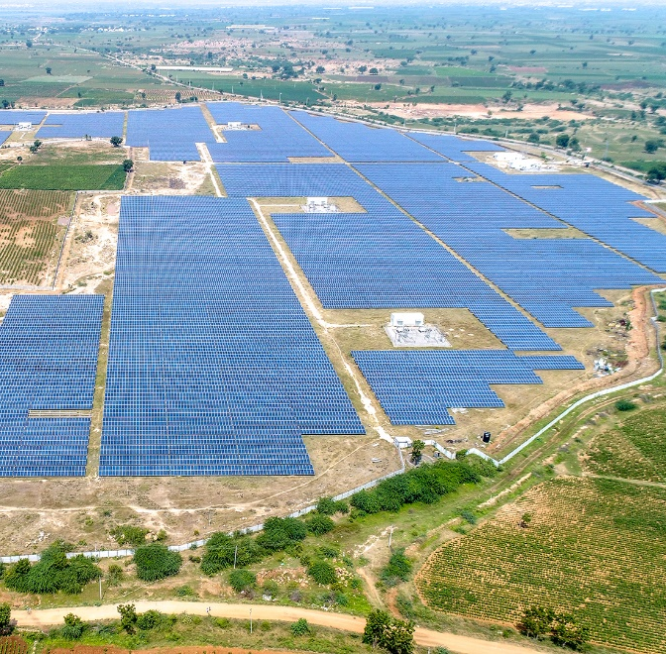
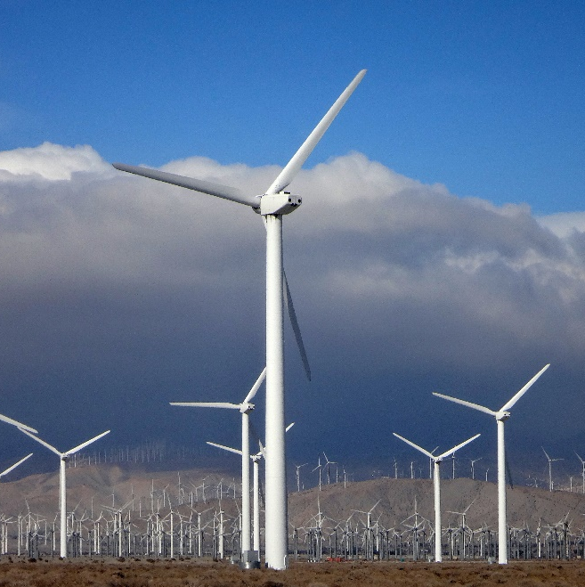
Impact of Wind, Solar, and Batteries
Amount of wind/solar/batteries on the Texas grid is much higher now than even in the last few years
High variability – more variety in base operating conditions
Inverter-connected – challenges intuitions based on synchronous-machine dominated system dynamics
  Faster response
  But without the physical inertia guaranteeing short-term power increases and inherent frequency coherence
Lots of smaller devices acting in aggregate; phenomena of interest are much faster time scales
  Larger, more detailed models are being required
Inverter-based generation is now a major component of the system’s stability characteristics

Slide 15
Summary and Takeaways
On synchronous machines
  Exciters with voltage regulators help control Q and V, which are related
  Turbine-governor systems help control P and omega, which are related
  Stabilizers help damp out unwanted oscillations
  Overall dynamics are slow, with much energy stored in rotating mass
For inverters
  Dynamics are much faster, with very little short-term power availability stored
  Commonly, devices do not contribute to system control and use a phase-locked loop to match the phase of the grid
  “Grid forming” control schemes have several frameworks which can help to contribute to system control and stability

Slide 16
Exam 2
Today is the end of material for Exam 2
Tuesday, Apr. 15th in class
90% - EMT theory from before Spring Break – Similar to Exam 1
  Principles
  Analytical methods
  Numerical methods
  Transmission line and transformer models
10% - Conceptual material from applications since Spring Break
  Sparse matrices
  Lightning
  Machines and inverters
  Control and stability
We will do some more review on Thursday

Slide 17
Semester Project
Use EMTP in the lab in WEB 205W
  Please use the same machine every time
  Lab is closed during the workday Monday, Thursday, Friday
Instructions for project are on the website
  Build EMTP model and run studies as described
  Write maximum 4-page report with figures and submit by email
Due date is Thursday, Apr. 24th at 8am. Early completion is strongly encouraged. To incentivize this there will be a 10 point bonus (up to 100 total points) for submissions before Friday, Apr. 18th at 5pm.
I can come to the lab during office hours today 3-4pm. Just come get me from my office. If I’m not in my office I may be in the lab.

