Slide 1
ECEN 616, Spring 2025
Electromagnetic Transients in Power Systems
Class 15: Active Components
Prof. Adam Birchfield
Dept. of Electrical and Computer Engineering
Texas A&M University
abirchfield@tamu.edu

Slide 2
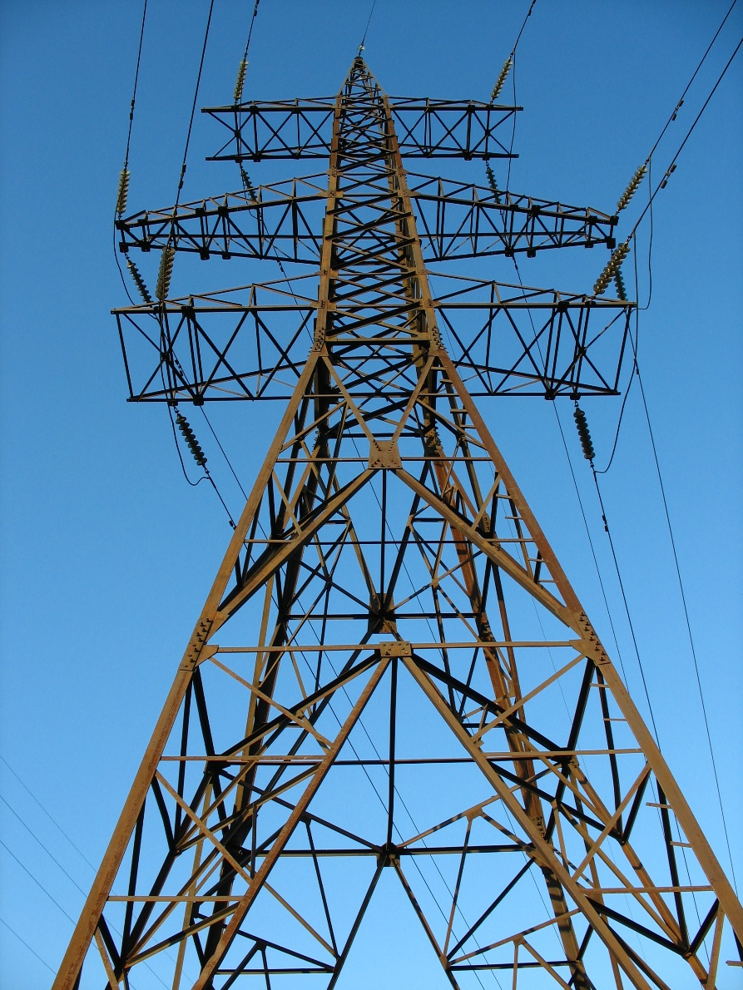
Passive and Active Components
Passive Components
  Resistor
  Inductor
  Capacitor
  Transformer
  Transmission Line
  Surge Arrester
Active Components
  Voltage source
  Current source
  Electric machine
  Power electronic converter
Already considered
More complex

Slide 3
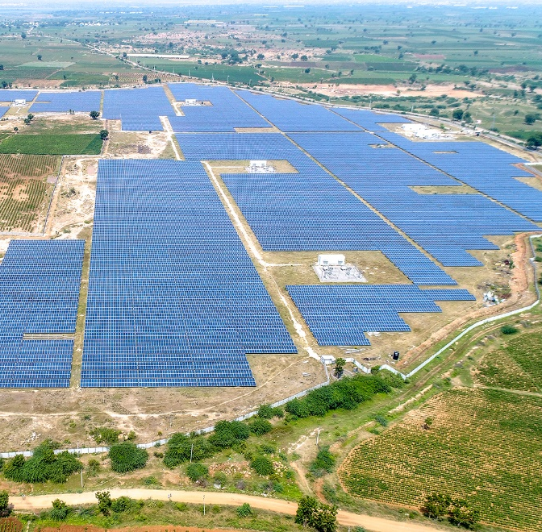
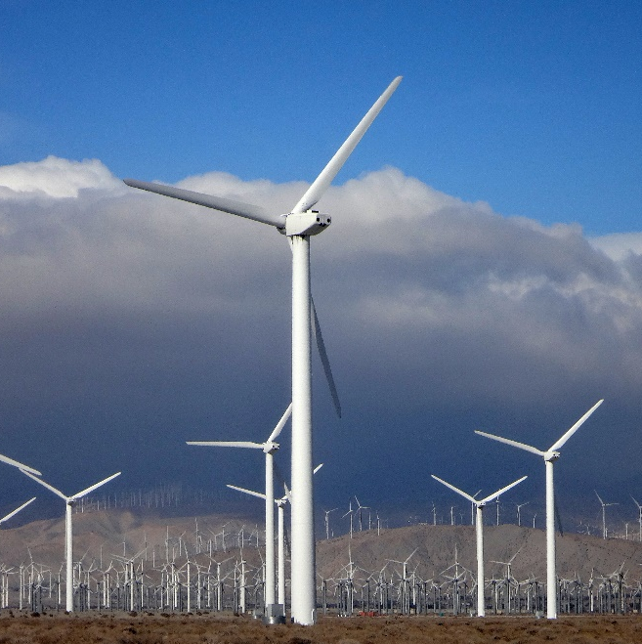
Active Sources of Energy in the Power System
Nuclear
Coal
Natural Gas
  Steam
  Combined Cycle
  Turbine
Hydro
Wind
Solar PV
Batteries
HVDC lines
Two big categories, but each type of generator or component has its own unique characteristics
Synchronous Machines
Inverters

Slide 4
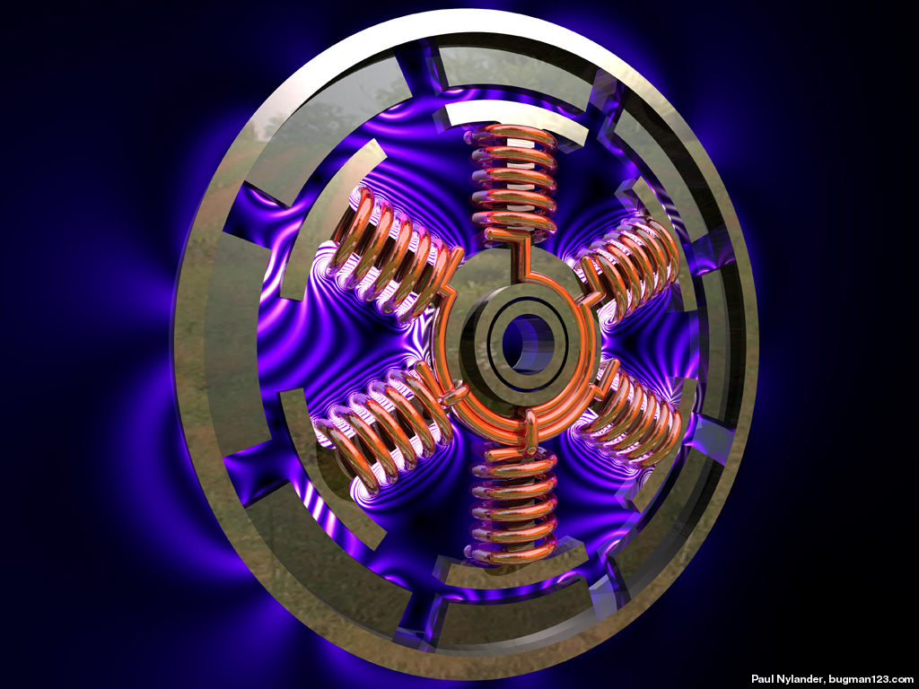
Electric Machines
Machines are used to convert between mechanical and electrical energy (motors and generators)
A much more thorough coverage of electric machine modeling is in other ECEN classes such as 667
Today we’ll hit the highlights and focus on a few issues germane to electromagnetic transient analysis
From presentation by Tcheslavski

Slide 5
The Basics of Electric Machines
Stator – the part that is stationary and does not move
Rotor – the part that rotates (moves)
Armature windings – windings on the “power side” that hook up to the grid
Field or excitation windings – the other windings, connected differently for different types of machines
Direct and quadrature axes – reference frame related to main field winding direction using Park’s transformation
Mechanical speed and angle – physical angular rotation and position of the rotor relative to the stator
Electrical speed and angle – frequency and phase offset of voltages and current sin the armature windings

Slide 6
Types of Machines
Synchronous machine – mechanical speed is equal to the electrical speed in steady-state. Armature windings are usually on the stator, and the rotor windings / field windings are connected to a separate DC excitation source
Induction machine – armature windings are on the stator, with the rotor/field windings short circuited. Power transfer is determined by the difference in mechanical speed or “slip” depending on the torque curve
DC machine – armature windings connected to dc source, usually on the rotor and connected through a commutator that swaps polarity
Doubly-fed induction machine – ac field windings that are externally connected to the grid as well via a back-to-back ac-dc-ac converter

Slide 7
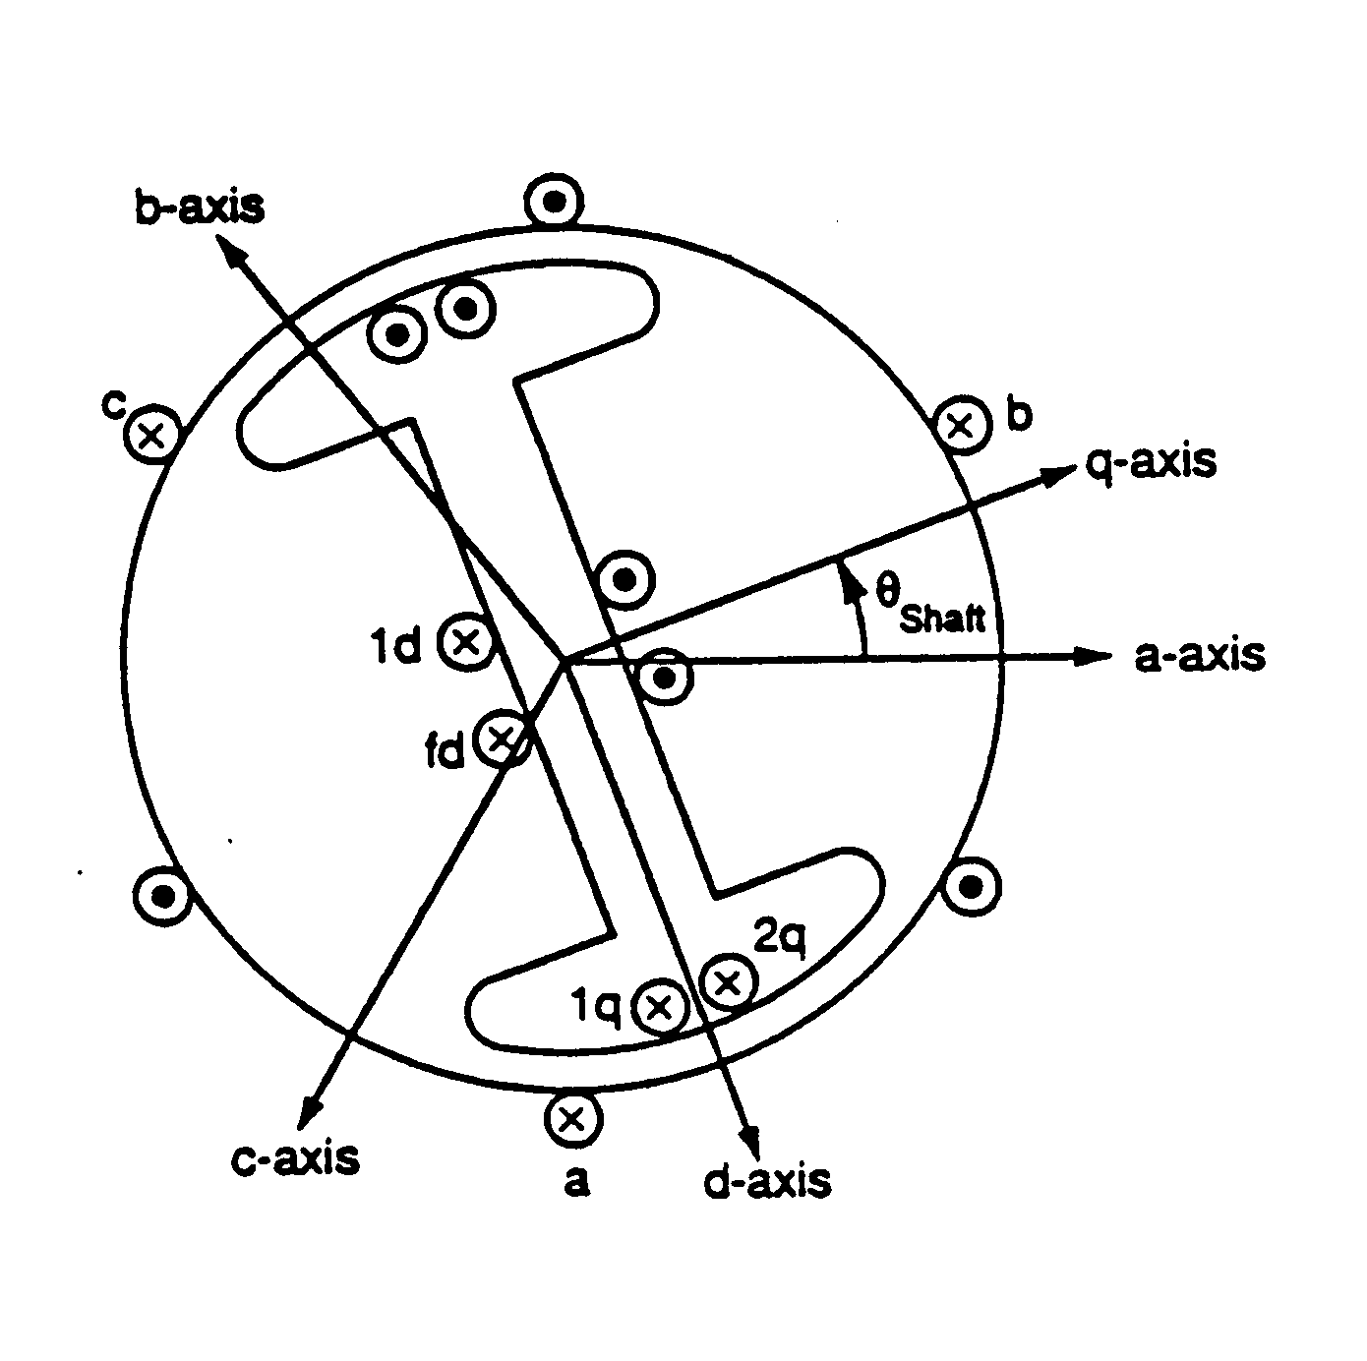
Synchronous Machine Modeling
Vast majority of electric energy is generated with synch. machines
Fundamental relationship between flux (voltage) and currents via inductance matrices

Slide 8
EMTP Modeling of Synchronous Machines
Remember our principles! We can’t make the same power flow assumptions that were made in the derivations of 667 for stability studies
  Not assuming balanced three-phase
  Not assuming stator transients are too fast to consider

Slide 9
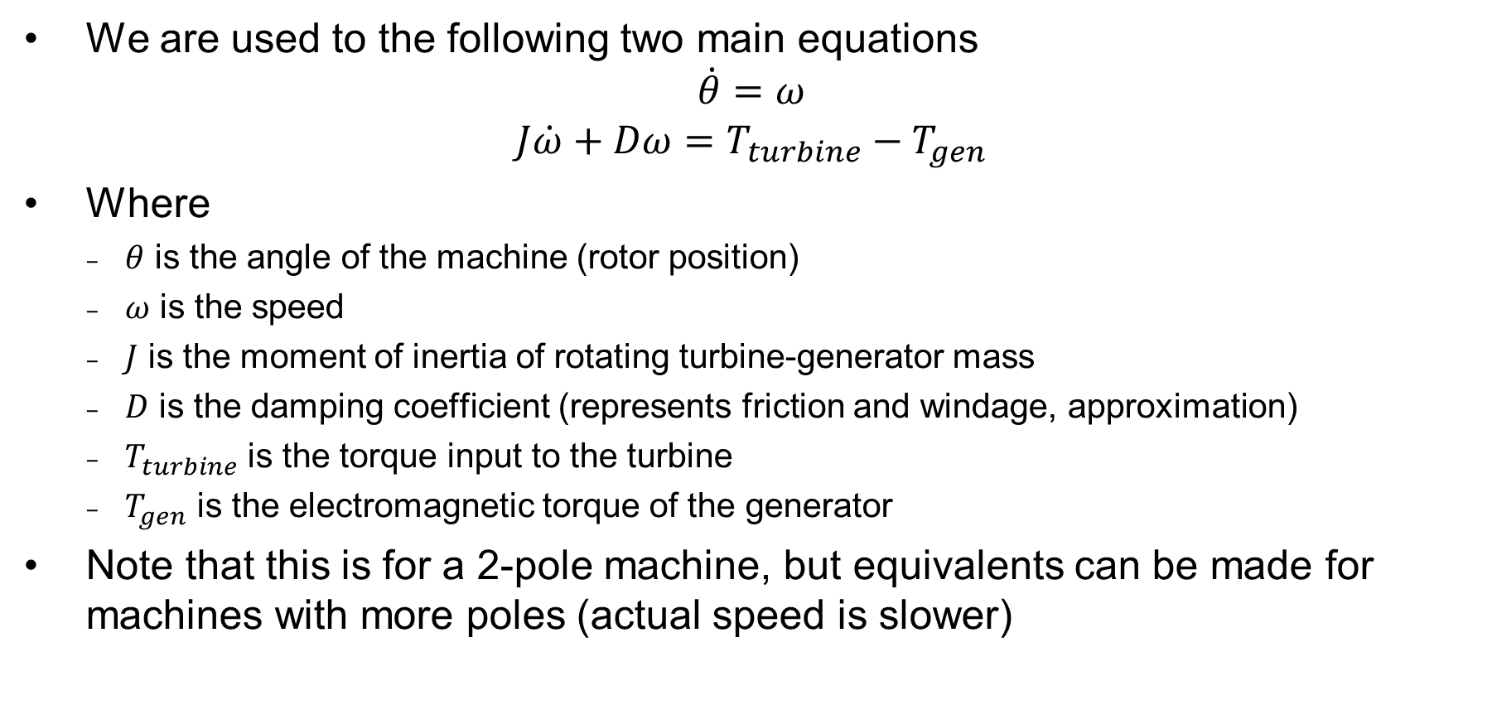
Mechanical Model of Synchronous Machine
We are used to the following two main equations
$$\dot{θ}=ω$$
$$J\dot{ω}+Dω=T_{turbine}−T_{gen}$$
Where
  $θ$ is the angle of the machine (rotor position)
  $ω$ is the speed
  $J$ is the moment of inertia of rotating turbine-generator mass
  $D$ is the damping coefficient (represents friction and windage, approximation)
  $T_{turbine}$ is the torque input to the turbine
  $T_{gen}$ is the electromagnetic torque of the generator
Note that this is for a 2-pole machine, but equivalents can be made for machines with more poles (actual speed is slower)

Slide 10
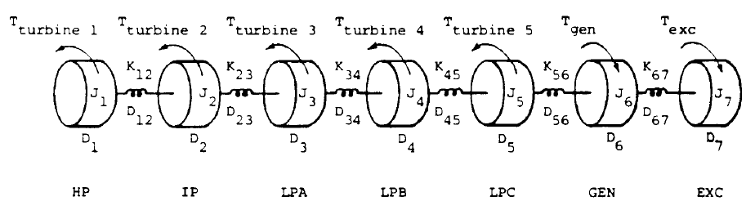

Mechanical Model of Synchronous Machine, cont.
For more advanced studies, torsional vibrations and other details may be important. In that case we can have a multi-mass model. See below for a 7-mass example.
$$J\dot{ω}+Dω+Kθ=T_{turbine}−T_{gen}$$
Now these are matrices and vectors for the torques, speeds, and angles of each mass component. $K$ is the tridiagonal matrix of spring stiffness coefficients.

Slide 11
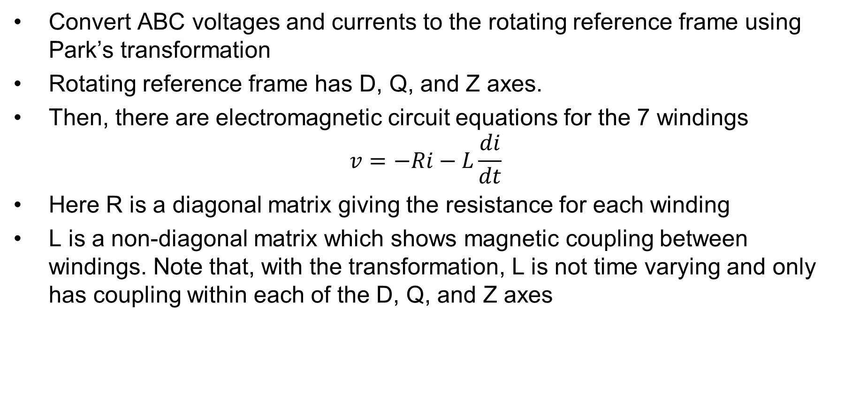
Electrical Modeling of Synchronous Machine
Convert ABC voltages and currents to the rotating reference frame using Park’s transformation
Rotating reference frame has D, Q, and Z axes.
Then, there are electromagnetic circuit equations for the 7 windings
$$v=−Ri−L\frac{di}{dt}$$
Here R is a diagonal matrix giving the resistance for each winding
L is a non-diagonal matrix which shows magnetic coupling between windings. Note that, with the transformation, L is not time varying and only has coupling within each of the D, Q, and Z axes

Slide 12
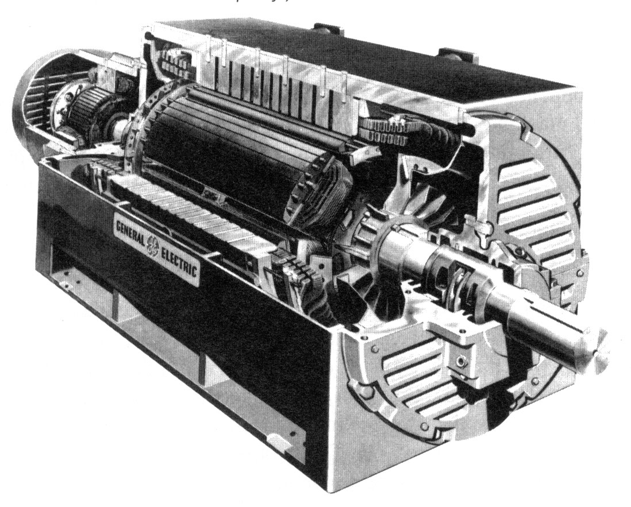
Control Systems for Synchronous Machines
Exciters
Turbine-Governors
Stabilizers

Slide 13
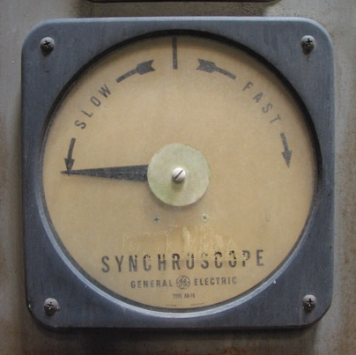
Issues for Transient Analysis in Electrical Machines
Motor / generator starting
  Synchronizing/parallelizing
Surge effects
Controls
Unbalanced faults
Oscillations

Slide 14
Inverters
Inverters act as active components to the electric grid by using switched power electronics to convert a DC power source to AC
Consider a three-wire, three-phase, two-level VSC as below
The “switches” are semiconductor based controlled gates. Many are either Insulated-Gate Bipolar Transistors (IGBT) or Integrated Gate-Commutated Thyristor (IGCT). Control of switching creates AC.
Much more complex configurations exist

Slide 15
Inverter Switching Models
Each switch can be a complex device in itself
  Current conducted in both on and off states
  Switching transients
Simplifying switch assumptions
  Either a short circuit (conducting) or open circuit (blocking)
  Ignore turn-off tailing current and diode reverse recovery current
  Instant state transitions
  In other words, ideal controlled switch
Averaged switching model

