Slide 1
ECEN 616, Spring 2025
Electromagnetic Transients in Power Systems
Class 14: Lightning
Prof. Adam Birchfield
Dept. of Electrical and Computer Engineering
Texas A&M University
abirchfield@tamu.edu

Slide 2
What is the Frequency, Peak Voltage, and Energy Discharge in a Typical Lightning Strike?
1 Hz
10 Hz
100 Hz
1 kHz
10 kHz
100 kHz
1 MHz
10 MHz
100 MHz
1 GHz
10 GHz
100 GHz
1 V
10 V
100 V
1 kV
10 kV
100 kV
1 MV
10 MV
100 MV
1 GV
10 GV
100 GV
1 Wh
10 Wh
100 Wh
1 kWh
10 kWh
100 kWh
1 MWh
10 MWh
100 MWh
1 GWh
10 GWh
100 GWh

Slide 3
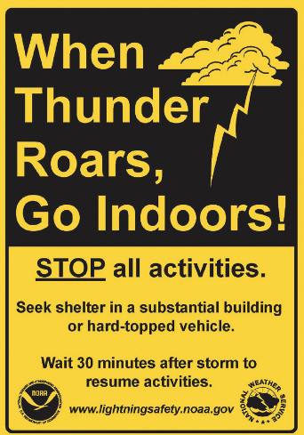
Lightning Safety
Lightning strikes have randomness about them, and can occur as far as 10 miles from rainfall
If you hear thunder or see lightning, get immediately to a safe place, such as inside a fully enclosed building or metal vehicle
If a lightning strike gets onto a metal pipe or wiring system, it can travel long distances, including into buildings
  Stay away from corded electrical equipment, showers, baths, and sinks, during a thunderstorm
  Unplug sensitive electronics or use surge protective devices
What state had the most lightning strikes per square mile in 2024?

Slide 4
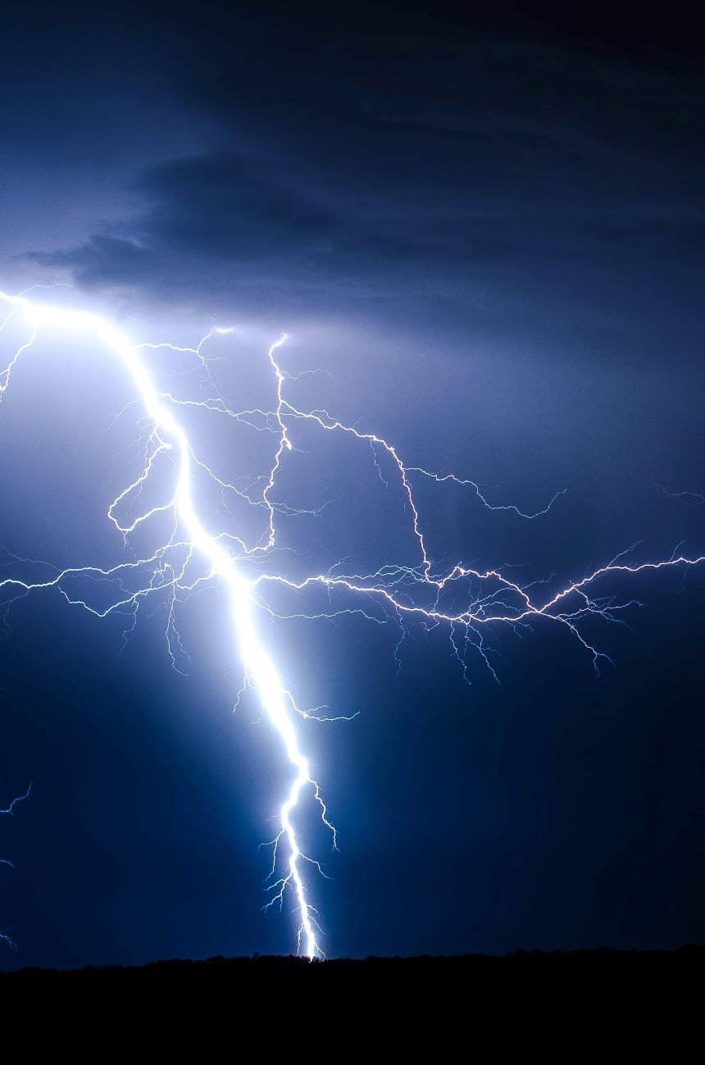
Effect of Lightning on a Power System
Direct lightning stroke to equipment
Direct lightning stroke to phase conductor
Lightning stroke to shield or ground wire
Lightning stroke to transmission tower
  Backflashover if the tower potential gets too high
Lightning stroke to ground in vicinity of phase conductors

Slide 5
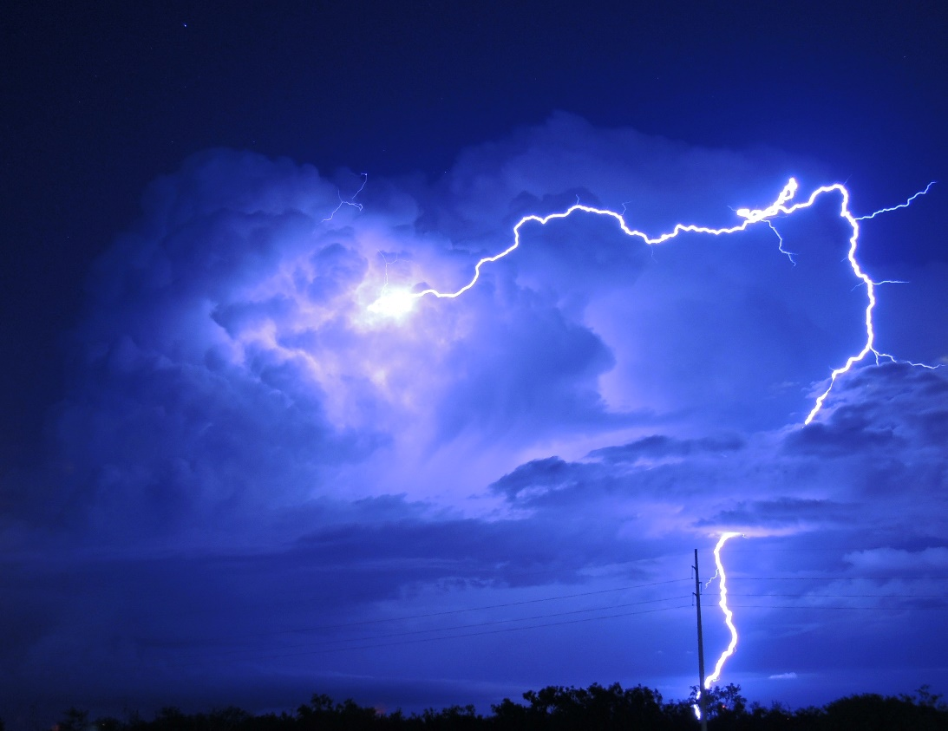
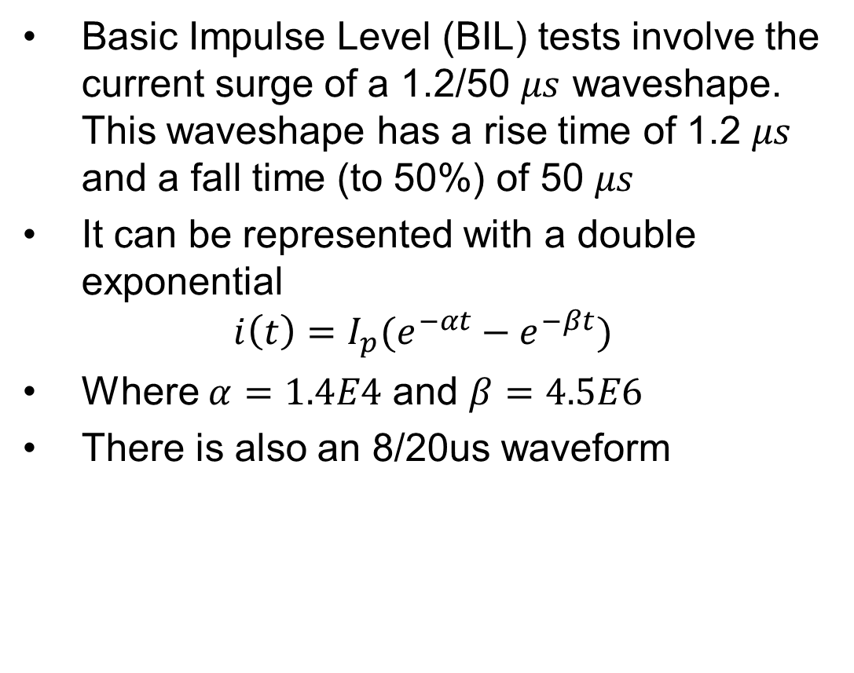
Modeling a Lightning-Induced Surge
Basic Impulse Level (BIL) tests involve the current surge of a 1.2/50 $μs$ waveshape. This waveshape has a rise time of 1.2 $μs$ and a fall time (to 50%) of 50 $μs$
It can be represented with a double exponential
$$i\left(t\right)=I_{p}(e^{−αt}−e^{−βt})$$
Where $α=1.4E4$ and $β=4.5E6$
There is also an 8/20us waveform

Slide 6
Shielding
Shield wires are grounded conductors placed above the phase conductors to reduce the chance of direct strikes to the phase conductors
How many and where to place them is shielding design

Slide 7
Surge Arresters
When an overvoltage surge approaches a surge arrestor, ideally the device should clamp the system voltage to its nominal value, avoiding flashover and damage to equipment
  Including lightning, switching surges, etc.
Technologies
  Rod gap: when voltage exceeds air breakdown voltage, an arc forms
  Silicon carbide
  Medal-oxide
Modeled with nonlinear resistors

Slide 8
Capacitor Switching
Switching caps
Switching multiple caps in a bank
Tripping cap banks
Resonance with distribution
Restrikes and prestrkes
Autoclosing with precharge
Harmonics
Inrush
Switching duty
Three-phase clearing

Slide 9
Overvoltage Limits and Temporary Overvoltages
Equipment has a nominal voltage at which it is designed to operate
Maximum voltage is the highest voltage the equipment is designed to be continuously operated at. Normally this is 5-10% above nominal.
There are different categories of temporary overvoltages depending on the expected timing of the overvoltage
  Fault overvoltages, which may last 10-100 ms, are typically 25-50% above nominal
  Switching overvoltages, lasting only a few ms or less, 2-3 times nominal
  Lightning overvoltages, 3-4 times nominal for a few microseconds (basic impulse level or BIL)
Why else may overvoltages occur? Charging an open line, switching a line terminated by a transformer, load shedding, disconnection of inductances, fault clearance

Slide 10
Closing and Reclosing Transmission Lines
Resonance
Compensation, ferro-resonance
Out-of-phase closing
Impact of trapped charge

Slide 11
Arc Current Interruption
When a breaker opens, there will be an arc of ionized air between the terminals, which must be extinguished to fully open the switch
Current-zero breakers extinguish the arc when the current passes through a zero crossing
Breakers usually take 2-5 cycles to interrupt the current fully

Slide 12
Modeling of System Grounding
Types of grounding
  Solid grounded systems: typical for transmission and often distribution. Easier to detect faults and keeps voltages lower.
  Resistance grounded systems: occasional for industrial or distribution, and in some other countries. Fault current is more limited
    Low-resistance
    High-resistance
  Ungrounded systems
Grounding safety considerations
  Step voltage
  Touch voltage
  Mesh voltage
  Fall of potential outside the grounding grid

