Slide 1
ECEN 616, Spring 2025 Electromagnetic Transients in Power Systems
Class 13: Sparse Matrices
Prof. Adam Birchfield
Dept. of Electrical and Computer Engineering
Texas A&M University
abirchfield@tamu.edu

Slide 2
Linear System Solution: Introduction
A problem that occurs in many is fields is the solution of linear systems Ax = b where A is an n by n matrix with elements a_{ij}, and x and b are n-vectors with elements x_{i} and b_{i} respectively
In power systems we are particularly interested in systems when n is relatively large and A is sparse
How large is large is changing
A matrix is sparse if a large percentage of its elements have zero values
Goal is to understand the computational issues (including complexity) associated with the solution of these systems

Slide 3
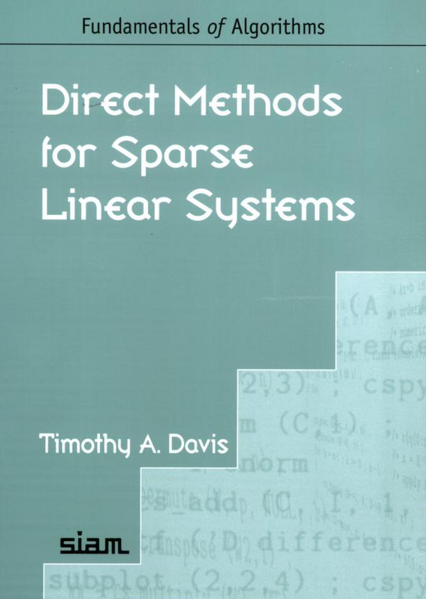
Introduction, cont.
Sparse matrices arise in many areas, and can have domain specific structures
Symmetric matrices
Structurally symmetric matrices
Tridiagnonal matrices
Banded matrices
Today we’ll talk about some specific issues that apply to electromagnetic transients in power systems
Much of the early sparse matrix work was done in power!
Great book on modern methods for solving sparse matrices is by Texas A&M professor Tim Davis

Slide 4
Algorithms for Sparse Matrices
What kinds of actions do we want to do for sparse matrix A?
Input/output
Transpose
Multiplication by scalar, vector
Addition
Matrix multiplication
Permutation (changing order of rows and columns)
Finding the norm
Solving triangular matrix with dense rhs Lx=b
Solving triangular matrix with sparse rhs Lx=b
LU factorization to solve Ax=b
Fill-reducing orderings

Slide 5
Data Structures
How do we represent a sparse matrix on a computer?
Dense matrix (just represent all the entries including the zeros)
List of triplets (row, column, value)
Linked list format (sparse element that points to next in the row or column)
Compressed-column form (or compressed-row) with size m-by-n, nzmax maximum elements
One integer vector p of length n+1, which points to first non-zero element on row
One integer vector i of length nzmax, containing row of each nonzero element
One double vector x of length nzmax, containing value of each nonzero element
What are the advantages and disadvantages of each?
Memory usage
Convenience
Speed of access (think caching)
Ease of modification

Slide 6
Sparse Matrix Computational Order
The computational order of factoring a sparse matrix, or doing a forward/backward substitution depends on the matrix structure
Full matrix is O(n³)
A diagonal matrix is O(n); that is, just invert each element
For power system problems the classic paper is F. L. Alvarado, “Computational complexity in power systems,” IEEE Transactions on Power Apparatus and Systems, May/June 1976
O(n^{1.4}) for factoring, O(n^{1.2}) for forward/backward
For a 100,000 by 100,000 matrix changes computation for factoring from 1 quadrillion to 10 million!

Slide 7
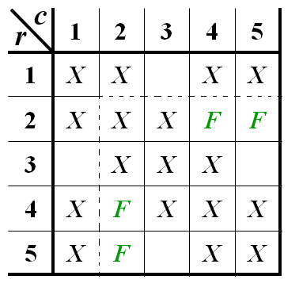
Other Good References
N. Sato, W.F. Tinney, “Techniques for Exploiting the Sparsity of the Network Admittance Matrix,” Power App. and Syst., pp 944-950, December 1963.
F. L. Alvarado, “Computational complexity in power systems,” IEEE Transactions on Power Apparatus and Systems, May/June 1976. Mainly the abstract, tables and figures, conclusion.
http://www.siam.org/meetings/la09/talks/duff.pdf
https://arxiv.org/pdf/2108.06653.pdf

Slide 8
Inverse of a Sparse Matrix
The inverse of a sparse matrix is NOT in general a sparse matrix
We never (or at least very, very, very seldom) explicitly invert a sparse matrix
Individual columns of the inverse of a sparse matrix can be obtained by solving x = A-1b with b set to all zeros except for a single nonzero in the position of the desired column
If a few desired elements of A-1 are desired (such as the diagonal values) they can usually be computed quite efficiently using sparse vector methods (a topic we’ll be considering soon)
We can’t invert a singular matrix (with sparse or not)

Slide 9
Fills
When doing a factorization of a sparse matrix some values that were originally zero can become nonzero during the factorization process
These new values are called “fills” (some call them fill-ins)
For a structurally symmetric matrix the fill occurs for both the element and its transpose value (i.e., Aij and Aji)
How many fills are required depends on how the matrix is ordered
For a power system case this depends on the bus ordering

Slide 10
Fills
There are two key issues associated with fills
Adding the fills
Ordering the matrix elements (buses in our case) to reduce the number of fills
The amount of computation required to factor a sparse matrix depends upon the number of nonzeros in the original matrix, and the number of fills added
How the matrix is ordered can have a dramatic impact on the number of fills, and hence the required computation
Usually a matrix cannot be ordered to totally eliminate fills

Slide 11
Example: 7 by 7 Matrix Structure
 | 1 | 2 | 3 | 4 | 5 | 6 | 7
1 | X | X | X | X | X | X
2 | X | X | X |  |  | X | X
3 | X | X | X |  |  | X | X
4 | X |  |  | X | X
5 | X |  |  | X | X | X
6 | X | X | X |  | X | X
7 |  | X | X |  |  |  | X
 | 1 | 2 | 3 | 4 | 5 | 6 | 7
1 | X | X | X | X | X | X
2 | X | X | X | F | F | X | X
3 | X | X | X | F | F | X | X
4 | X | F | F | X | X | F | F
5 | X | F | F | X | X | X | F
6 | X | X | X | F | X | X | F
7 |  | X | X | F | F | F | X
(a) The original zero-nonzero structure
(b) The post- elimination zero nonzero pattern

Slide 12
Example: 7 by 7 Matrix Reordered Structure
c
c
 | 4 | 5 | 1 | 6 | 7 | 3 | 2
4 | X | X | X
5 | X | X | X | X
1 | X | X | X | X |  | X | X
6 |  | X | X | X |  | X | X
7 |  |  |  |  | X | X | X
3 |  |  | X | X | X | X | X
2 |  |  | X | X | X | X | X
 | 4 | 5 | 1 | 6 | 7 | 3 | 2
4 | X | X | X
5 | X | X | X | X
1 | X | X | X | X |  | X | X
6 |  | X | X | X |  | X | X
7 |  |  |  |  | X | X | X
3 |  |  | X | X | X | X | X
2 |  |  | X | X | X | X | X
r
r
( c) The reordered system
(d) The post- elimination reordered system

Slide 13
Sparse Matrix Reordering
There is no computationally efficient way to optimally reorder a sparse matrix; however there are very efficient algorithms to greatly reduce the fills
Two steps here: 1) order the matrix, 2) add fills
A quite common algorithm combines ordering the matrix with adding the fills
The two methods discussed here were presented in the 1963 paper by Sato and Tinney from BPA; known as Tinney Scheme 1 and Tinney Scheme 2 since they are more explicitly described in Tinney’s 1967 paper

Slide 14
Tinney Scheme 1
Easy to describe, but not really used since the number of fills, while reduced, is still quite high
In graph theory the degree (or valence or valency) of a vertex is the number of edges incident to the vertex
Order the nodes (buses) by the number of incident branches (i.e., its valence) those with the lowest valence are ordered first
Nodes with just one incident line result in no new fills
Obviously in a large system many nodes will have the same number of incident branches; ties can be handled arbitrarily

Slide 15
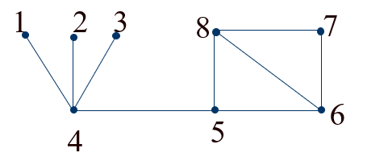
Tinney Scheme 1, Cont.
Once the nodes are reordered, the fills are added
Common approach to ties is to take the lower numbered node first
A shortcoming of this method is as the fills are added the valence of the adjacent nodes changes
Tinney 1 order is 1,2,3,7,5,6,8,4
Number of new branches is 2 (4-8, 4-6)

Slide 16
Tinney Scheme 2
The Tinney Scheme 2 usually combines adding the fills with the ordering in order to update the valence on-the-fly as the fills are added
As before the nodes are chosen based on their valence, but now the valence is the actual valence they have with the added lines (fills)
This is also known as the Minimum Degree Algorithm (MDA)
Ties are again broken using the lowest node number
This method is quite effective for power systems, and is highly recommended; however it is certainly not guaranteed to result in the fewest fills (i.e. not optimal)

Slide 17
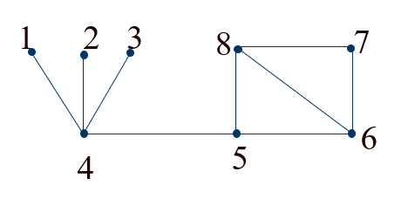
Tinney Scheme 2 Example
Consider the previous network:
Nodes 1,2,3 are chosen as before. But once these nodes are eliminated the valence of 4 is 1, so it is chosen next. Then 5 (with a new valence of 2 tied with 7), followed by 6 (new valence of 2), 7 then 8.

Slide 18
Some Example Values for Tinney 2
Number of buses | Nonzeros before fills | Fills | Total nonzeros | Percent nonzeros
37 | 63 | 72 | 135 | 9.86%
118 | 478 | 168 | 646 | 4.64%
18,190 | 64,948 | 31,478 | 96,426 | 0.029%
62,605 | 228,513 | 201,546 | 430,059 | 0.011%

Slide 19
Example Algorithm: Left-looking LU Factorization
Computing L and U one column at a time. In below matrix, middle column and row are row k that is currently being computed:
$$\left[\begin{matrix}L_{11} & & \\ ℓ_{21} & 1 & \\ L_{31} & ℓ_{32} & L_{33}\end{matrix}\right]\left[\begin{matrix}U_{11} & u_{12} & U_{13} \\ & u_{22} & u_{23} \\ & & U_{33}\end{matrix}\right]=\left[\begin{matrix}A_{11} & a_{12} & A_{13} \\ a_{21} & a_{22} & a_{23} \\ A_{31} & a_{32} & A_{33}\end{matrix}\right]$$
Assume all of A is known, and we have already computed left columns of LU
Then we can solve for $L_{11}u_{12}=a_{12}$, $ℓ_{21}u_{12}+u_{22}=a_{22}$, and $L_{31}u_{21}+ℓ_{32}u_{22}=a_{32}$
Or equivalently, solve the sparse triangular system:
$$\left[\begin{matrix}L_{11} & & \\ ℓ_{21} & 1 & \\ L_{31} & 0 & I\end{matrix}\right]\left[\begin{matrix}x_{1} \\ x_{2} \\ x_{3}\end{matrix}\right]=\left[\begin{matrix}a_{12} \\ a_{22} \\ a_{32}\end{matrix}\right]$$
Then set $u_{12}=x_{1}$, $u_{22}=x_{2}$, and $ℓ_{32}=x_{3}/u_{22}$

Slide 20
How to Use SuiteSparse in Your Code
https://people.engr.tamu.edu/davis/suitesparse.html
KLU is the part that is most applicable to power system problems
Pay attention to licensing requirements
Written in C for broad access and compilation options
Matlab sparse matrix software already uses SuiteSparse

