Slide 1
Summary of Class So Far
Principles of Electromagnetic Transient Analysis
Numerical Methods – Euler, Backw. Euler, Trap., RK2, Adams-Bashforth
Systematic numerical solutions with the companion circuit model, including how to model L and C with Norton equivalents
Analytical solutions – Laplace method, finding resonant frequency, simplification techniques
Transmission line modeling: Telegrapher’s equations, basic Bergeron model, lossy Bergeron, multi-conductor modal analysis, frequency dependence
Transformer models

Slide 2
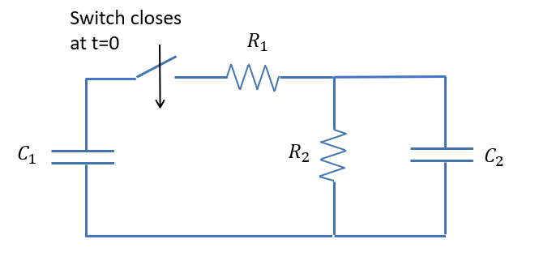
Example 9: Impulse Generator
$R_{1}=10 Ω, R_{2}=100 Ω$
$C_{1}=2 μF, C_{2}=0.05 μF$
At $t=0,$ $C_{1}$ is charged to 500 kV, and then the switch closes. Find $v_{2}(t)$, the voltage across $C_{2}$.
Analytically
and Numerically, using the companion circuit model with $Δt=10ns$

Slide 3
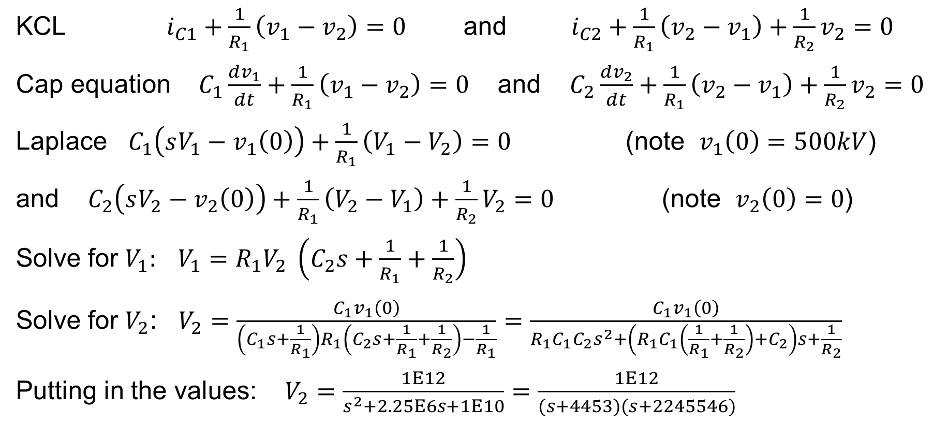
Analytical Solution
KCL $i_{C1}+\frac{1}{R_{1}}\left(v_{1}−v_{2}\right)=0$ and $i_{C2}+\frac{1}{R_{1}}\left(v_{2}−v_{1}\right)+\frac{1}{R_{2}}v_{2}=0$
Cap equation $C_{1}\frac{dv_{1}}{dt}+\frac{1}{R_{1}}\left(v_{1}−v_{2}\right)=0$ and $C_{2}\frac{dv_{2}}{dt}+\frac{1}{R_{1}}\left(v_{2}−v_{1}\right)+\frac{1}{R_{2}}v_{2}=0$
Laplace $C_{1}\left(sV_{1}−v_{1}\left(0\right)\right)+\frac{1}{R_{1}}\left(V_{1}−V_{2}\right)=0$ (note $v_{1}\left(0\right)=500kV$)
and $C_{2}\left(sV_{2}−v_{2}\left(0\right)\right)+\frac{1}{R_{1}}\left(V_{2}−V_{1}\right)+\frac{1}{R_{2}}V_{2}=0$ (note $v_{2}\left(0\right)=0$)
Solve for $V_{1}:$ $V_{1}=R_{1}V_{2} \left(C_{2}s+\frac{1}{R_{1}}+\frac{1}{R_{2}}\right)$
Solve for $V_{2}$: $V_{2}=\frac{C_{1}v_{1}\left(0\right)}{\left(C_{1}s+\frac{1}{R_{1}}\right)R_{1}\left(C_{2}s+\frac{1}{R_{1}}+\frac{1}{R_{2}}\right)−\frac{1}{R_{1}}}=\frac{C_{1}v_{1}\left(0\right)}{R_{1}C_{1}C_{2}s^{2}+\left(R_{1}C_{1}\left(\frac{1}{R_{1}}+\frac{1}{R_{2}}\right)+C_{2}\right)s+\frac{1}{R_{2}}}$
Putting in the values: $V_{2}=\frac{1E12}{s^{2}+2.25E6s+1E10}=\frac{1E12}{(s+4453)(s+2245546)}$

Slide 4
Analytical Solution, Continued
Factor the quadratic in the denominator to get it in a form on our Laplace table
$V_{2}(s)=\frac{1E12}{s^{2}+2.25E6s+1E10}=\frac{1E12}{(s+4453)(s+2245546)}$
Convert to time domain with Laplace table
$v_{2}\left(t\right)=\frac{1E12}{2245546−4453}\left(e^{−4453t}−e^{−2245546t}\right)$ [Volts]

Slide 5
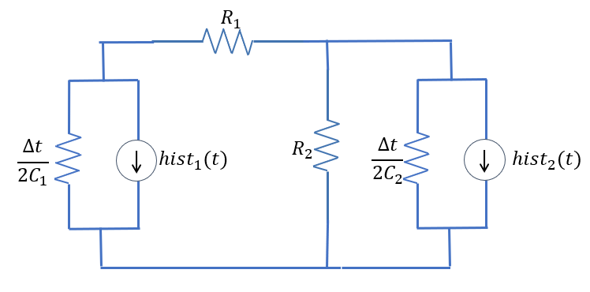
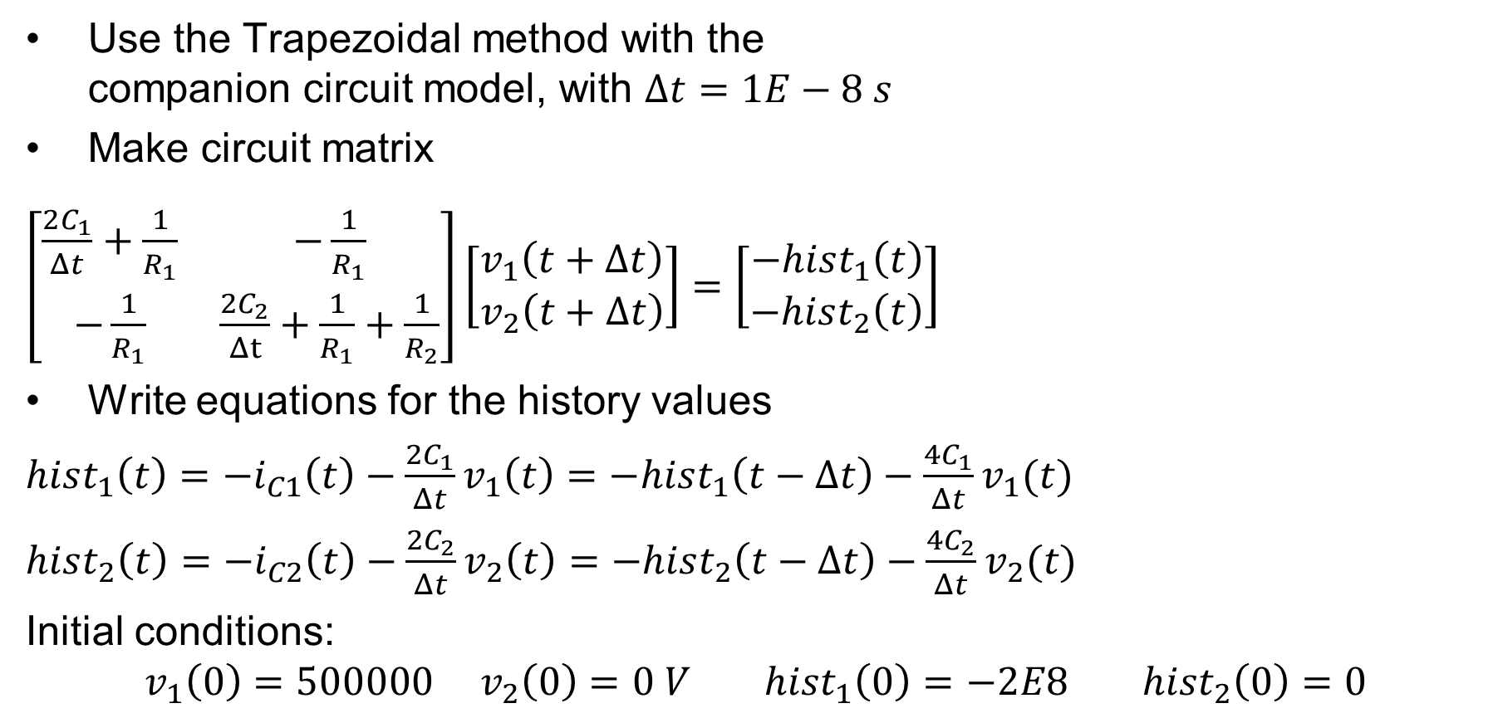
Numerical Solution
Use the Trapezoidal method with the companion circuit model, with $Δt=1E−8 s$
Make circuit matrix
$\left[\begin{matrix}\frac{2C_{1}}{Δt}+\frac{1}{R_{1}} & −\frac{1}{R_{1}} \\ −\frac{1}{R_{1}} & \frac{2C_{2}}{Δt}+\frac{1}{R_{1}}+\frac{1}{R_{2}}\end{matrix}\right]\left[\begin{matrix}v_{1}\left(t+Δt\right) \\ v_{2}\left(t+Δt\right)\end{matrix}\right]=\left[\begin{matrix}−hist_{1}\left(t\right) \\ −hist_{2}\left(t\right)\end{matrix}\right]$
Write equations for the history values
$hist_{1}\left(t\right)=−i_{C1}\left(t\right)−\frac{2C_{1}}{Δt}v_{1}\left(t\right)=−hist_{1}\left(t−Δt\right)−\frac{4C_{1}}{Δt}v_{1}(t)$
$hist_{2}\left(t\right)=−i_{C2}\left(t\right)−\frac{2C_{2}}{Δt}v_{2}\left(t\right)=−hist_{2}\left(t−Δt\right)−\frac{4C_{2}}{Δt}v_{2}(t)$
Initial conditions:
$$v_{1}\left(0\right)=500000 v_{2}\left(0\right)=0 V hist_{1}\left(0\right)=−2E8 hist_{2}\left(0\right)=0$$

Slide 6
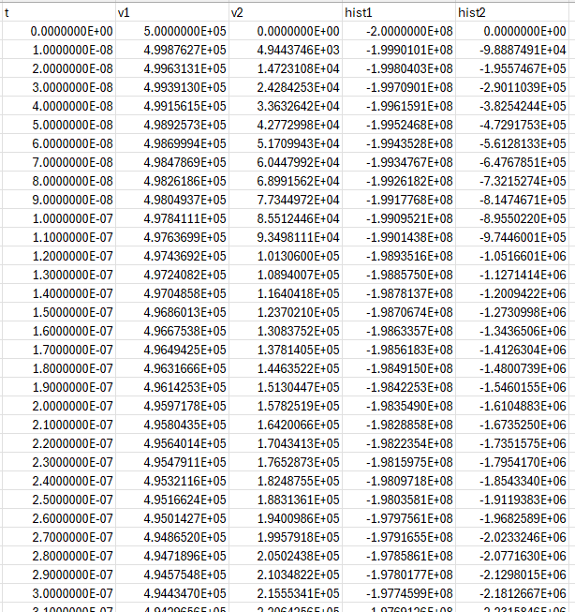
Numerical Solution, Cont.

Slide 7
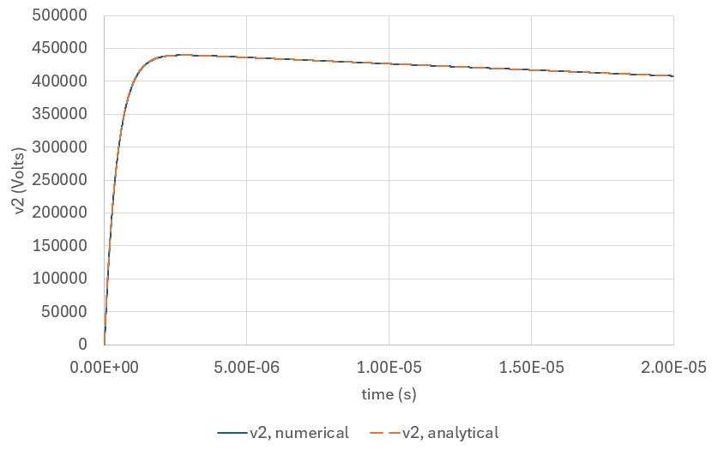
Plotting the Results
Excellent match!
This is a “pulse generator”
circuit.

