Slide 1
ECEN 616, Spring 2025
Methods of Electric Power System Analysis
Class 9: Transmission Lines, Part 2
Prof. Adam Birchfield
Dept. of Electrical and Computer Engineering
Texas A&M University
abirchfield@tamu.edu

Slide 2
Homework
Example 1 – Solve using analytical methods and numerical methods (Forward Euler, 2nd order Runge-Kutta, trapezoidal with companion circuit approach)
Read Dommel chapters 1-3, the Noda 2009 paper, Greenwood Chapter 5 (and reference Ch. 1-4)
By Feb. 20th, solve examples 2-7 analytically.
Read these two papers by Feb. 20th:
  J. R. Marti, "Accurate Modelling of Frequency-Dependent Transmission Lines in Electromagnetic Transient Simulations," in IEEE Transactions on Power Apparatus and Systems, vol. PAS-101, no. 1, pp. 147-157, Jan. 1982.
  A. Morched, B. Gustavsen and M. Tartibi, "A universal model for accurate calculation of electromagnetic transients on overhead lines and underground cables," in IEEE Transactions on Power Delivery, vol. 14, no. 3, pp. 1032-1038, July 1999.

Slide 3



















Transmission Lines: Differential Section
Consider a two-terminal transmission line of length $ℓ$. Refer to the “sending end” as $k$ and the “receiving end” as $m$. We’re interested in the sending and receiving end voltage and current, $v_{k}\left(t\right), i_{k}\left(t\right), v_{m}\left(t\right),$and$i_{m}(t)$
After boundary conditions are considered we get an exact solution
$$I_{k}=\frac{V_{k}}{Z_{c}}−\left(\frac{V_{m}}{Z_{c}}+I_{m}\right) e^{−γℓ}$$
$$I_{m}=\frac{V_{m}}{Z_{c}}−\left(\frac{V_{k}}{Z_{c}}+I_{k}\right) e^{−γℓ}$$
$$ℓ$$
$$i\left(t, 0\right)=i_{k}(t)$$
$$−i\left(t, ℓ\right)=i_{m}(t)$$
$$+$$
$$+$$
$$v\left(t, 0\right)=v_{k}(t)$$
$$v\left(t, ℓ\right)=v_{m}(t)$$
$$−$$
$$−$$
$$i(t, x)$$
$$R′$$
$$L′$$
$$i(t, x+Δx)$$
$$+$$
$$+$$
$$v(t, x)$$
$$C′$$
$$G′$$
$$v(t, x+Δx)$$
$$−$$
$$−$$
$$Δx$$

Slide 4
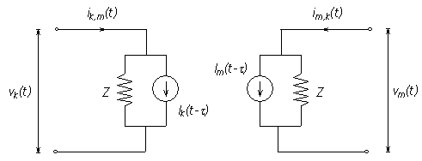
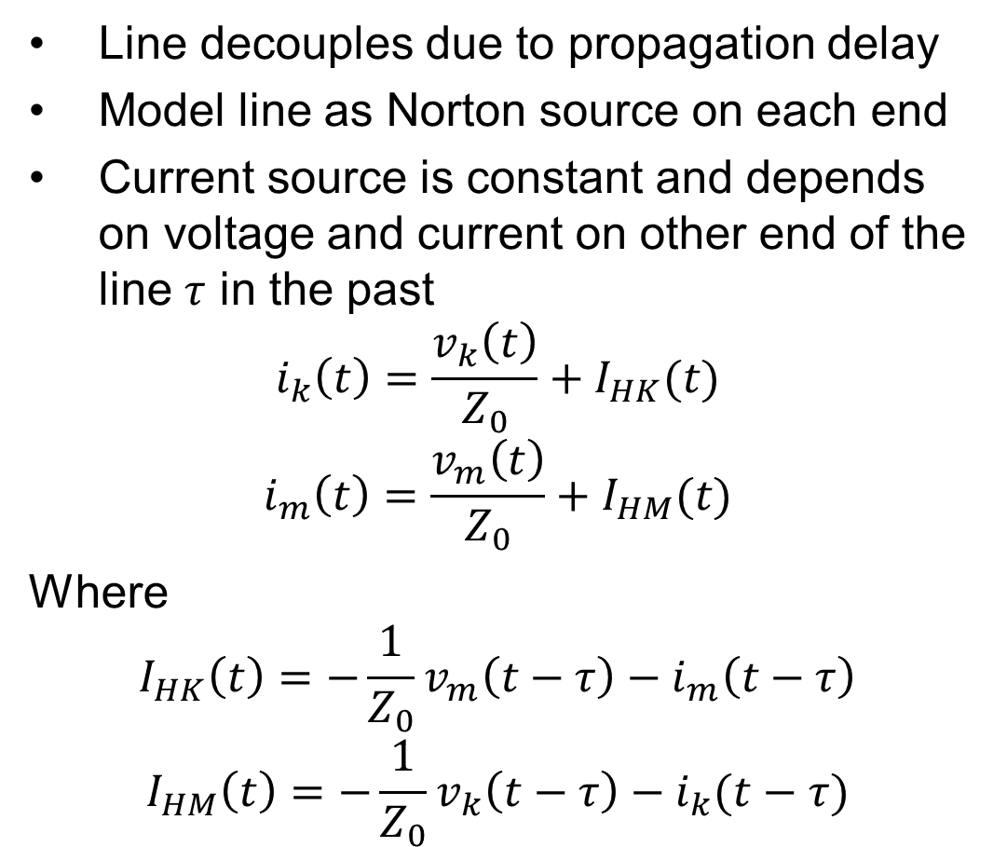
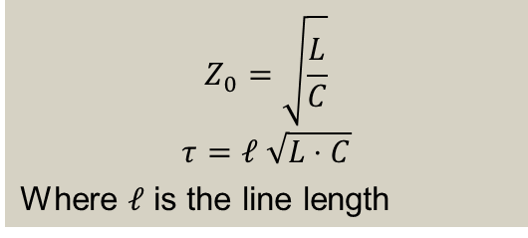
Recall, Bergeron Model (lossless, single-phase)
Line decouples due to propagation delay
Model line as Norton source on each end
Current source is constant and depends on voltage and current on other end of the line $τ$ in the past
$$i_{k}\left(t\right)=\frac{v_{k}\left(t\right)}{Z_{0}}+I_{HK}(t)$$
$$i_{m}\left(t\right)=\frac{v_{m}\left(t\right)}{Z_{0}}+I_{HM}(t)$$
Where
$$I_{HK}\left(t\right)=−\frac{1}{Z_{0}}v_{m}\left(t−τ\right)−i_{m}\left(t−τ\right)$$
$$I_{HM}\left(t\right)=−\frac{1}{Z_{0}}v_{k}\left(t−τ\right)−i_{k}(t−τ)$$
$$Z_{0}=\sqrt{\frac{L}{C}}$$
$$τ=ℓ \sqrt{L⋅C}$$
Where $ℓ$ is the line length
https://www.pscad.com/webhelp/ol-help.htm

Slide 5
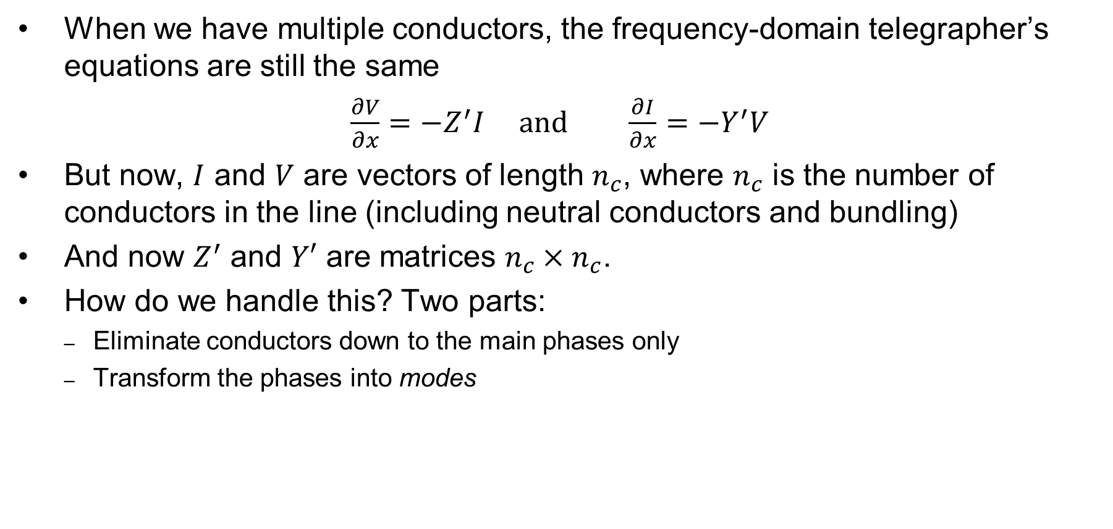
Multiple Conductors
When we have multiple conductors, the frequency-domain telegrapher’s equations are still the same
$\frac{∂V}{∂x}=−Z^{′}I$ and $\frac{∂I}{∂x}=−Y^{′}V$
But now, $I$ and $V$ are vectors of length $n_{c}$, where $n_{c}$ is the number of conductors in the line (including neutral conductors and bundling)
And now $Z^{′}$ and $Y′$ are matrices $n_{c}×n_{c}$.
How do we handle this? Two parts:
  Eliminate conductors down to the main phases only
  Transform the phases into modes

Slide 6
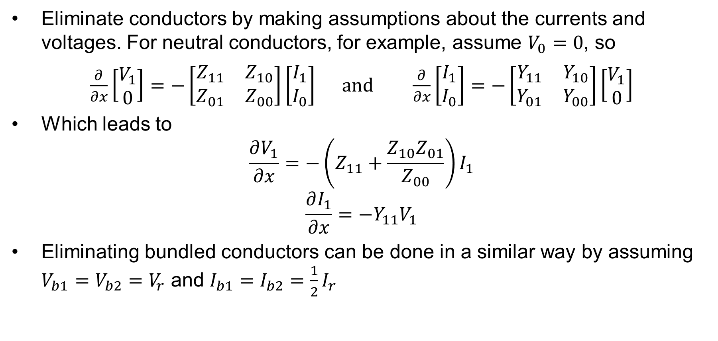
Eliminating Conductors
Eliminate conductors by making assumptions about the currents and voltages. For neutral conductors, for example, assume $V_{0}=0$, so
$\frac{∂}{∂x}\left[\begin{matrix}V_{1} \\ 0\end{matrix}\right]=−\left[\begin{matrix}Z_{11} & Z_{10} \\ Z_{01} & Z_{00}\end{matrix}\right]\left[\begin{matrix}I_{1} \\ I_{0}\end{matrix}\right]$ and $\frac{∂}{∂x}\left[\begin{matrix}I_{1} \\ I_{0}\end{matrix}\right]=−\left[\begin{matrix}Y_{11} & Y_{10} \\ Y_{01} & Y_{00}\end{matrix}\right]\left[\begin{matrix}V_{1} \\ 0\end{matrix}\right]$
Which leads to
$$\frac{∂V_{1}}{∂x}=−\left(Z_{11}+\frac{Z_{10}Z_{01}}{Z_{00}}\right)I_{1}$$
$$\frac{∂I_{1}}{∂x}=−Y_{11}V_{1}$$
Eliminating bundled conductors can be done in a similar way by assuming $V_{b1}=V_{b2}=V_{r}$ and $I_{b1}=I_{b2}=\frac{1}{2}I_{r}$

Slide 7
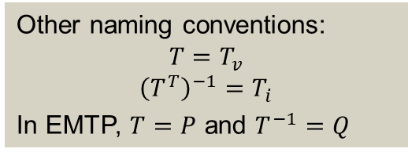
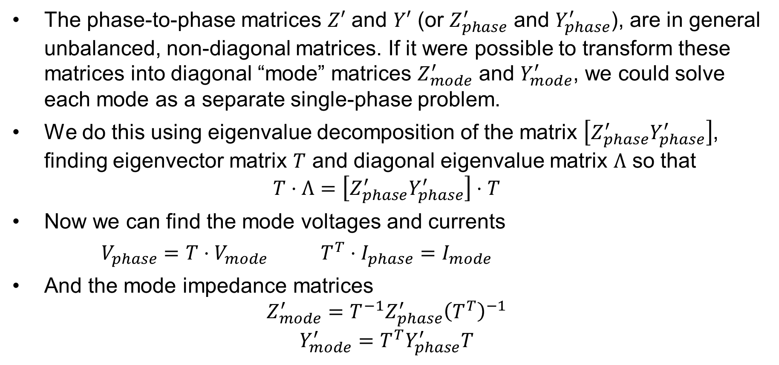
Modal Transformations
The phase-to-phase matrices $Z′$ and $Y′$ (or $Z_{phase}^{′}$ and $Y_{phase}^{′}$), are in general unbalanced, non-diagonal matrices. If it were possible to transform these matrices into diagonal “mode” matrices $Z_{mode}^{′}$ and $Y_{mode}^{′}$, we could solve each mode as a separate single-phase problem.
We do this using eigenvalue decomposition of the matrix $\left[Z_{phase}^{′}Y_{phase}^{′}\right]$, finding eigenvector matrix $T$ and diagonal eigenvalue matrix $Λ$ so that
$$T⋅Λ=\left[Z_{phase}^{′}Y_{phase}^{′}\right]⋅T$$
Now we can find the mode voltages and currents
$V_{phase}=T⋅V_{mode}$ $T^{T}⋅I_{phase}=I_{mode}$
And the mode impedance matrices
$$Z_{mode}^{′}=T^{−1}Z_{phase}^{′}{\left(T^{T}\right)}^{−1}$$
$$Y_{mode}^{′}=T^{T}Y_{phase}^{′}T$$
Other naming conventions:
$$T=T_{v}$$
$${\left(T^{T}\right)}^{−1}=T_{i}$$
In EMTP, $T=P$ and $T^{−1}=Q$

Slide 8
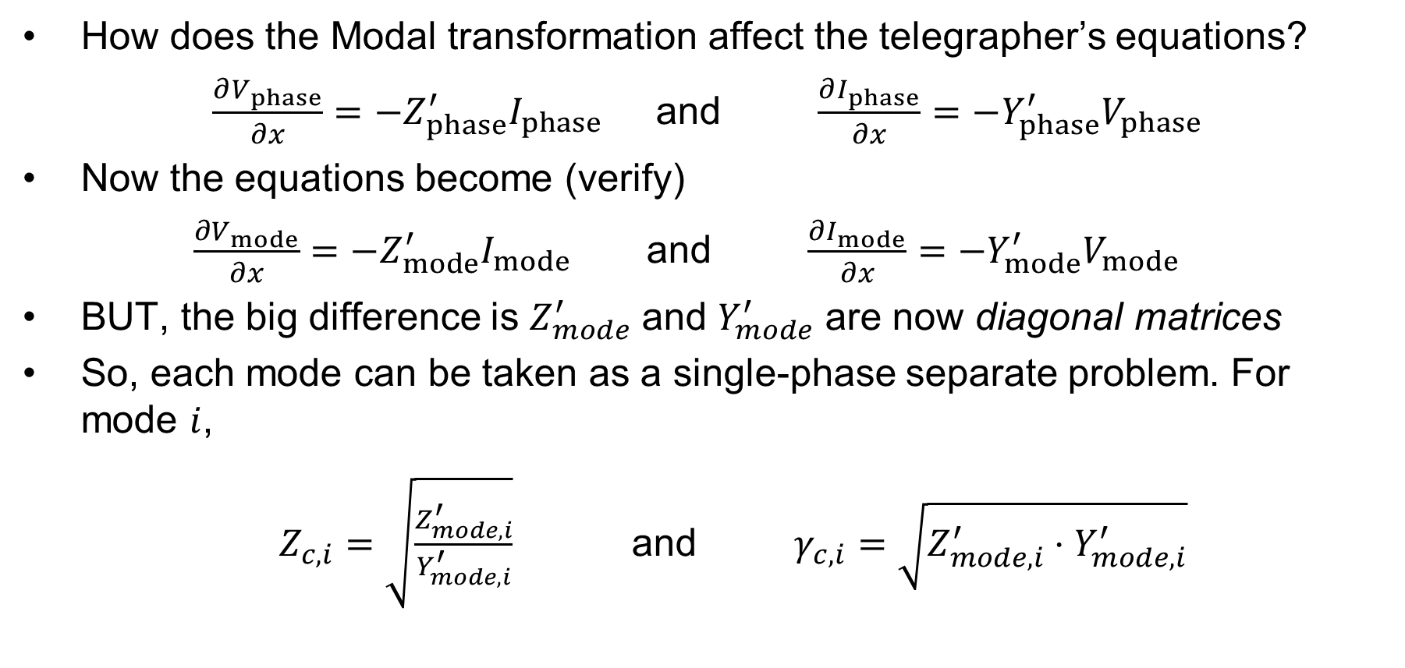
Modal Transformations, Cont.
How does the Modal transformation affect the telegrapher’s equations?
$\frac{∂V_{phase}}{∂x}=−Z_{phase}^{′}I_{phase}$ and $\frac{∂I_{phase}}{∂x}=−Y_{phase}^{′}V_{phase}$
Now the equations become (verify)
$\frac{∂V_{mode}}{∂x}=−Z_{mode}^{′}I_{mode}$ and $\frac{∂I_{mode}}{∂x}=−Y_{mode}^{′}V_{mode}$
BUT, the big difference is $Z_{mode}^{′}$ and $Y_{mode}^{′}$ are now diagonal matrices
So, each mode can be taken as a single-phase separate problem. For mode $i$,
$Z_{c,i}=\sqrt{\frac{Z_{mode,i}^{′}}{Y_{mode,i}^{′}}}$ and $γ_{c,i}=\sqrt{Z_{mode, i}^{′}⋅Y_{mode,i}^{′}}$

Slide 9
Exactness of Modal Transformations
For completely transposed lines, modal transformation reduces to the method of symmetrical components
For other lines, the exact transformation matrix will depend on frequency.
For the constant parameter model (CP) we pick a frequency to design the model for, so we just use the modal transformation matrix associated with that frequency
For frequency dependent models, there are multiple options:
  Assume that the modal transformation matrix will still be a constant (though the individual modes will have frequency dependence)
  Advanced methods take into account frequency dependence of the modal transformation

Slide 10
Modal Transformations
The phase-to-phase matrices $Z′$ and $Y′$ (or $Z_{phase}^{′}$ and $Y_{phase}^{′}$), are in general unbalanced, non-diagonal matrices. If it were possible to transform these matrices into diagonal “mode” matrices $Z_{mode}^{′}$ and $Y_{mode}^{′}$, we could solve each mode as a separate single-phase problem.
We do this using eigenvalue decomposition of the matrix $\left[Z_{phase}^{′}Y_{phase}^{′}\right]$, finding eigenvector matrix $T$ and diagonal eigenvalue matrix $Λ$ so that
$$T⋅Λ=\left[Z_{phase}^{′}Y_{phase}^{′}\right]⋅T$$
Now we can find the mode voltages and currents
$V_{phase}=T⋅V_{mode}$ $T^{T}⋅I_{phase}=I_{mode}$
And the mode impedance matrices
$$Z_{mode}^{′}=T^{−1}Z_{phase}^{′}{\left(T^{T}\right)}^{−1}$$
$$Y_{mode}^{′}=T^{T}Y_{phase}^{′}T$$
Other naming conventions:
$$T=T_{v}$$
$${\left(T^{T}\right)}^{−1}=T_{i}$$
In EMTP, $T=P$ and $T^{−1}=Q$

Slide 11
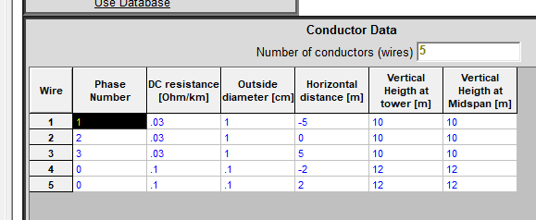
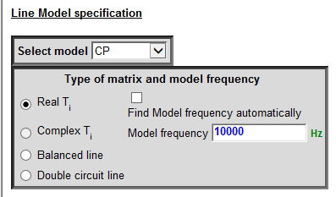
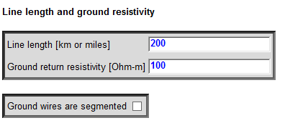
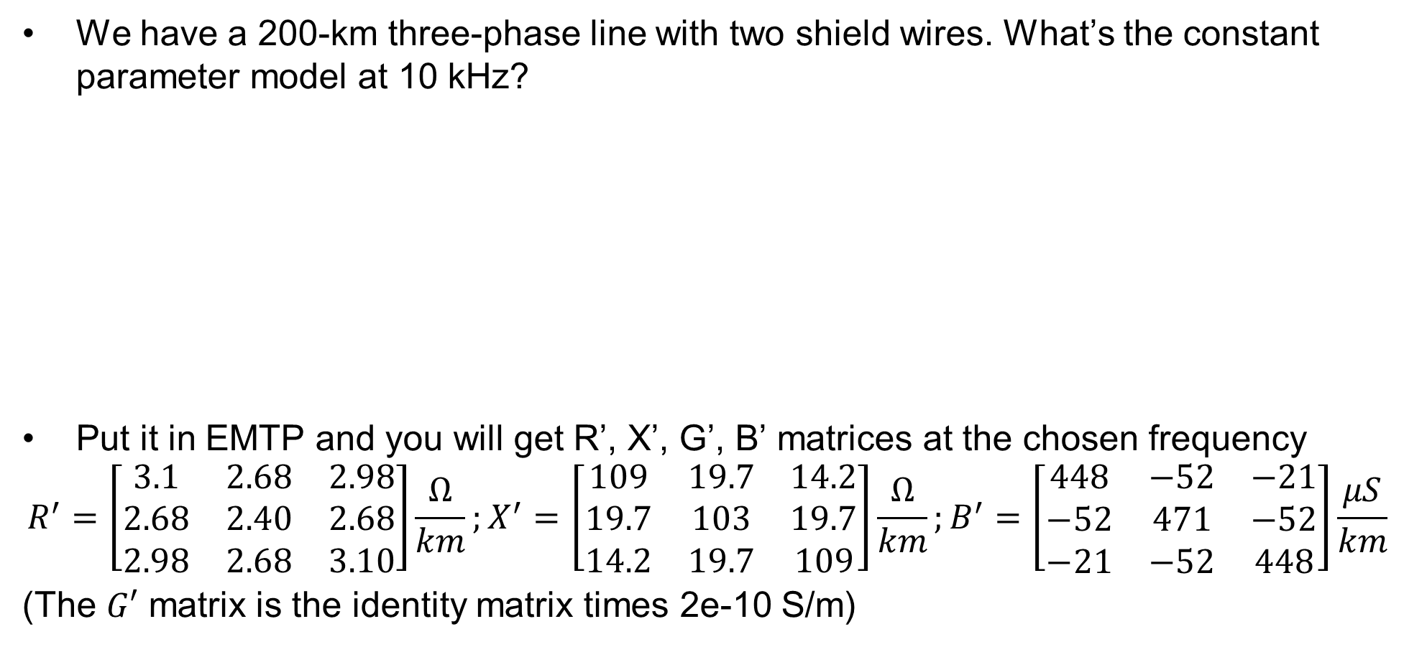
Example of Modal Transformations
We have a 200-km three-phase line with two shield wires. What’s the constant parameter model at 10 kHz?
Put it in EMTP and you will get R’, X’, G’, B’ matrices at the chosen frequency
$$R^{′}=\left[\begin{matrix}3.1 & 2.68 & 2.98 \\ 2.68 & 2.40 & 2.68 \\ 2.98 & 2.68 & 3.10\end{matrix}\right]\frac{Ω}{km};X^{′}=\left[\begin{matrix}109 & 19.7 & 14.2 \\ 19.7 & 103 & 19.7 \\ 14.2 & 19.7 & 109\end{matrix}\right]\frac{Ω}{km};B^{′}=\left[\begin{matrix}448 & −52 & −21 \\ −52 & 471 & −52 \\ −21 & −52 & 448\end{matrix}\right]\frac{μS}{km}$$
(The $G′$ matrix is the identity matrix times 2e-10 S/m)

Slide 12
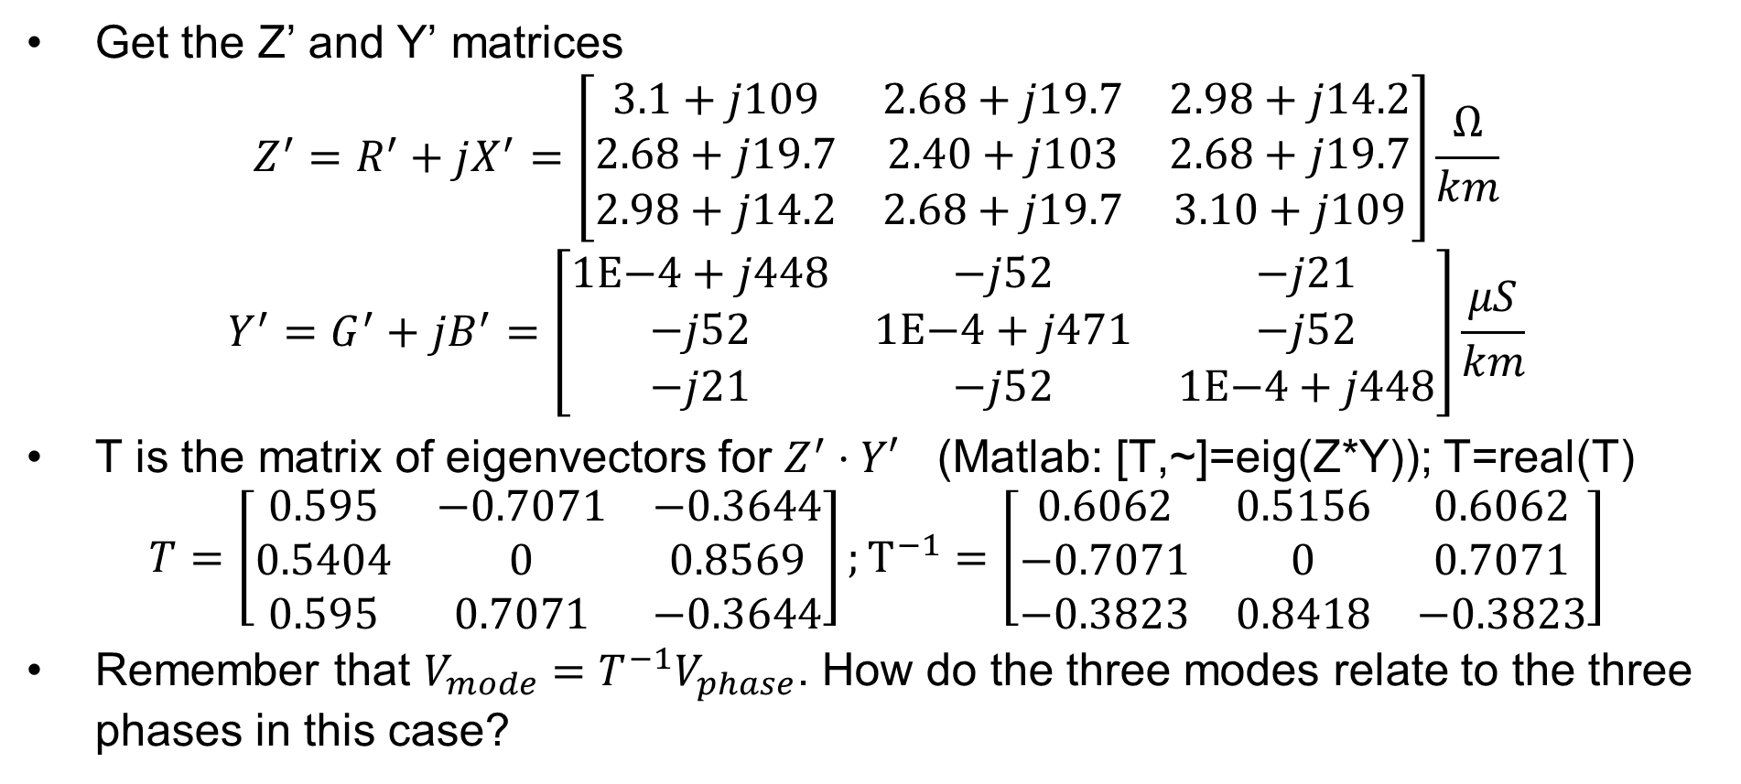
Example of Modal Transformations, cont.
Get the Z’ and Y’ matrices
$$Z^{′}=R^{′}+jX^{′}=\left[\begin{matrix}3.1+j109 & 2.68+j19.7 & 2.98+j14.2 \\ 2.68+j19.7 & 2.40+j103 & 2.68+j19.7 \\ 2.98+j14.2 & 2.68+j19.7 & 3.10+j109\end{matrix}\right]\frac{Ω}{km}$$
$$Y^{′}=G^{′}+jB^{′}=\left[\begin{matrix}1\text{E}\text{−4}+j448 & −j52 & −j21 \\ −j52 & 1\text{E}\text{−4}+j471 & −j52 \\ −j21 & −j52 & 1\text{E}\text{−4}+j448\end{matrix}\right]\frac{μS}{km}$$
T is the matrix of eigenvectors for $Z^{′}⋅Y′$ (Matlab: [T,~]=eig(Z*Y)); T=real(T)
$$T=\left[\begin{matrix}0.595 & −0.7071 & −0.3644 \\ 0.5404 & 0 & 0.8569 \\ 0.595 & 0.7071 & −0.3644\end{matrix}\right];T^{−1}=\left[\begin{matrix}0.6062 & 0.5156 & 0.6062 \\ −0.7071 & 0 & 0.7071 \\ −0.3823 & 0.8418 & −0.3823\end{matrix}\right]$$
Remember that $V_{mode}=T^{−1}V_{phase}$. How do the three modes relate to the three phases in this case?

Slide 13
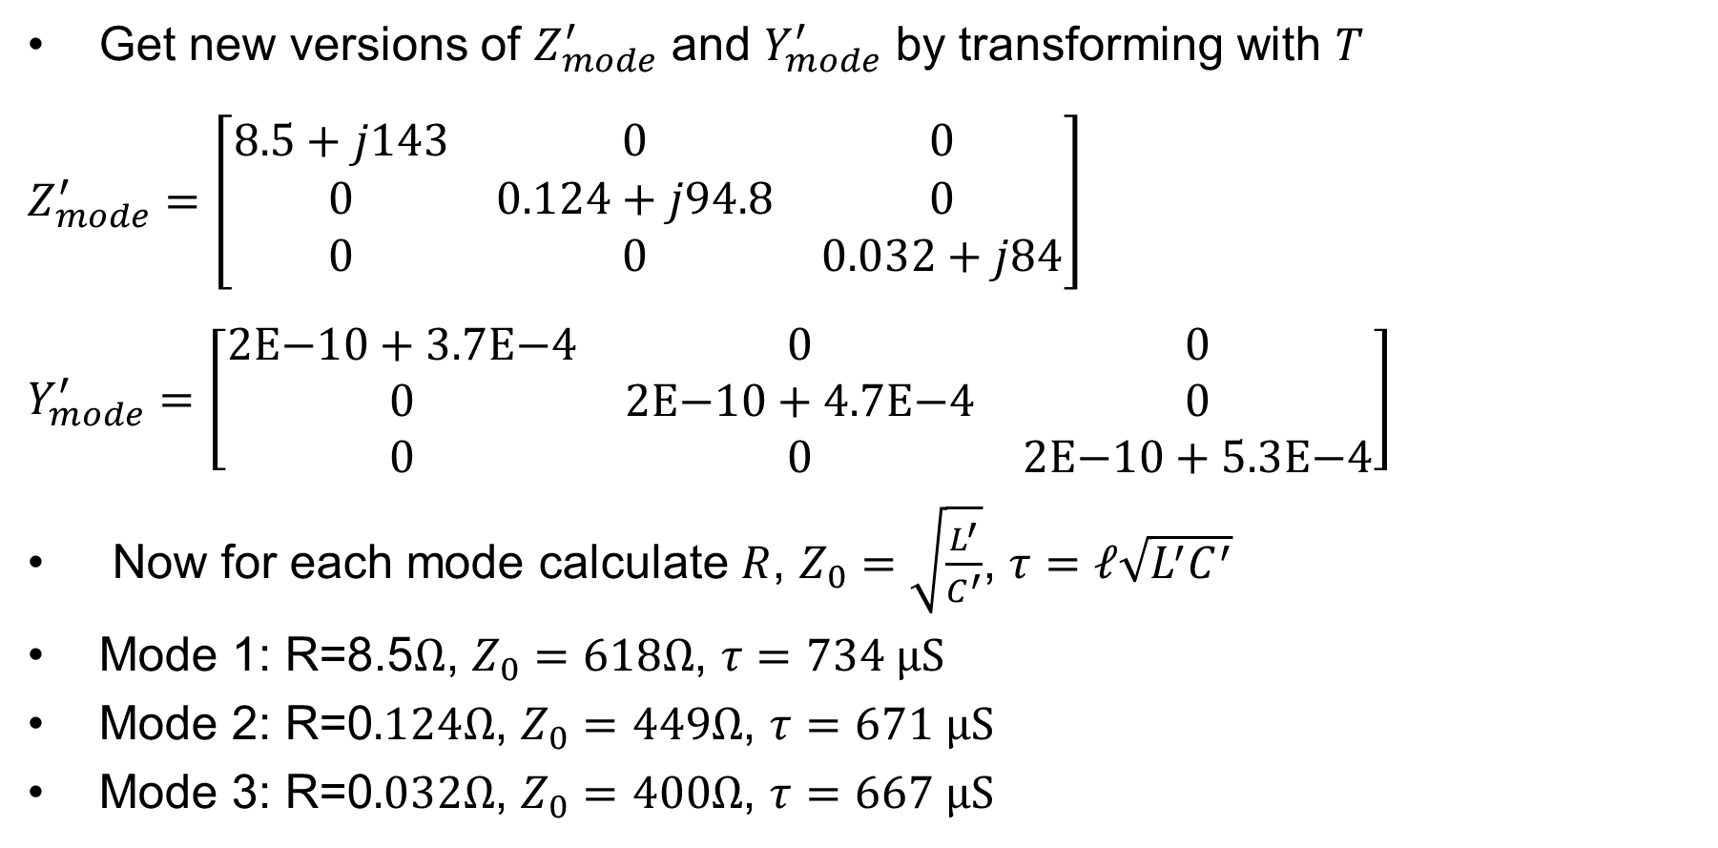
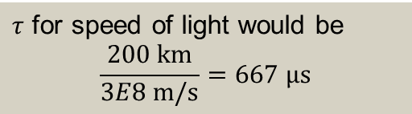
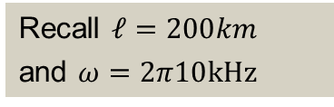
Example of Modal Transformations, cont.
Get new versions of $Z_{mode}^{′}$ and $Y_{mode}^{′}$ by transforming with $T$
$Z_{mode}^{′}=\left[\begin{matrix}8.5+j143 & 0 & 0 \\ 0 & 0.124+j94.8 & 0 \\ 0 & 0 & 0.032+j84\end{matrix}\right]$
$Y_{mode}^{′}=\left[\begin{matrix}2\text{E}\text{−10}+3.7\text{E}\text{−4} & 0 & 0 \\ 0 & 2\text{E}\text{−10}+4.7\text{E}\text{−4} & 0 \\ 0 & 0 & 2\text{E}\text{−10}+\text{5.3}\text{E}\text{−4}\end{matrix}\right]$
Now for each mode calculate $R$, $Z_{0}=\sqrt{\frac{L^{′}}{C^{′}}}$, $τ=ℓ\sqrt{L^{′}C^{′}}$
Mode 1: R=8.5$Ω$, $Z_{0}=618Ω$, $τ=734 \text{μS}$
Mode 2: R=0$.124Ω$, $Z_{0}=449Ω$, $τ=671 \text{μS}$
Mode 3: R=0$.032Ω$, $Z_{0}=400Ω$, $τ=667 \text{μS}$
Why does the first mode have much higher resistance?
Recall $ℓ=200km$
and $ω=2π10\text{kHz}$
$τ$ for speed of light would be
$$\frac{200 \text{km}}{3E8 \text{m}\text{/}\text{s}}=667 \text{μs}$$

