Slide 1
ECEN 616, Spring 2025 Methods of Electric Power System Analysis
Class 8: Transmission Lines, Part 1
Prof. Adam Birchfield
Dept. of Electrical and Computer Engineering
Texas A&M University
abirchfield@tamu.edu

Slide 2
Homework
Example 1 – Solve using analytical methods and numerical methods (Forward Euler, 2nd order Runge-Kutta, trapezoidal with companion circuit approach)
Read Dommel chapters 1-3, the Noda 2009 paper, Greenwood Chapter 5 (and reference Ch. 1-4)
By Feb. 20th, solve examples 2-7 analytically.
Read these two papers by Feb. 20th:
J. R. Marti, "Accurate Modelling of Frequency-Dependent Transmission Lines in Electromagnetic Transient Simulations," in IEEE Transactions on Power Apparatus and Systems, vol. PAS-101, no. 1, pp. 147-157, Jan. 1982.
A. Morched, B. Gustavsen and M. Tartibi, "A universal model for accurate calculation of electromagnetic transients on overhead lines and underground cables," in IEEE Transactions on Power Delivery, vol. 14, no. 3, pp. 1032-1038, July 1999.

Slide 3
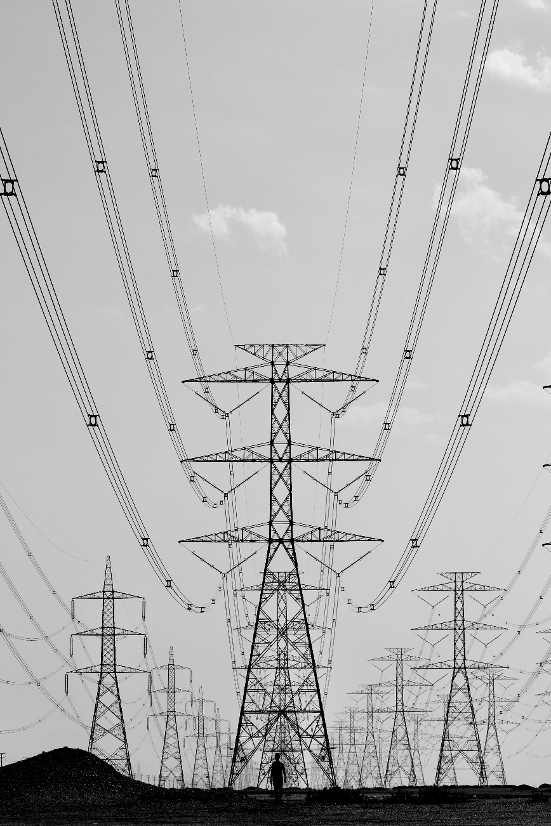
Transmission Line Characteristics
Multiple Conductors: Three phases, neutral wires, multiple circuits on the same tower or nearby towers, earth returns
Mutual inductances and capacitances
Overhead vs underground
Bundled conductors
Transposed or not
Segmented ground wires, periodic grounding
Sagging at midpoint between tower span
Frequency dependent parameters—introducing high degrees of nonlinearity
Skin effect

Slide 4
Modeling Transmission Lines
Transmission lines are characterized by a distributed complex impedance matrix $Z′$ and an admittance matrix $Y′$.
$$\frac{dV}{dx}=−Z′⋅I$$
$$\frac{dI}{dx}=−Y^{′}⋅V$$
Both $Z′$ and $Y′$ are frequency-dependent
The first step in modeling transmission lines is being able to get $Z′$ and $Y′$ from the line configuration
$$ℓ$$
$$i\left(t, 0\right)=i_{k}(t)$$
$$−i\left(t, ℓ\right)=i_{m}(t)$$
$$+$$
$$+$$
$$v\left(t, 0\right)=v_{k}(t)$$
$$v\left(t, ℓ\right)=v_{m}(t)$$
$$−$$
$$−$$
$$i(t, x)$$
$$R′$$
$$L′$$
$$i(t, x+Δx)$$
$$+$$
$$+$$
$$v(t, x)$$
$$C′$$
$$G′$$
$$v(t, x+Δx)$$
$$−$$
$$−$$
$$Δx$$

Slide 5
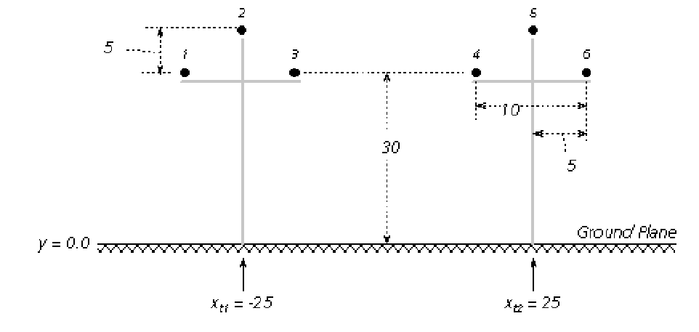
Conductor Input Data
Overhead conductor data
Phase or neutral
Horizontal position (relative)
Vertical position (0 is considered earth)
Radius
DC resistance
Bundling
Sag
Underground conductor data
Ground resistivity $ρ_{g}$ and relative permeability $μ_{g}$
Line length
https://www.pscad.com/webhelp/ol-help.htm

Slide 6
Conductor Sag
Conductor sag can be approximated by reducing the effective height of the conductor by a value 2/3 of the maximum sag.
h = height at midspan + 1/3 sag
Dommel

Slide 7
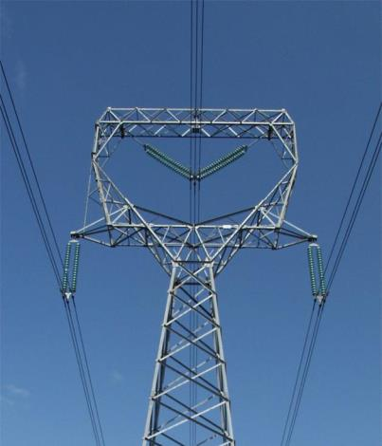
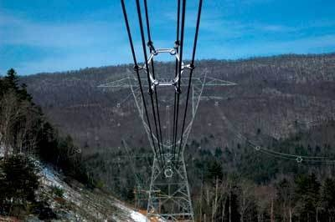
Bundled Conductor Pictures
The AEP Wyoming-Jackson Ferry 765 kV line uses 6-bundle conductors. Conductors in a bundle are at the same voltage!
Photo Source: BPA and American Electric Power

Slide 8
Bundling
Bundling can be handled one of two ways
(1) each conductor in the bundle can be separately modeled, then eliminated assuming the voltages are the same and current evenly split
(2) Use an equivalent radius GMR $= (r′d_{12}…d_{1b})^{\frac{1}{b}}$

Slide 9
Transposition
Transposed lines can be handled in detail, by modeling the actual transposed sections (either by rotating the phases or changing the X, Y coordinates within the line model
It is also possible to make the assumption that lines are fully transposed, which results in perfectly symmetric $Z′$ and $Y′$ matrices, thus balanced operation
https://www.pscad.com/webhelp/ol-help.htm

Slide 10
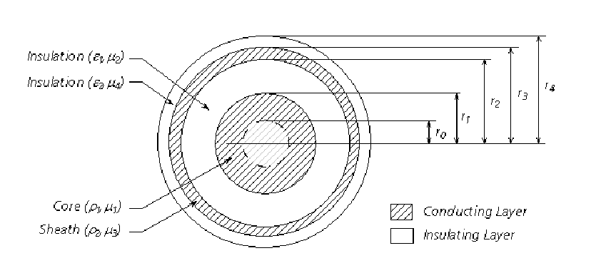
Underground Cables
Underground cables may have multiple concentric layers
Each layer has its own permittivity, permeability, and conductivity
Alternating conducting and insulating layers
https://www.pscad.com/webhelp/ol-help.htm

Slide 11
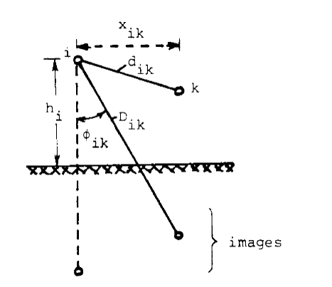
Earth Return
Including the effect of the earth plane requires knowledge or assumptions about the ground’s electrical properties
One method is Carson’s method, which is fairly accurate for homogeneous earth
It uses “images” of the conductors reflected across the ground plane
Adds correction terms to R and X
There is a lot of uncertainty in ground properties
Details are in Dommel and other papers
Dommel

Slide 12
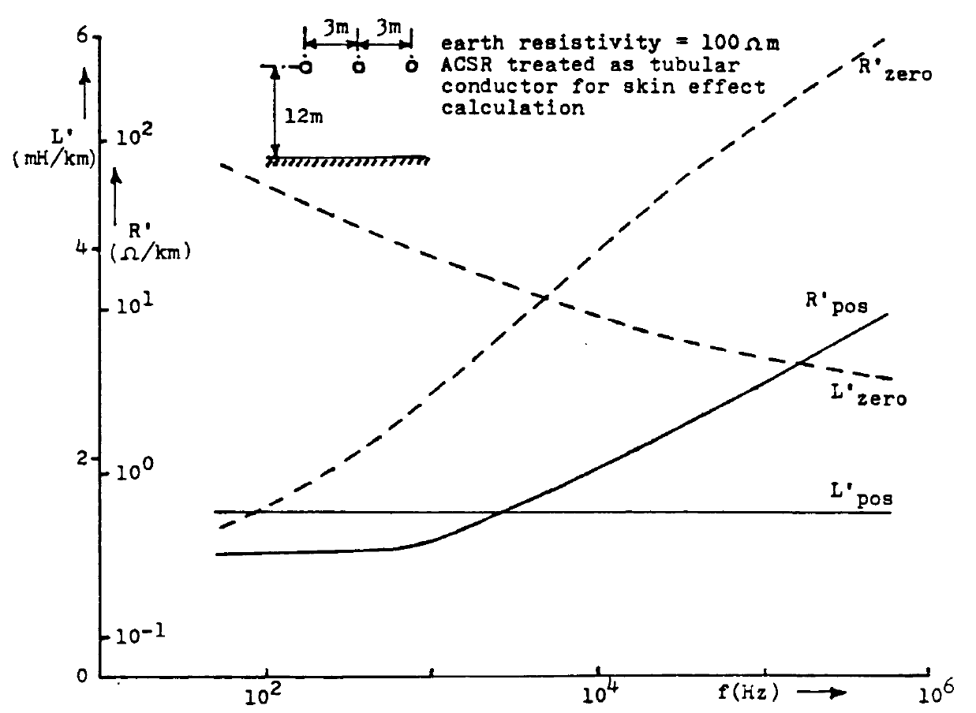
Skin Effect
The basic calculations give R and L for dc conditions
Due to skin effect, R will be higher for higher frequencies, and L will be lower
Tables and formulas are given in Dommel to correct for these
In this figure (Dommel), the zero sequence values are affected more by the ground path

Slide 13
Basic Equations
Transmission lines are basically characterized by a distributed complex impedance matrix $Z′$ and an admittance matrix $Y′$.
Both are $n×n$, where $n$ is the number of conductors (including neutrals), and are distributed along the length of the line.
Telegraphers' equations
$$\frac{dV}{dx}=−Z^{′}⋅I \frac{dI}{dx}=−Y^{′}⋅V$$
Both $Z′$ and $Y′$ are frequency-dependent, asymmetric, full matrices
$$ℓ$$
$$i\left(t, 0\right)=i_{k}(t)$$
$$−i\left(t, ℓ\right)=i_{m}(t)$$
$$+$$
$$+$$
$$v\left(t, 0\right)=v_{k}(t)$$
$$v\left(t, ℓ\right)=v_{m}(t)$$
$$−$$
$$−$$
$$i(t, x)$$
$$R′$$
$$L′$$
$$i(t, x+Δx)$$
$$+$$
$$+$$
$$v(t, x)$$
$$C′$$
$$G′$$
$$v(t, x+Δx)$$
$$−$$
$$−$$
$$Δx$$

Slide 14
Types of Line Modeling
PI model: $Z=Z^{′}⋅d$, $Y=Y^{′}⋅d$
Inductor + resistor in series, capacitor in shunt
R, L, C values evaluated for single frequency
Does not account for propagation delay
Can work for very short lines and when only a narrow band of frequencies is important
Single Frequency, Constant Parameters
Uses propagation delay, distributed-parameter model
Also known as Bergeron Model
Again, you must pick a single frequency for validity
Frequency-Dependent Model
Approximates the nonlinear frequency dependence by calculating different models per frequency level

Slide 15
Transmission Lines: Differential Section
Consider a two-terminal transmission line of length $ℓ$. Refer to the “sending end” as $k$ and the “receiving end” as $m$. We’re interested in the sending and receiving end voltage and current, $v_{k}\left(t\right), i_{k}\left(t\right), v_{m}\left(t\right),$and$i_{m}(t)$
We define the distributed parameter line model as shown with $R^{′}, L^{′}, G^{′}, C′$
From circuit theory as $Δx→0$
$$\frac{∂v}{∂x}=−R^{′}i−L^{′}\frac{∂i}{∂t}$$
$$\frac{∂i}{∂x}=−G^{′}v−C^{′}\frac{∂v}{∂t}$$
$$ℓ$$
$$i\left(t, 0\right)=i_{k}(t)$$
$$−i\left(t, ℓ\right)=i_{m}(t)$$
$$+$$
$$+$$
$$v\left(t, 0\right)=v_{k}(t)$$
$$v\left(t, ℓ\right)=v_{m}(t)$$
$$−$$
$$−$$
$$i(t, x)$$
$$R′$$
$$L′$$
$$i(t, x+Δx)$$
$$+$$
$$+$$
$$v(t, x)$$
$$C′$$
$$G′$$
$$v(t, x+Δx)$$
$$−$$
$$−$$
$$Δx$$

Slide 16
Solving the Telegrapher’s Equations
These two equations are the telegrapher’s equations. We use the Fourier transform to convert time to frequency using the relation $\frac{∂}{∂t}=jω$
$\frac{∂V}{∂x}=−\left(R^{′}+jωL^{′}\right)I=−Z^{′}I$ where $Z^{′}=R^{′}+jωL′$
$\frac{∂I}{∂x}=−\left(G^{′}+jωC^{′}\right)V=−Y^{′}V$ where $Y^{′}=G^{′}+jωC^{′}$
The solutions have the general form in the frequency domain
$$V\left(ω, x\right)=Ae^{−γx}+Be^{γx}$$
$$I\left(ω, x\right)=\frac{A}{Z_{C}}e^{−γx}−\frac{B}{Z_{c}}e^{γx}$$
Where $γ=\sqrt{Z′⋅Y′}$ and $Z_{c}=\frac{γ}{Y^{′}}=\sqrt{\frac{Z^{′}}{Y^{′}}}$, and A and B are unknown constants
$V, I, γ, and Z_{c}$ are all functions of frequency
Check that these solutions solve the differential equations

Slide 17
Boundary Conditions
Eliminate A and B by solving for $x=0$ and $x=ℓ$, using the k and m terms defined on the prior page
$$V\left(ω, 0\right)=V_{k}=A+B I\left(ω, 0\right)=I_{k}=\frac{A}{Z_{C}}−\frac{B}{Z_{c}}$$
$$V\left(ω, ℓ\right)=V_{m}=Ae^{−γℓ}+Be^{γℓ} −I\left(ω, ℓ\right)=I_{m}=−\frac{A}{Z_{C}}e^{−γℓ}+\frac{B}{Z_{c}}e^{γℓ}$$
After some algebra to eliminate A and B you get
$$I_{k}=\frac{V_{k}}{Z_{c}}−\left(\frac{V_{m}}{Z_{c}}+I_{m}\right) e^{−γℓ}$$
$$I_{m}=\frac{V_{m}}{Z_{c}}−\left(\frac{V_{k}}{Z_{c}}+I_{k}\right) e^{−γℓ}$$
Pause here. This is still an exact solution in the frequency domain, and we’ll come back here for frequency dependent models.
Remember $Z_{c}$ and $γ$ are functions of frequency

Slide 18
Lossless Model in the Time Domain
For the lossless model, we assume $R^{′}=G^{′}=0$, so $Z^{′}=jωL′$ and $Y^{′}=jωC^{′}$
So $Z_{c}=\sqrt{\frac{Z^{′}}{Y^{′}}}=\sqrt{\frac{L^{′}}{C^{′}}}=Z_{0}$ (which is a constant real number)
And $e^{−γℓ}=e^{−\sqrt{jωL^{′}⋅jωC^{′}}⋅ℓ}=e^{−jωτ}$, where $τ=\sqrt{L^{′}C^{′}}⋅ℓ$
And for the equations we get
$I_{k}=\frac{V_{k}}{Z_{0}}−\left(\frac{V_{m}}{Z_{0}}+I_{m}\right) e^{−jωτ}$ and $I_{m}=\frac{V_{m}}{Z_{0}}−\left(\frac{V_{k}}{Z_{0}}+I_{k}\right) e^{−jωτ}$
Convert to the time domain and get
$i_{k}\left(t\right)=\frac{v_{k}\left(t\right)}{Z_{0}}+I_{HK}(t)$ where $I_{HK}\left(t\right)=−\frac{1}{Z_{0}}v_{m}\left(t−τ\right)−i_{m}\left(t−τ\right)$
$i_{m}\left(t\right)=\frac{v_{m}\left(t\right)}{Z_{0}}+I_{HM}(t)$ where $I_{HM}\left(t\right)=−\frac{1}{Z_{0}}v_{k}\left(t−τ\right)−i_{k}(t−τ)$
This is exactly the lossless Bergeron model!

Slide 19
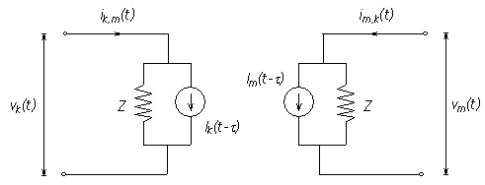
Bergeron Model (Lossless, Single-Phase)
Line decouples due to propagation delay
Model line as Norton source on each end
Current source is constant and depends on voltage and current on other end of the line $τ$ in the past
$$i_{k}\left(t\right)=\frac{v_{k}\left(t\right)}{Z_{0}}+I_{HK}(t)$$
$$i_{m}\left(t\right)=\frac{v_{m}\left(t\right)}{Z_{0}}+I_{HM}(t)$$
Where
$$I_{HK}\left(t\right)=−\frac{1}{Z_{0}}v_{m}\left(t−τ\right)−i_{m}\left(t−τ\right)$$
$$I_{HM}\left(t\right)=−\frac{1}{Z_{0}}v_{k}\left(t−τ\right)−i_{k}(t−τ)$$
$$Z_{0}=\sqrt{\frac{L}{C}}$$
$$τ=ℓ \sqrt{L⋅C}$$
Where $ℓ$ is the line length
https://www.pscad.com/webhelp/ol-help.htm

Slide 20
Bergeron Model, with Losses
The Bergeron model approximates losses by splitting the resistance (including resistance associated with ground earth return) into fourths
¼ at each end, ½ in the middle
Approximate the line as two lossless lines with ½ length each
Again, we require just one frequency

