Slide 1
ECEN 616, Spring 2025 Methods of Electric Power System Analysis
Class 6: Analytical Methods, Part 1
Prof. Adam Birchfield
Dept. of Electrical and Computer Engineering
Texas A&M University
abirchfield@tamu.edu

Slide 2
Homework
Example 1 – Solve using analytical methods and numerical methods (Forward Euler, 2nd order Runge-Kutta, trapezoidal with companion circuit approach)
Reading Dommel chapters 1-3 and the Noda 2009 paper.
By Feb. 13th, solve examples 2-4 analytically.
By Feb. 13th, read Greenwood Chapter 5 (and reference Ch. 1-4)
By Feb. 20th, solve examples 5-7 analytically.

Slide 3
Steps for Analytically Solving Transient Problems
Find the equivalent circuit for the system
What needs to be modeled?
Solve the circuit in steady state before the transient event
These will form the initial conditions for the differential equations
Solve the "particular solution" which is the steady-state condition after the transients have died out – again using steady-state techniques
Represent the transient conditions as differential equations
Solve in Laplace domain

Slide 4
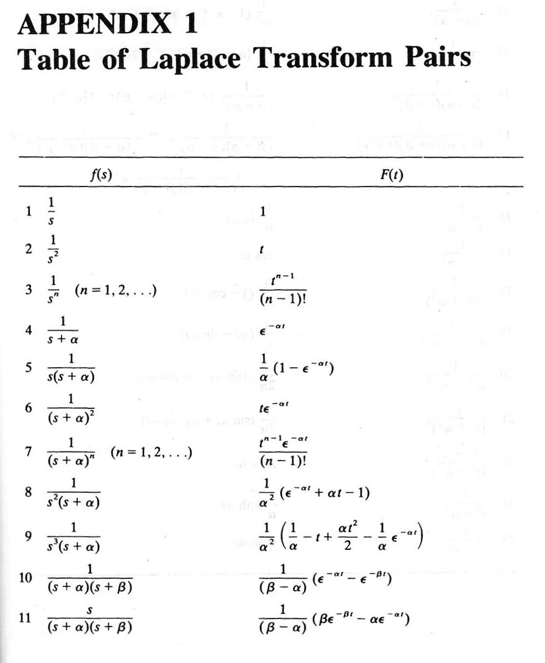
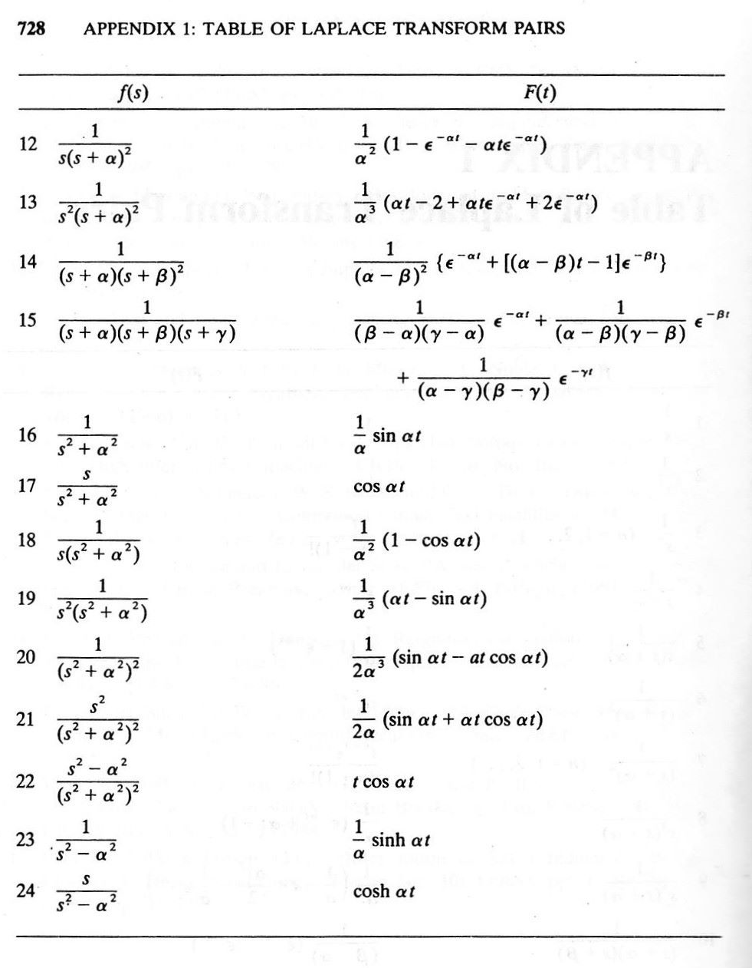
Common Laplace Transform Pairs

Slide 5
Common Laplace Transform Properties
Linearity: multiplying by scalar and adding is not affected
First derivative: multiply by s and subtract initial value
Second derivative: multiply by $s^{2}$, subtract s times initial value – initial first derivative
Integral: multiply by 1/s
Multiplication by t: negative derivative
Time delay by $a$: multiply by $e^{−as}$
Multiplication by $e^{−at}$: shift by a (replace s with s+a)
Time scaling by 1/a: $f\left(\frac{t}{a}\right)→aF\left(as\right)$
Time convolution: s-domain multiplication

Slide 6
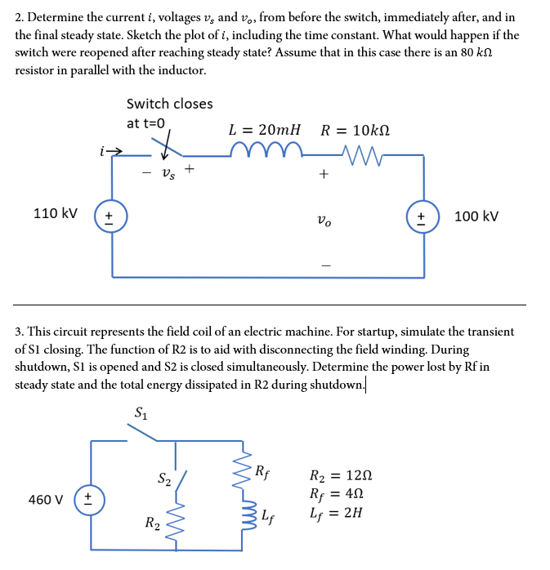
Examples 2 and 3
These can be solved with similar methods to the first example (example 1)
Try with Laplace method and with other Diff Eq approaches
Verify that solved equation satisfies the original DE
Verify initial and final conditions
Model in EMTP and check results
Try variations

Slide 7
Example 4
We want to solve for $i(t)$ after the switch closes.
Pre-switch condition: $i\left(t\right)=0$
Immediately following the switch: $i\left(0^{+}\right)=0$ as well, because inductor cannot change current instantaneously
$v\left(t\right)=V⋅\sin\left(ωt+θ\right)$
Using steady-state AC circuit theory, the steady-state value of $i\left(t\right)$ can be found, recognizing that $Z=R+jωL$ so that $I=\frac{V}{Z}=\frac{V}{\sqrt{R^{2}+ω^{2}L^{2}}}∠\left(θ−\tan^{−1}\left(\frac{ωL}{R}\right)\right)$
So, $i\left(∞\right)=$ $\frac{V}{\sqrt{R^{2}+ω^{2}L^{2}}}sin \left(ωt+θ−\tan^{−1}\left(\frac{ωL}{R}\right)\right)$
$$i$$
+
$$R$$
$$V∠θ$$
_
$$L$$

Slide 8
Example 4, cont
But what happens in the transient time period? Write a differential equation using KVL and the definition of R and L
$$v\left(t\right)−Ri−L\frac{di}{dt}=0$$
$$V\sin\left(ωt+θ\right)=Ri−L\frac{di}{dt}$$
$$V\cos{θ}\sin{ωt}+V\sin{θ}\cos{ωt}=Ri−L\frac{di}{dt}$$
Ok, now we just need to solve this differential equation
Use the Laplace transform, convert to the s domain
$$V\frac{ω\cos{θ}+s\sin{θ}}{s^{2}+ω^{2}}=RI+sLI−Li(0)$$
Recognize $i(0)=0$and isolate I(s)
$$I\left(s\right)=\frac{V}{L}\frac{ω\cos{θ}+s\sin{θ}}{\left(s^{2}+ω^{2}\right)\left(s+R/L\right)}$$
$$=\frac{V}{L}\frac{ω\cos{θ}}{\left(s^{2}+ω^{2}\right)\left(s+R/L\right)}+\frac{V}{L}\frac{s\sin{θ}}{\left(s^{2}+ω^{2}\right)\left(s+R/L\right)}$$
We need to convert this back to time domain, which requires algebraic manipulation and splitting into partial fractions (whoop!)

Slide 9
Example 4, cont
Redefine to easier variables and do partial fraction decomposition on the first term
$$I\left(s\right)=\frac{V}{L}\frac{ω\cos{θ}}{\left(s^{2}+ω^{2}\right)\left(s+R/L\right)}+\frac{V}{L}\frac{s\sin{θ}}{\left(s^{2}+ω^{2}\right)\left(s+R/L\right)}=\frac{A_{1}}{\left(s^{2}+ω^{2}\right)\left(s+α\right)}+\frac{sA_{2}}{\left(s^{2}+ω^{2}\right)\left(s+α\right)}$$
$$\frac{1}{\left(s^{2}+ω^{2}\right)\left(s+α\right)}=\frac{B_{1}}{s+α}+\frac{B_{2}}{s^{2}+ω^{2}}+\frac{sB_{3}}{s^{2}+ω^{2}}$$
Solve for the three B terms and you finally get (for the first term of I(s))
$$\frac{Vω\cos{θ}}{L\left(ω^{2}+α^{2}\right)}\left(\frac{−1}{s+α}+\frac{−α}{s^{2}+ω^{2}}+\frac{s}{s^{2}+ω^{2}}\right)$$
Which, in the time domain, is
$$\frac{Vω\cos{θ}}{L\left(ω^{2}+α^{2}\right)}\left(−e^{−αt}−\frac{α}{ω}\sin\left(ωt\right)+\cos\left(ωt\right)\right)$$

Slide 10
Example 4, cont
The second term is just the first term times s (which is derivative in the time domain)
$$\frac{V}{L}\frac{s\sin{θ}}{\left(s^{2}+ω^{2}\right)\left(s+R/L\right)}=\frac{V\sin{θ}}{L\left(ω^{2}+α^{2}\right)}s(\frac{−1}{s+α}+\frac{−α}{s^{2}+ω^{2}}+\frac{s}{s^{2}+ω^{2}})$$
$$\frac{V\sin{θ}}{L\left(ω^{2}+α^{2}\right)}⋅\frac{d}{dt}\left(−e^{−αt}−\frac{α}{ω}\sin\left(ωt\right)+\cos\left(ωt\right)\right)$$
$$=\frac{V\sin{θ}}{L\left(ω^{2}+α^{2}\right)}\left(αe^{−at}−α\cos\left(ωt\right)−ω\sin\left(ωt\right)\right)$$
Add the two terms and pull out like terms,
$$i\left(t\right)=\frac{V}{L\left(ω^{2}+α^{2}\right)}\left(\left(α\sin{θ}−ω\cos{θ}\right)e^{−at}−α\sin\left(ωt+θ\right)+ω\cos\left(ωt+θ\right)\right)$$

Slide 11
Example 4, cont
$$i\left(t\right)=\frac{V}{L\left(ω^{2}+α^{2}\right)}\left(\left(α\sin{θ}−ω\cos{θ}\right)e^{−at}−α\sin\left(ωt+θ\right)+ω\cos\left(ωt+θ\right)\right)$$
Define $φ=\tan^{−1}\left(\frac{ω}{α}\right)=\tan^{−1}\left(\frac{ωL}{R}\right), so that \frac{α}{\sqrt{ω^{2}+α^{2}}}=\cos{φ}and\frac{ω}{\sqrt{ω^{2}+α^{2}}}=\sin{φ}$
Now we can use our trig sum and difference formulas
$$i\left(t\right)=\frac{V}{L\sqrt{ω^{2}+α^{2}}}\left(\sin{(θ−φ)}e^{−αt}−\sin\left(ωt+θ−φ\right)\right)$$
Remember our definitions for $α$ and $φ$?
$$i\left(t\right)=\frac{V}{\sqrt{L^{2}ω^{2}+R^{2}}}\left(\sin\left(θ−\tan^{−1}\left(\frac{ωL}{R}\right)\right)e^{−\frac{R}{L}t}−\sin\left(ωt+θ−\tan^{−1}\left(\frac{ωL}{R}\right)\right)\right)$$
Check our boundary conditions
$$i\left(0\right)=0; i\left(∞\right)=\frac{V}{\sqrt{R^{2}+ω^{2}L^{2}}}sin \left(ωt+θ−\tan^{−1}\left(\frac{ωL}{R}\right)\right)$$

Slide 12
Think About the Solution
$$i\left(t\right)=\frac{V}{\sqrt{L^{2}ω^{2}+R^{2}}}\left(\sin\left(θ−\tan^{−1}\left(\frac{ωL}{R}\right)\right)e^{−\frac{R}{L}t}−\sin\left(ωt+θ−\tan^{−1}\left(\frac{ωL}{R}\right)\right)\right)$$
Compare to the cases of $R=0, L=0, ω=0$
What effect does $θ$ have? Under what conditions is there no transient?
The best closing angle is near where the final current will have a zero crossing
The worst closing angle is 90 degrees before or after that
Highest possible current? Cannot be more than double the final magnitude. If the closing angle is worst-case, ½ cycle in, it will be
$i\left(\frac{2}{ω}\right)=\frac{V}{\sqrt{L^{2}ω^{2}+R^{2}}}\left(1+e^{−\frac{2R}{ωL}}\right)$

Slide 13
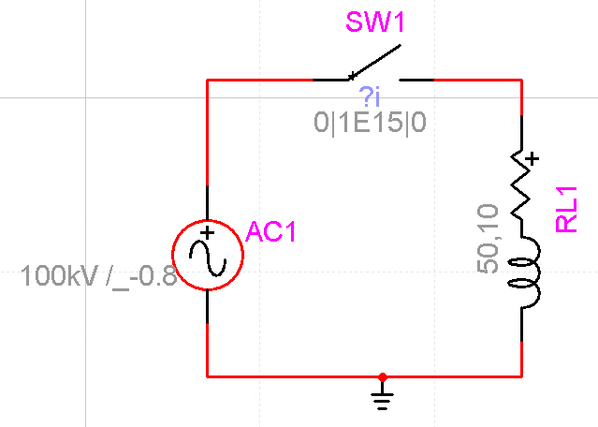
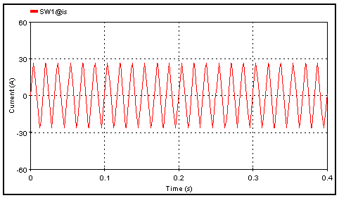
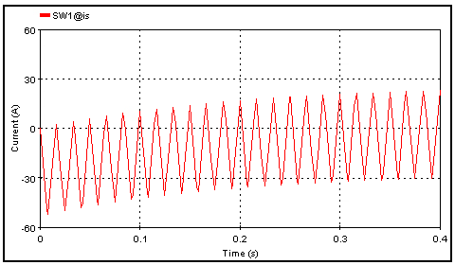
EMTP Version of Example 4
Let's use V=100 kV, $f=60 \text{Hz}$, $R=50 Ω$, $L=10 \text{H}$
Steady-state current is 26.5 A
EMTP ac source is cosine-based, not sine-based
This means the time constant will be $\frac{L}{R}=0.2s$
Ideal closing angle would be about 89.2$°$ with sine function, with cosine it is about -0.8$°$
Left: ideal closing angle
Right: worst-case closing angle

