Slide 1
ECEN 616, Spring 2025 Methods of Electric Power System Analysis
Class 10: Transmission Lines, Part 3
Prof. Adam Birchfield
Dept. of Electrical and Computer Engineering
Texas A&M University
abirchfield@tamu.edu

Slide 2
Homework
Example 1 – Solve using analytical methods and numerical methods (Forward Euler, 2nd order Runge-Kutta, trapezoidal with companion circuit approach)
Read Dommel chapters 1-3, the Noda 2009 paper, Greenwood Chapter 5 (and reference Ch. 1-4)
By Feb. 20th, solve examples 2-7 analytically.
Read these two papers by Feb. 20th:
J. R. Marti, "Accurate Modelling of Frequency-Dependent Transmission Lines in Electromagnetic Transient Simulations," in IEEE Transactions on Power Apparatus and Systems, vol. PAS-101, no. 1, pp. 147-157, Jan. 1982.
A. Morched, B. Gustavsen and M. Tartibi, "A universal model for accurate calculation of electromagnetic transients on overhead lines and underground cables," in IEEE Transactions on Power Delivery, vol. 14, no. 3, pp. 1032-1038, July 1999.

Slide 3
Transmission Lines: Differential Section
Consider a two-terminal transmission line of length $ℓ$. Refer to the “sending end” as $k$ and the “receiving end” as $m$. We’re interested in the sending and receiving end voltage and current, $v_{k}\left(t\right), i_{k}\left(t\right), v_{m}\left(t\right),$and$i_{m}(t)$
After boundary conditions are considered we get an exact solution
$$I_{k}=\frac{V_{k}}{Z_{c}}−\left(\frac{V_{m}}{Z_{c}}+I_{m}\right) e^{−γℓ}$$
$$I_{m}=\frac{V_{m}}{Z_{c}}−\left(\frac{V_{k}}{Z_{c}}+I_{k}\right) e^{−γℓ}$$
$$ℓ$$
$$i\left(t, 0\right)=i_{k}(t)$$
$$−i\left(t, ℓ\right)=i_{m}(t)$$
$$+$$
$$+$$
$$v\left(t, 0\right)=v_{k}(t)$$
$$v\left(t, ℓ\right)=v_{m}(t)$$
$$−$$
$$−$$
$$i(t, x)$$
$$R′$$
$$L′$$
$$i(t, x+Δx)$$
$$+$$
$$+$$
$$v(t, x)$$
$$C′$$
$$G′$$
$$v(t, x+Δx)$$
$$−$$
$$−$$
$$Δx$$

Slide 4
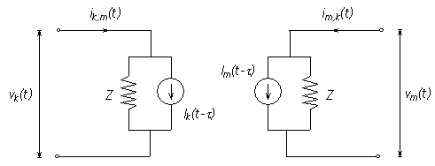
Recall, Bergeron Model (lossless, single-phase)
Line decouples due to propagation delay
Model line as Norton source on each end
Current source is constant and depends on voltage and current on other end of the line $τ$ in the past
$$i_{k}\left(t\right)=\frac{v_{k}\left(t\right)}{Z_{0}}+I_{HK}(t)$$
$$i_{m}\left(t\right)=\frac{v_{m}\left(t\right)}{Z_{0}}+I_{HM}(t)$$
Where
$$I_{HK}\left(t\right)=−\frac{1}{Z_{0}}v_{m}\left(t−τ\right)−i_{m}\left(t−τ\right)$$
$$I_{HM}\left(t\right)=−\frac{1}{Z_{0}}v_{k}\left(t−τ\right)−i_{k}(t−τ)$$
$$Z_{0}=\sqrt{\frac{L}{C}}$$
$$τ=ℓ \sqrt{L⋅C}$$
Where $ℓ$ is the line length
https://www.pscad.com/webhelp/ol-help.htm

Slide 5
Recall, Constant-Parameter, Multi-Conductor Model
Eigenvalue decomposition of the matrix $\left[Z_{phase}^{′}Y_{phase}^{′}\right]$, finding eigenvector matrix $T$ and diagonal eigenvalue matrix $Λ$ so that
$$T⋅Λ=\left[Z_{phase}^{′}Y_{phase}^{′}\right]⋅T$$
Now we can find the mode voltages, currents, impedance, and admittance
$V_{phase}=T⋅V_{mode}$ $T^{T}⋅I_{phase}=I_{mode}$
$$Z_{mode}^{′}=T^{−1}Z_{phase}^{′}{\left(T^{T}\right)}^{−1}$$
$$Y_{mode}^{′}=T^{T}Y_{phase}^{′}T$$
Now $Z_{mode}^{′}$ and $Y_{mode}^{′}$ are now diagonal matrices, so, each mode can be taken as a single-phase separate problem. For mode $i$,
$Z_{c,i}=\sqrt{\frac{Z_{mode,i}^{′}}{Y_{mode,i}^{′}}}$ and $γ_{c,i}=\sqrt{Z_{mode, i}^{′}⋅Y_{mode,i}^{′}}$

Slide 6
Mode-based Frequency Dependence
Two methods for including frequency dependence in transmission lines
Mode-domain frequency dependence. Assume the modal transformation is a constant, as in the constant-parameter, multi-conductor model. Then, treat each mode as a single-phase branch and handle the frequency dependence there.
Phase-domain frequency dependence. This is the general form of frequency dependence, in which the frequency dependence is considered directly in the phase domain.

Slide 7
Mode-Domain Frequency Dependence
Even though the transformation matrix $T$ does depend on frequency, we will assume it can be treated as constant. Hence we have a set of independent single-phase “modes” of the form (from last class)
$$I_{k}=\frac{V_{k}}{Z_{c}}−\left(\frac{V_{m}}{Z_{c}}+I_{m}\right) e^{−γℓ}$$
$$I_{m}=\frac{V_{m}}{Z_{c}}−\left(\frac{V_{k}}{Z_{c}}+I_{k}\right) e^{−γℓ}$$
Where $Z_{c}$ and $γ$ are complex nonlinear functions of frequency, making a direct conversion to time domain quite difficult
Mode-based frequency dependent (FD) models are based on approximating the effects of $Z_{c}$ and $γ$ that will be valid for many frequencies.
Key paper is J. R. Marti, “Accurate Modeling of FD Transmission Lines in EMT Simulations,” IEEE Trans. PAS, Jan. 1982

Slide 8
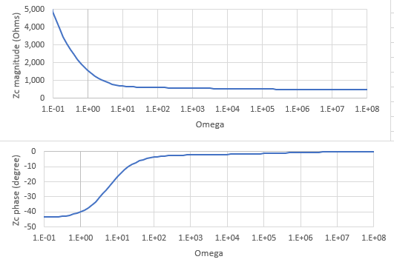
Approximation of $Z_{c}$ and $γ$ in Time-Domain
First, we focus on converting $Z_{c}\left(ω\right)$ and $γ(ω)$ to the time domain.
In practice, the equations are quite complicated (too complicated to directly convert to time domain), but we can sample them at various time points.
Then we find a simpler function that approximates the behavior within the frequency spectrum of interest.
Example Zc dependence on frequency

Slide 9
Rational Function Approximation
Let’s assume that $Z_{c}(ω)$ can be approximated as follows (or we could do the same with $γ\left(ω\right)$
$$Z_{c}\left(ω\right)≈r_{0}+\frac{r_{1}}{jω+p_{1}}+\frac{r_{2}}{jω+p_{2}}+\frac{r_{3}}{jω+p_{3}}+…=r_{0}+\sum_{k=1}^{n}{\frac{r_{k}}{jω+p_{k}}}$$
Where $n$ is the number of poles selected, $p_{k}$ is the value of the pole number $k$, and $r_{k}$ is the residual associated with the pole $k$.
If we could find such a function, the time domain equivalent would be
$$z_{c}\left(t\right)=r_{0}+\sum_{k=1}^{n}{r_{k}e^{−p_{k}t}}$$
Which is a nice exponential form.

Slide 10
Vector Fitting
But how do we find the poles and residuals? This is the methodology known as Vector Function Fitting.
Choose the number of poles, and begin by spacing them evenly on a logarithmic plot (1, 10, 100, 1000, etc., for example)
Iterations
Find the residuals with a linear least squares approach by evaluating it at many intervals.
Update the poles with a sensitivity methodology (see B. Gustavsen and A. Semlyen, "Rational approximation of frequency domain responses by vector fitting," in IEEE Transactions on Power Delivery, vol. 14, no. 3, pp. 1052-1061, July 1999).

Slide 11
Vector Fitting Example
Let’s say we have the following calculations for Zc, and we want to match it with one pole $p_{1}=15$.
So $\hat{Z_{c}}=r_{0}+\frac{r_{1}}{15+jω}$
And we have a vector of 18 frequency points and the resulting vector of Zc values $z$
Therefore we can create the 18x2 matrix A
$A\left(i,1\right)=1$ (coefficient of $r_{0}$)
$$A\left(i,2\right)=\frac{1}{15+jω_{i}}$$
This leads to the linear least squares problem
$A \left[\begin{matrix}r_{0} \\ r_{1}\end{matrix}\right]=z$ which has the solution $\left[\begin{matrix}r_{0} \\ r_{1}\end{matrix}\right]={\left(A^{T}A\right)}^{−1}A^{T}z≈\left[\begin{matrix}371 \\ 12037\end{matrix}\right]$
omega | Zc (Magnitude) | Zc (Phase)
62.83185 | 449.773 | -0.41153
81.68141 | 422.7524 | -0.34623
106.1858 | 403.9465 | -0.28397
138.0416 | 391.4493 | -0.22813
179.4541 | 383.4509 | -0.1805
233.2903 | 378.4718 | -0.14132
303.2774 | 375.4305 | -0.1099
394.2606 | 373.5955 | -0.08509
512.5387 | 372.4969 | -0.06571
666.3003 | 371.8422 | -0.05067
866.1905 | 371.4531 | -0.03903
1126.048 | 371.2224 | -0.03005
1463.862 | 371.0856 | -0.02313
1903.02 | 371.0046 | -0.01779
2473.927 | 370.9567 | -0.01369
3216.105 | 370.9283 | -0.01053
4180.936 | 370.9115 | -0.0081
5435.217 | 370.9016 | -0.00623

Slide 12
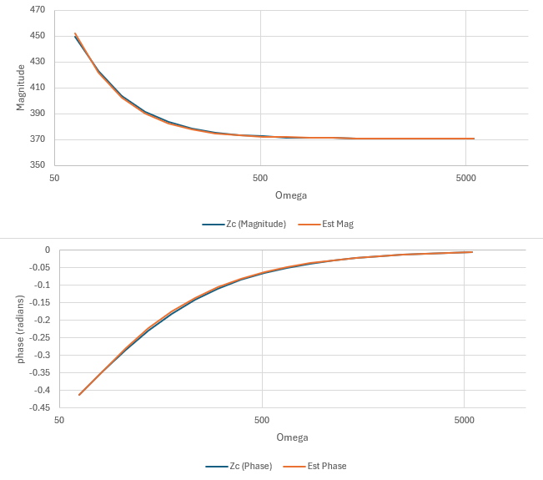
Vector Fitting Example, Cont.
If we use our fitted result and calculate $\hat{Z_{c}}=371+\frac{12037}{15+jω}$ we get
omega | Zc (Magnitude) | Zc (Phase) | Zc estimated (Magnitude) | Zc estimated (Phase)
62.83185 | 449.773 | -0.41153 | 452.1821 | -0.41242
81.68141 | 422.7524 | -0.34623 | 421.9883 | -0.3446
106.1858 | 403.9465 | -0.28397 | 402.3542 | -0.27986
138.0416 | 391.4493 | -0.22813 | 390.0056 | -0.22281
179.4541 | 383.4509 | -0.1805 | 382.4136 | -0.17508
233.2903 | 378.4718 | -0.14132 | 377.8144 | -0.13643
303.2774 | 375.4305 | -0.1099 | 375.0539 | -0.10576
394.2606 | 373.5955 | -0.08509 | 373.4065 | -0.08174
512.5387 | 372.4969 | -0.06571 | 372.4267 | -0.06305
666.3003 | 371.8422 | -0.05067 | 371.8451 | -0.04858
866.1905 | 371.4531 | -0.03903 | 371.5004 | -0.0374
1126.048 | 371.2224 | -0.03005 | 371.2962 | -0.02879
1463.862 | 371.0856 | -0.02313 | 371.1753 | -0.02215
1903.02 | 371.0046 | -0.01779 | 371.1038 | -0.01704
2473.927 | 370.9567 | -0.01369 | 371.0614 | -0.01311
3216.105 | 370.9283 | -0.01053 | 371.0363 | -0.01009
4180.936 | 370.9115 | -0.0081 | 371.0215 | -0.00776
5435.217 | 370.9016 | -0.00623 | 371.0127 | -0.00597
In this case, just one pole guess is great! In practice, more poles and pole updates will improve the fitting.

Slide 13
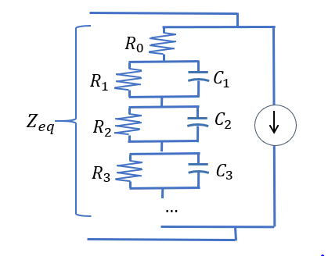
Time-Domain Frequency-Dependent Model
What is the frequency-domain representation of this circuit?
$$I\left(ω\right)=I_{source}+\frac{V\left(ω\right)}{Z_{eq}}$$
Where
$$Z_{eq}\left(ω\right)=R_{0}+\sum_{k=1}^{n}{\left(R_{k}||\left(\frac{1}{jωC_{k}}\right)\right)}=\frac{1/C_{k}}{1/R_{k}C_{k}+jω}$$
This is an exact representation of our rational approximation, where $C_{k}=1/r_{k}$ and $R_{k}=r_{k}/p_{k}$

Slide 14
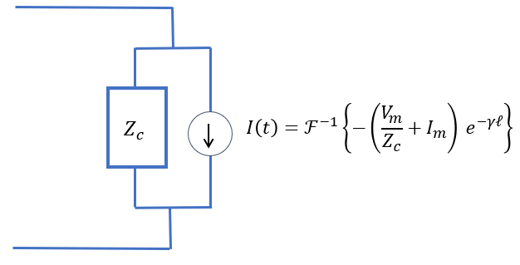
Handling Frequency Dependence of Zc
For constant-parameter models, we evaluate Zc at one frequency and call it $Z_{0}$, then we have a resistor in the model.
For frequency-dependent models, we approximate Zc over many frequencies with a rational function, then representing it as an equivalent RC ladder circuit

Slide 15
Handling Frequency Dependence of $γ$
With $Z_{c}$ taken care of, we are interested in this part of the equation
$$I_{source}\left(ω\right)=\left(\frac{V_{m}}{Z_{c}}+I_{m}\right) e^{−γℓ}$$
The part inside the parentheses can be found as history values from the other side as $I_{h}$, and we need to extract out of $e^{−γℓ}$ the fastest component as represented by $τ$. The remaining effect of $γ$’s frequency dependence is represented by the function $P(ω)$
$$I_{source}\left(ω\right)=I_{h}\left(ω\right) e^{−ωτ} P(ω)$$
Now our time-domain representation is
$$i_{source}\left(t\right)=i_{h}\left(t−τ\right)∗p(t)$$
Where p(t) is zero for all t < 0. This means that the source current depends only on historical values of $i_{h}$ (which is good for realization!)

Slide 16
Handling Frequency Dependence of $γ$, cont.
$$i_{source}\left(t\right)=i_{h}\left(t−τ\right)∗p(t)$$
Now we represent $P(ω)$ as a rational function approximation (use q for poles to avoid confusion)
$$\hat{P}=r_{0}+\sum_{k=1}^{n}{\frac{r_{k}}{jω+q_{k}}}$$
And now the equation becomes
$$i_{source}\left(t\right)=i_{h}\left(t−τ\right)∗\left(r_{0}+\sum_{k=1}^{n}{r_{k}e^{−q_{k}t}}\right)$$
$$=r_{0}i_{h}\left(t−τ\right)+\sum_{k=1}^{n}{r_{k}(i_{h}\left(t−τ\right)∗e^{−q_{k}t})}$$

Slide 17
Numerical Convolution
All of the poles add together linearly to make the current source. So we only need to consider how to do the convolution for one pole.
$$I_{source,k}(t)=i_{h}\left(t−τ\right)∗r_{k}e^{−q_{k}t}$$
Recall the definition of convolution (and limits inherent in the exponent)
$$I_{source,k}(t)=\int_{−∞}^{t}{r_{k}\left(i_{h}\left(u−τ\right)e^{−q_{k}(t−u)}\right)du}$$
We can then separate this for an iterative process
$$I_{source,k}\left(t\right)=\int_{−∞}^{t−Δt}{r_{k}\left(i_{h}\left(u−τ\right)e^{−q_{k}\left(t−Δt+Δt−u\right)}\right)du}+\int_{t−Δt}^{t}{r_{k}\left(i_{h}\left(u−τ\right)e^{−q_{k}(t−u)}\right)du}$$
$$I_{source,k}\left(t\right)=e^{Δt}I_{source,k}\left(t−Δt\right)+\int_{t−Δt}^{t}{r_{k}\left(i_{h}\left(u−τ\right)e^{−q_{k}(t−u)}\right)du}$$

Slide 18
Numerical Convolution, cont.
$$I_{source,k}\left(t\right)=e^{Δt}I_{source,k}\left(t−Δt\right)+\int_{t−Δt}^{t}{r_{k}\left(i_{h}\left(u−τ\right)e^{−q_{k}(t−u)}\right)du}$$
Apply the trapezoidal method of numerical integration
$=$ $e^{Δt}I_{source,k}\left(t−Δt\right)+\frac{r_{k}}{2Δt}\left(i_{h}\left(t−Δt−τ\right)e^{−q_{k}\left(t−t−Δt\right)}+i_{h}\left(t−τ\right)e^{−q_{k}\left(t−t\right)}\right)$
$$= e^{Δt}I_{source,k}\left(t−Δt\right)+\frac{r_{k}}{2Δt}\left(i_{h}\left(t−Δt−τ\right)e^{q_{k}Δt}+i_{h}\left(t−τ\right)\right)$$
$$I_{source,k}\left(t\right)=a_{1}I_{source,k}\left(t−Δt\right)+a_{2}i_{h}\left(t−Δt−τ\right)+a_{3}i_{h}\left(t−τ\right)$$
With constants defined as
$$a_{1}=e^{Δt}; a_{2}=\frac{r_{k}}{2Δt}e^{q_{k}Δt}; a_{3}=\frac{r_{k}}{2Δt}$$
This is quite computationally- and memory-efficient!

