Slide 1
ECEN 616, Spring 2025 Methods of Electric Power System Analysis
Class 5: Numerical Methods, Part 3
Prof. Adam Birchfield
Dept. of Electrical and Computer Engineering
Texas A&M University
abirchfield@tamu.edu

Slide 2
Homework
By today
Finish example 1 using analytical methods (ODE’s, Laplace, etc.)
Plot results using Matlab (or Python/etc.)
Try solving it with Euler’s method – compare different time steps.
Read Chapter 2 of the Dommel EMTP theory book.
Try solving it with the 2nd order Runge-Kutta method
Read the following paper:
T. Noda, K. Takenaka and T. Inoue, "Numerical Integration by the 2-Stage Diagonally Implicit Runge-Kutta Method for Electromagnetic Transient Simulations," in IEEE Transactions on Power Delivery, vol. 24, no. 1, pp. 390-399, Jan. 2009.
By next Tuesday 2/4
Read Dommel Chapters 1 and 3
Write code to solve Example 1 with trapezoidal method

Slide 3
Summary of Methods
Name | Type | Error | Notes
Euler | Explicit | $$O({\left(Δt\right)}^{2})$$
Backward Euler | Implicit | $$O({\left(Δt\right)}^{2})$$ | Because it is implicit, requires backsolving algebraic equations
Trapezoidal | Implicit | $$O({\left(Δt\right)}^{2})$$ | Because it is implicit, requires backsolving algebraic equations. Often better than backward Euler
Runge-Kutta 2 | Explicit | $$O({\left(Δt\right)}^{3})$$ | Requires differential equations be evaluated twice per time step
Runge-Kutta 4 | Explicit | $$O({\left(Δt\right)}^{5})$$ | Requires differential equations be evaluated four times per time step
Adams-Bashforth | Explicit | $$O({\left(Δt\right)}^{3})$$ | Uses prior time step solution, which may cause errors with discontinuities
An advantage of implicit methods is they are numerically stable. But that doesn’t mean explicit methods wouldn’t be appropriate in many applications.

Slide 4
Systematic Circuit Solving Method
We're going to work toward a systematic way to solve EMTs, based on the trapezoidal method for numerical integration
Let's start with just the following elements: resistors, voltage sources, current sources, and ideal transformers. Using the node-voltage representation, there are no differential equations and the solution at each time point can be written as a set of linear equations:
$$G⋅v=b$$
Where $v$ is the vector of node voltages (not including ground), matrix $G$ gives the linear coefficients and vector $b$ the right hand side of the equations
Most of the equations will be KCL summations, or ideal transformer relationships, or voltage sources
Solve for $v$ using sparse matrix techniques (described in ECEN 615)

Slide 5
Adding Inductors to the Systematic Method
For an inductor connected between bus voltages 1 and 2, we need to find the current and voltage relationship
$$\frac{di}{dt}=\frac{1}{L}(v_{1}−v_{2})$$
If we use the Trapezoidal method, we get
$$i\left(t+Δt\right)=i\left(t\right)+\frac{Δt}{2L}\left(v_{1}\left(t\right)−v_{2}\left(t\right)+v_{1}\left(t+Δt\right)−v_{2}(t+Δt)\right)$$
$$=\frac{Δt}{2L}\left(v_{1}\left(t+Δt\right)−v_{2}(t+Δt)\right)+hist(t)$$
Where $hist(t)$ can be defined by the prior time step values
$$hist\left(t\right)=i\left(t\right)+\frac{Δt}{2L}\left(v_{1}\left(t\right)−v_{2}\left(t\right)\right)$$
So $hist(t)$ is a like a fixed current source for any time step, and the $\frac{Δt}{2L}\left(v_{1}\left(t+Δt\right)−v_{2}(t+Δt)\right)$ term acts just like a resistor.
$$v_{1}$$
$$i$$
L
$$v_{2}$$
$$i$$
$$v_{1}$$
$$\frac{2L}{Δt}$$
$$hist(t)$$
$$v_{2}$$

Slide 6
Try the LR Circuit Energization
To solve this circuit, replace the inductor with the equivalent circuit
$$hist\left(t\right)=i\left(t\right)+\frac{Δt}{2L}v_{3}(t)$$
We close the switch, what’s the initial value of $hist$? 0 A
Closed switch equation: $v_{1}=v_{2}$
Voltage source: $v_{1}=V\cos{(ωt+θ)}$
Last equation is KCL at node $v_{3}$
$$\frac{v_{3}−v_{2}}{R}+\frac{v_{3}Δt}{2L}+hist\left(t\right)=0$$
$$i$$
$$R$$
+
$$V∠θ$$
$$L$$
_
$$i$$
$$v_{1}$$
$$v_{2}$$
$$R$$
$$v_{3}$$
+
$$V∠θ$$
$$\frac{2L}{Δt}$$
_
$$hist(t)$$

Slide 7
Try the LR Circuit Energization
In matrix form:
$$\left[\begin{matrix}1 & 0 & 0 \\ −1 & 1 & 0 \\ 0 & −\frac{1}{4} & \frac{1}{R}+\frac{Δt}{2L}\end{matrix}\right]\left[\begin{matrix}v_{1} \\ v_{2} \\ v_{3}\end{matrix}\right]=\left[\begin{matrix}V\cos\left(ωt+θ\right) \\ 0 \\ hist\left(t\right)\end{matrix}\right]$$
At each iteration, $hist\left(t\right)=i\left(t\right)+\frac{Δt}{2L}v_{3}\left(t\right)$
First, solve steady state (consider the inductor as a current source only of 0A)
$$i\left(0\right)=0, v_{1}\left(0\right)=v_{2}\left(0\right)=v_{3}\left(0\right)=Vcos(θ)$$
$$hist\left(0\right)=0+\frac{Δt}{2L}V\cos{θ}$$
Then, starting with $t=Δt$, use the circuit on the right to solve
$$i$$
$$v_{1}$$
$$v_{2}$$
$$R$$
$$v_{3}$$
+
$$V∠θ$$
$$\frac{2L}{Δt}$$
_
$$hist(t)$$

Slide 8
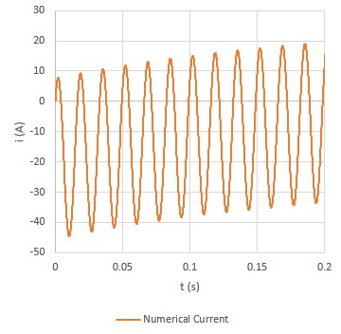
Example Results
Using $Δt=0.1ms$, $R=50Ω$, $L=10H$, $V_{0}=100 kV$, $θ=45°$, $f=60 Hz$
Error stays less than 6 mA for all time
t | hist | v1 | v2 | v3 | Numerical Current | Analytical Current | Diff
0 | 0.353553 | 70710.68 | 70710.68 | 70710.68 | 0 | 0 | 0
0.0001 | 1.03316 | 67995.34 | 67995.34 | 67960.67 | 0.693357 | 0.693438 | 8.1E-05
0.0002 | 1.684314 | 65183.37 | 65183.37 | 65115.44 | 1.358737 | 1.358896 | 0.000159
0.0003 | 2.306105 | 62278.78 | 62278.78 | 62179.02 | 1.99521 | 1.995442 | 0.000233
0.0004 | 2.897661 | 59285.68 | 59285.68 | 59155.59 | 2.601883 | 2.602186 | 0.000303
0.0005 | 3.458155 | 56208.34 | 56208.34 | 56049.44 | 3.177908 | 3.178278 | 0.00037
0.0006 | 3.986805 | 53051.12 | 53051.12 | 52864.99 | 3.72248 | 3.722913 | 0.000434
0.0007 | 4.482873 | 49818.51 | 49818.51 | 49606.77 | 4.234839 | 4.235332 | 0.000493
0.0008 | 4.945666 | 46515.11 | 46515.11 | 46279.39 | 4.71427 | 4.714818 | 0.000548
0.0009 | 5.374542 | 43145.6 | 43145.6 | 42887.6 | 5.160104 | 5.160704 | 0.0006
0.001 | 5.768905 | 39714.79 | 39714.79 | 39436.2 | 5.571724 | 5.57237 | 0.000647
0.0011 | 6.128206 | 36227.54 | 36227.54 | 35930.11 | 5.948555 | 5.949245 | 0.00069
0.0012 | 6.451949 | 32688.8 | 32688.8 | 32374.3 | 6.290077 | 6.290806 | 0.000729
0.0013 | 6.739687 | 29103.62 | 29103.62 | 28773.83 | 6.595818 | 6.596582 | 0.000764
0.0014 | 6.991025 | 25477.07 | 25477.07 | 25133.8 | 6.865356 | 6.86615 | 0.000794
0.0015 | 7.205619 | 21814.32 | 21814.32 | 21459.41 | 7.098322 | 7.099142 | 0.00082
0.0016 | 7.383178 | 18120.58 | 18120.58 | 17755.86 | 7.294398 | 7.29524 | 0.000842
0.0017 | 7.523462 | 14401.08 | 14401.08 | 14028.41 | 7.45332 | 7.454179 | 0.000859
0.0018 | 7.626285 | 10661.12 | 10661.12 | 10282.37 | 7.574874 | 7.575746 | 0.000872
0.0019 | 7.691516 | 6906.003 | 6906.003 | 6523.058 | 7.658901 | 7.659781 | 0.000881
0.002 | 7.719074 | 3141.076 | 3141.076 | 2755.811 | 7.705295 | 7.70618 | 0.000885

Slide 9
What about Capacitors?
We can make a similar model for capacitors, using the trapezoidal method
$$\frac{d}{dt}\left(v_{1}−v_{2}\right)=\frac{1}{C}i$$
$$v_{1}\left(t+Δt\right)−v_{2}\left(t+Δt\right)=v_{1}\left(t\right)−v_{2}\left(t\right)+\frac{Δt}{2C}\left(i\left(t\right)+i\left(t+Δt\right)\right)$$
$$i\left(t+Δt\right)=\frac{2C}{Δt}\left(v_{1}\left(t+Δt\right)−v_{2}\left(t+Δt\right)\right)+hist\left(t\right)$$
$$hist\left(t\right)=−i(t)−\frac{2C}{Δt}\left(v_{1}\left(t\right)−v_{2}\left(t\right)\right)$$
A capacitor can be modeled as just a linear combination of a current source and resistor
$$v_{1}$$
$$i$$
C
$$v_{2}$$
$$i$$
$$v_{1}$$
$$\frac{Δt}{2C}$$
$$hist(t)$$
$$v_{2}$$

Slide 10
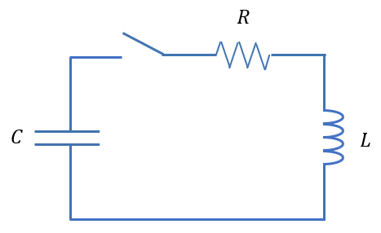
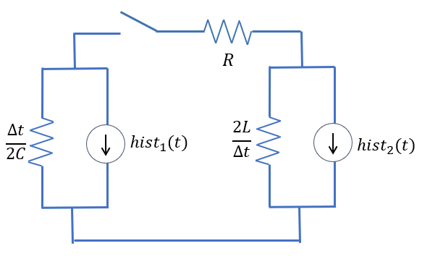
Series RLC Circuit
Capacitor charged to $V_{0}$, closing switch
Initial value of $hist_{1}$ is $−V_{0}⋅\frac{2C}{Δt}$
Initial value of $hist_{2}$ is 0
${Δt=0.1ms\text{,} V}_{0}=100 kV$, $R=1Ω$, $L=10mH$, $C=50μF$
$$\left[\begin{matrix}\frac{2C}{Δt}+\frac{1}{R} & −\frac{1}{R} \\ −\frac{1}{R} & \frac{Δt}{2L}+\frac{1}{R}\end{matrix}\right]\left[\begin{matrix}v_{1}(t+Δt) \\ v_{2}(t+Δt)\end{matrix}\right]=\left[\begin{matrix}−hist_{1}\left(t\right) \\ −hist_{2}\left(t\right)\end{matrix}\right]$$
$$hist_{1}\left(t\right)=−i_{c}\left(t\right)−\frac{2C}{Δt}v_{1}(t)$$
$$hist_{2}\left(t\right)=i_{L}\left(t\right)+\frac{Δt}{2L}v_{2}(t)$$

Slide 11
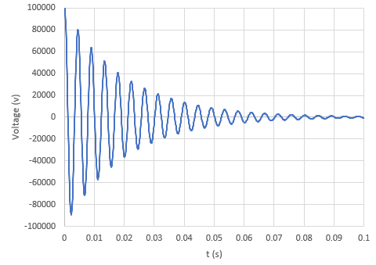
Results for the RLC Series Circuit
Frequency is close to 225 Hz, which we would expect from the LC combination.
Damped due to the resistance
Try one with a parallel RLC circuit

Slide 12
Overview of Systematic Transient Solution Process with Trapezoidal Numerical Method
Solve the steady-state circuit (dc and all ac frequencies summed together) which will get initial voltages on capacitor and currents in inductor. Use these to set initial values of hist for all inductors and capacitors.
At each time step, first build the G matrix, including capacitors with a resistance of $Δt/2C$ and inductors with a resistance of $2L/Δt$.
Then build the right-hand side vector $b$, with any current sources, including the $hist$ values for L and C components
Solve for voltage values with $Gv=b.$
Calculate capacitor and inductor currents, using these to set the new values of $hist$

