Slide 1
ECEN 616, Spring 2025 Methods of Electric Power System Analysis
Class 4: Numerical Methods, Part 2
Prof. Adam Birchfield
Dept. of Electrical and Computer Engineering
Texas A&M University
abirchfield@tamu.edu

Slide 2
Homework
By today
Finish example 1 using analytical methods (ODE’s, Laplace, etc.)
Plot results using Matlab (or Python/etc.)
Try solving it with Euler’s method – compare different time steps.
Read Chapter 2 of the Dommel EMTP theory book.
Thursday 1/30
Try solving it with the 2nd order Runge-Kutta method
Read the following paper:
T. Noda, K. Takenaka and T. Inoue, "Numerical Integration by the 2-Stage Diagonally Implicit Runge-Kutta Method for Electromagnetic Transient Simulations," in IEEE Transactions on Power Delivery, vol. 24, no. 1, pp. 390-399, Jan. 2009
By next Tuesday 2/4
Read Dommel Chapters 1 and 3.
Write code to solve Example 1 with trapezoidal method

Slide 3
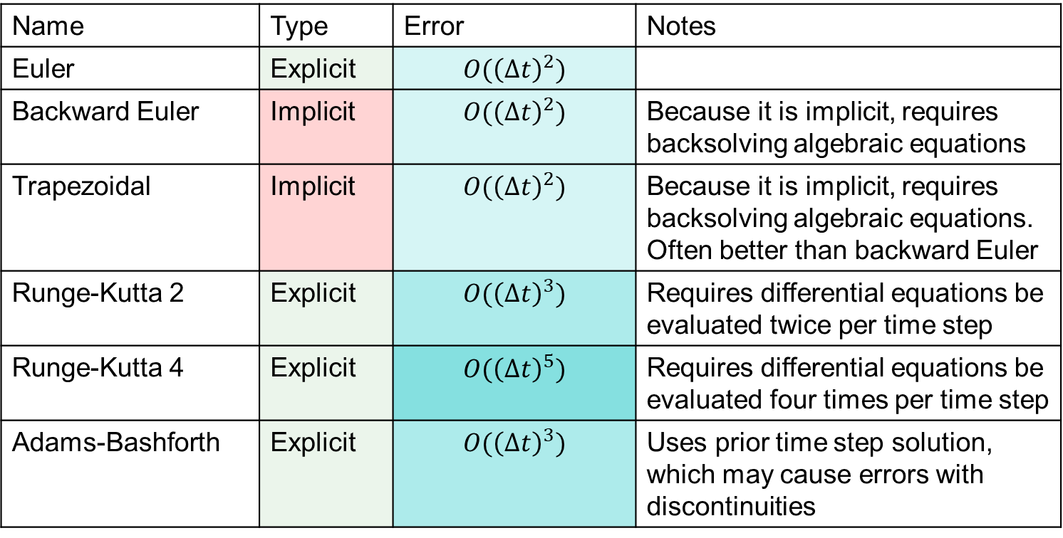
Summary of Methods
Name | Type | Error | Notes
Euler | Explicit | $$O({\left(Δt\right)}^{2})$$
Backward Euler | Implicit | $$O({\left(Δt\right)}^{2})$$ | Because it is implicit, requires backsolving algebraic equations
Trapezoidal | Implicit | $$O({\left(Δt\right)}^{2})$$ | Because it is implicit, requires backsolving algebraic equations. Often better than backward Euler
Runge-Kutta 2 | Explicit | $$O({\left(Δt\right)}^{3})$$ | Requires differential equations be evaluated twice per time step
Runge-Kutta 4 | Explicit | $$O({\left(Δt\right)}^{5})$$ | Requires differential equations be evaluated four times per time step
Adams-Bashforth | Explicit | $$O({\left(Δt\right)}^{3})$$ | Uses prior time step solution, which may cause errors with discontinuities
An advantage of implicit methods is they are numerically stable. But that doesn’t mean explicit methods wouldn’t be appropriate in many applications.
Note there are many versions of Runge-Kutta methods, some of which are implicit

Slide 4
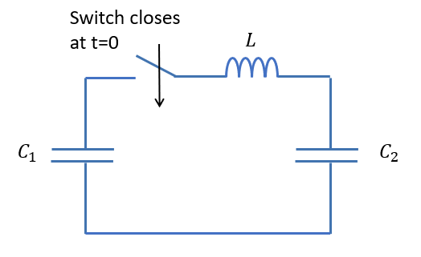
Returning to Example 1 (with the inductor)
Another way to state example 1 (part 2) is based on the current and voltage of the inductor
$\frac{di}{dt}=\frac{1}{L}v\left(t\right)$
$\frac{dv}{dt}=\frac{dv_{1}}{dt}−\frac{dv_{2}}{dt}=−i\left(t\right)\left(\frac{1}{C_{1}}+\frac{1}{C_{2}}\right)=−\frac{1}{c}i\left(t\right)$
Analytical solution: $v\left(t\right)=V_{0}cos⁡(ωt)$; $i\left(t\right)=\frac{V_{0}}{Z_{0}}sin⁡(ωt)$
Try formulating this for Euler
$i\left(t+Δt\right)=i\left(t\right)+Δt⋅\left(\frac{1}{L}v\left(t\right)\right)$
$v\left(t+Δt\right)=v\left(t\right)−Δt⋅\left(\frac{1}{C}i\left(t\right)\right)$
Now try Backward Euler and Trapezoidal

Slide 5
Example 1 part 2, with the Trapezoidal Method
Write the equations, then solve implicitly for $i(t+Δt)$
$v\left(t+Δt\right)=v\left(t\right)−\frac{Δt}{2C}\left(i\left(t\right)+i\left(t+Δt\right)\right)$
$i\left(t+Δt\right)=i\left(t\right)+\frac{Δt}{2L}\left(v\left(t\right)+v\left(t+Δt\right)\right)=\frac{\left(i\left(t\right)\left(1−\frac{{\left(Δt\right)}^{2}}{4LC}\right)+v\left(t\right)\frac{Δt}{L}\right)}{1+\frac{{\left(Δt\right)}^{2}}{4LC}}$
You can find a similar equation for $v(t+Δt)$, or just substitute in $i(t+Δt)$
Try Backward Euler, RK2, RK4, Adams-Bashforth

Slide 6
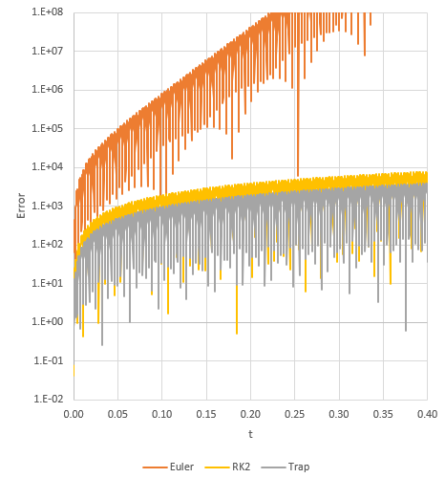
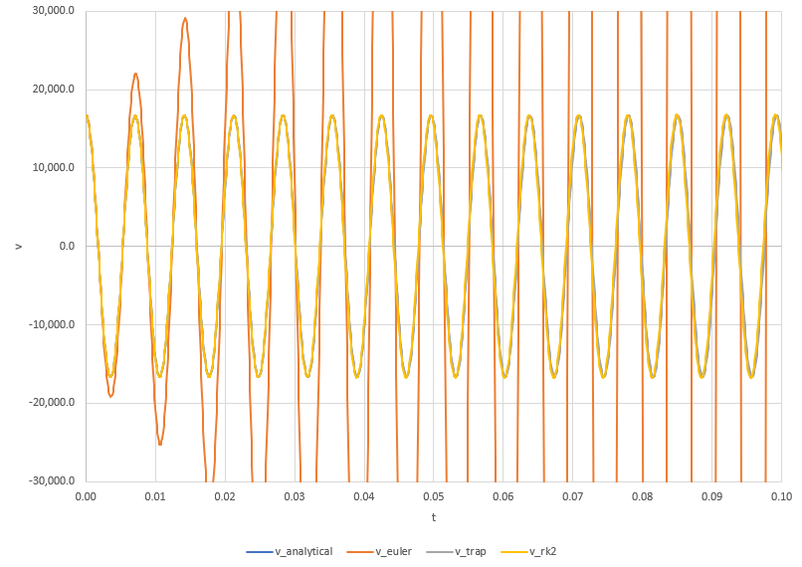
Numerical Results
$Δt=1e^{−4}$: Euler is unacceptable; Trap and RK2 are not too bad

Slide 7
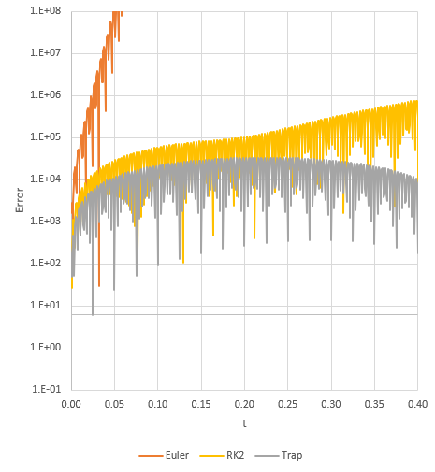
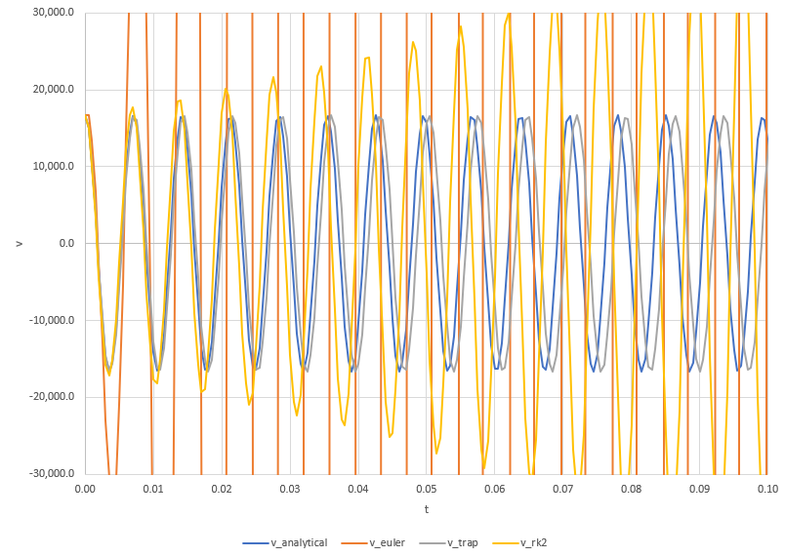
Numerical Results
Little, inconsequential ripples can mess up RK2
But when $Δt=5e^{−4}$, Trapezoidal is stable as opposed to RK2

Slide 8
Systematic Circuit Solving Method
We're going to work toward a systematic way to solve EMTs, based on the trapezoidal method for numerical integration
Let's start with just the following elements: resistors, voltage sources, current sources, and ideal transformers. Using the node-voltage representation, there are no differential equations and the solution at each time point can be written as a set of linear equations:
$$G⋅v=b$$
Where $v$ is the vector of node voltages (not including ground), matrix $G$ gives the linear coefficients and vector $b$ the right hand side of the equations
Most of the equations will be KCL summations, or ideal transformer relationships, or voltage sources
Solve for $v$ using sparse matrix techniques (described in ECEN 615)

Slide 9
Example 8
Formulate the following circuit as $G⋅v(t)=b(t)$ for the generic timestep $t$
Four non-ground nodes; four equations
V1 is a voltage source equation, V4 is KCL with a current source
V2 and V3 have two equations: transformer relationship and KCL

Slide 10

Example 8, cont.
$$\left[\begin{matrix}1 & 0 & 0 & 0 \\ 0 & 1 & −2 & 0 \\ −\frac{1}{5} & \frac{1}{5} & \frac{1}{7}+\frac{1}{12} & −\frac{1}{12} \\ 0 & 0 & −\frac{1}{12} & \frac{1}{12}+\frac{1}{9}\end{matrix}\right]\left[\begin{matrix}V_{1} \\ V_{2} \\ V_{3} \\ V_{4}\end{matrix}\right]=\left[\begin{matrix}10\cos\left(377t\right) \\ 0 \\ 0 \\ 0.2\cos\left(3000t\right)\end{matrix}\right]$$
First row: V1 is a constant source
Second row: ideal transformer relationship
Third row: KCL for combined V2 and V3 "super node"
Fourth row: KCL for V4, with the current source injection
At each time step:
Evaluate the right hand side
Solve for the vector V

Slide 11
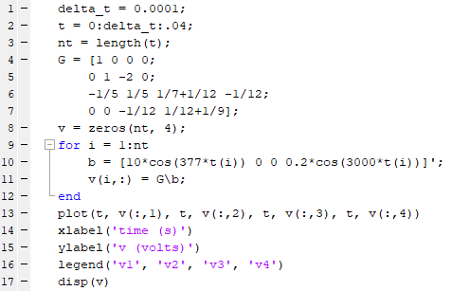
Trying it out in Matlab
We're not doing any derivatives here, just showing how the higher frequency current source interacts with the main power frequency of the voltage source

