Slide 1
ECEN 616, Spring 2025 Methods of Electric Power System Analysis
Class 3: Numerical Methods, Part 1
Prof. Adam Birchfield
Dept. of Electrical and Computer Engineering
Texas A&M University
abirchfield@tamu.edu

Slide 2
Principles of Electromagnetic Transient Analysis
You must understand your model.
Models must be validated.
Against your intuition (try ultra-simple, very predictable cases)
Against other models (both simpler and more complex)
Against real data (field measurement and lab tests)
EMT studies apply best to certain studies.
Transient conditions as opposed to steady-state
Very high frequency, short-duration events (roughly 1 kHz to 1 GHz)
Transmission or distribution, balanced or unbalanced
Electronic controls, lightning, and switching surges are key applications
Circuit theory fundamentals always apply.
KVL, KCL, equations for RLC
Conservation of charge, conservation of energy

Slide 3
Principles of Electromagnetic Transient Analysis
Power flow assumptions do NOT always apply.
Voltage and current are not phasors, be careful with reactive power
Impedance varies with frequency, t-lines aren’t usually PI models
Three-phase systems will usually be modeled in full, not with positive sequence
System is not in steady state, loads are rarely constant power
EMT programs use numerical methods that are subject to conditioning and convergence errors, and numerical instability.
Grounding is often modeled explicitly.
Longer transmission lines typically decouple the model.
Because there is not enough time for the signal to propagate down the line and back
Modeling decisions must be made based on the questions you are trying to answer.

Slide 4
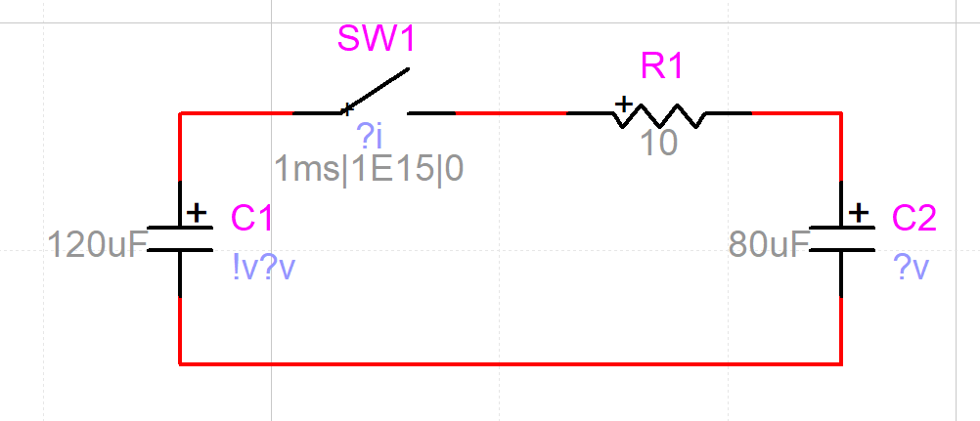
Exercise 1 in EMTP
EMTP is a commercial software that we may get to try later in the class
It is possible to confirm results with it

Slide 5
Homework
By today
Finish example 1 using analytical methods (ODE’s, Laplace, etc.)
Plot results using Matlab (or Python/etc.)
Next class 1/28
Try solving it with Euler’s method – compare different time steps.
Read Chapter 2 of the Dommel EMTP theory book.
Next Thursday 1/30
Try solving it with the 2nd order Runge-Kutta method
Read the following paper:
T. Noda, K. Takenaka and T. Inoue, "Numerical Integration by the 2-Stage Diagonally Implicit Runge-Kutta Method for Electromagnetic Transient Simulations," in IEEE Transactions on Power Delivery, vol. 24, no. 1, pp. 390-399, Jan. 2009.

Slide 6
What’s the Solution to this Differential Equation?
$\dot{x}\left(t\right)=f\left(t\right)=−x(t)$, $x\left(0\right)=1$
Analytical solution: $x\left(t\right)=e^{−t}$
Numerical methods: solving successive time values separated by $Δt$
Euler, or Forward Euler, is the simplest explicit method
Backward Euler, is the simplest implicit method
Trapezoidal, implicit method sort of like an average of Forward and Backward Euler
Runge-Kutta 2, explicit method based on further expansion of Taylor series
Runge-Kutta 4, extended version of RK2
Adams-Bashforth, a multi-step explicit method
Other methods…
Euler’s method says: $x\left(t+Δt\right)=x\left(t\right)+Δt⋅f\left(t\right)$
So for this example, $x\left(t+Δt\right)=x\left(t\right)+Δt⋅\left(−x\left(t\right)\right)=x\left(t\right)⋅(1−Δt)$
Table on right shows for $Δt=0.1$
t | Analytical | Euler
0 | 1 | 1
0.1 | 0.90484 | 0.90000
0.2 | 0.81873 | 0.81000
0.3 | 0.74082 | 0.72900
0.4 | 0.67032 | 0.65610
0.5 | 0.60653 | 0.59049
0.6 | 0.54881 | 0.53144

Slide 7
Definition of Other Methods
Backward Euler, is the simplest implicit method
Definition: $x\left(t+Δt\right)=x\left(t\right)+Δt⋅f\left(t+Δt\right)$
This means we have to do some algebraic manipulation (implicit method)
For our example: $x\left(t+Δt\right)=x\left(t\right)+Δt⋅\left(−x\left(t+Δt\right)\right)$
Solve for $x\left(t+Δt\right)=x\left(t\right)⋅\left(\frac{1}{1+Δt}\right)$
Trapezoidal, implicit method averaging Forward and Backward Euler
Definition: $x\left(t+Δt\right)=x\left(t\right)+\frac{Δt}{2}\left(f\left(t\right)+f\left(t+Δt\right)\right)$
For our example: $x\left(t+Δt\right)=x\left(t\right)+\frac{Δt}{2}⋅\left(−x(t)−x\left(t+Δt\right)\right)$
Solve again: $x\left(t+Δt\right)=x\left(t\right)\frac{1−{Δt}/2}{1+{Δt}/2}$
For both of these methods, we rely on being able to solve back for $x(t+Δt)$, which may not be easy for complicated non-linear functions
Theoretical error for any of these first three is $O({\left(Δt\right)}^{2})$

Slide 8
Definition of Other Methods, Continued
Runge-Kutta 2, explicit method based on second-order approximation of Taylor series (considering $f$ as a function of both $x$ and $t$)
$k_{1}=Δt⋅f(x(t), t)$ (This is the same as Euler term)
$k_{2}=Δt⋅f(x(t)+k_{1}, t+Δt)$
$x\left(t+Δt\right)=x\left(t\right)+\frac{1}{2}k_{1}+\frac{1}{2}k_{2}$
Derivation of this is given on the next two slides, for reference.
Runge-Kutta 4, extended version of RK2 to the fourth-order polynomial
$k_{1}=Δt⋅f\left(x\left(t\right), t\right)$
$k_{2}=Δt⋅f(x(t)+k_{1}/2, t+Δt/2)$
$k_{3}=Δt⋅f(x(t)+k_{2}/2, t+Δt/2)$
$k_{4}=Δt⋅f(x(t)+k_{3}, t+Δt)$
$x\left(t+Δt\right)=x\left(t\right)+(k_{1}+2k_{2}+2k_{3}+k_{4})/6$

Slide 9
Derivation of the Runge-Kutta 2nd Order Model
Take the Taylor series of $x(t+Δt)$ out to the second order
$x\left(t+Δt\right)=x\left(t\right)+Δt⋅f\left(x\left(t\right),t\right)+\left(\frac{Δt^{2}}{2}\right)\frac{df}{dt}\left(x\left(t\right), t\right)+O({\left(Δt\right)}^{3})$
$=x\left(t\right)+Δt⋅f\left(x\left(t\right),t\right)+\left(\frac{Δt^{2}}{2}\right)\left[\frac{∂f}{∂x}f+\frac{∂f}{∂t}\right]\left(x\left(t\right), t\right)+O({\left(Δt\right)}^{3})$
Now try to find a method with the following form
$k_{1}=Δt⋅f(x(t), t)$
$k_{2}=Δt⋅f(x(t)+βk_{1}, t+αΔt)$
$x\left(t+Δt\right)=x\left(t\right)+ak_{1}+bk_{2}$
Expand $k_{2}$ with a multi-variable Taylor series
$k_{2}=Δt \left(f\left(x\left(t\right),t\right)+\frac{∂f}{∂x}βk_{1}+\frac{∂f}{∂x}αΔt+O\left({\left(Δt\right)}^{2}\right)\right)$
Remember $f=\frac{dy}{dt}$

Slide 10
Derivation of the RK2, continued
Now plug in expanded version of k2 and k1
$$x\left(t+Δt\right)=x\left(t\right)+aΔt⋅f(x(t), t)+bΔt \left(f\left(x\left(t\right),t\right)+\frac{∂f}{∂x}βk_{1}+\frac{∂f}{∂x}αΔt+O\left({\left(Δt\right)}^{2}\right)\right)$$
$$=x\left(t\right)+(a+b)Δt⋅f(x(t), t)+βb{\left(Δt\right)}^{2}\frac{∂f}{∂x}f+αb{\left(Δt\right)}^{2}\frac{∂f}{∂x}+O\left({\left(Δt\right)}^{3}\right)$$
Comparing coefficients to the full Taylor series, we get $a+b=1;βb=\frac{1}{2};αb=\frac{1}{2}$
Arbitrarily choose $b=\frac{1}{2}$ and we get $a=\frac{1}{2};α=1;β=1$
Resulting formulation has error of $O\left({\left(Δt\right)}^{3}\right)$
Similar derivation for fourth-order Runge-Kutta, with error $O\left({\left(Δt\right)}^{5}\right)$
These are explicit methods, no need to solve algebraic equations

Slide 11
Definition of Other Methods, Continued
Adams-Bashforth, a multi-step explicit method
Definition: $x\left(t+Δt\right)=x\left(t\right)+\frac{Δt}{2}\left(3f\left(x\left(t\right),t\right)−f(x\left(t−Δt\right), t−Δt)\right)$
Notice it uses the prior time step $(t−Δt)$
This is good computationally since we should have this data already.
But one issue is nonlinearities and discontinuities
Error is order $O\left({\left(Δt\right)}^{3}\right)$
There are many other methods, including Adams-Moulton, predictor-corrector, along with higher-order RK methods

Slide 12
Summary of Methods
Name | Type | Error | Notes
Euler | Explicit | $$O({\left(Δt\right)}^{2})$$
Backward Euler | Implicit | $$O({\left(Δt\right)}^{2})$$ | Because it is implicit, requires backsolving algebraic equations
Trapezoidal | Implicit | $$O({\left(Δt\right)}^{2})$$ | Because it is implicit, requires backsolving algebraic equations. Often better than backward Euler
Runge-Kutta 2 | Explicit | $$O({\left(Δt\right)}^{3})$$ | Requires differential equations be evaluated twice per time step
Runge-Kutta 4 | Explicit | $$O({\left(Δt\right)}^{5})$$ | Requires differential equations be evaluated four times per time step
Adams-Bashforth | Explicit | $$O({\left(Δt\right)}^{3})$$ | Uses prior time step solution, which may cause errors with discontinuities
An advantage of implicit methods is they are numerically stable. But that doesn’t mean explicit methods wouldn’t be appropriate in many applications.
Note there are many versions of Runge-Kutta methods, some of which are implicit

Slide 13
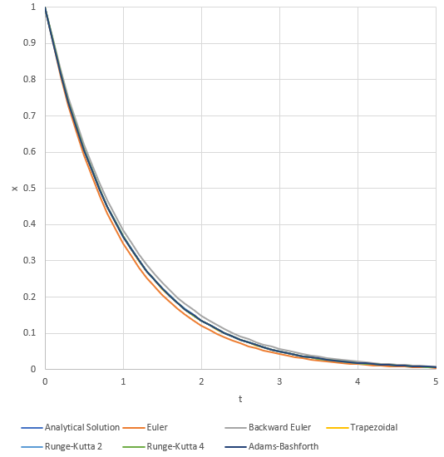
Numerical Experiments
t | Analytical Solution | Euler | Backward Euler | Trapezoidal | Runge-Kutta 2 | Runge-Kutta 4 | Adams-Bashforth
0 | 1 | 1 | 1 | 1 | 1 | 1 | 1
0.1 | 0.904837 | 0.9 | 0.909091 | 0.904762 | 0.905 | 0.904838 | 0.9
0.2 | 0.818731 | 0.81 | 0.826446 | 0.818594 | 0.819025 | 0.818731 | 0.815
0.3 | 0.740818 | 0.729 | 0.751315 | 0.740633 | 0.741218 | 0.740818 | 0.73775
0.4 | 0.67032 | 0.6561 | 0.683013 | 0.670096 | 0.670802 | 0.67032 | 0.667838
0.5 | 0.606531 | 0.59049 | 0.620921 | 0.606278 | 0.607076 | 0.606531 | 0.604549
0.6 | 0.548812 | 0.531441 | 0.564474 | 0.548537 | 0.549404 | 0.548812 | 0.547259
0.7 | 0.496585 | 0.478297 | 0.513158 | 0.496295 | 0.49721 | 0.496586 | 0.495397
0.8 | 0.449329 | 0.430467 | 0.466507 | 0.449029 | 0.449975 | 0.449329 | 0.448451
0.9 | 0.40657 | 0.38742 | 0.424098 | 0.406264 | 0.407228 | 0.40657 | 0.405953
1 | 0.367879 | 0.348678 | 0.385543 | 0.367573 | 0.368541 | 0.36788 | 0.367483
1.1 | 0.332871 | 0.313811 | 0.350494 | 0.332566 | 0.33353 | 0.332871 | 0.332658
1.2 | 0.301194 | 0.28243 | 0.318631 | 0.300893 | 0.301844 | 0.301195 | 0.301133
1.3 | 0.272532 | 0.254187 | 0.289664 | 0.272236 | 0.273169 | 0.272532 | 0.272596
1.4 | 0.246597 | 0.228768 | 0.263331 | 0.246309 | 0.247218 | 0.246597 | 0.246763
1.5 | 0.22313 | 0.205891 | 0.239392 | 0.222851 | 0.223732 | 0.22313 | 0.223379
1.6 | 0.201897 | 0.185302 | 0.217629 | 0.201627 | 0.202478 | 0.201897 | 0.20221
1.7 | 0.182684 | 0.166772 | 0.197845 | 0.182425 | 0.183242 | 0.182684 | 0.183048
1.8 | 0.165299 | 0.150095 | 0.179859 | 0.165051 | 0.165834 | 0.165299 | 0.165701
1.9 | 0.149569 | 0.135085 | 0.163508 | 0.149332 | 0.15008 | 0.149569 | 0.149998
2 | 0.135335 | 0.121577 | 0.148644 | 0.13511 | 0.135822 | 0.135336 | 0.135783

Slide 14
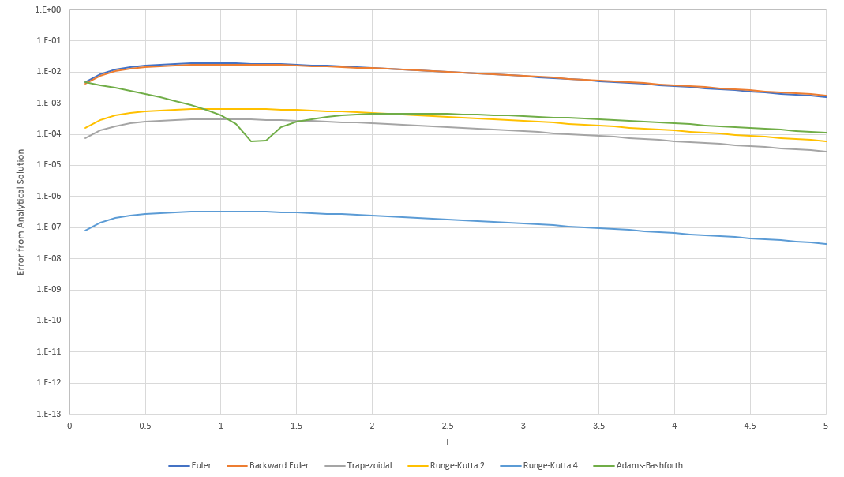
Error Analysis

