Slide 1
ECEN 616, Spring 2025 Methods of Electric Power System Analysis
Class 2: Principles of Electromagnetic Transient Analysis, Part 2
Prof. Adam Birchfield
Dept. of Electrical and Computer Engineering
Texas A&M University
abirchfield@tamu.edu

Slide 2
Announcements
Course website: https://birchfield.engr.tamu.edu/616s25/
Syllabus on website gives detailed course info
Textbooks: Greenwood and Dommel
For next Tuesday, finish your own calculations for Example 1, including Matlab plots and the inductive version
Office hours: Tuesday 3-4pm

Slide 3
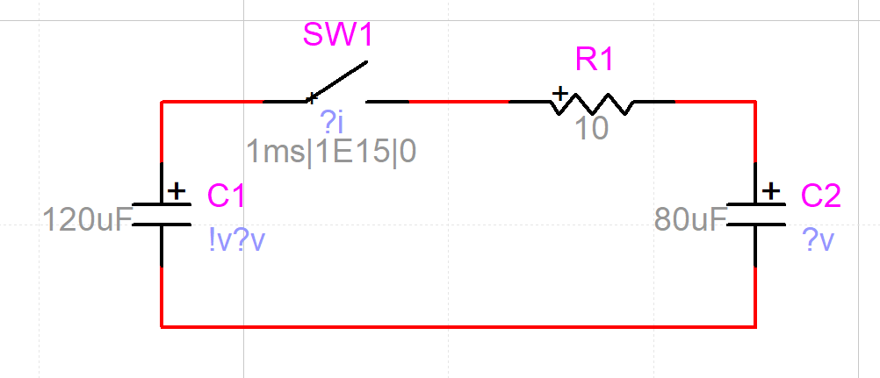
Exercise 1 in EMTP
EMTP is a commercial software that we may get to try later in the class
It is possible to confirm results with it

Slide 4
What This Class Will Cover
Electromagnetic Transients Theory
Principles of transient analysis
Analytical methods for solving transient problems
Numerical methods for solving transient problems
Block element models
Transmission line models (overhead/underground, single-phase/multi-phase, frequency dependent)
Transformer models
Electromagnetic Transients Applications
Capacitor and reactor switching
Transmission line switching
Lightning studies and insulation coordination
Transients with power-electronics components
Electric field coupling

Slide 5
Discussion: Reading Assignment

Slide 6
Principles of Electromagnetic Transient Analysis
You must understand your model.
Models must be validated.
Against your intuition (try ultra-simple, very predictable cases)
Against other models (both simpler and more complex)
Against real data (field measurement and lab tests)
EMT studies apply best to certain studies.
Transient conditions as opposed to steady-state
Very high frequency, short-duration events (roughly 1 kHz to 1 GHz)
Transmission or distribution, balanced or unbalanced
Electronic controls, lightning, and switching surges are key applications
Circuit theory fundamentals always apply.
KVL, KCL, equations for RLC
Conservation of charge, conservation of energy

Slide 7
Principles of Electromagnetic Transient Analysis
Power flow assumptions do NOT always apply.
Voltage and current are not phasors, be careful with reactive power
Impedance varies with frequency, t-lines aren’t usually PI models
Three-phase systems will usually be modeled in full, not with positive sequence
System is not in steady state, loads are rarely constant power
EMT programs use numerical methods that are subject to conditioning and convergence errors, and numerical instability.
Grounding is often modeled explicitly.
Longer transmission lines typically decouple the model.
Because there is not enough time for the signal to propagate down the line and back
Modeling decisions must be made based on the questions you are trying to answer.

