Slide 1
ECEN 616, Spring 2025 Methods of Electric Power System Analysis
Class 1: Principles of Electromagnetic Transient Analysis, Part 1
Prof. Adam Birchfield
Dept. of Electrical and Computer Engineering
Texas A&M University
abirchfield@tamu.edu

Slide 2
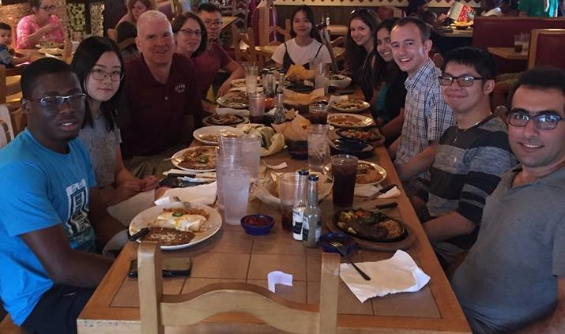
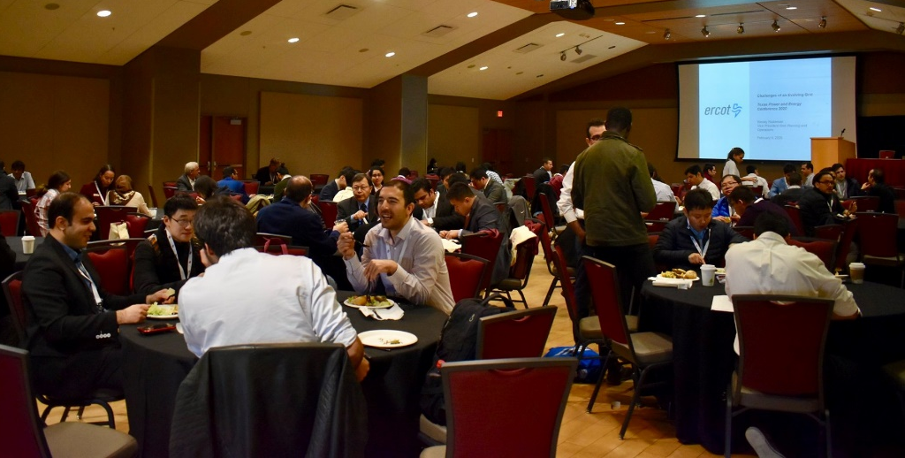
Energy and Power Group at Texas A&M
Texas A&M is a leader in power and energy research!
14+ Faculty members in various expertise areas of power systems, power electronics, and electric machines
Get connected!
Top: Smart grid control center facility in the center for infrastructure renewal on the RELLIS campus
Left: End of semester research group lunch
Right: TPEC is our graduate student-led IEEE technical conference that happens every year in February.

Slide 3
Welcome to ECEN 616!
Course website: https://birchfield.engr.tamu.edu/616s25/
Syllabus on website gives detailed course info
Textbooks: Greenwood and Dommel
Evaluation
10% Class participation. Attend class, do assigned reading, and contribute to class discussion.
30% Exam 1. Tentatively Thursday, March 6th.
30% Exam 2. Tentatively Tuesday, April 15th.
30% Project. Written reports tentatively due Tuesday, April 22nd at 8:00am.

Slide 4
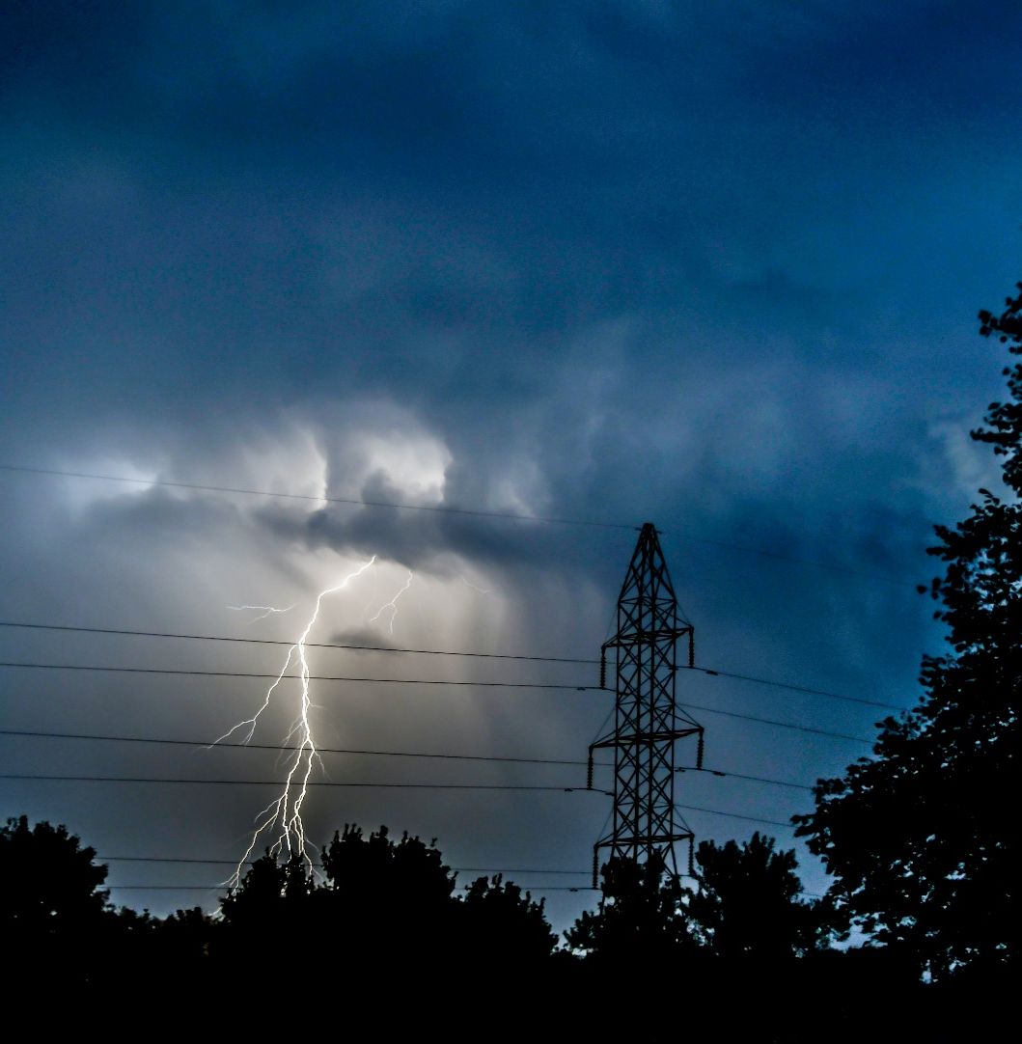
What This Class Will Cover
Electromagnetic Transients Theory
Principles of transient analysis
Analytical methods for solving transient problems
Numerical methods for solving transient problems
Block element models
Transmission line models (overhead/underground, single-phase/multi-phase, frequency dependent)
Transformer models
Electromagnetic Transients Applications
Capacitor and reactor switching
Transmission line switching
Lightning studies and insulation coordination
Transients with power-electronics components
Electric field coupling

Slide 5
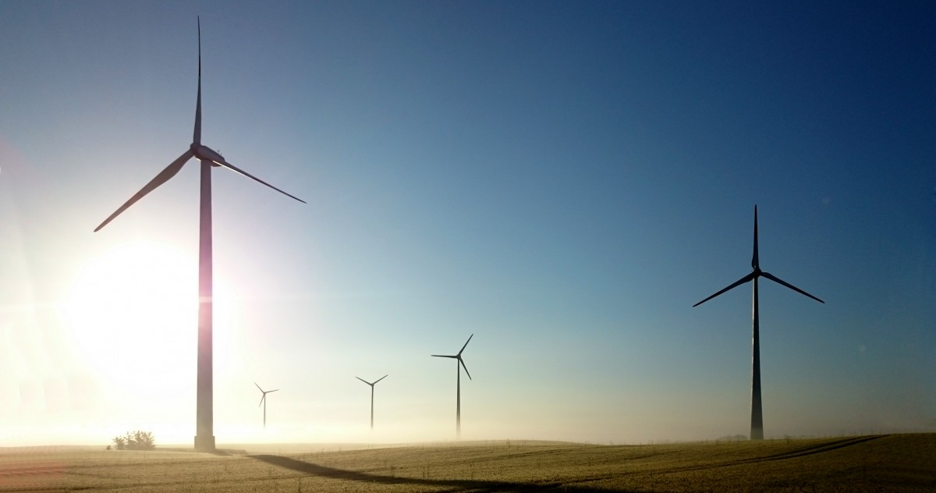
Reminders
Reading assignments for next class:
Go to the NERC Major Event Report Page: https://www.nerc.com/pa/rrm/ea/Pages/Major-Event-Reports.aspx
Read either the “April 2023 Southwest Utah Disturbance Report”
Take notes and be prepared to discuss on Thursday
If you need accommodation for a disability, talk to the Disability Resources office and me as soon as you can.
Office hours: Tuesdays 3:00 to 4:00 pm

Slide 6
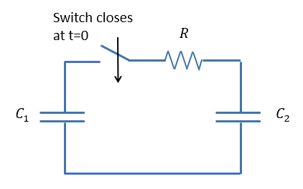
Exercise 1
$C_{1}=120 μF$ ; $C_{2}=80μF$ ; $R=10 Ω$
Initial charge on $C_{1}$ is 2 Coulombs; $C_{2}$ is discharged.
What happens to the current, voltages, charges, power, and energy?
Use Matlab or Python to plot current, voltages, charges, power, and energy.
Then solve it again, replacing the resistor with a 26.5 mH inductor.

Slide 7
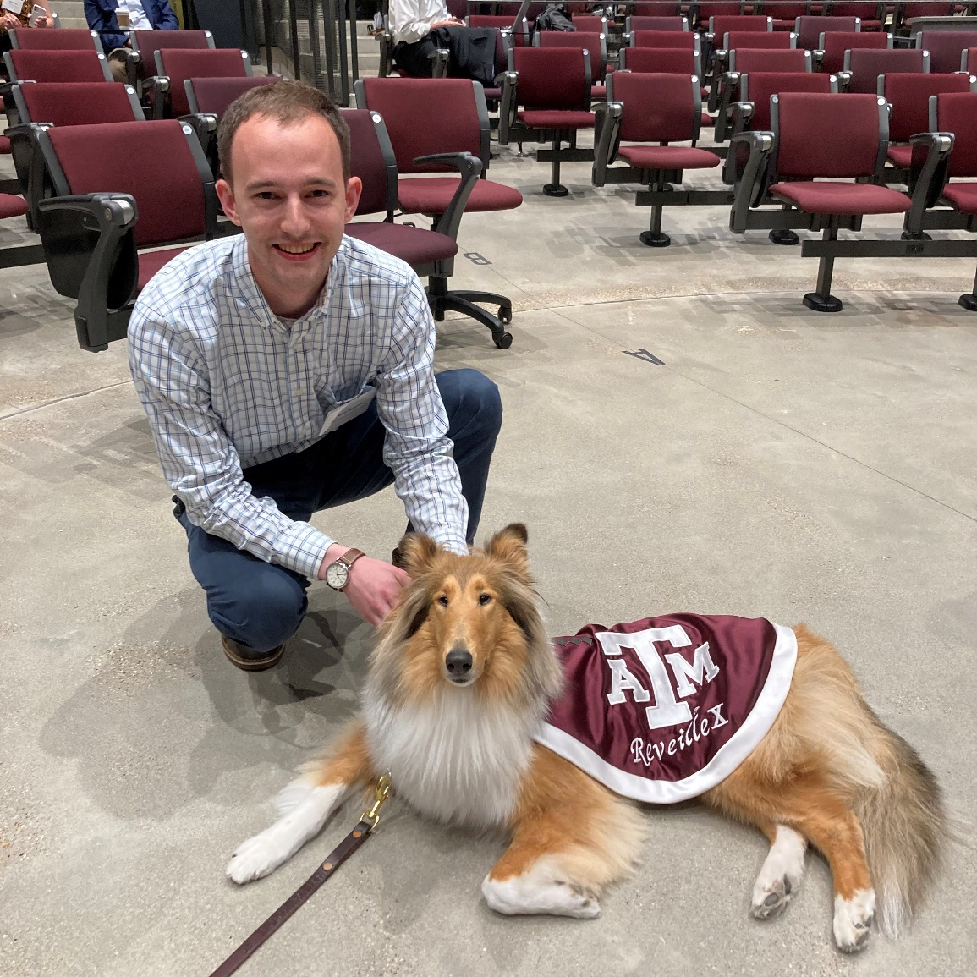
Aggie Core Values and Aggie Honor Code
Aggie Core Values
Respect
Excellence
Leadership
Loyalty
Integrity
Selfless Service
Aggie Honor Code: An Aggie does not lie, cheat, or steal, or tolerate those who do.
Reveille and I hope you have a great semester!

