Slide 1
ECEN 460, Spring 2024
Power System Operation and Control
Class 22: Additional Dynamics Topics
Prof. Adam Birchfield
Dept. of Electrical and Computer Engineering
Texas A&M University
abirchfield@tamu.edu

Slide 2
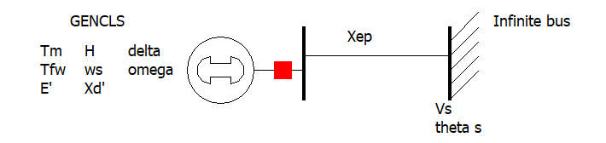
The Generator Dynamic Equations We Will Use
Example power system problem with differential algebraic equations (DAEs) is the classical synchronous generator connected to an infinite bus.
The two differential variables are $δ$ and $ω$; in practice dynamic models can have many more.
Generator Parameters
$H$ is the machine inertia constant (in seconds)
$ω_{s}$ is the synchronous frequency (2$π$60)
$T_{m}$ is the mechanical torque (power being supplied by the prime mover)
$E^{′}$ is the generator internal voltage, as controlled by the excitation system
$X_{d}^{′}$ is the generator transient impedance
$D$ damping constant of the generator
Infinite Bus / System
The infinite bus is defined by a Thevenin equivalent with voltage
$V_{s}∠θ_{vs}$
And reactance $X_{ep}$
These are the harder variables to get.
$\dot{δ} =ω$
$\frac{2H}{ω_{s}}\dot{ω}=T_{M}−\frac{E^{′}V_{s}}{X_{d}^{′}+X_{ep}}\sin\left(δ−θ_{vs}\right)−D⋅ω$

Slide 3
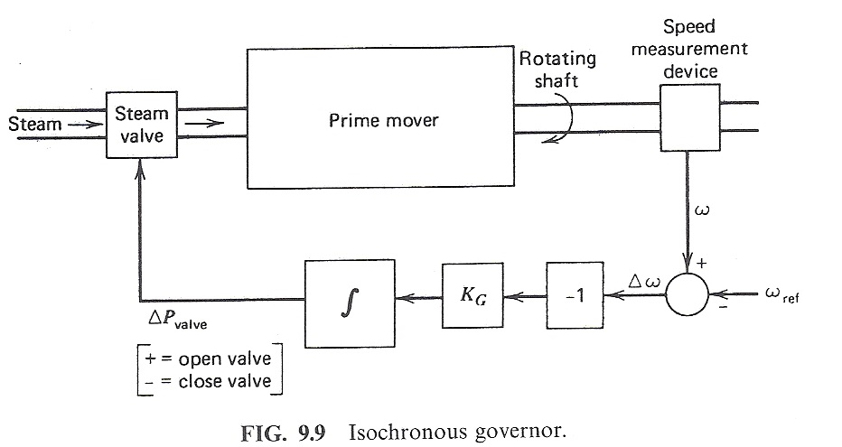
Control of Generation Overview
Goal is to maintain constant frequency with changing load
If there is just a single generator, such with an emergency generator or isolated system, then an isochronous governor is used
  Integrates frequency error to insure frequency goes back to
  the desired value
  Cannot be used with
  interconnected systems
  because of "hunting"
Image source: Wood/Wollenberg, 2nd edition

Slide 4
Isochronous Gen Example
WSCC 9 bus from before, gen 3 dropping (85 MW)
  No infinite bus, gen 1 is modeled with an isochronous generator (PW ISOGov1 model)
Gen 2 is modeled with a TGOV1 governor
Case is wscc_9bus_ISOGOV

Slide 5
Isochronous Gen Example
Graph shows the change in the mechanical output
Most of the change
in MWs due
to the loss of
gen 3 is
being picked
up by gen 1. This would not work in a large system.

Slide 6
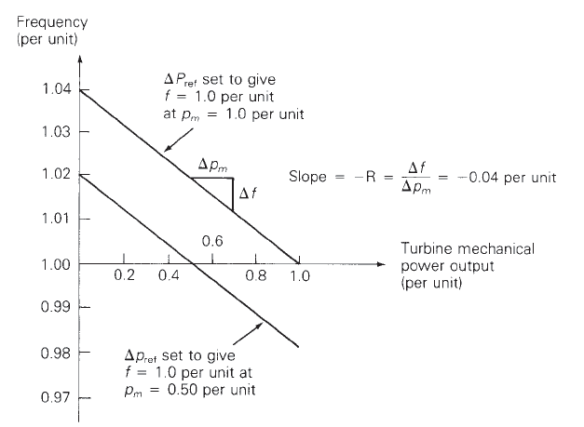
Droop Control
To allow power sharing between generators the solution is to use what is known as droop control, in which the desired set point frequency is dependent upon the generator’s output
R is known as the regulation constant or droop; a typical value is 4 or 5%.
At 60 Hz and a 5% droop, each 0.1 Hz change would change the output by 0.1/(60*0.05)=
3.33%

Slide 7
WSCC 9 Bus Droop Example
Assume the previous gen 3 drop contingency (85 MW), and that gens 1 and 2 have ratings of 500 and 250 MVA respectively and governors with a 5% droop. What is the final frequency (assuming no change in load)?
To solve the problem in per unit, all values need to be on a common base (100 MVA)
$$Δp_{m1}+Δp_{m2}=85/100=0.85 \\ R_{1,100MVA}=R_{1}\frac{100}{500}=0.01, R_{2,100MVA}=R_{2}\frac{100}{250}=0.02 \\ Δp_{m1}+Δp_{m2}=−\left(\frac{1}{R_{1,100MVA}}+\frac{1}{R_{2,100MVA}}\right)Δf=0.85 \\ Δf=−.85/150=0.00567=−0.34 \text{Hz}→59.66 \text{Hz}$$

Slide 8
WSCC 9 Bus Droop Example
The below graphs compare the mechanical power and generator speed; note the steady-state values match the calculated 59.66 Hz value
Case is wscc_9bus_TGOV1

Slide 9
WSCC 9 Bus Droop Example: R=0.01
Changing to the droop to 0.01 results in less steady-state frequency error, but at the cost of a faster generator response

Slide 10
Quick Interconnect Calculation
When studying a system with many generators, each with the same (or close) droop, then the final frequency deviation is
The online generator summation should only include generators that actually have governors that can respond, can move in the desired direction, and it does not take into account generators hitting their limits
The online generators
do not include the contingency generator(s)

Slide 11
Larger System Example (Prob 6.11)
As an example, consider the 37 bus, nine generator example from earlier; assume one generator with 42 MW is opened. The total MVA of the remaining generators is 1132. With R=0.05
Case is Bus37_TGOV1

Slide 12
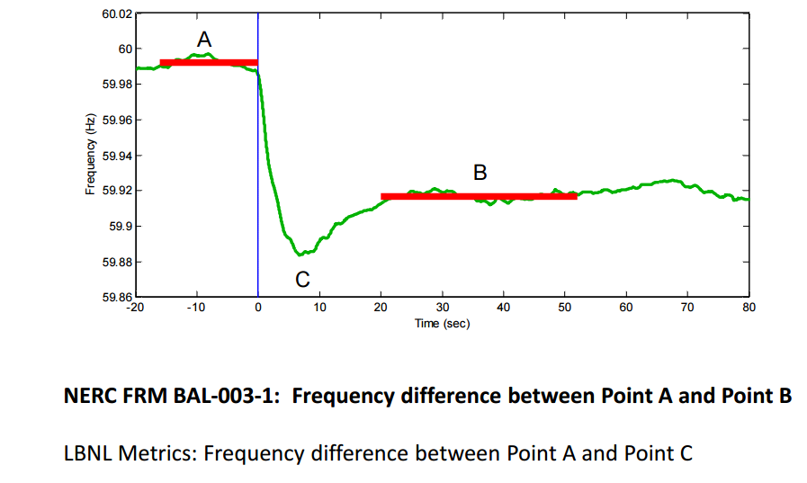
Frequency Response Measure
Source: wecc.biz/Reliability/Frequency%20Response%20Analysis%20-%20Dmitry%20Kosterev.pdf

Slide 13
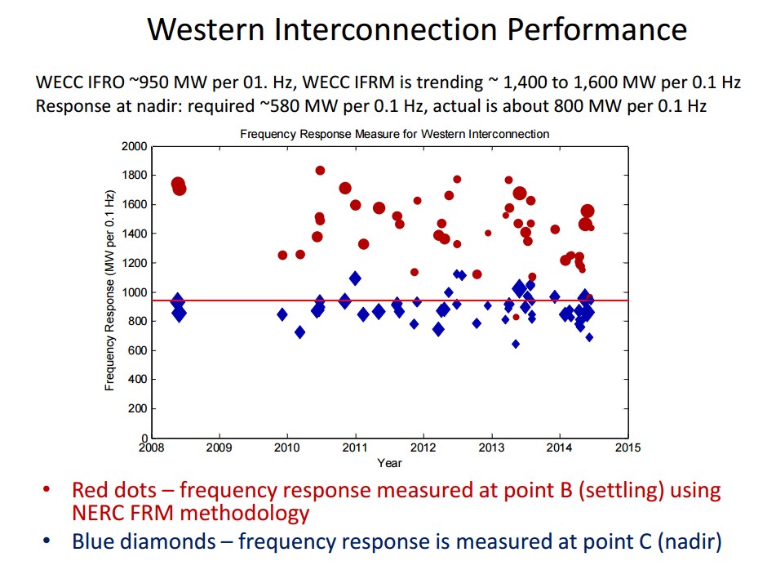
WECC Interconnection Performance
Higher values
are better!
Source: wecc.biz/Reliability/Frequency%20Response%20Analysis%20-%20Dmitry%20Kosterev.pdf

Slide 14
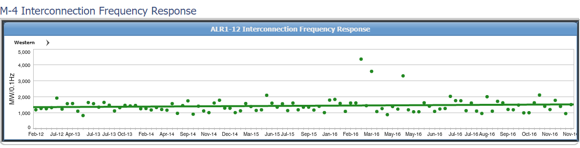
WECC Interconnect Frequency Response
Data for the four major interconnects is available from NERC; these are the values between points A and B
www.nerc.com/pa/RAPA/ri/Pages/InterconnectionFrequencyResponse.aspx

Slide 15
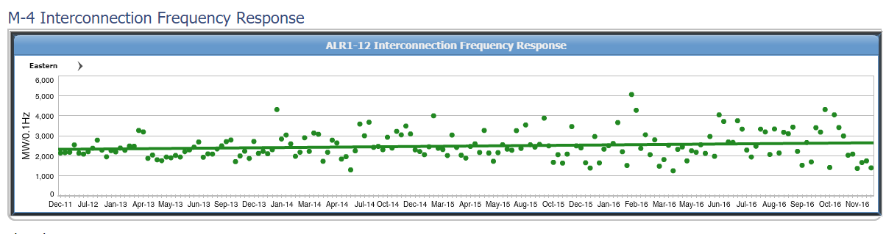
Eastern Interconnect Frequency Response
www.nerc.com/pa/RAPA/ri/Pages/InterconnectionFrequencyResponse.aspx

Slide 16
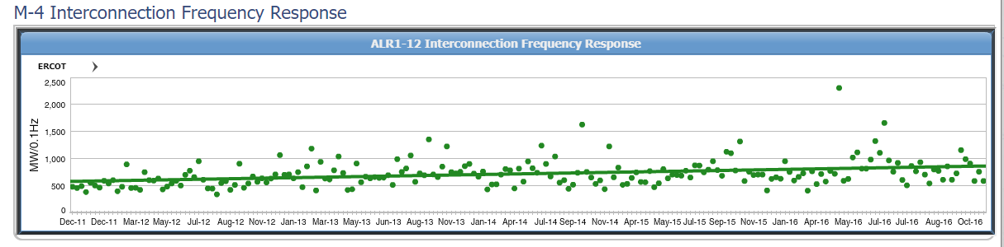
ERCOT Frequency Response
As expected, smaller grids have greater frequency sensitivity
www.nerc.com/pa/RAPA/ri/Pages/InterconnectionFrequencyResponse.aspx

Slide 17
Frequency Response Definition
FERC defines in RM13-11: “Frequency response is a measure of an Interconnection’s ability to stabilize frequency immediately following the sudden loss of generation or load, and is a critical component of the reliable operation of the Bulk-Power System, particularly during disturbances and recoveries.”
Design Event for WECC is N-2 (Palo Verde Outage) not to result in under frequency load shed (UFLS) (59.5 Hz in WECC)
ERCOT requires 5% load shed at 59.3 Hz, 10% at 58.9 Hz, and 10% at 58.5 Hz
Source: wecc.biz/Reliability/Frequency%20Response%20Analysis%20-%20Dmitry%20Kosterev.pdf

Slide 18
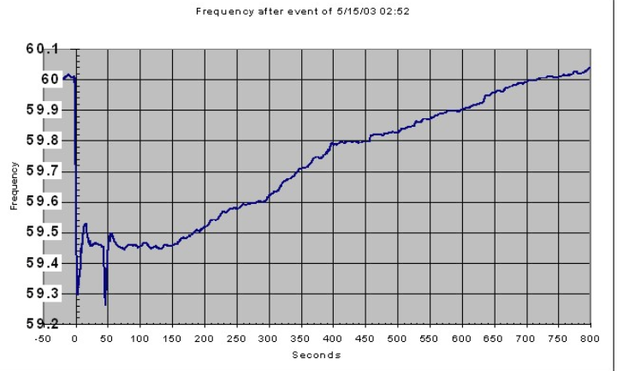
ERCOT May 15, 2003 event
On May 15, 2003 at 2:54 am
both Comanche Peak nuclear
units tripped due to breaker
failure from a lightning strike
  Located by Glen Rose, SW of Fort Worth
  2275 MW gen tripped immediately, 1146 MW also tripped within seconds, and 775 MW about 43 seconds afterwards
  System frequency got down to 59.26 Hz
471 MW of high-set under frequency load tripped at 59.7 Hz, and 1549 MW tripped at 59.3
Image source: ERCOT TAC Meeting, June 4, 2003 Presentation at http://slideplayer.com/slide/4543302/

Slide 19
Transient Stability Load Modeling
Load modeling is certainly challenging!
For large system models an aggregate load can consist of many thousands of individual devices
The load is constantly changing, with key diurnal and temperature variations
  For example, a higher percentage of lighting load at night, more air conditioner load on hot days
Load model behavior can be quite complex during the low voltages that may occur in transient stability
Testing aggregate load models for extreme conditions is not feasible – we need to wait for disturbances!

Slide 20
Transient Stability Load Modeling
Traditionally load models have been divided into two groups
  Static: load is a algebraic function of bus voltage and sometimes frequency
  Dynamic: load is represented with a dynamic model, with induction motor models the most common
The simplest load model is a static constant impedance
  Has been widely used
  Allowed the Ybus to be reduced, eliminating essentially all non-generator buses
  Presents no issues as voltage falls to zero
  Is rapidly falling out of favor

Slide 21
Induction Motor Models
Induction motors, both three phase and single phase, make up a very large percentage of the load
Term induction machine is used to indicate either generator or motor; most uses are as motors
Induction machines have two major components
  A stationary stator, which is supplied with an ac voltage; windings in stator create a rotating magnetic field
  A rotating rotor, in which an ac current is induced (hence the name)
Two basic design types based on rotor design
  Squirrel-cage: rotor consists of shorted conducting bars laid into magnetic material in a cage structure
  Wound-rotor: rotor has windings similar to stator, with slip rings used to provide external access to the rotor windings

Slide 22
Torque-Speed Curves
To help understand the behavior of an induction machine it is useful to plot various values as a function of speed (or equivalently, slip)
  Solve the equivalent circuit for a specified terminal voltage, and varying values of slip
  Plot results
  Recall torque times speed = power
    Here speed is the rotor speed
  When using per unit, the per unit speed is just 1-s, so
  PE = TE(1-s)

Slide 23
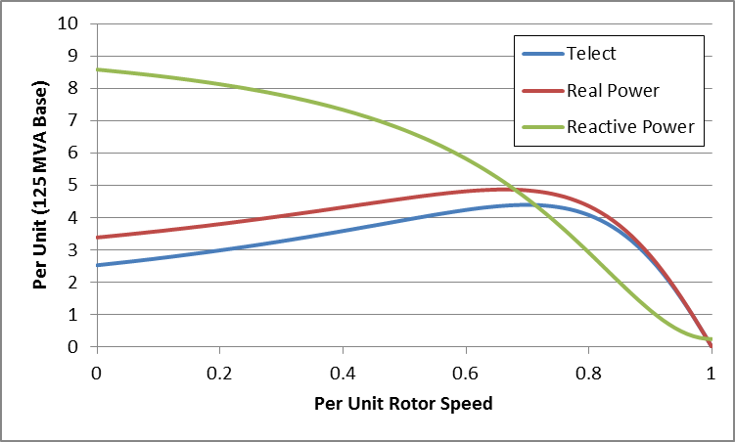
Induction Motor Example Torque-speed Curves
The below graph shows the torque-speed curve for this induction machine; note the high reactive power consumption on starting (which is why the lights may dim when starting a clothes dryer!)
From the graph
you can see with
a 100 MW load
(0.8 pu on the
125 MW base),
the slip is about
0.025

Slide 24
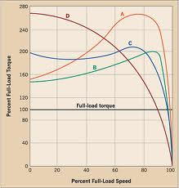
Induction Motor Classes
Four major classes of induction motors, based on application. Key values are starting torque, pull-out torque, full-load torque, and starting current
In steady-state the motor will operate on the right side
of the curve at the point at which the electrical torque
matches the mechanical torque
A: Fans, pumps machine tools
B: Similar to A
C: Compressors, conveyors
D: High inertia such as hoists
Image source: ecmweb.com/motors/understanding-induction-motor-nameplate-information

Slide 25
Induction Motor Stalling
The maximum of the torque-speed curve varies with the square of the terminal voltage
When the terminal voltage decreases, such as during a fault, the mechanical torque can exceed the electrical torque
  This causes the motor to decelerate, perhaps quite quickly, with the rate proportional to its inertia
  This deceleration causing the slip to increase, perhaps causing the motor to stall with s=1, resulting in a high reactive current draw
  Too many stalled motors can prevent the voltage from recovering

Slide 26
Motor Stalling Example
Using case WSCC_CIM5, which models the WSCC 9 bus case with 100% induction motor load
Change the fault scenario to say a fault midway between buses 5 and 7, cleared by opening the line
Results are for a 0.1 second fault
Usually motor load
is much less than 100%

Slide 27
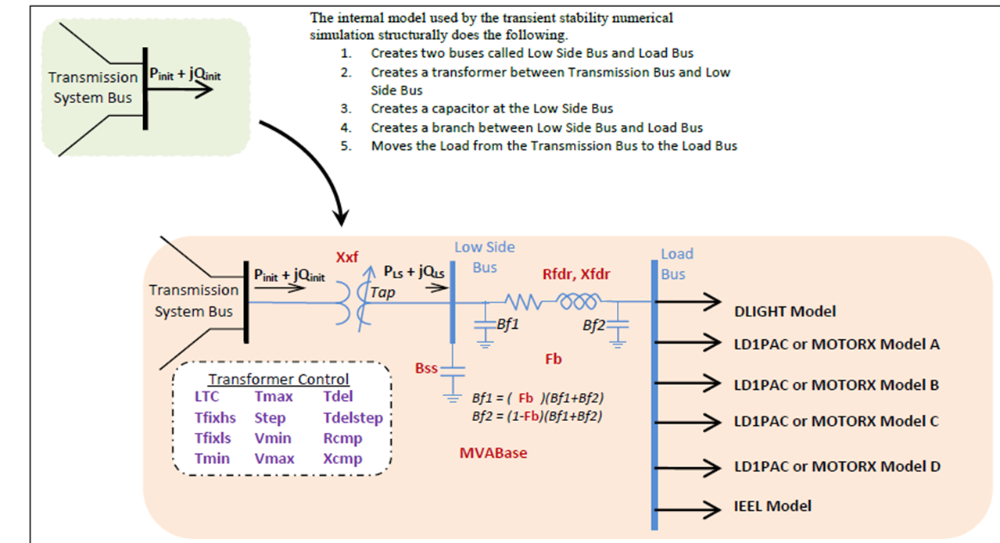
Composite Load Model
Contains up to four motors or single phase induction motor models; also includes potential for solar PV

Slide 28
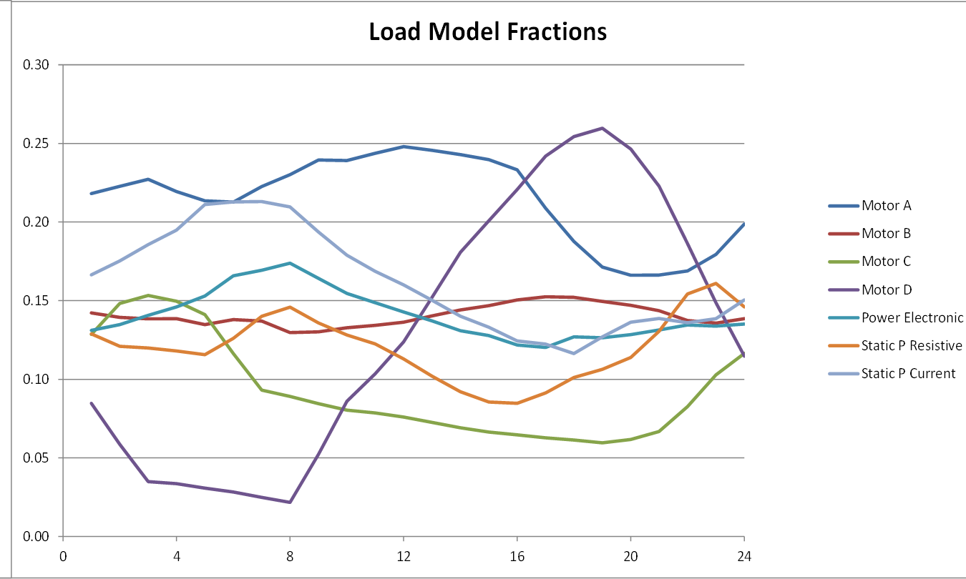
Modeling Time Variation in Load
Different time varying composite model parameters are now being used
Example of varying composite load percentages over a day

Slide 29

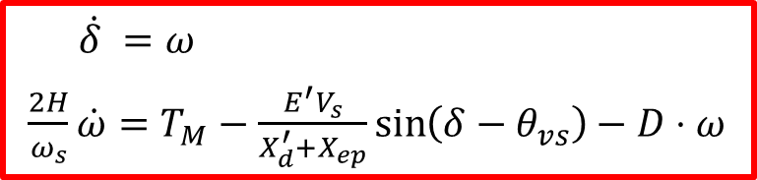
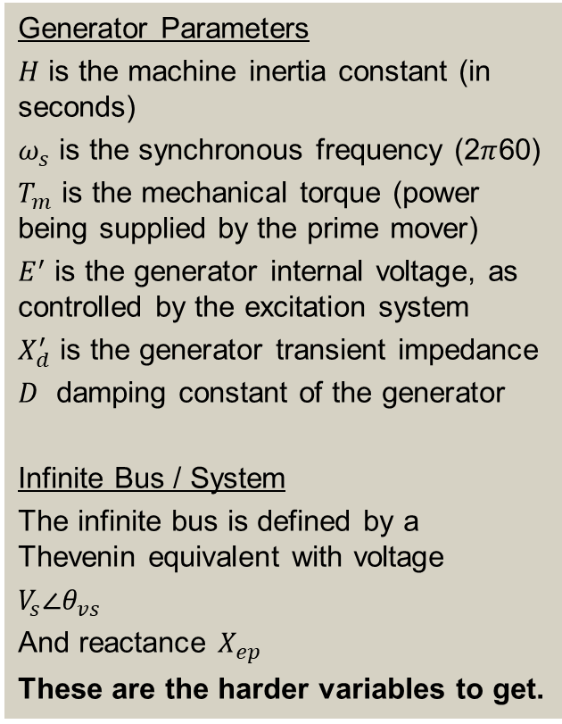
The Generator Dynamic Equations We Will Use
Example power system problem with differential algebraic equations (DAEs) is the classical synchronous generator connected to an infinite bus.
The two differential variables are $δ$ and $ω$; in practice dynamic models can have many more.
Generator Parameters
$H$ is the machine inertia constant (in seconds)
$ω_{s}$ is the synchronous frequency (2$π$60)
$T_{m}$ is the mechanical torque (power being supplied by the prime mover)
$E^{′}$ is the generator internal voltage, as controlled by the excitation system
$X_{d}^{′}$ is the generator transient impedance
$D$ damping constant of the generator
Infinite Bus / System
The infinite bus is defined by a Thevenin equivalent with voltage
$V_{s}∠θ_{vs}$
And reactance $X_{ep}$
These are the harder variables to get.
$\dot{δ} =ω$
$\frac{2H}{ω_{s}}\dot{ω}=T_{M}−\frac{E^{′}V_{s}}{X_{d}^{′}+X_{ep}}\sin\left(δ−θ_{vs}\right)−D⋅ω$

Slide 30

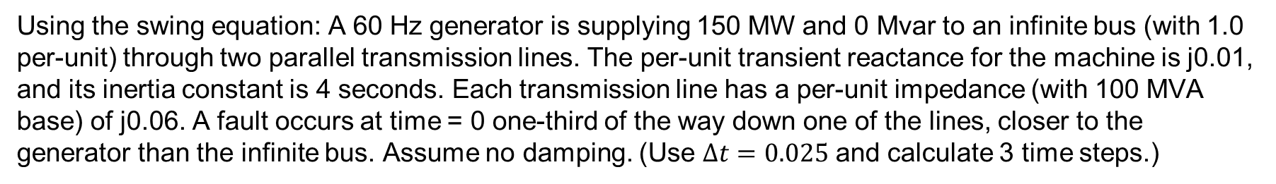
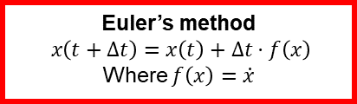
Homework Problem 3
$\dot{δ} =ω$
$\frac{2H}{ω_{s}}\dot{ω}=T_{M}−\frac{E^{′}V_{s}}{X_{d}^{′}+X_{ep}}\sin\left(δ−θ_{vs}\right)−D⋅ω$
Euler’s method
$$x\left(t+Δt\right)=x\left(t\right)+Δt⋅f\left(x\right)$$
Where $f\left(x\right)=\dot{x}$
Using the swing equation: A 60 Hz generator is supplying 150 MW and 0 Mvar to an infinite bus (with 1.0 per-unit) through two parallel transmission lines. The per-unit transient reactance for the machine is j0.01, and its inertia constant is 4 seconds. Each transmission line has a per-unit impedance (with 100 MVA base) of j0.06. A fault occurs at time = 0 one-third of the way down one of the lines, closer to the generator than the infinite bus. Assume no damping. (Use $Δt=0.025$ and calculate 3 time steps.)

Slide 31
Homework Problem 3
$\dot{δ} =ω$
$\frac{2H}{ω_{s}}\dot{ω}=T_{M}−\frac{E^{′}V_{s}}{X_{d}^{′}+X_{ep}}\sin\left(δ−θ_{vs}\right)−D⋅ω$
Euler’s method
$$x\left(t+Δt\right)=x\left(t\right)+Δt⋅f\left(x\right)$$
Where $f\left(x\right)=\dot{x}$
Using the swing equation: A 60 Hz generator is supplying 150 MW and 0 Mvar to an infinite bus (with 1.0 per-unit) through two parallel transmission lines. The per-unit transient reactance for the machine is j0.01, and its inertia constant is 4 seconds. Each transmission line has a per-unit impedance (with 100 MVA base) of j0.06. A fault occurs at time = 0 one-third of the way down one of the lines, closer to the generator than the infinite bus. Assume no damping. (Use $Δt=0.025$ and calculate 3 time steps.)

Slide 32
Homework Problem 3
$\dot{δ} =ω$
$\frac{2H}{ω_{s}}\dot{ω}=T_{M}−\frac{E^{′}V_{s}}{X_{d}^{′}+X_{ep}}\sin\left(δ−θ_{vs}\right)−D⋅ω$
Euler’s method
$$x\left(t+Δt\right)=x\left(t\right)+Δt⋅f\left(x\right)$$
Where $f\left(x\right)=\dot{x}$
Using the swing equation: A 60 Hz generator is supplying 150 MW and 0 Mvar to an infinite bus (with 1.0 per-unit) through two parallel transmission lines. The per-unit transient reactance for the machine is j0.01, and its inertia constant is 4 seconds. Each transmission line has a per-unit impedance (with 100 MVA base) of j0.06. A fault occurs at time = 0 one-third of the way down one of the lines, closer to the generator than the infinite bus. Assume no damping. (Use $Δt=0.025$ and calculate 3 time steps.)

Slide 33

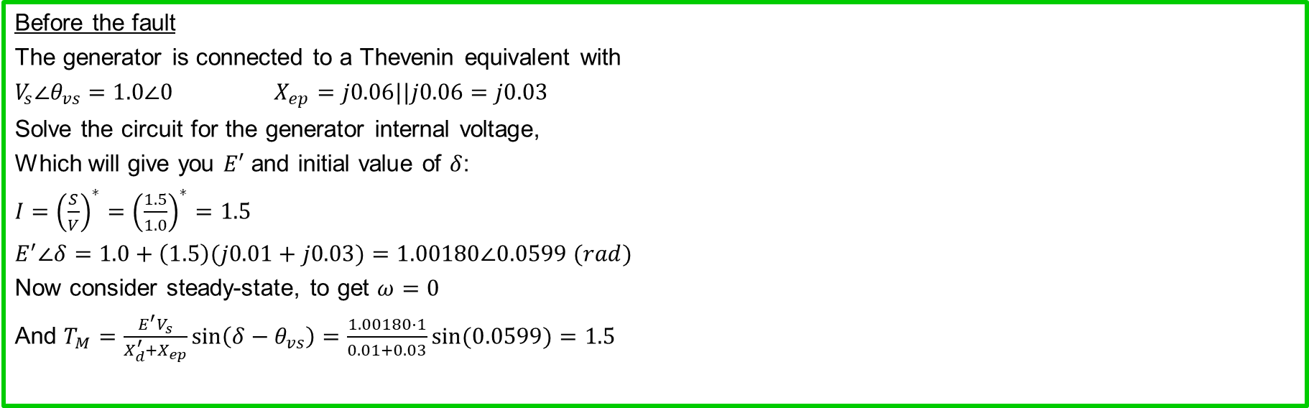



Homework Problem 3
$\dot{δ} =ω$
$\frac{2H}{ω_{s}}\dot{ω}=T_{M}−\frac{E^{′}V_{s}}{X_{d}^{′}+X_{ep}}\sin\left(δ−θ_{vs}\right)−D⋅ω$
Euler’s method
$$x\left(t+Δt\right)=x\left(t\right)+Δt⋅f\left(x\right)$$
Where $f\left(x\right)=\dot{x}$
Using the swing equation: A 60 Hz generator is supplying 150 MW and 0 Mvar to an infinite bus (with 1.0 per-unit) through two parallel transmission lines. The per-unit transient reactance for the machine is j0.01, and its inertia constant is 4 seconds. Each transmission line has a per-unit impedance (with 100 MVA base) of j0.06. A fault occurs at time = 0 one-third of the way down one of the lines, closer to the generator than the infinite bus. Assume no damping. Damping constant D=0.1.
Before the fault
The generator is connected to a Thevenin equivalent with
$V_{s}∠θ_{vs}=1.0∠0$ $X_{ep}=j0.06||j0.06=j0.03$
Solve the circuit for the generator internal voltage,
Which will give you $E′$ and initial value of $δ$:
$I={\left(\frac{S}{V}\right)}^{∗}={\left(\frac{1.5}{1.0}\right)}^{∗}=1.5$
$E^{′}∠δ=1.0+\left(1.5\right)(j0.01+j0.03)=1.00180∠0.0599 (rad)$
Now consider steady-state, to get $ω=0$
And $T_{M}=\frac{E^{′}V_{s}}{X_{d}^{′}+X_{ep}}\sin\left(δ−θ_{vs}\right)=\frac{1.00180⋅1}{0.01+0.03}\sin{(0.0599)}=1.5$
$H=4$seconds $X_{d}^{′}=0.01$
j0.06
j0.01
+
+
E$∠δ°$
j0.06
1$∠0°$
_
_
Initial values:
$δ\left(0\right)=0.0599$
$ω\left(0\right)=0$

Slide 34

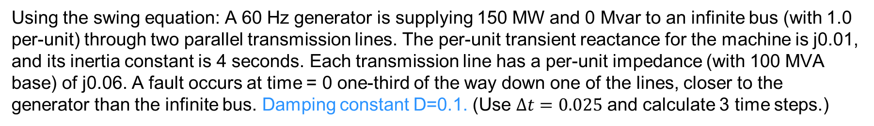



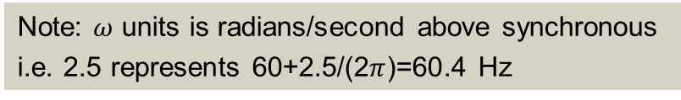
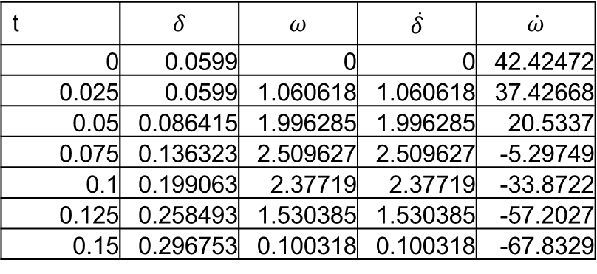
Homework Problem 3
$\dot{δ} =ω$
$\frac{2H}{ω_{s}}\dot{ω}=T_{M}−\frac{E^{′}V_{s}}{X_{d}^{′}+X_{ep}}\sin\left(δ−θ_{vs}\right)−D⋅ω$
Euler’s method
$$x\left(t+Δt\right)=x\left(t\right)+Δt⋅f\left(x\right)$$
Where $f\left(x\right)=\dot{x}$
Using the swing equation: A 60 Hz generator is supplying 150 MW and 0 Mvar to an infinite bus (with 1.0 per-unit) through two parallel transmission lines. The per-unit transient reactance for the machine is j0.01, and its inertia constant is 4 seconds. Each transmission line has a per-unit impedance (with 100 MVA base) of j0.06. A fault occurs at time = 0 one-third of the way down one of the lines, closer to the generator than the infinite bus. Damping constant D=0.1. (Use $Δt=0.025$ and calculate 3 time steps.)
After the fault
The Thevenin equivalent changes.
$V_{s}∠θ_{vs}=1.0 \left(\frac{0.02}{0.02+0.06}\right)=0.25∠0$
$X_{ep}=j0.06||j0.02=j0.015$
Now rewrite the swing equation
$\frac{8}{2π60}\dot{ω}=1.5−\frac{1.00180⋅0.25}{0.01+0.015}\sin\left(δ\right)+0.1ω$
$H=4$seconds $X_{d}^{′}=0.01$
t | $$δ$$ | $$ω$$ | $$\dot{δ}$$ | $$\dot{ω}$$
0 | 0.0599 | 0 | 0 | 42.42472
0.025 | 0.0599 | 1.060618 | 1.060618 | 37.42668
0.05 | 0.086415 | 1.996285 | 1.996285 | 20.5337
0.075 | 0.136323 | 2.509627 | 2.509627 | -5.29749
0.1 | 0.199063 | 2.37719 | 2.37719 | -33.8722
0.125 | 0.258493 | 1.530385 | 1.530385 | -57.2027
0.15 | 0.296753 | 0.100318 | 0.100318 | -67.8329
j0.06
j0.01
+
+
E$∠δ°$
1$∠0°$
_
j0.02
j0.04
_
Note: $ω$ units is radians/second above synchronous
i.e. 2.5 represents 60+2.5/(2$π$)=60.4 Hz

