Slide 1
ECEN 460, Spring 2024
Power System Operation and Control
Class 24: A Smarter Grid for the Future
Prof. Adam Birchfield
Dept. of Electrical and Computer Engineering
Texas A&M University
abirchfield@tamu.edu

Slide 2
Announcements
Final exam May 6th at 1:00pm
Three hand-written note sheets allowed
Main topics
  Three-phase AC power calculations
  Structure, history, and design of power systems
  Modeling power system components: generators, load, transmission line, transformers
  Power flow (Newton-Raphson method, DCPF approximation)
  Large-scale power system operations
  Power system economics and markets (economic dispatch)
  Dynamics and stability of power systems
  Emerging topics: high-impact, low-frequency events, smart grid, distribution system

Slide 3

End-of-Semester Feedback
Please fill out your end-of-semester feedback if you haven't already!
End-of-semester student survey is used by instructors, TAs, ECEN department, College of Engineering, and the university for improving this course
We greatly value your feedback!
There is no grade associated with any of the student surveys
tamu.aefis.net

Slide 4
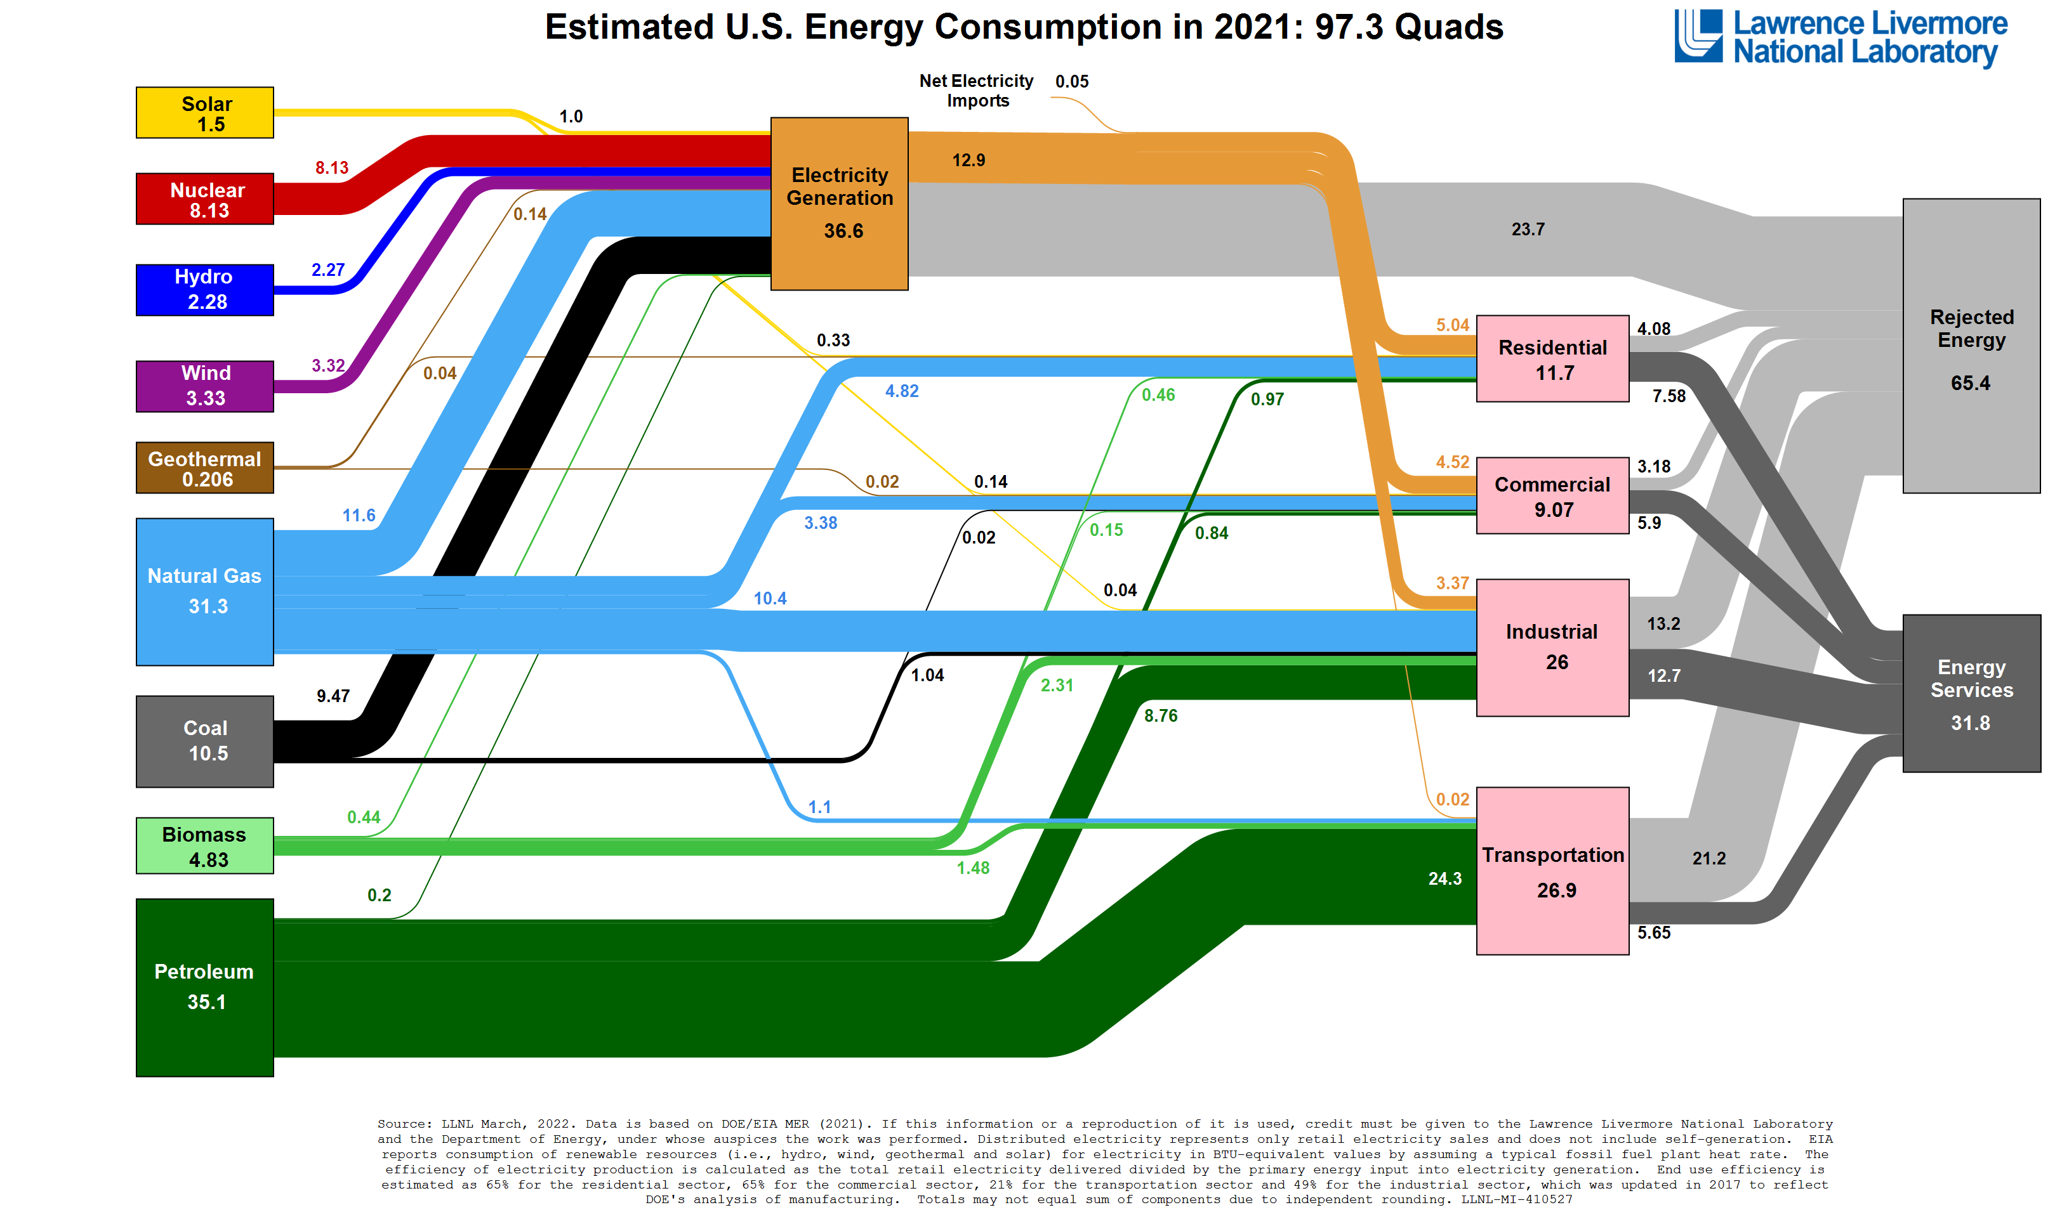

Slide 5
The Smart Grid
As defined by DOE a Smart Grid has the following seven characteristics
  Self-healing from power disturbance events
  Enabling active participation by consumers in demand response
  Operating resiliently against physical/cyber attack
  Providing power quality for 21st century needs
  Accommodating all generation and storage options
  Enabling new products, services, and markets
  Optimizing assets and operating efficiently

Slide 6
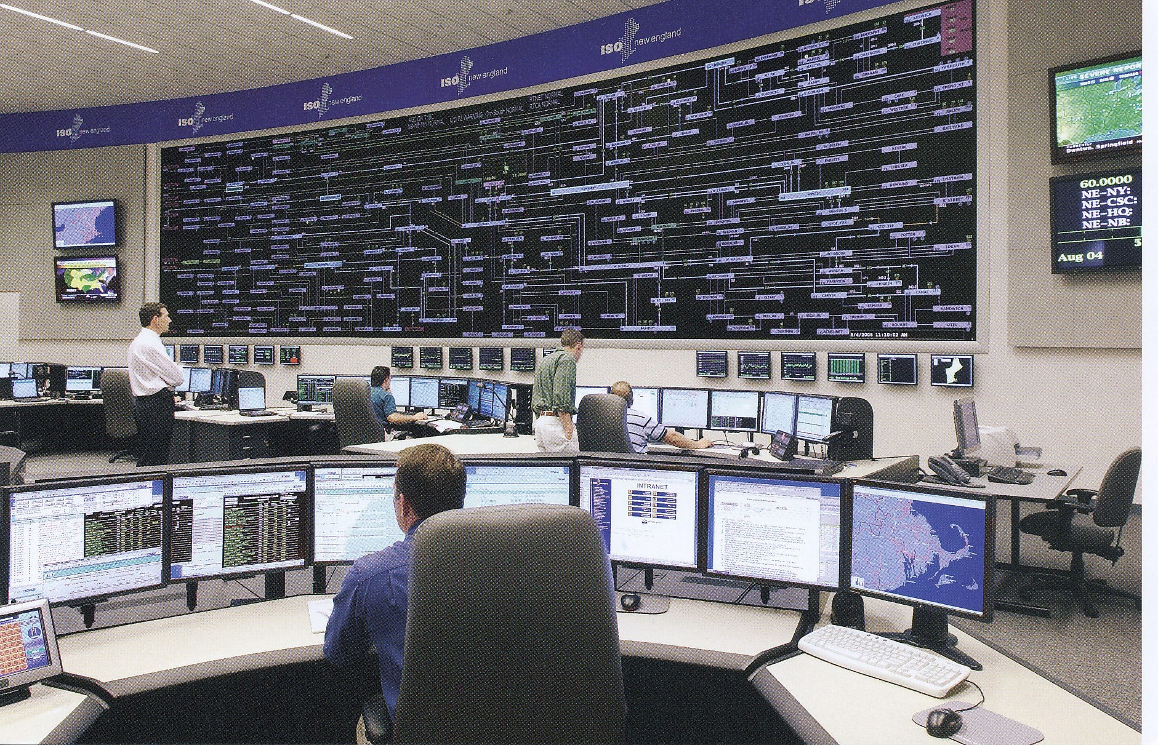
Electric Utilities Have Been Leaders in the Use of Technology
ISO New England Control Center

Slide 7
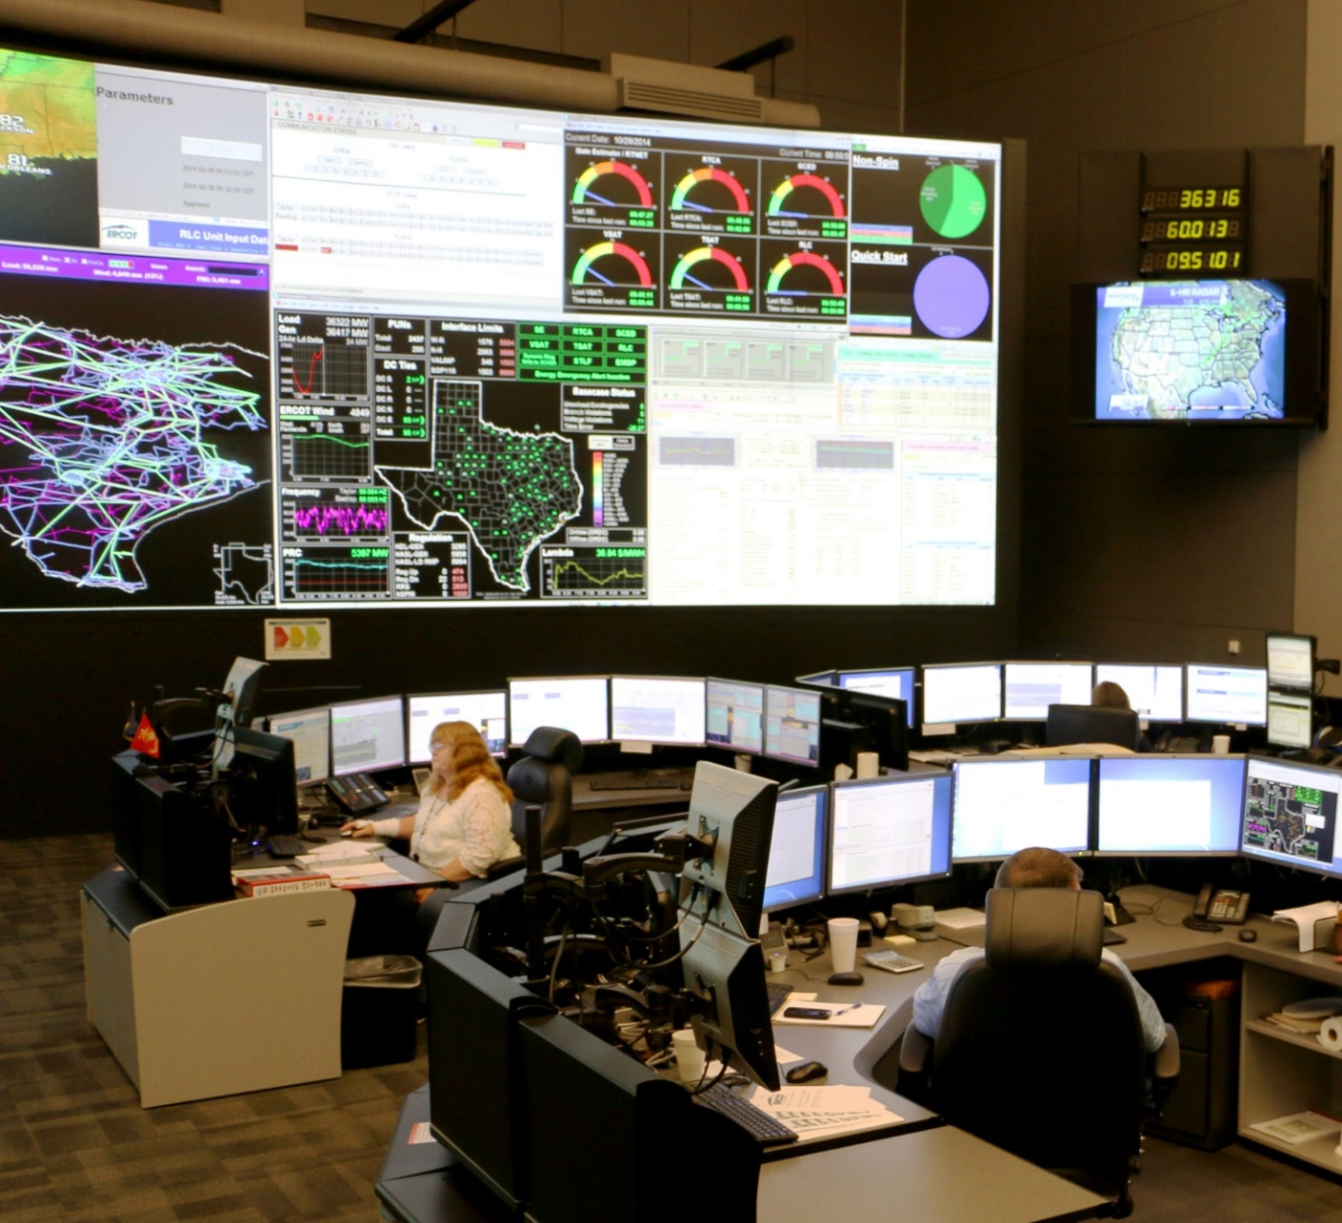
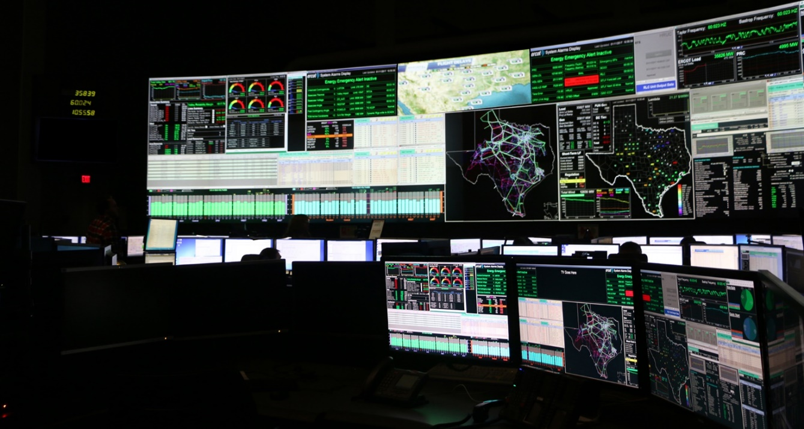

ERCOT Control Room
Photos courtesy ERCOT, http://www.ercot.com/news/mediakit/corp_images

Slide 8
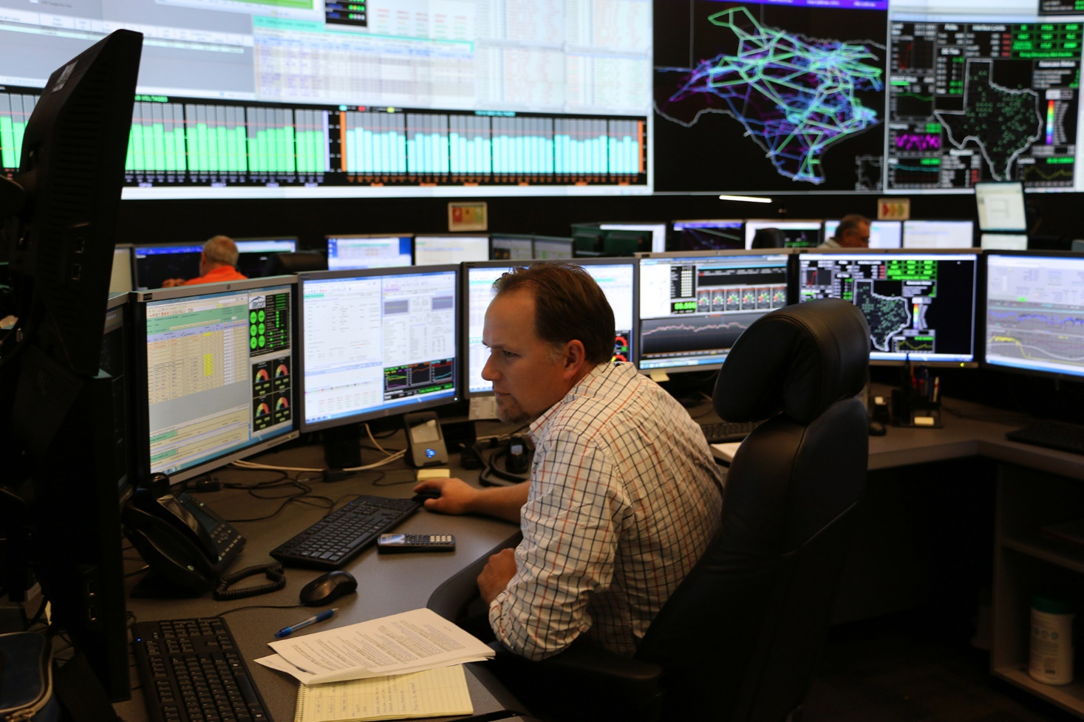
ERCOT Control Room Operator
Photos courtesy ERCOT, http://www.ercot.com/news/mediakit/corp_images

Slide 9
Key Drivers for Smart Grid: Control and Improved Reliability
Key needs for the Smart Grid idea are to allow for the integration of much more non-controllable electric generation like wind and solar, and improved customer reliability
Adding electric vehicle loads also requires charging control
Germane Power Grid characteristics
  Electric energy cannot be economically stored
  Electric power flow is difficult to directly control
  Customers have been in complete control

Slide 10
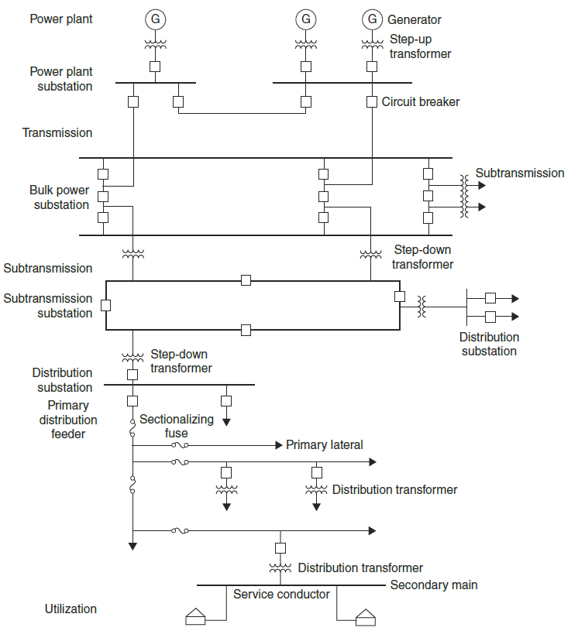
Distribution System
The distribution system is the lower voltage portion (< 50 kV) of the grid
  Usually radial, though networked in some urban areas
  Historically the power flow was from transmission, into distribution to load;
  but this is changing with more distributed generation
Much recent interest in the distribution system

Slide 11
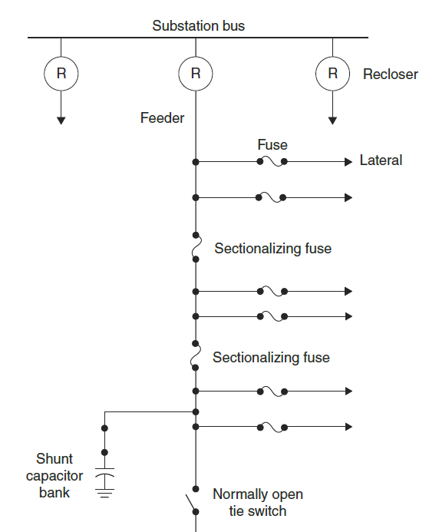
Distribution System Components
Primary distribution uses voltages between 34.5 kV down to 2.4, with 13.8 and 12.4 kV common
Secondary distribution uses the end customer utilization voltages (120/240, 208Y/120, 480Y/277 V)
Distribution transformers come in a wide variety of sizes; often they have load tap changers (LTCs) to control the voltage

Slide 12
Distribution System Analysis
Full three-phase modeling is essential
  Many sections of feeders are 1 or 2 phases
  Customers tend to be single-phase: utilities often try to balance the customer load among the three phases
  Single-phase and split-phase transformers
Usually studies in a decoupled way from the transmission system
Voltage regulation is a primary concern
European style is different: more common to have three-phase at the secondary level and more load on a single secondary transformer

Slide 13
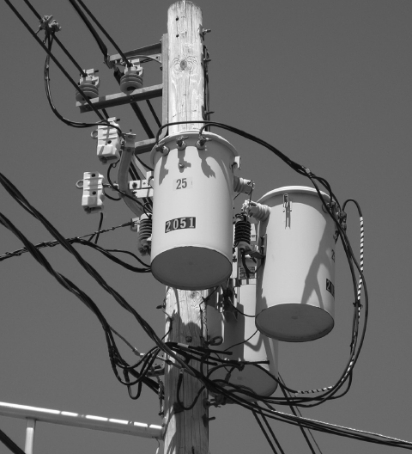
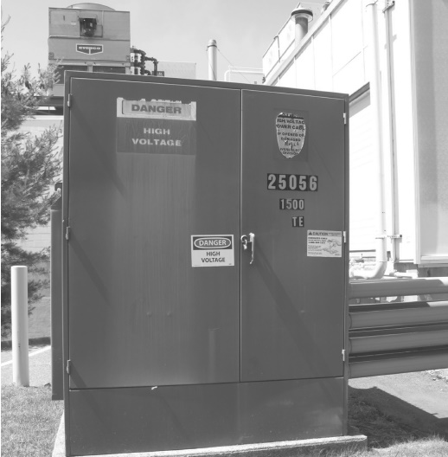
Pole and Padmount Transformers

Slide 14
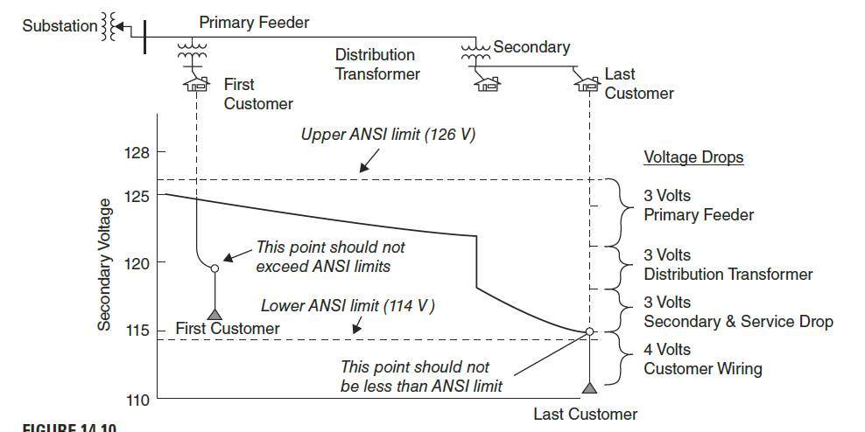
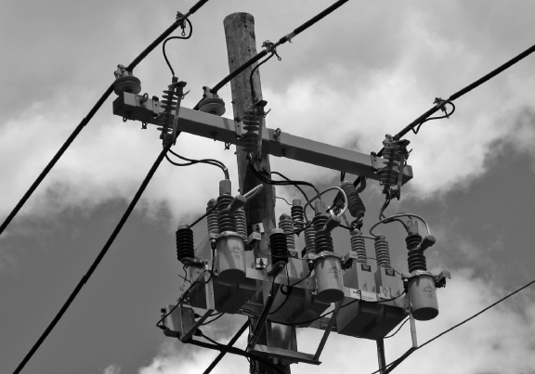
Distribution System Components, Cont.
Maintaining adequate voltage levels to all customers is a key
distribution system requirement
Shunt capacitors are widely used for voltage control
  In the future some of this reactive power could come for solar PV inverters

Slide 15
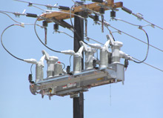
Smart Grid and the Distribution system
Distribution system automation has been making steady advances for many years, a trend that should accelerate with smart grid funding
Self-healing is often used to refer to automatic distribution
system reconfiguration
Some EMSs already monitor portions of the distribution system
S&C IntelliRupter® PulseCloser

Slide 16
Smart Grid and Controllable Load
A key goal of the smart grid is to make the load more flexible (controllable). One advantage (to utilities) of smart meters is the ability to remotely disconnect folks.
This requires 1) two-way communication, and 2) at least some loads equipped with controls
The best methods for achieving this control are still being considered. Communications is key, with the “last mile” the key challenge.
Potential options are 1) use existing customer broadband connections, 2) broadband over power line (BPL), 3) meshed wireless

Slide 17
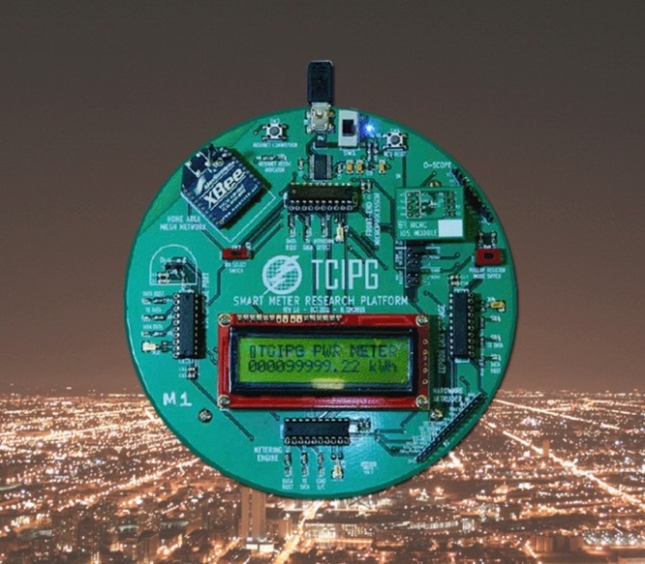
The Smart Grid Starts at the Meter
Traditional electric meters integrated the electric demand and had no communication capability
  needed to be read manually.
Newer meters have the ability to
measure the demand on a second
by second basis, and have at least
some communication capability
  Can be used to provide consumer
  access to their electric demand, and also
  can be used by the utility to remotely disconnect customers

Slide 18
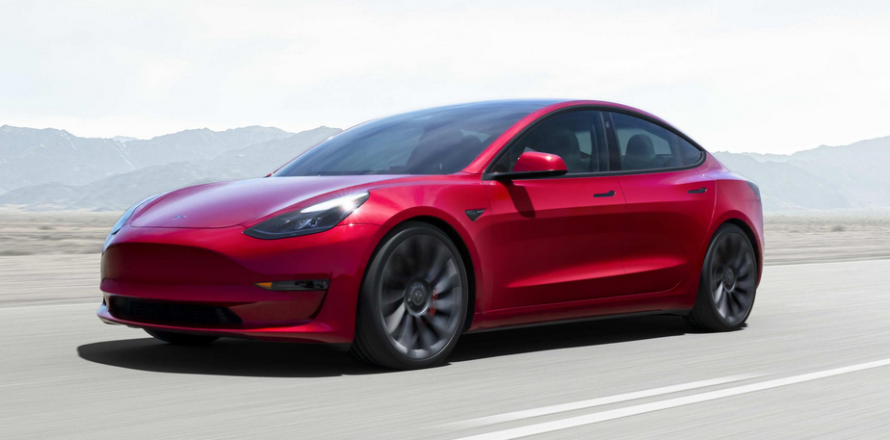
Electric Vehicles
The real driver for widespread implementation of controllable electric load could well be electric vehicles (Evs) and pluggable hybrid electric vehicles
Recharging all EVs when their drivers return home at 5pm would be a really bad idea, so some type of load control is a must.
Range on the all-electric Tesla Model S (shown above) is about 396 miles with a 100 kWh battery
Image: www.teslamotors.com/models/drive

Slide 19
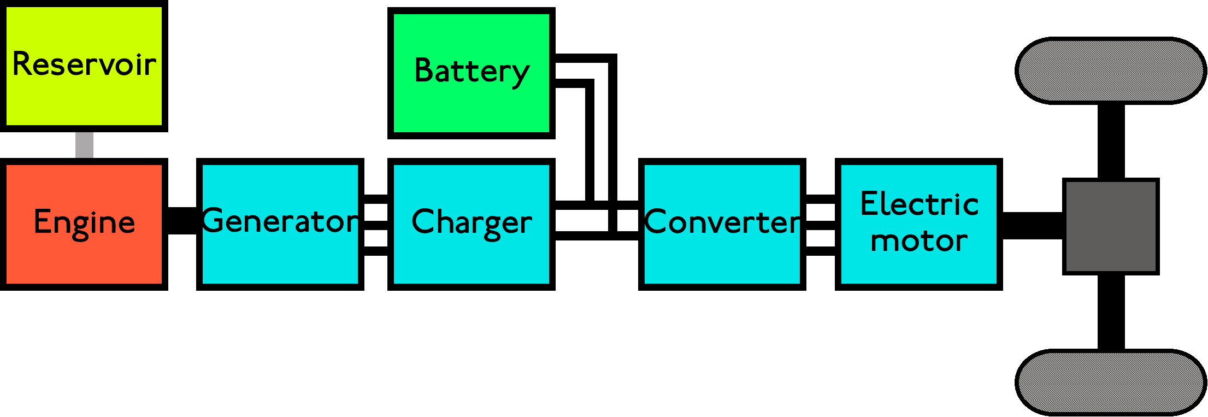
PHEVs
PHEVs give the range of a gas vehicle with the lower cost of an electric vehicle, allowing all electric travel for about 40 miles with an energy storage capacity of around 10 to 17 kWh
  One gallon of gasoline has 36.6 kWh but the energy in the battery can be used with a much higher efficiency than that stored in chemical form in gasoline

Slide 20
EV Charging Rate and Demand
Power demand and time required to fully charge depend upon the energy needed and the charging voltage
  A standard 120V, 20A outlet can provide a maximum of about 1.5 kW, requiring 6 hours to provide 9 kWh.
  A 240V, 60A outlet could provide the same charge in about 1 hour at 9.0 kW.
Having people in a neighborhood trying to simultaneously charge their cars at high rates could overload the distribution system

Slide 21
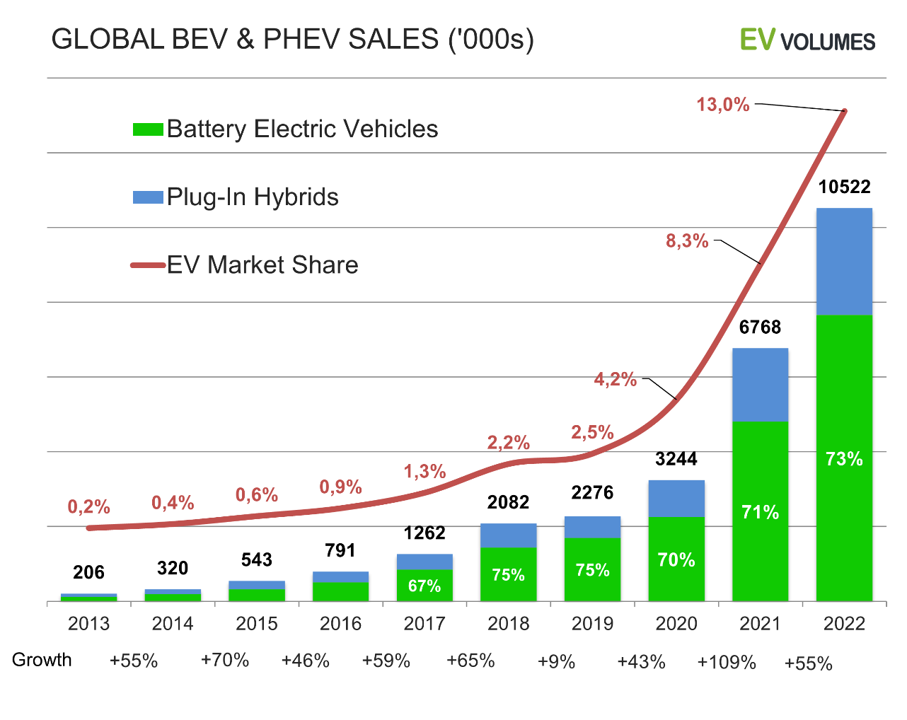
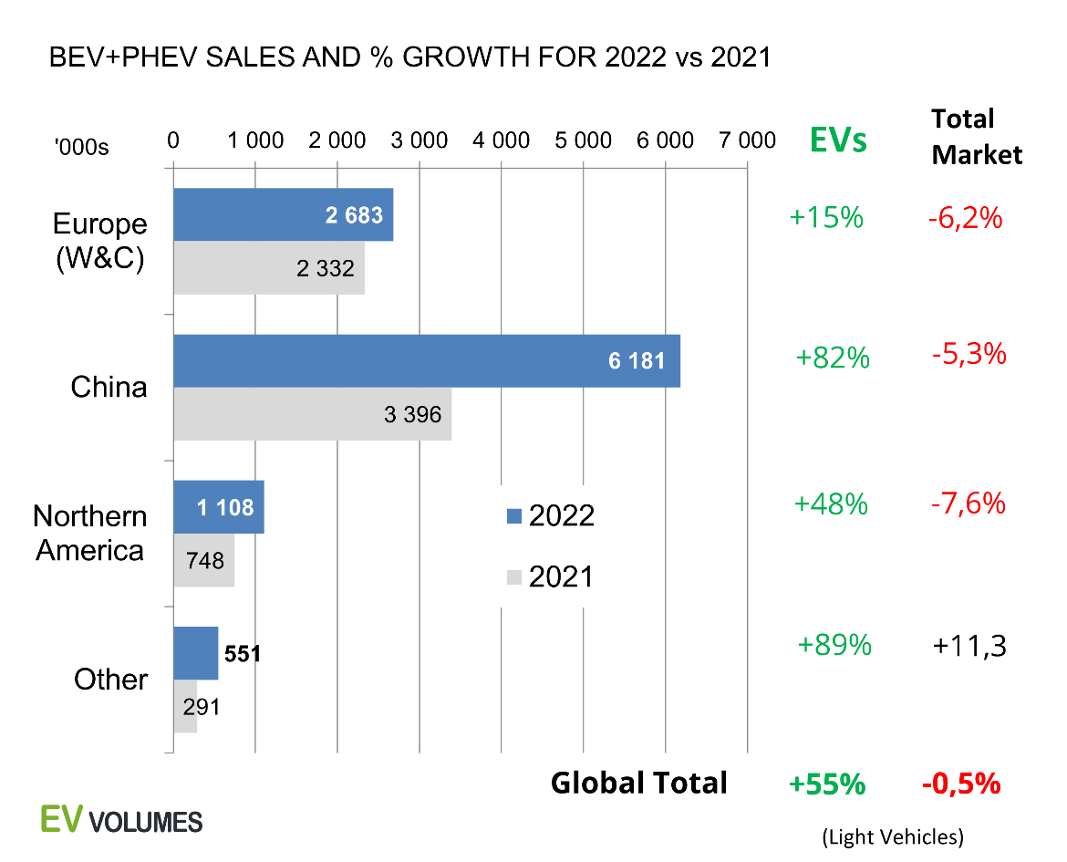
EV and PHEV Sales
Sales have increased dramatically in the last few years
https://www.ev-volumes.com/

Slide 22
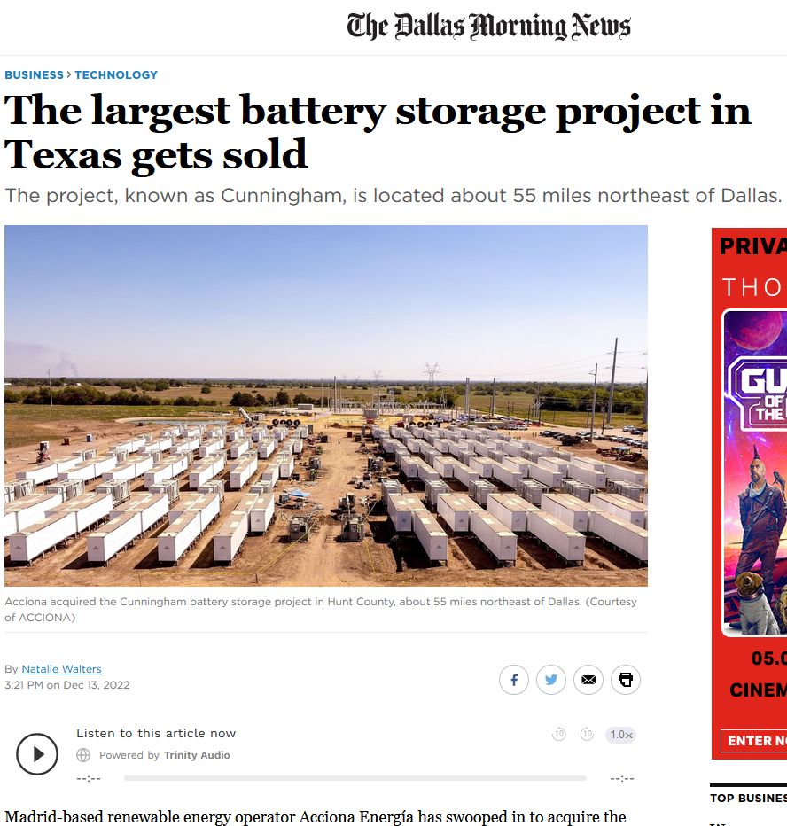
Energy Storage
Texas has large numbers of energy storage (battery) installations in the queue.
Main function is smoothing out solar and wind

Slide 23
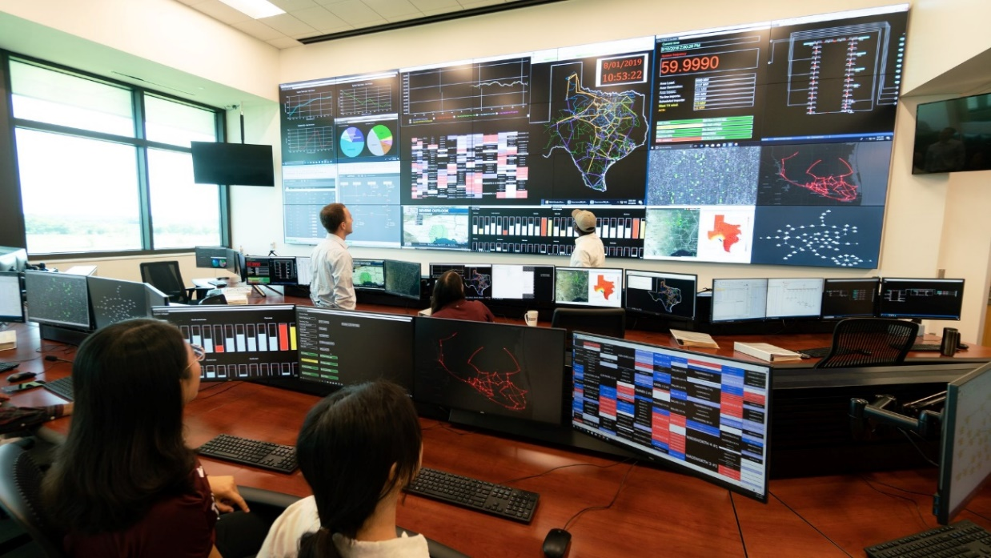
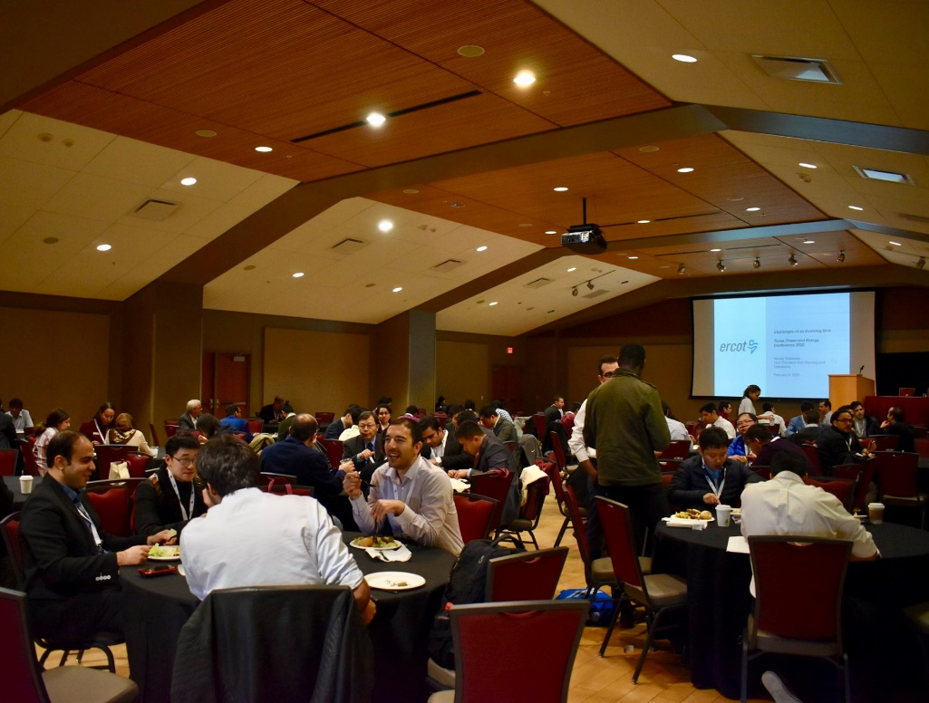

Energy and Power Group at Texas A&M
Texas A&M is a leader in power and energy research!
13+ Faculty members in various expertise areas of power systems, power electronics, and electric machines
Graduate school is a great way to learn more in-depth topics and contribute to research projects in electrical (M.S. or Ph.D.)
Undergraduate research opportunities may also be available
If interested, I'm happy to talk to you about it!
Left: Graduate students plan and operate a sponsored IEEE technical conference every year, TPEC
Top: smart grid control center facility in the center for infrastructure renewal on the RELLIS campus
Right: end of semester research group lunch

