Slide 1
ECEN 460, Spring 2024 Power System Operation and Control
Class 21: Governors and Exciters
Prof. Adam Birchfield
Dept. of Electrical and Computer Engineering
Texas A&M University
abirchfield@tamu.edu

Slide 2
The Generator Dynamic Equations We Will Use
Example power system problem with differential algebraic equations (DAEs) is the classical synchronous generator connected to an infinite bus.
The two differential variables are $δ$ and $ω$; in practice dynamic models can have many more.
Generator Parameters
$H$ is the machine inertia constant (in seconds)
$ω_{s}$ is the synchronous frequency (2$π$60)
$T_{m}$ is the mechanical torque (power being supplied by the prime mover)
$E^{′}$ is the generator internal voltage, as controlled by the excitation system
$X_{d}^{′}$ is the generator transient impedance
$D$ damping constant of the generator
Infinite Bus / System
The infinite bus is defined by a Thevenin equivalent with voltage
$V_{s}∠θ_{vs}$
And reactance $X_{ep}$
These are the harder variables to get.
$\dot{δ} =ω$
$\frac{2H}{ω_{s}}\dot{ω}=T_{M}−\frac{E^{′}V_{s}}{X_{d}^{′}+X_{ep}}\sin\left(δ−θ_{vs}\right)−D⋅ω$

Slide 3
Handout from Last Class
A 60 Hz generator is supplying 200 MW and 0 Mvar to an infinite bus (with 1.0 per-unit) through two parallel transmission lines. Each transmission line has a per-unit impedance (with 100 MVA base) of j0.04. The per-unit transient reactance for the machine is j0.03, and its inertia constant is 10 seconds. (No damping.) A fault occurs at time = 0 halfway down one of the lines.
Rewrite the equations above with the only remaining variables: $δ$, $ω$, $E′$, $T_{M}$, $V_{s}$, and $X_{ep}$.
Draw a circuit diagram of the system (a) before the fault and (b) during the fault. Use this to calculate the Thevenin equivalent impedance $X_{ep}$ for each condition.
The pre-fault condition is in steady-state. Calculate the internal voltage, which will be equal to $E^{′}∠δ$. What are the constant values of $E′$ and $T_{M}$, and the initial values of the variables $δ$ and $ω$?
Use Euler’s method with a time step of $Δt=0.01$ seconds, find the value of $δ$ and $ω$ at $t=0.01$ and $t=0.02$.

Slide 4
$\dot{δ} =ω$
$\frac{2H}{ω_{s}}\dot{ω}=T_{M}−\frac{E^{′}V_{s}}{X_{d}^{′}+X_{ep}}\sin\left(δ−θ_{vs}\right)−D⋅ω$
Euler’s method
$$x\left(t+Δt\right)=x\left(t\right)+Δt⋅f\left(x\right)$$
Where $f\left(x\right)=\dot{x}$
A 60 Hz generator is supplying 200 MW and 0 Mvar to an infinite bus (with 1.0 per-unit) through two parallel transmission lines. Each transmission line has a per-unit impedance (with 100 MVA base) of j0.04. The per-unit transient reactance for the machine is j0.03, and its inertia constant is 10 seconds. (No damping.) A fault occurs at time = 0 halfway down one of the lines.
Before the fault
The generator is connected to a Thevenin equivalent with
$V_{s}∠θ_{vs}=1.0∠0$ $X_{ep}=j0.04||j0.04=j0.02$
Solve the circuit for the generator internal voltage,
Which will give you $E′$ and initial value of $δ$:
$I={\left(\frac{S}{V}\right)}^{∗}={\left(\frac{2.0}{1.0}\right)}^{∗}=2.0$
$E^{′}∠δ=1.0+\left(2.0\right)(j0.03+j0.02)=1.005∠0.0997 (rad)$
Now consider steady-state, to get $ω=0$
And $T_{M}=\frac{E^{′}V_{s}}{X_{d}^{′}+X_{ep}}\sin\left(δ−θ_{vs}\right)=\frac{1.005⋅1}{0.03+0.02}\sin{(0.0997)}=2.0$
After the fault
The Thevenin equivalent changes. Find the open circuit voltage and equivalent impedance
$V_{s}∠θ_{vs}=1.0 \left(\frac{0.02}{0.02+0.04}\right)=0.33∠0$
$X_{ep}=j0.04||j0.02=j0.0133$
Now rewrite the swing equation
$\frac{20}{2π60}\dot{ω}=2.0−\frac{1.005⋅0.33}{0.03+0.0133}\sin\left(δ\right)$
Initial conditions:
$$δ\left(0\right)=0.0997$$
$$ω\left(0\right)=0$$
j0.04
j0.04
j0.03
j0.03
+
+
+
+
E$∠δ°$
1$∠0°$
_
j0.02
j0.02
_
E$∠δ°$
j0.04
1$∠0°$
_
_

Slide 5
Handout from Last Class – Solution
t | $$δ$$ | $$ω$$ | $$\dot{δ}$$ | $$\dot{ω}$$
0 | 0.0997 | 0 | 0 | 23.32872
0.01 | 0.0997 | 0.233287 | 0.233287 | 23.32872
0.02 | 0.102033 | 0.466574 | 0.466574 | 22.99362
0.03 | 0.106699 | 0.696511 | 0.696511 | 22.32367
0.04 | 0.113664 | 0.919747 | 0.919747 | 21.32418
0.05 | 0.122861 | 1.132989 | 1.132989 | 20.00557
0.06 | 0.134191 | 1.333045 | 1.333045 | 18.38331
0.07 | 0.147522 | 1.516878 | 1.516878 | 16.4778
0.08 | 0.16269 | 1.681656 | 1.681656 | 14.31411
0.09 | 0.179507 | 1.824797 | 1.824797 | 11.92169
0.1 | 0.197755 | 1.944014 | 1.944014 | 9.333903

Slide 6
Homework
Keep working through handout, including practice problems:
More practice for Euler’s method: calculate the first three time steps of each initial value problem.
1. $3\dot{x}=2x^{2}−x$ $x\left(0\right)=1$
2. $\dot{x}=−5y+3 \dot{y}=−x x\left(0\right)=y\left(0\right)=0$
3.
Use the swing equation from before:
A 60 Hz generator is supplying 150 MW and 0 Mvar to an infinite bus (with 1.0 per-unit) through two parallel transmission lines. The per-unit transient reactance for the machine is j0.01, and its inertia constant is 4 seconds. Each transmission line has a per-unit impedance (with 100 MVA base) of j0.06. A fault occurs at time = 0 one-third of the way down one of the lines, closer to the generator than the infinite bus.

Slide 7
Example 11.5

Slide 8
Transient Stability Example, Cont'd

Slide 9
Two-Axis Synchronous Machine Model
Classical model is appropriate only for the most basic studies; no longer widely used in practice
More realistic models are required to couple in other devices such as exciters and governors
A more realistic synchronous machine model requires that the machine be expressed in a reference frame that rotates at rotor speed
Standard approach is d-q reference frame, in which the major (direct or d-axis) is aligned with the rotor poles and the quadrature (q-axis) leads the direct axis by 90°

Slide 10
Synchronous Machine Modeling
3φ bal. windings (a,b,c) – stator
Damper windings are added to damp out oscillations
Field winding (fd) on rotor
Damper in “d” axis
(1d) on rotor
2 dampers in “q” axis
(1q, 2q) on rotor

Slide 11
Two Main Types of Synchronous Machines
Round Rotor
Air-gap is constant, used with higher speed machines
Salient Rotor (often called Salient Pole)
Air-gap varies circumferentially
Used with many pole, slower machines such as hydro
Narrowest part of gap in the d-axis and the widest along the q-axis

Slide 12
DQ Reference Frame
Machine voltage and current are “transformed” into the d-q reference frame using the rotor angle, δ
Terminal voltage in network (power flow) reference frame are VT = Vr - Vi

Slide 13
Two-Axis Model Equations
Numerous models exist for synchronous machines. The following is a relatively simple model that represents the field winding and one damper winding; it also includes the generator swing eq.

Slide 14
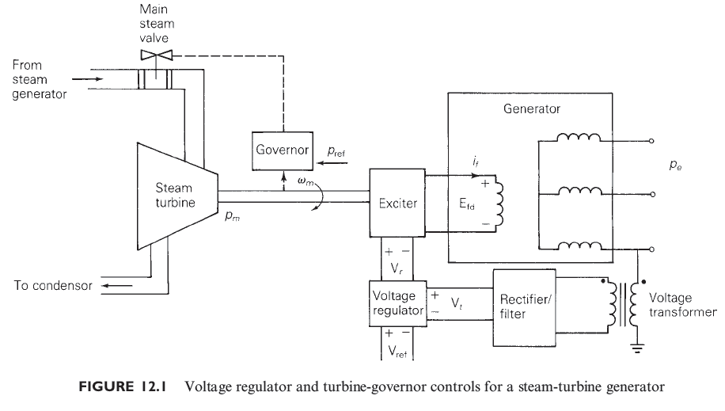
Generator Exciters and Governors
The two-axis synchronous model takes as an input the field voltage and the mechanical power. The next section discusses how these values are controlled

Slide 15
Generator Exciters
The purpose of the exciter is to maintain the generator terminal voltage (or other close by voltage) at a specified value.
Input is the sensed voltage
Output is the field voltage to the machine, Efd
Physically several technologies are used.
Older generators used dc machines with brushes transferring the power
With the newer brushless (or static) exciters power is obtained from an “inverted” synchronous generator whose field voltage is on the stator and armature windings are on rotor; output is rectified to create dc.

Slide 16
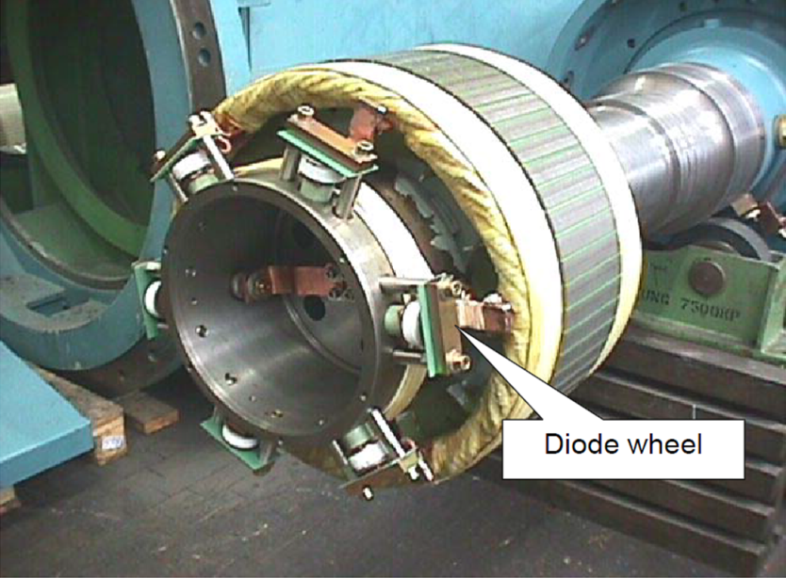
ABB UNICITER Example
Image source: www02.abb.com, Brushless Excitation Systems Upgrade,

Slide 17
Exciter Block Diagrams
Block diagrams are used to set up the transient stability models. The common IEEE Type 1 exciter is shown below (neglecting saturation); this is a dc type exciter. Initial state values are determined by knowing Efd and the terminal voltage Vt.

Slide 18
Exciter Block Diagram Example
Consider the Example 11.10 case, with an IEEE T1 exciter with Tr = 0, Ka = 100, Ta = 0.05, Vrmax = 5, Vrmin = -5, Ke = 1, Te = 0.26, Kf = 0.01 and Tf = 1.0. Determine the initial states. Initial value of Efd = 2.9135 and Vt = 1.0946

Slide 19
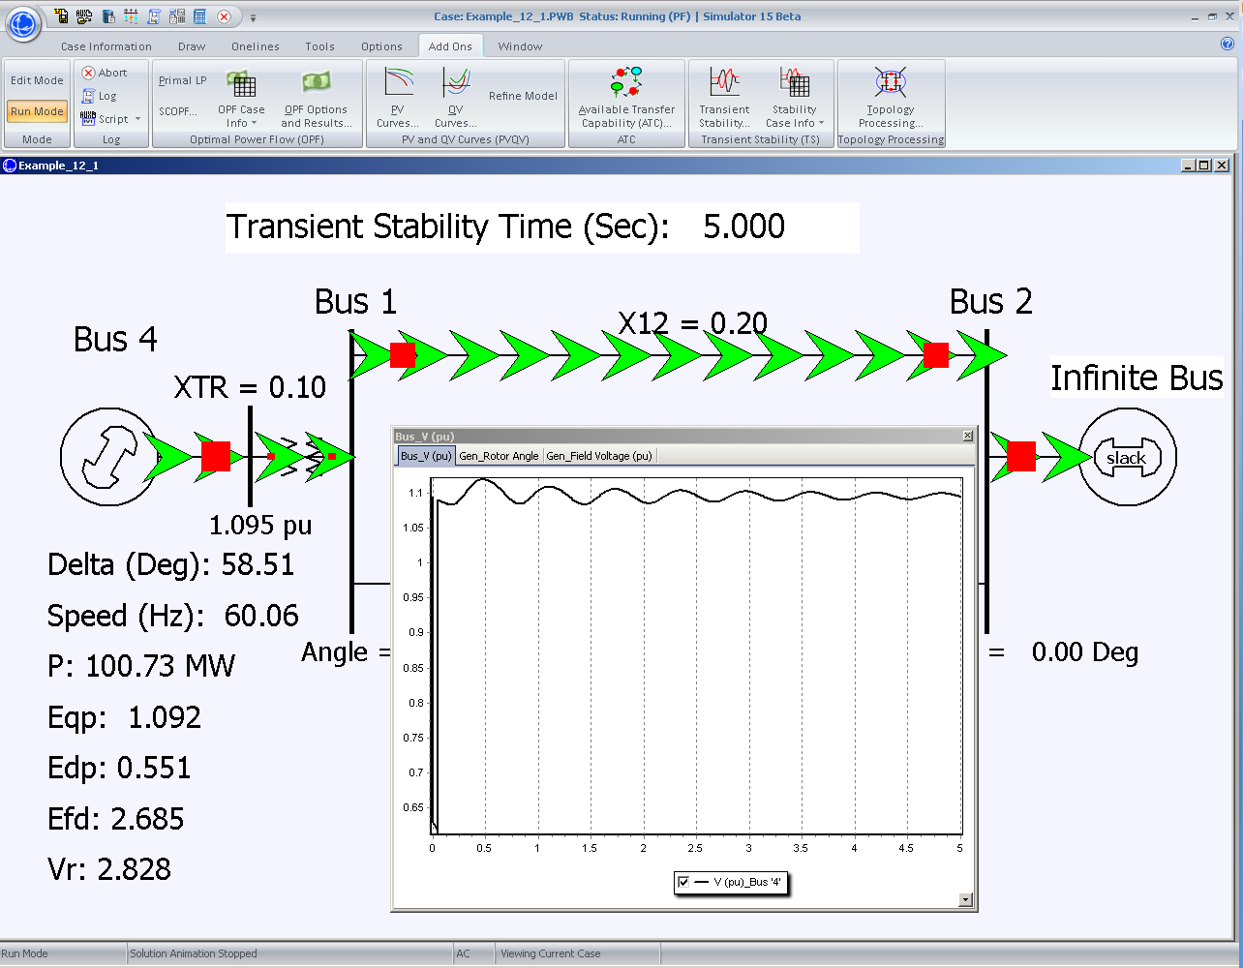
PowerWorld Example 12.1 Solution

Slide 20
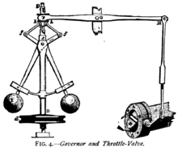
Generator Governors
The other key generator control system is the governor, which changes the mechanical power into the generator to maintain a desired speed and hence frequency.
Historically centrifugal “flyball” governors have been used to regulate the speed of devices such as steam engines
The centrifugal force varies with speed, opening or closing the throttle valve
Photo source: en.wikipedia.org/wiki/Centrifugal_governor

Slide 21
Isochronous Governors
Ideally we would like the governor to maintain the frequency at a constant value of 60 Hz (in North America)
This can be accomplished using an isochronous governor.
A flyball governor is not an isochronous governor since the control action is proportional to the speed error
An isochronous governor requires an integration of the speed error
Isochronous governors are used on stand alone generators but cannot be used on interconnected generators because of “hunting”

Slide 22
Generator “Hunting”
Control system “hunting” is oscillation around an equilibrium point
Trying to interconnect multiple isochronous generators will cause hunting because the frequency setpoints of the two generators are never exactly equal
One will be accumulating a frequency error trying to speed up the system, whereas the other will be trying to slow it down
The generators will not share the power load proportionally.

Slide 23
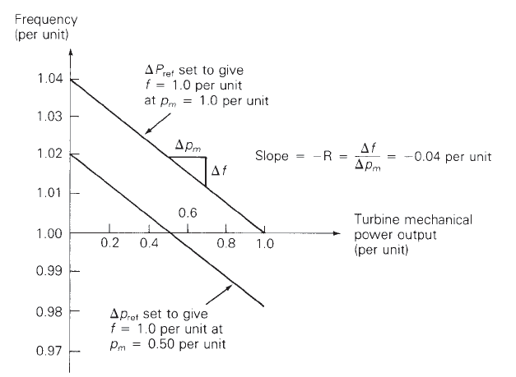
Droop Control
The solution is to use what is known as droop control, in which the desired set point frequency is dependent upon the generator’s output
R is known as the regulation constant or droop; a typical value is 4 or 5%.
$$Δp_{m}=Δp_{ref}−\frac{1}{R}Δf$$

Slide 24
Governor Block Diagrams
The block diagram for a simple stream unit, the TGOV1 model, is shown below. The T1 block models the governor delays, whereas the second block models the turbine response.

Slide 25
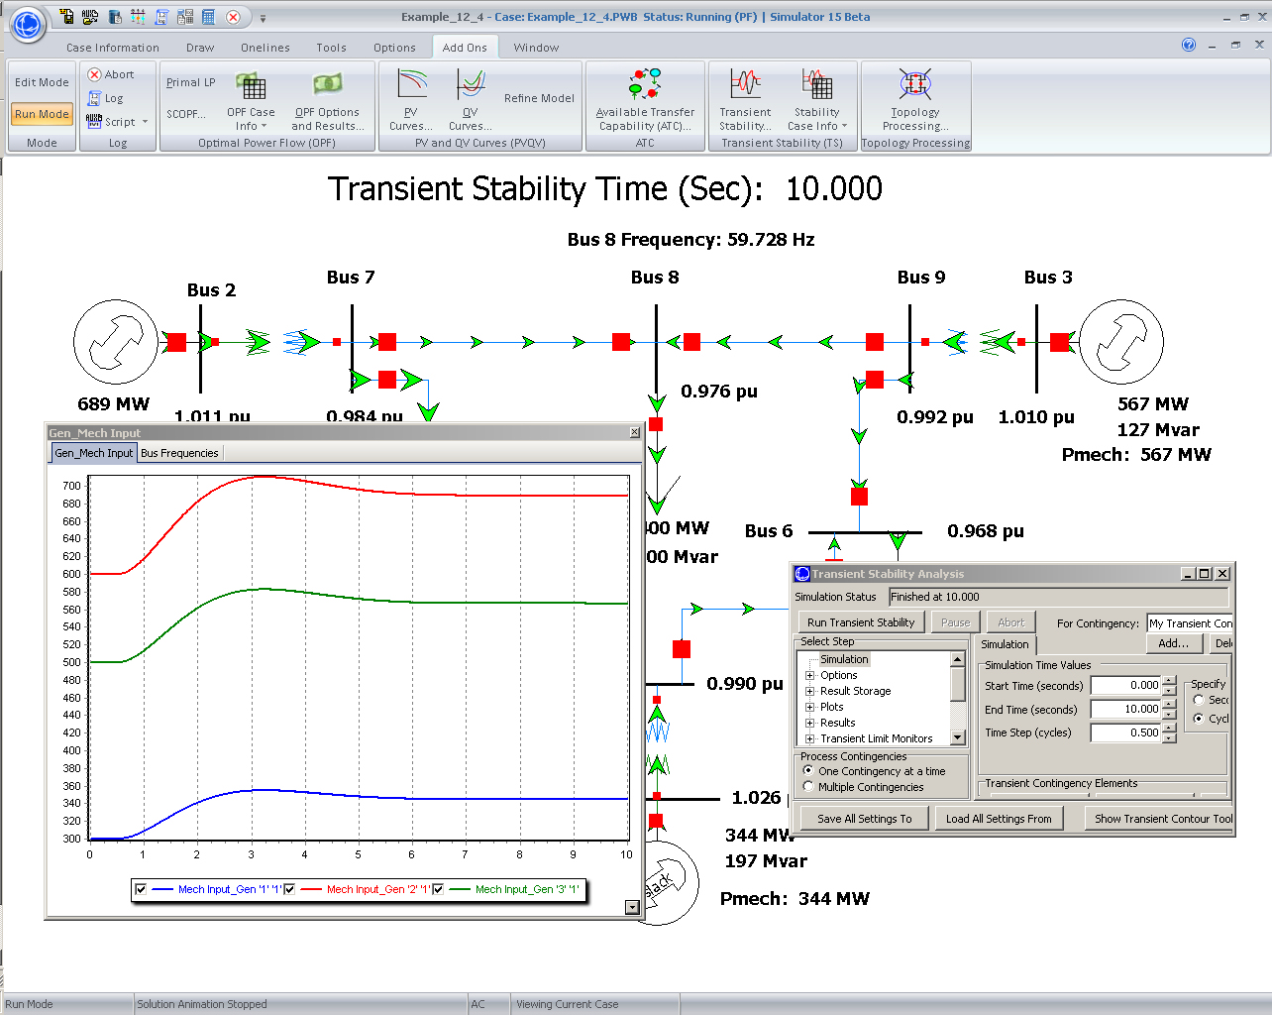
Example 12.4 System Response

Slide 26
Restoring Frequency to 60 Hz
In an interconnected power system the governors do not automatically restore the frequency to 60 Hz
Rather this is done via the ACE (area control area calculation). Previously we defined ACE as the difference between the actual real power exports from an area and the scheduled exports. But it has an additional term ACE = $P_{actual}−P_{scheduled}−10⋅b⋅(f_{act}−f_{sched})$
b is the balancing authority frequency bias in MW/0.1 Hz with a negative sign. It is about 0.8% of peak load/generation

Slide 27
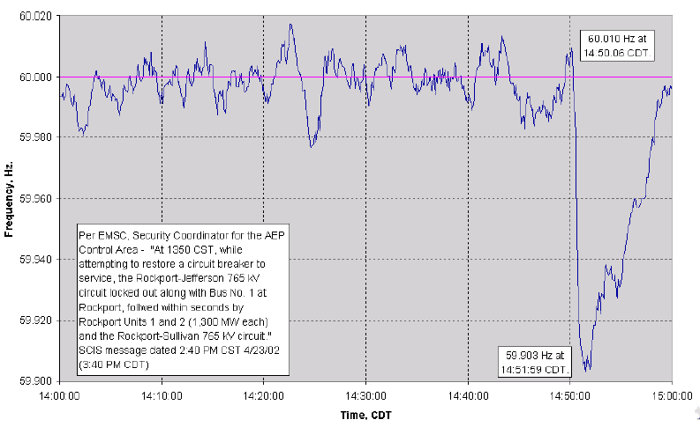
2600 MW Loss Frequency Recovery
Frequency recovers in about ten minutes

