Slide 1
ECEN 460, Spring 2024 Power System Operation and Control
Class 20: Power System Generator Dynamic Models
Prof. Adam Birchfield
Dept. of Electrical and Computer Engineering
Texas A&M University
abirchfield@tamu.edu

Slide 2
Generator Transient Stability Models
In order to study the transient response of a power system we need to develop models for the generator valid during the transient time frame of several seconds following a system disturbance
We need to develop both electrical and mechanical models for the generators

Slide 3
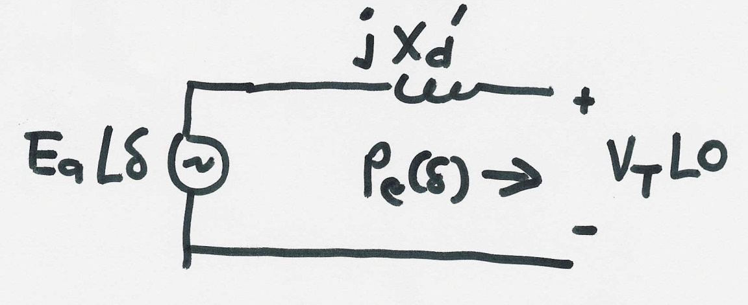
Generator Electrical Model
The simplest generator model, known as the classical model, treats the generator as a voltage source behind the direct-axis transient reactance; the voltage magnitude is fixed, but its angle changes according to the mechanical dynamics

Slide 4
Generator Mechanical Model
Generator Mechanical Block Diagram

Slide 5
Generator Mechanical Model, Cont’d
In general power = torque x angular speed
Hence, when a generator is spinning at speed $ω_{s}$
$$T_{m}=Jα_{m}+T_{D}+T_{e}\left(δ\right)$$
$$T_{m}ω_{s}=\left(Jα_{m}+T_{D}+T_{e}\left(δ\right)\right)ω_{s}=P_{m}$$
$$P_{m}=Jα_{m}ω_{s}+T_{d}ω_{s}+P_{e}\left(δ\right)$$
Initially we'll assume no damping ($T_{d}=0)$.
Then $P_{m}−P_{e}\left(δ\right)=J α_{M}ω_{s}$
$P_{m}$ is the mechanical power input, which is assumed initially to be constant throughout the study time period.

Slide 6
Generator Mechanical Model, Cont’d
$$P_{m}−P_{e}(δ) = Jα_{m}ω_{s} \\ θ_{m} = ω_{s}t+δ = \text{rotor} \text{angle} \\ ω_{m} = \frac{dθ_{m}}{dt} = {\dot{θ}}_{m}= ω_{s}+\dot{δ} \\ α_{m} = {\dot{ω}}_{m} = \ddot{δ} \\ P_{m}−P_{e}(δ)= Jω_{s}α_{m}= Jω_{s}\ddot{δ} \\ Jω_{s} = \text{inertia} \text{of} \text{machine} \text{at} \text{synchronous} \text{speed} \\ \text{Convert} \text{to} \text{per} \text{unit} \text{by} \text{dividing} \text{by} \text{MVA} \text{rating}\text{, }S_{B}, \\ \frac{P_{m}}{S_{B}}−\frac{P_{e}(δ)}{S_{B}} = \frac{Jω_{s}\ddot{δ}}{S_{B}} \frac{2ω_{s}}{2ω_{s}}$$

Slide 7
Generator Mechanical Model, Cont’d
$$\frac{P_{m}}{S_{B}}−\frac{P_{e}(δ)}{S_{B}} = \frac{Jω_{s}\ddot{δ}}{S_{B}} \frac{2ω_{s}}{2ω_{s}} \\ \frac{P_{m}−P_{e}(δ)}{S_{B}}= \frac{Jω_{s}^{2}}{2S_{B}} \frac{1}{πf_{s}}\ddot{δ} (\text{since} ω_{s}=2πf_{s}) \\ \text{Define} \frac{Jω_{s}^{2}}{2S_{B}} ≜ H = \text{per} \text{unit} \text{inertia} \text{constant} (\text{sec}) \\ \text{All} \text{values} \text{are} \text{now} \text{converted} \text{to} \text{per} \text{unit} \\ P_{m}−P_{e}(δ) = \frac{H}{πf_{s}}\ddot{δ} \text{Define} M =\frac{H}{πf_{s}} \\ \text{Then} P_{m}−P_{e}(δ) = M\ddot{δ}$$

Slide 8
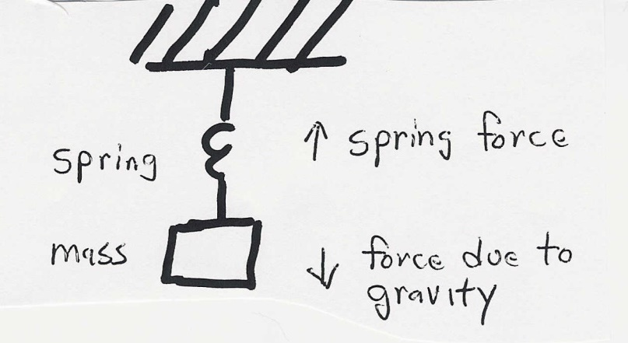
Generator Swing Equation

Slide 9
Single Machine Infinite Bus (SMIB)
To understand the transient stability problem we’ll first consider the case of a single machine (generator) connected to a power system bus with a fixed voltage magnitude and angle (known as an infinite bus) through a transmission line with impedance jXL

Slide 10
SMIB, Cont’d

Slide 11
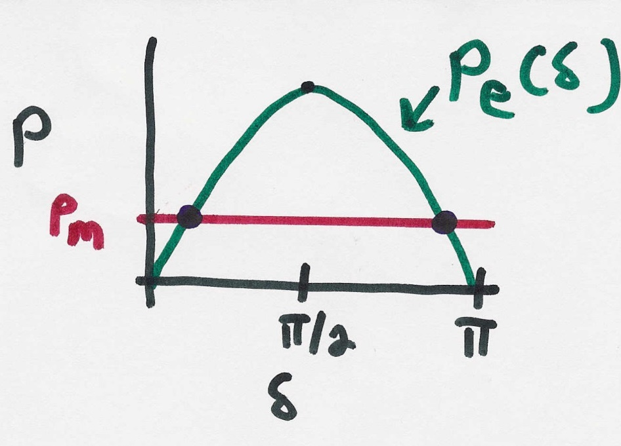
SMIB Equilibrium Points
$$\text{Equilibrium} \text{points} \text{are} \text{determined} \text{by} \text{setting} \text{the} \\ \text{right}\text{−}\text{hand} \text{side} \text{to} \text{zero} \\ M\ddot{δ}+D\dot{δ} = P_{M}−\frac{E_{a}}{X_{d}^{′}+X_{L}}\sin{δ}$$

Slide 12
Transient Stability Analysis
For transient stability analysis we need to consider three systems
Prefault - before the fault occurs the system is assumed to be at an equilibrium point
Faulted - the fault changes the system equations, moving the system away from its equilibrium point
Postfault - after fault is cleared the system hopefully returns to a new operating point
Actual transient stability studies can have multiple events

Slide 13
Transient Stability Solution Methods
There are two methods for solving the transient stability problem
Numerical integration
this is by far the most common technique, particularly for large systems; during the fault and after the fault the power system differential equations are solved using numerical methods
Direct or energy methods; for a two bus system this method is known as the equal area criteria
mostly used to provide an intuitive insight into the transient stability problem

Slide 14
SMIB Example
Assume a generator is supplying power to an infinite bus through two parallel transmission lines. Then a balanced three phase fault occurs at the terminal of one of the lines. The fault is cleared by the opening of this line’s circuit breakers.

Slide 15
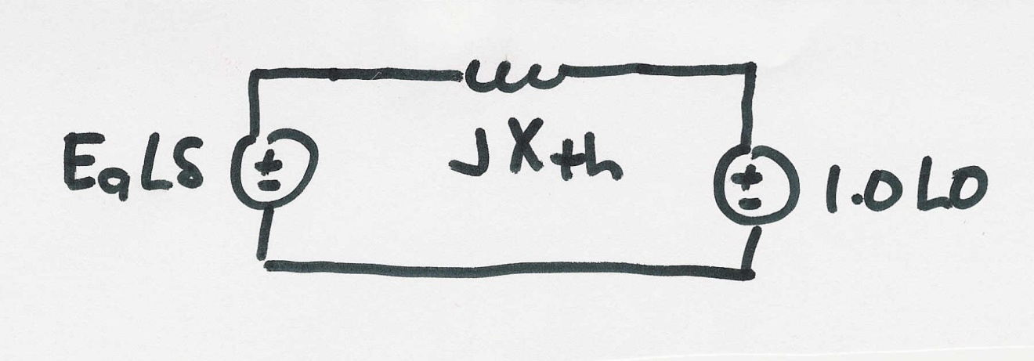
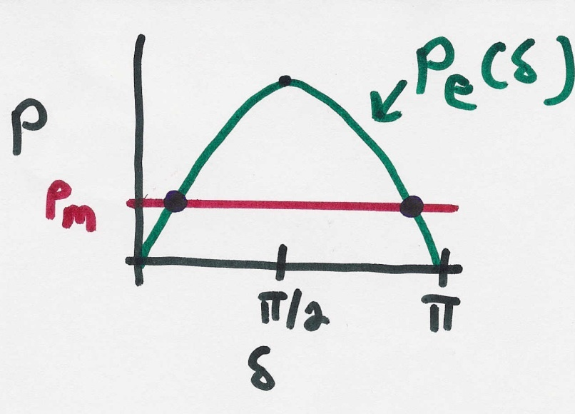
SMIB Example, Cont’d
Simplified prefault system
$$\text{The} \text{prefault} \text{system} \text{has} \text{two} \\ \text{equilibrium} \text{points}\text{; }\text{the} \text{left} \text{one} \\ \text{is} \text{stable}\text{, }\text{the} \text{right} \text{one} \text{unstable} \\ δ = \sin^{−1}\left(\frac{P_{M}X_{th}}{E_{a}}\right)$$

Slide 16
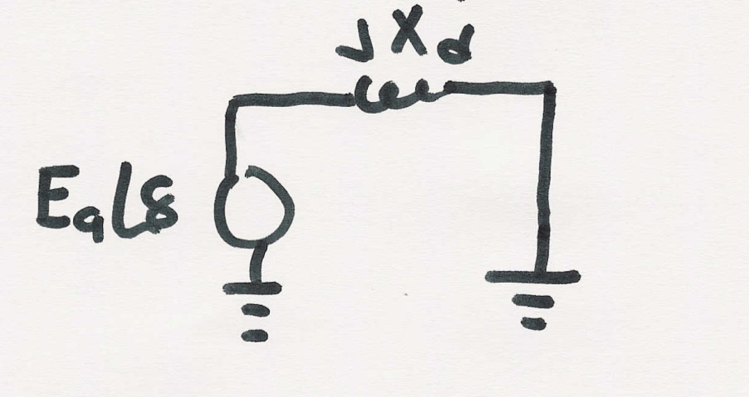
SMIB Example, Faulted System
During the fault the system changes
The equivalent system during the fault is then
During this fault no
power can be transferred
from the generator to
the system

Slide 17
SMIB Example, Post Fault System
After the fault the system again changes
The equivalent system after the fault is then

Slide 18
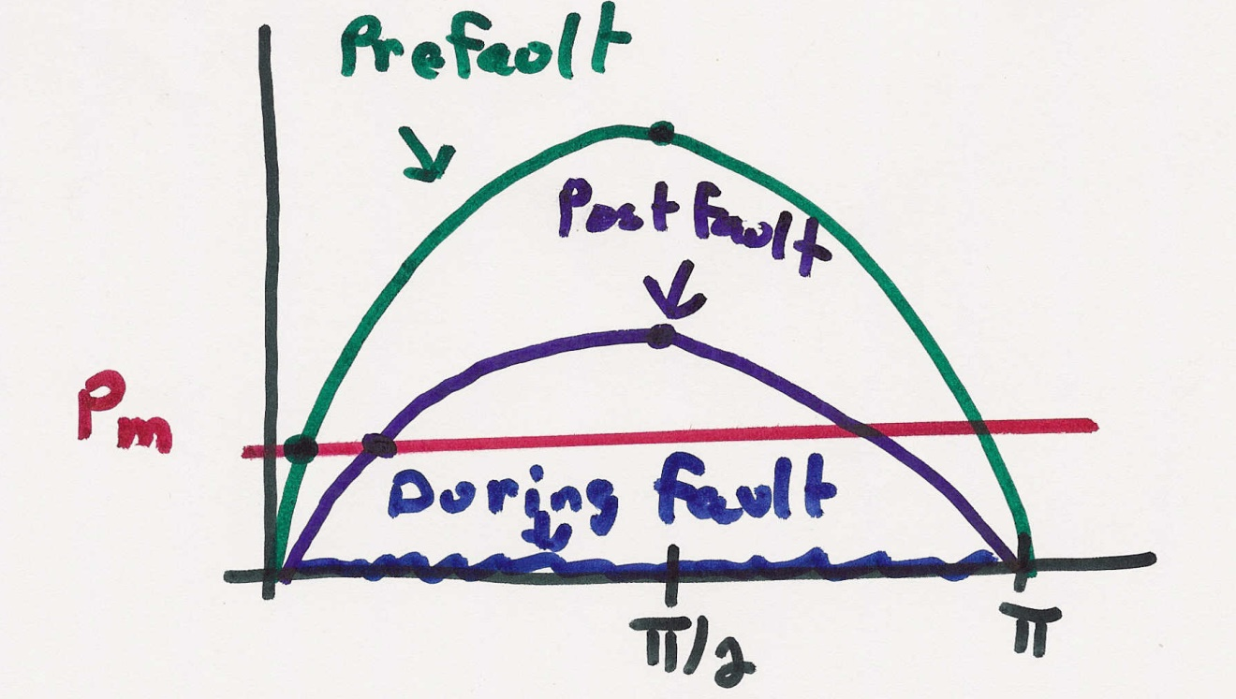
SMIB Example, Dynamics

Slide 19
The Generator Dynamic Equations We Will Use
Example power system problem with differential algebraic equations (DAEs) is the classical synchronous generator connected to an infinite bus.
The two differential variables are $δ$ and $ω$; in practice dynamic models can have many more.
Generator Parameters
$H$ is the machine inertia constant (in seconds)
$ω_{s}$ is the synchronous frequency (2$π$60)
$T_{m}$ is the mechanical torque (power being supplied by the prime mover)
$E^{′}$ is the generator internal voltage, as controlled by the excitation system
$X_{d}^{′}$ is the generator transient impedance
$D$ damping constant of the generator
Infinite Bus / System
The infinite bus is defined by a Thevenin equivalent with voltage
$V_{s}∠θ_{vs}$
And reactance $X_{ep}$
These are the harder variables to get.
$\dot{δ} =ω$
$\frac{2H}{ω_{s}}\dot{ω}=T_{M}−\frac{E^{′}V_{s}}{X_{d}^{′}+X_{ep}}\sin\left(δ−θ_{vs}\right)−D⋅ω$

Slide 20
SMIB Example
Assume a generator is supplying power to an infinite bus through two parallel transmission lines. Then a balanced three phase fault occurs at the terminal of one of the lines. The fault is cleared by the opening of this line’s circuit breakers.

Slide 21
SMIB Example, Cont’d
Simplified prefault system, with $X_{th}=X_{d}^{′}+\left(X_{L1} | X_{L2}\right)$

Slide 22
SMIB Example, Faulted System
During the fault the system changes
The equivalent system during the fault is then
During this fault no
power can be transferred
from the generator to
the system

Slide 23
SMIB Example, Post Fault System
After the fault the system again changes
The equivalent system after the fault is then

Slide 24
Handout Example
A 60 Hz generator is supplying 200 MW and 0 Mvar to an infinite bus (with 1.0 per-unit) through two parallel transmission lines. Each transmission line has a per-unit impedance (with 100 MVA base) of j0.04. The per-unit transient reactance for the machine is j0.03, and its inertia constant is 10 seconds. A fault occurs at time = 0 halfway down one of the lines.
Rewrite the equations above with the only remaining variables: $δ$, $ω$, $E′$, $T_{M}$, $V_{s}$, and $X_{ep}$.
Draw a circuit diagram of the system (a) before the fault and (b) during the fault. Use this to calculate the Thevenin equivalent impedance $X_{ep}$ for each condition.
The pre-fault condition is in steady-state. Calculate the internal voltage, which will be equal to $E^{′}∠δ$. What are the constant values of $E′$ and $T_{M}$, and the initial values of the variables $δ$ and $ω$?
Use Euler’s method with a time step of $Δt=0.01$ seconds, find the value of $δ$ and $ω$ at $t=0.01$ and $t=0.02$.

Slide 25
$\dot{δ} =ω$
$\frac{2H}{ω_{s}}\dot{ω}=T_{M}−\frac{E^{′}V_{s}}{X_{d}^{′}+X_{ep}}\sin\left(δ−θ_{vs}\right)−D⋅ω$
Euler’s method
$$x\left(t+Δt\right)=x\left(t\right)+Δt⋅f\left(x\right)$$
Where $f\left(x\right)=\dot{x}$
A 60 Hz generator is supplying 200 MW and 0 Mvar to an infinite bus (with 1.0 per-unit) through two parallel transmission lines. Each transmission line has a per-unit impedance (with 100 MVA base) of j0.04. The per-unit transient reactance for the machine is j0.03, and its inertia constant is 10 seconds. A fault occurs at time = 0 halfway down one of the lines.

Slide 26
$\dot{δ} =ω$
$\frac{2H}{ω_{s}}\dot{ω}=T_{M}−\frac{E^{′}V_{s}}{X_{d}^{′}+X_{ep}}\sin\left(δ−θ_{vs}\right)−D⋅ω$
Euler’s method
$$x\left(t+Δt\right)=x\left(t\right)+Δt⋅f\left(x\right)$$
Where $f\left(x\right)=\dot{x}$
A 60 Hz generator is supplying 200 MW and 0 Mvar to an infinite bus (with 1.0 per-unit) through two parallel transmission lines. Each transmission line has a per-unit impedance (with 100 MVA base) of j0.04. The per-unit transient reactance for the machine is j0.03, and its inertia constant is 10 seconds. A fault occurs at time = 0 halfway down one of the lines.

Slide 28
Homework
Keep working through handout, including practice problems:
More practice for Euler’s method: calculate the first three time steps of each initial value problem.
1. $3\dot{x}=2x^{2}−x$ $x\left(0\right)=1$
2. $\dot{x}=−5y+3 \dot{y}=−x x\left(0\right)=y\left(0\right)=0$
3.
Use the swing equation from before:
A 60 Hz generator is supplying 150 MW and 0 Mvar to an infinite bus (with 1.0 per-unit) through two parallel transmission lines. The per-unit transient reactance for the machine is j0.01, and its inertia constant is 4 seconds. Each transmission line has a per-unit impedance (with 100 MVA base) of j0.06. A fault occurs at time = 0 one-third of the way down one of the lines, closer to the generator than the infinite bus.

