Slide 1
ECEN 460, Spring 2024
Power System Operation and Control
Class 19: Introduction to Power System Stability
Prof. Adam Birchfield
Dept. of Electrical and Computer Engineering
Texas A&M University
abirchfield@tamu.edu

Slide 2
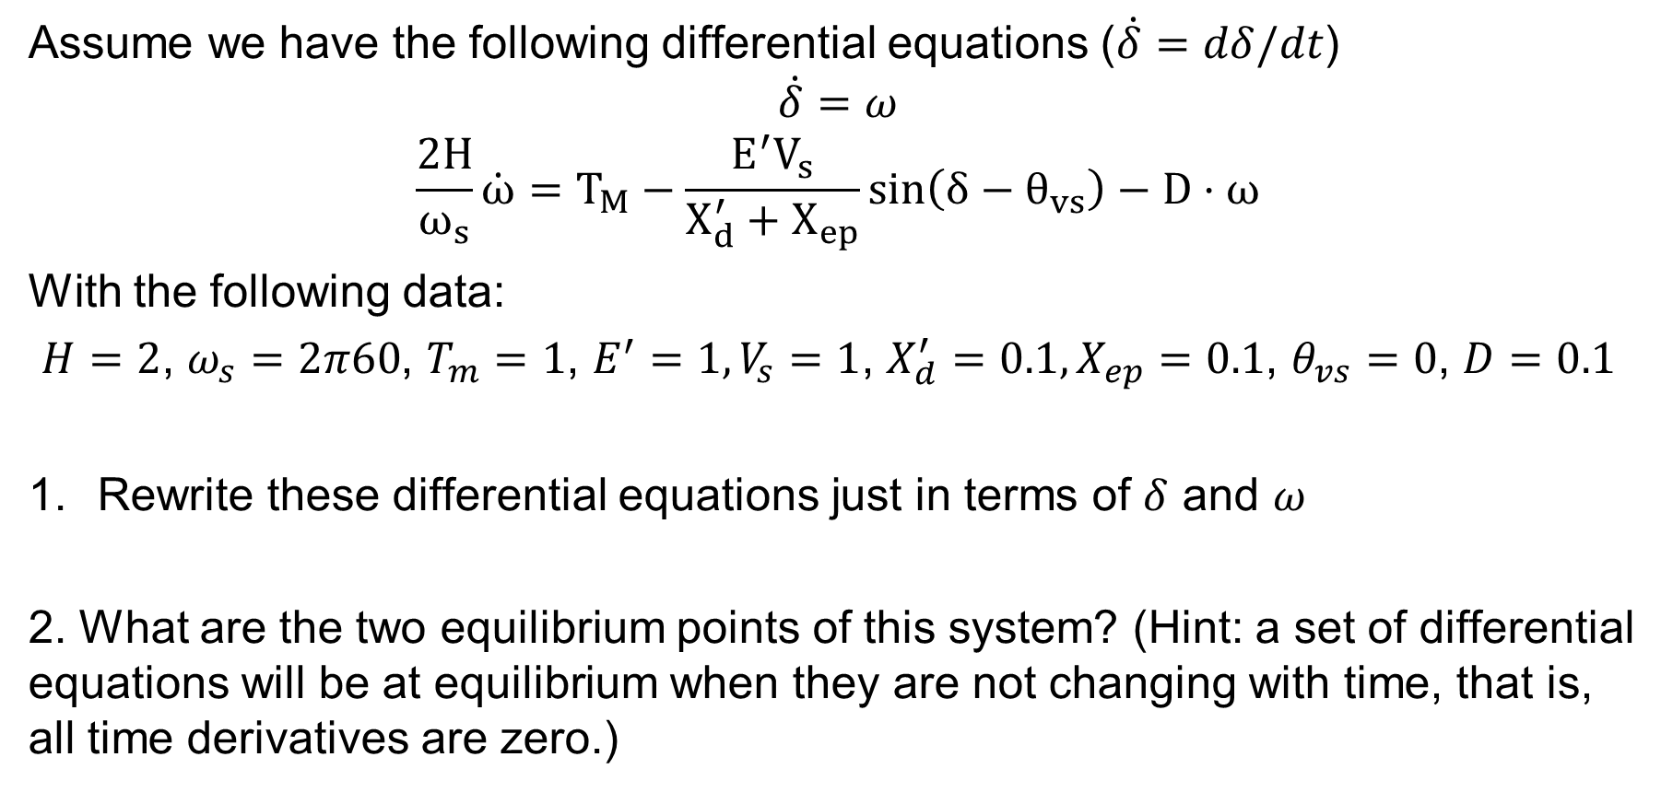
Handout Example
Assume we have the following differential equations ($\dot{δ}=dδ/dt$)
$$\dot{δ}=ω$$
$$\frac{2H}{ω_{s}}\dot{ω}=T_{M}−\frac{E^{′}V_{s}}{X_{d}^{′}+X_{ep}}\sin\left(δ−θ_{vs}\right)−D⋅ω$$
With the following data:
$H=2$, $ω_{s}=2π60$, $T_{m}=1$, $E^{′}=1, V_{s}=1$, $X_{d}^{′}=0.1, X_{ep}=0.1$, $θ_{vs}=0$, $D=0.1$
Rewrite these differential equations just in terms of $δ$ and $ω$
2. What are the two equilibrium points of this system? (Hint: a set of differential equations will be at equilibrium when they are not changing with time, that is, all time derivatives are zero.)

Slide 3
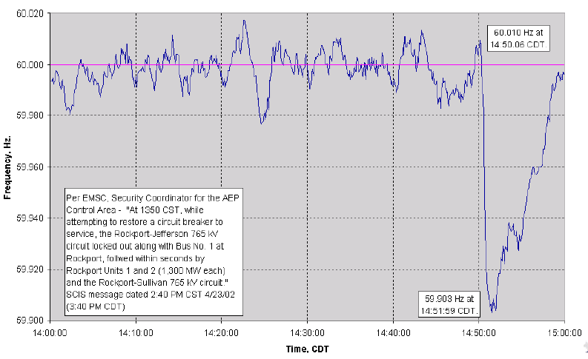
Example of Frequency Variation
Figure shows Eastern Interconnect frequency variation after loss of 2600 MW

Slide 4
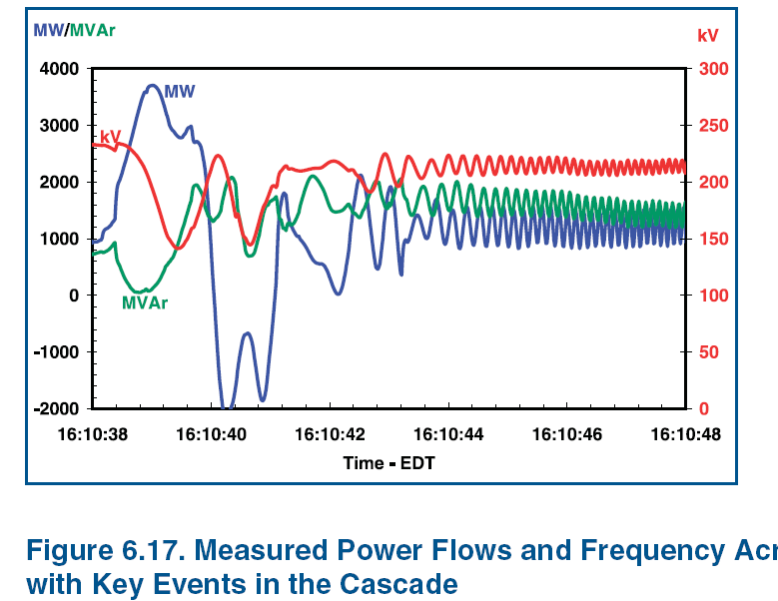
Example of Dynamics Behavior
Source: August 14th 2003 Blackout Final Report

Slide 5
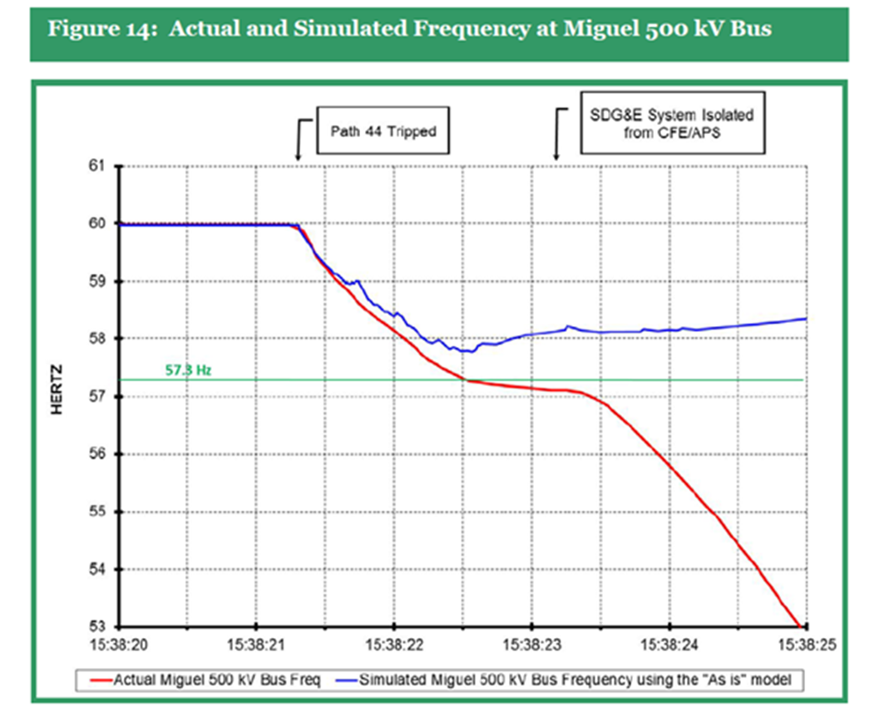
Power System Dynamics Motivation: Frequency Decline September 2011 Blackout
Image Source: Arizona-Southern California Outages on September 8, 2011 Report, FERC and NERC, April 2012

Slide 6
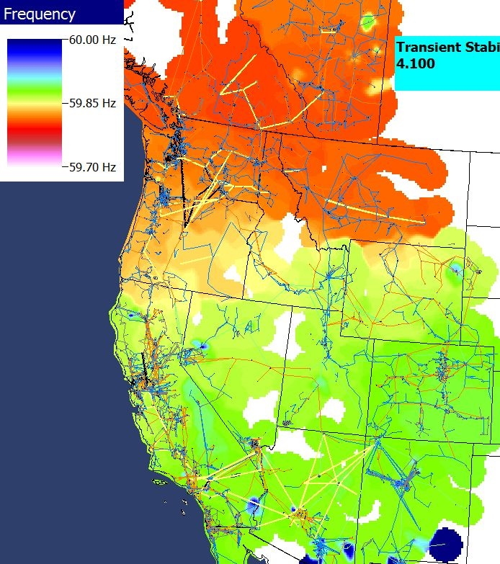
Power Grid Disturbance Example
Figures show the frequency change as a result of the sudden loss of a large amount of generation in the Southern WECC
Green is bus quite close to location of generator trip while blue and red are quite distant.
Frequency in HZ
Frequency contour
Time in seconds

Slide 7
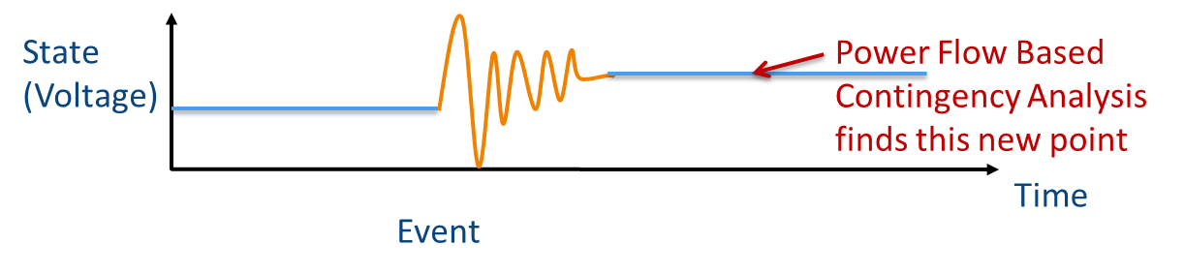
Recap: Power Flow
The power flow is used to determine a quasi steady-state operating condition for a power system
  Goal is to solve a set of algebraic equations
    g(y) = 0 [y variables are bus voltage and angle]
  Models employed reflect the steady-state assumption
  Using a power flow, after a contingency occurs (such as opening a line), the algebraic equations are solved to determine a new equilibrium

Slide 8
Power Flow vs. Dynamics
Dynamic simulations are used to determine whether following a contingency the power system returns to a steady-state operating point
  Goal is to solve a set of differential and algebraic equations,
    dx/dt = f(x,y) [y variables are bus voltage and angle]
    g(x,y) = 0 [x variables are dynamic state variables]
  Starts in steady-state, and hopefully returns to a usually new steady-state value
  Models reflect the transient stability time frame (up to dozens of seconds)
    Slow Values → Treat as constants
    Ultra Fast States → Treat as algebraic relationships

Slide 9
Power System Transient Stability
In order to operate as an interconnected system all of the generators (and other synchronous machines) must remain in synchronism with one another
  Synchronism requires that (for two pole machines) the rotors turn at exactly the same speed
Loss of synchronism results in a condition in which no net power can be transferred between the machines
A system is said to be transiently unstable if following a disturbance one or more of the generators lose synchronism

Slide 10
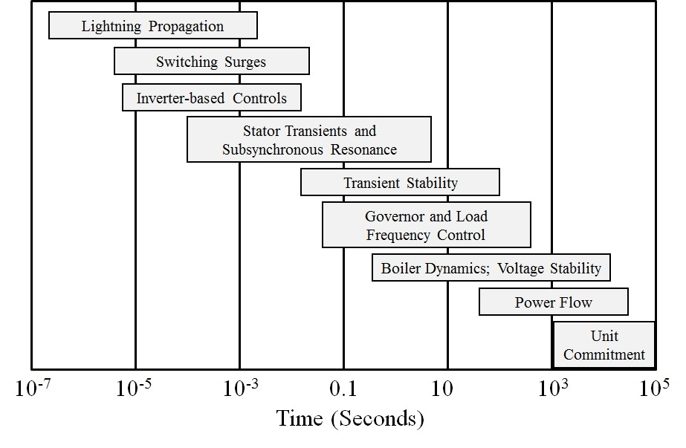
Power System Time Scales and Transient Stability
Image source: P.W. Sauer, M.A. Pai, Power System Dynamics and Stability, 1997, Fig 1.2, modified

Slide 11
Power System Stability Terms
Terms continue to evolve, but a good reference is [1]; image shows Figure 1 from this reference
[1] IEEE/CIGRE Joint Task Force on Stability Terms and Definitions, “Definitions and Classification of Power System Stability,” IEEE Transactions Power Systems, May 2004, pp. 1387-1401

Slide 12
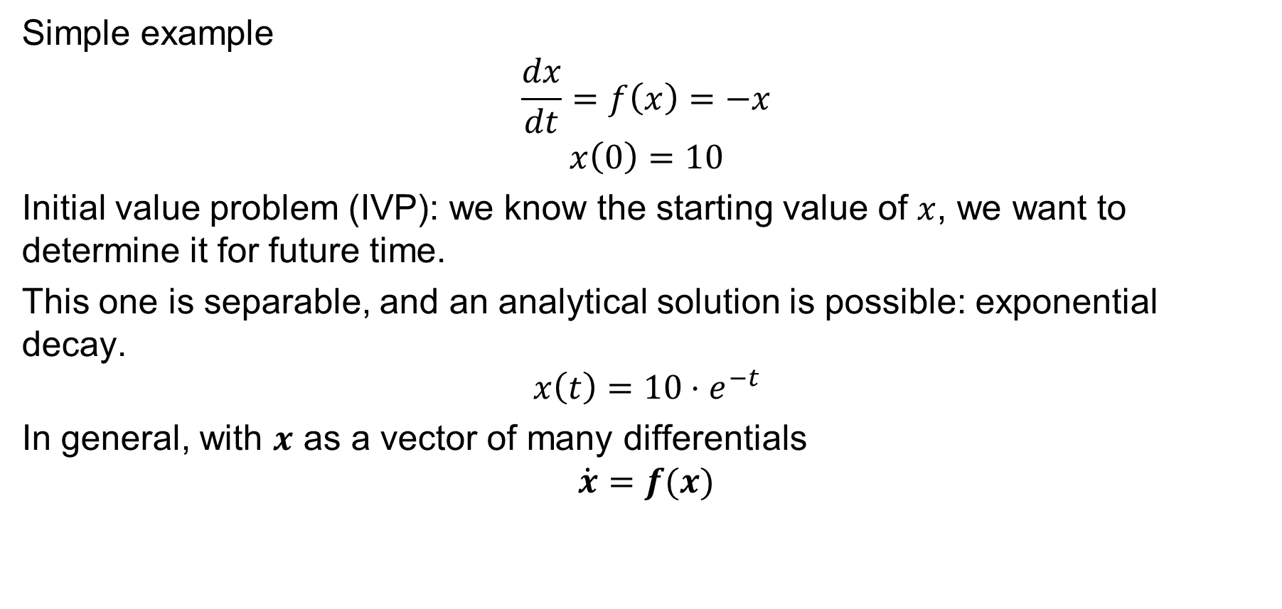
Differential Algebraic Equations (DAEs)
Simple example
$$\frac{dx}{dt}=f\left(x\right)=−x$$
$$x\left(0\right)=10$$
Initial value problem (IVP): we know the starting value of $x$, we want to determine it for future time.
This one is separable, and an analytical solution is possible: exponential decay.
$$x\left(t\right)=10⋅e^{−t}$$
In general, with $x$ as a vector of many differentials
$$\dot{x}=f(x)$$

Slide 13
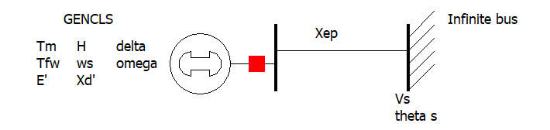
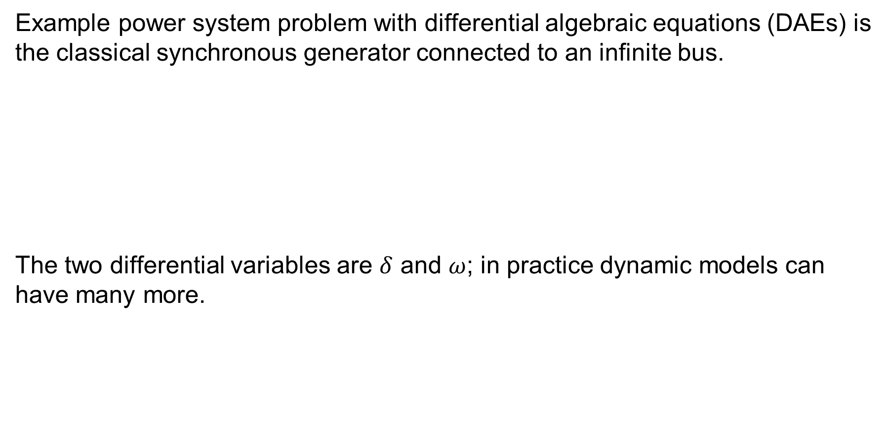
Power System Dynamics DAEs
Example power system problem with differential algebraic equations (DAEs) is the classical synchronous generator connected to an infinite bus.
The two differential variables are $δ$ and $ω$; in practice dynamic models can have many more.

Slide 14
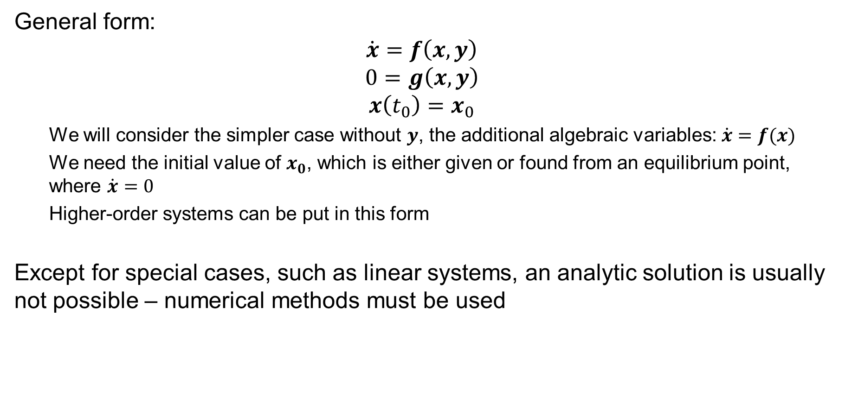
Solving DAEs
General form:
$$\dot{x}=f\left(x,y\right)$$
$$0=g\left(x,y\right)$$
$$x\left(t_{0}\right)=x_{0}$$
  We will consider the simpler case without $y$, the additional algebraic variables: $\dot{x}=f(x)$
  We need the initial value of $x_{0}$, which is either given or found from an equilibrium point, where $\dot{x}=0$
  Higher-order systems can be put in this form
Except for special cases, such as linear systems, an analytic solution is usually not possible – numerical methods must be used

Slide 15
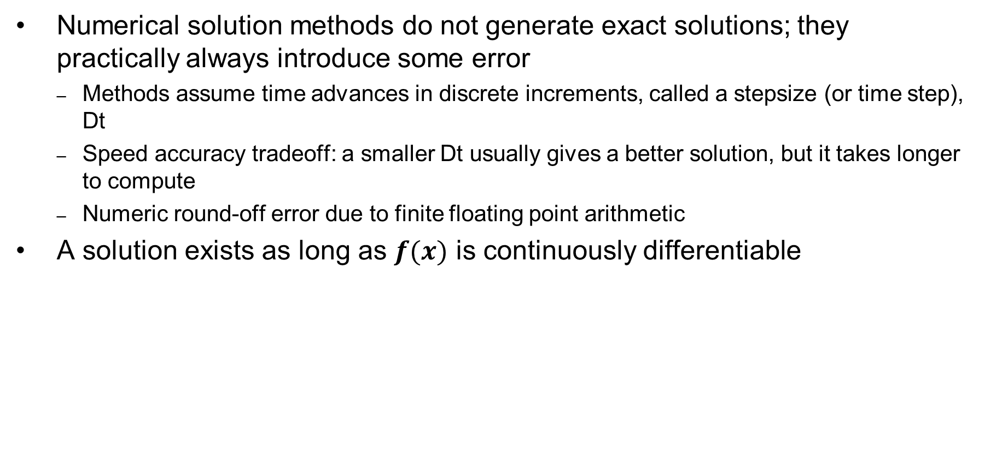
Solving DAEs Numerically
Numerical solution methods do not generate exact solutions; they practically always introduce some error
  Methods assume time advances in discrete increments, called a stepsize (or time step), Dt
  Speed accuracy tradeoff: a smaller Dt usually gives a better solution, but it takes longer to compute
  Numeric round-off error due to finite floating point arithmetic
A solution exists as long as $f(x)$ is continuously differentiable

Slide 16
Error Propagation
At each time step the total round-off error is the sum of the local round-off at time and the propagated error from steps 1, 2 , … , k − 1
An algorithm with the desirable property that local round-off error decays with increasing number of steps is said to be numerically stable
Otherwise, the algorithm is numerically unstable
Numerically unstable algorithms can nevertheless give quite good performance if appropriate time steps are used
  This is particularly true when coupled with algebraic equations

Slide 17
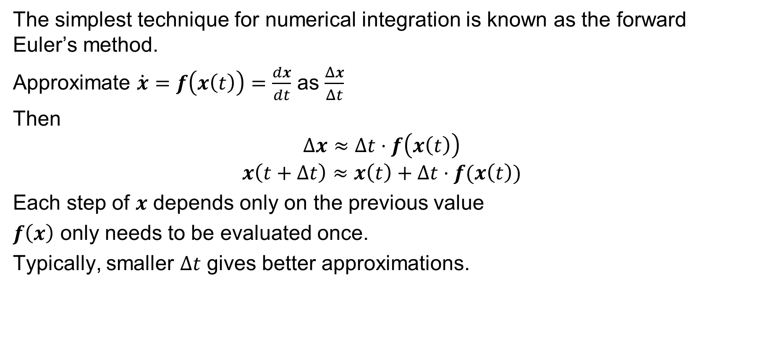
Euler’s Method
The simplest technique for numerical integration is known as the forward Euler’s method.
Approximate $\dot{x}=f\left(x\left(t\right)\right)=\frac{dx}{dt}$ as $\frac{Δx}{Δt}$
Then
$$Δx≈Δt⋅f\left(x\left(t\right)\right)$$
$$x\left(t+Δt\right)≈x\left(t\right)+Δt⋅f(x\left(t\right))$$
Each step of $x$ depends only on the previous value
$f\left(x\right)$ only needs to be evaluated once.
Typically, smaller $Δt$ gives better approximations.

Slide 18

Euler’s Method Algorithm
Set $t=t_{0}$ (usually 0)
$x\left(t_{0}\right)=x_{0}$
Pick a time step $Δt$, which is problem specific
While $t≤t^{end}$ Do
$x\left(t+Δt\right)=x\left(t\right)+Δt⋅f\left(x\left(t\right)\right)$
$t=t+Δt$
End While

Slide 19
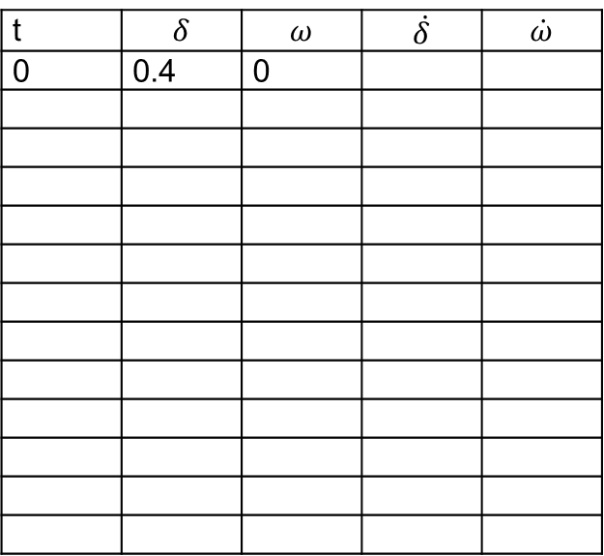
Handout Example
Fill out the following table for this system starting at the given point, using Euler’s method with a time step of 0.01 seconds. Try it on a spreadsheet or with a script out to 2 seconds. Is the system stabilizing to an equilibrium point?
t | $$δ$$ | $$ω$$ | $$\dot{δ}$$ | $$\dot{ω}$$
0 | 0.4 | 0

Slide 20
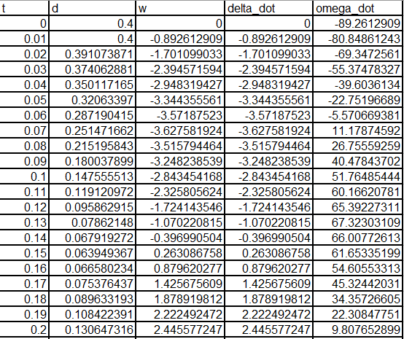
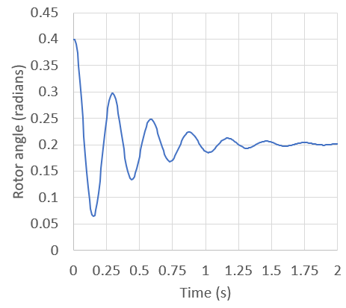
Solution to Handout Example
Yes, it is stabilizing to the first equilibrium point

Slide 21
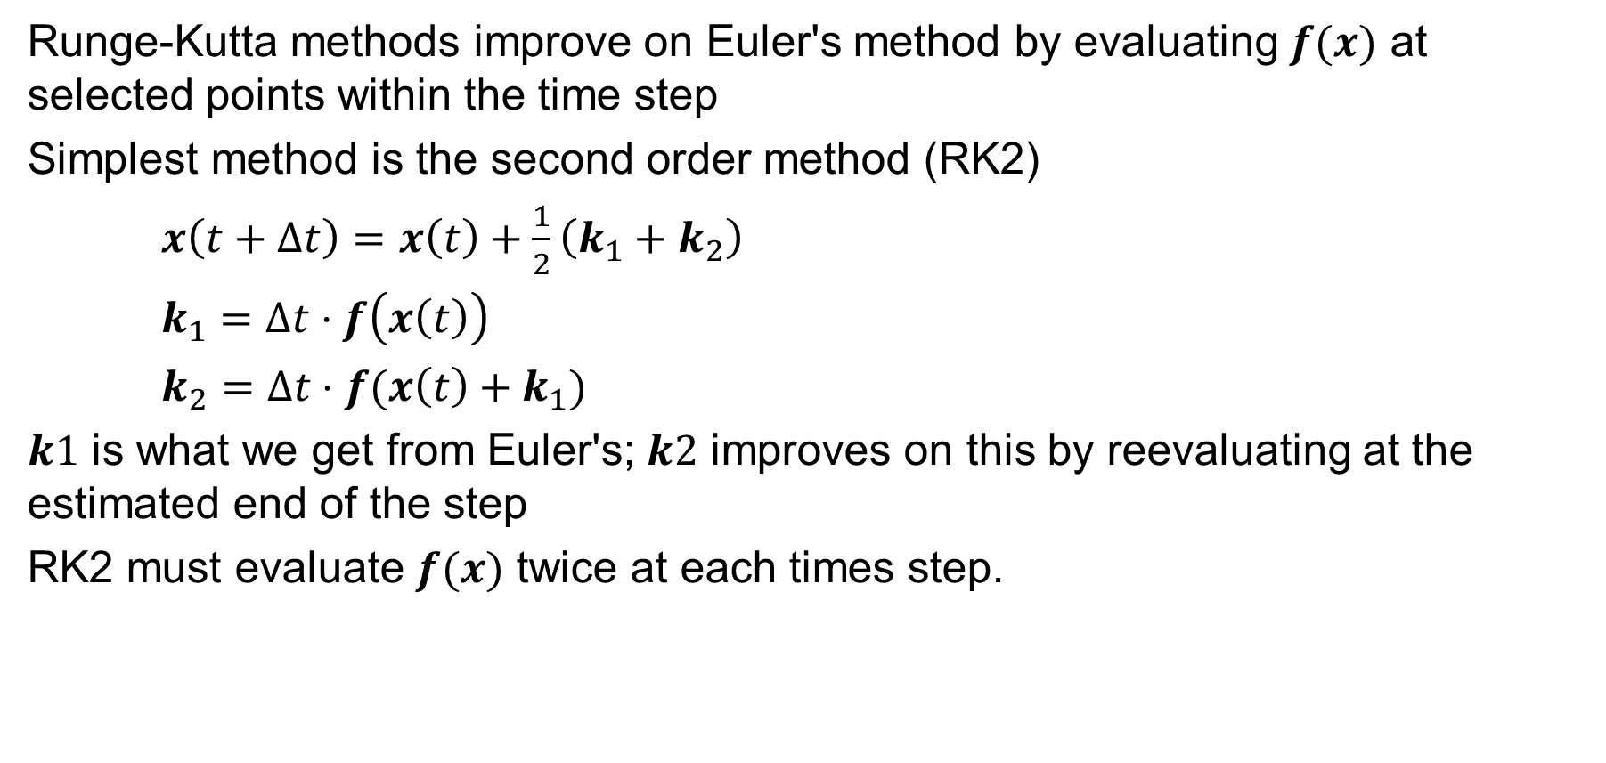
Runge-Kutta Methods
Runge-Kutta methods improve on Euler's method by evaluating $f(x)$ at selected points within the time step
Simplest method is the second order method (RK2)
$x\left(t+Δt\right)=x\left(t\right)+\frac{1}{2}\left(k_{1}+k_{2}\right)$
$k_{1}=Δt⋅f\left(x\left(t\right)\right)$
$k_{2}=Δt⋅f(x\left(t\right)+k_{1})$
$k1$ is what we get from Euler's; $k2$ improves on this by reevaluating at the estimated end of the step
RK2 must evaluate $f(x)$ twice at each times step.

Slide 22
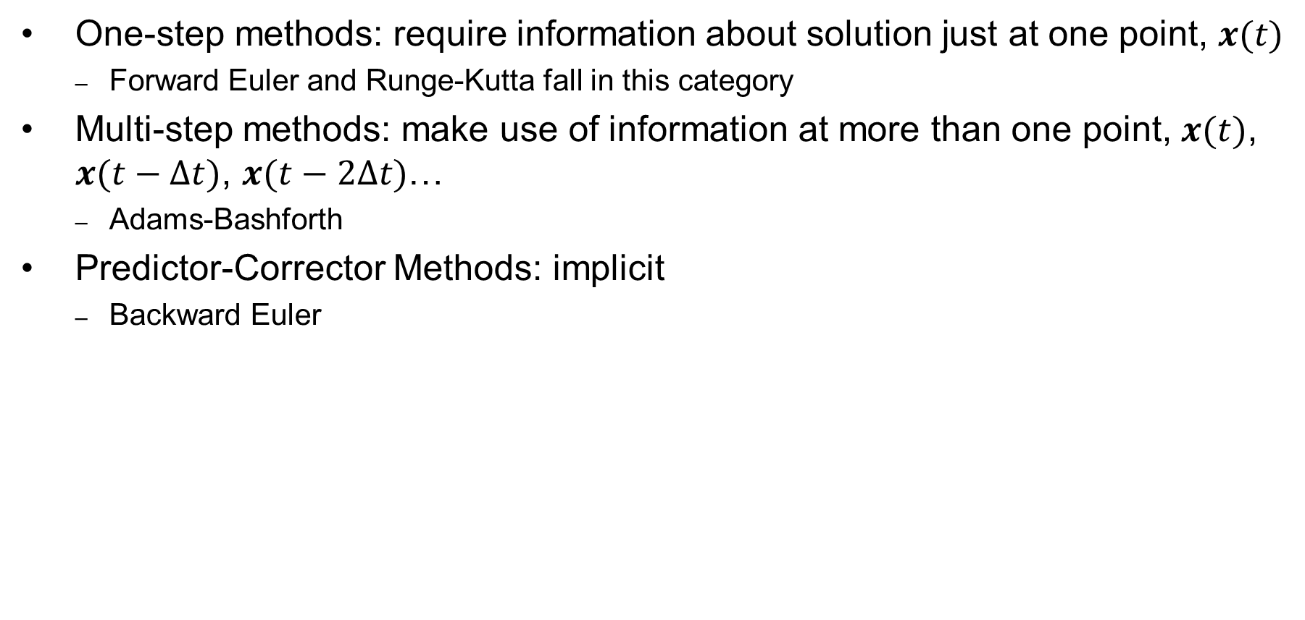
Other Numerical Solution Methods
One-step methods: require information about solution just at one point, $x(t)$
  Forward Euler and Runge-Kutta fall in this category
Multi-step methods: make use of information at more than one point, $x(t)$, $x(t−Δt)$, $x(t−2Δt)$…
  Adams-Bashforth
Predictor-Corrector Methods: implicit
  Backward Euler

Slide 23
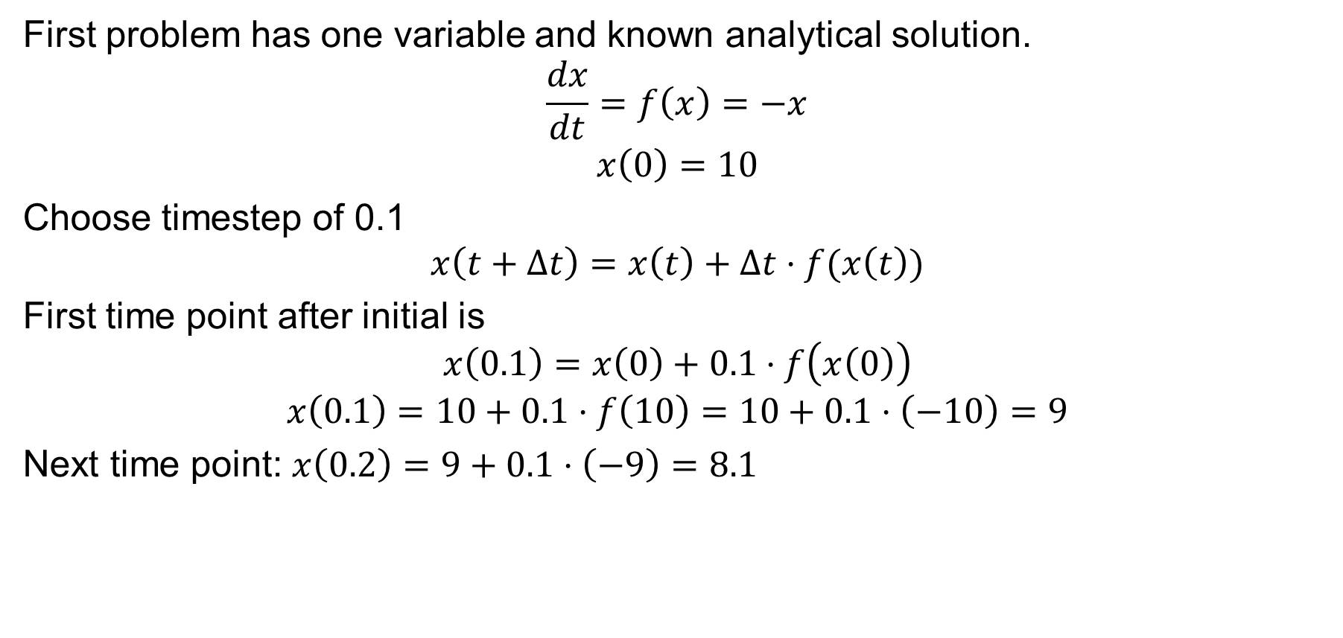
Example #1
First problem has one variable and known analytical solution.
$$\frac{dx}{dt}=f\left(x\right)=−x$$
$$x\left(0\right)=10$$
Choose timestep of 0.1
$$x\left(t+Δt\right)=x\left(t\right)+Δt⋅f(x\left(t\right))$$
First time point after initial is
$$x\left(0.1\right)=x\left(0\right)+0.1⋅f\left(x\left(0\right)\right)$$
$$x\left(0.1\right)=10+0.1⋅f\left(10\right)=10+0.1⋅\left(−10\right)=9$$
Next time point: $x\left(0.2\right)=9+0.1⋅\left(−9\right)=8.1$

Slide 24
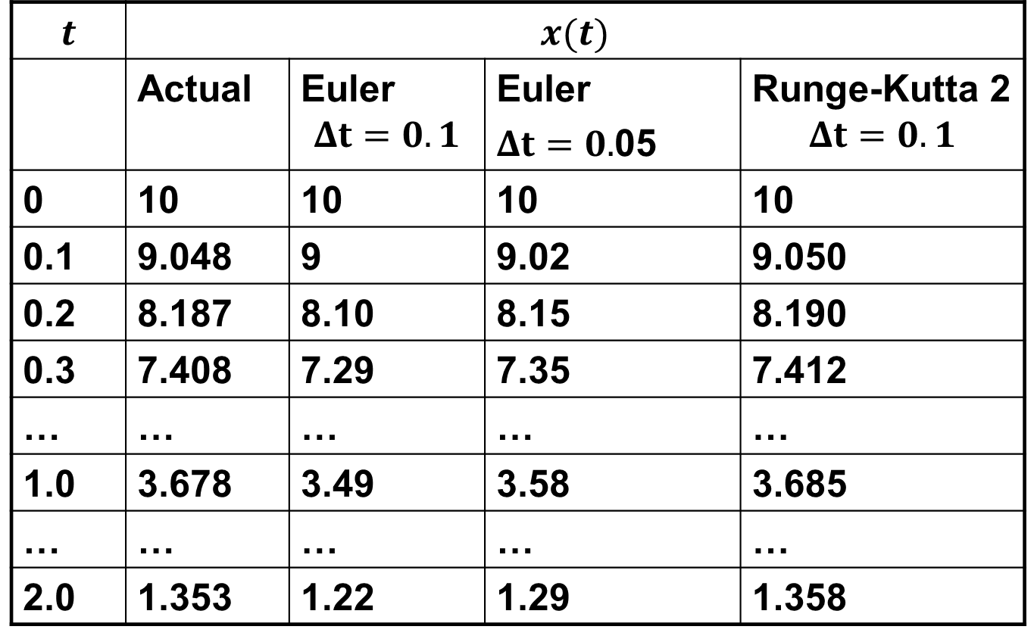
Example #1, Cont.
$$t$$ | $$x(t)$$
 | Actual | Euler $$Δt=0.1$$ | Euler $Δt=0.$05 | Runge-Kutta 2 $$Δt=0.1$$
0 | 10 | 10 | 10 | 10
0.1 | 9.048 | 9 | 9.02 | 9.050
0.2 | 8.187 | 8.10 | 8.15 | 8.190
0.3 | 7.408 | 7.29 | 7.35 | 7.412
… | … | … | … | …
1.0 | 3.678 | 3.49 | 3.58 | 3.685
… | … | … | … | …
2.0 | 1.353 | 1.22 | 1.29 | 1.358

Slide 25
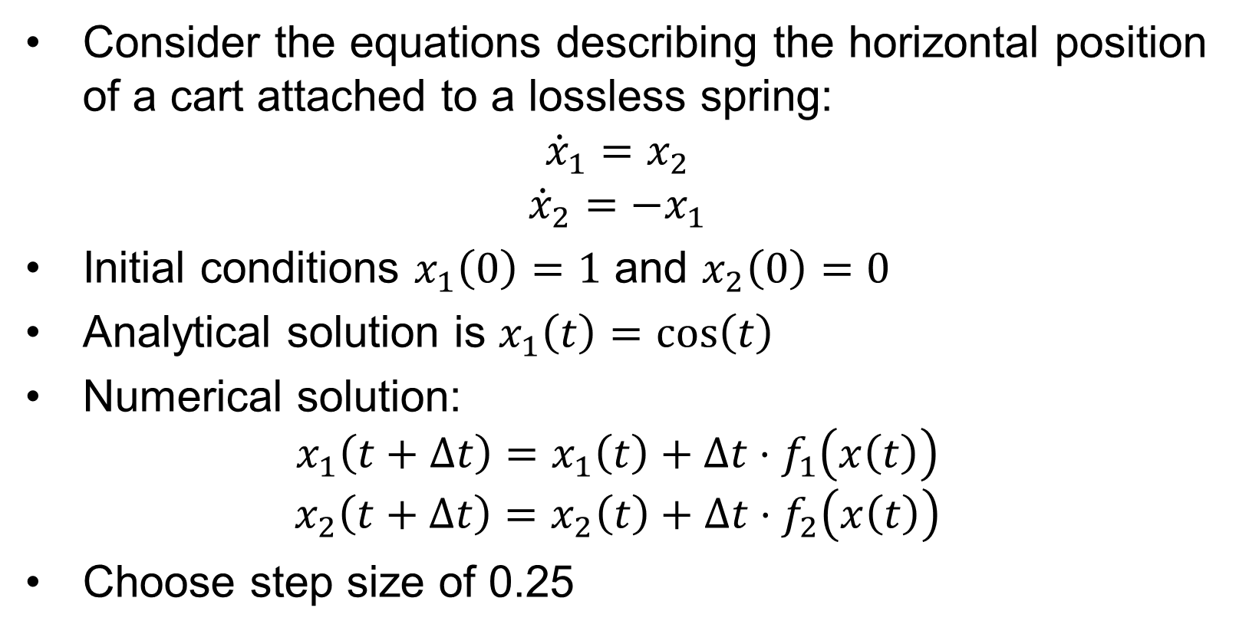
Example #2
Consider the equations describing the horizontal position of a cart attached to a lossless spring:
$${\dot{x}}_{1}=x_{2}$$
$${\dot{x}}_{2}=−x_{1}$$
Initial conditions $x_{1}\left(0\right)=1$ and $x_{2}\left(0\right)=0$
Analytical solution is $x_{1}\left(t\right)=\cos\left(t\right)$
Numerical solution:
$$x_{1}\left(t+Δt\right)=x_{1}\left(t\right)+Δt⋅f_{1}\left(x\left(t\right)\right)$$
$$x_{2}\left(t+Δt\right)=x_{2}\left(t\right)+Δt⋅f_{2}\left(x\left(t\right)\right)$$
Choose step size of 0.25

Slide 26
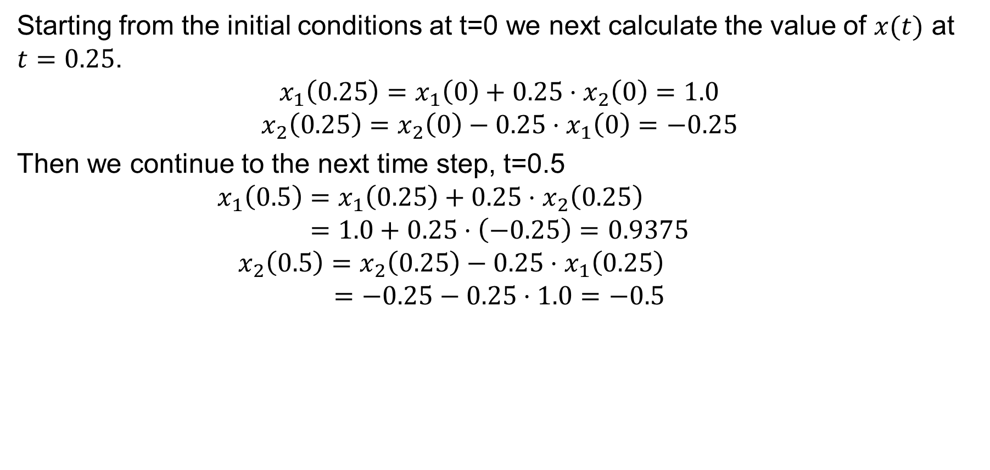
Example #2, Cont.
Starting from the initial conditions at t=0 we next calculate the value of $x(t)$ at $t=0.25$.
$$x_{1}\left(0.25\right)=x_{1}\left(0\right)+0.25⋅x_{2}\left(0\right)=1.0$$
$$x_{2}\left(0.25\right)=x_{2}\left(0\right)−0.25⋅x_{1}\left(0\right)=−0.25$$
Then we continue to the next time step, t=0.5
$$x_{1}\left(0.5\right)=x_{1}\left(0.25\right)+0.25⋅x_{2}\left(0.25\right)$$
$$=1.0+0.25⋅\left(−0.25\right)=0.9375$$
$$x_{2}\left(0.5\right)=x_{2}\left(0.25\right)−0.25⋅x_{1}\left(0.25\right)$$
$$=−0.25−0.25⋅1.0=−0.5$$

Slide 27
Example #2, Cont.
t | x₁^{actual}(t) | x₁(t) Dt=0.25
0 | 1 | 1
0.25 | 0.9689 | 1
0.50 | 0.8776 | 0.9375
0.75 | 0.7317 | 0.8125
1.00 | 0.5403 | 0.6289
… | … | …
10.0 | -0.8391 | -3.129
100.0 | 0.8623 | -151,983
Since we know from
the exact solution that
x₁ is bounded between
-1 and 1, clearly the
method is numerically
unstable

Slide 28
Example #2, Cont.
Below is a comparison of the solution values for x₁(t)
at time t = 10 seconds
Dt | x₁(10)
actual | -0.8391
0.25 | -3.129
0.10 | -1.4088
0.01 | -0.8823
0.001 | -0.8423

