Slide 1
ECEN 460, Spring 2024 Power System Operation and Control
Class 18: Economic Dispatch Example and Markets Demo
Prof. Adam Birchfield
Dept. of Electrical and Computer Engineering
Texas A&M University
abirchfield@tamu.edu

Slide 2
Economic Dispatch, Exercise 3
Use the Lambda Iteration method to find the optimal dispatch of three generators. Verify using the direct method.
$C_{1}\left(P_{1}\right)=0.025 P_{1}^{2}+16{ P}_{1}$ $15≤P_{1}≤115$
$C_{2}\left(P_{2}\right)=0.035 P_{2}^{2}+9 P_{2}$ $30≤P_{2}≤185$
$C_{3}\left(P_{3}\right)=0.004 P_{3}^{2}+15 P_{3}$ $8≤P_{3}≤325$
Assume the total load is 200 MW. Start with guessing $λ_{H}=40$and $λ_{L}=10$.

Slide 3
Work Along With Code!

Slide 4
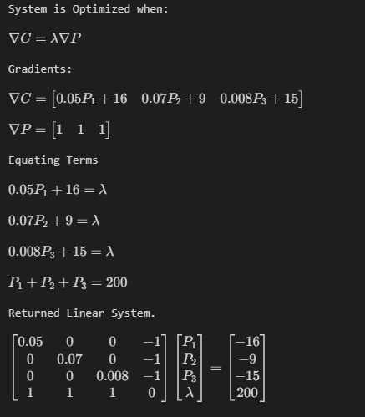
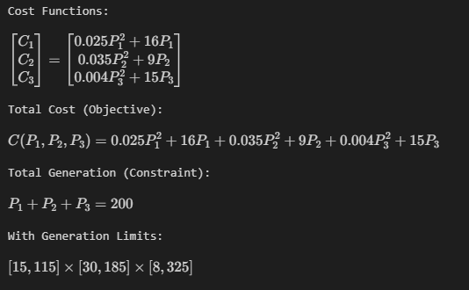
Direct Method Code Example
Direct Method
Turn the problem into a linear algebra problem

Slide 5
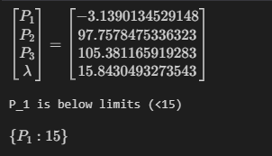
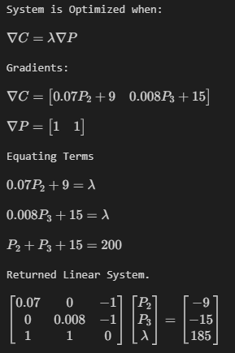
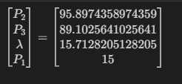
Direct Method Code Example
1st Solution
Out of bounds. Fix the lower limit of P1 and resolve
Solution in Bounds!
Complete.
New Equations with P1=15

Slide 6
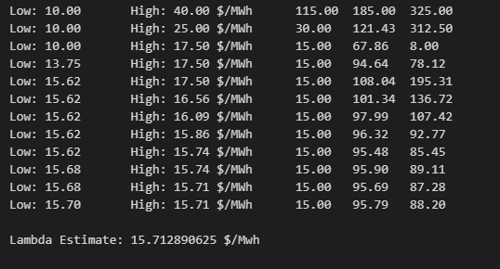
Iteration Method Code Example
Starting from the Gradients of the Direct method, we solve for P values in terms of lambda
Then Perform our high-low search…

Slide 7
Convergence Animation
This shows the example problem we just computed converging between high and low guesses.

Slide 8
Direct vs Iterative
Direct Solution
Iterative Solution
We get the same answer!

Slide 9
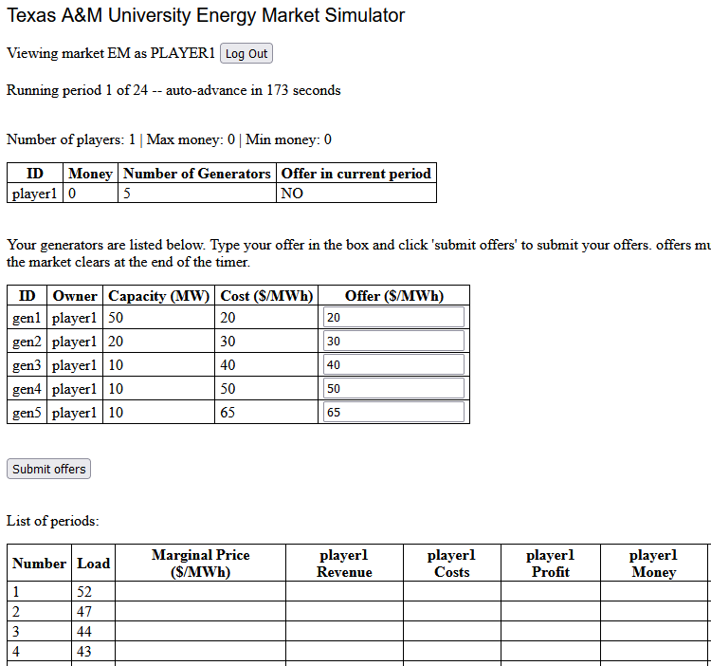
Lab 8 Introduction
Lab 8 involves simulating a (friendly) competitive energy market between students in the lab
TA will be operating a market to supply a certain amount of load per period
Students own 5 generators each with varying costs and MW capacities
Each period, bid a price for each generator
Two payment methods: last-accepted offer (LAO) and pay-as-offered (PAO)

