Slide 1
ECEN 460, Spring 2024
Power System Operation and Control
Class 16: Large Power System Operations
Prof. Adam Birchfield
Dept. of Electrical and Computer Engineering
Texas A&M University
abirchfield@tamu.edu

Slide 2
Announcements
Exam 2 date changed to Tuesday, April 16th
Friday March 22nd is the power plant tour
Homework on economic dispatch due March 26th: 6th edition book problems 6.62, 6.63, 6.65 or 7th edition book problems 7.1, 7.2, 7.4
Review economic dispatch for Quiz next class
Take note of remaining lab schedule below:
 | Wednesday | Friday
Lab 7 | 3/27 | 4/5
Lab 8 | 4/3 | 4/12
Lab 9 | 4/10 | 4/19
Lab 10 | 4/24 | 4/26

Slide 3
Large Power System Controls
So far we've looked at modeling power system components (generators, lines, transformers).
We've looked at how the power flow works, including last class with some advanced techniques and simplifications
Today we're going to talk about how large power systems (the bulk grid) are controlled.
There are lots of things we could say about power system control.
Let's look at Twenty-Four Statements About Power System Control
When you come back to study, make sure you understand what each of them is saying.

Slide 4
Dispatch
Statement 1. All else being equal, the lowest-cost generators are dispatched to meet the load.
The major variable cost in power systems is associated with generation.
Cost to generate a MWh can vary widely.
For some types of units (such as hydro and nuclear) it is difficult to quantify.
For thermal units it is much easier, as we will discuss.
Economic dispatch (ED) determines the least cost dispatch of generation for an area.
For a lossless system, the ED occurs when all the generators have equal marginal costs.
IC1(PG,1) = IC2(PG,2) = … = ICm(PG,m)

Slide 5

Transmission Limits
Statement 2. Transmission lines and transformers have power flow limits, and good operations means transmission lines and transformers must stay within their limits.
As we discussed when studying transmission lines, these limits occur from several factors, such as thermal constraints, angle limits, and stability
For transformers the limits are thermal and saturation based
North American Electric Reliability Corporation (NERC) now has legal authority to enforce reliability standards (and there are now lots of them). See
www.nerc.com/pa/stand/pages/reliabilitystandards.aspx

Slide 6
Transmission Limits
Statement 3. The only direct way to control the power through a line is by opening and closing its associated circuit breakers.
This will cause the line flow to almost instantaneously change.
There is no other way to directly control line flow – i.e. no "valves" as in piping.
Note that opening a line because it is overloaded is usually a bad idea, because the flows will have to redistributed to other lines, potentially causing a cascade!

Slide 7
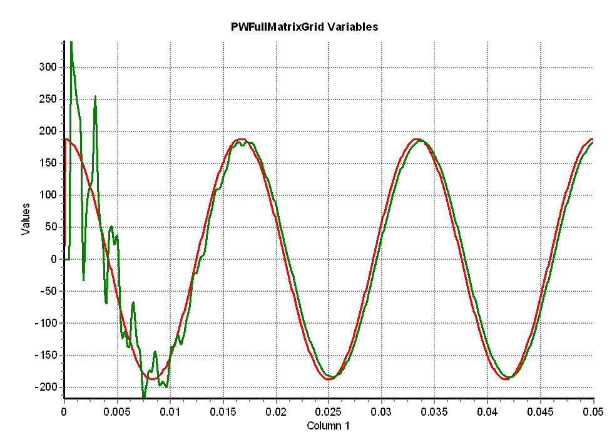
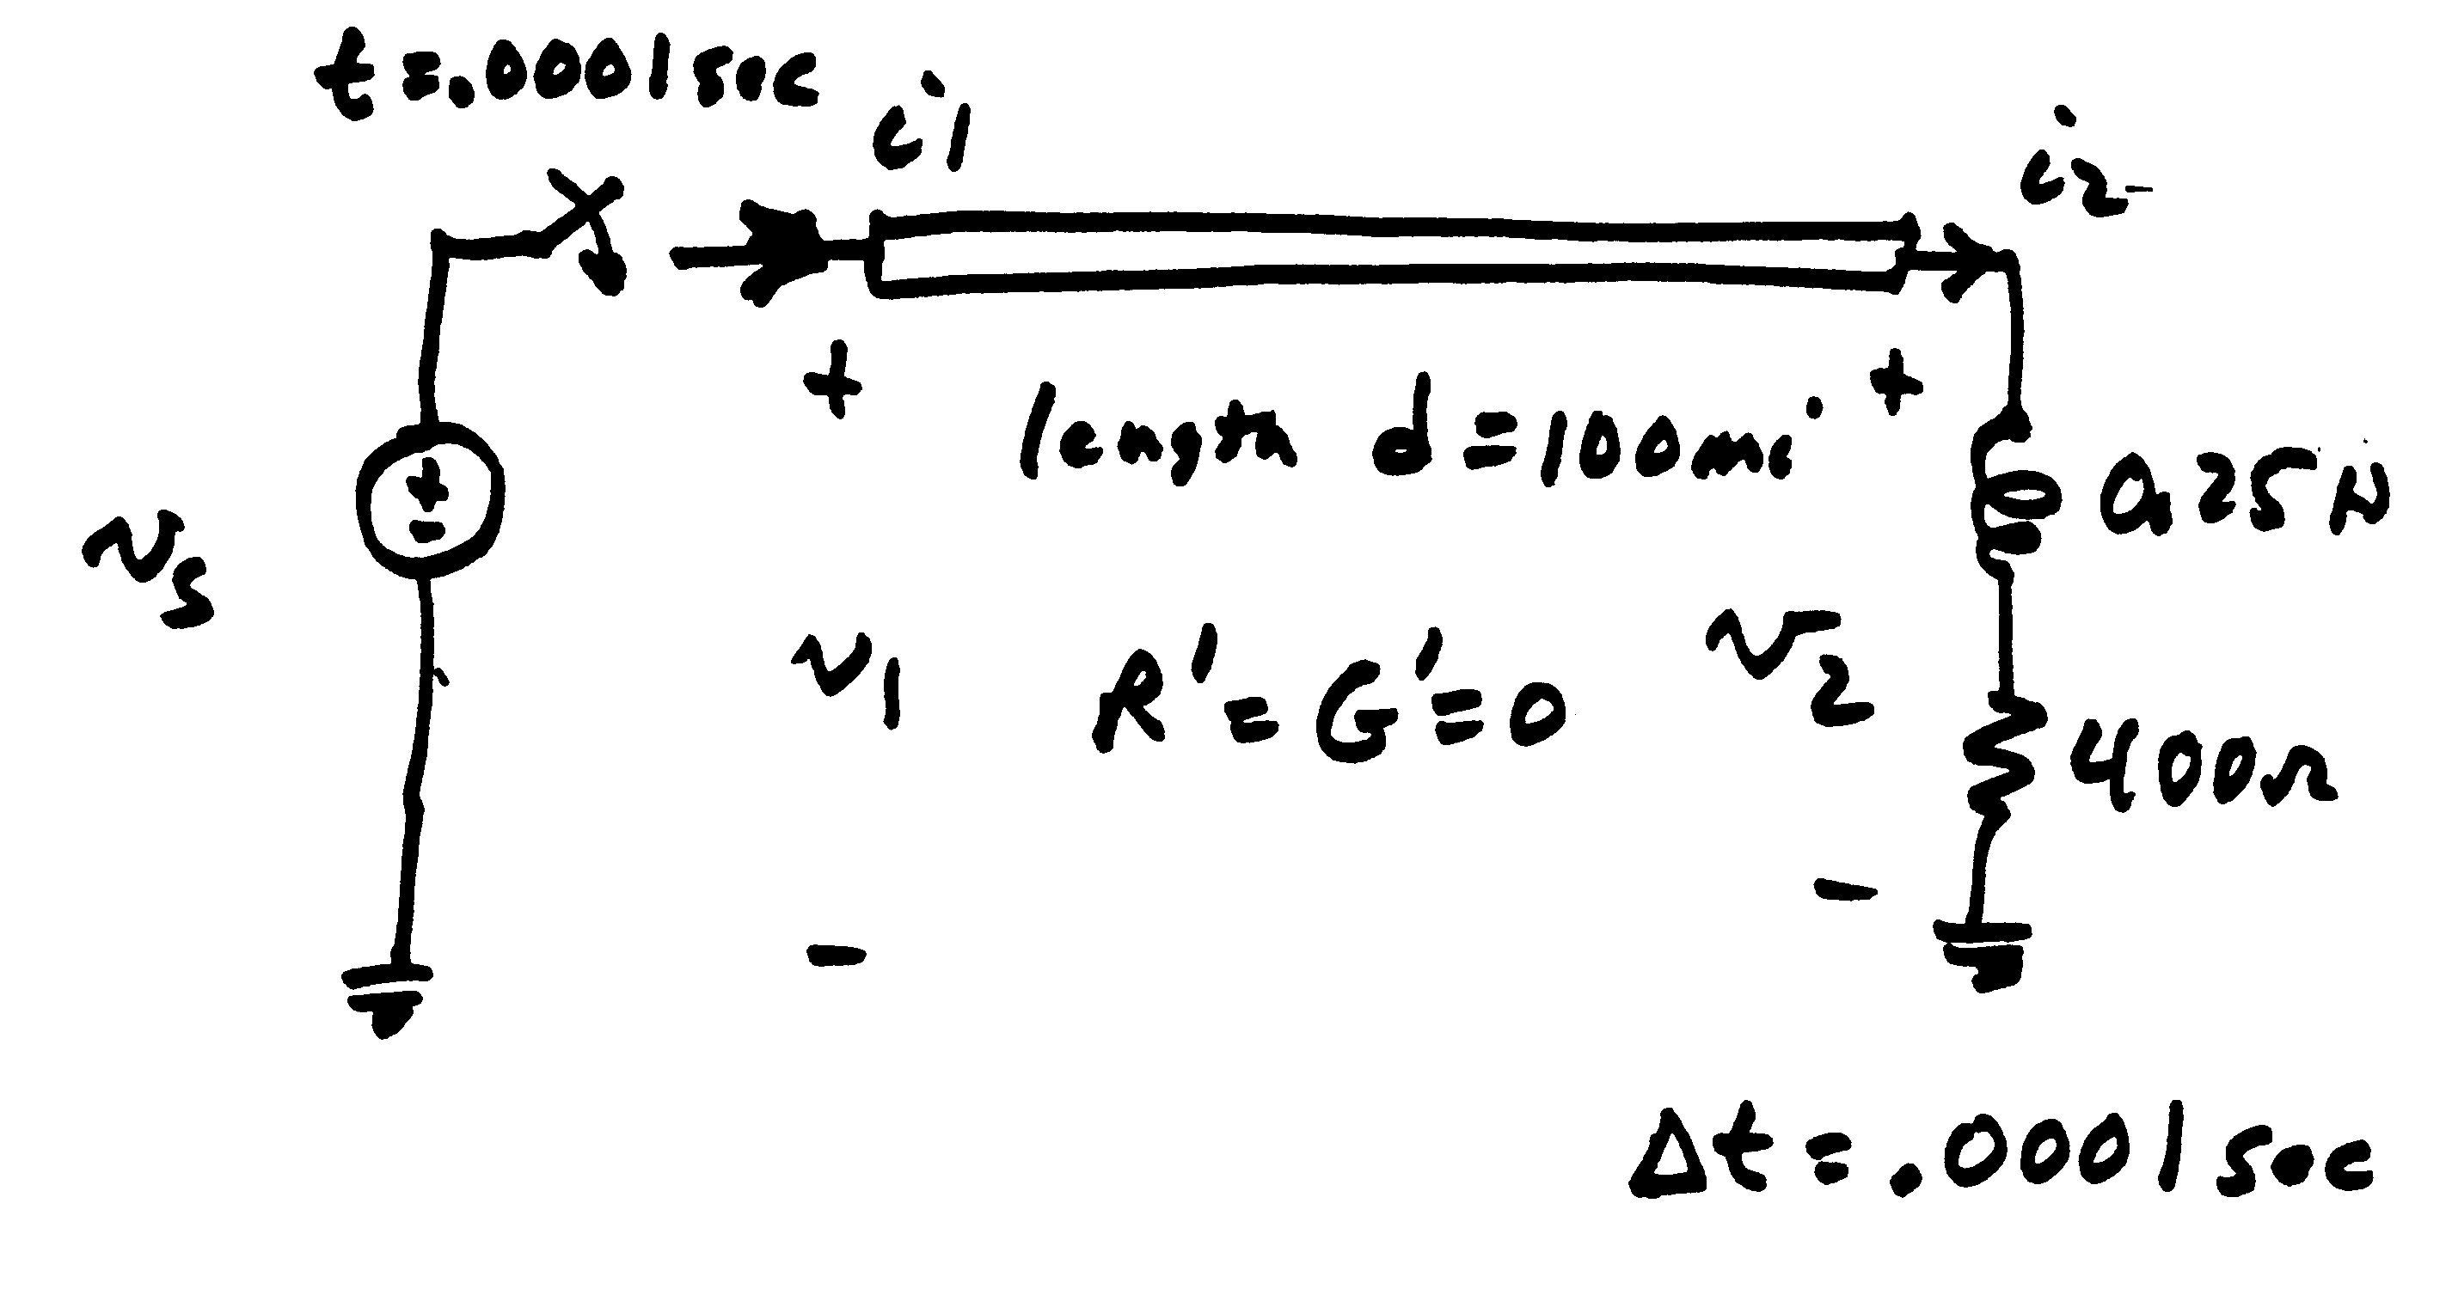
Modeling Consideration – Change is Not Really Instantaneous!
The change isn’t really instantaneous because of propagation delays, which are near the speed of light; there also wave reflection issues
  This is covered in chapters 5 and 13
Red is the v_{s} end, green the v₂ end

Slide 8
Transmission Limits
Statement 4. Indirect transmission flow control can be done by changing generator outputs.
Example of an overloaded transmission line. To fix this, indirectly change the flow by adjusting generator outputs.

Slide 9
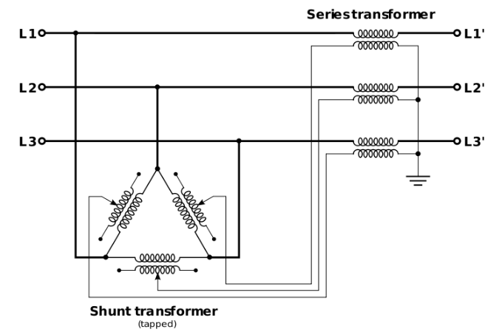

Transmission Limits
Statement 5. Real power flow is closely tied with the phase angle of the bus voltage, so phase shifters can be used to help control real power flows indirectly.
Go back to the derivation of the Fast-Decoupled Power Flow and see from the equations why $θ$ and $P$ are so closely related.

Slide 10
Volt-Var Control
Statement 6. Buses have a minimum and maximum voltage magnitude limit that must be maintained in good operations.
These are also covered by NERC standards. Typical limits would be 0.95 for a minimum limit and 1.08 for a maximum limit

Slide 11
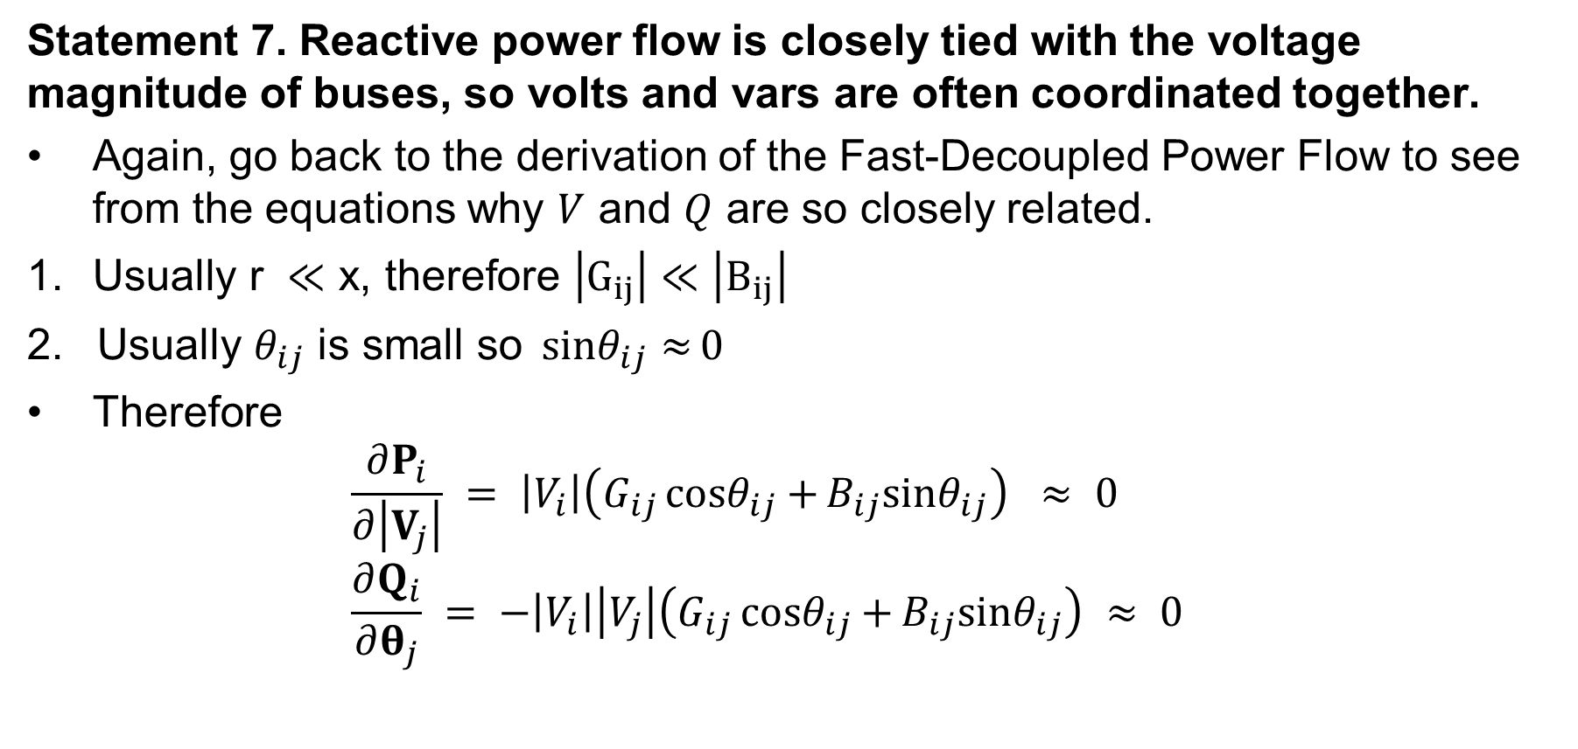
Volt-Var Control
Statement 7. Reactive power flow is closely tied with the voltage magnitude of buses, so volts and vars are often coordinated together.
Again, go back to the derivation of the Fast-Decoupled Power Flow to see from the equations why $V$ and $Q$ are so closely related.
$\text{Usually} \text{r} ≪\text{x}\text{, }\text{therefore} \left|G_{ij}\right|≪\left|B_{ij}\right|$
2. $\text{Usually} θ_{ij} \text{is} \text{small} \text{so} {sinθ}_{ij}{≈}0$
$\text{Therefore}$
$\frac{∂P_{i}}{∂\left|V_{j}\right|} = \left|V_{i}\right|\left(G_{ij}{cosθ}_{ij}{+}B_{ij}{sinθ}_{ij}\right) ≈ 0$
$\frac{∂Q_{i}}{∂θ_{j}} = −\left|V_{i}\right|\left|V_{j}\right|\left(G_{ij}{cosθ}_{ij}{+}B_{ij}{sinθ}_{ij}\right) ≈ 0$

Slide 12
Volt-Var Control
Statement 8. Generator voltage magnitudes are scheduled, with generators changing their reactive power output to control their voltage.

Slide 13
Zion Nuclear Power Plant
The Zion nuclear power plant, located on Lake Michigan, on the Illinois/Wisconsin border, use to be a 2000 MW generator, commissioned in 1973-74
In 1997 a control-room operator inserted control rods too far during a shut down, then withdrew them without following procedures
  NRC also said there were too many people in the control room
  ComEd ended up shutting down both units because it was too costly to fix the damage (estimated at $435 million!)
However, the plant was used for many years as a source of reactive power for North Illinois

Slide 14
Zion Nuclear Power Plant

Slide 15
Volt-Var Control
Statement 9. Some transformers have variable tap ratios that can be used to control voltage.

Slide 16
Volt-Var Control
Statement 10. Reactive power resources, such a shunt capacitors, static VAR compensators, and synchronous condensers, are primarily used as voltage control devices.
Reactive power controllers include switched shunts, static var compensators (SVCs), LTC transformers, sometimes generator voltage setpoints
Goal is to maintain adequate system voltages and reduce losses
Reactive power control is much less linear than real power control; this is partially due to the much higher reactive power losses because for high voltage transmission lines X is usually much larger than R
  Losses are very nonlinear
Vars do not travel far

Slide 17
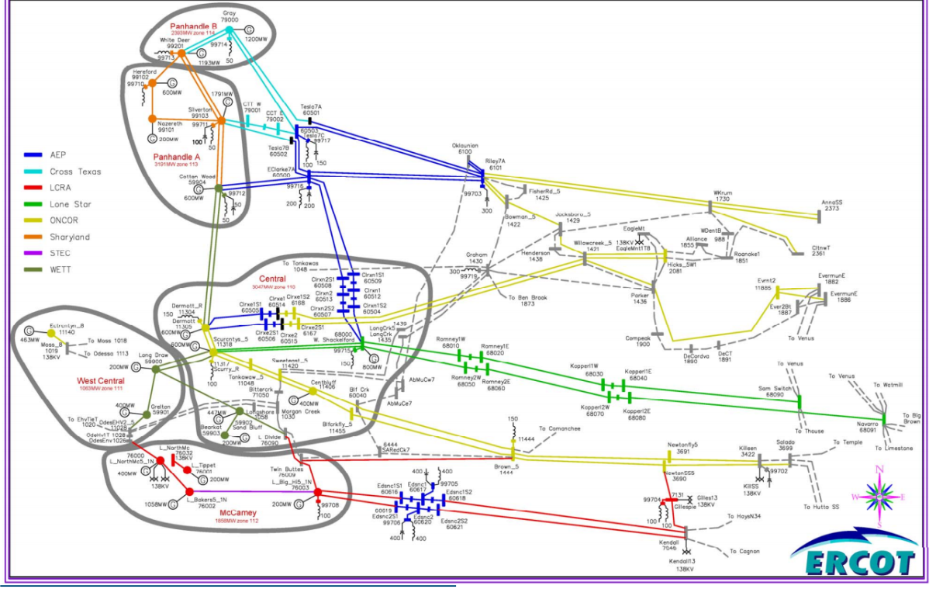
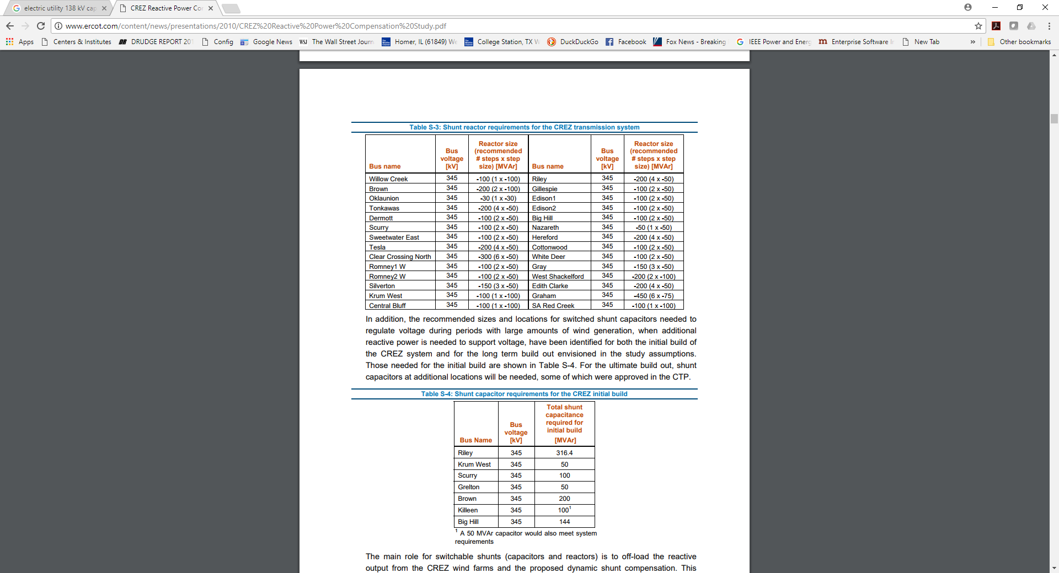
Example: ERCOT Competitive Renewable Energy Zones (CREZ) Study
In 2005 Texas Legislature ordered a grid study in order to accommodate more renewable generation in West Texas; reactive compensation was a key aspect
Starting System Topology
Shunt Additions (< 0=caps)
17
Source: www.ercot.com/content/news/presentations/2010/CREZ%20Reactive%20Power%20Compensation%20Study.pdf

Slide 18
Volt-Var Control
Statement 11. Under-voltage is typically a problem in heavily loaded systems, needing more capacitor banks, while over-voltage can be a problem in lightly-loaded systems, needing more reactor banks.
The pi model when current is low will produce a lot of reactive power
The pi model when current is high will consume a lot of reactive power
Recall, the surge impedance loading (SIL) is on the boundary

Slide 19
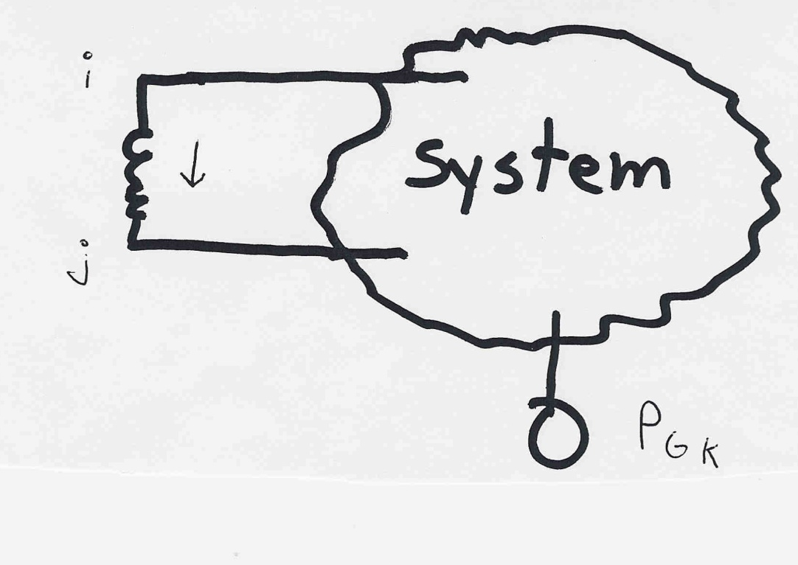
Power System Sensitivities
Statement 12. Sensitivities can be helpful to explain how different power values are related to each other, to give insights into control.
The assumption is
that the change
in generation is
absorbed by the
slack bus

Slide 20
Power Flow Simulation - Before
One way to determine the impact of a generator change is to compare a before/after power flow.
For example below is a three bus case with an overload

Slide 21
Power Flow Simulation - After
Increasing the generation at bus 3 by 95 MW (and hence decreasing it at bus 1 by a corresponding amount), results in a 30.3 MW drop in the MW flow on the line from bus 1 to 2, and a 64.7 MW drop on the flow from 1 to 3.
Expressed as a
percent, 30.3/95
=32% and
64.7/95=68%

Slide 22

Analytic Calculation of Sensitivities
Calculating control sensitivities by repeat power flow solutions is tedious and would require many power flow solutions. An alternative approach is to analytically calculate these values
$$\text{The} \text{power} \text{flow} \text{from} \text{bus} \text{i} \text{to} \text{bus} \text{j} \text{is} \\ P_{ij}≈\frac{\left|V_{i}\right|\left|V_{j}\right|}{X_{ij}}\sin{(}θ_{i}−θ_{j})≈\frac{θ_{i}−θ_{j}}{X_{ij}} \\ \text{So} ΔP_{ij}≈ \frac{Δθ_{i}−Δθ_{j}}{X_{ij}} \text{We} \text{just} \text{need} \text{to} \text{get} \frac{Δθ_{ij}}{ΔP_{Gk}}$$

Slide 23

Analytic Sensitivities
$\text{From} \text{the} \text{fast} \text{decoupled} \text{power} \text{flow} \text{we} \text{know}$
$Δθ=B^{−1}ΔP(x)$
$\text{So} \text{to} \text{get} \text{the} \text{change} \text{in} Δθ \text{due} \text{to} \text{a} \text{change} \text{of}$
$\text{generation} \text{at} \text{bus} \text{k}\text{, }\text{just} \text{set} ΔP(x) \text{equal} \text{to}$
$\text{all} \text{zeros} \text{except} \text{a} \text{minus} \text{one} \text{at} \text{position} \text{k}\text{. }$
$ΔP = \left[\begin{matrix}0 \\ ⋮ \\ −1 \\ 0 \\ ⋮\end{matrix}\right]← \text{Bus} \text{k}$

Slide 24

Three Bus Sensitivity Example
$\text{For} \text{the} \text{previous} \text{three} \text{bus} \text{case} \text{with} {\text{Z}}_{\text{line}}=j0.1$
$Y_{\text{bus}}=j\left[\begin{matrix}−20 & 10 & 10 \\ 10 & −20 & 10 \\ 10 & 10 & −20\end{matrix}\right]→B=\left[\begin{matrix}−20 & 10 \\ 10 & −20\end{matrix}\right]$
$\text{Hence} \text{for} \text{a} \text{change} \text{of} \text{generation} \text{at} \text{bus}\text{ 3}$
$\left[\begin{matrix}Δθ_{2} \\ Δθ_{3}\end{matrix}\right] ={\left[\begin{matrix}−20 & 10 \\ 10 & −20\end{matrix}\right]}^{−1}\left[\begin{matrix}0 \\ −1\end{matrix}\right]=\left[\begin{matrix}0.0333 \\ 0.0667\end{matrix}\right]$
$\text{Then} ΔP_{\text{3 }\text{to}\text{ 1}}=\frac{0.0667−0}{0.1}=\text{0.667 }\text{pu}$
$ΔP_{\text{3 }\text{to}\text{ 2}}=0.333 \text{pu} ΔP_{\text{ 2 }\text{to}\text{ 1}}=0.333 \text{pu}$

Slide 25
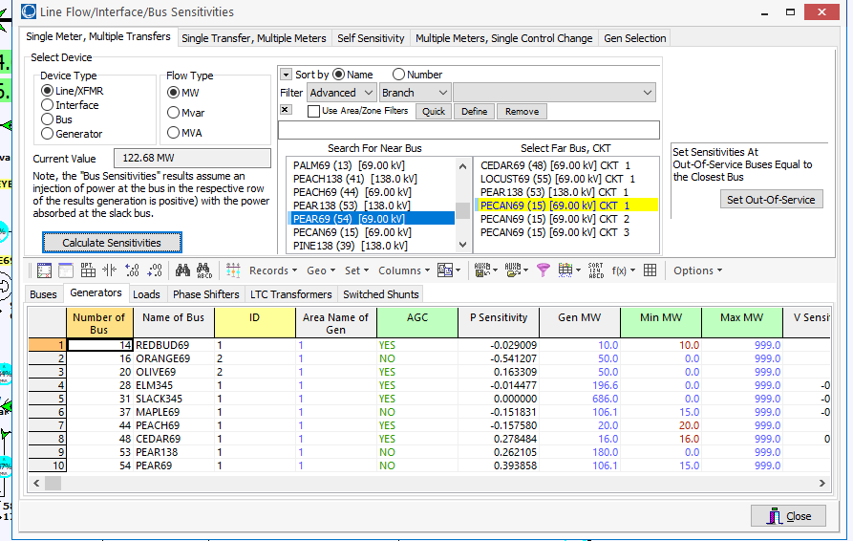
PowerWorld Analytic Sensitivities
Select Tools, Sensitivities, Flow and Voltage Sensitivities to see lots of sensitivities. The below image shows values for our example.

Slide 26
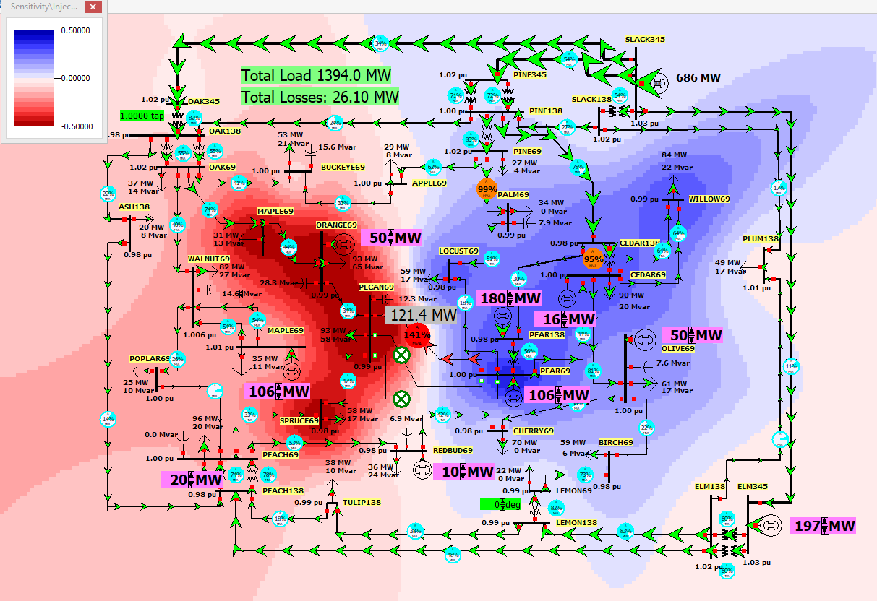
Contour of the Line Flow to Bus Injection Sensitivities
Image shows how a change in injection at
a bus affects the
flow on the Pear69-Pecan69 line
This is a contour of the bus field: Sensitivity\Injection
Value dValue/dP

Slide 27
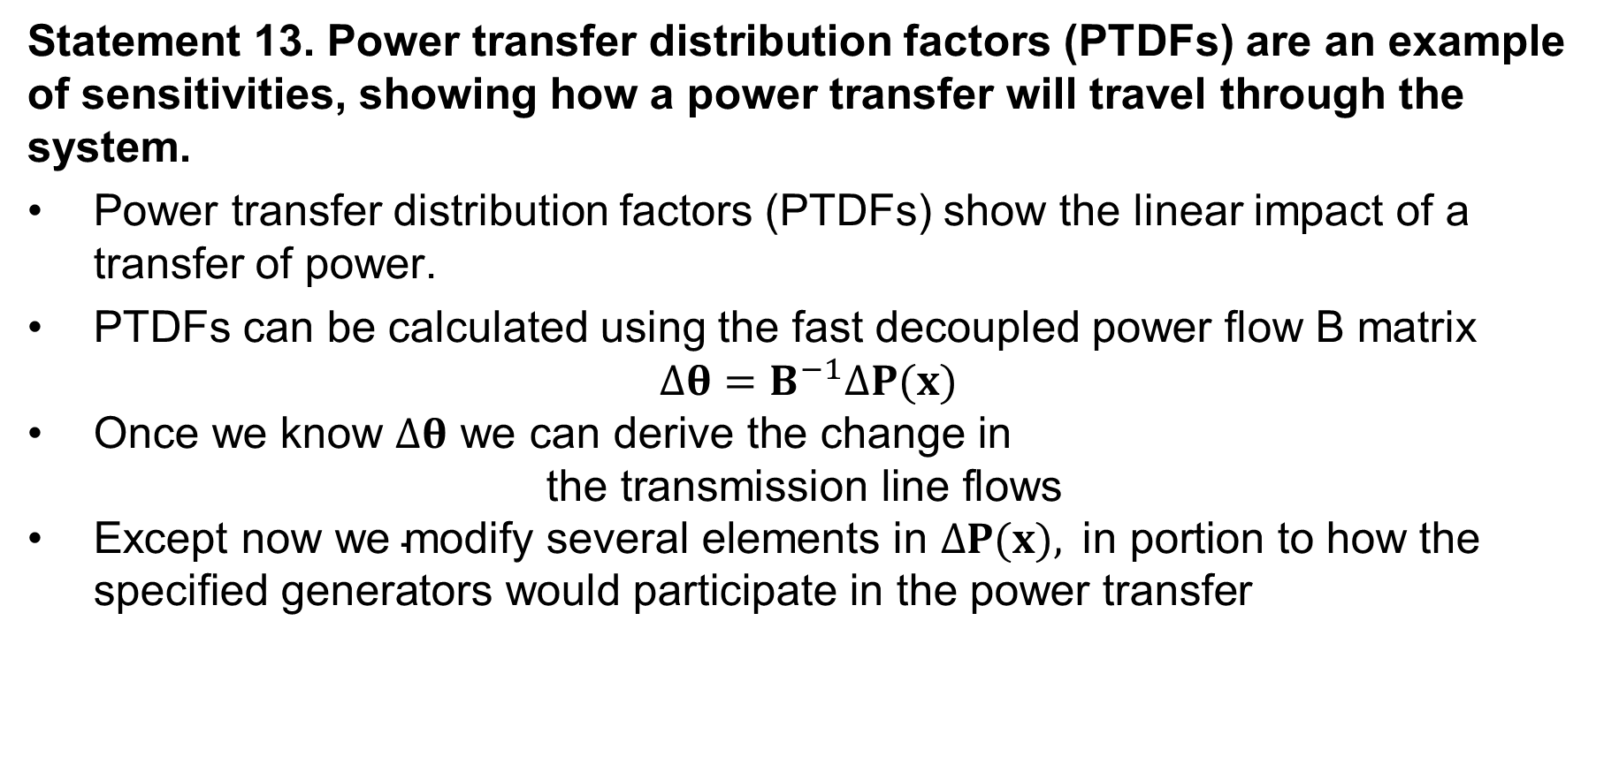
Power System Sensitivities
Statement 13. Power transfer distribution factors (PTDFs) are an example of sensitivities, showing how a power transfer will travel through the system.
Power transfer distribution factors (PTDFs) show the linear impact of a transfer of power.
PTDFs can be calculated using the fast decoupled power flow B matrix
$$Δθ=B^{−1}ΔP(x)$$
$\text{Once} \text{we} \text{know} Δθ \text{we} \text{can} \text{derive} \text{the} \text{change} \text{in}$
$\text{the} \text{transmission} \text{line} \text{flows}$
$\text{Except} \text{now} \text{we} \text{modify} \text{several} \text{elements} \text{in} ΔP(x), \text{in} \text{portion} \text{to} \text{how} \text{the} \text{specified} \text{generators} \text{would} \text{participate} \text{in} \text{the} \text{power} \text{transfer}$

Slide 28
Nine Bus PTDF Example
Figure shows initial flows for a nine bus power system

Slide 29
Nine Bus PTDF Example, Cont'd
Figure now shows percentage PTDF flows from A to I

Slide 30
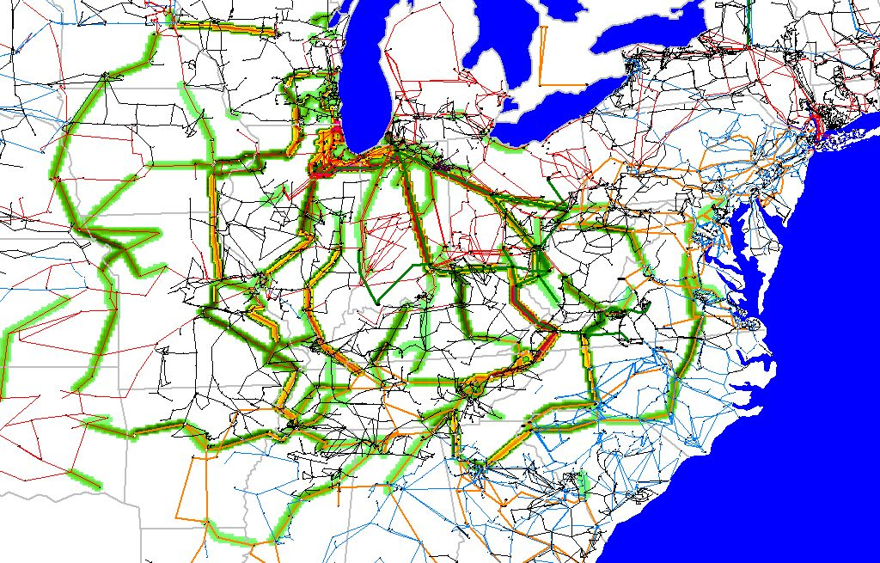
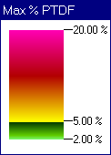
WE to TVA PTDFs

Slide 31
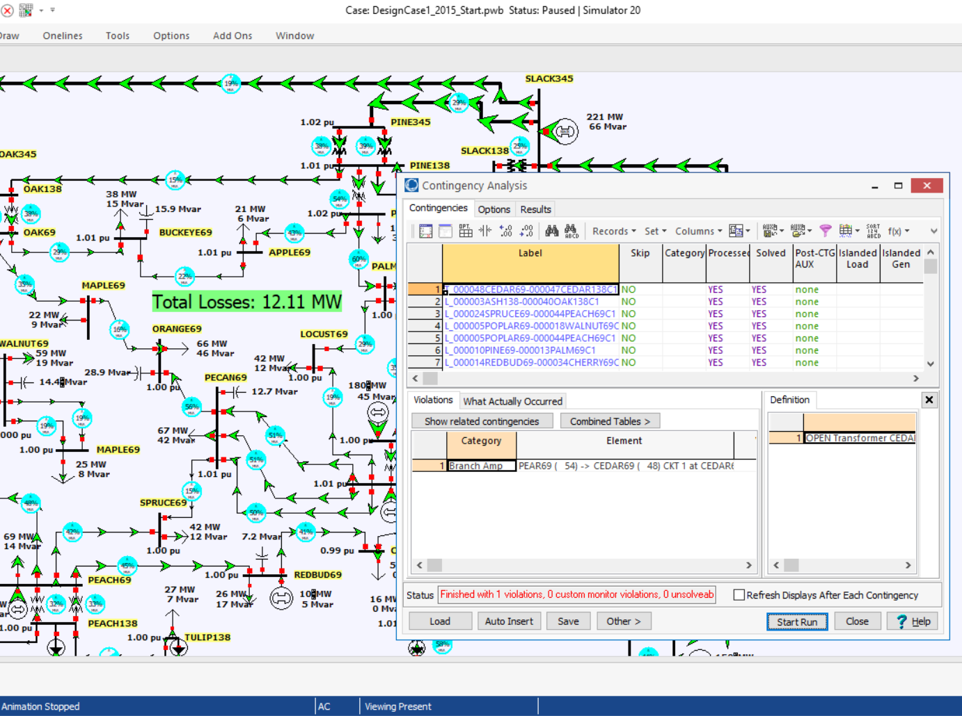
Contingency Analysis
Statement 14. Power systems are designed to be operated with N-1 security, that is, they would stay within limits after losing any single generator, line, or transformer.
Contingency analysis provides an automatic way of looking at all the statistically likely contingencies. In this example the contingency set is all the single line/transformer outages

Slide 32
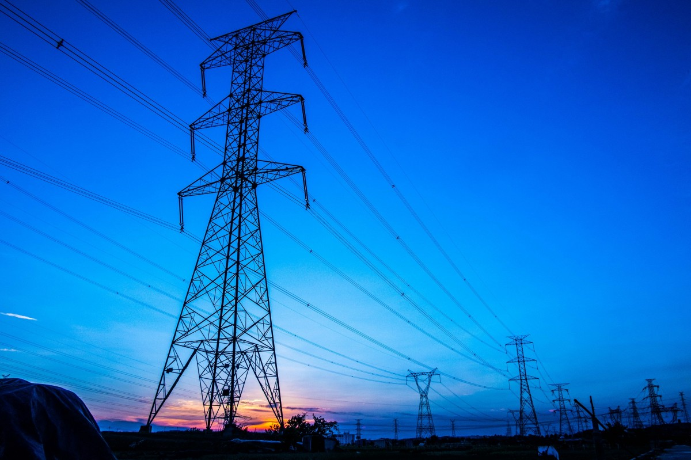
Losses
Statement 15. Generators must supply the power not only of loads but also of losses incurred in delivering power to the loads.
Typical on the transmission system is 3-5%, but a lot varies with the distance traveled and voltage levels used.

Slide 33
Multi-Area Operation
Statement 16. Transmission interconnects are divided into large areas that monitor the total load, generation, losses, and interchange with other areas.

Slide 34
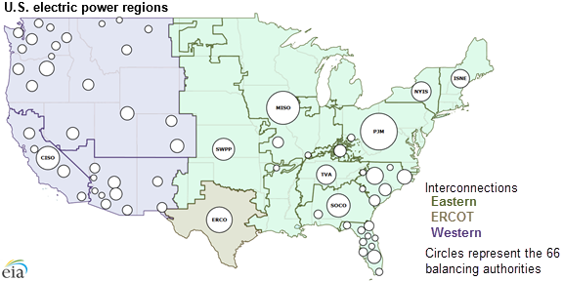
Contiguous US Balancing Authority Areas
Image Source: www.eia.gov/todayinenergy/detail.php?id=27152

Slide 35
Multi-Area Operation
Statement 17. Each area’s interchange must balance: Generation – Load – Losses = Exports – Imports.
Individual utilities only own and operate a small portion of the system, which is referred to an operating area (or an area).
Transmission lines that join two areas are known as tie-lines.
The net power out of an area is the sum of the flow on its tie-lines.
The flow out of an area is equal to
total gen - total load - total losses = tie-flow
Trend is towards larger balancing authority areas
  ERCOT combined all their balancing authority areas in 2001

Slide 36
Power Balance Constraints
Power flow refers to how the power is moving through the system.
At all times in the simulation the total power flowing into any bus MUST be zero!
This is know as Kirchhoff’s law. And it can not be repealed or modified.
Power is lost in the transmission system.

Slide 37
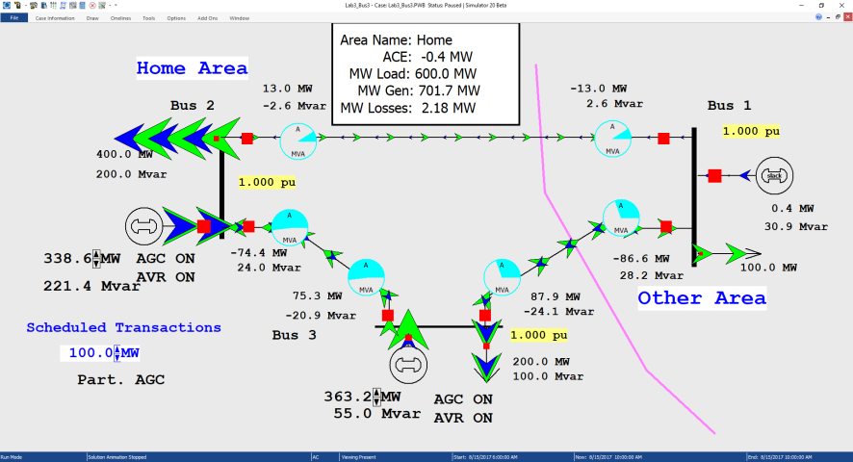
Multi-Area Operation
Statement 18. An area schedules imports and exports with other areas, resulting in scheduled transactions requiring power transfers between the areas.
Scheduled 100 MW Transaction
from Home Area to Other Area
Net tie-line
flow is now
100 MW

Slide 38
Multi-Area Operation
Statement 19. Area control error (ACE) measures the difference between scheduled and actual net exports for an area.
Power transactions are contracts between areas to do power transactions.
Contracts can be for any amount of time at any price for any amount of power.
Scheduled power transactions are implemented by modifying the area ACE:
ACE = Pactual,tie-flow - Psched

Slide 39
Area Control Error (ACE)
The area control error is the difference between the actual flow out of an area, and the scheduled flow.
  There is also a frequency dependent component that we’ll address in Chapter 12
Ideally the ACE should always be zero.
Because the load is constantly changing, each utility must constantly change its generation to “chase” the ACE.

Slide 40
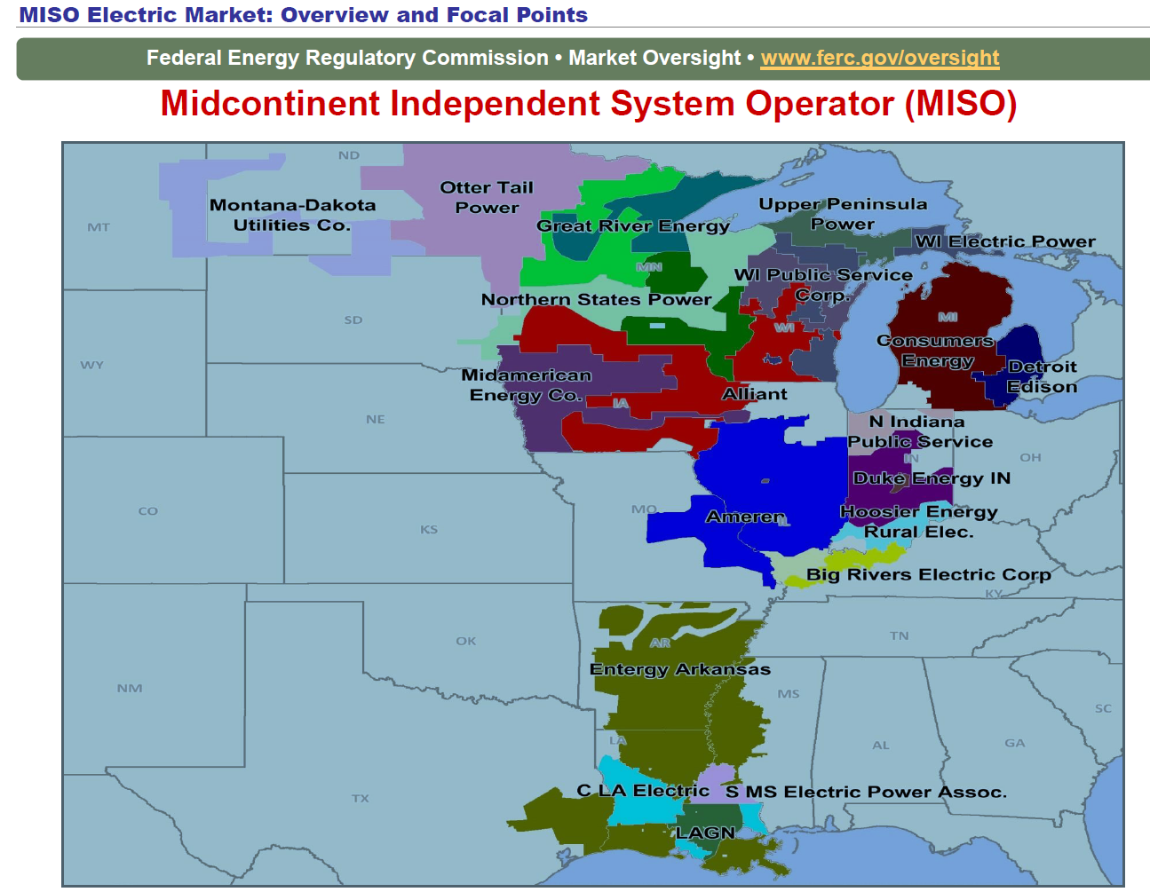
MISO Real-Time ACE (US Members)
Previously many MISO utilities did their own ACE calculations; now they are part of MISO, which does one for the region
https://www.misoenergy.org/MARKETSOPERATIONS/REALTIMEMARKETDATA/Pages/ACEChart.aspx

Slide 41
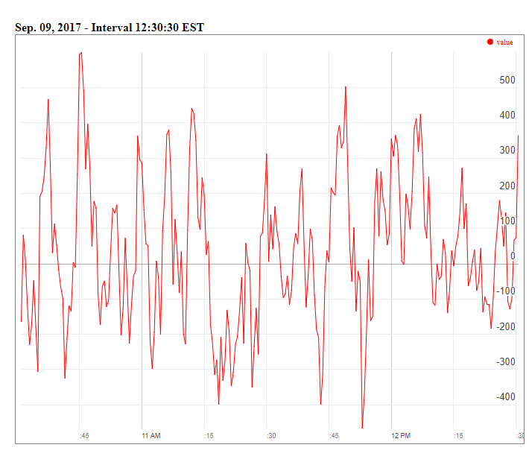
MISO Real-Time ACE Example
MISO's real-time ACE is available online (along with lots of other data)
https://www.misoenergy.org/MARKETSOPERATIONS/REALTIMEMARKETDATA/Pages/ACEChart.aspx

Slide 42
Multi-Area Operation
Statement 20. Areas have an automatic generator control (AGC) system that sends signals to generators to change their MW outputs to help control the ACE and make sure load and generation balance with scheduled interchanges.
Most utilities use automatic generation control (AGC) to automatically change their generation to keep their ACE close to zero
Usually the utility control center calculates ACE based upon tie-line flows; then the AGC module sends control signals out to the generators every couple seconds.

Slide 43
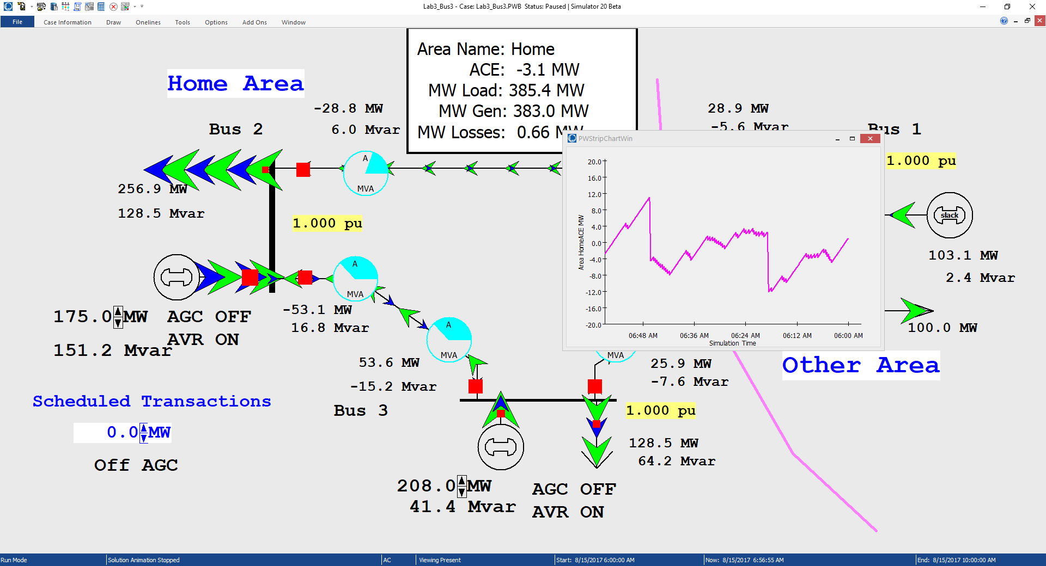
Three Bus Case with Manual ACE Control
Generation is manually
changed to match
change in load, keep
ACE close to zero

Slide 44
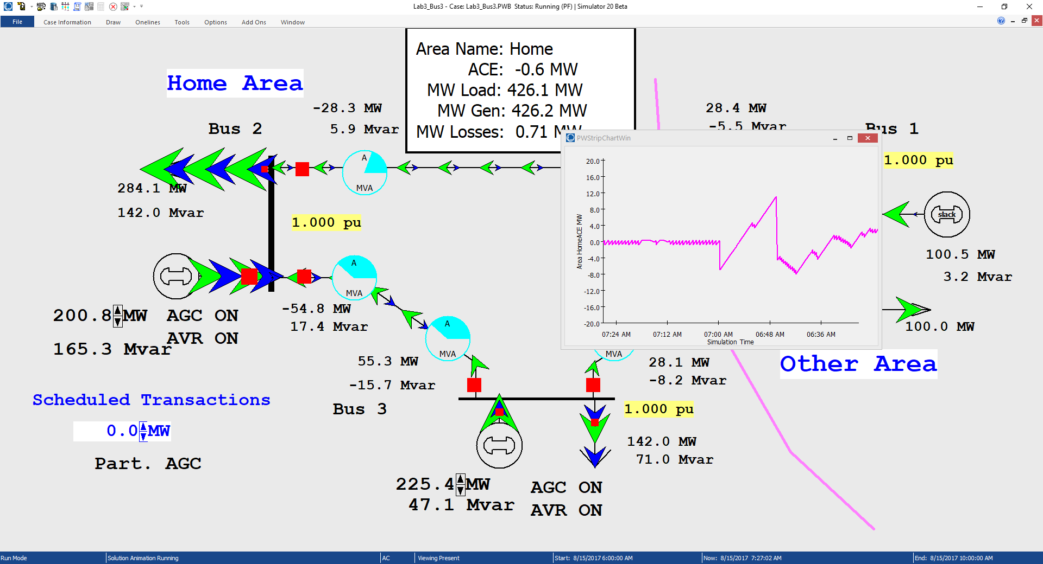
Three Bus Case with AGC
Ripple is due to the deadband, used to prevent excessive change in the generation
Generation real power is now being automatically controlled

Slide 45
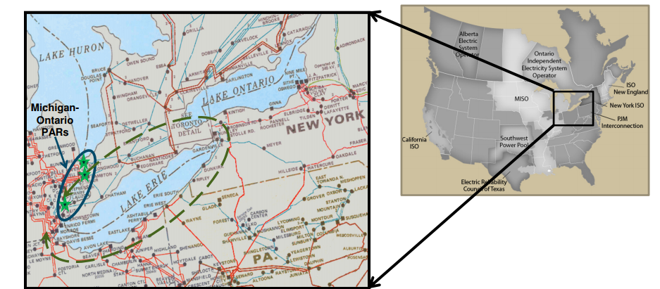
Multi-Area Operation
Statement 21. Transactions within areas and between areas will not exclusively follow the direct paths and may sometimes create loop flows through non-participating areas.

Slide 46
Seven Bus Case: One-line
System has
three areas
Area top
has five
buses
Area left has one bus
Area right has one bus

Slide 47
Seven Bus Case: Area View
Actual
flow
between
areas
System has
40 MW of
“Loop Flow”
Scheduled
flow
Loop flow can result in higher losses

Slide 48
Seven Bus - Loop Flow?
Note that
Top’s
Losses have
increased
from
7.09MW to
9.44 MW
100 MW Transaction
between Left and Right
Transaction has actually decreased
the loop flow

Slide 49
Generator Dispatch and Electricity Pricing
Statement 22. The actual generator dispatch is by economics, but it is subject to constraints associated with transmission system, including contingency constraints.
Dispatch is no longer optimal due to need to keep line
from bus 2 to bus 3 from overloading

Slide 50
Security Constrained Economic Dispatch
Transmission constraints often limit system economics.
Such limits required a constrained dispatch in order to maintain system security.
In three bus case the generation at bus 3 must be constrained to avoid overloading the line from bus 2 to bus 3.

Slide 51
Generator Dispatch and Electricity Pricing
Statement 23. Electricity is priced locationally through locational marginal prices (LMPs).
Cost to supply electricity to bus is called the locational marginal price (LMP)
Presently some electric markets post LMPs on the web
In an ideal electricity market with no transmission limitations the LMPs are equal
Transmission constraints can segment a market, resulting in differing LMP
Determination of LMPs requires the solution on an Optimal Power Flow (OPF)

Slide 52
Three Bus LMPs with Overload Ignored
Gen 2’s
cost
is $12
per
MWh
Gen 1’s
cost
is $10
per
MWh
Line from Bus 1 to Bus 3 is over-loaded; all buses have same marginal cost

Slide 53
Now with the Line Limit Enforced
Line from 1 to 3 is no longer overloaded, but now
the marginal cost of electricity at 3 is $14 / MWh

Slide 54
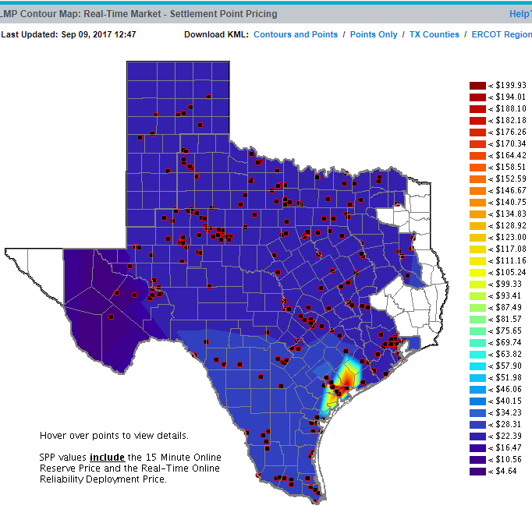
ERCOT LMPs 9/9/17 at 12:47 PM
http://www.ercot.com/content/cdr/contours/rtmLmpHg.html

Slide 55
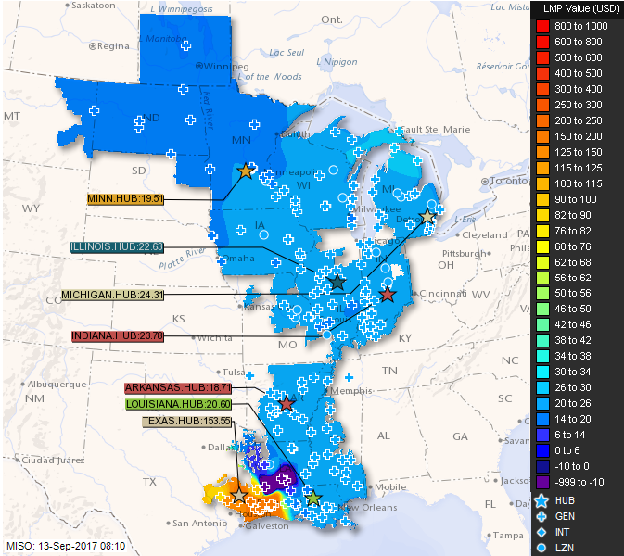
MISO LMPs 9/13/17 at 8:10 AM
https://www.misoenergy.org/LMPContourMap/MISO_All.html

Slide 56
Generator Dispatch and Electricity Pricing
Statement 24. Flowgates are constraints in the dispatch under base or contingency conditions, restricting the allowed flow through one or more parallel transmission paths.
The real-time loading of the power grid is accessed via “flowgates”
A flowgate “flow” is the real power flow on one or more transmission element for either base case conditions or a single contingency
  contingent flows are determined using LODFs
Flowgates are used as proxies for other types of limits, such as voltage or stability limits
Flowgates could be calculated using a spreadsheet
A list of the MISO flowgates is given at
http://www.oatioasis.com/woa/docs/MISO/MISOdocs/MISO-COORDINATED_FLOWGATES.pdf

Slide 57
Line Outage Distribution Factors (LODFS)
LODFs are used to approximate the change in the flow on one line caused by the outage of a second line
  typically they are only used to determine the change in the MW flow
  LODFs are used extensively in real-time operations
  LODFs are state-independent but do dependent on the assumed network topology

Slide 58
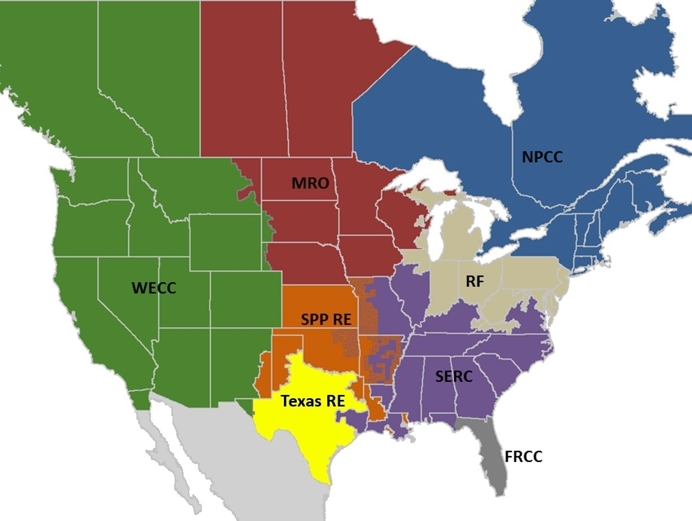
NERC Regional Reliability Councils
NERC is the
North American
Electric Reliability
Council
Image: www.nerc.com/AboutNERC/keyplayers/PublishingImages/2017_NERC_Regions_May2017.jpg

