Slide 1
ECEN 460, Spring 2024
Power System Operation and Control
Class 15: Economic Dispatch
Prof. Adam Birchfield
Dept. of Electrical and Computer Engineering
Texas A&M University
abirchfield@tamu.edu

Slide 2
Announcements
Exam 2 date changed to Tuesday, April 16th
No project this semester
Friday March 22nd is the power plant tour
Homework on economic dispatch due March 26th: 6th edition book problems 6.62, 6.63, 6.65 or 7th edition book problems 7.1, 7.2, 7.4
Review DC power flow and examples for Quiz next class
Dropping 3 quizzes for the semester instead of 2
Take note of remaining lab schedule below:
 | Wednesday | Friday
Lab 7 | 3/27 | 4/5
Lab 8 | 4/3 | 4/12
Lab 9 | 4/10 | 4/19
Lab 10 | 4/24 | 4/26

Slide 3
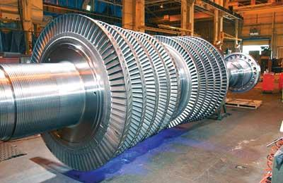
Introduction to Power System Economics
Today we're going to have introduce the economic side of power system operations
The key challenge is the economic dispatch (ED) problem, which asks how we can
  Serve all of the load
  Using the cheapest dispatch of generators
  Subject to other reliability and efficiency constraints
The Optimal Power Flow problem (OPF), which we'll discuss next week, combines ED with the Power Flow
Source: http://images.pennnet.com/articles/pe/cap/cap_gephoto.jpg

Slide 4
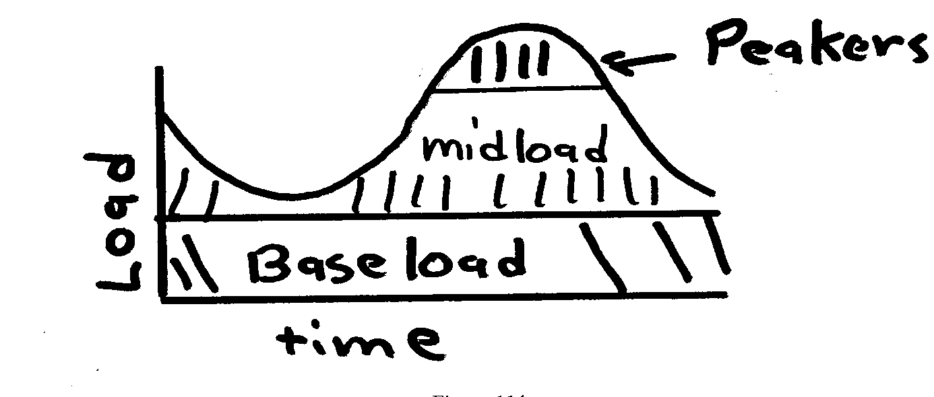
Generator Costs and Types
Generator costs depend on the fuel type, unit design,
and system conditions
Traditionally there are three broad categories
  Baseload: large coal and nuclear,
  operated 24/7 at maximum
  Cycling or Midload: coal and gas plants
  that cycle on and off daily
  Peakers: smaller gas, petroleum, hydro units that are
  mainly used during periods of high demand
Non-dispatchable sources such as wind and solar can be quite variable, but have a low incremental cost. Usually they are operated at the maximum available power.
For hydro the fuel (water) is free but there may be many constraints on operation: total water availability, reservoir level coordination, downstream flow for wildlife

Slide 5
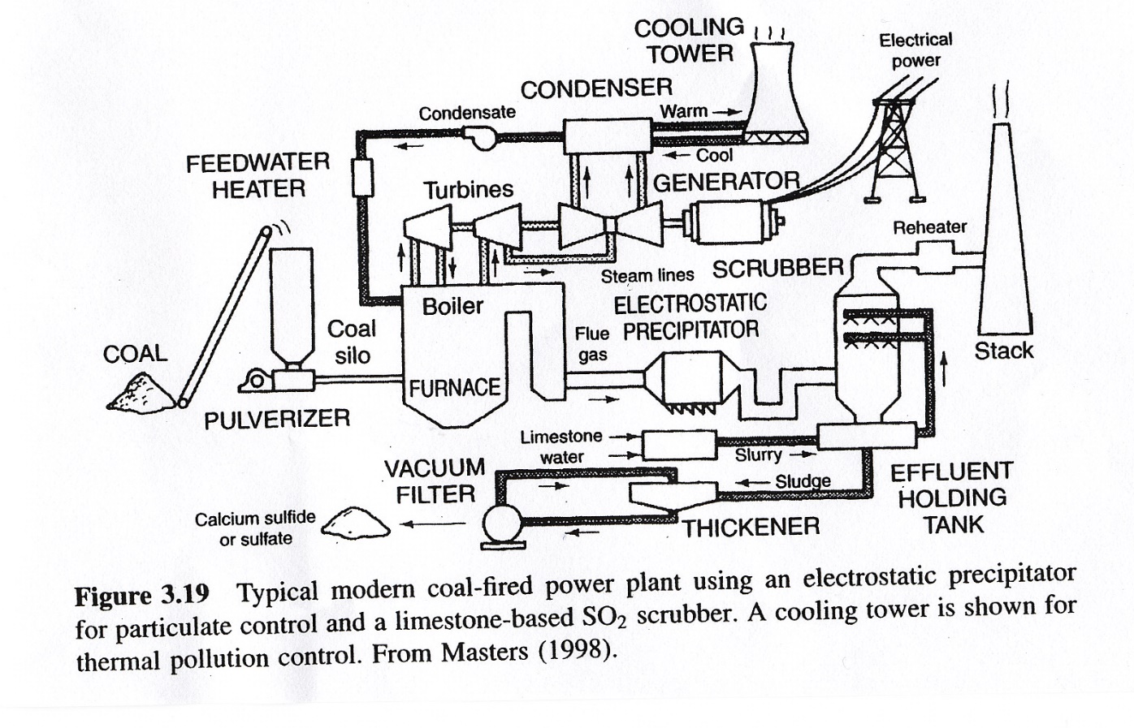
Steam Plant (Coal)
Source: Masters, Renewable and Efficient Electric Power Systems, 2004

Slide 6
Natural Gas Simple Cycle and Combined Cycle
Combined Cycle
Simple Cycle
Efficiencies of up to 60% can be achieved, with even higher values when the steam is used for heating. Fuel is usually natural gas
Typical efficiency is around 30 to 35%

Slide 7
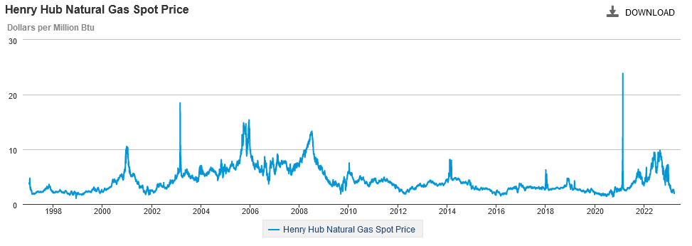
Variation in Natural Gas Prices
Our Feb 14, 2021 event set a 12-year record. Marginal cost for natural gas fired electricity price in $/MWh is about 7-10 times gas price.
Source: EIA

Slide 8
Mathematical Formulation of Costs
Generator cost curves are usually not smooth. However the curves can usually be adequately approximated using piece-wise smooth, functions.
Two representations predominate
  quadratic or cubic functions
  piecewise linear functions
In 460 we’ll generally assume a quadratic representation
$$C_{i}(P_{Gi}) = α_{i}+βP_{Gi}+γP_{Gi}^{2} \text{\$/}\text{hr} (\text{fuel}\text{−}\text{cost}) \\ IC_{i}(P_{Gi}) = \frac{dC_{i}(P_{Gi})}{dP_{Gi}} =β+2γP_{Gi} \text{\$/}\text{MWh}$$

Slide 9
Incremental Cost Example
$\text{For} \text{a} \text{two} \text{generator} \text{system} \text{assume}$
$C_{1}(P_{G1}) = 1000+​20P_{G1}+0.01P_{G1}^{2} \$/hr$
$C_{2}(P_{G2}) = 400+​15P_{G2}+0.03P_{G2}^{2} \$/hr$
$\text{Then}$
$IC_{1}(P_{G1}) = \frac{dC_{1}(P_{G1})}{dP_{G1}} =20+0.02P_{G1} \text{\$/}\text{MWh}$
$IC_{2}(P_{G2}) = \frac{dC_{2}(P_{G2})}{dP_{G2}}=15+0.06P_{G2} \text{\$/}\text{MWh}$
$$\text{If} {\text{P}}_{\text{G}\text{1}}=250 \text{MW}$$
$$\text{and} {\text{P}}_{\text{G}\text{2}}=150 \text{MW}​$$
Then
$$C_{1}(250) = 1000+​20×250+0.01×250^{2} =\text{\$ 6625/}\text{hr} \\ C_{2}(150) = 400+​15×150+0.03×150^{2} = \$6025\text{/}\text{hr} \\ \text{Then} \\ IC_{1}(250) = 20+0.02×250 =\$\text{ 25/}\text{MWh} \\ IC_{2}(150) = 15+0.06×150 =\$\text{ 24/}\text{MWh}$$

Slide 10
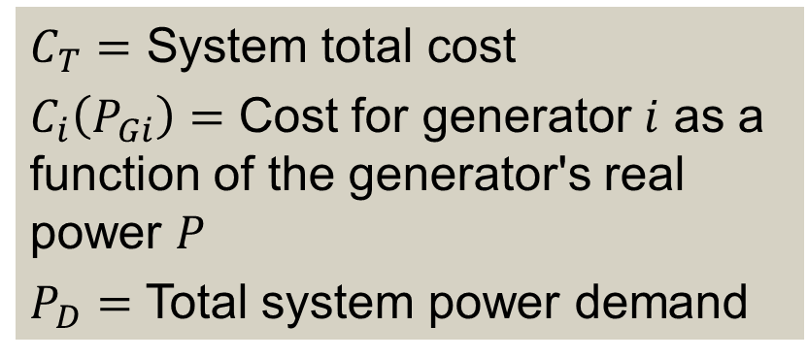
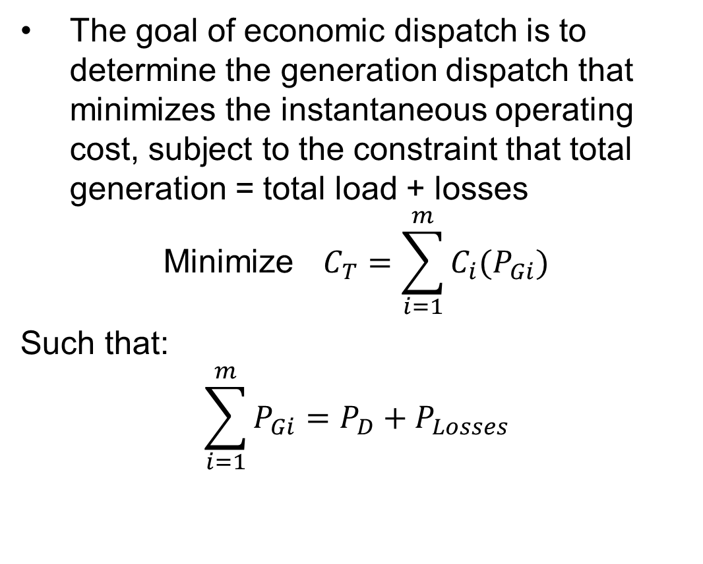
Economic Dispatch Problem
The goal of economic dispatch is to determine the generation dispatch that minimizes the instantaneous operating cost, subject to the constraint that total generation = total load + losses
$$\text{Minimize} C_{T}=\sum_{i=1}^{m}{C_{i}(P_{Gi})}$$
Such that:
$$\sum_{i=1}^{m}{P_{Gi}}=P_{D}+P_{Losses}$$
$C_{T}=$ System total cost
$C_{i}\left(P_{Gi}\right)=$ Cost for generator $i$ as a function of the generator's real power $P$
$P_{D}=$ Total system power demand

Slide 11
Economic Dispatch Problem, Example 1
A system has two generators with the following cost curves.
$C_{1}$ and $C_{2}$ are the generator costs, in $/hr
$P_{1}$ and $P_{2}$ are the generator real power outputs, in MW
$$C_{1}\left(P_{1}\right)=5500+14 P_{1}+0.002 P_{1}^{2}$$
$$C_{2}\left(P_{2}\right)=2000+12 P_{2}+0.004 P_{2}^{2}$$
Each generator must be dispatched within the following limits
$$10 \text{MW}≤P_{1}≤200 \text{MW}$$
$$50 \text{MW}≤P_{2}≤500 \text{MW}$$
If the total system load is 325 MW, what should be $P_{1}$ and $P_{2}$ to minimize the total system cost $C_{1}+C_{2}$?
Also, what is the incremental cost to supply 1 more MW? How does the solution change if the load goes up to 400 MW? Down to 250 MW? Up to 570 MW? Up to 750 MW?

Slide 12
Economic Dispatch Problem, Example 1
Fundamental principle: For generators within their limits, the incremental cost should be equal to the system marginal cost $λ$
So we basically have two equations: We need to meet the load
$$P_{1}+P_{2}=325$$
And we need the incremental cost (derivatives) to be equal
$$λ=\frac{dC_{1}}{dP_{1}}=\frac{dC_{2}}{dP_{2}}$$
Take the derivatives to find the incremental cost
$$λ=\frac{dC_{1}}{dP_{1}}=14+0.004 P_{1}$$
$$λ=\frac{dC_{2}}{dP_{2}}=12 +0.008 P_{2}$$
Solving, we get $P_{1}=50 \text{MW}, P_{2}=275 \text{MW}, λ=14.2\frac{\$}{MWh}$

Slide 13
Economic Dispatch Problem, Example 1
Now try with the other values of the load
  For load of 400 MW, you get $P_{1}=100, P_{2}=300, λ=14.4 \$/MWh$
  For load of 250 MW, you get $P_{1}=0, P_{2}=250, λ=14 \$/MWh$
  For load of 570 MW, you get $P_{1}=213, P_{2}=357, λ=14.85 \$/MWh$
  For load of 750 MW, you get $P_{1}=333, P_{2}=417, λ=15.33 \$/MWh$
But wait a minute, check the limits
  In the first case, we are fine, no limit violations
  In the second case, $P_{1}$ will be stuck at its min limit, $P_{1}=50$, $P_{2}=200$, $λ=13.6 \$/MWh$
  In the third case, $P_{1}$ will be stuck at its max limit, $P_{1}=200$, $P_{2}=370$, $λ=14.96 \$/MWh$
  In the fourth case, we have a problem!!
Note that lambda and the incremental cost are related in this way
$$\left\{\begin{matrix}IC<λ & if \text{Generator} \text{at} \text{max} \text{limit} \\ IC=λ & if \text{Generator} \text{not} \text{at} \text{limit} \\ IC>λ & if \text{Generator} \text{at} \text{min} \text{limit}\end{matrix}\right.$$

Slide 14
System Lambda and Generator Limits
When the ED problem is solved, part of the solution is the incremental cost $λ$ in $/MWh. This would be the cost to serve one more MW of power. Higher $λ$ is typical for a more constrained or higher-load situation.
Generators have limits on the minimum and maximum amount of power they can produce
  Often times the minimum limit is not zero. This represents a limit on the generator’s operation with the desired fuel type
  Because of varying system economics usually many generators in a system are operated at their maximum MW limits.
Each generator has an incremental cost
  If the generator's incremental cost is < $λ$, the generator should be operated at its maximum.
  If the generator's incremental cost is > $λ$, it should be operated at its minimum.
  Some generators may have their incremental cost = $λ$, these are the marginal units operated somewhere between minimum and maximum.

Slide 15
Unconstrained Minimization
This is a minimization problem with a single equality constraint
For an unconstrained minimization a necessary (but not sufficient) condition for a minimum is the gradient of the function must be zero,
The gradient generalizes the first derivative for multi-variable problems:
$$∇f(x)≜\left[\frac{∂f(x)}{∂x_{1}},\frac{∂f(x)}{∂x_{2}},…,\frac{∂f(x)}{∂x_{n}}\right]$$

Slide 16
Minimization with Equality Constraint
When the minimization is constrained with an equality constraint we can solve the problem using the method of Lagrange Multipliers
Key idea is to modify a constrained minimization problem to be an unconstrained problem
$\text{That} \text{is}\text{, }\text{for} \text{the} \text{general} \text{problem}$:
$$\text{minimize} f\left(x\right)$$
$$\text{s}\text{.}\text{t}\text{. }g(x) = 0$$
$$\text{We} \text{define} \text{the} \text{Lagrangian} \text{L}(x,λ)=f(x)+λ^{T}g(x)$$
$$\text{Then} \text{a} \text{necessary} \text{condition} \text{for} \text{a} \text{minimum} \text{is} \text{the} \\ ∇L_{x}\left(x,λ\right)=0 \text{and} ∇L_{λ}(x,λ)=0$$

Slide 17
Economic Dispatch Lagrangian
$\text{For} \text{the} \text{economic} \text{dispatch} \text{we} \text{have} \text{a} \text{minimization}$
$\text{constrained} \text{with} \text{a} \text{single} \text{equality} \text{constraint}$
$$L(P_{G},λ) = \sum_{i=1}^{m}{C_{i}(P_{Gi})+λ(P_{D}−\sum_{i=1}^{m}{P_{Gi})}} (\text{no} \text{losses})$$
$$\text{The} \text{necessary} \text{conditions} \text{for} \text{a} \text{minimum} \text{are}$$
$$\frac{∂L(P_{G},λ)}{∂P_{Gi}} = \frac{dC_{i}(P_{Gi})}{dP_{Gi}}−λ=0 (\text{for} \text{i} =\text{1 }\text{to} \text{m}) \\ P_{D}−\sum_{i=1}^{m}{P_{Gi}=0}$$
For generators not at their limits, the incremental cost is equal to $λ$

Slide 18
Economic Dispatch Example
Calculate the economic dispatch for a two-generator system:
$${\text{P}}_{D}=P_{G1}+P_{G2}=500 \text{MW} \text{and} \\ C_{1}(P_{G1}) = 1000+​20P_{G1}+0.01P_{G1}^{2} \$/hr \\ C_{2}(P_{G2}) = 400+​15P_{G2}+0.03P_{G2}^{2} \$/hr$$

Slide 19
Economic Dispatch Example Solution
Calculate the economic dispatch for a two-generator system:
$${\text{P}}_{D}=P_{G1}+P_{G2}=500 \text{MW} \text{and} \\ C_{1}(P_{G1}) = 1000+​20P_{G1}+0.01P_{G1}^{2} \$/hr \\ C_{2}(P_{G2}) = 400+​15P_{G2}+0.03P_{G2}^{2} \$/hr$$
Using the Lagrange multiplier method we know
$$\frac{dC_{1}(P_{G1})}{dP_{G1}} −λ =20+0.02P_{G1}−λ =0 \\ \frac{dC_{2}(P_{G2})}{dP_{G2}}−λ =15+0.06P_{G2}−λ =0$$
$$500−P_{G1}−P_{G2} = 0$$

Slide 20
Economic Dispatch Example Solution, Cont’d
$\text{We} \text{therefore} \text{need} \text{to} \text{solve} \text{three} \text{linear} \text{equations}$
$$20+0.02P_{G1}−λ =0 \\ 15+0.06P_{G2}−λ =0 \\ 500−P_{G1}−P_{G2} = 0$$
$$\left[\begin{matrix}0.02 & 0 & −1 \\ 0 & 0.06 & −1 \\ −1 & −1 & 0\end{matrix}\right]\left[\begin{matrix}P_{G1} \\ P_{G2} \\ λ\end{matrix}\right]=\left[\begin{matrix}−20 \\ −15 \\ −500\end{matrix}\right]$$
$$\left[\begin{matrix}P_{G1} \\ P_{G2} \\ λ\end{matrix}\right] = \left[\begin{matrix}312.5 \text{MW} \\ 187.5 \text{MW} \\ 26.2\text{ \$/}\text{MWh}\end{matrix}\right]$$

Slide 21
Worksheet -- Economic Dispatch, Exercise 2
Four generators with the following cost equations and limits:
$C_{1}\left(P_{1}\right)=0.025 P_{1}^{2}+16{ P}_{1}$ $15≤P_{1}≤115$
$C_{2}\left(P_{2}\right)=0.035 P_{2}^{2}+9 P_{2}$ $30≤P_{2}≤185$
$C_{3}\left(P_{3}\right)=0.004 P_{3}^{2}+15 P_{3}$ $8≤P_{3}≤325$
$C_{4}\left(P_{4}\right)=14 P_{4}$ $0≤P_{4}≤250$
Two parts to this question:
Make a table with five values of $λ$ (system marginal cost): 9, 12, 15, 18, 21 $/MWh. Calculate $P_{1}, P_{2}, P_{3},P_{4},$and total system P for each of these $λ$’s. (Remember, $λ=dC_{i}/dP_{i}$ for each generator i not at a limit.)
If we want to serve a total of 500 MW of load, what is the optimal dispatch ($P_{1}, P_{2}, P_{3},P_{4}$), the system marginal cost $λ$, and total cost?

Slide 22
Economic Dispatch, Exercise 2
$λ$ ($/MWh) | $$P_{1}$$ | $$P_{2}$$ | $$P_{3}$$ | $$P_{4}$$ | $$P_{total}$$
9
12
15
18
21

Slide 23
Lambda-Iteration Solution Method
The direct solution only works well if the incremental cost curves are linear and no generators are at their limits
A more general method is known as the lambda-iteration
  the method requires that there be a unique mapping between a value of lambda and each generator’s MW output
  the method then starts with values of lambda below and above the optimal value, and then iteratively brackets the optimal value

Slide 24
Lambda-Iteration Algorithm
$$\text{Pick} λ^{L} \text{and} λ^{H} \text{such} \text{that} \\ \sum_{\text{i}\text{=1}}^{m}{P_{\text{Gi}}(λ^{L})−P_{D}<0} \sum_{\text{i}\text{=1}}^{m}{P_{\text{Gi}}(λ^{H})−P_{D}>0} \\ \text{While} \left|λ^{H}−λ^{L}\right|>ε \text{Do} \\ λ^{M}=(λ^{H}+λ^{L})/2 \\ \text{If} \sum_{\text{i}\text{=1}}^{m}{P_{\text{Gi}}(λ^{M})−P_{D}>0 \text{Then} }λ^{H}=λ^{M} \\ \text{Else} λ^{L}=λ^{M} \\ \text{End} \text{While}$$

Slide 25
Lambda-Iteration: Graphical View
In the graph shown, for each value of lambda
there is a unique P_{Gi} for each generator. This
relationship is the P_{Gi}(λ) function.

Slide 26
Lambda-Iteration Example
$$\text{Consider} \text{a} three−generator \text{system} \text{with} \\ IC_{1}(P_{G1}) = 15+0.02P_{G1} =λ \text{\$/}\text{MWh} \\ IC_{2}(P_{G2}) = 20+0.01P_{G2} =λ \text{\$/}\text{MWh} \\ IC_{3}(P_{G3}) = 18+0.025P_{G3} =λ \text{\$/}\text{MWh} \\ \text{and} \text{with} \text{constraint} P_{G1}+P_{G2}+P_{G3}=1000\text{MW}$$

Slide 27
Lambda-Iteration Example
$$\text{Consider} \text{a} three−generator \text{system} \text{with} \\ IC_{1}\left(P_{G1}\right) = 15+0.02P_{G1} =λ \text{\$/}\text{MWh} \\ IC_{2}(P_{G2}) = 20+0.01P_{G2} =λ \text{\$/}\text{MWh} \\ IC_{3}(P_{G3}) = 18+0.025P_{G3} =λ \text{\$/}\text{MWh} \\ \text{and} \text{with} \text{constraint} P_{G1}+P_{G2}+P_{G3}=1000\text{MW}$$
$$\text{Rewriting} \text{as} \text{a} \text{function} \text{of} λ\text{, }{\text{P}}_{\text{Gi}}(λ), \text{we} \text{have} \\ P_{\text{G}\text{1}}(λ)=\frac{λ−15}{0.02} P_{\text{G}\text{2}}(λ)=\frac{λ−20}{0.01} \\ P_{\text{G}\text{3}}(λ)=\frac{λ−18}{0.025}$$

Slide 28
Lambda-Iteration Example, Cont’d
$$\text{Pick} λ^{L }\text{so} \sum_{\text{i}\text{=1}}^{m}{P_{\text{Gi}}(λ^{L})}−1000<0 \text{and} \\ \sum_{\text{i}\text{=1}}^{m}{P_{\text{Gi}}(λ^{H})}−1000>0 \\ \text{Try} λ^{L }=\text{ 20 }\text{then} \sum_{i=1}^{m}{P_{Gi}(20)}−1000 = \\ \frac{λ−15}{0.02}+\frac{λ−20}{0.01}+\frac{λ−18}{0.025}−1000=−670 \text{MW} \\ \text{Try} λ^{\text{H} }=\text{ 30 }\text{then} \sum_{i=1}^{m}{P_{Gi}(30)}−1000 =1230 \text{MW}$$

Slide 29
Lambda-Iteration Example, Cont’d
$$\text{Pick} \text{convergence} \text{tolerance} ε = 0.05\text{ \$/}\text{MWh} \\ \text{Then} \text{iterate} \text{since} \left|λ^{H}−λ^{L}\right|>0.05 \\ λ^{M}=(λ^{H}+λ^{L})/2=25 \\ \text{Then} \text{since} \sum_{i=1}^{m}{P_{Gi}(25)}−1000=280 \text{we} \text{set} λ^{H}=25 \\ \text{Since} \left|25−20\right|>0.05 \\ λ^{M}=(25+20)/2=22.5 \\ \sum_{i=1}^{m}{P_{Gi}(22.5)}−1000=−195 \text{we} \text{set} λ^{L}=22.5$$

Slide 30
Lambda-Iteration Example, Cont’d
$$\text{Continue} \text{iterating} \text{until} \left|λ^{H}−λ^{L}\right|<0.05 \\ \text{The} \text{solution} \text{value} \text{of} λ\text{, }λ^{∗}, \text{is}\text{ 23.53 \$/}\text{MWh} \\ \text{Once} λ^{∗} \text{is} \text{known} \text{we} \text{can} \text{calculate} \text{the} {\text{P}}_{\text{Gi}} \\ P_{\text{G}\text{1}}(23.5)=\frac{23.53−15}{0.02}=426 \text{MW} \\ P_{\text{G}\text{2}}(23.5)=\frac{23.53−20}{0.01}=353 \text{MW} \\ P_{\text{G}\text{3}}(23.5)=\frac{23.53−18}{0.025}=221 \text{MW}$$

Slide 31
Penalty Factors
The losses on the transmission system are a function of the generation dispatch. In general, using generators closer to the load results in lower losses
This impact on losses should be included when doing the economic dispatch, and can be done by using what are known as penalty factors
A penalty factor is multiplied by the generator cost to represent the effect of losses: i.e. a generator that increases the losses by operating has a penalty factor > 1.0
For Lab 6 we looked at the effect of penalty factors

Slide 32

Mid-Term Survey
Today instead of a quiz we have a mid-term survey to get student feedback on this course
Your instructor and TAs greatly value your feedback for improving the course this semester and in the future.
There is no grade associated with this mid-term survey.
For each statement, give a numerical rating 1-5 based on how much you agree with it, where 1 is strongly disagree and 5 is strongly agree.
Then add any comments, including specific things that are good about the class or can be improved.

