Slide 1
ECEN 460, Spring 2024 Power System Operation and Control
Class 6: Transformers, Part 2
Prof. Adam Birchfield
Dept. of Electrical and Computer Engineering
Texas A&M University
abirchfield@tamu.edu
Special guest lecturer TA Luke Lowery

Slide 2
Homework 3 and 4
No homework on generators. Make sure you understand the lecture notes and labs 3 and 4 (starting next week).
Homework 3 on transformers: book problems 3.4, 3.23, due Feb. 8th.
Homework 4 on transmission lines: book regular problems 4.10, 4.11, 4.20, and 4.41, 5.14 (a,b), 5.38, and 5.41 (a,b), due Feb. 15th.

Slide 3
Non-Ideal Transformer Example
Example: A single phase, 15 MVA, 35/13 kV transformer has the following test data:
open circuit: 14 amps, with 3 kW losses
short circuit: 6 kV, with 200 kW losses
Determine the model parameters.
n

Slide 4
Transformer Example, Cont’d
From the short circuit test $$I_{sc}=\frac{15MVA}{35kV}=429 A, \left|R_{e}+jX_{e}\right|=\frac{6 kV}{429 A}=14 Ω \\ P_{\text{sc}}=R_{e}I_{sc}^{2}=500 \text{kW} →R_{e}=1.09 Ω, \\ \text{Hence} {\text{X}}_{e}=\sqrt{{14}^{2}−1^{2}}=14 Ω$$
From the open circuit test $$R_{c}=\frac{35 kV^{2}}{3 kW}=0.408 MΩ \\ \left|R_{e}+jX_{e}+jX_{m}\right|=\frac{35 kV}{14 A}=2500 Ω { X}_{m}=2500 Ω$$

Slide 5
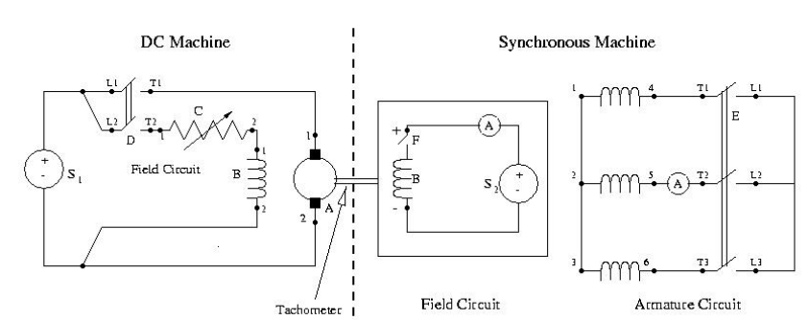
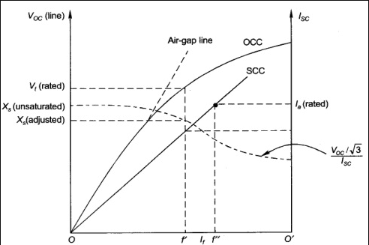
Relating to Lab 3
The machine we will use in Lab 3
Unsaturated Synchronous Reactance Xu
Reactance before machine is saturated, follows AGL
Saturated Synchronous Reactance Xs
Reactance when machine in saturated state, calculate per saturated operating point
$$X_{u}=\frac{V_{AGL}}{I_{0}}$$
$$X_{s}=\frac{V_{r}}{I_{0}}$$
https://www.eeeguide.com/determination-of-the-synchronous-reactance/

Slide 6
Three Phase Per-Unit
Motivation
Actual Value Analysis
Solving this is hard, can’t it be easier?
Proposal
A one-time value normalization that does this ‘voltage-level’ handling for us!
13.8kV:115kV
P=0.2
V = 1.08
115kV:69kV
20 MW
15kV
13.8kV:69kV
P=0.3
V=1
P=0.5
50 MW
30 MW
13.8kV
13.8kV:69kV

Slide 7
Three Phase Per-Unit
Goal Convert all grid values to Per-Unit
Stage 1 Determine Bases
Power Base
Reference Loading
Voltage Base
Nominal Voltage
Impedance Base
Impedance that Causes Reference Load
Current Base
Current Value that Causes Reference Load
Stage 2 Convert to Per-Unit
Scaling actual observed values by their base converts the system to a unitless system that doesn’t care about ratings or voltage levels in analysis! (with ideal transformers)
Pros:
No Longer Have to Consider XFMRs
Easy calculations between HV/LV areas
Simplified View of System

Slide 8
Three Phase Per-Unit
Procedure is very similar to 1 phase except we use a 3 phase VA base, and use line to line voltage bases
Pick a $3φ$ VA base for the entire system
Pick a voltage base for each different voltage level, $V_{B}$. Voltages are line to line.
Calculate the impedance base
Exactly the same impedance bases as with single phase!

Slide 9
Three Phase Per-Unit
Step 1
Pick a $3φ$ VA base for the entire system
We always use 100 MVA for system-base
Step 2
Pick a voltage base for each Zone
Voltages are line-to-line
Step 3
Calculate the impedance base for Each Zone
Since we chose S & V, we must calculate Z to satisfy Ohm’s Law
$$S_{B}^{3φ} \underset{→}{ Pick } 100 MVA$$
$$V_{B,ll} \underset{→}{ Pick } XXX kV$$
$$Z_{B} \underset{→}{ Calc } \frac{{(V_{B,ll}^{ })}^{2}}{S_{B}^{3φ}}Ω$$

Slide 10
Three Phase Per-Unit , Cont'd
Step 4
Calculate the current base
CAREFUL! $\sqrt{3}$
$$I_{B}^{3φ} \underset{→}{ Calc } \frac{(S_{B}^{3φ})}{\sqrt{3}(V_{B,ll})}$$
Why $\sqrt{3}$ in Current?
In this analysis, we care about line-to-neutral current, because this represents the ‘actual’ current flowing through the transmission line.
But since it is standard to use the line-to-line voltage, that means we are calculating a line-to-neutral value from a line-to-line value!
Source
$$I_{ln}$$
Load
$$V_{B,ll}$$

Slide 11
Three Phase Per-Unit , Cont'd
Final Step
Convert All Values to Per-Unit
Lines, Transformers, Generators, Loads
$$x_{pu}=\frac{x_{actual}}{x_{B}}$$
Transformers Where MVA != 100
$Z_{pu}=Z_{\%}{\left(\frac{V_{ll}^{low}}{V_{B1}}\right)}^{2}\left(\frac{S_{B}^{3φ}}{S^{xfmr}}\right)$ or $Z_{pu}=Z_{\%}{\left(\frac{V_{ll}^{high}}{V_{B2}}\right)}^{2}\left(\frac{S_{B}^{3φ}}{S^{xfmr}}\right)$
From Steps 1-4
$$S_{B}^{3φ}=100 MVA$$
$$V_{B,ll}=XXX kV$$
$$Z_{B}= \frac{{(V_{B,ll}^{ })}^{2}}{S_{B}^{3φ}}Ω$$
$I_{B}^{3φ}=\frac{(S_{B}^{3φ})}{\sqrt{3}(V_{B,ll})}$ $kA$
Zone 1
$$V_{B1}=15kV$$
Zone 2
$$V_{B2}=138kV$$
LV
HV
MVA = 50
Z = 1%
13.8kV:138kV

Slide 12
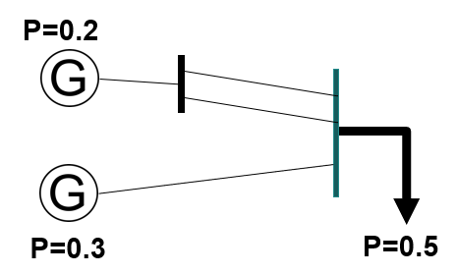
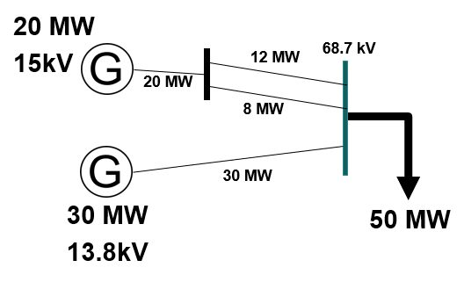
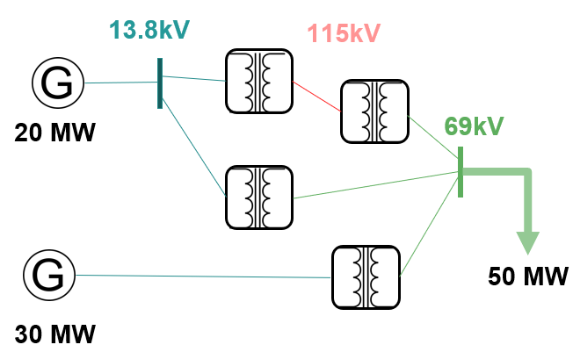
Three Phase Per-Unit
TA-DA!
Circuit Analysis
PU
Actual
Determine Bases per Zone
Lines, Generators, Loads
XFMRs
Base Type | Formula
Power | $$S_{B}^{3φ}=100 MVA$$
Voltage | $$V_{B,ll}=XXX kV$$
Impedance | $$Z_{B}= \frac{{(V_{B,ll}^{ })}^{2}}{S_{B}^{3φ}}Ω$$
Current | $$I_{B}^{3φ}=\frac{(S_{B}^{3φ})}{\sqrt{3}(V_{B,ll})}kA$$
$$Z_{pu}=Z_{\%}{\left(\frac{V_{xfmr}^{low}}{V_{B,low}}\right)}^{2}\left(\frac{S_{B}^{3φ}}{S^{xfmr}}\right)$$
$$V_{pu}=\frac{V_{actual}}{V_{B,ll}}$$
$Z_{pu}=\frac{Z_{actual}}{Z_{B}}$ $I_{pu}=\frac{I_{actual}}{I_{B}}$
$P_{pu}=\frac{P_{actual}}{S_{B}^{3φ}}$ $Q_{pu}=\frac{Q_{actual}}{S_{B}^{3φ}}$
or
$$Z_{pu}=Z_{\%}{\left(\frac{V_{xfmr}^{high}}{V_{B,high}}\right)}^{2}\left(\frac{S_{B}^{3φ}}{S^{xfmr}}\right)$$

Slide 13
Per Unit Change of MVA Base
Parameters for equipment are often given using power rating of equipment as the MVA base
To analyze a system all per unit data must be on a common power base
$$Z_{pu}^{OriginalBase}→Z_{actual}→Z_{pu}^{NewBase} \\ \text{Hence} {\text{Z}}_{pu}^{OriginalBase}×\frac{V_{base}^{2}}{S_{Base}^{OriginalBase}}/\frac{V_{base}^{2}}{S_{Base}^{NewBase}}=Z_{pu}^{NewBase} \\ {\text{Z}}_{pu}^{OriginalBase}×\frac{S_{Base}^{NewBase}}{S_{Base}^{OriginalBase}}=Z_{pu}^{NewBase}$$

Slide 14
Per Unit Change of Base Example
A 54 MVA transformer has a leakage reactance of 3.69%. What is the reactance on a 100 MVA base?

Slide 15
Transformer Reactance
Transformer reactance is often specified as a percentage, say 10%. This is a per unit value (divide by 100) on the power base of the transformer.
Example: A 350 MVA, 230/20 kV transformer has leakage reactance of 10%. What is p.u. value on 100 MVA base? What is value in ohms (230 kV)?
$$X_{e}=0.10×\frac{100}{350}=0.0286 \text{p}\text{.}\text{u}\text{.} \\ \text{0.0286}×\frac{230^{2}}{100}=15.1 Ω$$

Slide 16
Three Phase Per-Unit Example
Solve for the current, load voltage and load power in the previous circuit, assuming a $3φ$ power base of 300 MVA, and line to line voltage bases of 13.8 kV,138 kV and 27.6 kV (square root of 3 larger than the 1f example voltages). Also assume the generator is Y-connected so its line to line voltage is 13.8 kV.
Convert to per unit
as before. Note the
system is exactly the
same!

Slide 17
3$φ$ Per-Unit Example, Cont'd
$I = \frac{1.0∠0°}{3.91+j2.327}=0.22∠−30.8° \text{p}\text{.}\text{u}\text{. }(\text{not} \text{amps})$ $V_{L} = 1.0∠0°−0.22∠−30.8°×2.327∠90°$ $= 0.859∠−30.8° \text{p}\text{.}\text{u}\text{.}$ $S_{L}= V_{L}I_{L}^{∗}=\frac{{\left|V_{L}\right|}^{2}}{Z}=0.189 \text{p}\text{.}\text{u}\text{.}$ $S_{G} = 1.0∠0°×0.22∠30.8°=0.22∠30.8° \text{p}\text{.}\text{u}\text{.}$
Again, analysis is exactly the same!

Slide 18
3$φ$ Per-Unit Example, Cont'd
$$V_{L}^{\text{Actual}}= 0.859∠−30.8°×27.6 \text{kV}=23.8∠−30.8°\text{kV} \\ S_{L}^{\text{Actual}}=0.189∠0°×300 \text{MVA}=56.7∠0° \text{MVA} \\ S_{G}^{\text{Actual}}=0.22∠30.8°×300 \text{MVA}=66.0∠30.8° \text{MVA} \\ I_{B}^{\text{Middle}} = \frac{300 \text{MVA}}{\sqrt{3} \text{138 }\text{kV}}=1250 \text{Amps} (\text{same} \text{current}\text{!}) \\ I_{\text{Middle}}^{\text{Actual}} = 0.22∠−30.8°×1250 \text{Amps} =275∠−30.8° Α$$
Differences appear when we convert back to actual values

Slide 19
3$φ$ Per-Unit Example 2
Assume a $3φ$ load of 100+j50 MVA with $V_{LL}$ of 69 kV is connected to a source through the below network:
What is the supply current and complex power?
Answer: I=467 amps, S = 103.3 + j76.0 MVA

Slide 20
3$φ$ Per-Unit Example 2
Assume a $3φ$ load of 100+j50 MVA with $V_{LL}$ of 69 kV is connected to a source through the below network:
Analysis in PU
Zone 1
Zone 2
Convert to PU
$$S_{B}^{3φ}=100 MVA$$
$$V_{B,ll}=138 kV$$
$$Z_{B}=190.44 Ω$$
$I_{B}^{3φ}=0.418$ $kA$
$$S_{B}^{3φ}=100 MVA$$
$$V_{B,ll}=69 kV$$
$$Z_{B}=47.61 Ω$$
$I_{B}^{3φ}=0.837$ $kA$
What is the supply current and complex power?
Answer: I=467 amps, S = 103.3 + j76.0 MVA
Convert to Actual Values

