Slide 1
ECEN 460, Spring 2024 Power System Operation and Control
Class 14: DC Power Flow Examples
Prof. Adam Birchfield
Dept. of Electrical and Computer Engineering
Texas A&M University
abirchfield@tamu.edu

Slide 2
A DC Power Flow Example
$$θ=−B^{−1} P$$
Here were the impedances we found, in per-unit on the system base:
$Z_{xf12}=0.0186+j0.187$
$Z_{line23}=0.054+j0.1$
$Z_{xf34}=0.027+j0.216$
Note: we are modeling the generator as the slack bus (no impedance) and the load as constant power 20 MW and 10 Mvar
Solve the system with the DC power flow

Slide 3

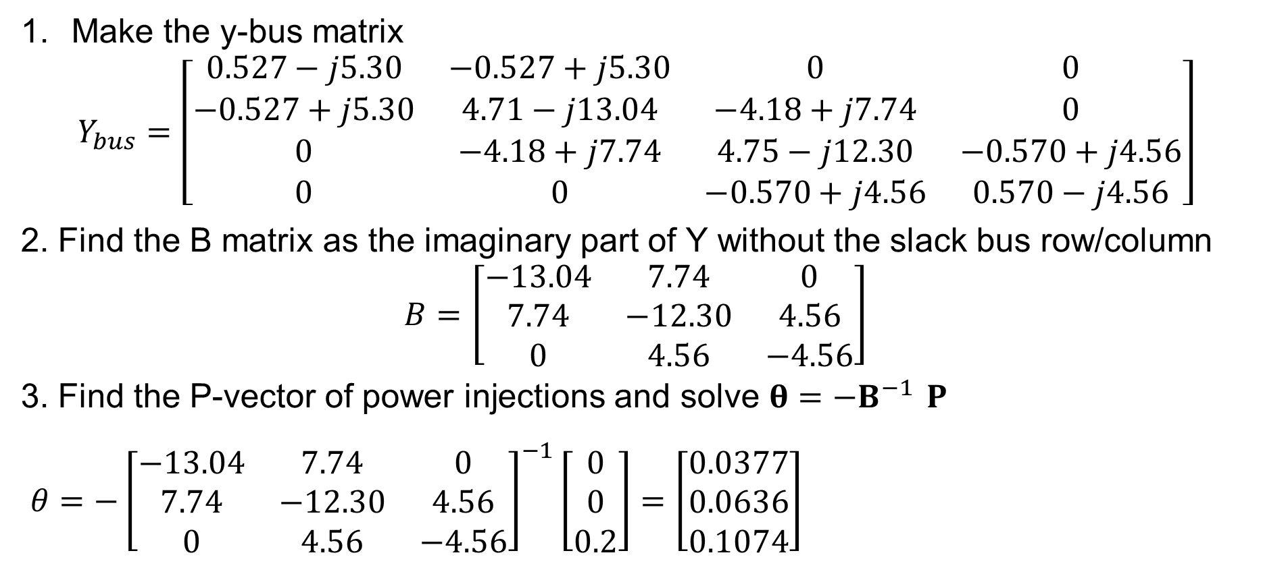
A DC Power Flow Example, cont.
Make the y-bus matrix
$$Y_{bus}=\left[\begin{matrix}0.527−j5.30 & −0.527+j5.30 & 0 & 0 \\ −0.527+j5.30 & 4.71−j13.04 & −4.18+j7.74 & 0 \\ 0 & −4.18+j7.74 & 4.75−j12.30 & −0.570+j4.56 \\ 0 & 0 & −0.570+j4.56 & 0.570−j4.56\end{matrix}\right]$$
2. Find the B matrix as the imaginary part of Y without the slack bus row/column
$$B=\left[\begin{matrix}−13.04 & 7.74 & 0 \\ 7.74 & −12.30 & 4.56 \\ 0 & 4.56 & −4.56\end{matrix}\right]$$
3. Find the P-vector of power injections and solve $θ=−B^{−1} P$
$θ=−{\left[\begin{matrix}−13.04 & 7.74 & 0 \\ 7.74 & −12.30 & 4.56 \\ 0 & 4.56 & −4.56\end{matrix}\right]}^{−1}\left[\begin{matrix}0 \\ 0 \\ 0.2\end{matrix}\right]=\left[\begin{matrix}0.0377 \\ 0.0636 \\ 0.1074\end{matrix}\right]$
Solution:
$$V_{1}=1∠0°$$
$$V_{2}=1∠2.16°$$
$$V_{3}=1∠3.64°$$
$$V_{4}=1∠6.16°$$

Slide 4
Another Power Flow Example
For this four-bus power flow problem
Make the Y-bus matrix
Identify the bus type and known/unknown variables for each bus
Write the P and Q equations for bus 4
Write the last row ($Q_{4}$) of the Jacobian matrix
Solve the dc power flow for this problem
What is the approximate power flow on the line 1-2?
Bus 1
Bus 3
Bus 4
Bus 2
Bus 1: Generator with voltage setpoint of 1.00 pu
Bus 2: Generator with voltage setpoint of 1.02 pu and power setpoint of 75 MW
Bus 4: Load with 180 MW and 55 Mvar
Line 1-3: Z = j0.25
Line 1-2: Z = j0.05
Line 2-3: Z = j0.2
Line 3-4: Z = 0.04+j0.08

Slide 5
Another Power Flow Example, Cont.
$$θ=B^{−1} P$$
Y-bus matrix
$$\left[\begin{matrix}−j24 & j20 & j4 & 0 \\ j20 & −j25 & j5 & 0 \\ j4 & j5 & 5−j19 & −5+j10 \\ 0 & 0 & −5+j10 & 5−j10\end{matrix}\right]$$
Bus 1 is slack (unknown $P/Q$)
Bus 2 is PV (unknown $θ$/$Q$)
Buses 3&4 are PQ (unkn. $θ/V$)
$P_{4}=−1.8=V_{4}V_{3}\left(−5\cos{θ_{43}}+10\sin{θ_{43}}\right)+5V_{4}^{2}$
$Q_{4}=−0.55=V_{4}V_{3}\left(−5\sin{θ_{43}}−10\cos{θ_{43}}\right)−10V_{4}^{2}$
In last row of Jacobian: $\frac{∂Q_{4}}{∂θ_{3}}=V_{4}V_{3}\left(5\cos{θ_{43}}−10\sin{θ_{43}}\right);\frac{∂Q_{4}}{∂θ_{4}}=−\frac{∂Q_{4}}{∂θ_{3}}$
$\frac{∂Q_{4}}{∂V_{3}}=V_{4}\left(−5\sin{θ_{43}}−10\cos{θ_{43}}\right);\frac{∂Q_{4}}{∂V_{4}}=V_{3}\left(−5\sin{θ_{43}}−10\cos{θ_{43}}\right)−20V_{4}$
$$P_{i} = \sum_{k=1}^{n}{\left|V_{i}\right|\left|V_{k}\right|}(g_{ik}\cos{θ_{ik}}+b_{ik}\sin{θ_{ik}})=P_{Gi}−P_{Di} \\ Q_{i} = \sum_{k=1}^{n}{\left|V_{i}\right|\left|V_{k}\right|}(g_{ik}\sin{θ_{ik}}−b_{ik}\cos{θ_{ik}})=Q_{Gi}−Q_{Di}$$

Slide 6
Another Power Flow Example, dc part
$$θ=B^{−1} P$$
B matrix – imaginary part of y-bus without slack row and column
$$\left[\begin{matrix} & & & \\ & −25 & 5 & 0 \\ & 5 & −19 & 10 \\ & 0 & 10 & −10\end{matrix}\right]$$
P vector based on power leaving non-slack buses
$$P=\left[\begin{matrix}−0.75 \\ 0 \\ 1.8\end{matrix}\right]$$
Solve for theta (remember this is an approximation)
$$θ=B^{−1}P=\left[\begin{matrix}−0.01125 \\ −0.20625 \\ −0.38625\end{matrix}\right]$$
Get line flow based on dc assumptions
$P_{12}=(−B_{Line})\left(θ_{1}−θ_{2}\right)=20\left(0−−0.01125\right)=0.225$p.u. (or 22.5 MW)

