Slide 1
ECEN 460, Spring 2024
Power System Operation and Control
Class 12: Power Flow Examples, Part 2
Prof. Adam Birchfield
Dept. of Electrical and Computer Engineering
Texas A&M University
abirchfield@tamu.edu

Slide 2
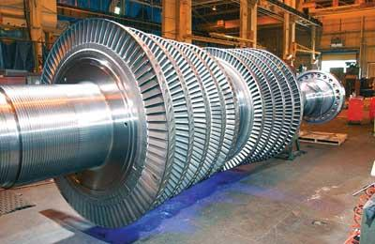
Intro to Lab 6
We're going to have an initial discussion of power system economics as a background for Labs 6-7
The key challenge is the economic dispatch (ED) problem, which asks how we can
  Serve all of the load
  Using the cheapest dispatch of generators
  Subject to other reliability and efficiency constraints
The Optimal Power Flow problem (OPF), which we'll discuss in a few weeks, combines ED with the Power Flow
Source: http://images.pennnet.com/articles/pe/cap/cap_gephoto.jpg

Slide 3
Generator Costs and Dispatch
Generator costs depend on the fuel type, unit design, and system conditions
Traditionally there are three broad categories: Baseload, Cycling or Midload, Peakers
Non-dispatchable sources such as wind and solar can be quite variable, but have a low incremental cost. Usually they are operated at the maximum available power
The goal of economic dispatch is to determine the generation dispatch that minimizes the instantaneous operating cost, subject to the constraint that total generation = total load + losses
We’ll work on solving the economic dispatch problem after spring break

Slide 4
Penalty Factors
The losses on the transmission system are a function of the generation dispatch. In general, using generators closer to the load results in lower losses
This impact on losses should be included when doing the economic dispatch, and can be done by using what are known as penalty factors
A penalty factor is multiplied by the generator cost to represent the effect of losses: i.e. a generator that increases the losses by operating has a penalty factor > 1.0
For Lab 6 we will look at the effect of penalty factors

Slide 5
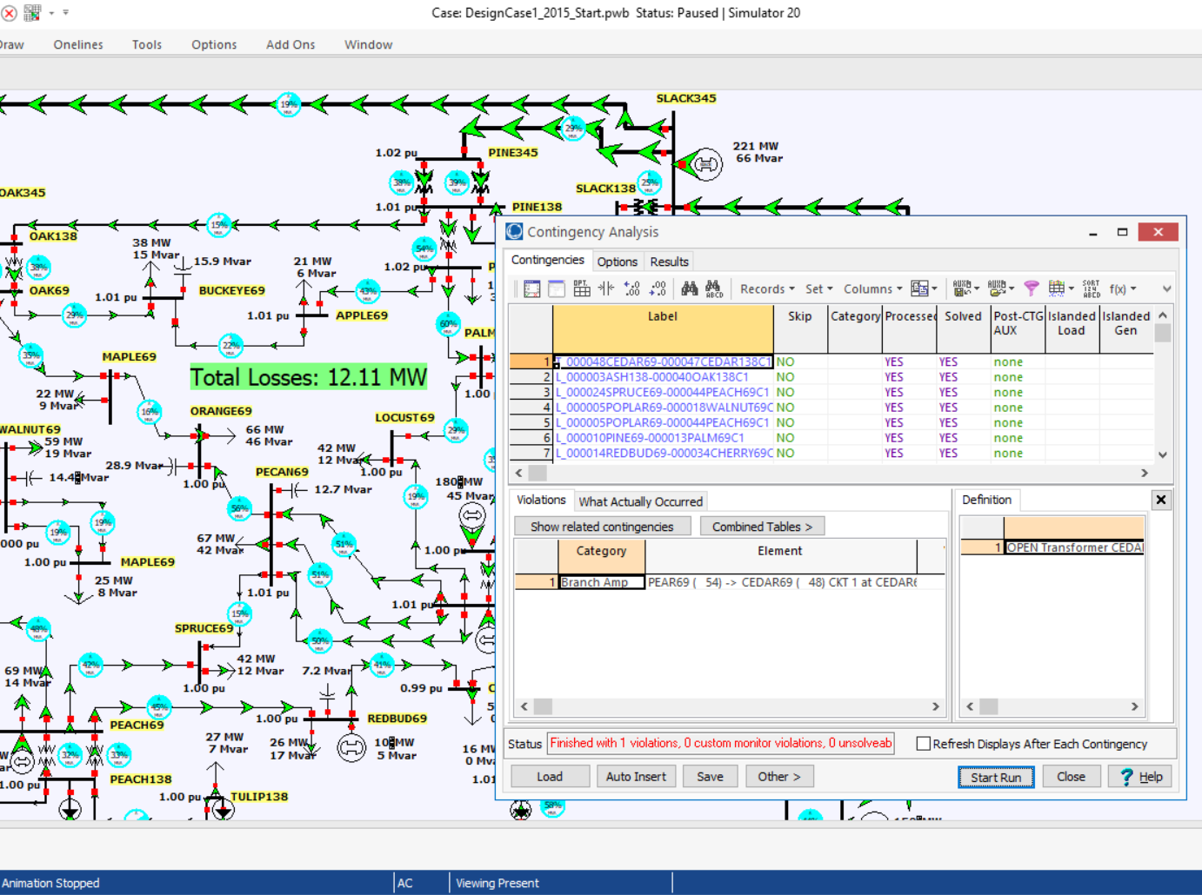
Contingency Analysis
Contingency analysis provides an automatic way of looking at all the statistically likely contingencies. In this example the contingency set is all the single line and transformer outages
Notes:
5

Slide 6
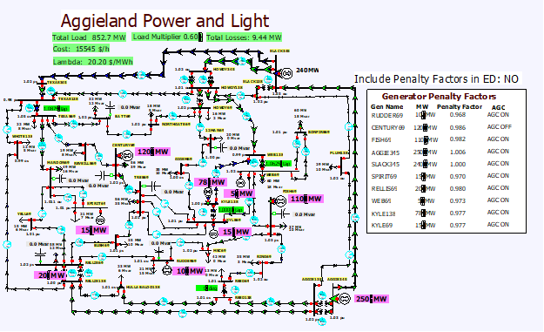
Lab 6 Introduction: 37 Bus
Lab 6 considers the system economic dispatch under varying load conditions, using a uniform load scalar
In first part of lab you’ll observe how values change without consideration of losses
Second part is a repeat considering the impact of marginal losses
Third part looks at contingency analysis, with the goal to fix voltage and flow violations
Last part looks at loss minimization

Slide 7
Contingency Analysis and the Reference Case
Contingency analysis works by first storing a reference case, then sequentially applying each contingency to the reference case, reloading the reference case between contingencies
In PowerWorld the reference case can be changed by either closing and reopening the contingency analysis form, or using an option on the form
This allows you to easily look at of individual contingency cases
  Right click on the contingencies and select Contingency Records, Solve Selected Contingency

Slide 8
Lab 6 Introduction: 2000 Bus Case, Operating North Central Texas
The North
Central Texas
Area has 483
Buses
Case for lab is
setup with just
77 500 kV line
contingencies

Slide 9
The N-R Power Flow: 5-Bus Example
T2
800 MVA
345/15 kV
1
T1
5
4
3
520 MVA
Line 3 345 kV
50 mi
400 MVA
15 kV
800 MVA
15 kV
400 MVA
15/345 kV
345 kV 100 mi
345 kV 200 mi
40 Mvar
80 MW
Line 2
Line 1
2
280 Mvar
800 MW
Single-line diagram

Slide 10
The N-R Power Flow: 5-Bus Example
Bus | Type | V per unit | δ degrees | P_{G} per unit | Q_{G} per unit | P_{L} per unit | Q_{L} per unit | Q_{Gmax} per unit | Q_{Gmin} per unit
1 | Swing | 1.0 | 0 | ⎯ | ⎯ | 0 | 0 | ⎯ | ⎯
2 | Load | ⎯ | ⎯ | 0 | 0 | 8.0 | 2.8 | ⎯ | ⎯
3 | Constant voltage | 1.05 | ⎯ | 5.2 | ⎯ | 0.8 | 0.4 | 4.0 | -2.8
4 | Load | ⎯ | ⎯ | 0 | 0 | 0 | 0 | ⎯ | ⎯
5 | Load | ⎯ | ⎯ | 0 | 0 | 0 | 0 | ⎯ | ⎯
Table 1.
Bus input
data
Bus-to-Bus | R’ per unit | X’ per unit | G’ per unit | B’ per unit | Maximum MVA per unit
2-4 | 0.0090 | 0.100 | 0 | 1.72 | 12.0
2-5 | 0.0045 | 0.050 | 0 | 0.88 | 12.0
4-5 | 0.00225 | 0.025 | 0 | 0.44 | 12.0
Table 2.
Line input data
Notes:
10

Slide 11
The N-R Power Flow: 5-Bus Example
Bus-to-Bus | R per unit | X per unit | G_{c} per unit | B_{m} per unit | Maximum MVA per unit | Maximum TAP Setting per unit
1-5 | 0.00150 | 0.02 | 0 | 0 | 6.0 | —
3-4 | 0.00075 | 0.01 | 0 | 0 | 10.0 | —
Table 3.
Transformer
input data
Bus | Input Data | Unknowns
1 | V₁ = 1.0, δ₁ = 0 | P₁, Q₁
2 | P₂ = P_{G2}-P_{L2} = -8 Q₂ = Q_{G2}-Q_{L2} = -2.8 | V₂, δ₂
3 | V₃ = 1.05 P₃ = P_{G3}-P_{L3} = 4.4 | Q₃, δ₃
4 | P₄ = 0, Q₄ = 0 | V₄, δ₄
5 | P₅ = 0, Q₅ = 0 | V₅, δ₅
Table 4. Input data
and unknowns
Notes:
11

Slide 12
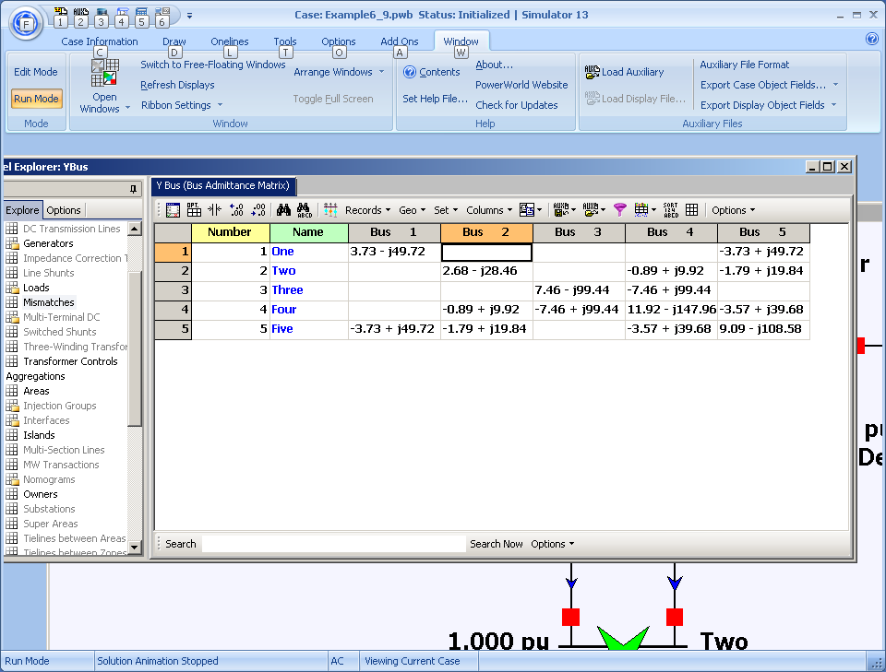
Time to Close the Hood: Let the Computer Do the Math! (Ybus Shown)
Notes:
12

Slide 13
Ybus Details
Elements of Y_{bus} connected to bus 2
Notes:
13

Slide 14
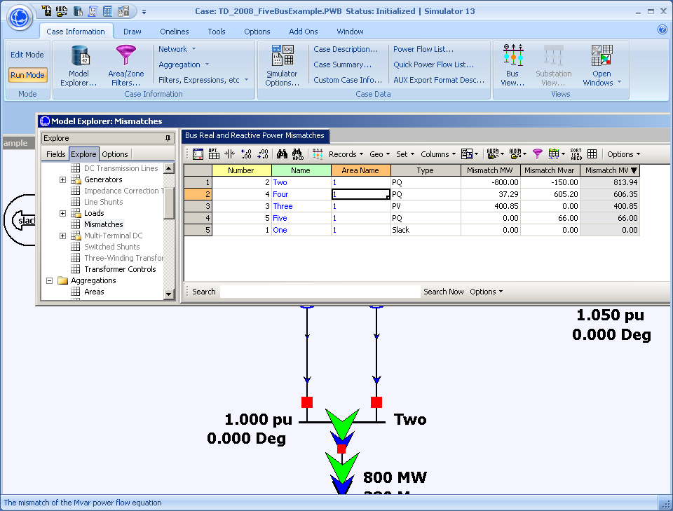
Here Are the Initial Bus Mismatches
Notes:
14

Slide 15
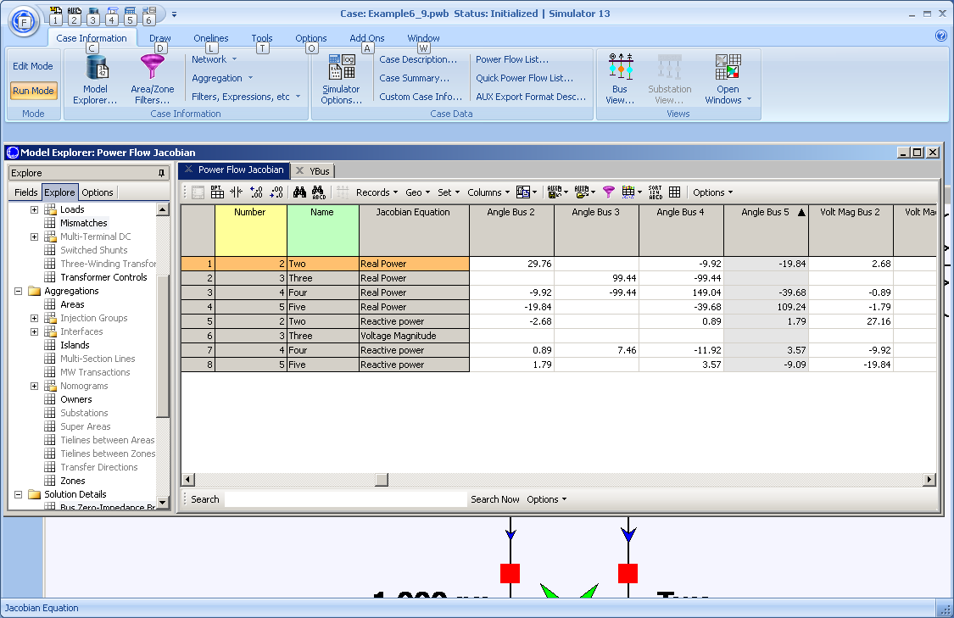
And the Initial Power Flow Jacobian
Notes:
15

Slide 16
And the Hand Calculation Details!
Notes:
16

Slide 17
Five Bus Power System Solved
Notes:
17

Slide 18
Five Bus System with Capacitor
A capacitor has been added at bus 2 to fix its low voltage

Slide 19
Contingency Analysis
Contingency analysis provides an automatic way of looking at all the statistically likely contingencies. In this example the contingency set is all the single line and transformer outages
Notes:
19

Slide 20
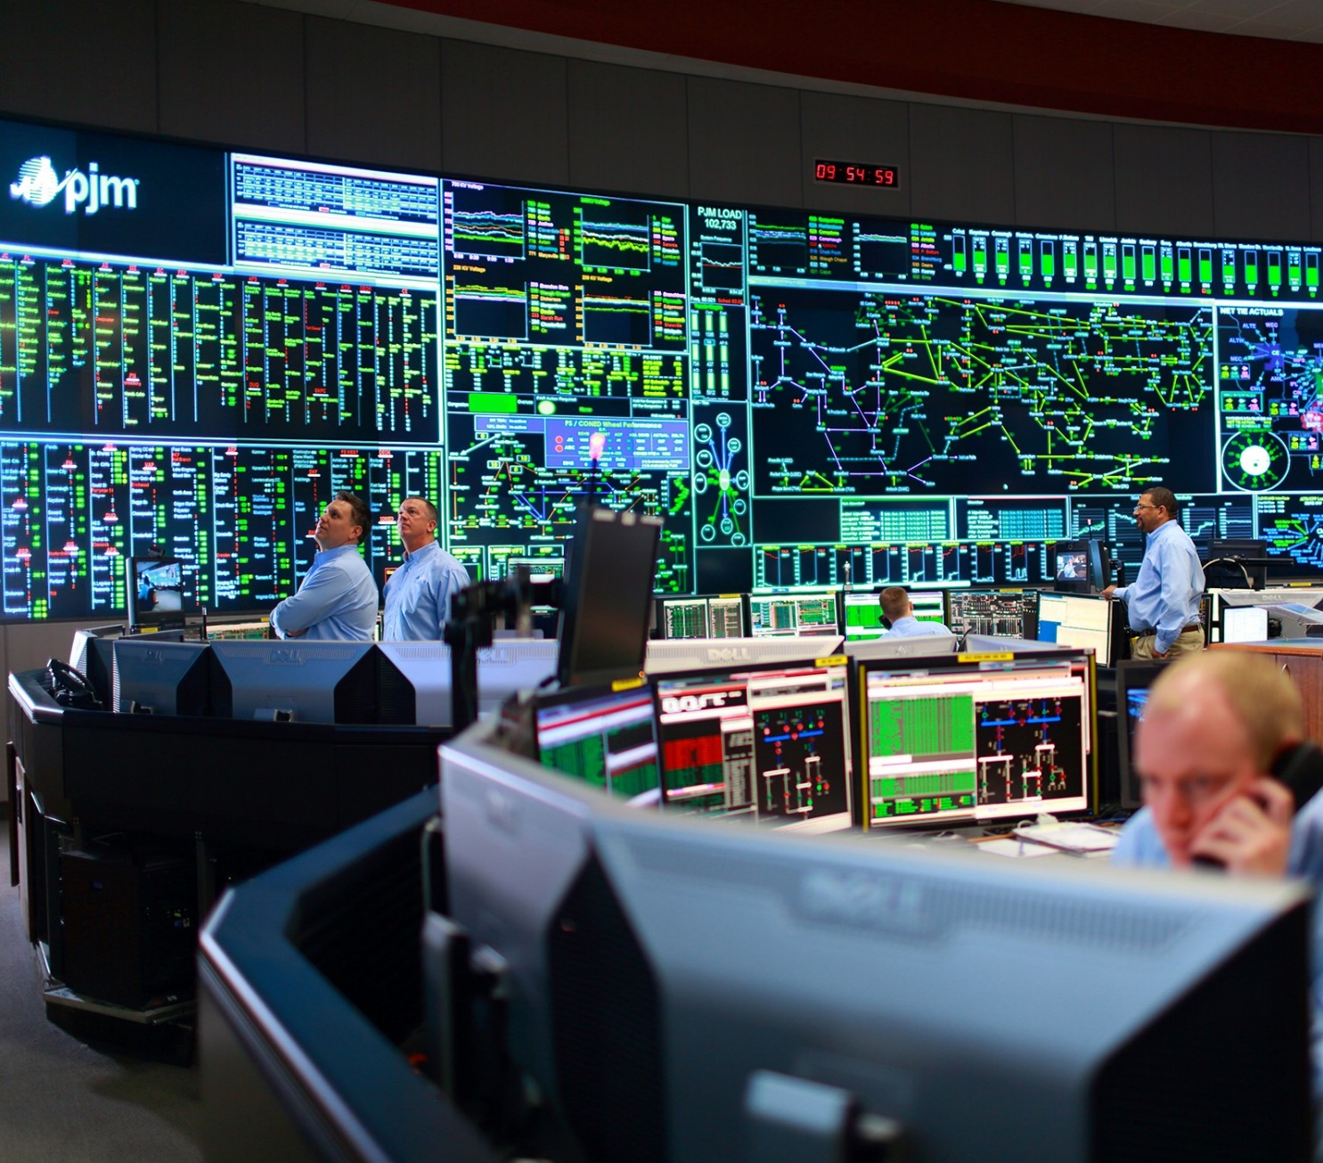
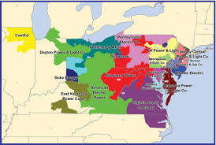
Power Flow Application - PJM Control Center
Their generation capacity is about 177 GW

