Slide 1
ECEN 460, Spring 2024
Power System Operation and Control
Class 10: Power Flow, Part 2
Prof. Adam Birchfield
Dept. of Electrical and Computer Engineering
Texas A&M University
abirchfield@tamu.edu

Slide 2
Announcements
Homework #4: book problems 6.9, 6.12, 6.18, 6.25, 6.38, due 2/27/2024
  Practice problems for Gauss and Newton-Raphson methods, and the power flow
For next class, know how to build a Y-bus matrix for a power system

Slide 3

Recall, Transmission Line and Transformer Models
Transmission lines use the "pi" model
Transformer non-ideal model is simplified with the per-unit system (and neglecting shunt elements)
These devices reduce down to impedances

Slide 4

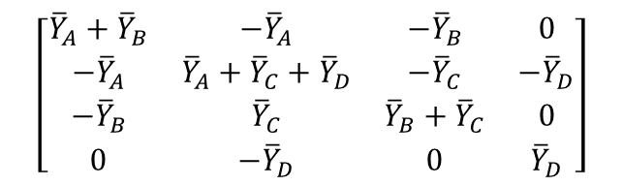
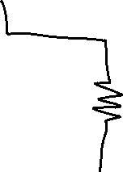

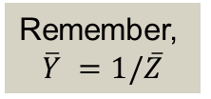

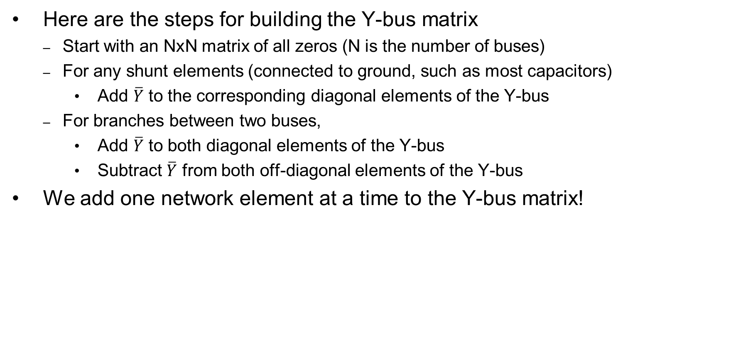



Recall, Building the Y-Bus Matrix
Here are the steps for building the Y-bus matrix
  Start with an NxN matrix of all zeros (N is the number of buses)
  For any shunt elements (connected to ground, such as most capacitors)
    Add $\overline{Y}$ to the corresponding diagonal elements of the Y-bus
  For branches between two buses,
    Add $\overline{Y}$ to both diagonal elements of the Y-bus
    Subtract $\overline{Y}$ from both off-diagonal elements of the Y-bus
We add one network element at a time to the Y-bus matrix!
Remember,
$$\overline{Y} =1/\overline{Z}$$
$$\left[\begin{matrix}{\overline{Y}}_{A}+{\overline{Y}}_{B} & −{\overline{Y}}_{A} & −{\overline{Y}}_{B} & 0 \\ −{\overline{Y}}_{A} & {\overline{Y}}_{A}+{\overline{Y}}_{C}+{\overline{Y}}_{D} & −{\overline{Y}}_{C} & −{\overline{Y}}_{D} \\ −{\overline{Y}}_{B} & {\overline{Y}}_{C} & {\overline{Y}}_{B}+{\overline{Y}}_{C} & 0 \\ 0 & −{\overline{Y}}_{D} & 0 & {\overline{Y}}_{D}\end{matrix}\right]$$

Slide 5
The Power Flow Problem
What we know:
  Generator real power
  Generator voltage magnitude
  Load real and reactive power
What we don't know:
  Bus voltage angles
  Non-generator bus voltage magnitude
  Generator reactive power
  Current injections of generators or loads
Note that the problem is formulated with power values, not current, so we cannot use the Y-bus equations directly
Power flow problem is non-linear

Slide 6
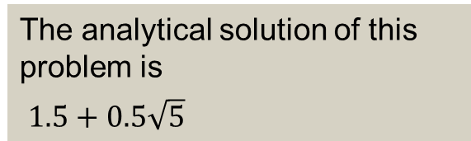
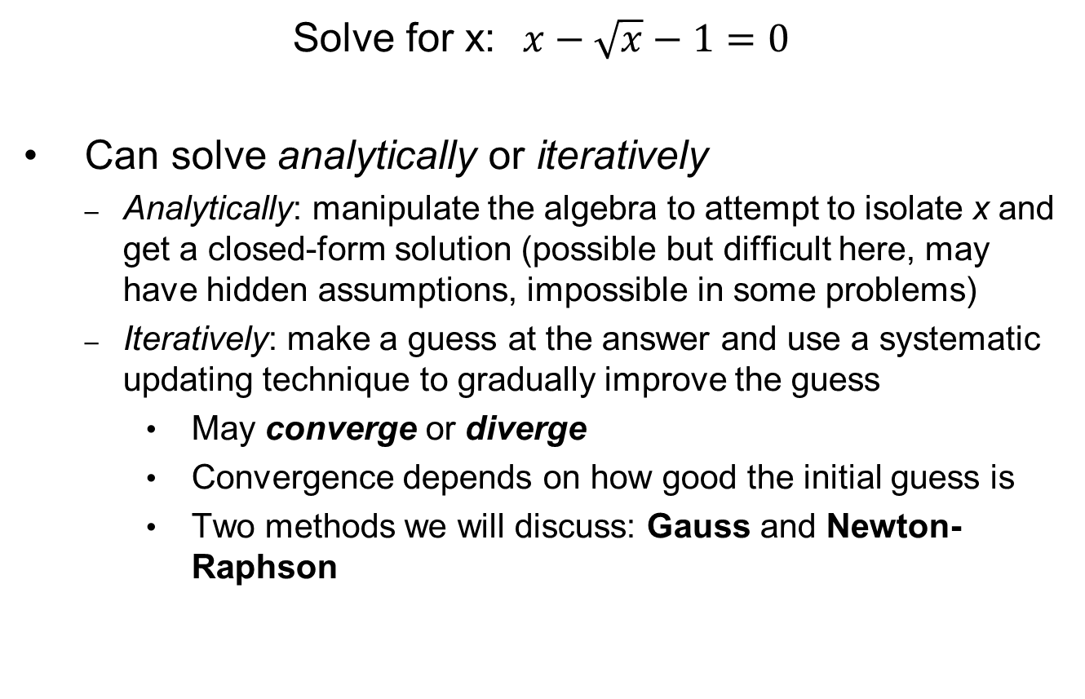
Example of a Non-Linear Problem
Solve for x:$x−\sqrt{x}−1=0$
Can solve analytically or iteratively
  Analytically: manipulate the algebra to attempt to isolate x and get a closed-form solution (possible but difficult here, may have hidden assumptions, impossible in some problems)
  Iteratively: make a guess at the answer and use a systematic updating technique to gradually improve the guess
    May converge or diverge
    Convergence depends on how good the initial guess is
    Two methods we will discuss: Gauss and Newton-Raphson
The analytical solution of this problem is
$1.5+0.5\sqrt{5}$

Slide 7
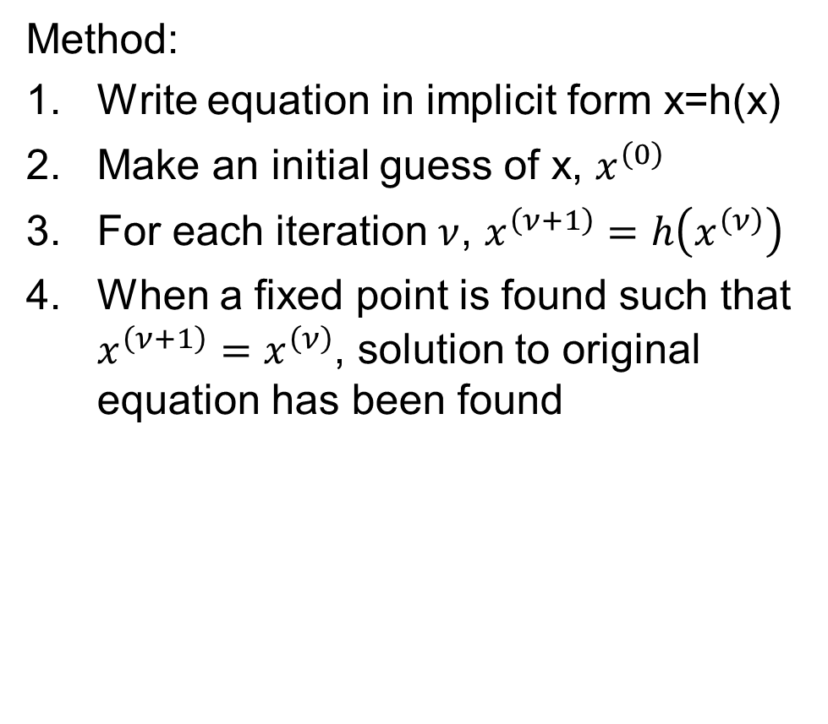
Gauss Method
Method:
Write equation in implicit form x=h(x)
Make an initial guess of x, $x^{\left(0\right)}$
For each iteration $ν$, $x^{\left(ν+1\right)}=h\left(x^{\left(ν\right)}\right)$
When a fixed point is found such that $x^{\left(ν+1\right)}=x^{\left(ν\right)}$, solution to original equation has been found

Slide 8
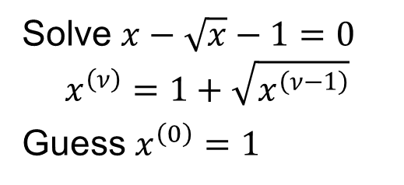
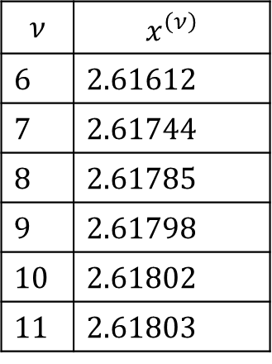
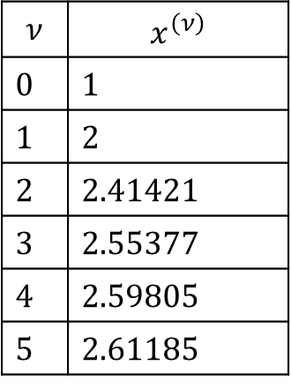
Gauss Method
Method:
Write equation in implicit form x=h(x)
Make an initial guess of x, $x^{\left(0\right)}$
For each iteration $ν$, $x^{\left(ν+1\right)}=h\left(x^{\left(ν\right)}\right)$
When a fixed point is found such that $x^{\left(ν+1\right)}=x^{\left(ν\right)}$, solution to original equation has been found
Solve $x−\sqrt{x}−1=0$
$$x^{\left(ν\right)}=1+\sqrt{x^{\left(ν−1\right)}}$$
Guess $x^{\left(0\right)}=1$
$$ν$$ | $$x^{\left(ν\right)}$$
0 | 1
1 | 2
2 | 2.41421
3 | 2.55377
4 | 2.59805
5 | 2.61185
$$ν$$ | $$x^{\left(ν\right)}$$
6 | 2.61612
7 | 2.61744
8 | 2.61785
9 | 2.61798
10 | 2.61802
11 | 2.61803

Slide 9
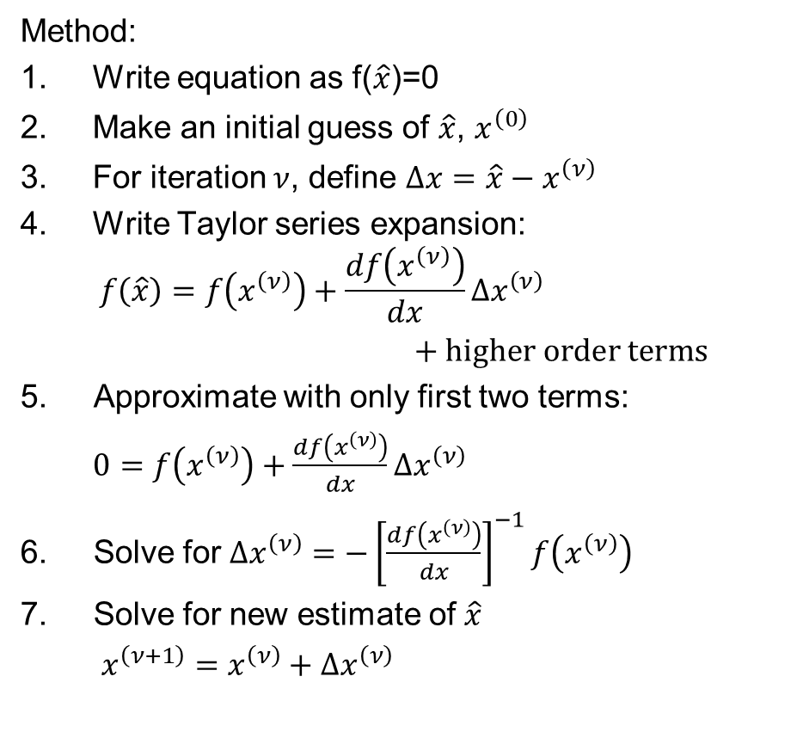
Newton-Raphson Method
Method:
Write equation as f($\hat{x}$)=0
Make an initial guess of $\hat{x}$, $x^{\left(0\right)}$
For iteration $ν$, define $Δx=\hat{x}−x^{\left(ν\right)}$
Write Taylor series expansion:
$$f\left(\hat{x}\right)=f\left(x^{\left(ν\right)}\right)+\frac{df\left(x^{\left(ν\right)}\right)}{dx}Δx^{\left(ν\right)}$$
$+ \text{higher} \text{order} \text{terms}$
Approximate with only first two terms:
$0=f\left(x^{\left(ν\right)}\right)+\frac{df\left(x^{\left(ν\right)}\right)}{dx}Δx^{\left(ν\right)}$
Solve for $Δx^{\left(ν\right)}=−{\left[\frac{df\left(x^{\left(ν\right)}\right)}{dx}\right]}^{−1}f\left(x^{\left(ν\right)}\right)$
Solve for new estimate of $\hat{x}$
$x^{\left(ν+1\right)}=x^{\left(ν\right)}+Δx^{\left(ν\right)}$

Slide 10
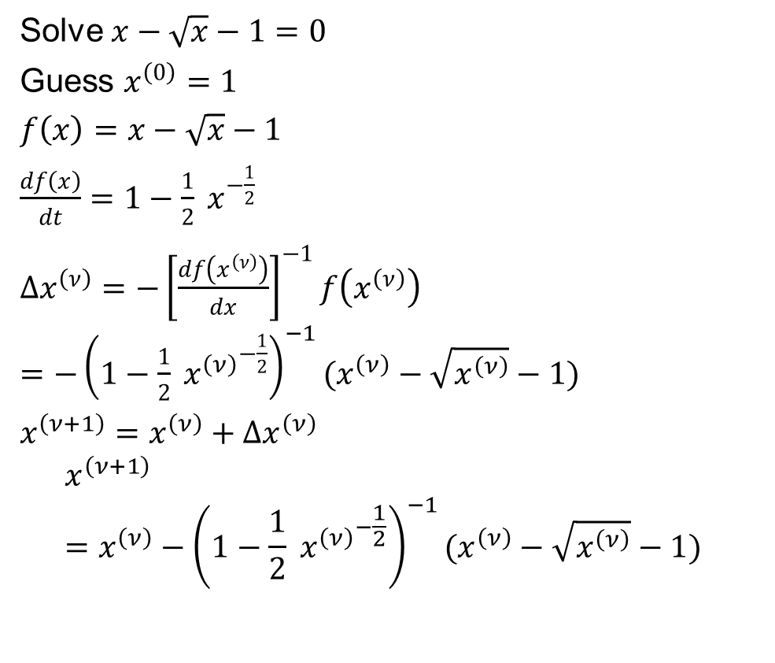
Newton-Raphson Method, example
Method:
Write equation as f($\hat{x}$)=0
Make an initial guess of $\hat{x}$, $x^{\left(0\right)}$
For iteration $ν$, define $Δx=\hat{x}−x^{\left(ν\right)}$
Write Taylor series expansion:
$$f\left(\hat{x}\right)=f\left(x^{\left(ν\right)}\right)+\frac{df\left(x^{\left(ν\right)}\right)}{dx}Δx^{\left(ν\right)}$$
$+ \text{higher} \text{order} \text{terms}$
Approximate with only first two terms:
$0=f\left(x^{\left(ν\right)}\right)+\frac{df\left(x^{\left(ν\right)}\right)}{dx}Δx^{\left(ν\right)}$
Solve for $Δx^{\left(ν\right)}=−{\left[\frac{df\left(x^{\left(ν\right)}\right)}{dx}\right]}^{−1}f\left(x^{\left(ν\right)}\right)$
Solve for new estimate of $\hat{x}$
$x^{\left(ν+1\right)}=x^{\left(ν\right)}+Δx^{\left(ν\right)}$
Solve $x−\sqrt{x}−1=0$
Guess $x^{\left(0\right)}=1$
$f\left(x\right)=x−\sqrt{x}−1$
$\frac{df\left(x\right)}{dt}=1−\frac{1}{2} x^{−\frac{1}{2}}$
$Δx^{\left(ν\right)}=−{\left[\frac{df\left(x^{\left(ν\right)}\right)}{dx}\right]}^{−1}f\left(x^{\left(ν\right)}\right)$
$=−{\left(1−\frac{1}{2} {x^{\left(ν\right)}}^{−\frac{1}{2}}\right)}^{−1}(x^{\left(ν\right)}−\sqrt{x^{\left(ν\right)}}−1)$
$x^{\left(ν+1\right)}=x^{\left(ν\right)}+Δx^{\left(ν\right)}$
$$x^{\left(ν+1\right)}=x^{\left(ν\right)}−{\left(1−\frac{1}{2} {x^{\left(ν\right)}}^{−\frac{1}{2}}\right)}^{−1}(x^{\left(ν\right)}−\sqrt{x^{\left(ν\right)}}−1)$$

Slide 11
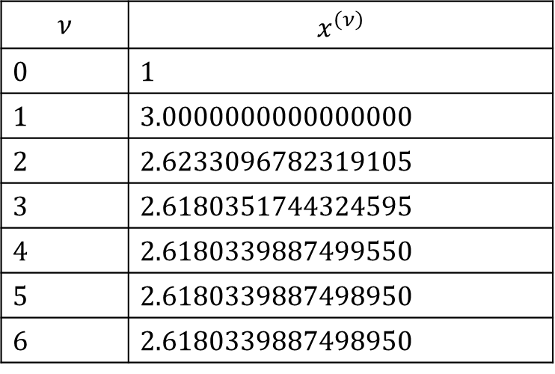
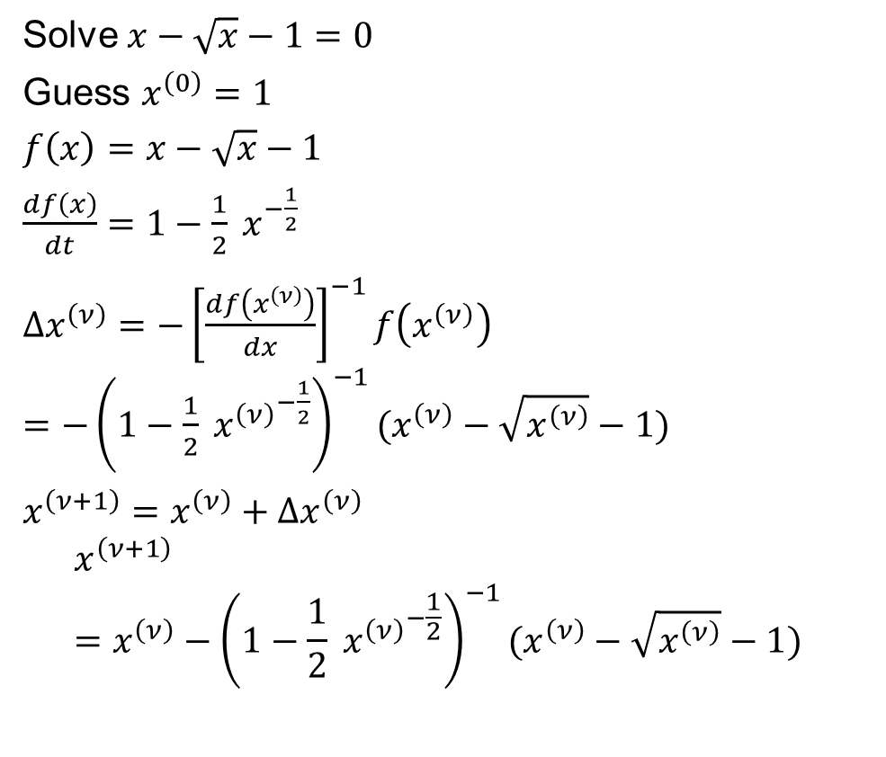
Newton-Raphson Method, example
Solve $x−\sqrt{x}−1=0$
Guess $x^{\left(0\right)}=1$
$f\left(x\right)=x−\sqrt{x}−1$
$\frac{df\left(x\right)}{dt}=1−\frac{1}{2} x^{−\frac{1}{2}}$
$Δx^{\left(ν\right)}=−{\left[\frac{df\left(x^{\left(ν\right)}\right)}{dx}\right]}^{−1}f\left(x^{\left(ν\right)}\right)$
$=−{\left(1−\frac{1}{2} {x^{\left(ν\right)}}^{−\frac{1}{2}}\right)}^{−1}(x^{\left(ν\right)}−\sqrt{x^{\left(ν\right)}}−1)$
$x^{\left(ν+1\right)}=x^{\left(ν\right)}+Δx^{\left(ν\right)}$
$$x^{\left(ν+1\right)}=x^{\left(ν\right)}−{\left(1−\frac{1}{2} {x^{\left(ν\right)}}^{−\frac{1}{2}}\right)}^{−1}(x^{\left(ν\right)}−\sqrt{x^{\left(ν\right)}}−1)$$
$$ν$$ | $$x^{\left(ν\right)}$$
0 | 1
1 | 3.0000000000000000
2 | 2.6233096782319105
3 | 2.6180351744324595
4 | 2.6180339887499550
5 | 2.6180339887498950
6 | 2.6180339887498950

Slide 12
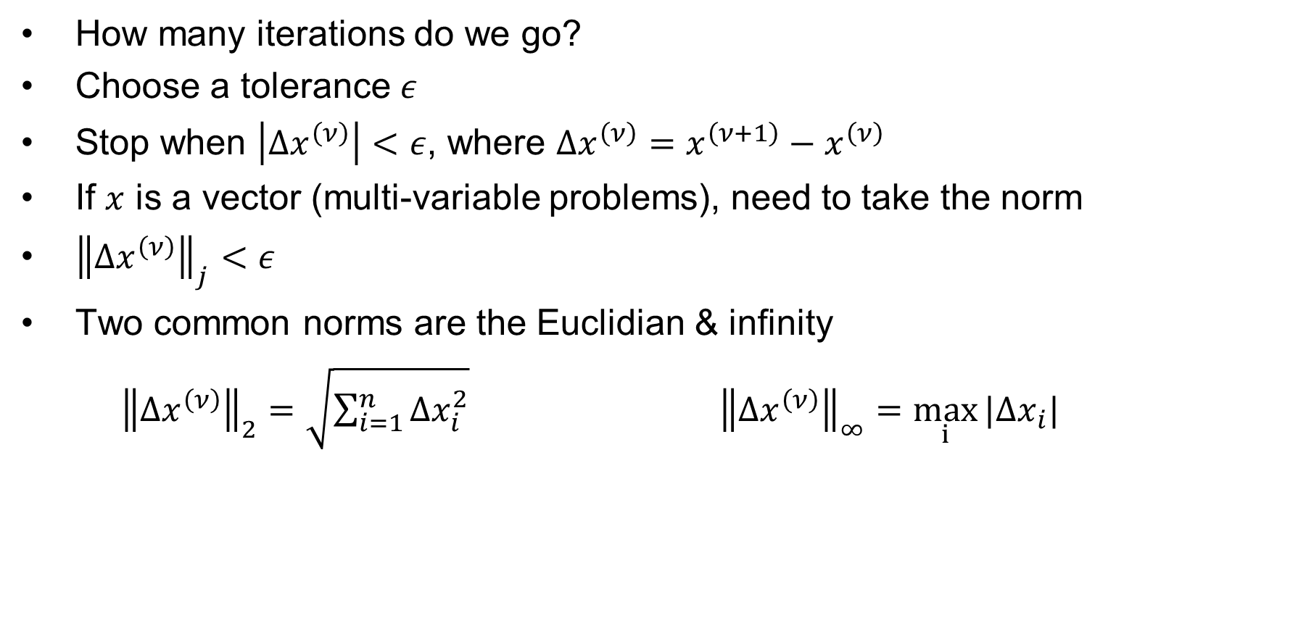
Stopping Criteria
How many iterations do we go?
Choose a tolerance $ε$
Stop when $\left|Δx^{\left(ν\right)}\right|<ε$, where $Δx^{\left(ν\right)}=x^{\left(ν+1\right)}−x^{\left(ν\right)}$
If $x$ is a vector (multi-variable problems), need to take the norm
${\left\|Δx^{\left(ν\right)}\right\|}_{j}<ε$
Two common norms are the Euclidian & infinity
${\left\|Δx^{\left(ν\right)}\right\|}_{2}=\sqrt{\sum_{i=1}^{n}{Δx_{i}^{2}}}$ ${\left\|Δx^{\left(ν\right)}\right\|}_{∞}=\max_{i}{|Δx_{i}|}$

Slide 13
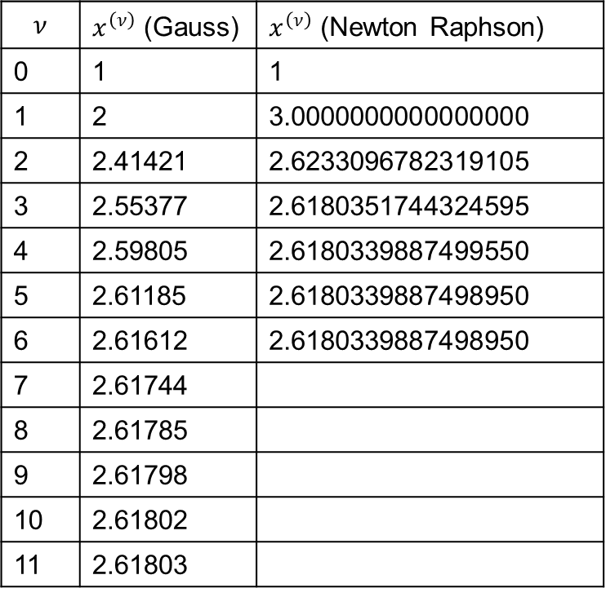
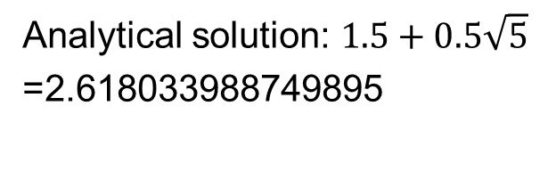
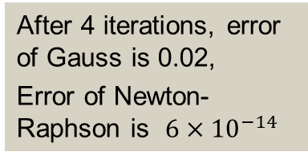
Compare Gauss and Newton-Raphson
Gauss
  Relatively fast iterations, easy to calculate and program
  For power flow, requires programming complex numbers
  Convergence can be slower and unreliable
Newton-Raphson
  More complicated because it requires calculating the derivative
  Much better convergence: when close to solution, the error decreases quite quickly—method has quadratic convergence
Analytical solution: $1.5+0.5\sqrt{5}$
=2.618033988749895
$$ν$$ | $x^{\left(ν\right)}$ (Gauss) | $x^{\left(ν\right)}$ (Newton Raphson)
0 | 1 | 1
1 | 2 | 3.0000000000000000
2 | 2.41421 | 2.6233096782319105
3 | 2.55377 | 2.6180351744324595
4 | 2.59805 | 2.6180339887499550
5 | 2.61185 | 2.6180339887498950
6 | 2.61612 | 2.6180339887498950
7 | 2.61744
8 | 2.61785
9 | 2.61798
10 | 2.61802
11 | 2.61803
After 4 iterations, error of Gauss is 0.02,
Error of Newton-Raphson is $6×{10}^{−14}$

Slide 14
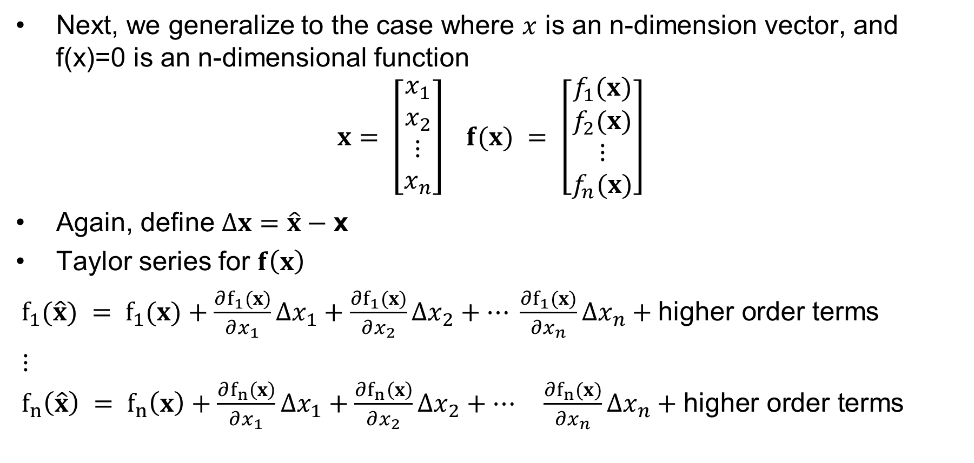
Multi-Variable Newton-Raphson
Next, we generalize to the case where $x$ is an n-dimension vector, and f(x)=0 is an n-dimensional function
$$x = \left[\begin{matrix}x_{1} \\ x_{2} \\ ⋮ \\ x_{n}\end{matrix}\right] f(x) = \left[\begin{matrix}f_{1}(x) \\ f_{2}(x) \\ ⋮ \\ f_{n}(x)\end{matrix}\right]$$
Again, define $Δx=\hat{x}−\text{x}$
Taylor series for $f\left(x\right)$
$f_{1}(\hat{x}) = f_{1}(x)+\frac{∂f_{1}(x)}{∂x_{1}}Δx_{1}+\frac{∂f_{1}(x)}{∂x_{2}}Δx_{2}+… \frac{∂f_{1}(x)}{∂x_{n}}Δx_{n}+\text{higher} \text{order} \text{terms}$
$⋮$
$f_{n}\left(\hat{x}\right) = f_{n}\left(x\right)+\frac{∂f_{n}\left(x\right)}{∂x_{1}}Δx_{1}+\frac{∂f_{n}\left(x\right)}{∂x_{2}}Δx_{2}+… \frac{∂f_{n}(x)}{∂x_{n}}Δx_{n}+\text{higher} \text{order} \text{terms}$

Slide 15
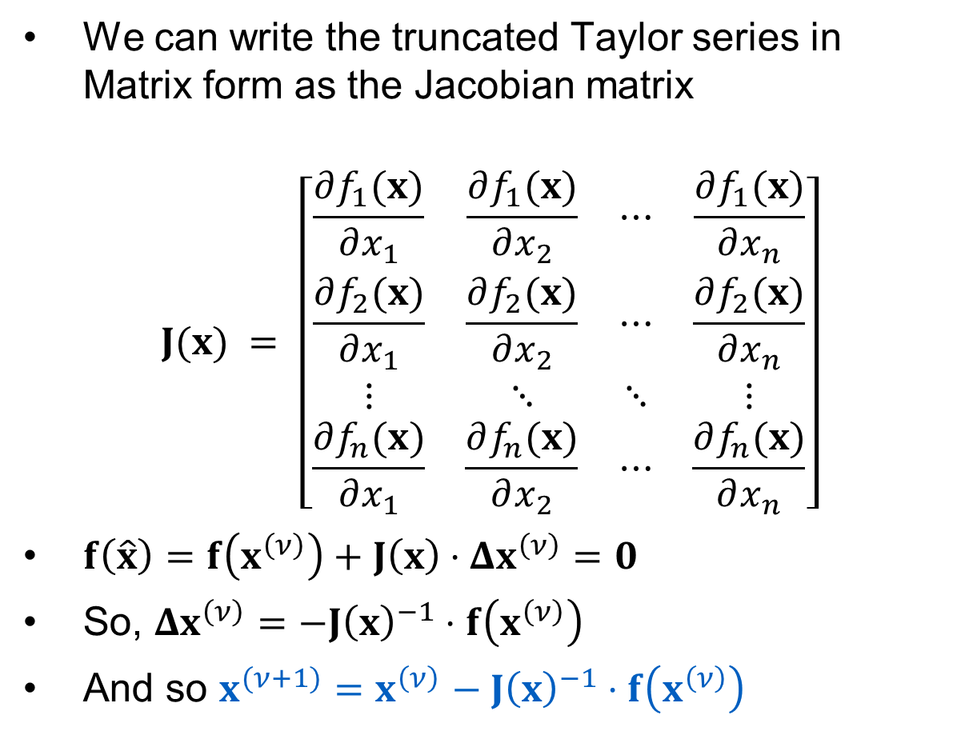
Jacobian Matrix
We can write the truncated Taylor series in Matrix form as the Jacobian matrix
$$J(x) = \left[\begin{matrix}\frac{∂f_{1}(x)}{∂x_{1}} & \frac{∂f_{1}(x)}{∂x_{2}} & ⋯ & \frac{∂f_{1}(x)}{∂x_{n}} \\ \frac{∂f_{2}(x)}{∂x_{1}} & \frac{∂f_{2}(x)}{∂x_{2}} & ⋯ & \frac{∂f_{2}(x)}{∂x_{n}} \\ ⋮ & ⋱ & ⋱ & ⋮ \\ \frac{∂f_{n}(x)}{∂x_{1}} & \frac{∂f_{n}(x)}{∂x_{2}} & ⋯ & \frac{∂f_{n}(x)}{∂x_{n}}\end{matrix}\right]$$
$f\left(\hat{x}\right)=f\left(x^{\left(ν\right)}\right)+J\left(x\right)⋅Δx^{\left(ν\right)}=0$
So, $Δx^{\left(ν\right)}=−J{\left(x\right)}^{−1}⋅f\left(x^{\left(ν\right)}\right)$
And so $x^{(ν+1)}=x^{\left(ν\right)}$ $− J{\left(x\right)}^{−1}⋅f\left(x^{\left(ν\right)}\right)$

Slide 16

Multi-Variable Newton-Raphson Example
Solve for $x_{1}$ and $x_{2}$ such that
$f_{1}\left(x_{1},x_{2}\right)=2x_{1}^{2}+x_{2}^{2}−8=0$
$f_{2}\left(x_{1},x_{2}\right)=x_{1}^{2}−x_{2}^{2}+x_{1}x_{2}−4=0$

Slide 17


Multi-Variable Newton-Raphson Example
Solve for $x_{1}$ and $x_{2}$ such that
$f_{1}\left(x_{1},x_{2}\right)=2x_{1}^{2}+x_{2}^{2}−8=0$
$f_{2}\left(x_{1},x_{2}\right)=x_{1}^{2}−x_{2}^{2}+x_{1}x_{2}−4=0$
First, symbolically determine the Jacobian
$$J(x) = \left[\begin{matrix}\frac{∂f_{1}(x)}{∂x_{1}} & \frac{∂f_{1}(x)}{∂x_{2}} \\ \frac{∂f_{2}(x)}{∂x_{1}} & \frac{∂f_{2}(x)}{∂x_{2}}\end{matrix}\right] = \left[\begin{matrix}4x_{1} & 2x_{2} \\ 2x_{1}+x_{2} & x_{1}−2x_{2}\end{matrix}\right]$$
Then
$$\left[\begin{matrix}Δx_{1} \\ Δx_{2}\end{matrix}\right]=−{\left[\begin{matrix}4x_{1} & 2x_{2} \\ 2x_{1}+x_{2} & x_{1}−2x_{2}\end{matrix}\right]}^{−1}\left[\begin{matrix}f_{1}(x) \\ f_{2}(x)\end{matrix}\right]$$
Arbitrarily guess $x^{(0)}=\left[\begin{matrix}1 \\ 1\end{matrix}\right]$
$$x^{(1)} = \left[\begin{matrix}1 \\ 1\end{matrix}\right]−{\left[\begin{matrix}4 & 2 \\ 3 & −1\end{matrix}\right]}^{−1}\left[\begin{matrix}−5 \\ −3\end{matrix}\right] = \left[\begin{matrix}2.1 \\ 1.3\end{matrix}\right]$$
$$x^{(2)} = \left[\begin{matrix}2.1 \\ 1.3\end{matrix}\right]−{\left[\begin{matrix}8.40 & 2.60 \\ 5.50 & −0.50\end{matrix}\right]}^{−1}\left[\begin{matrix}2.51 \\ 1.45\end{matrix}\right] = \left[\begin{matrix}1.8284 \\ 1.2122\end{matrix}\right]$$
Each iteration we check $\left\|f(x)\right\|$to see if it is below our specified tolerance $ε$
$$f(x^{(2)}) = \left[\begin{matrix}0.1556 \\ 0.0900\end{matrix}\right] \\ \text{If} ε\text{ = 0.2 }\text{then} \text{we} \text{would} \text{be} \text{done}\text{. }\text{Otherwise}\text{,} \text{we}\text{′}\text{d} \\ \text{continue} \text{iterating}\text{. }$$

Slide 18
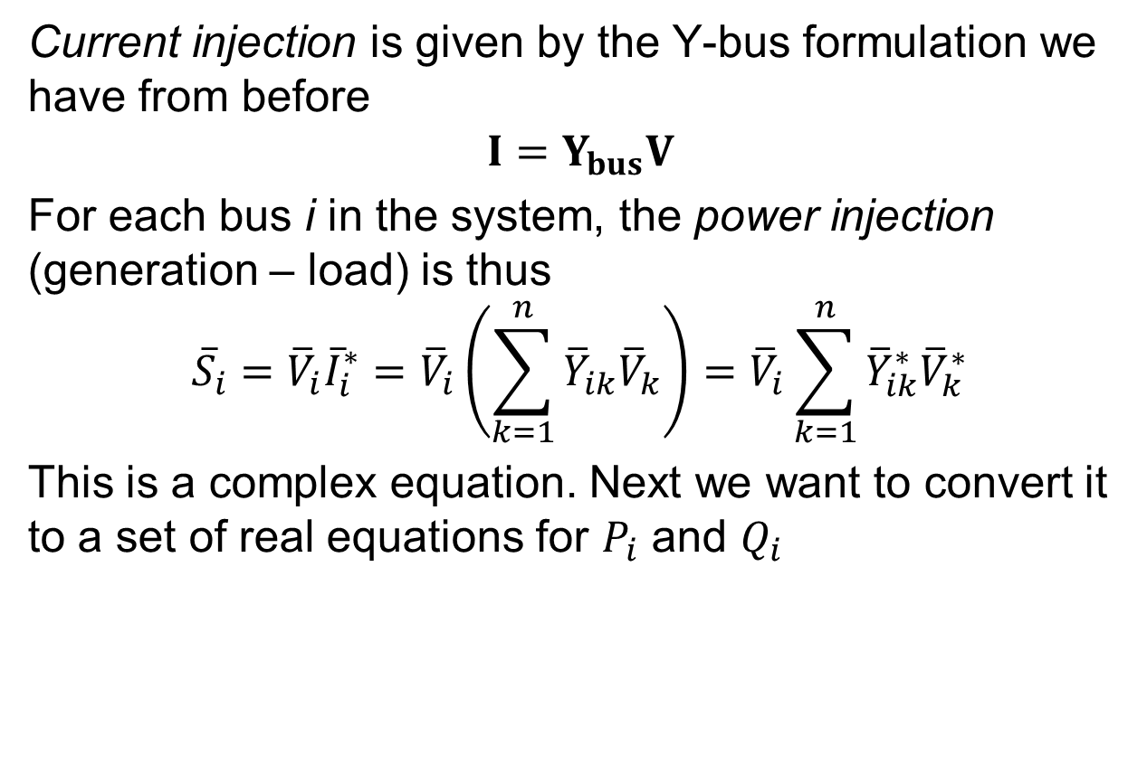
Power Balance Equations
Current injection is given by the Y-bus formulation we have from before
$$I=Y_{bus}V$$
For each bus i in the system, the power injection (generation – load) is thus
$${\overline{S}}_{i}={\overline{V}}_{i}{\overline{I}}_{i}^{∗}={\overline{V}}_{i}\left(\sum_{k=1}^{n}{{\overline{Y}}_{ik}{\overline{V}}_{k}}\right)={\overline{V}}_{i}\sum_{k=1}^{n}{{\overline{Y}}_{ik}^{∗}{\overline{V}}_{k}^{∗}}$$
This is a complex equation. Next we want to convert it to a set of real equations for $P_{i}$ and $Q_{i}$

Slide 19

Power Balance Equations, cont.
First, define ${\overline{Y}}_{ik}^{∗}=g_{ik}+jb_{k}$ and ${\overline{V}}_{i}=V_{i}∠θ_{i}=V_{i}(\cos{θ_{i}}+j\sin{θ_{i}})$
And use $θ_{ij}=θ_{i}−θ_{j}$
$${\overline{S}}_{i}=P_{i}+jQ_{i}={\overline{V}}_{i}\sum_{k=1}^{n}{{\overline{Y}}_{ik}^{∗}{\overline{V}}_{k}^{∗}}=\sum_{k=1}^{n}{\left|V_{i}\right|\left|V_{k}\right|} e^{jθ_{ik}}\left(g_{ik}−jb_{ik}\right)= \sum_{k=1}^{n}{\left|V_{i}\right|\left|V_{k}\right|} (\cos{θ_{ik}}+j\sin{θ_{ik}})(g_{ik}−jb_{ik})$$
Resolve into real and imaginary parts:
$$P_{i} = \sum_{k=1}^{n}{\left|V_{i}\right|\left|V_{k}\right|}(g_{ik}\cos{θ_{ik}}+b_{ik}\sin{θ_{ik}})=P_{Gi}−P_{Di} \\ Q_{i} = \sum_{k=1}^{n}{\left|V_{i}\right|\left|V_{k}\right|}(g_{ik}\sin{θ_{ik}}−b_{ik}\cos{θ_{ik}})=Q_{Gi}−Q_{Di}$$
Power balance equations

Slide 20
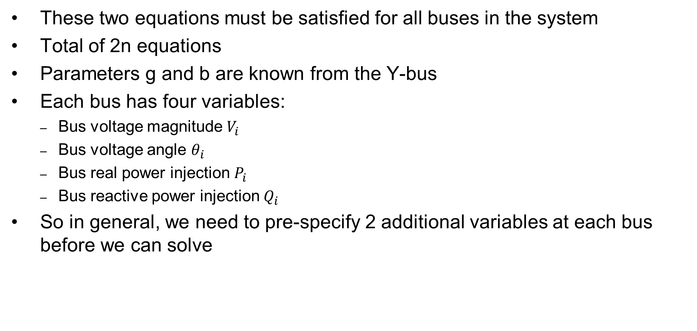
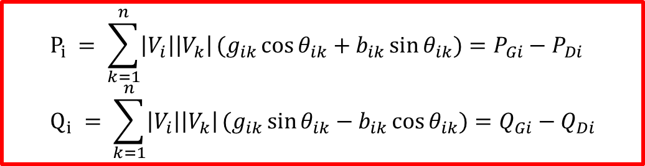
Power Flow Problem Variables
These two equations must be satisfied for all buses in the system
Total of 2n equations
Parameters g and b are known from the Y-bus
Each bus has four variables:
  Bus voltage magnitude $V_{i}$
  Bus voltage angle $θ_{i}$
  Bus real power injection $P_{i}$
  Bus reactive power injection $Q_{i}$
So in general, we need to pre-specify 2 additional variables at each bus before we can solve
$$P_{i} = \sum_{k=1}^{n}{\left|V_{i}\right|\left|V_{k}\right|}(g_{ik}\cos{θ_{ik}}+b_{ik}\sin{θ_{ik}})=P_{Gi}−P_{Di} \\ Q_{i} = \sum_{k=1}^{n}{\left|V_{i}\right|\left|V_{k}\right|}(g_{ik}\sin{θ_{ik}}−b_{ik}\cos{θ_{ik}})=Q_{Gi}−Q_{Di}$$

Slide 21
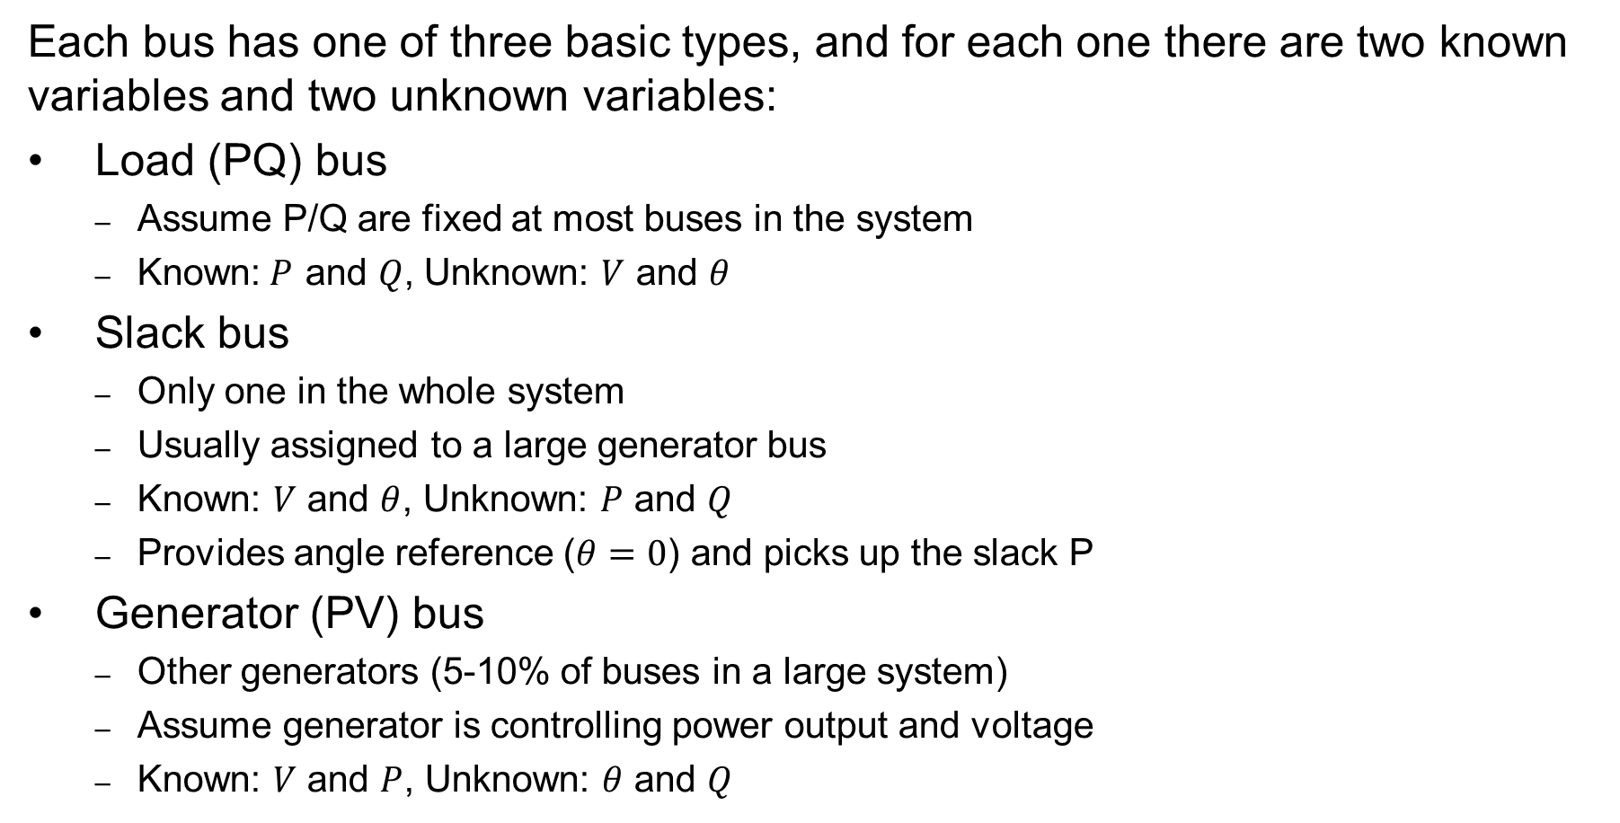
Power Flow Bus Types
  Each bus has one of three basic types, and for each one there are two known variables and two unknown variables:
Load (PQ) bus
  Assume P/Q are fixed at most buses in the system
  Known:$P$ and $Q$, Unknown: $V$ and $θ$
Slack bus
  Only one in the whole system
  Usually assigned to a large generator bus
  Known: $V$ and $θ$, Unknown: $P$ and $Q$
  Provides angle reference ($θ=0$) and picks up the slack P
Generator (PV) bus
  Other generators (5-10% of buses in a large system)
  Assume generator is controlling power output and voltage
  Known: $V$ and $P$, Unknown: $θ$ and $Q$

Slide 22
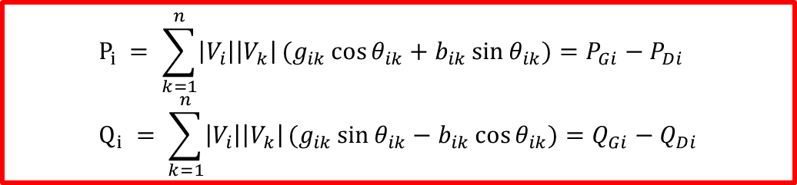
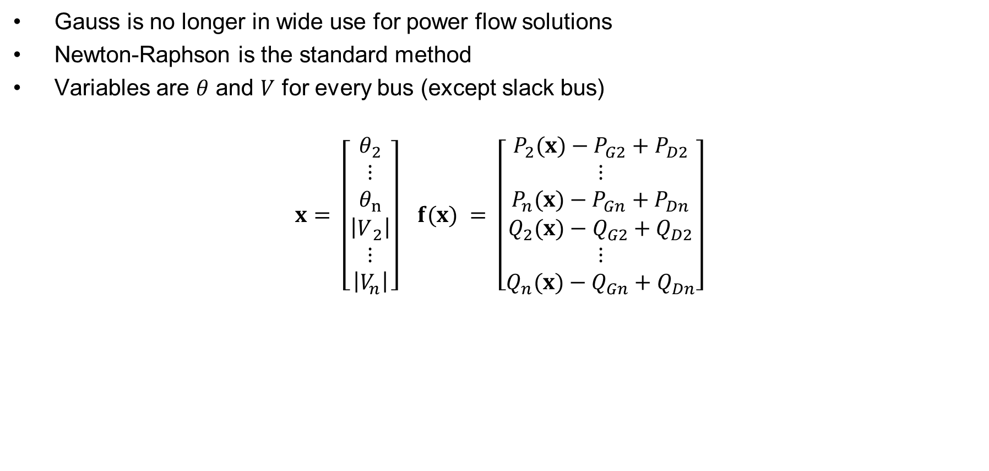
Using Newton-Raphson to Solve the Power Flow Problem
Gauss is no longer in wide use for power flow solutions
Newton-Raphson is the standard method
Variables are $θ$ and $V$ for every bus (except slack bus)
$$x = \left[\begin{matrix}θ_{2} \\ ⋮ \\ θ_{n} \\ \left|V​_{2}\right| \\ ⋮ \\ \left|V_{n}\right|\end{matrix}\right] f(x) = \left[\begin{matrix}P_{2}(x)−P_{G2}+P_{D2} \\ ⋮ \\ P_{n}(x)−P_{Gn}+P_{Dn} \\ Q_{2}(x)−Q_{G2}+Q_{D2} \\ ⋮ \\ Q_{n}(x)−Q_{Gn}+Q_{Dn}\end{matrix}\right]$$
$$P_{i} = \sum_{k=1}^{n}{\left|V_{i}\right|\left|V_{k}\right|}(g_{ik}\cos{θ_{ik}}+b_{ik}\sin{θ_{ik}})=P_{Gi}−P_{Di} \\ Q_{i} = \sum_{k=1}^{n}{\left|V_{i}\right|\left|V_{k}\right|}(g_{ik}\sin{θ_{ik}}−b_{ik}\cos{θ_{ik}})=Q_{Gi}−Q_{Di}$$

Slide 23
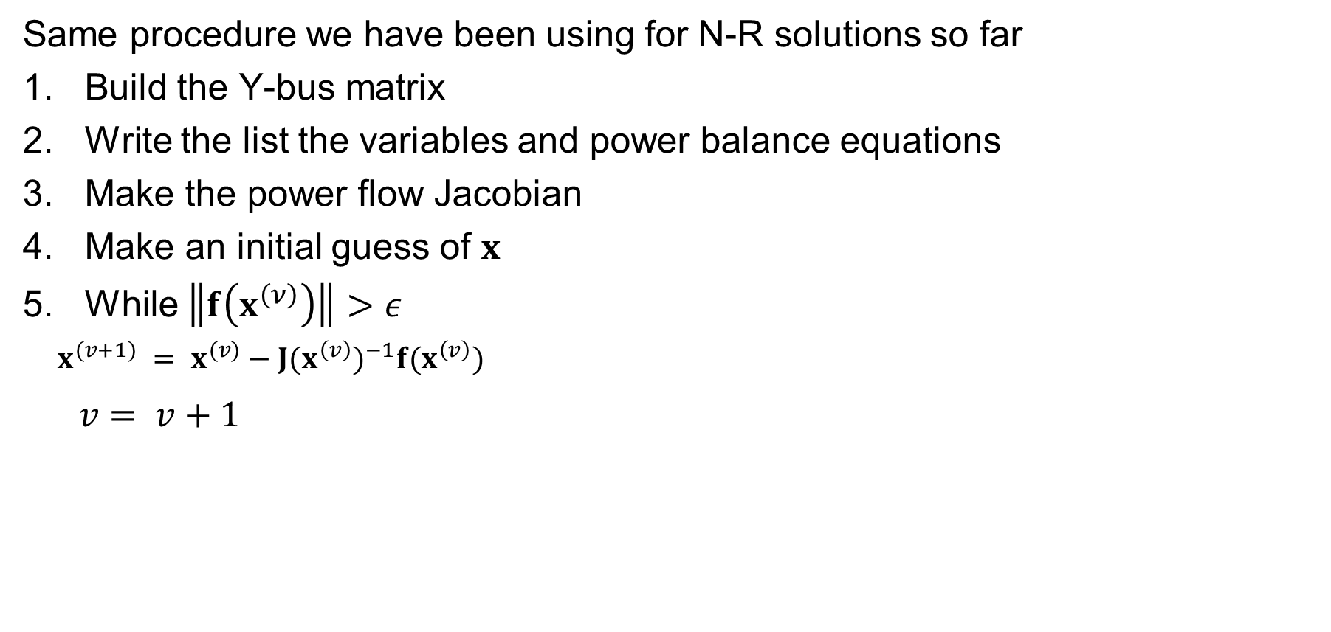
Newton-Raphson Power Flow Procedure
Same procedure we have been using for N-R solutions so far
Build the Y-bus matrix
Write the list the variables and power balance equations
Make the power flow Jacobian
Make an initial guess of $x$
While $\left\|f\left(x^{\left(ν\right)}\right)\right\|>ε$
  $x^{(v+1)} = x^{(v)}−J(x^{\left(v\right)})^{−1}f(x^{\left(v\right)})$
$v = v+1$

Slide 24
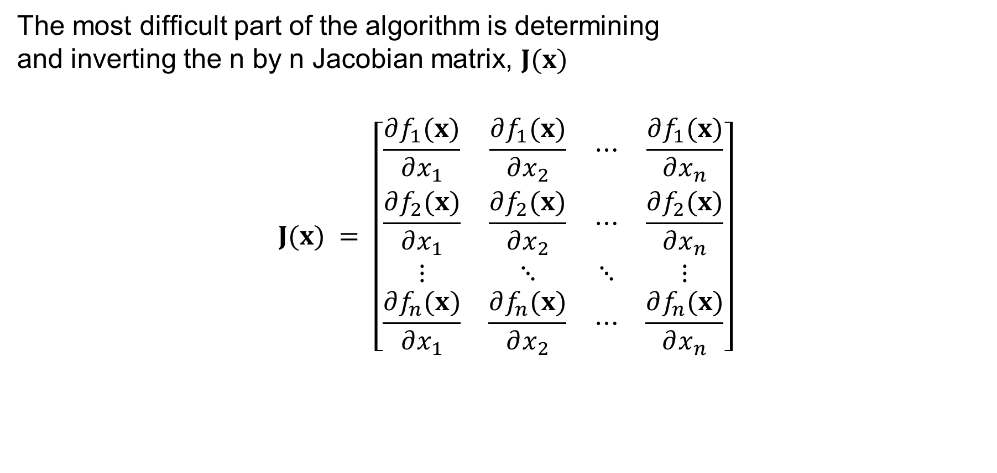
Power Flow Jacobian Matrix
The most difficult part of the algorithm is determining
and inverting the n by n Jacobian matrix$\text{, }J(x)$
$$J(x) = \left[\begin{matrix}\frac{∂f_{1}(x)}{∂x_{1}} & \frac{∂f_{1}(x)}{∂x_{2}} & ⋯ & \frac{∂f_{1}(x)}{∂x_{n}} \\ \frac{∂f_{2}(x)}{∂x_{1}} & \frac{∂f_{2}(x)}{∂x_{2}} & ⋯ & \frac{∂f_{2}(x)}{∂x_{n}} \\ ⋮ & ⋱ & ⋱ & ⋮ \\ \frac{∂f_{n}(x)}{∂x_{1}} & \frac{∂f_{n}(x)}{∂x_{2}} & ⋯ & \frac{∂f_{n}(x)}{∂x_{n}}\end{matrix}\right]$$

Slide 25
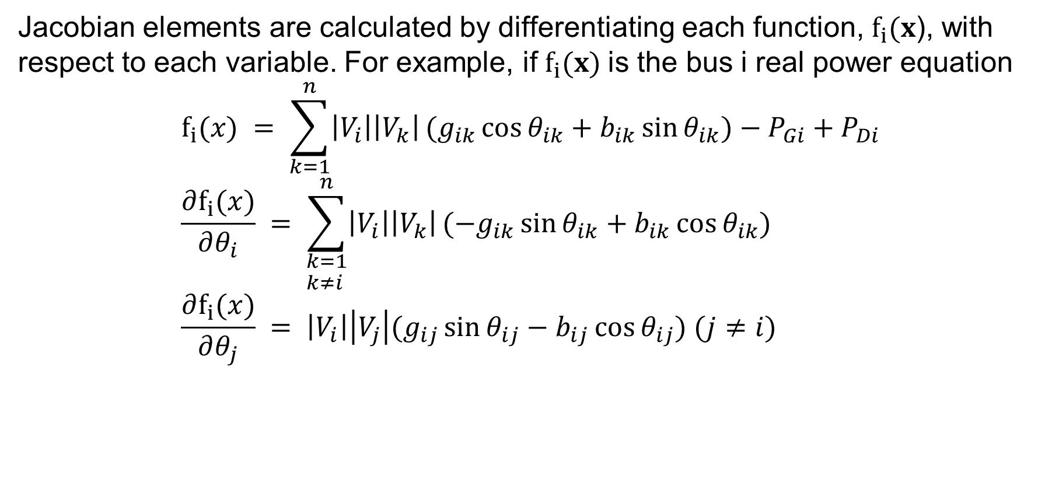
Power Flow Jacobian Matrix, Cont.
Jacobian elements are calculated by differentiating each function, ${\text{f}}_{i}(x$), with respect to each variable. For example, if ${\text{f}}_{i}(x)$is the bus i real power equation
$$f_{i}(x) = \sum_{k=1}^{n}{\left|V_{i}\right|\left|V_{k}\right|}(g_{ik}\cos{θ_{ik}}+b_{ik}\sin{θ_{ik}})−P_{Gi}+P_{Di} \\ \frac{∂f_{i}(x)}{∂θ_{i}} = \sum_{\begin{aligned}&k=1 \\ &k≠i\end{aligned}}^{n}{\left|V_{i}\right|\left|V_{k}\right|}(−g_{ik}\sin{θ_{ik}}+b_{ik}\cos{θ_{ik}}) \\ \frac{∂f_{i}(x)}{∂θ_{j}} = \left|V_{i}\right|\left|V_{j}\right|(g_{ij}\sin{θ_{ij}}−b_{ij}\cos{θ_{ij}}) (j≠i)$$

