Slide 1
ECEN 460, Spring 2024
Power System Operation and Control
Class 4: Generators and Machines, Part 2
Prof. Adam Birchfield
Dept. of Electrical and Computer Engineering
Texas A&M University
abirchfield@tamu.edu

Slide 2
Generators
Sources of energy in the power system
  Nuclear
  Coal-fired steam
  Gas
    Gas turbine
    Steam turbine
    Combined Cycle
  Hydro
  Oil / Petroleum
  Wind
  Solar
  Other
Synchronous Machines (Tuesday)
Power Electronics / Other (Today)

Slide 3
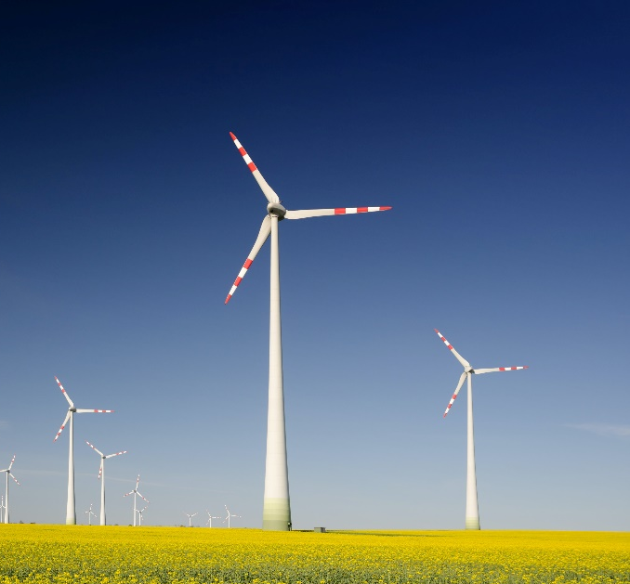
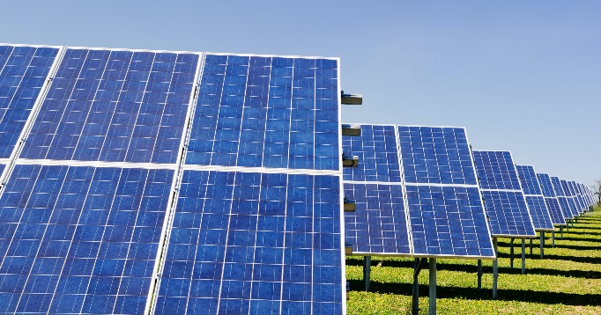
Renewable Energy Sources
Renewable energy sources are ones where the energy source is constantly replenished
  They help to make the system more sustainable over the long term
  They are often more environmentally friendly as well
Examples of sustainable energy sources
  Hydroelectric
  Wind
  Solar (photovoltaic and solar thermal)
  Geothermal
  Biomass
  Tidal and wave
There has been significant growth in renewable electric energy in the last few decades, particularly with wind and solar

Slide 4
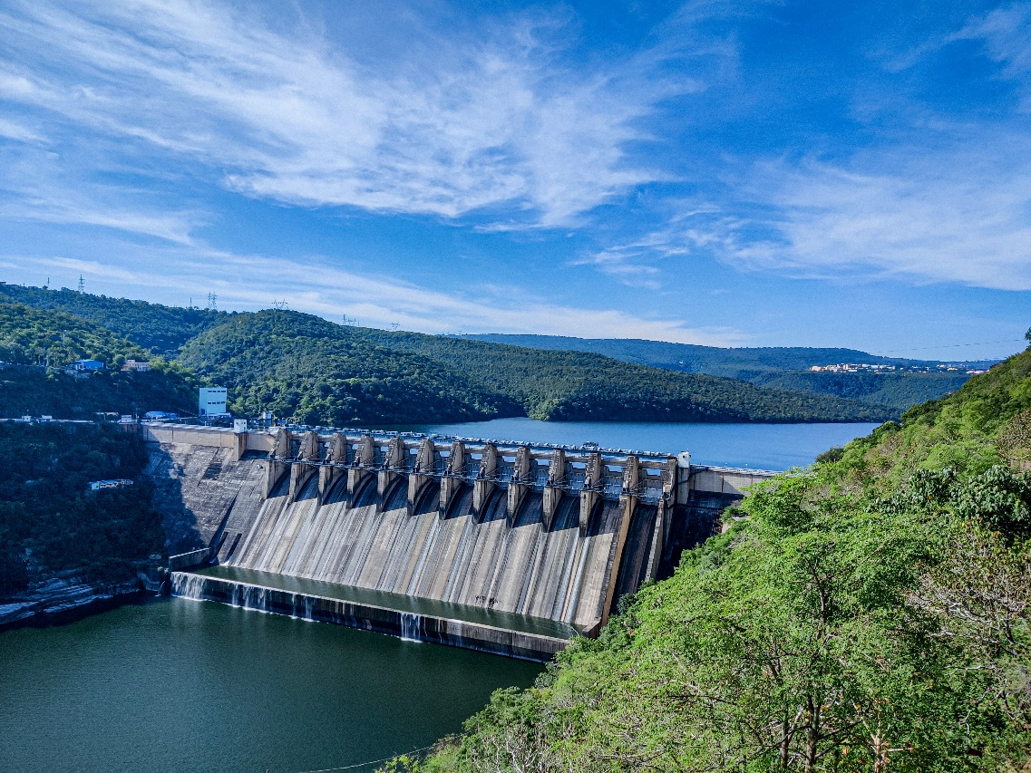
Hydroelectric Power
Hydroelectric power is one of the oldest significant source of renewable electric power in the US
A typical design uses a large, salient pole synchronous machine (modeled like most generators we have been studying)
Availability for growth is limited in the US
In some cases, dams can operate in reverse (pumped storage), acting as a source of energy storage
Challenges include scheduling the hydro and coordinating with reservoir levels and wildlife/ecological constraints

Slide 5
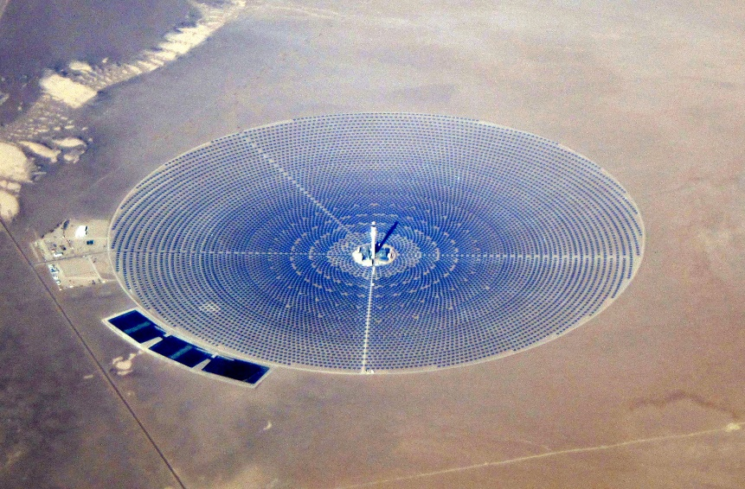
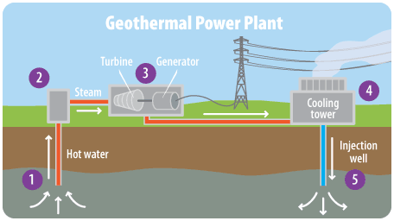
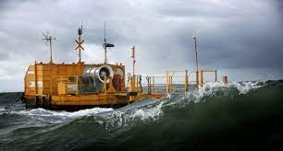
Thermal and Ocean Power Sources
Concentrated solar thermal power involves many mirrors concentrating sun's energy to heat chemicals to power a turbine.
Geothermal powers a turbine with water heated below the earth's surface
Ocean power takes energy from natural processes of tides, waves, and ocean currents

Slide 6
Wind and Solar
Wind and solar are the focus of the next few slides
These are the highest-growth renewable energy sources
Goal is to develop models for integrated system studies
Wind and solar plant modeling is different from synchronous machine modeling (fossil, nuclear, hydro)

Slide 7
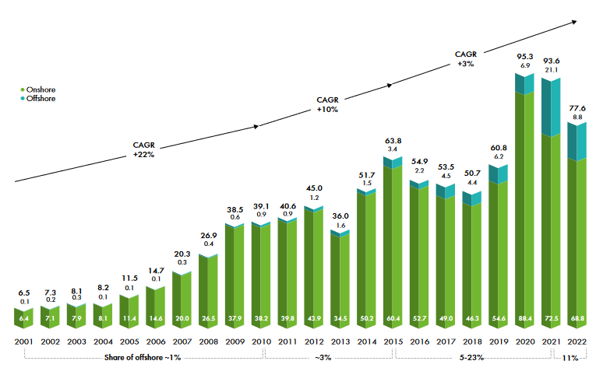
Growth in Wind Worldwide
Source: Global Wind 2023 Report, Global Wind Energy Council
2022 was slowest wind year since 2018, in part due to supply chain issues and in part due to grid interconnection issues

Slide 8
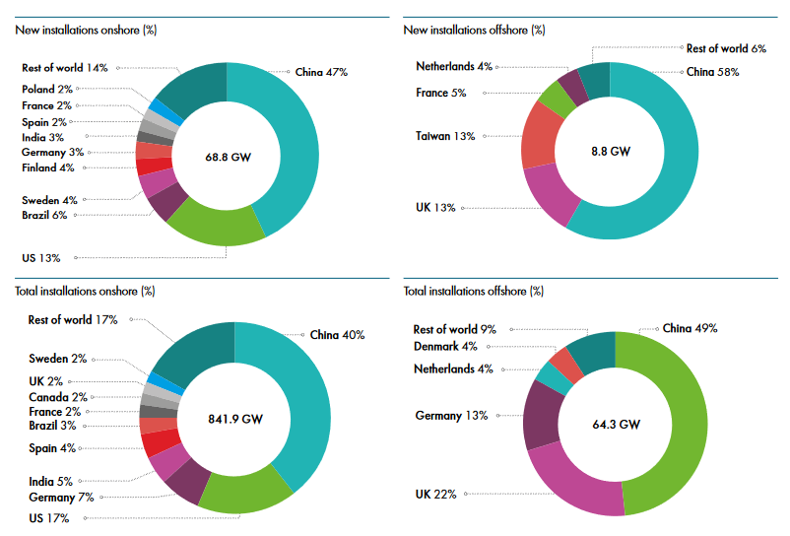
Growth in Wind Worldwide
Source: Global Wind 2023 Report, Global Wind Energy Council

Slide 9
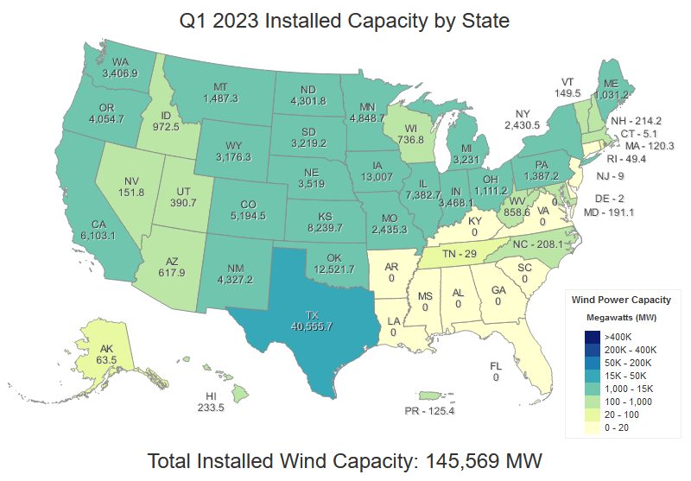
2023 Installed Capacity by State:
Texas Continues to Dominate!
https://windexchange.energy.gov/maps-data/321

Slide 10
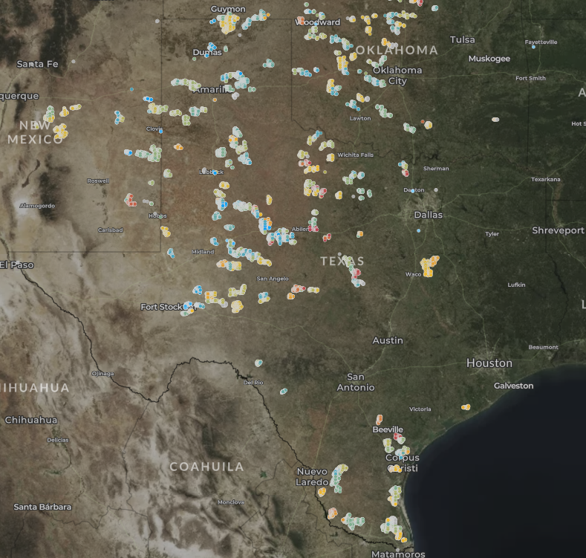
Wind Farm and Wind-related Plant Locations
https://eerscmap.usgs.gov/uswtdb/viewer/#5.34/31.787/-99.912

Slide 11
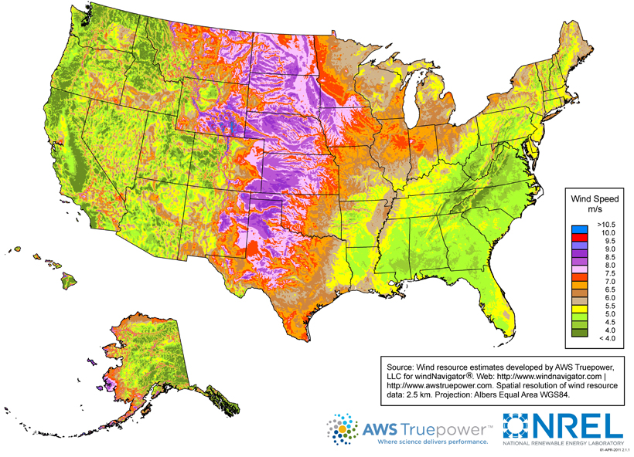
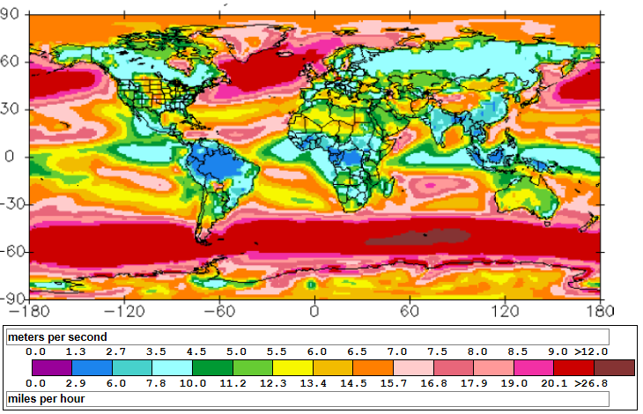
Wind Resources in the US and Globally
Source: http://www.windpoweringamerica.gov/wind_maps.asp
http://www.climate-charts.com/World-Climate-Maps.html#wind-speed

Slide 12
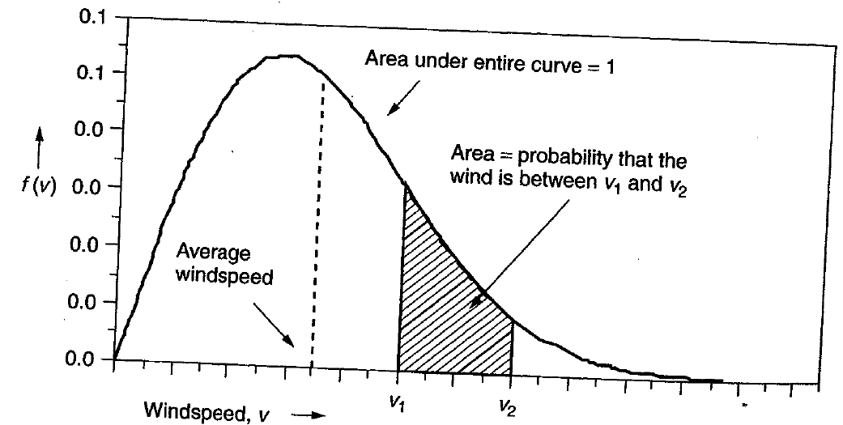
Power in the Wind
The power in the wind is proportional to the cube of the wind speed
  Velocity increases with height, with more increase over rougher terrain (doubling at 100m compared to 10m for a small town, but only increasing by 60% over crops or 30% over calm water)
Maximum rotor efficiency is 59.3%, from Betz' law
Expected available
energy depends on
the wind speed
probability density
function (pdf)

Slide 13
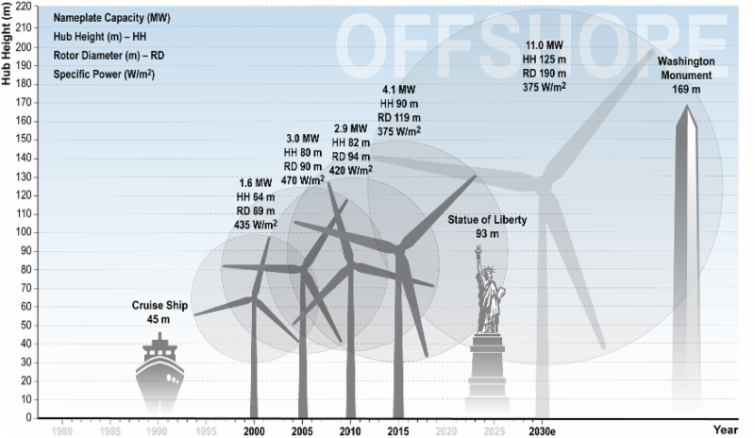
Wind Turbine Height and Size
The largest wind
turbine by
capacity is
the Vestas
V164 which
has a capacity
of 8 MW, a
height of
220 m,
and diameter
of 164 m.
Source: cdn.arstechnica.net/wp-content/uploads/2016/11/6e9cb9fc-0c18-46db-9176-883cbb08eace.png

Slide 14
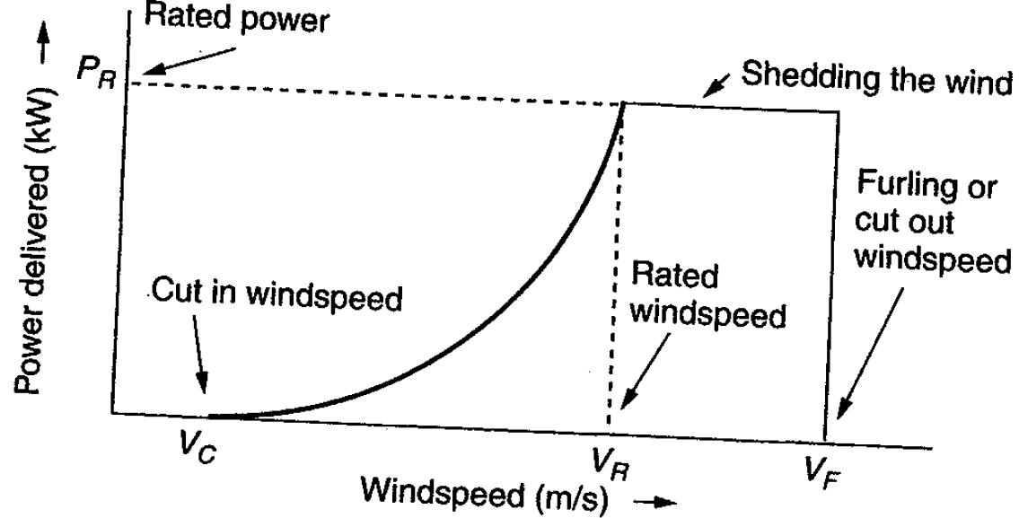
Extracted Power
WTGs are designed for rated power and windspeed
  For speeds above this blades are pitched to operate at rated power; at furling speed the WTG is cut out

Slide 15
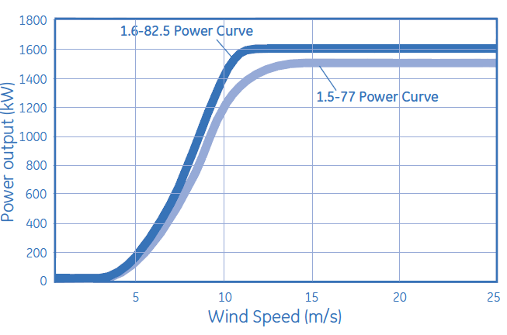
Example: GE 1.5 and 1.6 MW Turbines
Power speed curves for the GE 1.5 and 1.6 MW WTGs
  Hub height is 80/100 m; cut-out at 25 m/s wind
Source: http://site.ge-energy.com/prod_serv/products/wind_turbines/en/15mw/index.htm

Slide 16
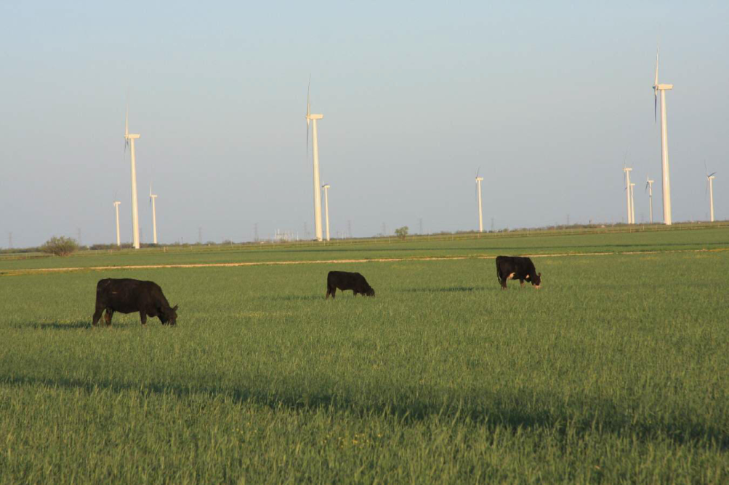
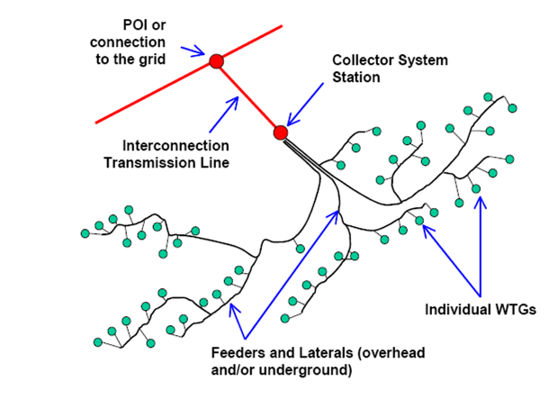
Wind Farms (or Parks)
Usually wind farm is modeled in aggregate for grid studies; wind farm can consist of many small (1 to 3 MW) wind turbine-generators (WTGs) operating at low voltage (e.g. 0.6kV) stepped up to distribution level (e.g., 34.5 kV)
Photo Source: www.energyindustryphotos.com/photos_of_wind_farm_turbines.htm

Slide 17
Economies of Scale
Presently large wind farms produce electricity more economically than small operations
Factors that contribute to lower costs are
  Wind power is proportional to the area covered by the blade (square of diameter) while tower costs vary with a value less than the square of the diameter
  Larger blades are higher, permitting access to faster winds, but size limited by transportation for most land wind farms
  Fixed costs associated with construction (permitting, management) are spread over more MWs of capacity
  Efficiencies in managing larger wind farms typically result in lower O&M costs (on-site staff reduces travel costs)

Slide 18
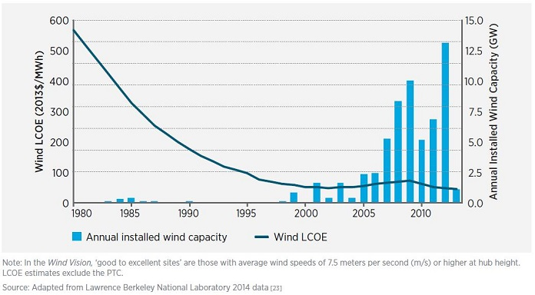
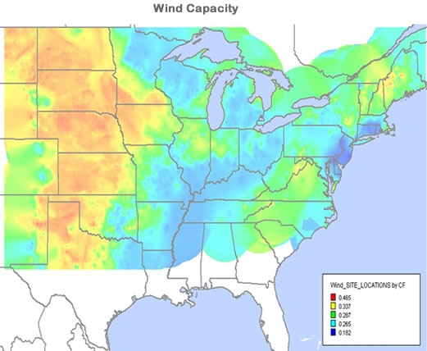
Wind Energy Economics
Most of the cost is in the initial purchase and construction (capital costs); current estimate is about $1690/kW; how much wind is generated depends on the capacity factor, best is about 40%
Source: www.awea.org/falling-wind-energy-costs

Slide 19
Environmental Aspects of Wind Energy
US National Academies issued report on issue in 2007
Wind system emit no air pollution and no carbon dioxide; they also have essentially no water requirements
Wind energy serves to displace the production of energy from other sources (usually fossil fuels) resulting in a net decrease in pollution
Other impacts of wind energy are on animals, primarily birds and bats, and on humans (aesthetic, noise, shadow)

Slide 20
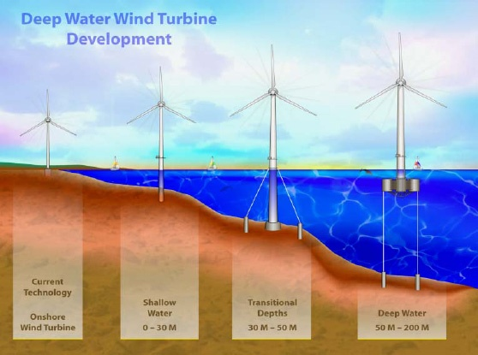
Offshore Wind
Offshore wind turbines currently need to be in relatively shallow water, so maximum distance from shore depends on the seabed
Capacity
factors tend
to increase
as turbines
move further
off-shore
Image Source: National Renewable Energy Laboratory

Slide 21
Offshore: Advantages and Disadvantages
All advantages/disadvantages are somewhat site specific
Advantages
  Can usually be sited much closer to the load (often by coast)
  Offshore wind speeds are higher and steadier
  Easier to transport large wind turbines by ship
  Minimal sound impacts and visual impacts (if far enough offshore), no land usage issues
Disadvantages
  High construction costs, particularly since they are in windy (and hence wavy) locations
  Higher maintenance costs
  Some environmental issues (e.g., seabed disturbance)

Slide 22
Types of Wind Turbines
Electrically there are four main generic types of wind turbines
  Type 1: Induction machine
  Type 2: Induction machine with varying rotor resistance to adjust slip
  Type 3: Doubly Fed Asynchronous Generator (DFAG) (or DFIG)
  Type 4: Full Asynchronous Generator
New wind farms are primarily of Type 3 or 4

Slide 23
Types of Wind Turbines
Several different approaches to aggregate modeling of wind farms in power system analysis
  Wind turbine manufacturers provide detailed, public models of their WTGs; these models are incorporated into software packages; example is GE 1.5, 1.6 and 3.6 MW WTGs (see Modeling of GE Wind Turbine-Generators for Grid Studies, version 4.6, March 2013, GE Energy)
  Proprietary models are included as user defined models; covered under NDAs to maintain confidentiality
  Generic models are developed to cover the range of WTGs, with parameters set based on the individual turbine types
    Concern by some manufacturers that the generic models to not capture their WTGs' behavior, such as during low voltage ride through (LVRT)

Slide 24
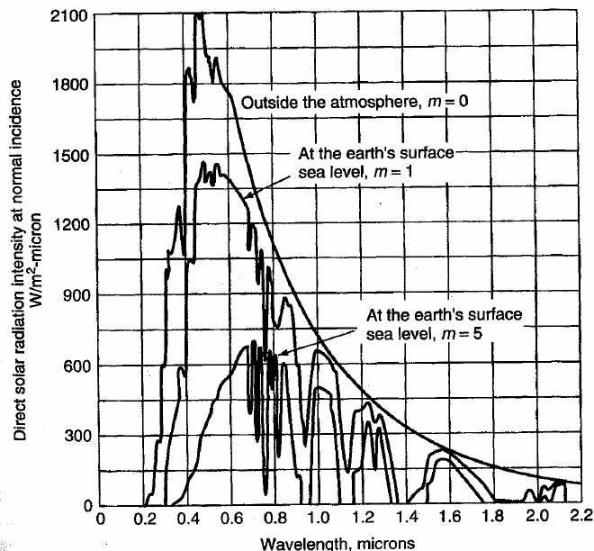
Solar Photovoltaic Energy
Solar energy is rapidly growing, both in the US and worldwide
Takes energy provided by the sun, with the amount available having substantial geographic and time variation
  Maximum is about 1 kW
  per square meter
Total average energy
available is often
given in kWh/m2 per
day averaged over a year

Slide 25
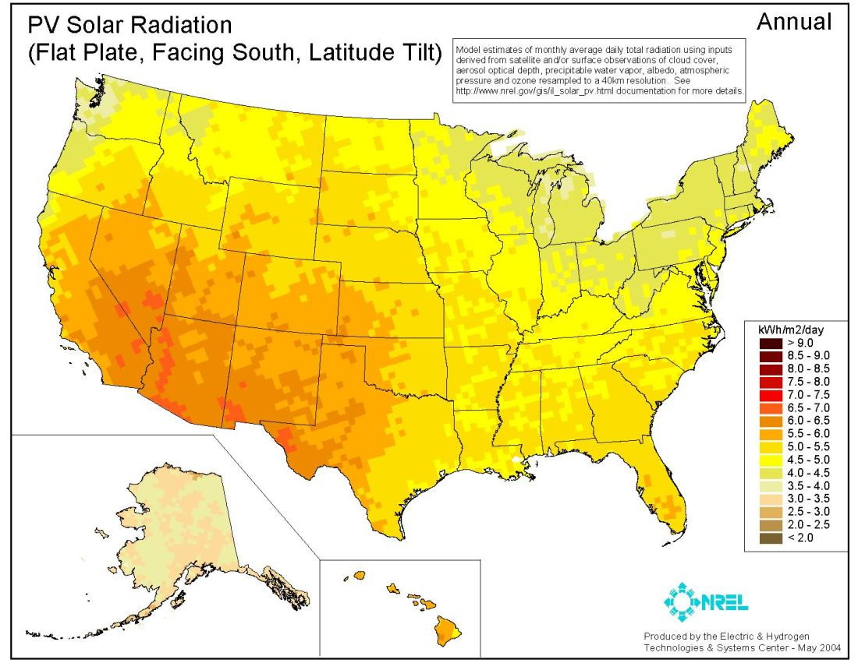
US Annual Insolation
The capacity
factor is
roughly this
number
divided by
24 hours
per day

Slide 26
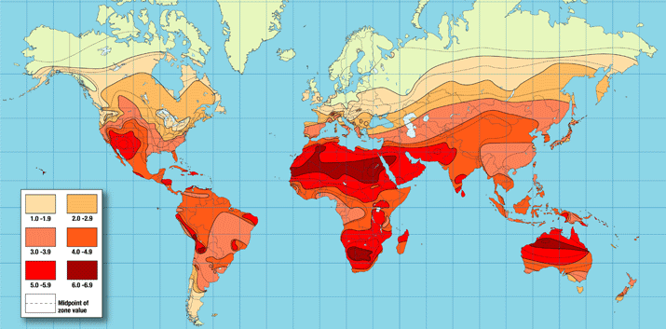
Worldwide Annual Insolation
In 2016 the top countries for total solar capacity are China (78.1 GW),
Japan (42.8 GW), Germany (41.2 GW), US (40.3), Italy (19.3);
In just 2016 China added 34.5 GW, US 14.7, Japan 8.6, Indian 4 GW
Source: http://www.iea-pvps.org/

Slide 27
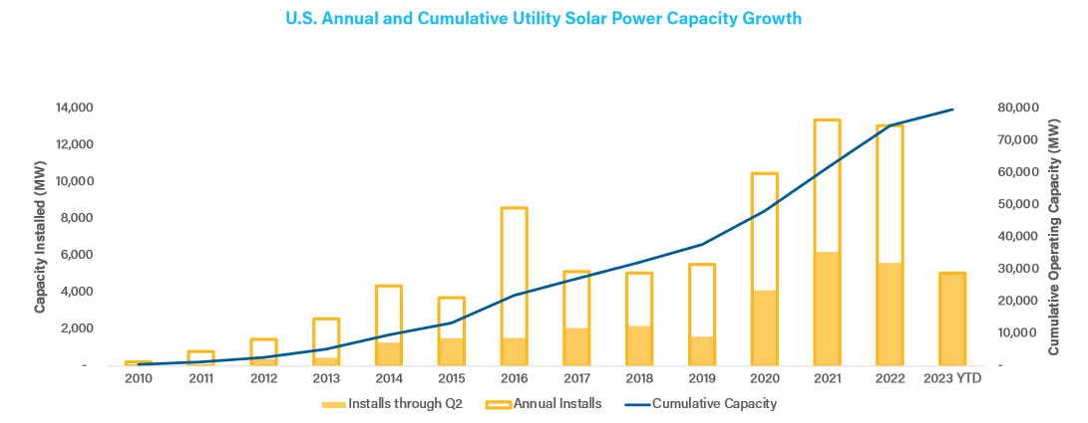
US Solar Generated Electricity
Clean Power Quarterly, 2023 Q2

Slide 28
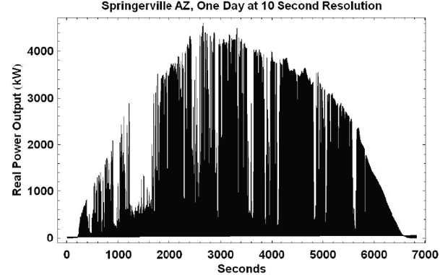
Impact of Clouds
Intermittency
can be reduced
some when
PV is
distributed
over a larger
region; key
issue is
correlation
across an area
Image: http://www.megawattsf.com/gridstorage/gridstorage.htm

Slide 29
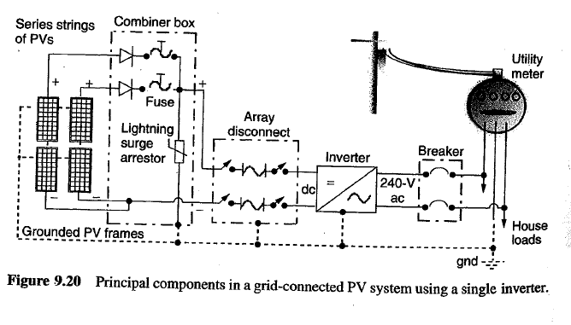
Components of Grid-connected PV

Slide 30
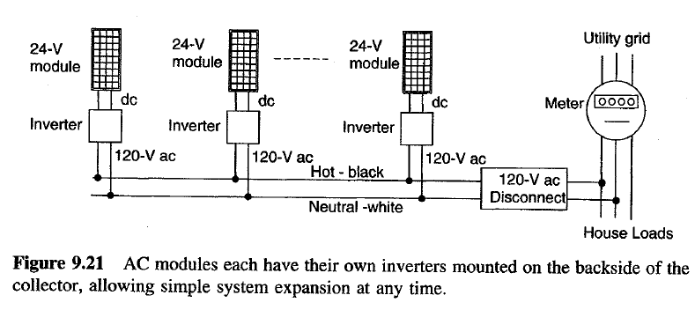
Individual Inverter Concept
Easily allow expansion
Connections to house distribution panel are simple
Less need for expensive DC cabling

Slide 31
Distributed PV System Modeling
PV in the distribution system is usually operated at unity power factor
  There is research investigating the benefits of changing this
  IEEE Std 1547 now allows both non-unity power factor and voltage regulation
  A simple model is just as negative constant power load
An issue is tripping on abnormal frequency or voltage conditions
  IEEE Std 1547 says, "The DR unit shall cease to energize the Area EPS for faults on the Area EPS circuit to which it is connected.” (note EPS is electric power system)

Slide 32
Distributed PV System Modeling
An issue is tripping on abnormal frequency or voltage conditions (from IEEE 1547-2003, 2014 amendment)
  This is a key safety requirement!
  Units need to disconnect if the voltage is < 0.45 pu in 0.16 seconds, in 1 second between 0.45 and 0.6 pu, in 2 seconds if between 0.6 and 0.88 pu; also in 1 second if between 1.1 and 1.2, and in 0.16 seconds if higher
  Units need to disconnect in 0.16 seconds if the frequency is > 62 or less than 57 Hz; in 2 seconds if > 60.5 or < 59.5
  Reconnection is after minutes
  Values are defaults; different values can be used through mutual agreement between EPS and DR operator

