Slide 1
ECEN 460, Spring 2024 Power System Operation and Control
Class 3: Generators and Machines, Part 1
Prof. Adam Birchfield
Dept. of Electrical and Computer Engineering
Texas A&M University
abirchfield@tamu.edu

Slide 2
The Next Three Weeks
How to model parts of the power system
Three main parts we will focus on
Generation (this week Jan 23/25)
Transformers (next week Jan 30/Feb 1)
Transmission Lines (following week Feb 6/8)
When we're done with this, we'll have all we need to start modeling a full power system

Slide 3
Things to Remember About Modeling
Take a small, basic 1 Ohm resistor for a breadboard. 10,000 amps should give you 10,000 volts, right? V=IR? Don't try it. The circuit model is wrong.
Models are always only an approximation of reality, and are dependent upon the assumptions that are made in making that model
"All models are wrong, but some are useful." – George Box
The engineer's job in doing analysis is more than just putting numbers into a model and getting results.
It is figuring out the appropriate model to use that will be useful (though still ultimately wrong), given the questions you're trying to answer.
What range of currents and voltages are we talking about? What time frame? Microseconds? Years? How accurately do we need the answer? The model will change
You should always be asking: What assumptions am I making and are they reasonable?
There are lots of different power system component models, for different purposes, and all of them are ultimately "wrong" i.e., incomplete

Slide 4
Generators
Sources of energy in the power system
Nuclear
Coal-fired steam
Gas
Gas turbine
Steam turbine
Combined Cycle
Hydro
Oil / Petroleum
Wind
Solar
Other
Synchronous Machines (Today)
Power Electronics / Other (Thursday)

Slide 5
Machines: Generators and Motors
Electric machines are used to convert energy
Generators: mechanical into electrical
Motors: electrical into mechanical
Many devices can operate in either mode, but are usually customized for one or the other
Majority of electricity is generated using synchronous generators and some is consumed using synchronous motors
Much literature on subject, and sometimes overly confusing with the use of different conventions and nomenclature

Slide 6
Stator and Rotor
Stator
The part of the machine that does not move
Contains sets of windings or “armature windings” surrounding the rotor
Rotor
Internal part of the machine that rotates
Separated from the stator by airgap
Also has one or more windings or “field windings”
There may be some electrical connection between the spinning rotor windings and the stator
Occasionally the rotor is a permanent magnetic, but this limits control of the machine

Slide 7
Main Types of AC Machines
Synchronous
Rotor windings have dc current powered separately
Stator is connected to the machine terminals
In steady state, rotor speed stays in-synch with the electrical frequency (i.e., some constant multiple)
Induction
Rotor windings are shorted through an impedance
Stator is connected to the machine terminals
In steady state, the rotor speed may vary from the electrical frequency according to a “slip”
Both can be 1 phase or 3 phase

Slide 8
Three-phase Synchronous Machines
Our focus today is on three-phase synchronous machines.
The three stator windings have a three-phase voltage. In a motor or interconnected generator this voltage is supplied. In a stand-alone generator, it is induced.
The stator ac electrical currents are arranged to create a rotating magnetic field.
The rotor dc current creates a constant magnetic field which mechanically spins “in synch” with the stator field.

Slide 9
Diagram of Synchronous Machine
3φ bal. windings (a,b,c) – stator
Field winding (fd) on rotor
Damper in “d” axis
(1d) on rotor
2 dampers in “q” axis
(1q, 2q) on rotor

Slide 10
Round and Salient Pole Rotors
Machines may have multiple pole pairs
$\text{Rotor} \text{mechanical} \text{speed}=(f_{s}×120)/(\# \text{Poles})$
With more poles, the rotor can spin slower than the stator electrical frequency $f_{s}$
Round rotor
Air gap is constant, usually with higher speed machines
Salient pole rotor
Air gap varies circumferentially
Used with slow, many-pole machines such as hydro

Slide 11
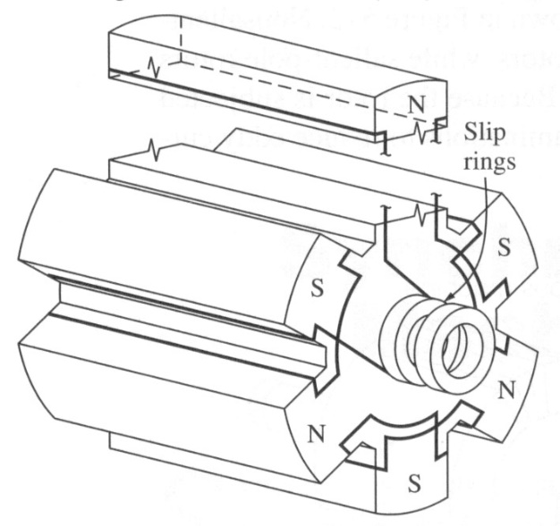
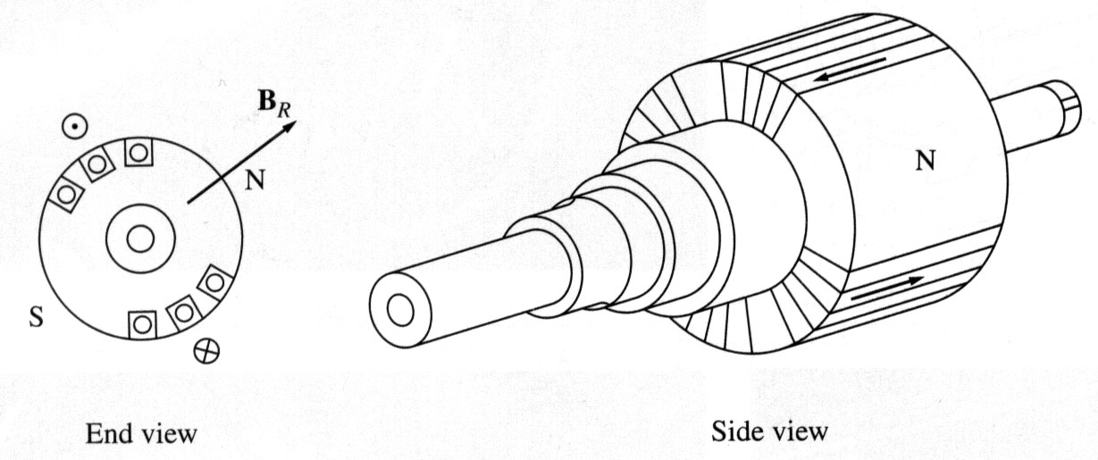
Rotor Examples
Rotors are essentially electromagnets
Two pole (P) round rotor
Six pole salient
rotor
Image Source: Dr. Gleb Tcheslavski, ee.lamar.edu/gleb/teaching.htm

Slide 12
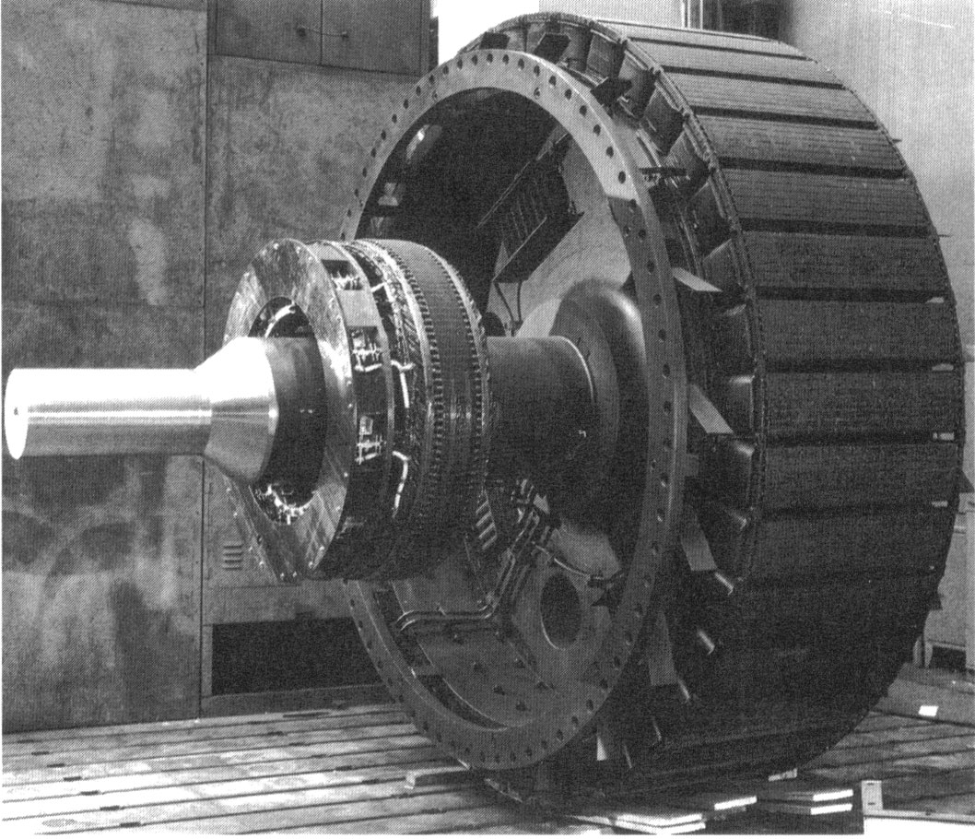
Large Salient Rotor Example
High pole salient rotor
Shaft
Part of exciter, which is used to control the field current
Image Source: Dr. Gleb Tcheslavski, ee.lamar.edu/gleb/teaching.htm

Slide 13
Creating a Voltage in an Open-Circuited Generator
With zero stator current, the only magnetic flux is due to the field current
When the generator is at standstill, the flux linking each coil depends on its angle relative to the rotor’s position (and hence the field winding)
The three phases are physically shifted by 120 degrees from each other
The maximum flux depends on the field current

Slide 14
Creating a Voltage in an Open-Circuited Generator
No voltage is generated at standstill
Now assume the rotor is spinning at a uniform rate, $ω$ = $2πf$ so

Slide 15
Creating a Voltage in an Open-Circuited Generator
Then by Faraday’s law a voltage is induced

Slide 16
Creating a Voltage in an Open-Circuited Generator
For a linear magnetic circuit, we can also write this as proportional to field current
The negative sign could be removed with a change in the assumed polarity

Slide 17
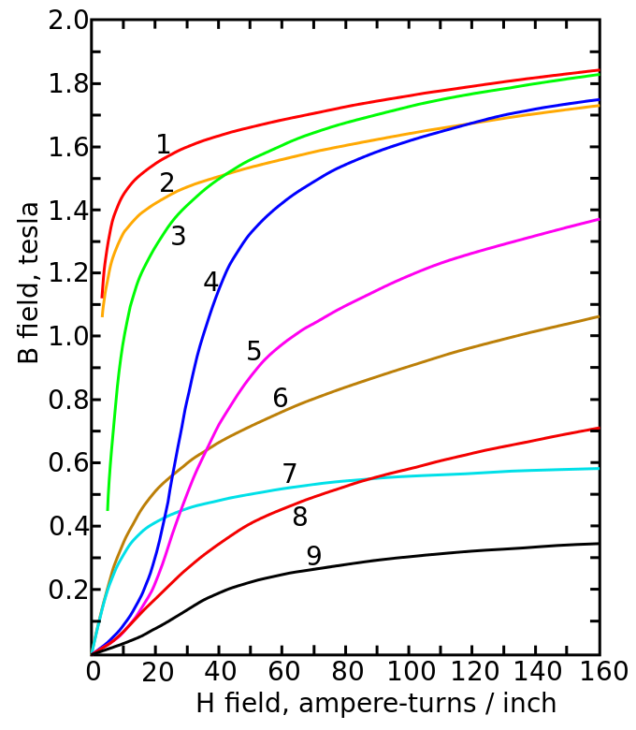
Magnetic Saturation and Hysteresis
A linear magnetic circuit assumes the flux density B is always proportional to current, but real magnetic materials saturate
Magnetization curves of 9 ferromagnetic materials, showing saturation. 1.Sheet steel, 2.Silicon steel, 3.Cast steel, 4.Tungsten steel, 5.Magnet steel, 6.Cast iron, 7.Nickel, 8.Cobalt, 9.Magnetite; highest saturation materials can get to around 2.2 or 2.3T
H is proportional to current
Image Source: en.wikipedia.org/wiki/Saturation_(magnetic)

Slide 18
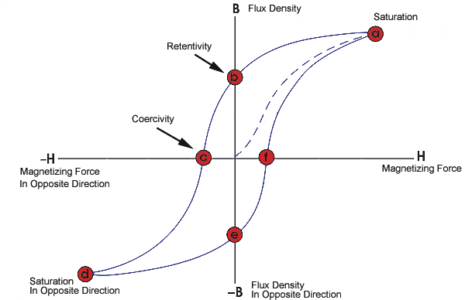
Magnetic Saturation and Hysteresis
Magnetic materials also exhibit hysteresis, so there is some residual magnetism when the current goes to zero; design goal is to reduce the area enclosed by the hysteresis loop
To minimize the amount of magnetic material, and hence cost and weight, electric machines are designed to operate close to saturation
Image source: www.nde-ed.org/EducationResources/CommunityCollege/MagParticle/Graphics/BHCurve.gif

Slide 19
Frequency Impacts
Assuming no saturation, the generated voltage is then proportional to frequency
To create the same voltage with less flux, we just need to increase the frequency; this is why aircraft operate at a higher frequency (e.g., 400 Hz)
When controlling motors with variable frequency, common control is to use constant volt/Hz, preventing saturation

Slide 20
Synchronous Machines with Output Current
When operating with an output current, the terminal voltage is not equal to the internally generated voltage
This is due to several factors
Resistance in the stator windings
Self-inductance in the stator windings
Distortion of the air-gap magnetic field due to the stator current; that is, the stator current induces a magnetic field
Salient pole characteristics of the machine
The stator reactance is called the synchronous reactance, $X_{s}$, and is sometimes broken into two parts
X_{l} is due to the winding self inductance

Slide 21
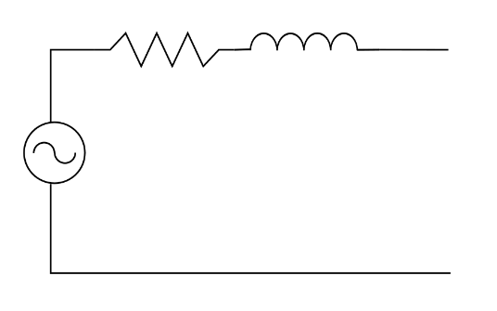
A Synchronous Machine Model
This gives us the following per phase model, which can be helpful in considering how the steady-state real and reactive output of the machine changes with changes in the field current
This model is not particularly good for saturation and understanding the generator’s dynamic response, something we’ll revisit later
$$R_{A}+jX_{S}$$
$$E_{A}$$

Slide 22
Synchronous Machine Testing to Determine its Parameters
These synchronous machine parameters can be determined from two tests
Open-circuit test: measure the machine’s response when there is no load, and the field current is gradually changed
Short-circuit test: measure the machine’s response when it is operated at rated speed and its terminals are short-circuited

Slide 23
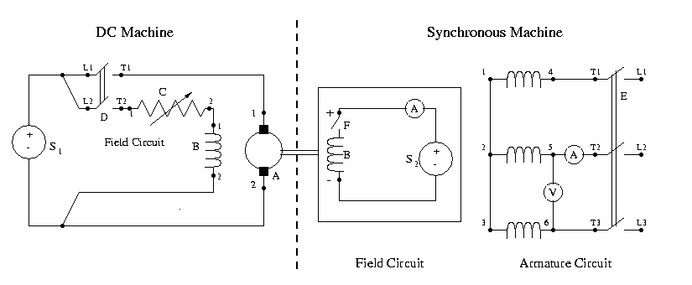
Lab 3 & 4 Setup
We use a DC machine (which is speed controllable) to drive a synchronous generator. In lab 4 we do open-circuit and short-circuit tests to determine its parameters
In the experiment you measure line-to-line values, which are sqrt(3) times the line-to-neutral values

Slide 24
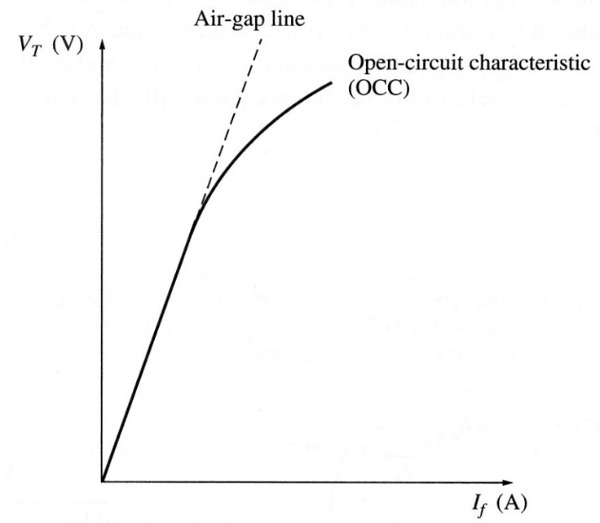
Open-Circuit Characteristic (OCC)
The open-circuit characteristic (OCC) can be derived by gradually changing the field current when operating at a fixed frequency (e.g., synchronous speed)
Hysteresis needs to be considered when making field current adjustments
Because there is no stator current, the internal voltage can be directly measured at the terminals
We’ll be using phasor values here

Slide 25
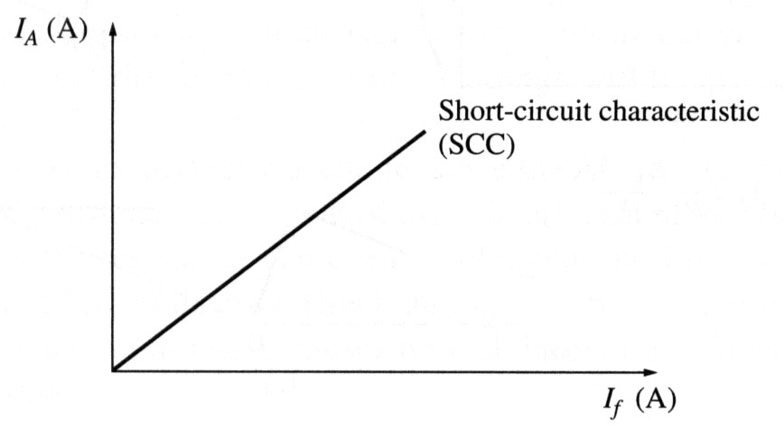
Short-Circuit Test
The short-circuit characteristic measures the relationship between the field current and the terminal current
With the model we get
Since usually XS >> RA, so
This curve is almost linear since there is little saturation because the fluxes in the machine tend to cancel.

Slide 26
Short-Circuit Test, Cont.
However, in doing this test we cannot directly measure EA and of course the terminal voltage is now zero during the short-circuit.
One approach is to approximate it as

Slide 27
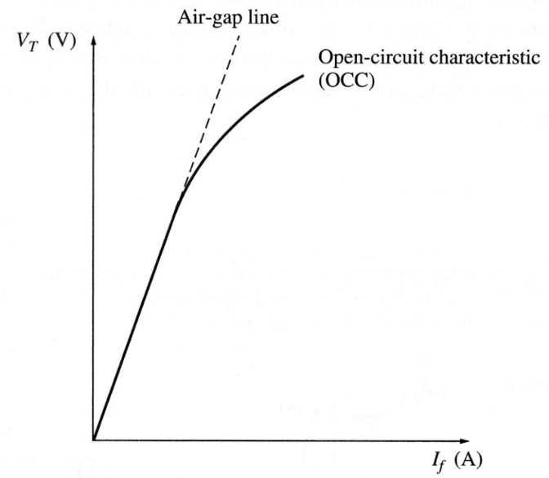
Short-Circuit Test, Cont.
This approach is accurate up to the point of saturation. An alternative approach is to substitute the equivalent air-gap voltage instead of the VOCC value.
This is commonly called the unsaturated synchronous reactance, Xu
The amount of saturation depends on loading; in large generators saturation is explicitly modeled

Slide 28
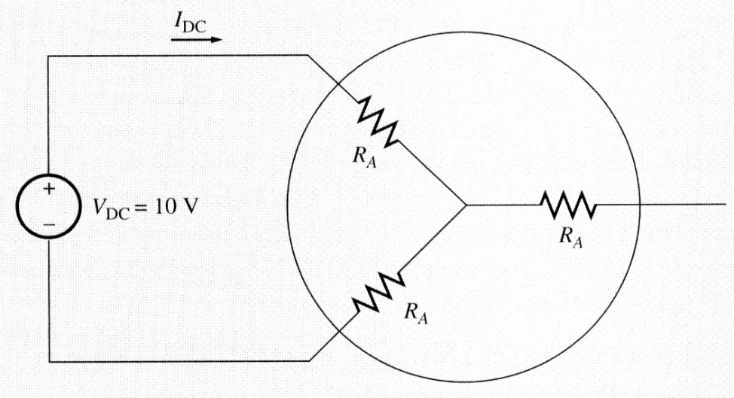
Measuring RA
The winding resistance can be calculated at standstill by applying a small dc voltage to two of the terminals, and then measuring the dc current
Or one could just use an ohmmeter

Slide 29
Operating Synchronous Machines Under Load
We’ve seen that the terminal voltage of a synchronous machine can be controlled by adjusting its field voltage (and hence field current)
Large generators have a number of automatic control systems, including one called an exciter to keep the terminal voltage or other voltage at a specified value
Small machines might operate with a constant field current
$$R_{A}+jX_{S}$$
$$E_{A}$$

Slide 30
Operating Synchronous Machines Under Load with a Constant Field
If the field voltage and hence field current are assumed constant, and the speed is assumed constant (which in practice would be controlled by a governor), then the internal voltage can be assumed to be constant
How the voltage varies with loading is then given by
$$R_{A}+jX_{S}$$
$$E_{A}$$

Slide 31
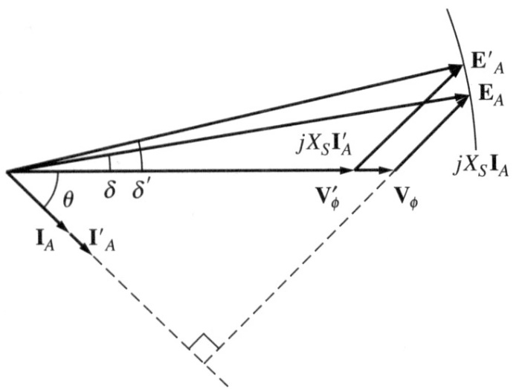
Operating Synchronous Machines Under Load with a Constant Field
To help gain insight, we’ll neglect the usually small RA so then
Arbitrarily we can set the angle of VT to zero
If the load has a lagging power factor then internal voltage magnitude is higher
If leading pf then internal voltage is lower than the terminal voltage

Slide 32
Operating Synchronous Machines Under Load with a Constant Field
With $R_{A}$ neglected, the power out of the machine is given by
$δ$ is called the torque angle; in general, it is the angle difference between the internal voltage angle and the terminal voltage angle

Slide 33
Example
A 200 kVA, 480 V (line-to-line), 60 Hz, Y-connected generator with a rated field voltage of 5A was tested with the following results
VT,LL = 540 V at rated field current
IA,SC = 300 A at rated field current
When disconnected, a dc voltage of 10 V is applied to two of the terminals, giving a current of 25 A
Find the model

Slide 34
Example, Cont.
The internal, per phase voltage is
The synchronous reactance at the rated field current is
If we wished to include the impact of RA it would be

Slide 35
Example, Cont.
Now assume a three-phase, wye-connected load is attached to its terminal with Z = 4∠20° Ω. The field current is adjusted so the line-to-line terminal voltage is 480 V and the generator is operated at 60 Hz. What is the internal voltage, and what is the total power delivered to the load? Use XS = 1.04 Ω. Then repeat with Z = 4∠-20° Ω.

Slide 36
Example, Cont.
With Z = 4∠20° Ω
With Z = 4∠-20° Ω

Slide 37
DC Machines
Prior to widespread use of machine drives, dc motors had an important advantage of easy speed control
Example is a model railroad
On the stator a dc machine has either a permanent magnet or a single concentrated winding
With winding field voltage is Vf and field current is If
Rotor (armature) currents are supplied through brushes and commutator

Slide 38
DC Machines
If there is a field winding (i.e., not a permanent magnet machine) then the machine could be connected in the following ways
Separately-excited: Field and armature windings are connected to separate power sources
For an exciter, control is provided by varying the field current (which is stationary), which changes the armature voltage
Series-excited: Field and armature windings are in series
Shunt-excited: Field and armature windings are in parallel

Slide 39
DC Machines
In a machine with a field winding the equations are
In steady-state these can be simplified to
In a shunt-connected machine, VT = VF so
G is a machine constant, w_{m} is its speed

