Slide 1
ECEN 615, Fall 2023 Methods of Electric Power System Analysis
Class 24: Power System Restoration
Prof. Adam Birchfield
Dept. of Electrical and Computer Engineering
Texas A&M University
abirchfield@tamu.edu

Slide 2
Power System Restoration
Power system restoration or black start (or blackstart)
A procedure to restore power in the event of a partial or total shutdown of the power system
A highly complex decision problem
Object is to serve the load as soon as possible without violating operating constraints
Actions are time critical
Primarily manual work by operators
Offline restoration planning usually based on simulations

Slide 3
Power System Restoration
Common characteristics of restoration (even though strategies are different)
Immediate resupply of station service
Time consuming nature of switching operation
Start-up timings of thermal units
Voltage rise problems of energizing unloaded transmission lines
Frequency response of prime movers to a sudden load pickup
Cold load inrush, power factors and coincident demand factors

Slide 4
System Restoration Efforts - IEEE
After 1977 New York City blackout, DOE required operating companies to develop a power system restoration plan, train personnel, regularly update and maintain the plan.
In response to this requirement in 1978, the Power System Operation Committee established the Power System Restoration (PSR) Task Force (TF) within the System Operation Subcommittee of the Power System Engineering Committee.
A few years later, the PSR TF was upgraded to PSR working group (WG)

Slide 5
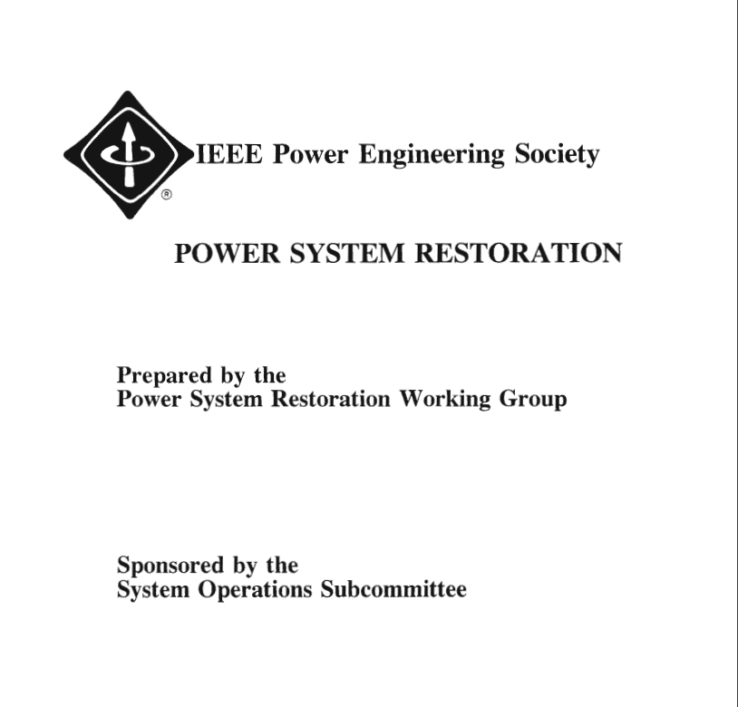
System Restoration Efforts - IEEE
In 1993 a 110 page brochure was prepared by PSR WG and published by the IEEE PES
Includes:
14 IEEE Committee Reports
5 SRWG member papers in IEEE publication
13 related IEEE transaction papers

Slide 6
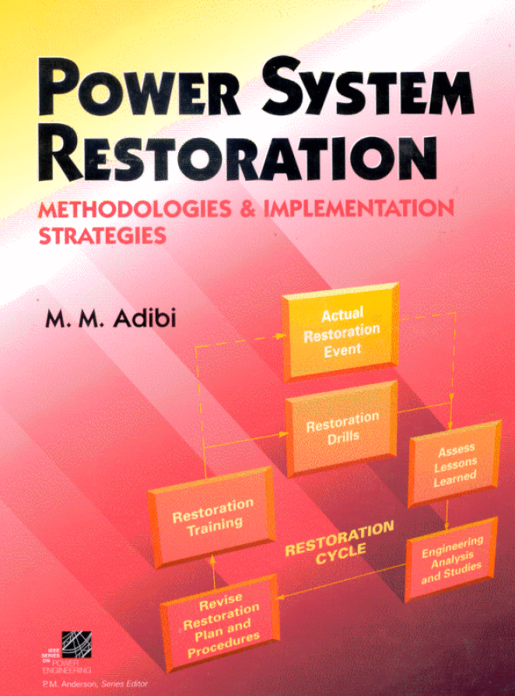
System Restoration Efforts - IEEE
In 2000 a 700 page book was prepared by PSRWG and published by Wiley-IEEE Press
Includes 87 papers including 14 papers in the original 1993 collection

Slide 7
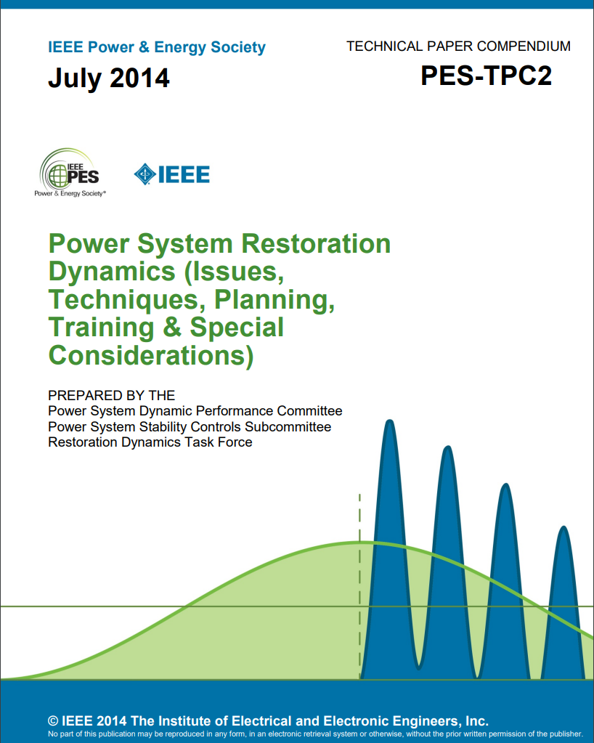
System Restoration Efforts - IEEE
In 2014 40 IEEE papers by 110 authors including 42 panelists of Restoration Dynamics Task Force
Covers:
Real power balance and control of frequency
Reactive power balance and control of voltages
Critical tasks (time sensitive functions)
Analyses and simulations

Slide 8
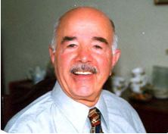
Mahmood Mike Adibi (1924 – 2018)
Key contributor to power system restoration
B.S.E. in 1950 from University of Birmingham, U.K.
M.S.E in 1960 from Polytech Institute of Brooklyn, NY
IEEE Life Fellow
Founder and chairman of the IEEE System Restoration Working Group in 1979
Author of the book, “Power System Restoration – Methodologies and Implementation Strategies”
A great review book of IEEE papers between 1987 and 1999
Developed restoration plans for over a dozen utilities

Slide 9
Other Good References
PJM Manual 36: System Restoration
EPRI, “Development of Power System Restoration Tool Based on Generic Restoration Milestones,” 2010.
PSERC, “Development and Evaluation of System Restoration Strategies from a Blackout,” 2009.
IESO, “Part 7.8: Ontario Power System Restoration Plan,” 2017.
K. Sun et al., “Power System Control Under Cascading Failures: Understanding, Mitigation, and System Restoration,” Wiley-IEEE Press. 2019.
Yutian Liu, Rui Fan, and Vladimir Terzija, “Power system restoration: a literature review from 2006 to 2016,” J. Mod. Power Syst. Clean Energy, 2016, 4(3), pp. 332-341
PNNL, “Electric grid blackstart: Trends, challenges, and opportunities,” October 2020.

Slide 10
NERC Standards on Restoration
NERC System Restoration and Black Start standards
EOP-005-2 & EOP-005-3
System Restoration from Black Start Resources
Ensure plans, Facilities, and personnel are prepared to enable System restoration from Black Start Resources to assure reliability is maintained during restoration and priority is placed on restoring the Interconnection
EOP-006-2 & EOP-006-3
System Restoration Coordination
Ensure plans are established and personnel are prepared to enable effective coordination of the System restoration process to ensure reliability is maintained during restoration and priority is placed on restoring the Interconnection.

Slide 11
Common Issues During Restoration
Active power balance and frequency control
Need to maintain system frequency within limits by system stability and protection settings
Can be accomplished by picking up loads in increments
Reactive power balance and overvoltage control
Energizing few high voltage lines
Operating generators at minimum voltage levels
Deactivating switched shunt capacitors
Connecting shunt reactors
Adjusting transformer taps
Picking up reactive loads

Slide 12
Common Issues During Restoration
Transient switching voltages
Switching surges occur when energizing equipment
Self-excitation
When the charging current is high relative to the size of generators
When opening a line at the sending end but leaving the line connected to a large motor
This causes overvoltage and damages equipment
Cold load pickup
When load has been de-energized for several hours or more
Inrush current can be as high as 8 – 10 times of the normal value

Slide 13
Common Issues During Restoration
System stability
Voltage should be within limits
Angle stability have to be maintained
Frequency is the main issue in stability assessment
Protective systems and load control
Continuous change in system configuration and in operating conditions may trigger undesirable operation of relays
Load shedding can be useful in case of low frequency conditions

Slide 14
Common Issues During Restoration
Partitioning system into islands
Necessary to speed up the process, especially for large systems
NERC standards
Each islands must have sufficient black start capability
Each islands should have enough cranking paths to gens and loads
Each islands should be able to match generation and load within prescribed frequency limits
Each islands should have adequate voltage controls
All tie points must be capable of synchronization with adjacent subsystems
All islands should share information with other islands

Slide 15
Generic Restoration Steps
Preparation stage (1–2 hours)
Evaluate pre- and post-disturbance conditions
Define the target system
Restart generators and rebuild transmission network
System restoration stage (3–4 hours)
Energize transmission paths
Restore load to stabilize generation and voltage
Synchronize islands and reintegrate bulk power system
Load restoration stage (8–10 hours)
Load restoration is the governing control objective
Load pickup is scheduled based on generation availability
Load restoration is effected in increasingly larger steps

Slide 16
System Restoration Tasks
Know the status of the grid
List and rank critical loads by priority
List and rank initial sources of power by availability
Maximize generation capabilities with the available black start resources
Determine the most effective ways of brining the two together
Schedule tasks and resources during restoration
Establish transmission capability and paths while meeting operating constraints

Slide 17
Initial Power and Load
Initial source of power
Initial critical loads
Type | Time (min) | Success probability
Run-of-the-River Hydro | 5-10 | High
Pump-Storage Hydro | 5-10 | High
Combustion Turbine | 5-15 | Medium
Tie-line with Adjacent Systems | Short
Type | Priorities
Cranking drum-type units | High
Pipe-type cables pumping plants | High
Transmission stations | High to Medium depending on location
Distribution stations | High to Medium depending on location
Industrial loads | Medium to low

Slide 18
End-of-Semester Feedback
Please fill out your end-of-semester feedback if you haven't already!
End-of-semester student survey is used by instructors, TAs, ECEN department, College of Engineering, and the university for improving this course
We greatly value your feedback!
There is no grade associated with any of the student surveys
tamu.aefis.net

