Slide 1
ECEN 615, Fall 2023
Methods of Electric Power System Analysis
Class 23: Synthetic Electric Grids
Prof. Adam Birchfield
Dept. of Electrical and Computer Engineering
Texas A&M University
abirchfield@tamu.edu

Slide 2
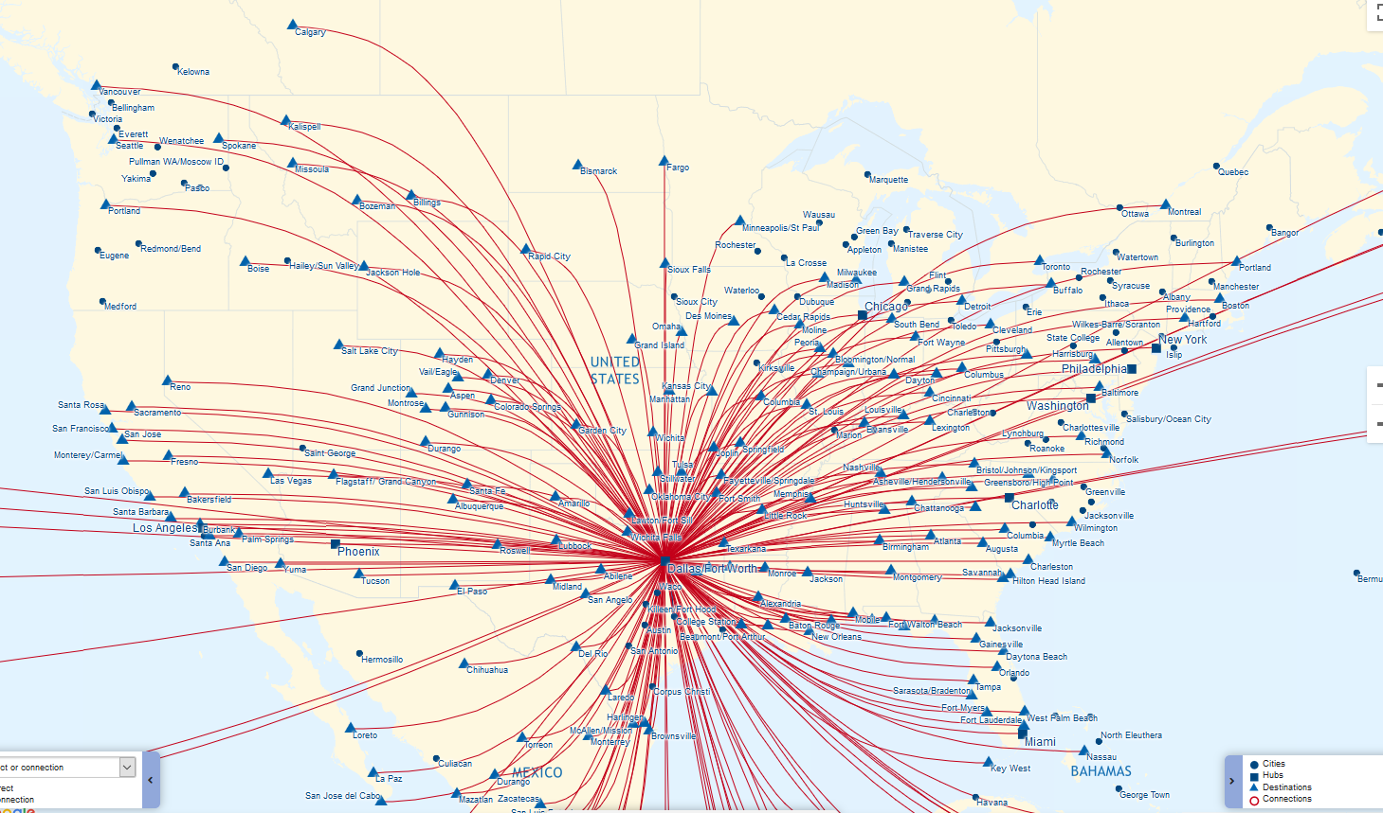
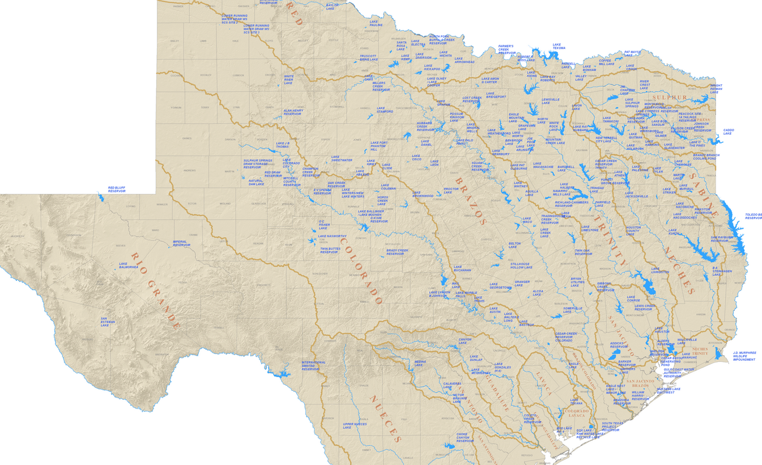
Real-World Complex Networks
A complex network is a large graph: collection of nodes (vertices) connected by links (edges) that represents some real-world system of interactions
Examples: Interstate highways, movie co-stars, brain neurons, water drainage, Facebook, airline routes, the internet, the power grid
Aspects of network structure provide insight for assessing system resilience and designing for greater robustness and efficiency.
For each type of network, what network characteristics or metrics do they have in common with other types, and what characteristics are unique? What sort of network is the power grid?
Sources: American Airlines, Texas Water Development Board

Slide 3
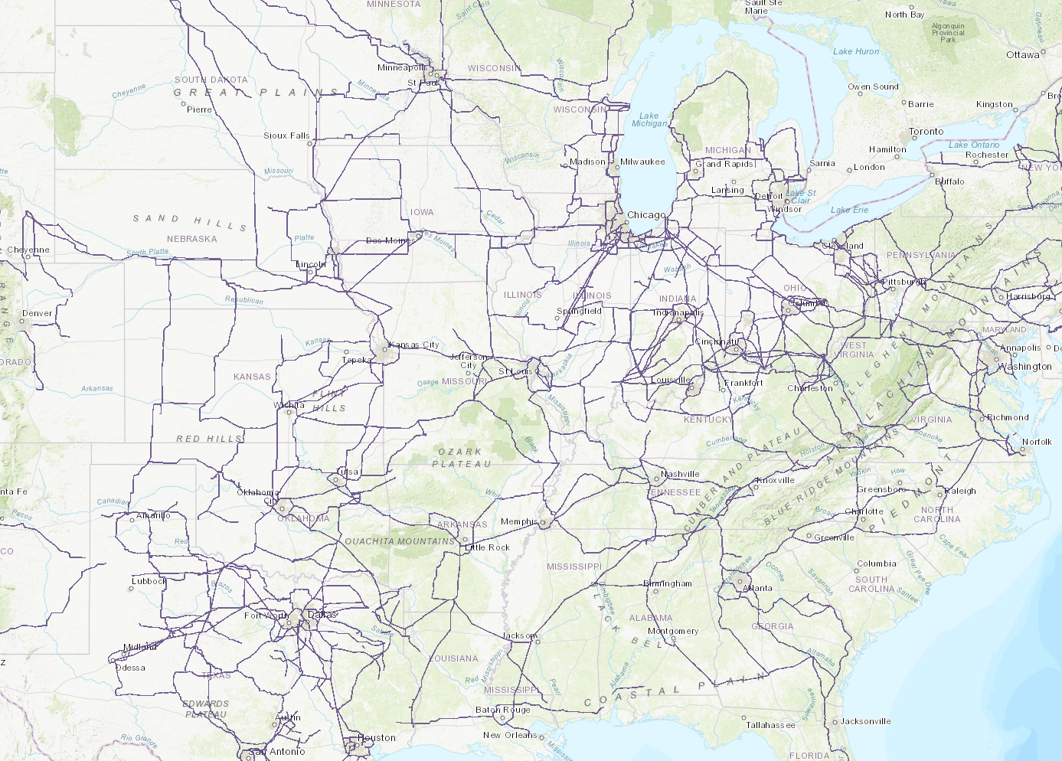
The U.S. Electric Grid Network
Vertices: electric substations or circuit nodes/buses
Edges: transmission lines, transformers
Intuitive characteristics:
  Carefully designed
  Interconnected
  Geographically constrained
  Multi-level (MV, HV and EHV)
  Robust to contingent outages
Source: EIA

Slide 4

Modeling Considerations
Power grid statistics can be contradictory in the complex network literature
Some explanations for this:
  Different data sources and the fact that electric grids in different places have different design practices—not all electric grids are alike
  Modeling decisions: substation-line, bus-branch, node-breaker
To avoid these issues, in this presentation we look primarily at substation-line topologies
1 vertex, 4 edges, average degree 4
2 vertices, 5 edges, average degree 3
A. B. Birchfield and T. J. Overbye, "Planning sensitivities for building contingency robustness and graph properties into large synthetic grids," HICSS, Jan. 2020.
20 vertices, 23 edges, average degree 2.1

Slide 5
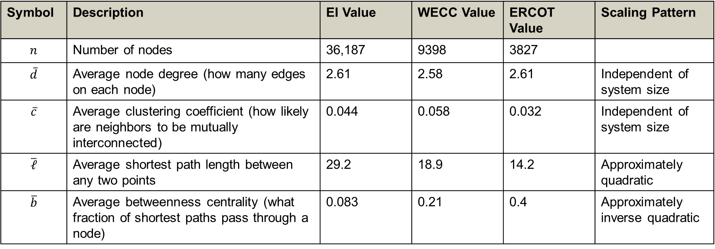
Some Complex Network Properties
Symbol | Description | EI Value | WECC Value | ERCOT Value | Scaling Pattern
$$n$$ | Number of nodes | 36,187 | 9398 | 3827
$$\overline{d}$$ | Average node degree (how many edges on each node) | 2.61 | 2.58 | 2.61 | Independent of system size
$$\overline{c}$$ | Average clustering coefficient (how likely are neighbors to be mutually interconnected) | 0.044 | 0.058 | 0.032 | Independent of system size
$$\overline{ℓ}$$ | Average shortest path length between any two points | 29.2 | 18.9 | 14.2 | Approximately quadratic
$$\overline{b}$$ | Average betweenness centrality (what fraction of shortest paths pass through a node) | 0.083 | 0.21 | 0.4 | Approximately inverse quadratic

Slide 6
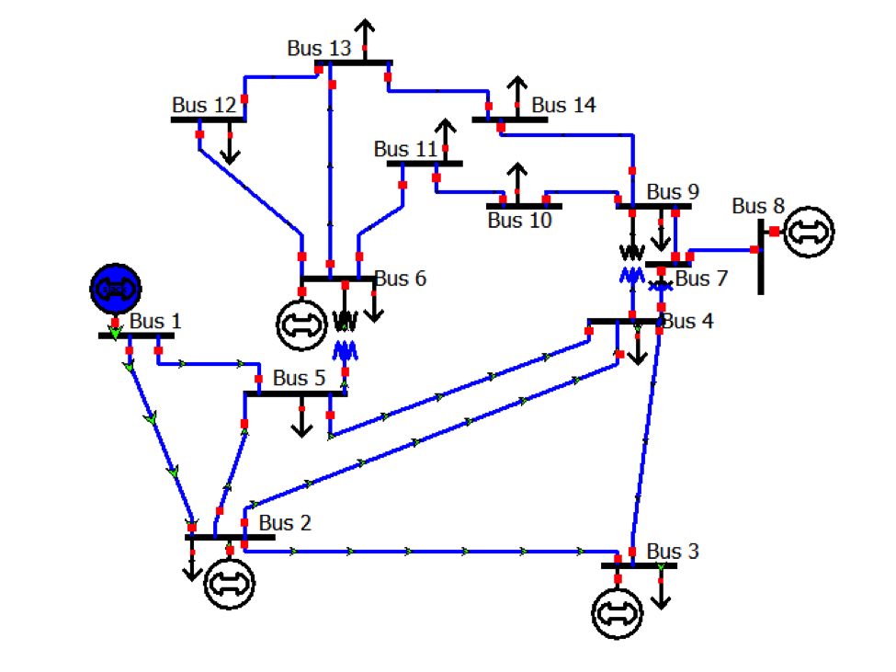
Application to Building Synthetic Grids
One application of collecting complex network characteristics of electric grids is to reproduce these properties in synthetic grids.
Power grid data is critical energy infrastructure information (CEII)
Existing test cases—prior to synthetic grids—are small, simple, and outdated
Goal of building synthetic power grids is to drive innovation by providing test cases that are large, complex, realistic, and fully public.
Some existing test cases, such as the IEEE 14-bus (pictured) and 118-bus case, despite their popularity, are known to vary significantly from actual grids.

Slide 7
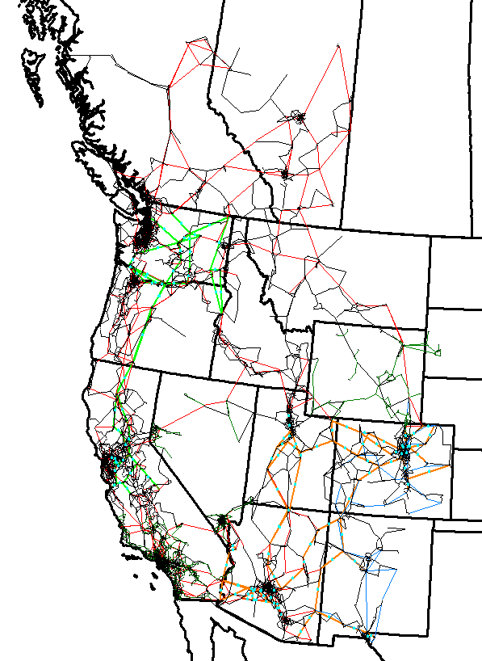
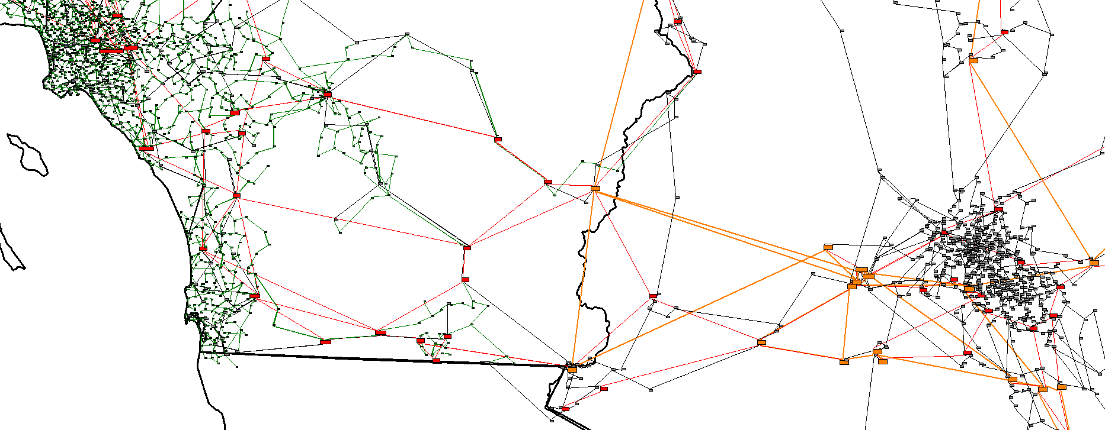
Recent Progress in Building Synthetic Electric Grids
Large: This case is 20,000 buses, similar to the actual Western Interconnect (WECC)
Complex: Multiple interacting voltage levels, remote regulation, capacitors, taps
Realistic: Matching a large suite of validation metrics against actual systems
Fully public: It does not correspond to any actual grid or contain any confidential information

Slide 8
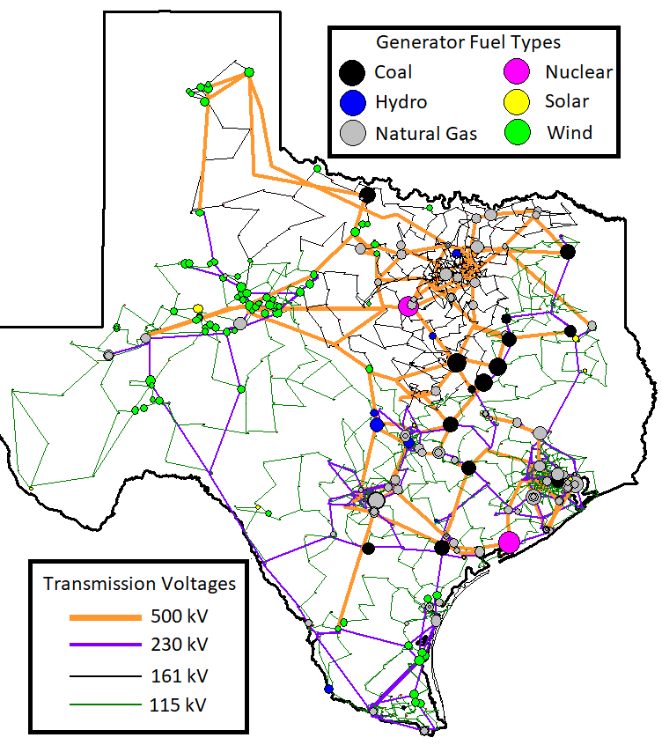
Creation of Synthetic Grids Overview
Substation Planning
  Start with public data for generation, load
  Cluster substations, add buses, transformers
Transmission Planning
  Place lines and transformers
  Iterative dc power flow algorithm
  Match topological, geographic metrics
  Contingency overload sensitivity
Reactive Power Planning
  Power flow solution (ac), voltage control devices
Extensions
  Transient stability, geomagnetic disturbances, single-line diagrams, optimal power flow (OPF), time series scenarios, interactive simulations, …
2000-bus synthetic grid on the Texas footprint

Slide 9
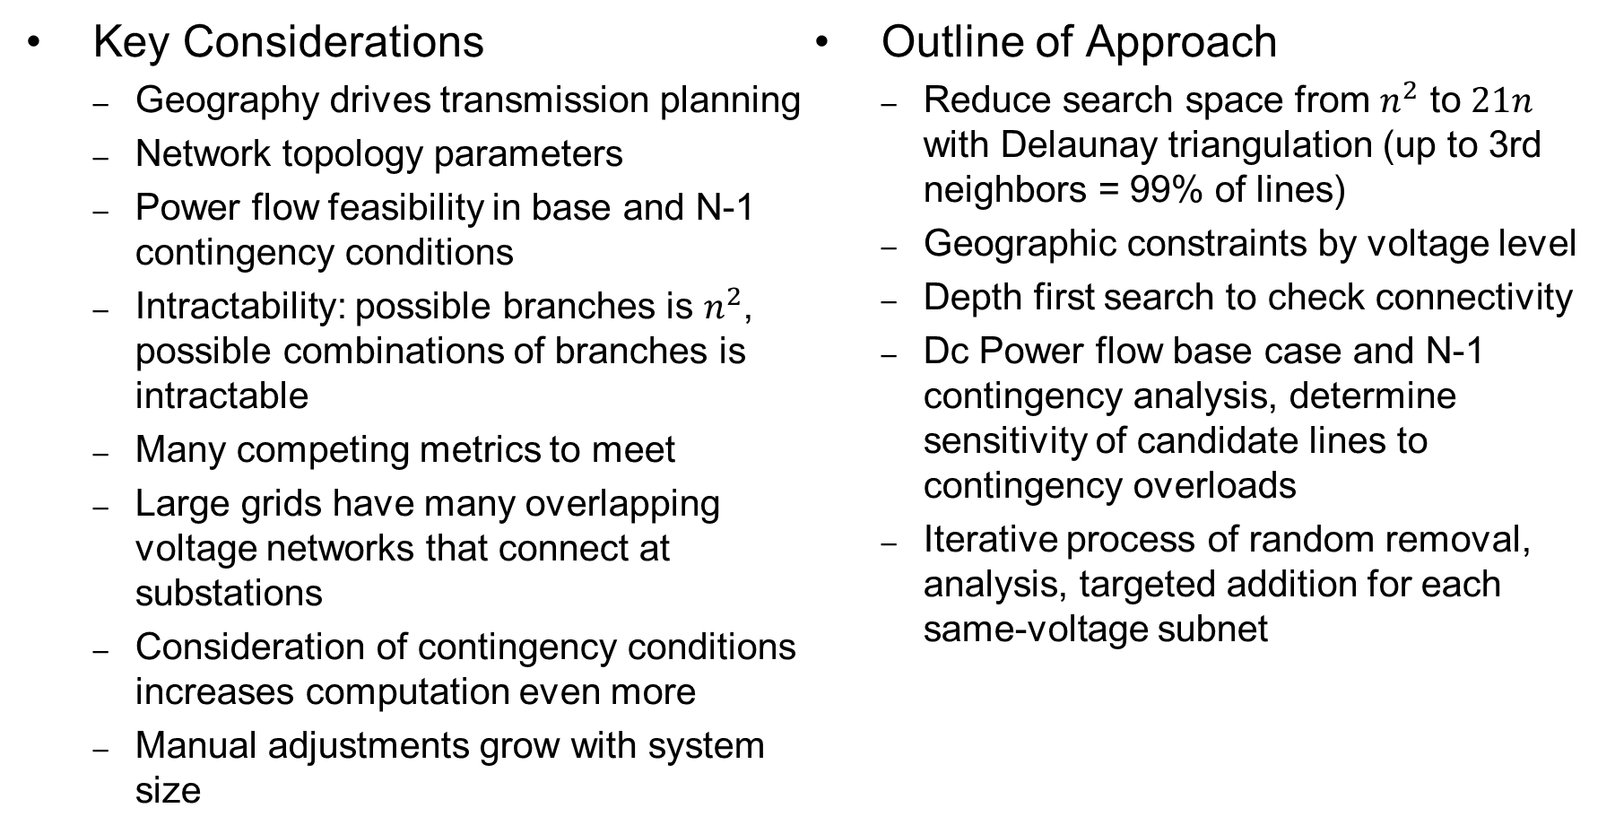
Transmission Planning Approach
Key Considerations
  Geography drives transmission planning
  Network topology parameters
  Power flow feasibility in base and N-1 contingency conditions
  Intractability: possible branches is $n^{2}$, possible combinations of branches is intractable
  Many competing metrics to meet
  Large grids have many overlapping voltage networks that connect at substations
  Consideration of contingency conditions increases computation even more
  Manual adjustments grow with system size
Outline of Approach
  Reduce search space from $n^{2}$ to $21n$ with Delaunay triangulation (up to 3rd neighbors = 99% of lines)
  Geographic constraints by voltage level
  Depth first search to check connectivity
  Dc Power flow base case and N-1 contingency analysis, determine sensitivity of candidate lines to contingency overloads
  Iterative process of random removal, analysis, targeted addition for each same-voltage subnet

Slide 10
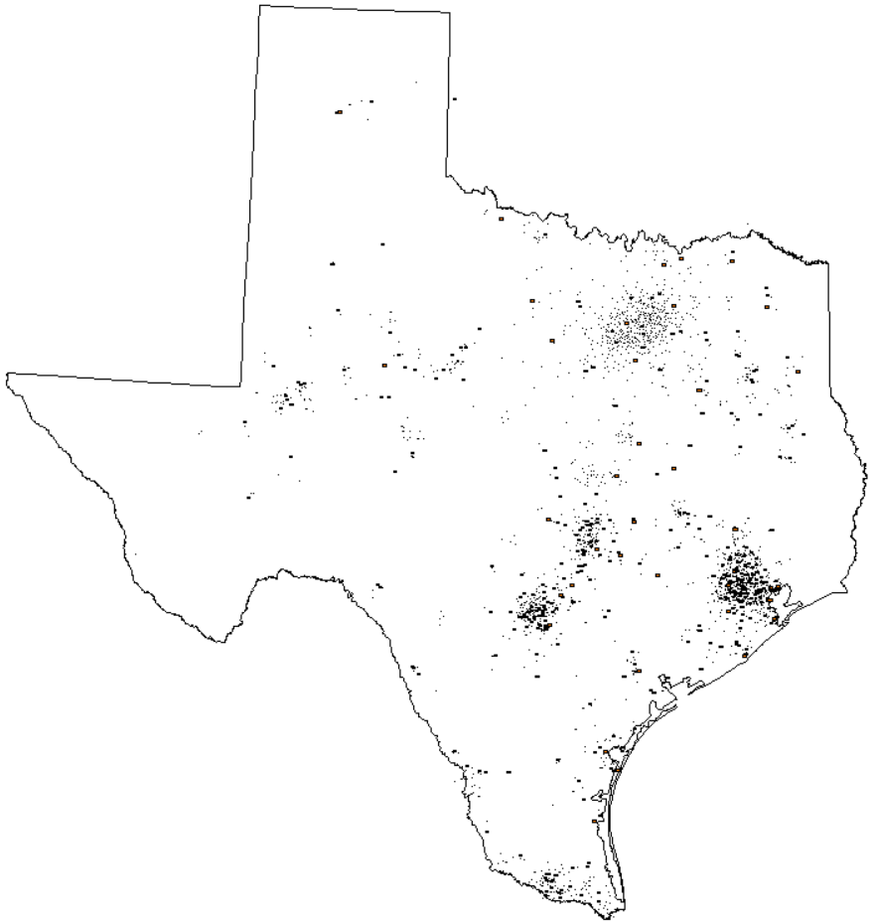
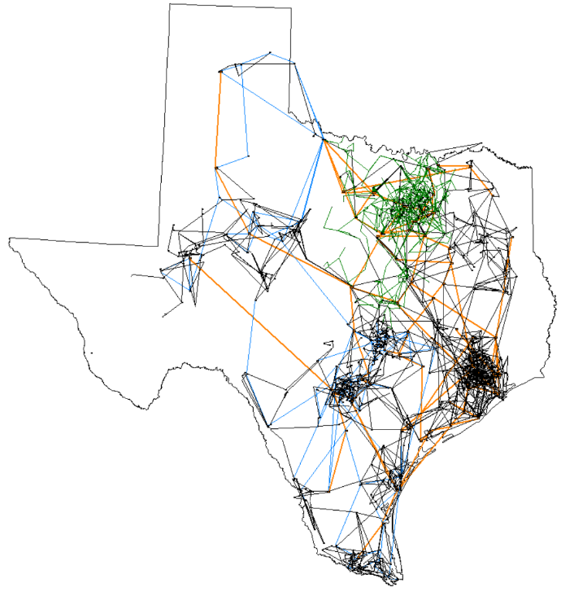
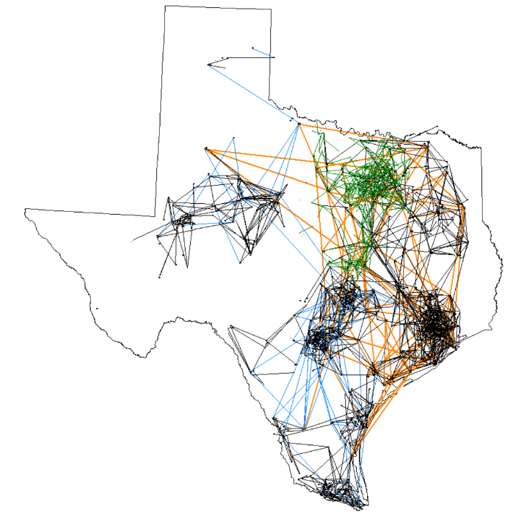
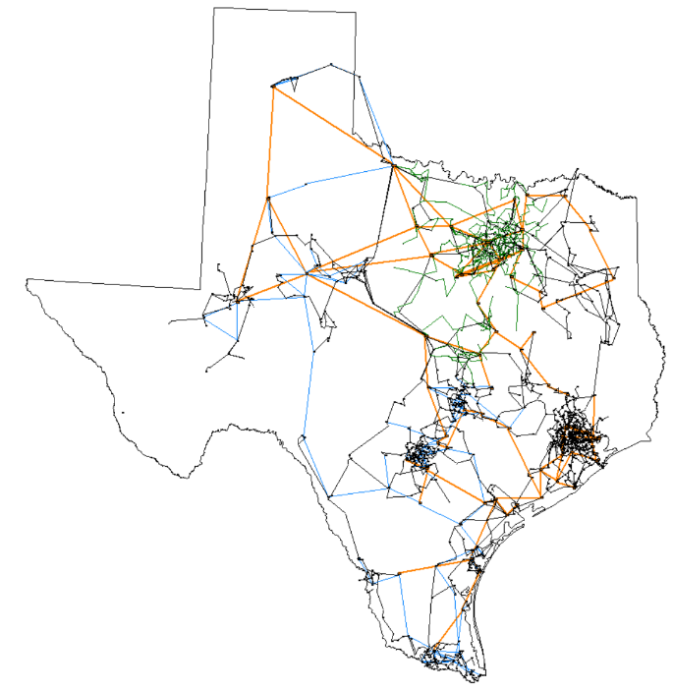
Stages of Transmission Planning Process
(1) The starting point is the geographic placement of substations
(3) After 100 iterations of random removal followed by targeted addition, the grid begins to match more geographic and reliability constraints
(2) The grid is initialized with a random subset of 1.2n of the 21n candidate transmission lines
(4) After 10,000 iterations, nearly all reliability and geographic constraints are met together.

Slide 11
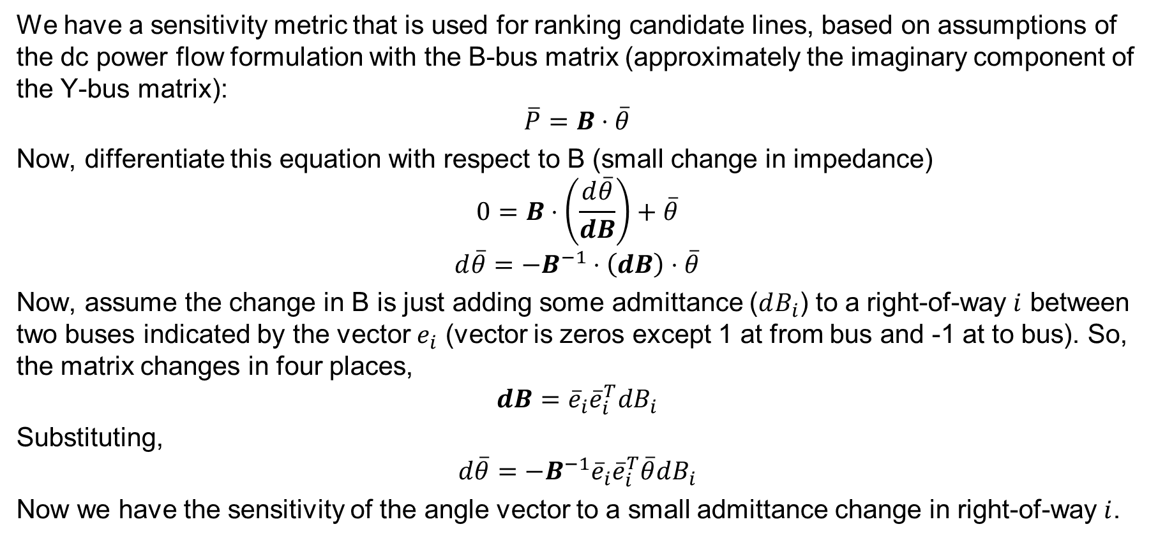
N-1 Security Planning Sensitivity Calculations
We have a sensitivity metric that is used for ranking candidate lines, based on assumptions of the dc power flow formulation with the B-bus matrix (approximately the imaginary component of the Y-bus matrix):
$$\overline{P}=B⋅\overline{θ}$$
Now, differentiate this equation with respect to B (small change in impedance)
$$0=B⋅\left(\frac{d\overline{θ}}{dB}\right)+\overline{θ}$$
$$d\overline{θ}=−B^{−1}⋅\left(dB\right)⋅\overline{θ}$$
Now, assume the change in B is just adding some admittance ($dB_{i}$) to a right-of-way $i$ between two buses indicated by the vector $e_{i}$ (vector is zeros except 1 at from bus and -1 at to bus). So, the matrix changes in four places,
$$dB={\overline{e}}_{i}{\overline{e}}_{i}^{T}dB_{i}$$
Substituting,
$$d\overline{θ}=−B^{−1}{\overline{e}}_{i}{\overline{e}}_{i}^{T}\overline{θ}dB_{i}$$
Now we have the sensitivity of the angle vector to a small admittance change in right-of-way $i$.

Slide 12
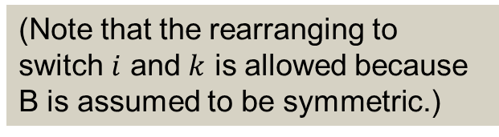
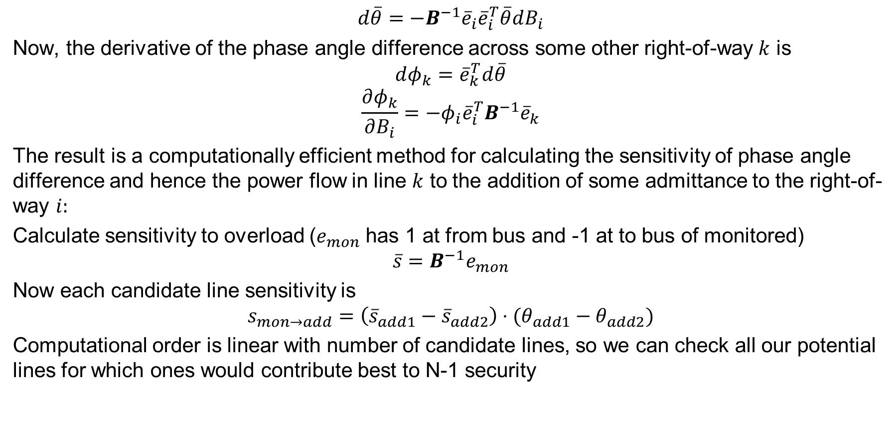
N-1 Security Planning Sensitivity Calculations, cont.
$$d\overline{θ}=−B^{−1}{\overline{e}}_{i}{\overline{e}}_{i}^{T}\overline{θ}dB_{i}$$
Now, the derivative of the phase angle difference across some other right-of-way $k$ is
$$dφ_{k}={\overline{e}}_{k}^{T}d\overline{θ}$$
$$\frac{∂φ_{k}}{∂B_{i}}=−φ_{i}{\overline{e}}_{i}^{T}B^{−1}{\overline{e}}_{k}$$
The result is a computationally efficient method for calculating the sensitivity of phase angle difference and hence the power flow in line $k$ to the addition of some admittance to the right-of-way $i:$
Calculate sensitivity to overload ($e_{mon}$ has 1 at from bus and -1 at to bus of monitored)
$$\overline{s}=B^{−1}e_{mon}$$
Now each candidate line sensitivity is
$$s_{mon→add}=\left({\overline{s}}_{add1}−{\overline{s}}_{add2}\right)⋅(θ_{add1}−θ_{add2})$$
Computational order is linear with number of candidate lines, so we can check all our potential lines for which ones would contribute best to N-1 security
(Note that the rearranging to switch $i$ and $k$ is allowed because B is assumed to be symmetric.)

Slide 13
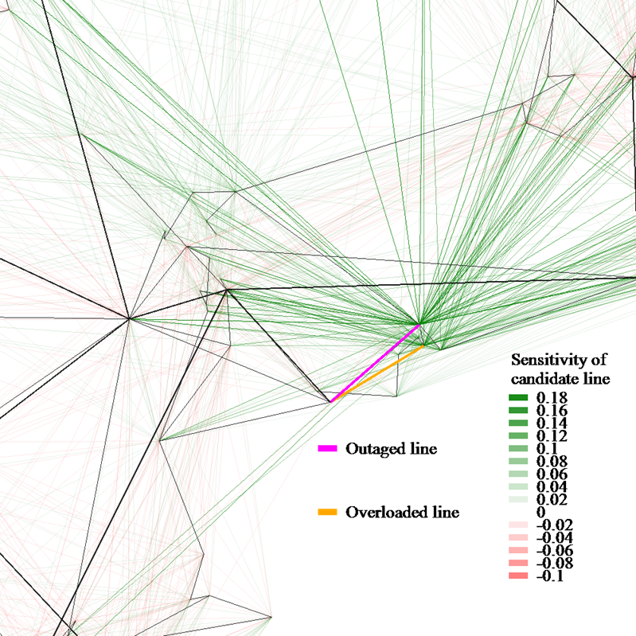
Line Sensitivity Results
This is part-way through the transmission grid creation process
Black lines are currently in the network
We're focusing on a contingency of the magenta line causing an overload in the orange line
Possible candidates are shown in red, gray, and green
The darkest green lines are the most helpful to improving this contingency outage
This metric is balanced against other considerations, such as line length

Slide 14
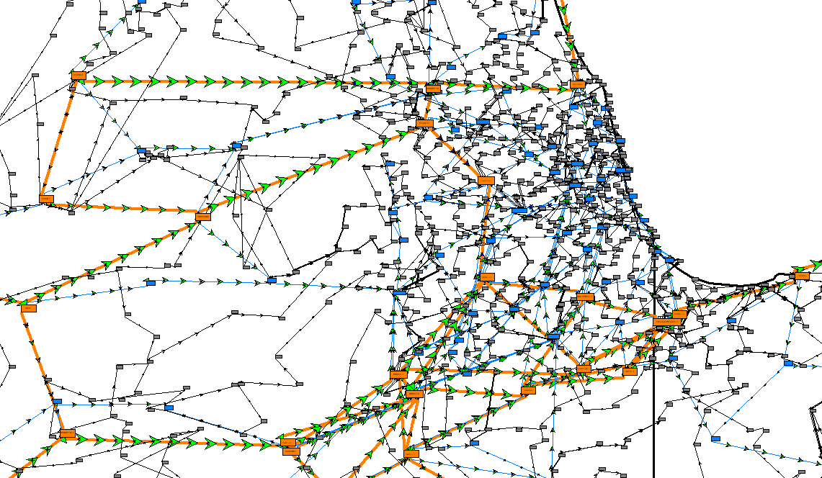
Synthetic Grid Validation
Statistics collected from 3 actual interconnects and 12 subset cases, from FERC 715 data
Because of the variety in engineering design and practice, actual grids are quite diverse
  Challenge is to capture distribution and realistic ranges
  Thresholds are set that should not be violated unless justified with an engineering design choice. Thus this is a screening process.
Categories of metrics
  Size and structure: ratio and proportions of elements
  Parameter distributions and correlation
  Topological network structure
  Power flow metrics and voltage control devices
Zoomed-in view of Chicago metro area in 70,000 bus case. Constraints include Lake Michigan and the Chicago metro area. Orange is 500 kV, blue is 230 kV, and gray is 115 kV.

Slide 15
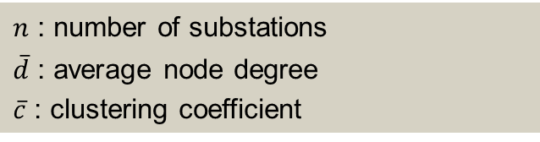
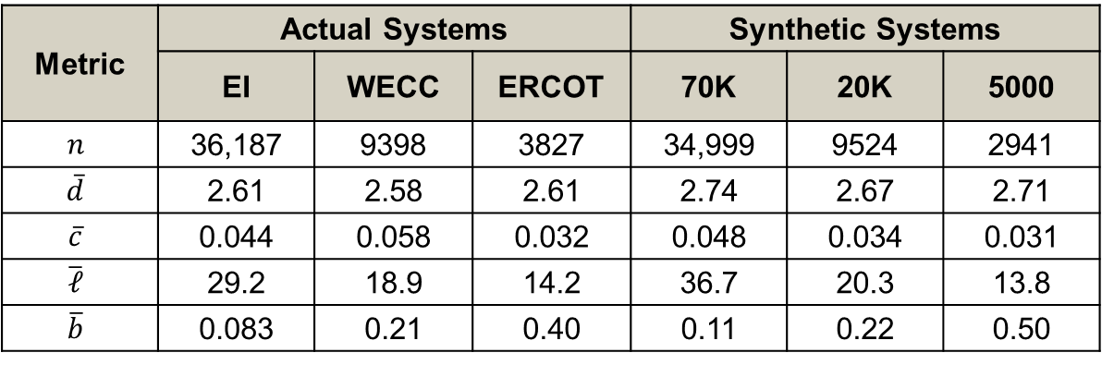
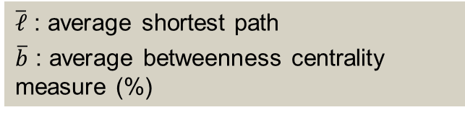
Validation Example: Complex Network Properties
Metric | Actual Systems |  |  | Synthetic Systems
 | EI | WECC | ERCOT | 70K | 20K | 5000
$$n$$ | 36,187 | 9398 | 3827 | 34,999 | 9524 | 2941
$$\overline{d}$$ | 2.61 | 2.58 | 2.61 | 2.74 | 2.67 | 2.71
$$\overline{c}$$ | 0.044 | 0.058 | 0.032 | 0.048 | 0.034 | 0.031
$$\overline{𝓁}$$ | 29.2 | 18.9 | 14.2 | 36.7 | 20.3 | 13.8
$$\overline{b}$$ | 0.083 | 0.21 | 0.40 | 0.11 | 0.22 | 0.50
$n$ : number of substations
$\overline{d}$ : average node degree
$\overline{c}$ : clustering coefficient
$\overline{ℓ}$ : average shortest path
$\overline{b}$ : average betweenness centrality measure (%)

Slide 16
Combined Transmission and Distribution Grids
TAMU + NREL project is developed down-to-the-meter synthetic grids
Parcel data is used to seed the algorithms for distribution.
This case is Travis County, Texas. We now have all of the ERCOT footprint of Texas (a MASSIVE dataset).
The figure shows the transmission system (blue is 230 kV and cyan 69 kV) and the distribution system modeled down to 307,000 meters. The distribution data is in the OpenDSS format.

Slide 17
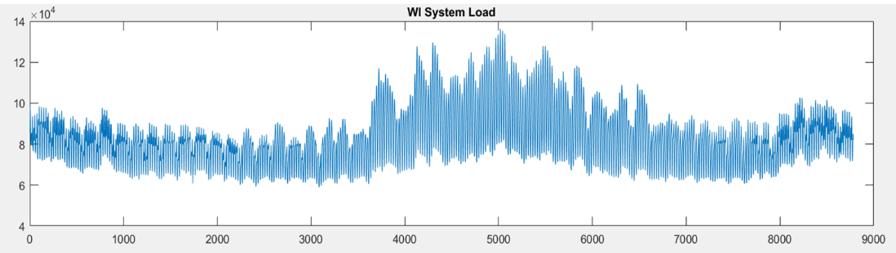
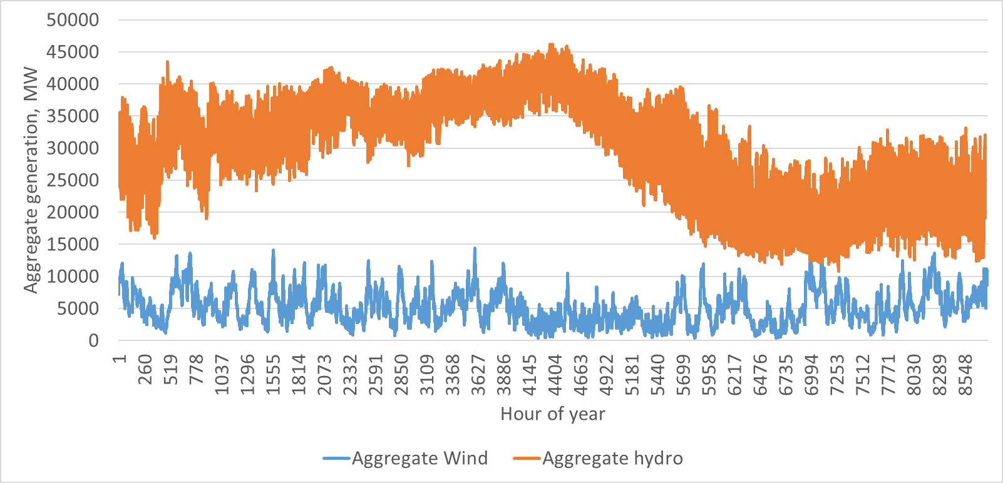
Time Series Scenarios
We have developed detailed, yearly scenarios with variation of both bus level load and gen.
Transmission models
have hourly snapshots,
with nonconforming
bus loads modeled. The
“down to the meter”
grids have synthetic
loads every 15 minutes
for each meter
(provided by NREL).

Slide 18
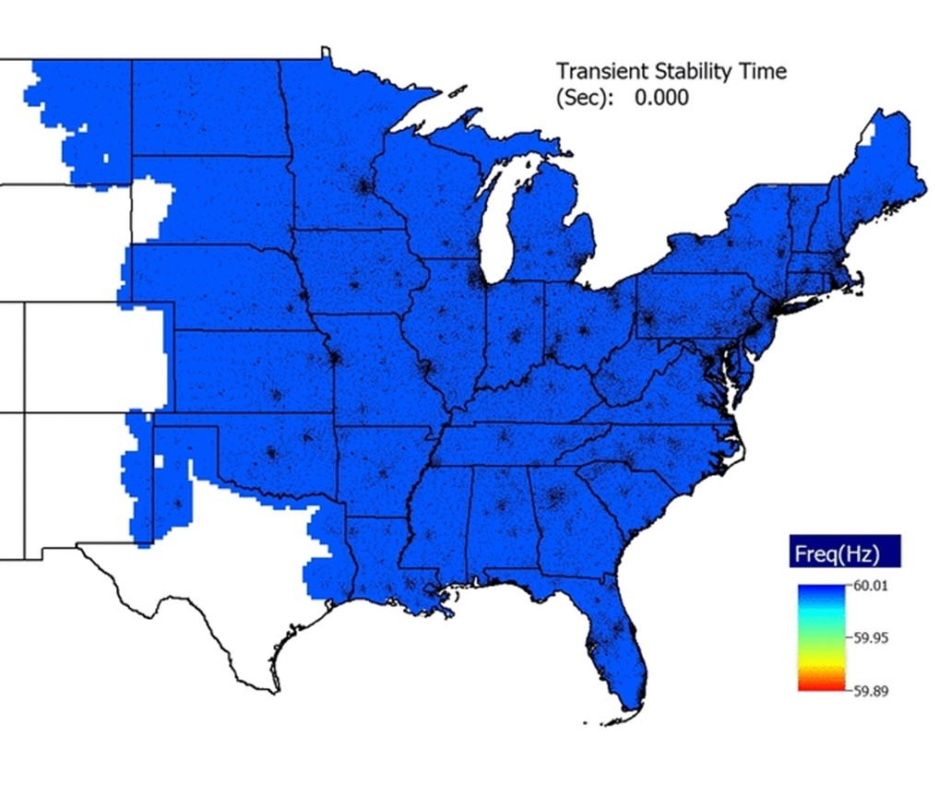
Dynamics Models
The models and all the data associated with
this image are public
Ongoing research is focused on developing more detailed
dynamic models, including the protection systems

Slide 19
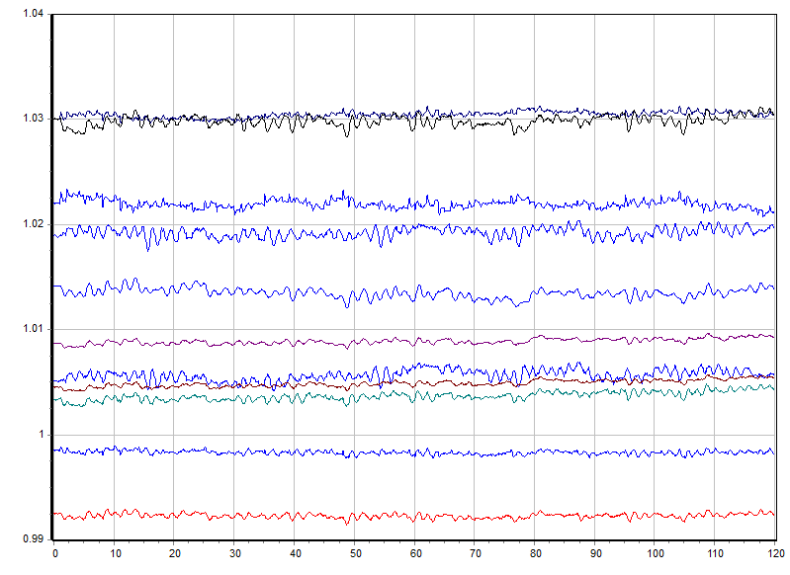
Synthetic PMU Data
To create synthetic PMU data we use dynamic simulations with realistic variation in the load and generation, and appropriate PMU errors.
On our 2000 bus Texas synthetic grid was can provide more then 10,000 signals at PMU data rates (30 times per second) in real-time. This is data creation at about 4GB per hour.

Slide 20
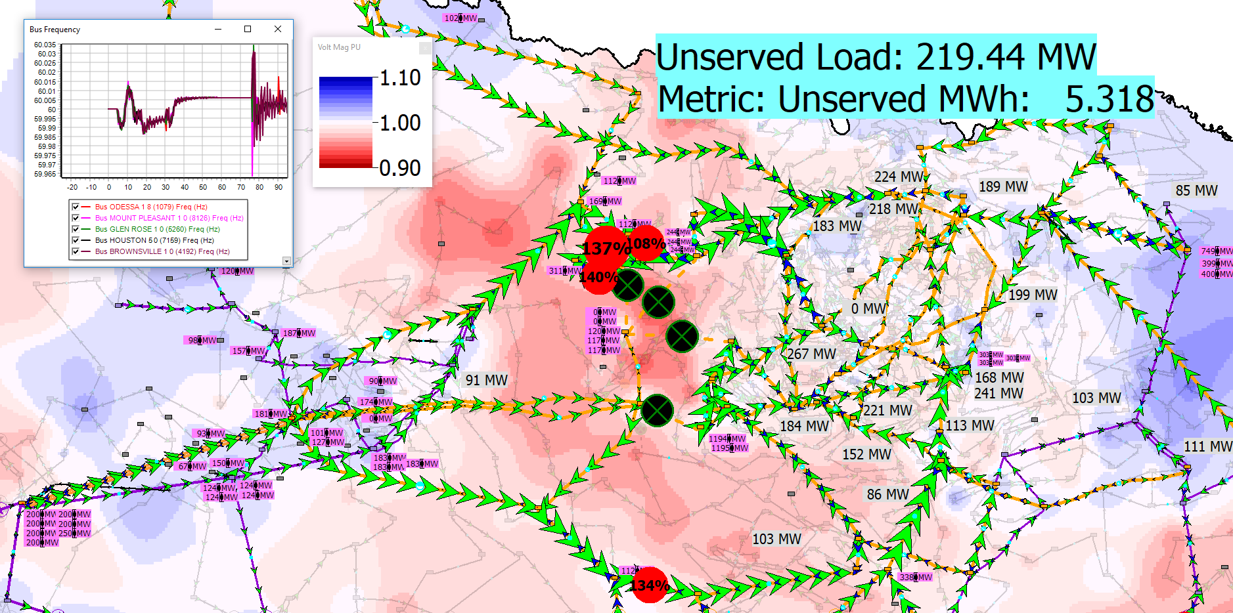
Applications: Undergraduate Education
Lab assignments involving the 2000 bus case have been integrated into Texas A&M’s ECEN 460: large-system exercises for power flow, economic dispatch, contingency analysis, SCOPF, and transient stability
Two teams of capstone design and one senior thesis
In this real-time scenario simulation, students try to save a synthetic Texas grid from voltage collapse!

Slide 21
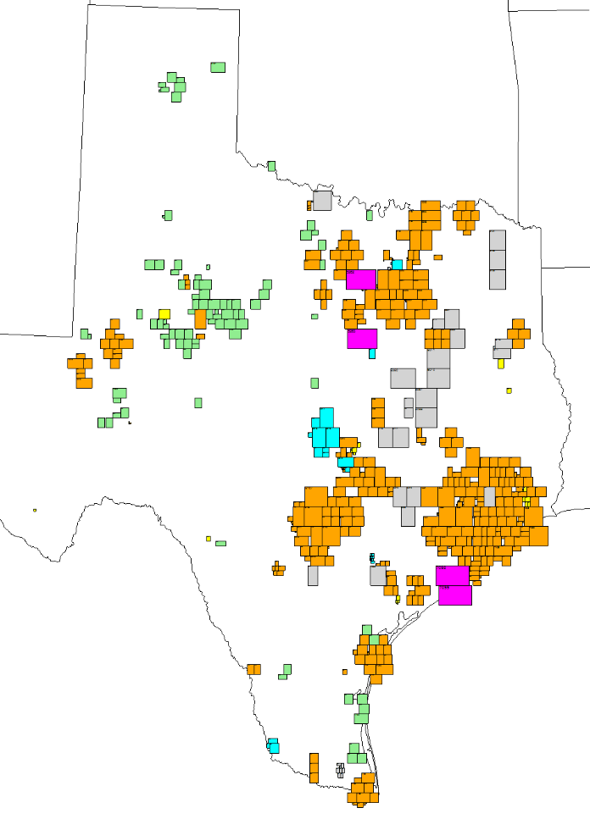
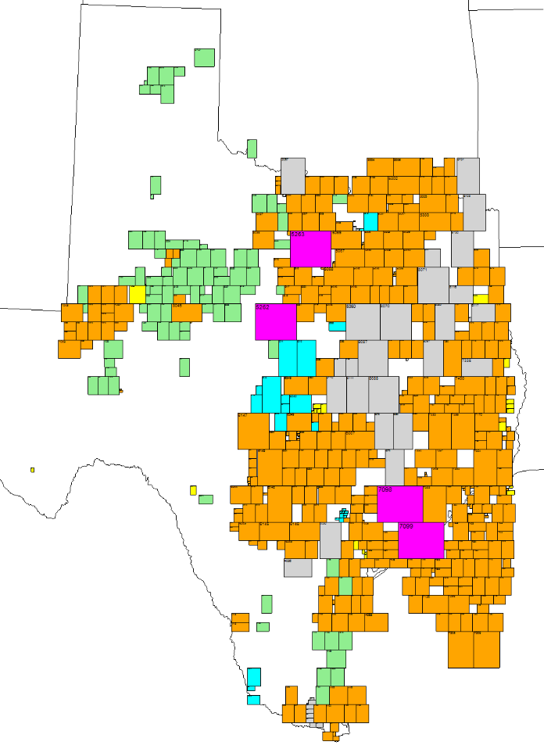
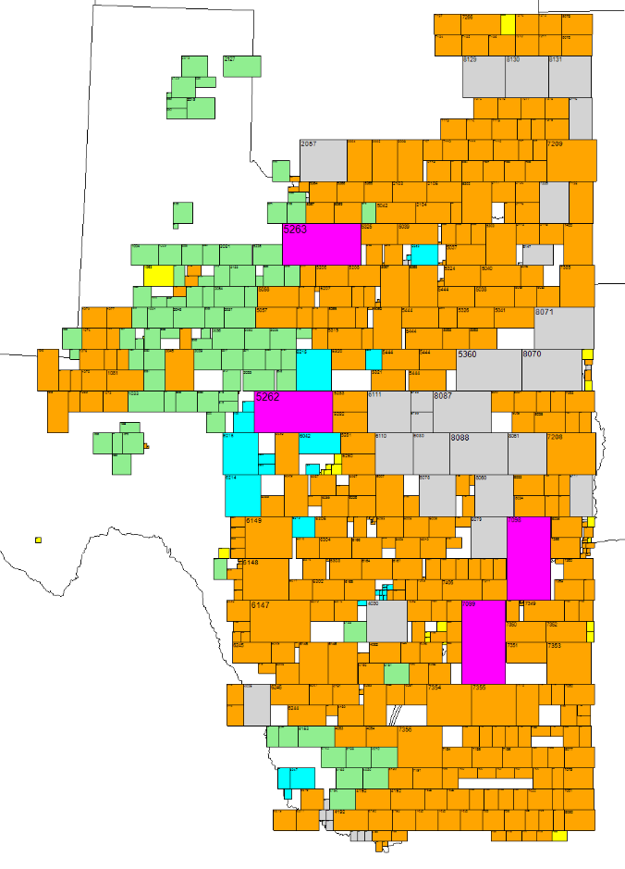
Applications: Visualization
Mosaic displays show tiles of data in a way that catches geographic context without overlapping. In this case, generators are shown by size and fuel type. New algorithms can arrange the tiles quickly at a custom scaling.
10%
30%
50%

Slide 22
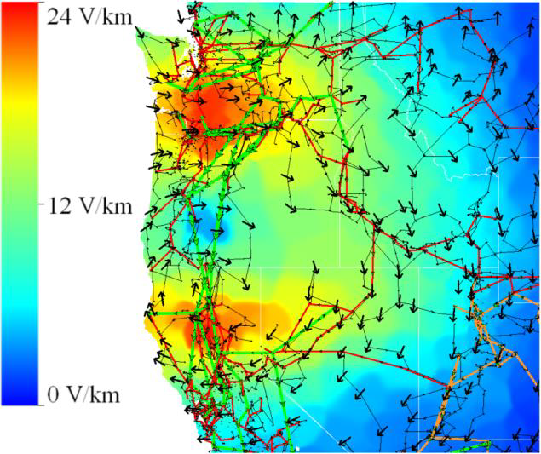
The Impact and Applications of Synthetic Grids
Test cases for power systems research
  Higher quality, larger, more complex, and more realistic than existing test cases
  Improved ability to cross-validate published research results in power systems literature
  Security for working with and publishing on sensitive research topics
Demonstration platforms without restrictions
  For teaching university students about large power grids, in lecture and lab assignments
  For showing new innovations in power systems analysis and visualization
Insights into power system structure and properties
  Crucial insights for vulnerability analysis, restoration and resilience in extreme events
R. H. Lee, et al., "Using Detailed Ground Modeling to Evaluate Electric Grid Impacts of E3 HEMP," in IEEE Transactions on Power Systems, March 2019.

Slide 23
Publications
A. B. Birchfield and T. J. Overbye, "Planning sensitivities for building contingency robustness and graph properties into large synthetic grids," Hawaii International Conference on System Sciences, Jan. 2020, pp. 1-8.
H. Li et al., "Building highly detailed synthetic electric grid data sets for combined transmission and distribution systems," in IEEE Open Access Journal of Power and Energy.
A. B. Birchfield and T. J. Overbye, "Mosaic packing to visualize large-scale electric grid data," in IEEE Open Access Journal of Power and Energy, vol. 7, pp. 212-221, 2020.
A. B. Birchfield, T. J. Overbye and K. R. Davis, "Educational Applications of Large Synthetic Power Grids," in IEEE Transactions on Power Systems, vol. 34, no. 1, pp. 765-772, Jan. 2019.
A. B. Birchfield and T. J. Overbye, "Techniques for drawing geographic one-line diagrams: Substation spacing and line routing," IEEE Transactions on Power Systems, vol. 33, no. 6, pp. 7269-7276, Nov. 2018.
A. B. Birchfield, T. Xu, and T. J. Overbye, "Power flow convergence and reactive power planning in the creation of large synthetic grids," IEEE Transactions on Power Systems, vol. 33, no. 6, pp. 6667-6674, Nov. 2018.
T. Xu, A. B. Birchfield, and T. J. Overbye, "Modeling, tuning, and validating system dynamics in synthetic electric grids," IEEE Transactions on Power Systems, vol. 33, no. 6, pp. 6501-6509, Nov. 2018.
A. B. Birchfield, T. Xu, K. M. Gegner, K. S. Shetye, and T. J. Overbye, "Grid structural characteristics as validation criteria for synthetic networks," IEEE Transactions on Power Systems, vol. 32, no. 4, pp. 3258-3265, Jul. 2017.

