Slide 1
ECEN 615, Fall 2023
Methods of Electric Power System Analysis
Class 21: Voltage Stability
Prof. Adam Birchfield
Dept. of Electrical and Computer Engineering
Texas A&M University
abirchfield@tamu.edu

Slide 2
Exam 2
In class Wednesday, November 29, 4:10-5:25 PM
Distance students will take via Examity as before
All exams are closed-book, closed-notes. You may use one hand-written notesheet (8.5” by 11”, front and back) and standard calculators.
Aggie Honor Code: An Aggie does not lie, cheat, or steal, or tolerate those who do.
Covers any material from class so far: Assigned reading, videos, class notes, class discussion, assignments. May include conceptual as well as quantitative parts.
Main topics: Advanced power flow, Sparse matrix methods, Sensitivities and distribution factors, State estimation and least squares, Optimization applications, Equivalencing

Slide 3
Power System Voltage Stability
Voltage Stability: The ability to maintain system voltage so that both power and voltage are controllable. System voltage responds as expected (i.e., an increase in load causes proportional decrease in voltage).
Voltage Instability: Inability to maintain system voltage. System voltage and/or power become uncontrollable. System voltage does not respond as expected.
Voltage Collapse: Process by which voltage instability leads to unacceptably low voltages in a significant portion of the system. Typically results in loss of system load.
From a power flow perspective, a key issue associated with voltage stability is power system maximum loadability, which relates to whether the power flow has a solution or converges to low-voltage solutions

Slide 4
Voltage Stability
Two good references are
  P. Kundur, et. al., “Definitions and Classification of Power System Stability,” IEEE Trans. on Power Systems, pp. 1387-1401, August 2004.
  T. Van Cutsem, “Voltage Instability: Phenomena, Countermeasures, and Analysis Methods,” Proc. IEEE, February 2000, pp. 208-227.
Classified by either size of disturbance or duration
  Small or large disturbance: small disturbance is just perturbations about an equilibrium point (power flow)
  Short-term (several seconds) or long-term (many seconds to minutes)

Slide 5
Small Disturbance Voltage Stability
Small disturbance voltage stability can be assessed using a power flow (maximum loadability)
Depending on the assumed load model, the power flow can have multiple (or no solutions)
PV curve is created by plotting power versus voltage
Assume V_{slack}=1.0
Where B is the line susceptance =-10, V∠θ is the load voltage

Slide 6
Small Disturbance Voltage Stability
Question: how do the power flow solutions vary as the load is changed?
A Solution: Calculate a series of power flow solutions for various load levels and see how they change
Power flow Jacobian

Slide 7
Maximum Loadability When Power Flow Jacobian is Singular
An important paper considering this was by Sauer and Pai from IEEE Trans. Power Systems in Nov 1990, “Power system steady-state stability and the load-flow Jacobian”
Other earlier papers were looking at the characteristics of multiple power flow solutions
Work with the power flow optimal multiplier around the same time had shown that optimal multiplier goes to zero as the power flow Jacobian becomes singular
The power flow Jacobian depends on the assumed load model (we’ll see the impact in a few slides)

Slide 8
Relationship Between Stability and Power Flow Jacobian
The Sauer/Pai paper related system stability to the power flow Jacobian by noting the system dynamics could be written as a set of differential algebraic equations
What Sauer and Pai show is if ∂g/∂y is singular then the system is unstable; if ∂g/∂y is nonsingular then the system may or may not be stable
Hence it provides an upper bound on stability

Slide 9
Voltage Stability and Bifurcations
In general, bifurcation is the division of something into two branches or parts
For a dynamic system, a bifurcation occurs when small changes in a parameter cause a new quality of motion of the dynamic system
Two types of bifurcation are considered for voltage stability
  Saddle node bifurcation is the disappearance of an equilibrium point for parameter variation; for voltage stability it is two power flow solutions coalescing with parameter variation
  Hopf bifurcation is cause by two eigenvalues crossing into the right-half plane

Slide 10
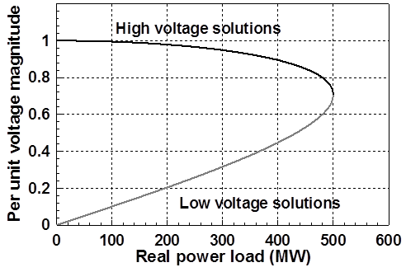
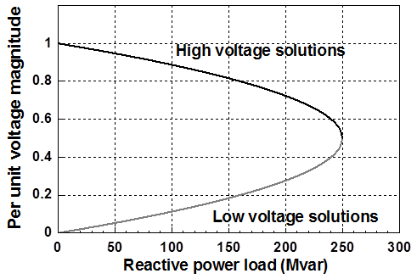
PV and QV Curves
PV curves can be traced by plotting the voltage as the real power is increased; QV curves as reactive power is increased
  At least for the upper portion of the curve
Two bus example PV and QV curves

Slide 11
Small Disturbance Voltage Collapse
At constant frequency (e.g., 60 Hz) the complex power transferred down a transmission line is S=VI*
  V is phasor voltage, I is phasor current
  This is the reason for using a high voltage grid
Line real power losses are given by RI2 and reactive power losses by XI2
  R is the line’s resistance, and X its reactance; for a high voltage line X >> R
Increased reactive power tends to drive down the voltage, which increases the current, which further increases the reactive power losses

Slide 12
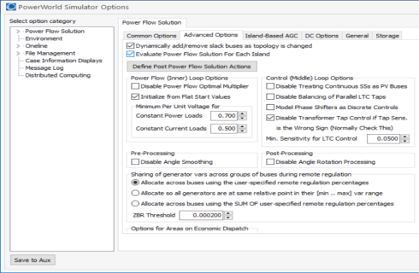
PowerWorld Two Bus Example
Commercial power flow software usually auto converts constant power loads at low voltages; set these fields to zero to disable this conversion
Case is Bus2_PV

Slide 13
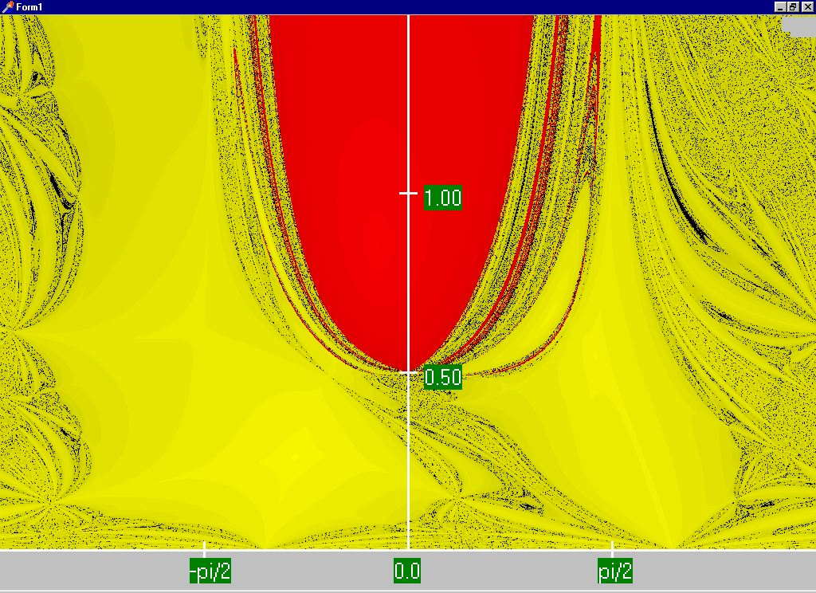
Power Flow Voltage Space Region of Convergence
Convergence
regions with
P=100 MW,
Q=0 Mvar

Slide 14
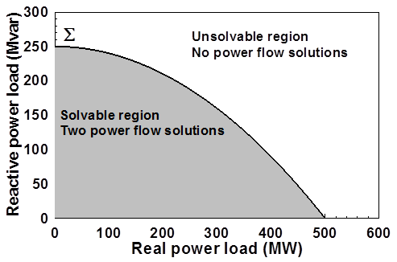
Load Parameter Space Representation
With a constant power model there is a maximum loadability surface, S
  Defined as point in which the power flow Jacobian is singular
  For the lossless two bus system it can be determined as
With the Bus2_PV compare
the convergence for different
initial voltage guesses, also
varying the Minimum Per Unit
Voltage load options

Slide 15
Load Model Impact
With a static load model regardless of the voltage dependency the same PV curve is traced
  But whether a point of maximum loadability exists depends on the assumed load model
    If voltage exponent is > 1 then multiple solutions do not exist (see B.C. Lesieutre, P.W. Sauer and M.A. Pai “Sufficient conditions on static load models for network solvability,” NAPS 1992, pp. 262-271)
The constant power load model is very common in transmission-level power flows, and is well justified because the distribution level LTCs usually keep the load voltage fairly constant in the power flow time frame
Change the load to constant impedance; hence it becomes a linear model

Slide 16
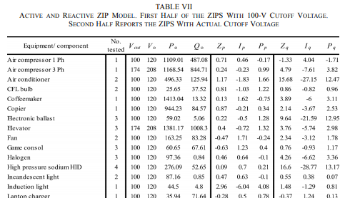
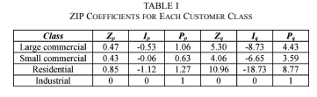
ZIP Model Coefficients
One popular static load model is the ZIP; lots of papers on the “correct” amount of each type
Table 1 from M. Diaz-Aguilo, et. al., “Field-Validated Load Model for the Analysis of CVR in Distribution Secondary Networks: Energy Conservation,” IEEE Trans. Power Delivery, Oct. 2013
Table 7 from A, Bokhari, et. al., “Experimental Determination of the ZIP Coefficients for Modern Residential, Commercial, and Industrial Loads,” IEEE Trans. Power Delivery, June. 2014

Slide 17
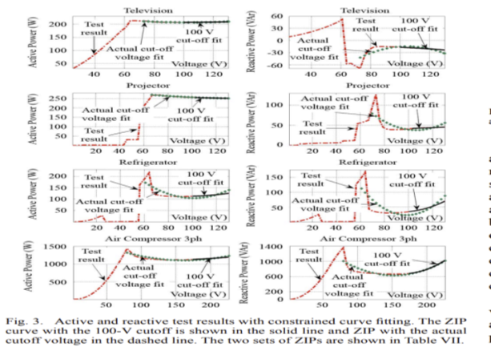
ZIP Model Coefficients
Figure 3 from A, Bokhari, et. al., “Experimental Determination of the ZIP Coefficients for Modern Residential, Commercial, and Industrial Loads,” IEEE Trans. Power Delivery, June. 2014

Slide 18
Application: Conservation Voltage Reduction (CVR)
If the “steady-state” load has a true dependence on voltage, then a change (usually a reduction) in the voltage should result in a total decrease in energy consumption
If an “optimal” voltage could be determined, then this could result in a net energy savings
Some challenges are 1) the voltage profile across a feeder is not constant, 2) the load composition is constantly changing, 3) a decrease in power consumption might result in a decrease in useable output from the load, and 4) loads are dynamic and an initial decrease might be balanced by a later increase

Slide 19
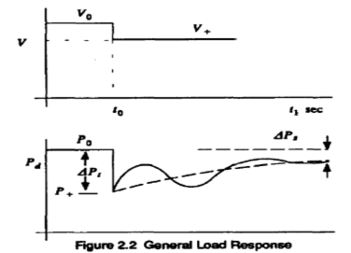
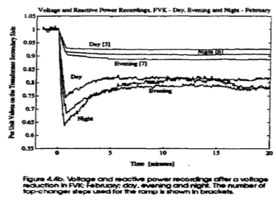
Dynamic Load Response
As first reported in the below paper, following a change in voltage there will be a dynamic load response
  Residential supply voltage should be between 114 and 126 V
If there is a heating load the response might be on the order of ten minutes
  Longer term issues can also come into play
Useful paper and figure reference: D. Karlsson, D.J. Hill, “Modeling and Identification of Nonlinear Dynamic Loads in Power Systems,” IEEE. Trans. on Power Systems, Feb 1994, pp. 157-166

Slide 20
Determining a Metric to Voltage Collapse
The goal of much of the voltage stability work was to determine an easy to calculate metric (or metrics) of the current operating point to voltage collapse
  PV and QV curves (or some combination) can determine such a metric along a particular path
  Goal was to have a path independent metric. The closest boundary point was considered,
  but this could be quite misleading if the system was not going to move in that direction
  Any linearization about the current operating point (i.e., the Jacobian) does not consider important nonlinearities like generators hitting their reactive power limits
The distance to the boundary is ultimately path dependent

Slide 21
Assessing Voltage Margin Using PV and QV Curve Analysis
A common method for assessing the distance in parameter space to voltage instability (or an undesirable voltage profile) is to trace how the voltage magnitudes vary as the system parameters (such as the loads) are changed in a specified direction (e.g., a “path”)
  If the direction involves changing the real power (P) this is known as a PV curve; if the change is with the reactive power (Q) then this is a QV curve
PV/QV curve analysis can be generalized to any parameter change, and can include the consideration of contingencies

Slide 22
PV and QV Analysis in PowerWorld
Requires setting up what is known in PowerWorld as an injection group
  An injection group specifies a set of objects, such as generators and loads, that can inject or absorb power
  Injection groups can be defined by selecting Case Information, Aggregation, Injection Groups
The PV and/or QV analysis then varies the injections in the injection group, tracing out the PV curve
This allows optional consideration of contingencies
The PV tool can be displayed by selecting Add-Ons, PV
The injection groups have already been defined for the Bus2_PV case

Slide 23
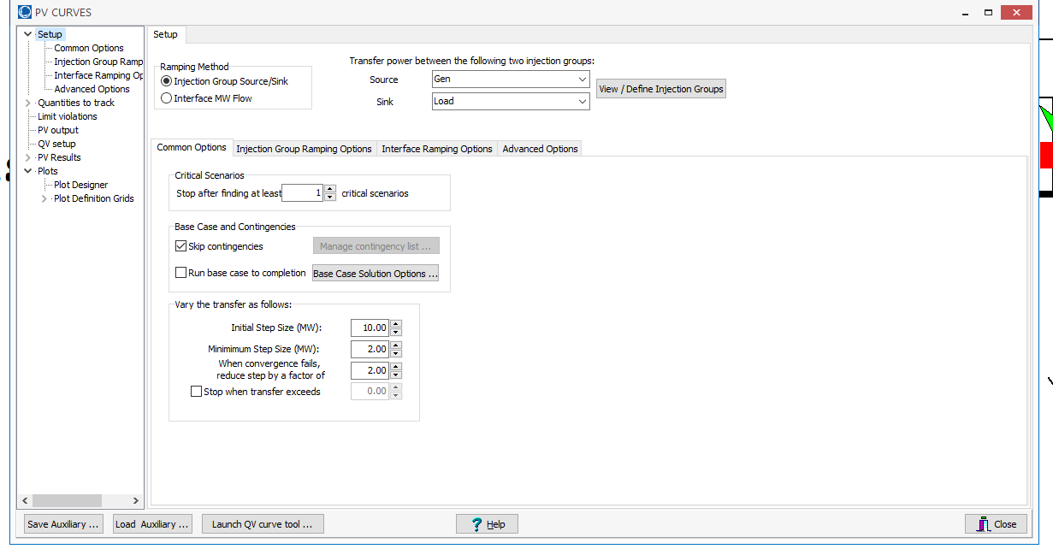
PV and QV Analysis in PowerWorld: Two Bus Example
Setup page defines the source and sink and step size
Define the source and sink
Optionally contingencies
can be considered

Slide 24
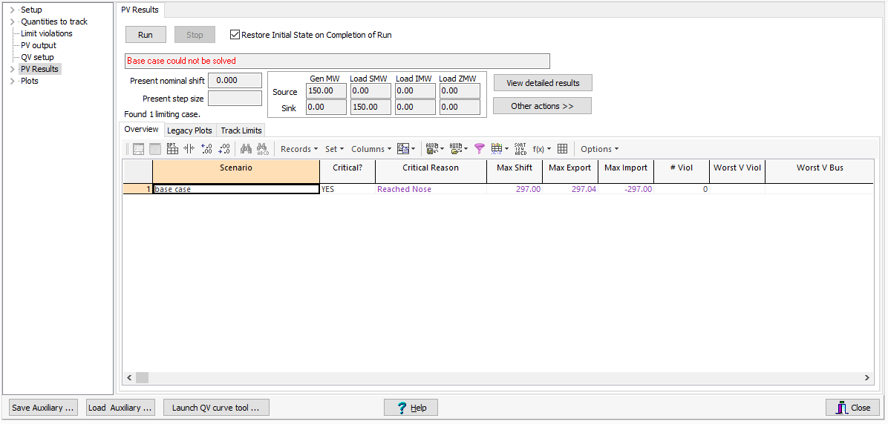
PV and QV Analysis in PowerWorld: Two Bus Example
The PV Results Page does the actual solution
  Plots can be defined to show the results
    This should be done beforehand
  Other Actions, Restore initial state restores the pre-study state
Click the Run button
to run the PV analysis;
Check the Restore
Initial State on
Completion of Run to
restore the pre-PV
state (by default it is
not restored)
Plots should be defined beforehand to make sure the desired fields are saved

Slide 25
PV and QV Analysis in PowerWorld: Two Bus Example

Slide 26
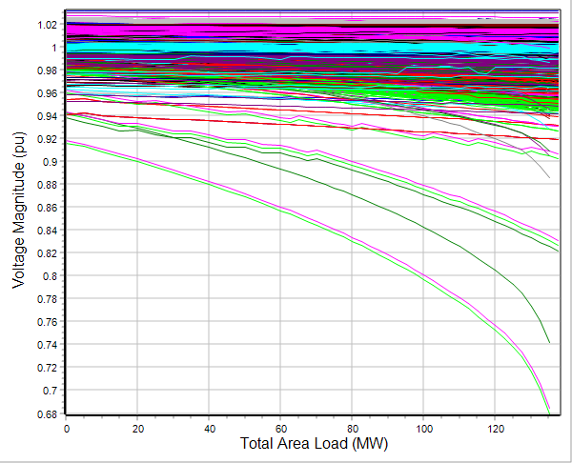
PV and QV Analysis in PowerWorld: 37 Bus Example
Usually other limits also need to be considered in doing a realistic PV analysis; example case is Bus37_PV

Slide 27
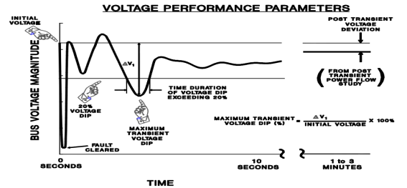
Shorter Term Dynamics
On a shorter time-scale (minutes down to seconds) voltage stability is impacted by controls hitting limits (such as the action of generator over excitation limiters), the movement of voltage control devices (such as LTC transformers) and load dynamics
  Motor stalling can have a major impact
The potential for voltage instability can be quantified by looking at the amount and duration of voltage dips following an event
Image from WECC Planning and Operating Criteria

Slide 28
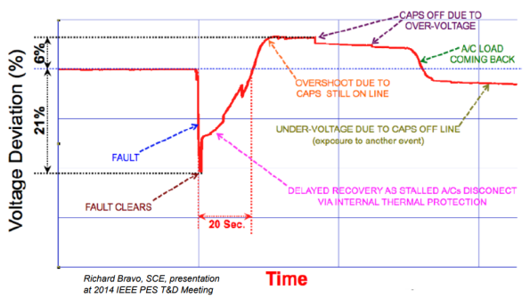
Fault Induced Delayed Voltage Recovery (FIDVR)
FIDVR is a situation in which the system voltage remains significantly reduced for at least several seconds following a fault (at either the transmission or distribution level)
  It is most concerning in the high voltage grid, but found to be unexpectedly prevalent in the distribution system
Stalled residential air conditioning units are a key cause of FIDVR –
they can stall within the three cycles needed to clear a fault
Image Source: NERC, Fault Induced Delayed Voltage Recovery (FIDVR) Advisory, July 2015

Slide 29
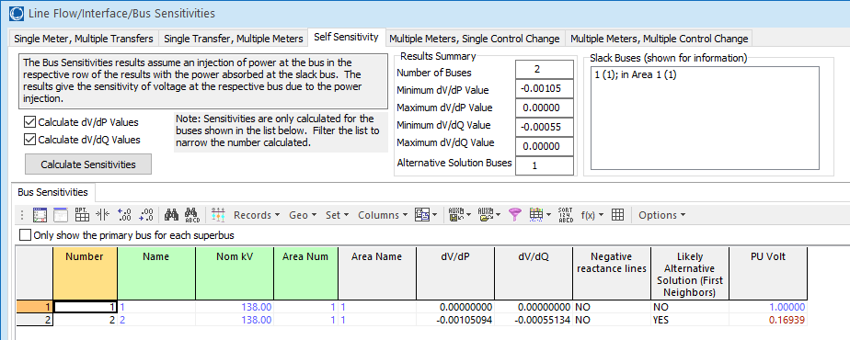
Determining If Power Flow Solved to a Low-Voltage Solution
While it is sometimes apparent if the power flow solved a low voltage solution, sometimes it can be different to determine without doing sensitivity analysis
PowerWorld has some tools to help with this analysis
  In Tools, Sensitivities, Flow and Voltage Sensitivities, go to the Self Sensitivity page; as an example of a power flow solved to a low-voltage solution, load the Bus2_PV_Low case; click on the Calculate Sensitivities button
This shows the likely location of the low-voltage solution
The voltage is quite low in this example

Slide 30
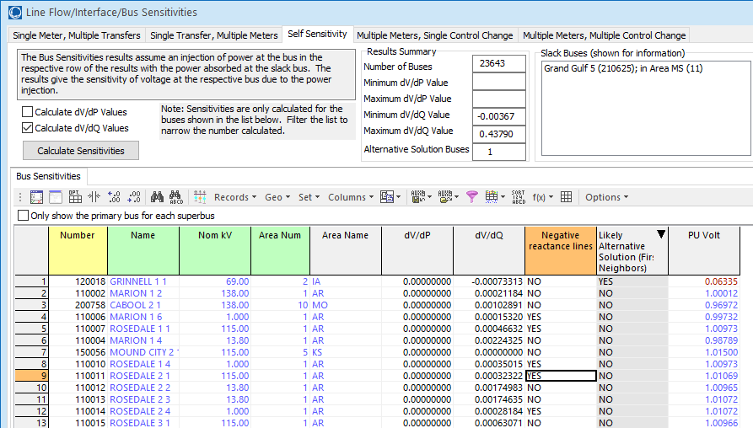
Midwest 24K Low Voltage Solution
Using a low voltage initial guess at bus 120018, and disabling the constant power load conversion option, the case Midwest24_LowSolution has solved to a low voltage solution
Doing the previous sensitivity analysis shows the location of the low solution; it is also picked in the summary and contour onelines

Slide 31
Midwest 24K Low Voltage Solution Contour

