Slide 1
ECEN 615, Fall 2023
Methods of Electric Power System Analysis
Class 20: Power System Equivalencing
Prof. Adam Birchfield
Dept. of Electrical and Computer Engineering
Texas A&M University
abirchfield@tamu.edu

Slide 2
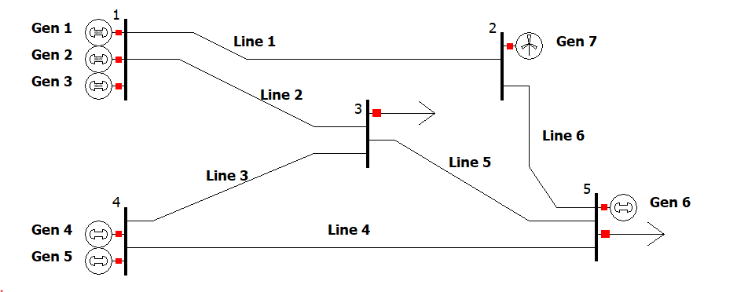
Assignment 5
A five-bus unit commitment problem with the following features
  Power flow is modeled with dc assumptions (4 bus theta variables)
  12 time points with varying load
  One wind generator with a varying maximum power
  7 total generating units
    Cost: start-up, shut-down, fixed, variable
    Minimum and maximum generation
  6 transmission lines have maximum flow limits
Solution will determine
  Status of generator at each of the 12 time points
  Generator output power p at each time point
  Line flow and bus angle at each time point
  Total cost of generation

Slide 3
Power System Equivalents
No electric grid model is ever going to completely represent a real electric grid
  “All models are wrong but some models are useful”
A key modeling consideration is how much of the electric grid to represent
  For large-scale systems the distribution system is usually equivalenced at some point; this has few system level ramifications if it is radial; if it is networked then there are potential issues
  At the transmission level either the full interconnect is represented or it is equivalenced
  In an SE model in large grids (like the Eastern Interconnect) it is always an electrical equivalent

Slide 4
Kron Reduction, Ward Equivalents
For decades power system network models have been equivalenced using the approach originally presented by J.B. Ward in 1949 AIEE paper “Equivalent Circuits for Power-Flow Studies”
  Paper’s single reference is to 1939 book by Gabriel Kron, so this is also known as Kron’s reduction or a Ward equivalent
System buses are partitioned into a study system (s) to be retained and an external system (e) to be eliminated; buses in study system that connect to the external are known as boundary buses

Slide 5
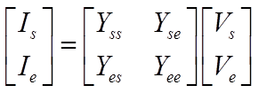

Ward Equivalents
The Ward approach is based on the below relationship
No impact on study, non-boundary buses
Equivalent is created by doing a partial factorization of the Ybus
  Computationally efficient

Slide 6
Other Types of Equivalents
There are many different methods available for creating power system equivalents
  A classic paper is by S. Deckmann, et. al., “Studies on Power System Load Flow Equivalencing,” IEEE Transactions Power App. And Syst., Nov/Dec 1980
  Companion paper covers numerical testing of equivalents
The major equivalencing types are
  Ward-Type Equivalence: this is what we’ll be covering, with the major differences associated with how the generator buses and equivalent loads are represented
  REI Equivalents: All boundary buses connect to one “REI” bus
  Linearized Methods: Linearize about an operating point
  Others: PTDF-based, backbone type

Slide 7
Equivalent System Properties
An equivalent is usually created from a larger model
  In the Eastern Interconnect there are full grid models that are used for wide-area planning, these are equivalenced for real-time usage or more specialized studies
The equivalent is usually smaller and less detailed
  Solves quicker
  Requires less storage
  Requires less up-to-date data
Equivalences contain fictitious elements
  This can make modeling/updating more difficult
The equivalent only approximates the behavior of the original

Slide 8
Study vs External System
The key decision in creating an equivalent is to divide the system into a study portion that is represented in detail, and an external portion that is represented by the equivalent
The two systems are joined at boundary buses, which are part of the study subsystem
How this is done is application specific; for example:
  for real-time use it does not make sense to retain significant portions of the grid for which there is no real-time information
  for contingency analysis the impact of the contingency is localized
  for planning the new system additions have localized impacts

Slide 9
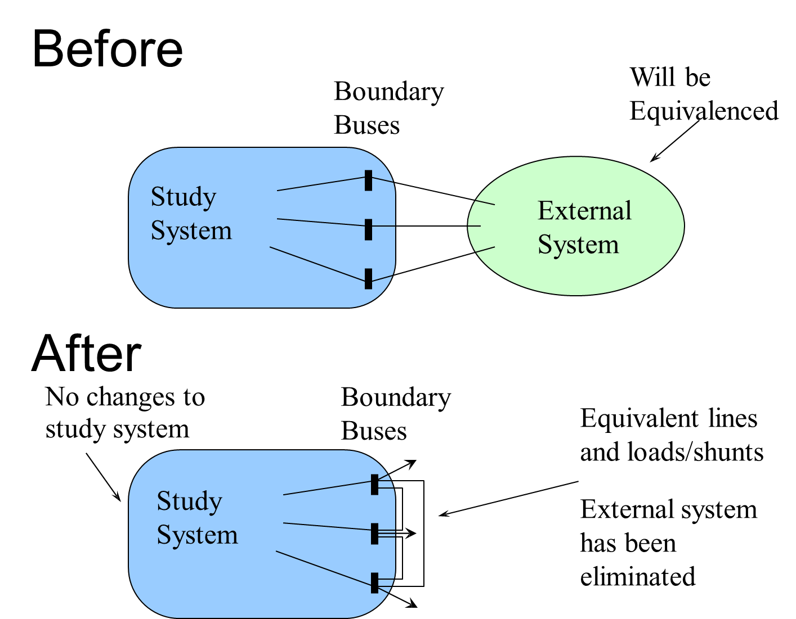
Ward Type Equivalencing

Slide 10
Ward Type Equivalencing Considerations
The Ward equivalent is calculated by doing a partial factorization of the Ybus
  The equivalent buses are numbered before the study buses
  As the equivalent buses are eliminated their first neighbors are joined together
  At the end, many of the boundary buses are connected
  This can GREATLY decrease the sparsity of the system
  Buses with different voltages can be directly connected

Slide 11
Ward Type Equivalencing Considerations
At the end of the Ward process often many of the new equivalent lines have high impedances
  Often there is an impedance threshold, and lines with impedances above this value are eliminated
The equivalent lines may have unusual values, including negative resistances
Load and generation is represented as equivalent current injections or shunts; sometimes these values are converted back to constant power
Consideration needs to be given to loss of reactive support
The equivalent embeds the present load and gen values

Slide 12
B7Flat_Eqv Example
In this example the B7Flat_Eqv case is reduced, eliminating buses 1, 3 and 4. The study system is then 2, 5, 6, 7, with buses 2 and 5 the boundary buses
For ease of
comparison
system is
modeled
unloaded

Slide 13
B7Flat_Eqv Example
Original Ybus

Slide 14
B7Flat_Eqv Example
Note Y_{es}=Y_{se}'
if no phase
shifters

Slide 15
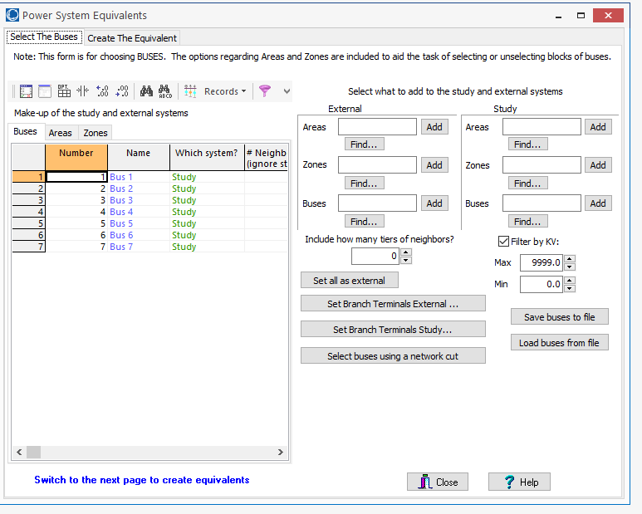
Equivalencing in PowerWorld
Open a case and solve it; then select Edit Mode, Tools, Equivalencing; this displays the Power System Equivalents Form
Next step is then to
divide the buses into
the study system and
the external system;
buses can be loaded
from a text file as
well

Slide 16
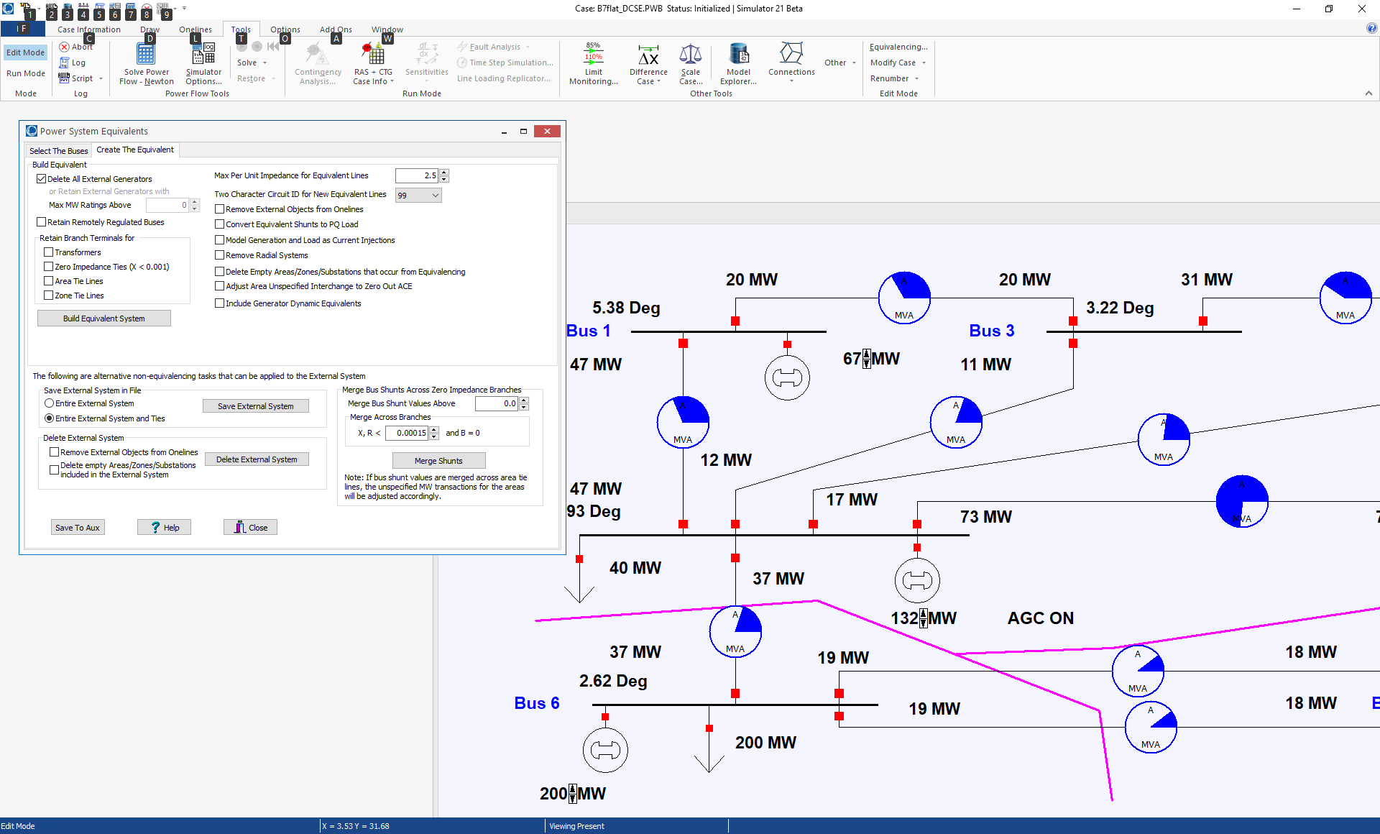
Equivalencing in PowerWorld
Then go to the Create The Equivalent page, select the desired options and select Build Equivalent System
Maximum
impedance
lines to retain
Removes equivalenced objects from the oneline
Click to create the equivalent
’99’ or ‘EQ’
are common
circuit values
for equivalent
lines

Slide 17
Small System Equivalent Example
Example shows the creation of an equivalent for Aggieland37 example
First example is
simple, just removing
WHITE138 (bus 3);
note TEXAS138 is
now directly joined to
RELLIS138..
Case is Aggieland37_HW5

Slide 18
Small System Equivalent Example
Only bus 3 was removed; the new equivalent line was auto-inserted.
Don’t save the
equivalent with the
same name as the
original, unless you
want to lose the
original

Slide 19
Small System Equivalent Example
Now remove buses at WHITE138 and TEXAS and RELLIS (1, 3, 12, 40, 41, 44); set Max Per Unit Impedance for Equivalent Lines to 99 (per unit) to retain all lines. Again do an auto-insert to show the equivalent lines.

Slide 20
Small System Equivalent Example
Now set the Max Per Unit Impedance for Equivalent Lines to 2.5.

Slide 21
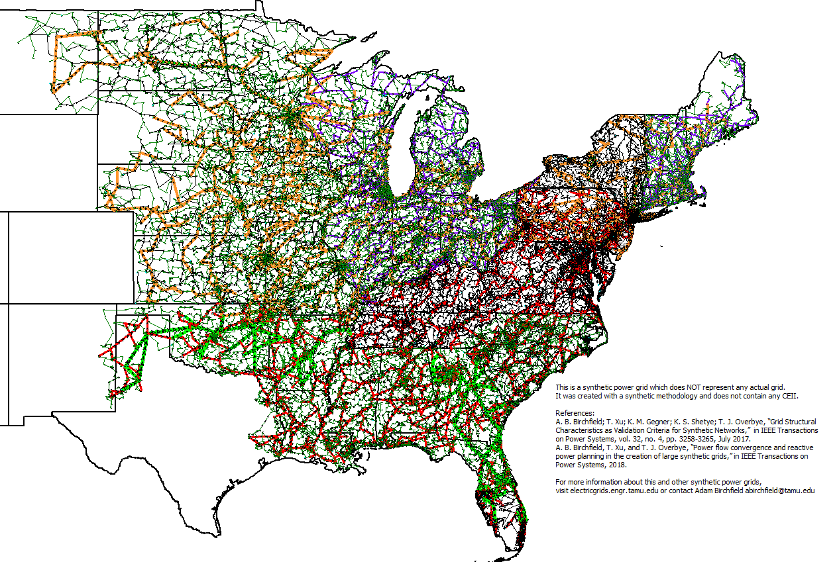
Large System Example: 70K Case
Original System has 70,000 buses and 71,343 lines

Slide 22
Large System Example: 70K Case
Just retain the Oklahoma Area; now 1591 buses and 1745 lines (deleting ones above 2.5 pu impedance)

Slide 23
Grid Equivalent Examples
A 2016 EI case had about 350 lines with a circuit ID of ’99’ and about 60 with ‘EQ’ (out of a total of 102,000)
  Both WECC and the EI use ’99’ or ‘EQ’ circuit IDs to indicate equivalent lines
  One would expect few equivalent lines in interconnect wide models
A ten year old EI case had about 1633 lines with a circuit ID of ’99’ and 400 with ‘EQ’ (out of a total of 65673)
A ten year old case with about 5000 buses and 5000 lines had 600 equivalent lines

