Slide 1
ECEN 615, Fall 2023
Methods of Electric Power System Analysis
Class 19: Power System Optimization, Part 2
Prof. Adam Birchfield
Dept. of Electrical and Computer Engineering
Texas A&M University
abirchfield@tamu.edu

Slide 2
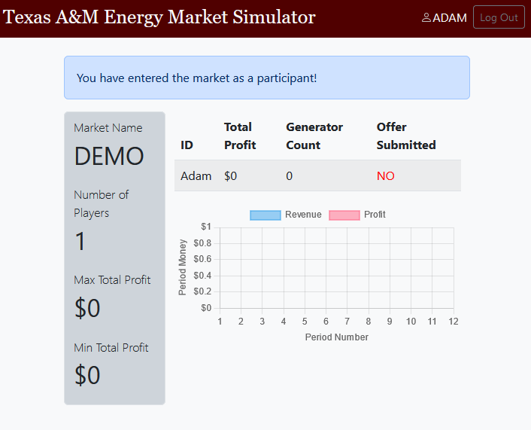
Market Bidding Exercise
Developed over several years for a lab in ECEN 460, our undergrad power systems class
Special thanks to Luke for developing a nice user interface
http://people.tamu.edu/~wyattluke.lowery/

Slide 3
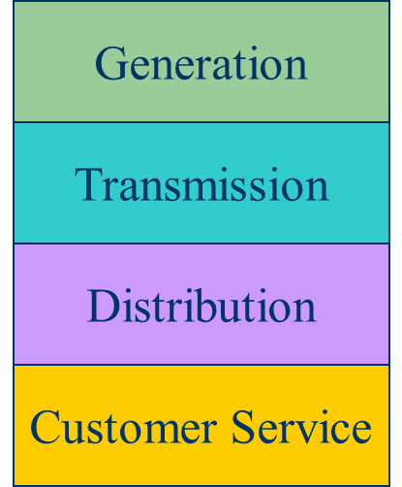
Vertically Integrated Utilities vs Markets
For decades electric utilities operated as vertical monopolies, with their rates set by state regulators
  Utilities had an obligation to serve and customers had no choice (There was little third party generation)
Major change in US occurred in 1992 with the National Energy Policy Act that mandated utilities provide “nondiscriminatory” access to the high voltage grid
  Goal was to setup true competition in generation
With the vertically integrated utility, a small number of entities (typically utilities) did most of the planning (Regulators needed to know the utilities actual costs so they could provide them with a fixed rate of return)
  With markets the larger number of participants often make individual decisions in reaction to prices (Generator owners in general to not need to reveal their true costs; rather they make offers into the market)

Slide 4
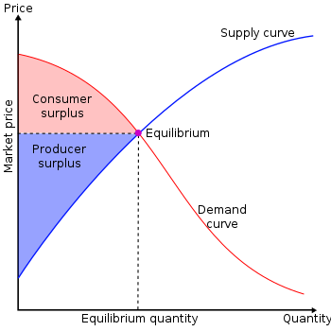
Markets Goal
Goal is to maximize the economic surplus (or total welfare), which is the sum of the consumer surplus and the producer surplus (i.e., their profit)
Generation owners have to decide their offer prices
If their price is too high, they are not selected to generate
At the wholesale level, the consumers often just see a price, though there can be price responsive load bids
Image Source: en.wikipedia.org/wiki/Economic_surplus#/media/File:Economic-surpluses.svg

Slide 5
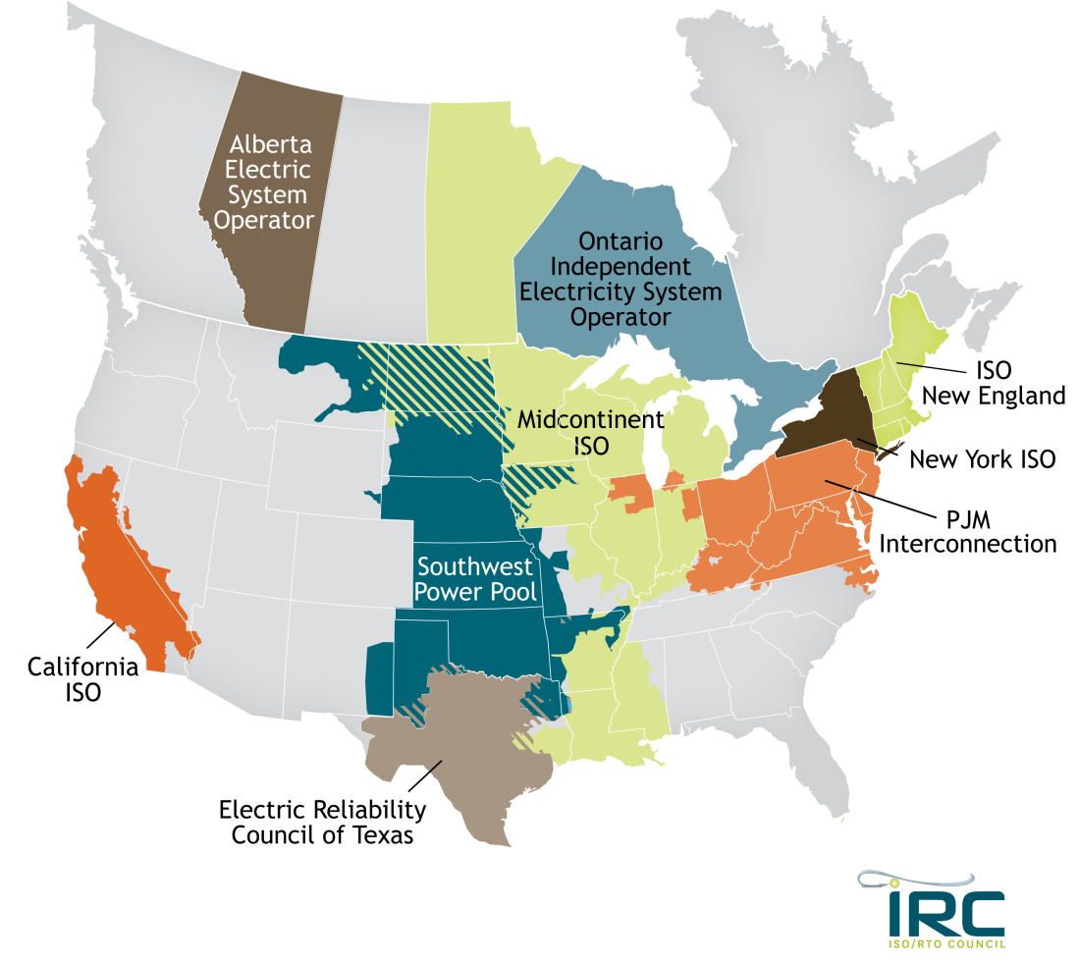
Electricity Markets Today
Starting in about 1995 electricity markets gradually started to develop, both in the US and elsewhere
In North America more than 60% of the load is supplied via wholesale electricity markets
  Day ahead market – this is needed because time is required to make decisions about committing generators
  Real-time energy market – needed because day ahead forecasts are never perfect, and unexpected events can occur
  Ancillary Services – such as reserves
Pricing is done using locational marginal prices, determined by an SCOPF
Generators are paid according to LMPs
Image: www.isorto.org/about/default

Slide 6
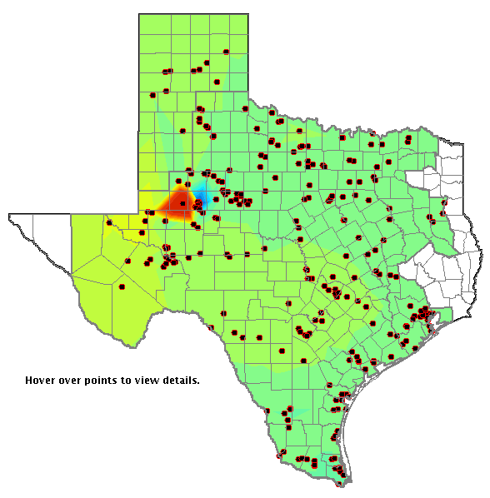
LMP Energy Markets
Generators are free to offer their electricity at whatever price they desire; they do not have to reveal their “true” costs
Most of the times markets work as planned, and prices are competitive
During times of shortages (scarcity) there are limits on LMPs; ERCOT’s is $9000/MWh
Markets are run by independent system operators (ISOs)
LMP Color gradient in ERCOT (red are high prices, blue low)

Slide 7
LMP Energy Markets, Cont.
In an LMP energy market the generation is paid the LMP at the bus, and the loads pay the LMP at the bus
  This is done in both the day ahead market and in the real-time market (which makes up the differences between actual and the day ahead)
The generator surplus (profit) is the difference between the LMP and the actual cost of generation
Generators that offer too high are not selected to run, and hence make no profit
A key decision for the generation owners is what values to offer
LMP Color gradient in ERCOT (red are high prices, blue low)

Slide 8
OPF and SCOPF History
A nice OPF history from Dec 2012 is provided by the below link, and briefly summarized here
Prior to digital computers economic dispatch was solved by hand and the power flow with network analyzers
Digital power flow developed in late 50’s to early 60’s
First OPF formulations in the 1960’s
  J. Carpienterm, “Contribution e l’étude do Dispatching Economique,” Bulletin Society Francaise Electriciens, 1962
  H.W. Dommel, W.F. Tinney, “Optimal power flow solutions,” IEEE Trans. Power App. and Systems, Oct. 1968
    “Only a small extension of the power flow program is required”
www.ferc.gov/industries/electric/indus-act/market-planning/opf-papers/acopf-1-history-formulation-testing.pdf (by M Cain, R. O’Neill, A. Castillo)

Slide 9
OPF and SCOPF History, Cont.
A linear programming (LP) approach was presented by Stott and Hobson in 1978
  B. Stott, E. Hobson, “Power System Security Control Calculations using Linear Programming,” (Parts 1 and 2) IEEE Trans. Power App and Syst., Sept/Oct 1978
Optimal Power Flow By Newton’s Method
  D.I. Sun, B. Ashley, B. Brewer, B.A. Hughes, and W.F. Tinney, "Optimal Power Flow by Newton Approach", IEEE Trans. Power App and Syst., October 1984
Follow-up LP OPF paper in 1990
  O. Alsac, J. Bright, M. Prais, B. Stott, “Further Developments in LP-based Optimal Power Flow,” IEEE Trans. Power Systems, August 1990

Slide 10
OPF and SCOPF History, Cont.
Critique of OPF Algorithms
  W.F. Tinney, J.M. Bright, K.D. Demaree, B.A. Hughes, “Some Deficiencies in Optimal Power Flow,” IEEE Trans. Power Systems, May 1988
Hundreds of other papers on OPF
Comparison of ac and dc optimal power flow methods
  T.J. Overbye, X. Cheng, Y. San, “A Comparison of the AC and DC Power Flow Models for LMP Calculations,” Proc. 37th Hawaii International Conf. on System Sciences, 2004

Slide 11
OPF Problem Formulation
The OPF is usually formulated as a minimization with equality and inequality constraints
where x is a vector of dependent variables (such as the bus voltage magnitudes and angles), u is a vector of the control variables, F(x,u) is the scalar objective function, g is a set of equality constraints (e.g., the power balance equations) and h is a set of inequality
constraints (such as line flows)

Slide 12
LP OPF Solution Method
Solution iterates between
  solving a full ac or dc power flow solution
    enforces real/reactive power balance at each bus
    enforces generator reactive limits
    system controls are assumed fixed
    takes into account non-linearities
  solving a primal LP
    changes system controls to enforce linearized constraints while minimizing cost

Slide 13
Two Bus with Unconstrained Line
With no overloads the
OPF matches
the economic
dispatch
Transmission line is not overloaded
Marginal cost of supplying
power to each bus (locational marginal costs)

Slide 14
Two Bus with Constrained Line
With the line loaded to its limit, additional load at Bus A must be supplied locally, causing the marginal costs to diverge.

Slide 15
Three Bus (B3) Example
Consider a three bus case (Bus 1 is system slack), with all buses connected through 0.1 pu reactance lines, each with a 100 MVA limit
Let the generator marginal costs be
  Bus 1: 10 $ / MWhr; Range = 0 to 400 MW
  Bus 2: 12 $ / MWhr; Range = 0 to 400 MW
  Bus 3: 20 $ / MWhr; Range = 0 to 400 MW
Assume a single 180 MW load at bus 2

Slide 16
B3 with Line Limits NOT Enforced
Line between
Bus 1 and Bus 3
is over-loaded;
all buses have
the same
marginal cost

Slide 17
B3 with Line Limits Enforced
LP OPF changes
generation to
remove violation.
Bus marginal
costs are now
different.

Slide 18
Verify Bus 3 Marginal Cost
One additional MW
of load at bus 3
raised total cost by
14 $/hr, as G2 went
up by 2 MW and G1
went down by 1MW

Slide 19
Why is the Bus 3 LMP = $14 /MWh ?
All lines have equal impedance. Power flow in a simple network distributes inversely to impedance of path.
  For bus 1 to supply 1 MW to bus 3, 2/3 MW would take direct path from 1 to 3, while 1/3 MW would “loop around” from 1 to 2 to 3.
  Likewise, for bus 2 to supply 1 MW to bus 3, 2/3MW would go from 2 to 3, while 1/3 MW would go from 2 to 1 to 3.
With the line from 1 to 3 limited, no additional power flows are allowed on it.
To supply 1 more MW to bus 3 we need
  ΔP_{G1} + ΔP_{G2} = 1 MW
  2/3 Δ P_{G1} + 1/3 Δ P_{G2} = 0; (no more flow on 1-3)
Solving requires we up P_{G2} by 2 MW and drop P_{G1} by 1 MW -- a net increase of $24 – $10 = $14.

Slide 20
Both Lines into Bus 3 Congested
For bus 3 loads
above 200 MW,
the load must be
supplied locally.
Then what if the
bus 3 generator
opens?

Slide 21
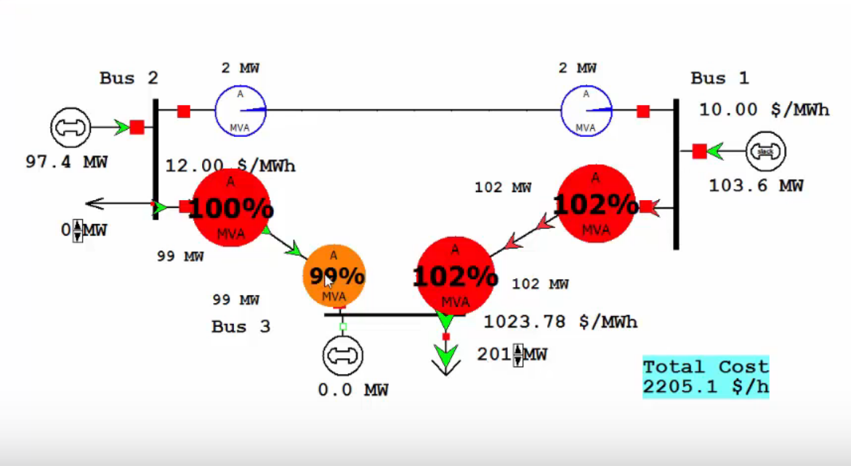
Both lines into Bus 3 Congested

Slide 22
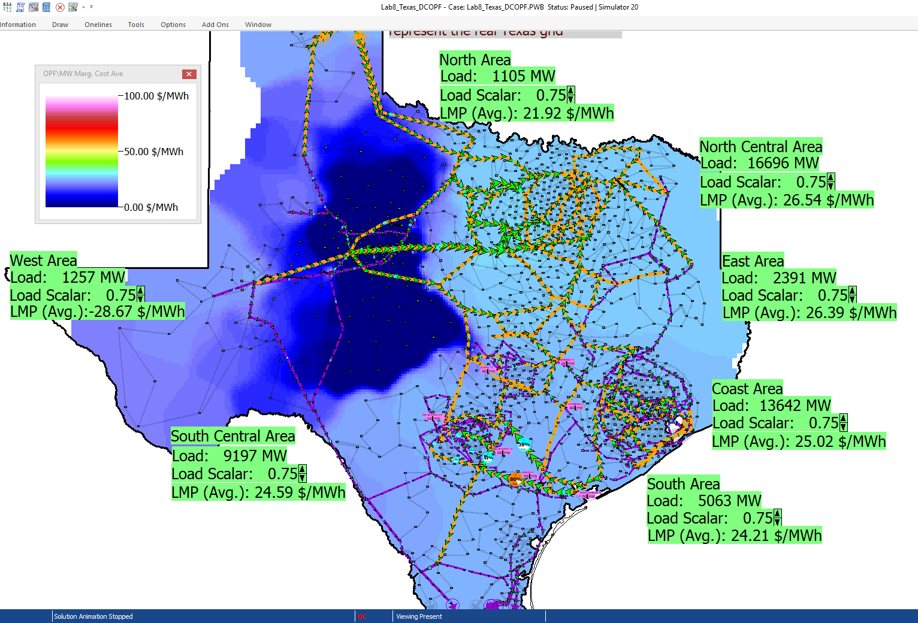
2000 Bus Texas Synthetic DC OPF Example
This system does a DC OPF solution, with the ability to change the load in the areas
The quite
low LMPs
are actually
due to a
constraint
on a single
230/115 kV
transformer

Slide 23
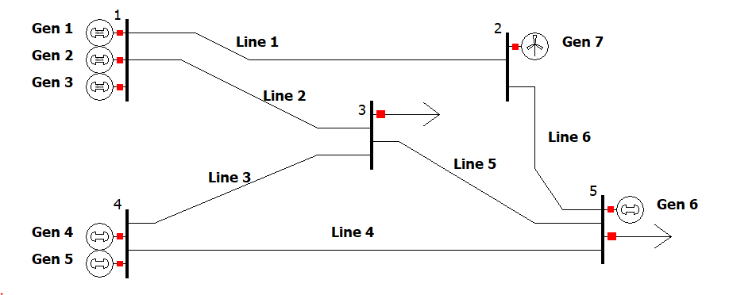
Assignment 5
A five-bus unit commitment problem with the following features
  Power flow is modeled with dc assumptions (4 bus theta variables)
  12 time points with varying load
  One wind generator with a varying maximum power
  7 total generating units
    Cost: start-up, shut-down, fixed, variable
    Minimum and maximum generation
  6 transmission lines have maximum flow limits
Solution will determine
  Status of generator at each of the 12 time points
  Generator output power p at each time point
  Line flow and bus angle at each time point
  Total cost of generation

