Slide 1
ECEN 615, Fall 2023 Methods of Electric Power System Analysis
Class 17: State Estimation, Part 2
Prof. Adam Birchfield
Dept. of Electrical and Computer Engineering
Texas A&M University
abirchfield@tamu.edu

Slide 2
Discussion: “Digital Twin”

Slide 3
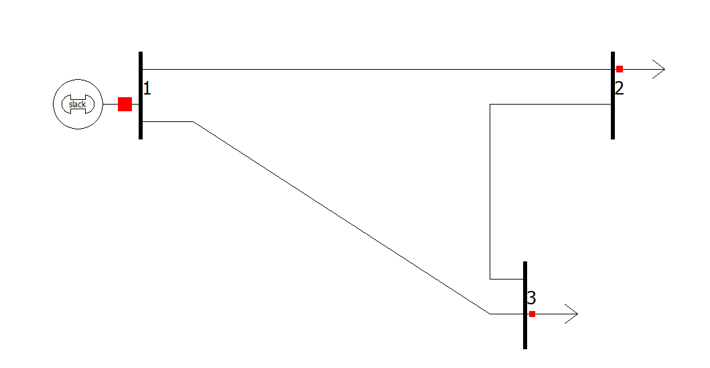
DC State Estimation Example Solution
Assume $X_{12}=0.1$, $X_{13}=0.25$, $X_{23}=0.2$
Measurement | Value
$$P_{12}$$ | 103.5 MW
$$P_{13}$$ | 83.8 MW
$$P_{23}$$ | 51.4 MW
$$P_{G1}$$ | 183.4 MW
$$P_{L2}$$ | 53.3 MW
$$P_{L3}$$ | 130.8 MW
$$P_{12}$$
$$P_{G1}$$
$$P_{L2}$$
$$P_{23}$$
$$P_{13}$$
$$P_{L3}$$
$x^{∗}={\left(A^{T}A\right)}^{−1}A^{T}b$
State estimation solution: $θ_{2}=−0.1031$, $θ_{3}=−0.2036$

Slide 4
SE Observability
In order to estimate all n states we need at least n measurements. However, where the measurements are located is also important, a topic known as observability
In order for a power system to be fully observable usually we need to have a measurement available no more than one bus away
At buses we need to have at least measurements on all the injections into the bus except one (including loads and gens)
Loads are usually flows on feeders, or the flow into a transmission to distribution transformer
Generators are usually just injections from the GSU

Slide 5
Pseudo Measurements
Pseudo measurements are used at buses in which there is no load or generation; that is, the net injection into the bus is know with high accuracy to be zero
In order to enforce the net power balance at a bus we need to include an explicit net injection measurement
To increase observability sometimes estimated values are used for loads, shunts and generator outputs
These “measurements” are represented as having a higher much standard deviation

Slide 6
SE Bad Data Detection
The quality of the measurements available to an SE can vary widely, and sometimes the SE model itself is wrong. Causes include
Modeling Errors: perhaps the assumed system topology is incorrect, or the assumed parameters for a transmission line or transformer could be wrong
Data Errors: measurements may be incorrect because of in correct data specifications, like the CT ratios or even flipped positive and negative directions
Transducer Errors: the transductors may be failing or may have bias errors
Sampling Errors: SCADA does not read all values simultaneously and power systems are dynamic

Slide 7
SE Bad Data Detection
The challenge for SE is to determine when there is likely a bad measurement (or multiple ones), and then to determine the particular bad measurements
J(x) is random number, with a probability density function (PDF) known as a chi-squared distribution, χ2(K), where K is the degrees of freedom, K=m-n
It can be shown the expected mean for J(x) is K, with a standard deviation of
Values of J(x) outside of several standard deviations indicate possible bad measurements, with the measurement residuals used to track down the likely bad measurements
SE can be re-run without the bad measurements

Slide 8
Example SE Application: PJM and MISO
PJM provides information about their EMS model in
www.pjm.com/-/media/documents/manuals/m03a.ashx
Data here is from the Sept 2018 (Rev 16) document

Slide 9
Example SE Application: PJM and MISO
PJM measurements are required for 69 kV and up
PJM SE is triggered to execute every minute
PJM SE solves well over 98% of the time
Below reference provides info on MISO SE from March 2015
54,433 buses
54,415 network branches
6332 generating units
228,673 circuit breakers
289,491 mapped points
https://www.naspi.org/sites/default/files/2017-05/3a%20MISO-NASPIWokshop-Synchrophasor%20Data%20and%20State%20Estimation.pdf

Slide 10
Energy Management Systems (EMSs)
EMSs are now used to control most large scale electric grids
EMSs developed in the 1970’s and 1980’s out of SCADA systems
An EMS usually includes a SCADA system; sometimes called a SCADA/EMS
Having a SE is almost the definition of an EMS. The SE then feeds data to the more advanced functions
EMSs have evolved as the industry as evolved as the industry has evolved, with functionality customized for the application (e.g., a reliability coordinator or a vertically integrated utility)

Slide 11
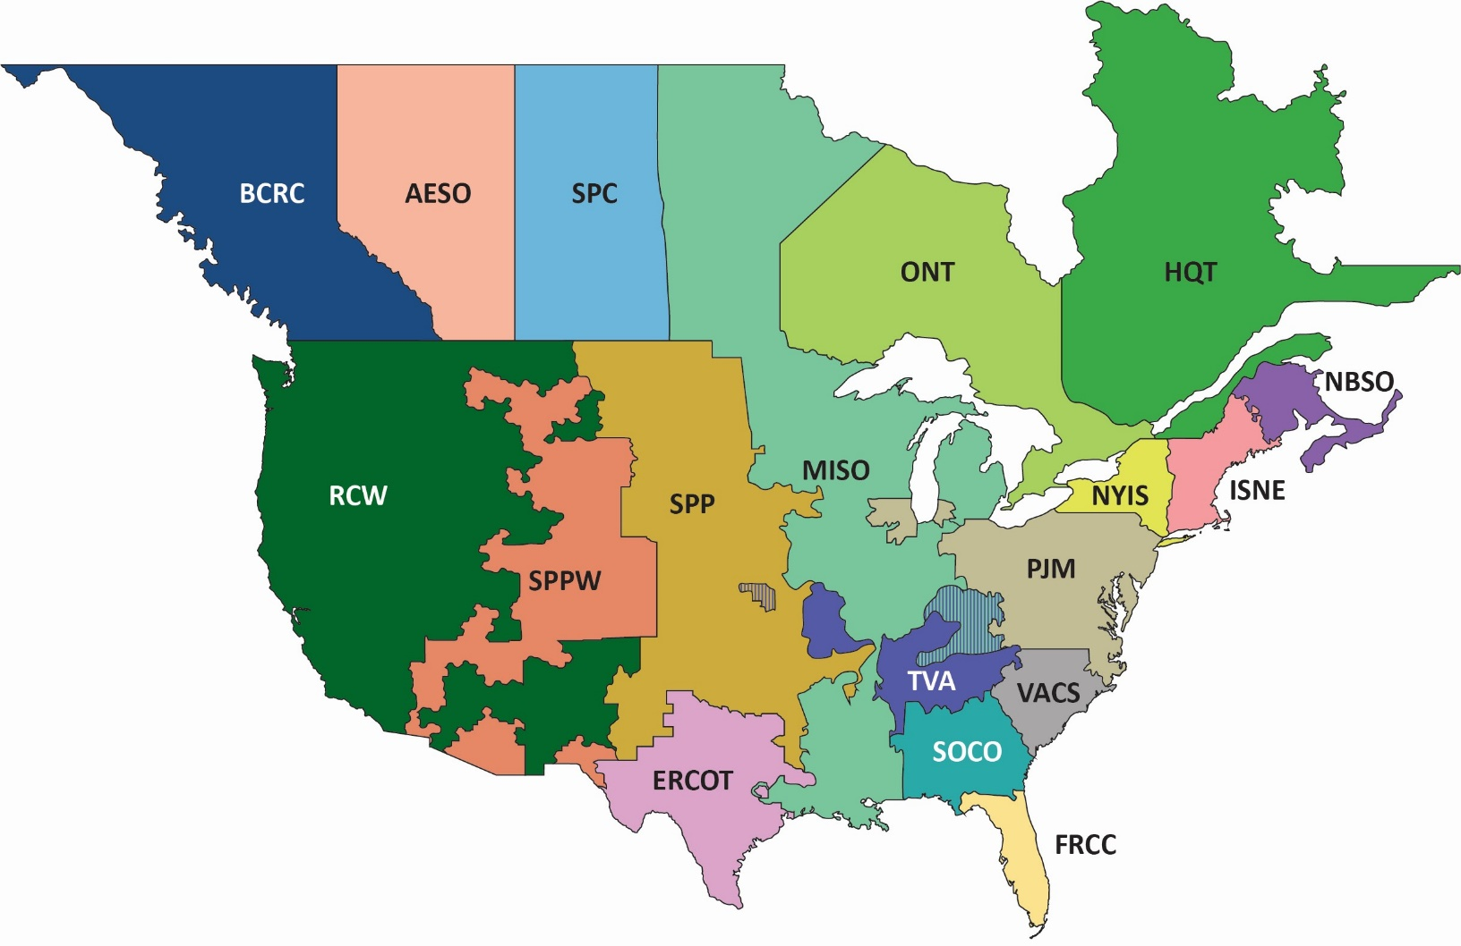
NERC Reliability Coordinators
Source: www.nerc.com/pa/rrm/TLR/Pages/Reliability-Coordinators.aspx

Slide 12
EEI Member Companies

Slide 13
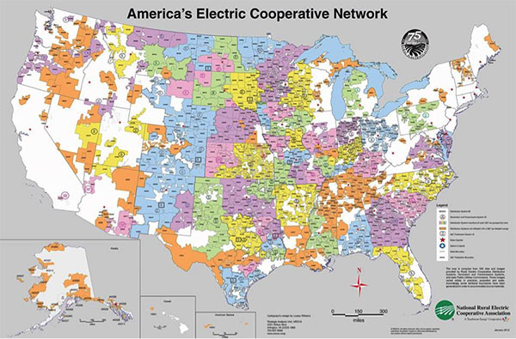
Electric Coops

Slide 14
Texas Electric Coops

Slide 15
ERCOT Control Center with EMS
Courtesy of ERCOT

Slide 16
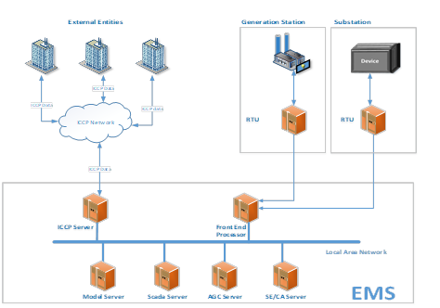
ERCOT EMS
Slide source: ERCOT, D. Penney, J. Mandavilli, M. Henry, “Loss of SCADA, EMS or LCC”

Slide 17
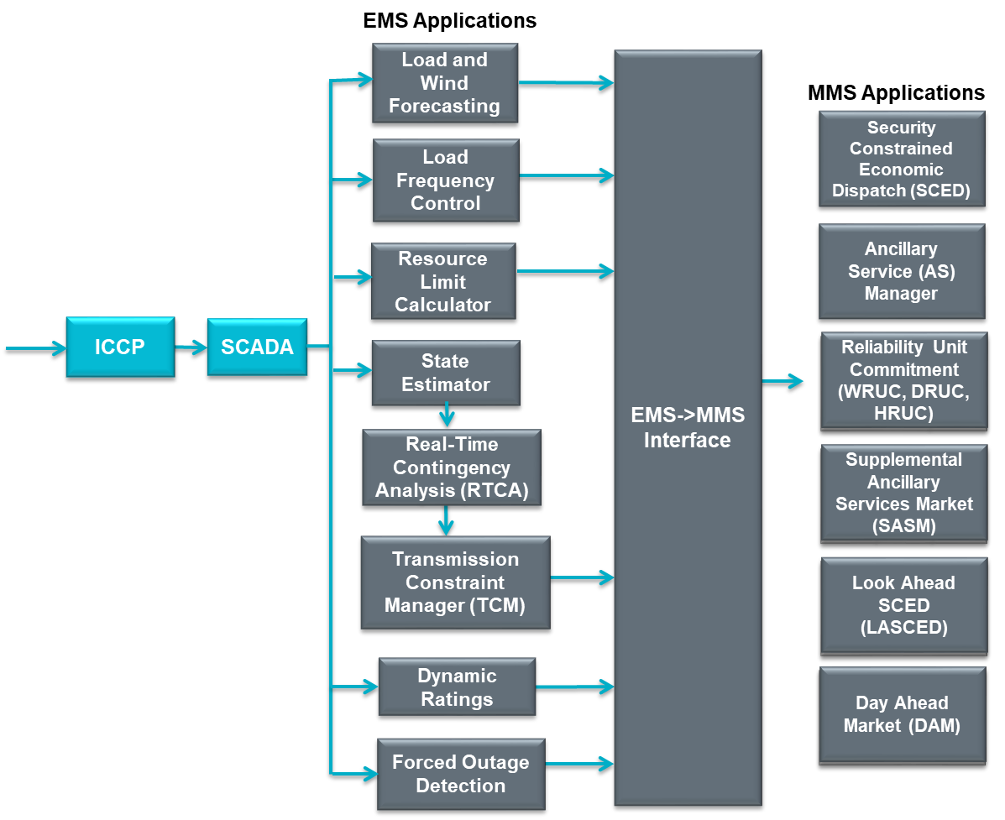
ERCOT EMS

Slide 18
SE Iterative Solution Algorithm
We make an initial guess of x, x⁽⁰⁾ and iterate, calculating Δx each iteration
H is the partial derivatives
R is the measurement standard deviations
This is exactly the least squares form developed earlier with H^{T}R⁻¹H an n by n matrix. This could be solved with Gaussian elimination, but this isn't preferred because the problem is often ill-conditioned
Keep in mind that H is no longer constant, but varies as x changes. often ill-conditioned

Slide 19
Example: Two Bus Case
Assume a two bus case with a generator supplying a load through a single line with x=0.1 pu. Assume measurements of the p/q flow on both ends of the line (into line positive), and the voltage magnitude at both the generator and the load end. So B₁₂ = B₂₁=10.0
We need to assume a reference angle unless we directly measuring phase

Slide 20
Example: Two Bus Case
Let
We assume an angle reference of q₁=0

Slide 21
Example: Two Bus Case
With a flat start guess we get

Slide 22
Example: Two Bus Case

Slide 23
QR Factorization
Used in in SE since it handles ill-conditioned m by n matrices (with m >= n)
Can be used with sparse matrices
As before we will first split the R-1 matrix
QR factorization represents the m by n H' matrix as with Q an m by m orthonormal matrix and U an upper triangular matrix (most books use Q R but we use U to avoid confusion with the previous R)

Slide 24
QR Factorization
We then have
But since Q is an orthonormal matrix,
Hence we have
Q is an m by m matrix

Slide 25
QR Factorization
When factored the U matrix (i.e., what most call the R matrix) will be an m by n upper triangular matrix
Several methods are available
The Householder method
See Prof. Tim Davis’s book for sparse matrix QR factorization
The Givens Method
Givens can often be faster when dealing with sparse matrices
A good reference is Gene H. Golub and Charles F. Van Loan, “Matrix Computations,” second edition, Johns Hopkins University Press, 1989.
For a full matrix, Givens is O(mn²) since each element in the lower triangle needs to be zeroed O(nm), and each operation is O(n)
The QR factorization (Householder or Givens) is often used to solve State Estimation problems for power systems

Slide 26
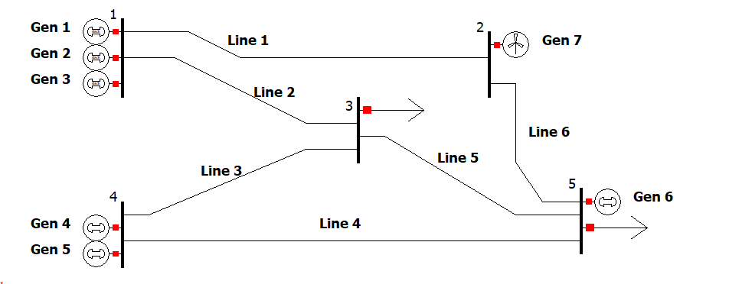
Assignment 5
Assignment 5 has to do with mixed-integer optimization using Python or Matlab with Gurobi (or another optimization platform)
You’ll be solving a unit commitment problem, which we’ll discuss in class next time.
For next class:
Read through the assignment instructions
Install and license Gurobi according to the instructions
Set it up for Matlab or Python according to the instructions
Run the example Matlab or Python case I provided you
Bring your laptop to class
We’ll have some time in class to work on this assignment (last one of the semester!)
Due date: November 20th, 2023 at 4pm

