Slide 1
ECEN 615, Fall 2023
Methods of Electric Power System Analysis
Class 15: Power System Sensitivities, Part 2
Prof. Adam Birchfield
Dept. of Electrical and Computer Engineering
Texas A&M University
abirchfield@tamu.edu

Slide 2
Five Bus Example Reference

Slide 3
Five Bus ISF, Line 4, Bus 2 (to Slack)

Slide 4
Five Bus Example
The row of A correspond to
the lines and transformers,
the columns correspond to
the non-slack buses (buses 2
to 5); for each line there
is a 1 at one end, a -1 at the
other end (hence an
assumed sign convention!).
Here we put a 1 for the
lower numbered bus, so positive flow is assumed from the lower numbered bus to the higher number

Slide 5
Five Bus Example
With bus 1 as the slack, the buses (columns) go for 2 to 5

Slide 6
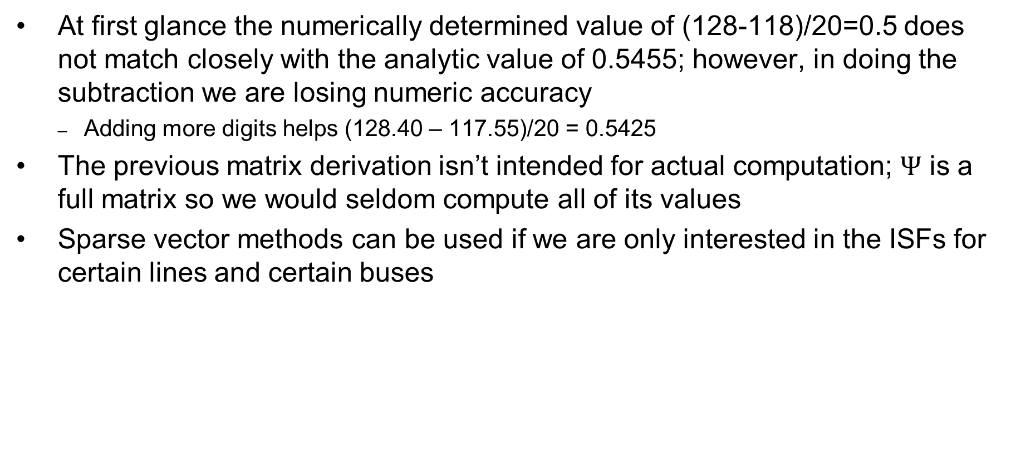
Five Bus Example Comments
At first glance the numerically determined value of (128-118)/20=0.5 does not match closely with the analytic value of 0.5455; however, in doing the subtraction we are losing numeric accuracy
  Adding more digits helps (128.40 – 117.55)/20 = 0.5425
The previous matrix derivation isn’t intended for actual computation; $Ψ$ is a full matrix so we would seldom compute all of its values
Sparse vector methods can be used if we are only interested in the ISFs for certain lines and certain buses

Slide 7
Distribution Factors
Various additional distribution factors may be defined
  power transfer distribution factor (PTDF)
  line outage distribution factor (LODF)
  line closure distribution factor (LCDF)
  outage transfer distribution factor (OTDF)
These factors may be derived from the ISFs making judicious use of the superposition principle

Slide 8
Definition: Basic Transaction
A basic transaction involves the transfer of a specified amount of power t from an injection node m to a withdrawal node n

Slide 9
Definition: Basic Transaction
We use the notation
to denote a basic transaction
injection node
withdrawal node
quantity

Slide 10
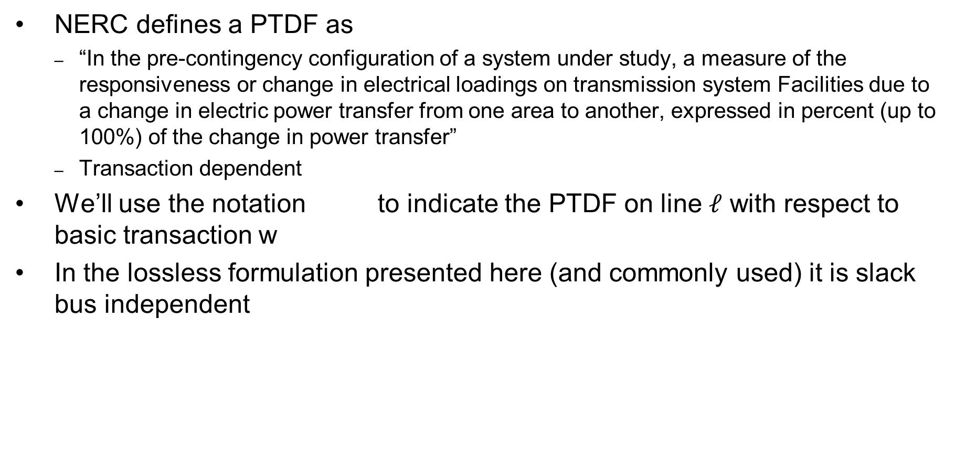
Definition: PTDF
NERC defines a PTDF as
  “In the pre-contingency configuration of a system under study, a measure of the responsiveness or change in electrical loadings on transmission system Facilities due to a change in electric power transfer from one area to another, expressed in percent (up to 100%) of the change in power transfer”
  Transaction dependent
We’ll use the notation to indicate the PTDF on line $ℓ$ with respect to basic transaction w
In the lossless formulation presented here (and commonly used) it is slack bus independent

Slide 11
PTDFs
Note, the PTDF is independent of the amount t; which is often expressed as a percent

Slide 12
PTDF Evaluation in Two Parts
=
+

Slide 13
PTDF Evaluation

Slide 14
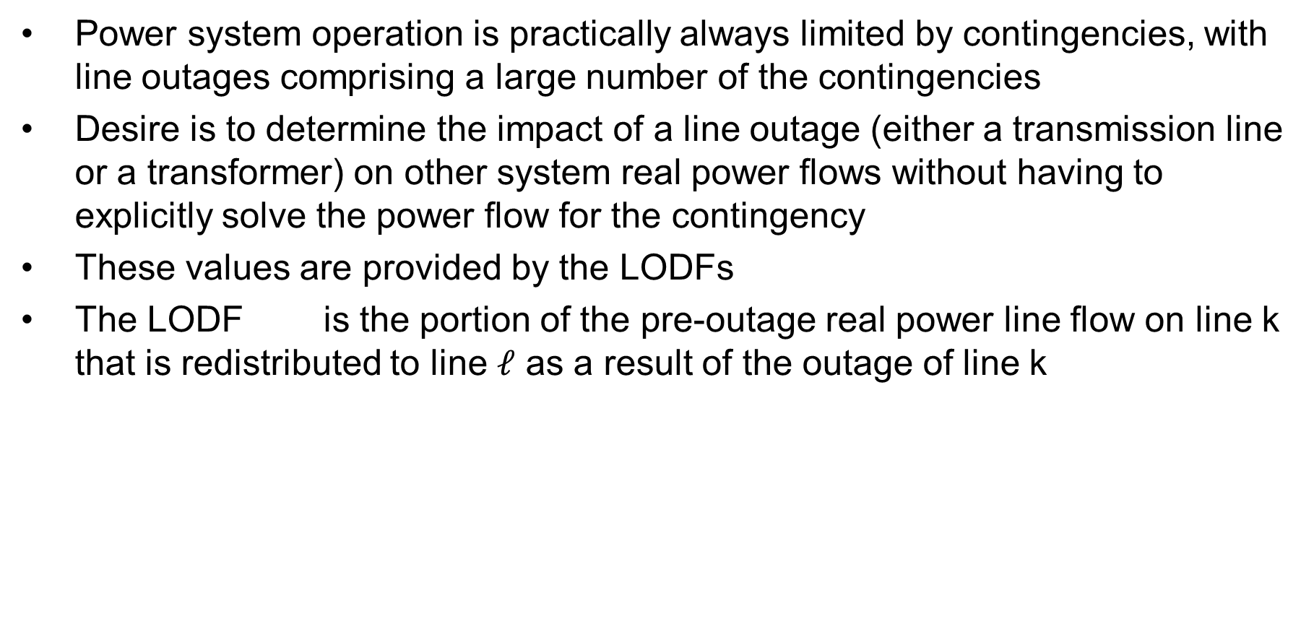
Line Outage Distribution Factors (LODFs)
Power system operation is practically always limited by contingencies, with line outages comprising a large number of the contingencies
Desire is to determine the impact of a line outage (either a transmission line or a transformer) on other system real power flows without having to explicitly solve the power flow for the contingency
These values are provided by the LODFs
The LODF is the portion of the pre-outage real power line flow on line k that is redistributed to line $ℓ$ as a result of the outage of line k

Slide 15
LODFs
outaged
base case
outage case
Best reference is Chapter 7 of the course book

Slide 16
LODF Evaluation
We simulate the impact of the outage of line k by adding the basic transaction
and selecting Δt_{k} in such a way that the flows on the dashed lines become exactly zero
In general this Δt_{k} is not
equal to the original line
flow

Slide 17
LODF Evaluation
We select Δtk to be such that
where Δƒ k is the active power flow change on the line k due to the transaction wk
The line k flow from wk depends on its PTDF
it follows that

Slide 18
LODF Evaluation
For the rest of the network, the impacts of the outage of line k are the same as the impacts of the additional basic transaction wk
Therefore, by definition the LODF is

Slide 19
Five Bus Example
Assume we wish to calculate the values for the outage of line 4 (between buses 2 and 3); this is line k
Say we wish
to know the change in flow
on the line
3 (Buses 3 to 4). PTDFs for
a transaction
from 2 to 3
are 0.7273
on line 4
and 0.0909
on line 3

Slide 20
Five Bus Example
Hence we get

Slide 21
Five Bus Example Compensated
Here is the
system with the
compensation
added to bus
2 and removed
at bus 3; we
are canceling
the impact of
the line 4 flow
for the reset
of the network.

Slide 22
Five Bus Example
Below we see the network with the line actually outaged
The line 3
flow changed
from 63 MW
to 106 MW,
an increase
of 43 MW,
matching the
LODF
value

Slide 23
Developing a Critical Eye
In looking at the below formula you need to be thinking about what conditions will cause the formula to fail
Here the obvious situation is when the denominator is zero
That corresponds to a situation in which the contingency causes system islanding
  An example is line 6 (between buses 4 and 5)
  Impact modeled by injections at the buses within each viable island

Slide 24
Line Closure Distribution Factors (LCDFs)
Closed line
base case
line k addition case

Slide 25
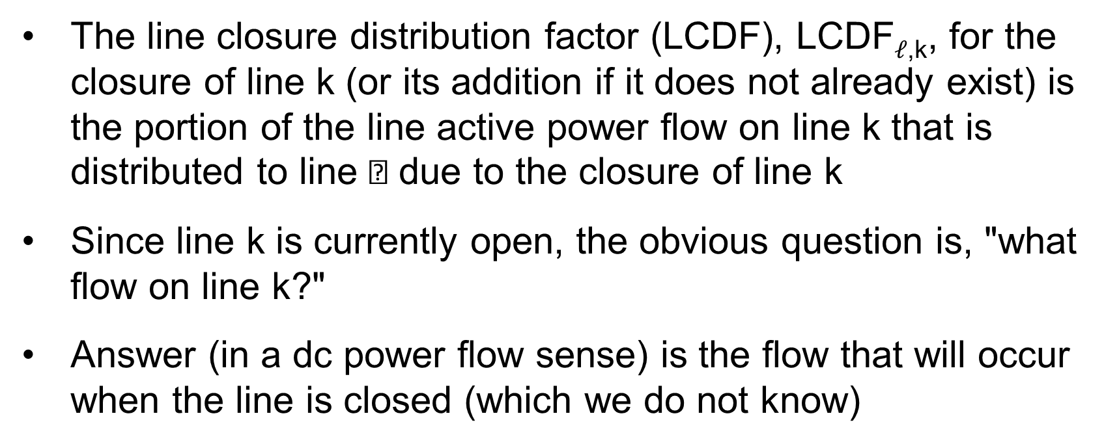
LCDF Definition
The line closure distribution factor (LCDF), LCDF$ℓ$_{,k}, for the closure of line k (or its addition if it does not already exist) is the portion of the line active power flow on line k that is distributed to line  due to the closure of line k
Since line k is currently open, the obvious question is, "what flow on line k?"
Answer (in a dc power flow sense) is the flow that will occur when the line is closed (which we do not know)

Slide 26
LCDF Evaluation
We simulate the impact of the closure of line k by imposing the additional basic transaction
on the base case network and we select Δt_{k} so that

Slide 27
LCDF Evaluation
For the other parts of the network, the impacts of the addition of line k are the same as the impacts of adding the basic transaction wk
Therefore, the definition is
The post-closure flow ƒk is determined (in a dc power flow sense) as the flow that would occur from the angle difference divided by (1 + )

Slide 28
Outage Transfer Distribution Factor
The outage transfer distribution factor (OTDF) is defined as the PTDF with the line k outaged
The OTDF applies only to the post-contingency configuration of the system since its evaluation explicitly considers the line k outage
This is a quite important value since power system operation is usually contingency constrained

Slide 29
Outage Transfer Distribution Factor (OTDF)
outaged
line

Slide 30
OTDF Evaluation
=
+

Slide 31
OTDF Evaluation
Since
and
then
so that

Slide 32
Five Bus Example
Say we would like to know the PTDF on line 1 for a transaction between buses 2 and 3 with line 2 out

Slide 33
Five Bus Example
Hence we want to calculate these values without having to explicitly outage line 2
Hence the
value we
are looking
for is 0.2
(20%)

Slide 34
Five Bus Example
Evaluating: the PTDF for the bus 2 to 3 transaction on line 1 is 0.2727; it is 0.1818 on line 2 (from buses 1 to 3); the LODF is on line 1 for the outage of line 2 is -0.4
Hence
For line 4 (buses 2 to 3) the value is

Slide 35
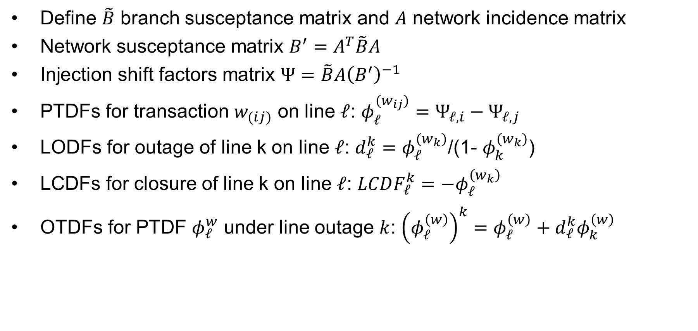
Summary of Sensitivity Calculations
Define $\tilde{B}$ branch susceptance matrix and $A$ network incidence matrix
Network susceptance matrix $B^{′}=A^{T}\tilde{B}A$
Injection shift factors matrix $Ψ=\tilde{B}A{\left(B^{′}\right)}^{−1}$
PTDFs for transaction $w_{(ij)}$ on line $ℓ$: $φ_{ℓ}^{(w_{ij})}=Ψ_{ℓ,i}−Ψ_{ℓ,j}$
LODFs for outage of line k on line $ℓ$: $d_{ℓ}^{k}=$ $φ_{ℓ}^{(w_{k})}$/(1- $φ_{k}^{(w_{k})}$)
LCDFs for closure of line k on line $ℓ$: $LCDF_{ℓ}^{k}=−φ_{ℓ}^{\left(w_{k}\right)}$
OTDFs for PTDF $φ_{ℓ}^{w}$ under line outage $k$: ${\left(φ_{ℓ}^{\left(w\right)}\right)}^{k}=φ_{ℓ}^{\left(w\right)}+d_{ℓ}^{k}φ_{k}^{\left(w\right)}$

Slide 36
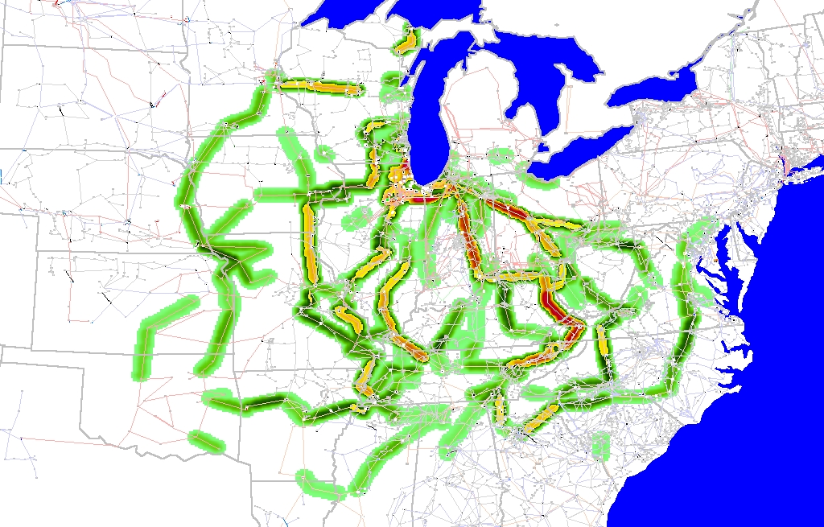
Eastern Interconnect Example: Wisconsin Utility to TVA PTDFs
In this
example
multiple
generators
contribute
for both
the seller
and the
buyer
Contours show lines that would carry at least 2% of a power transfer from Wisconsin to TVA

Slide 37
Additional Comments
Distribution factors are defined as small signal sensitivities, but in practice, they are also used for simulating large signal cases
Distribution factors are widely used in the operation of the electricity markets where the rapid evaluation of the impacts of each transaction on the line flows is required
Applications to actual system show that the distribution factors provide satisfactory results in terms of accuracy
For multiple applications that require fast turn around time, distribution factors are used very widely, particularly, in the market environment
They do not work well with reactive power!

Slide 38
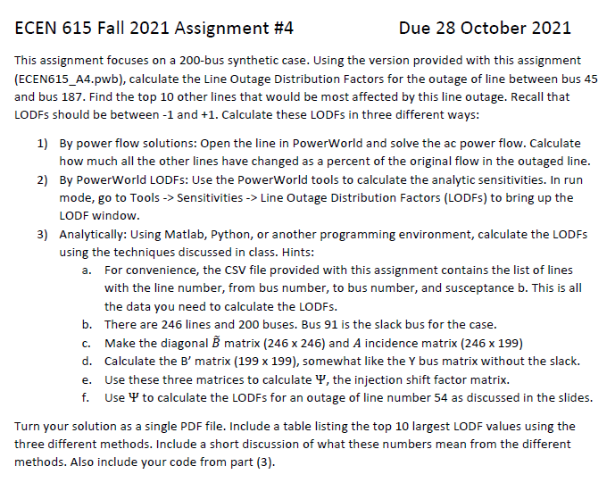
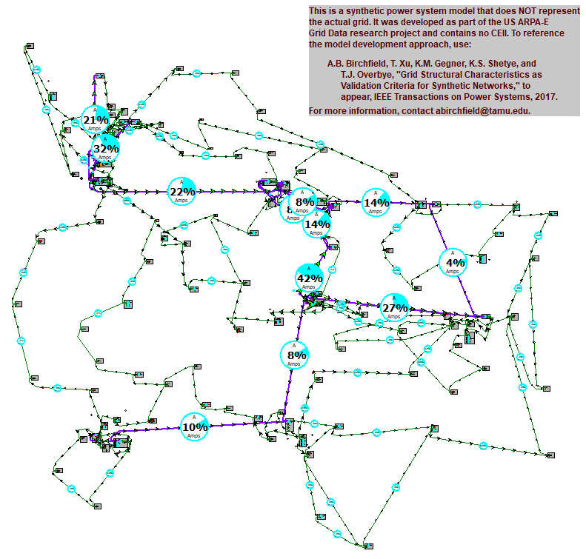
Assignment 4

