Slide 1
ECEN 615, Fall 2023
Methods of Electric Power System Analysis
Class 13: Power System Sensitivities, Part 1
Prof. Adam Birchfield
Dept. of Electrical and Computer Engineering
Texas A&M University
abirchfield@tamu.edu

Slide 2
Announcements
Assignment 3 due date changed to Monday, Oct 30th at 4pm
Assignment 4 is assigned today and on the website, with due date of Wednesday, Nov 8th at 4pm
Be reading/reviewing sparse matrices

Slide 3
Sparse Matrix Review
Write this matrix in all the sparse formats we’ve talked about
Draw the graph equivalent
What is the Tinney 1 and Tinney 2 ordering of the buses?
General questions:
  What are fills?
  What is pivoting and why do we do it?
  Approximate computational order of power flow with sparse matrix techniques?
5 |  |  | -2 |  | -1 | -1
 | 3 | -3
 | -3 | 19 | -2 | -4 |  | -10
-2 |  | -2 | 10 |  |  |  |  | -6
 |  | -4 |  | 14 |  | -10
-1 |  |  |  |  | 2
-1 |  | -10 |  | -10 |  | 32 | -9 | -2
 |  |  |  |  |  | -9 | 16 | -7
 |  |  | -6 |  |  | -2 | -7 | 17 | -2
 |  |  |  |  |  |  |  | -2 | 2

Slide 4
Contingency Analysis
Contingency analysis is the process of checking the impact of statistically likely contingencies
  Example contingencies include the loss of a generator, the loss of a transmission line or the loss of all transmission lines in a common corridor
  Statistically likely contingencies can be quite involved, and might include automatic or operator actions, such as switching load
Reliable power system operation requires that the system be able to operate with no unacceptable violations even when these contingencies occur
  N-1 reliable operation considers the loss of any single element

Slide 5
Contingency Analysis
Of course this process can be automated with the usual approach of first defining a contingency set, and then sequentially applying the contingencies and checking for violations
  This process can naturally be done in parallel
  Contingency sets can get quite large, especially if one considers N-2 (outages of two elements) or N-1-1 (initial outage, followed by adjustment, then second outage
The assumption is usually most contingencies will not cause problems, so screening methods can be used to quickly eliminate many contingencies
  We’ll cover these later

Slide 6
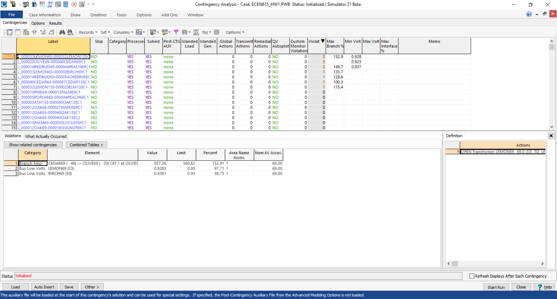
Contingency Analysis in PowerWorld
Automated using the Contingency Analysis tool

Slide 7
Power System Control and Sensitivities
A major issue with power system operation is the limited capacity of the transmission system
  lines/transformers have limits (usually thermal)
  no direct way of controlling flow down a transmission line (e.g., there are no valves to close to limit flow)
  open transmission system access associated with industry restructuring is stressing the system in new ways
We need to indirectly control transmission line flow by changing the generator outputs
Similar control issues with voltage

Slide 8
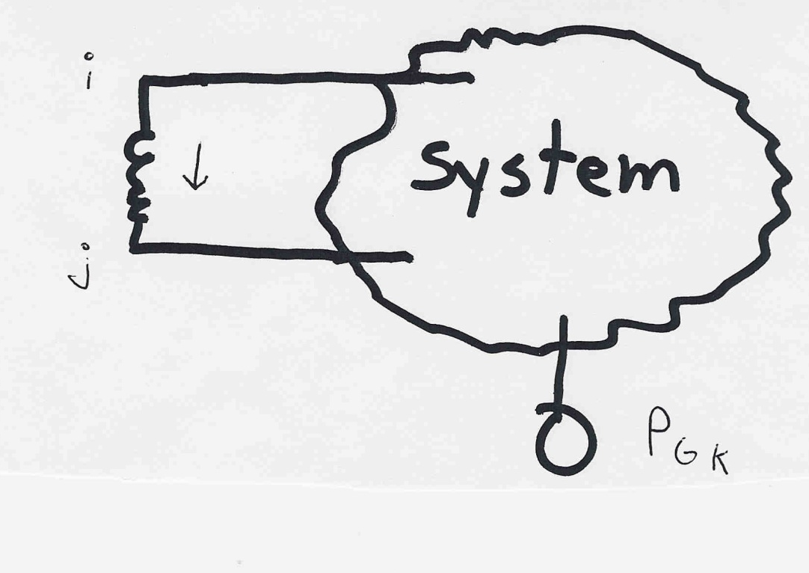
Indirect Transmission Line Control
What we would like to determine is how a change in generation at bus k affects the power flow on a line from bus i to bus j.
The assumption is
that the change
in generation is
absorbed by the
slack bus

Slide 9
Power Flow Simulation - Before
One way to determine the impact of a generator change is to compare a before/after power flow.
For example below is a three bus case with an overload

Slide 10
Power Flow Simulation - After
Increasing the generation at bus 3 by 95 MW (and hence decreasing it at bus 1 by a corresponding amount), results in a 30.3 MW drop in the MW flow on the line from bus 1 to 2, and a 64.7 MW drop
on the flow from 1 to 3.
Expressed as a
percent,
30.3/95 =32% and
64.7/95=68%

Slide 11
Analytic Calculation of Sensitivities
Calculating control sensitivities by repeat power flow solutions is tedious and would require many power flow solutions. An alternative approach is to analytically calculate these values

Slide 12
Analytic Sensitivities

Slide 13
Three Bus Sensitivity Example

Slide 14
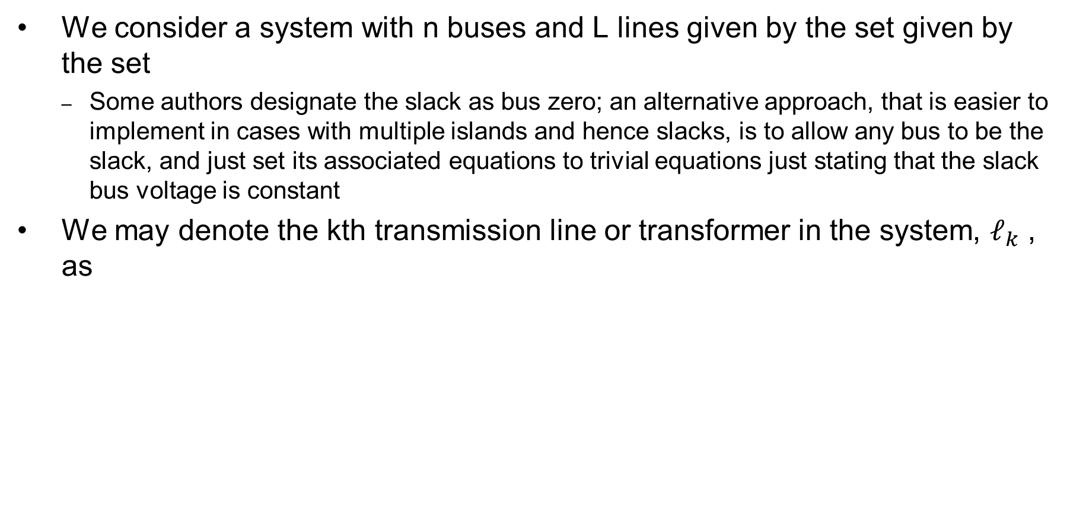
General Sensitivity Analysis: Notation
We consider a system with n buses and L lines given by the set given by the set
  Some authors designate the slack as bus zero; an alternative approach, that is easier to implement in cases with multiple islands and hence slacks, is to allow any bus to be the slack, and just set its associated equations to trivial equations just stating that the slack bus voltage is constant
We may denote the kth transmission line or transformer in the system, $ℓ_{k}$ , as
from node
to node

Slide 15
Notation, cont.
We’ll denote the real power flowing on k from bus i to bus j as k
The vector of real power flows on the L lines is:
which we simplify to
The bus real and reactive power injection vectors are

Slide 16
Notation, cont.
The series admittance of line is g +jb and we define
We define the L×N incidence matrix
The component j of a_{i} is
nonzero whenever line is
coincident with node j. Hence
A is quite sparse, with two
nonzeros per row

Slide 17
Analysis Example: Available Transfer Capability
The power system available transfer capability or ATC is defined as the maximum additional MW that can be transferred between two specific areas, while meeting all the specified pre- and post-contingency system conditions
ATC impacts measurably the market outcomes and system reliability and, therefore, the ATC values impact the system and market behavior
A useful reference on ATC is Available Transfer Capability Definitions and Determination from NERC, June 1996 (available online)

Slide 18
ATC and Its Key Components
Total transfer capability (TTC )
  Amount of real power that can be transmitted across an interconnected transmission network in a reliable manner, including considering contingencies
Transmission reliability margin (TRM)
  Amount of TTC needed to deal with uncertainties in system conditions; typically expressed as a percent of TTC
Capacity benefit margin (CBM)
  Amount of TTC needed by load serving entities to ensure access to generation; typically expressed as a percent of TTC

Slide 19
ATC and Its Key Components
Uncommitted transfer capability (UTC)
UTC = TTC – existing transmission commitment
Formal definition of ATC is
ATC = UTC – CBM – TRM
We focus on determining Um,n, the UTC from node m to node n
Um,n is defined as the maximum additional MW that can be transferred from node m to node n without violating any limit in either the base case or in any post-contingency conditions
Calculation of this in a brute force way can be computational difficult

Slide 20
Sensitivity Problem Formulation
Denote the system state by
Denote the conditions corresponding to the existing commitment/dispatch by s(0), p(0) and f(0) so that
the power flow equations
line real power flow vector

Slide 21
Sensitivity Problem Formulation
g includes the real and reactive
power balance equations

Slide 22
Sensitivity Problem Formulation
For a small change, Δp, that moves the injection from p(0) to p(0) + Δp , we have a corresponding change in the state Δx with
We then apply a first order Taylor’s series expansion

Slide 23
Sensitivity Problem Formulation
We consider this to be a “small signal” change, so we can neglect the higher order terms (h.o.t.) in the expansion
Hence we should still be satisfying the power balance equations with this perturbation; so

Slide 24
Sensitivity Problem Formulation
Also, from the power flow equations, we obtain
and then just the power flow Jacobian

Slide 25
Sensitivity Problem Formulation
With the standard assumption that the power flow Jacobian is nonsingular, then
We can then compute the change in the line real power flow vector

Slide 26
Sensitivity Comments
Sensitivities can easily be calculated even for large systems
  If Δp is sparse (just a few injections) then we can use a fast forward; if sensitivities on a subset of lines are desired we could also use a fast backward
Sensitivities are dependent upon the operating point
  They also include the impact of marginal losses
Sensitivities could easily be expanded to include additional variables in x (such as phase shifter angle), or additional equations, such as reactive power flow

Slide 27
Linearized Sensitivity Analysis
By using the approximations from the fast decoupled power flow we can get sensitivity values that are independent of the current state. That is, by using the B’ and B’’ matrices
For line flow we can approximate

Slide 28
Linearized Sensitivity Analysis
Also, for each line
and so,

Slide 29

Sensitivity Analysis: Recall the Matrix Notation
The series admittance of line $ℓ$ is g +jb and we define
We define the L×N incidence matrix
where the component j of a_{i} is
nonzero whenever line _{i} is
coincident with node j. Hence
A is quite sparse, with at most two nonzeros per row

Slide 30
Linearized Active Power Flow Model
Under these assumptions the change in the real power line flows are given as
The constant matrix
is called the injection shift factor matrix (ISF)

Slide 31
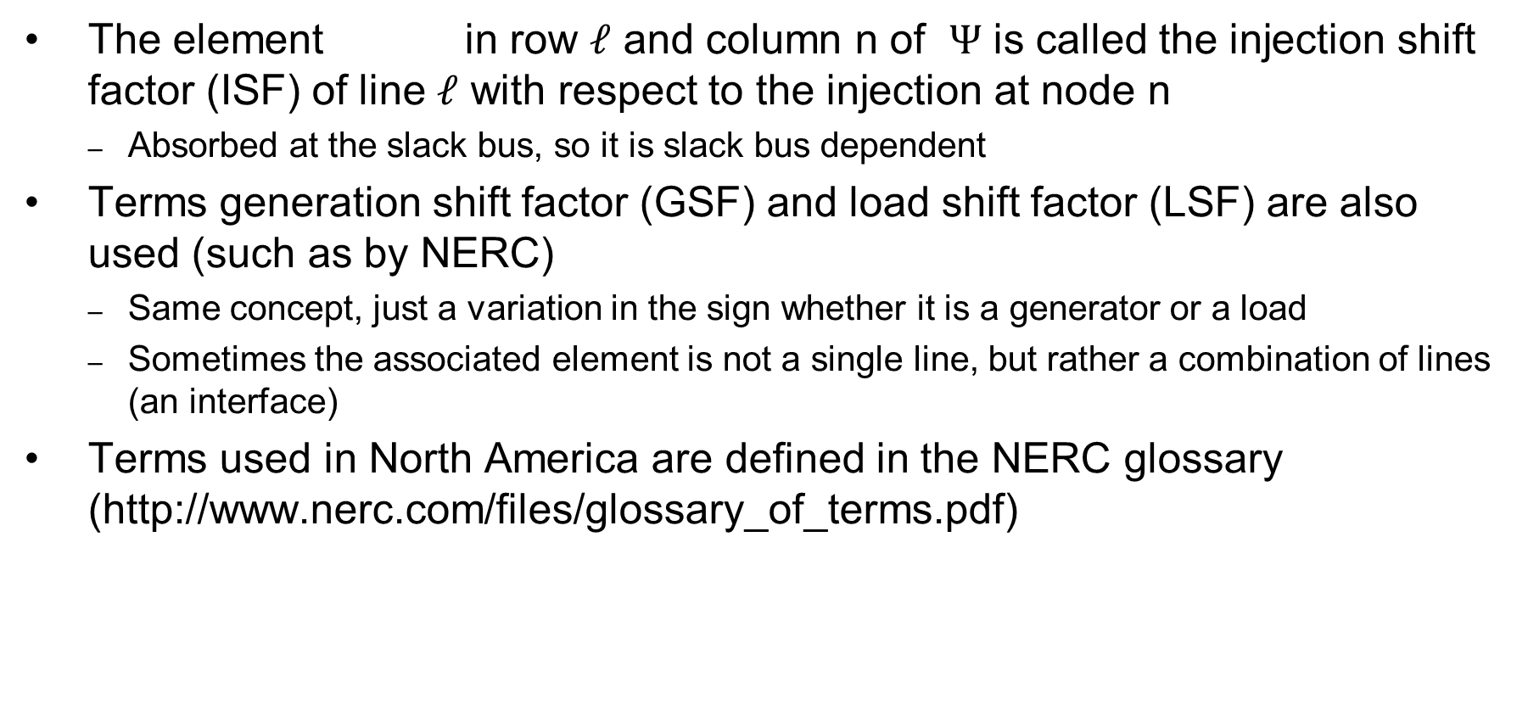
Injection Shift Factors (ISFs)
The element in row $ℓ$ and column n of $Ψ$ is called the injection shift factor (ISF) of line $ℓ$ with respect to the injection at node n
  Absorbed at the slack bus, so it is slack bus dependent
Terms generation shift factor (GSF) and load shift factor (LSF) are also used (such as by NERC)
  Same concept, just a variation in the sign whether it is a generator or a load
  Sometimes the associated element is not a single line, but rather a combination of lines (an interface)
Terms used in North America are defined in the NERC glossary (http://www.nerc.com/files/glossary_of_terms.pdf)

Slide 32

ISF Interpretation
is the fraction of the additional 1 MW injection at node n that goes though line $ℓ$
slack
node

Slide 33

ISF Properties
By definition, depends on the location of the slack bus
By definition, for since the injection and withdrawal buses are identical in this case and, consequently, no flow arises on any line $ℓ$
The magnitude of is at most 1 since
Note, this is strictly true only for the linear (lossless)
case. In the nonlinear case, it is possible that a
transaction decreases losses. Hence a 1 MW injection
could change a line flow by more than 1 MW.

Slide 34
Five Bus Example Reference

Slide 35
Five Bus ISF, Line 4, Bus 2 (to Slack)

Slide 36
Five Bus Example
The row of A correspond to
the lines and transformers,
the columns correspond to
the non-slack buses (buses 2
to 5); for each line there
is a 1 at one end, a -1 at the
other end (hence an
assumed sign convention!).
Here we put a 1 for the
lower numbered bus, so positive flow is assumed from the lower numbered bus to the higher number

Slide 37
Five Bus Example
With bus 1 as the slack, the buses (columns) go for 2 to 5

Slide 38
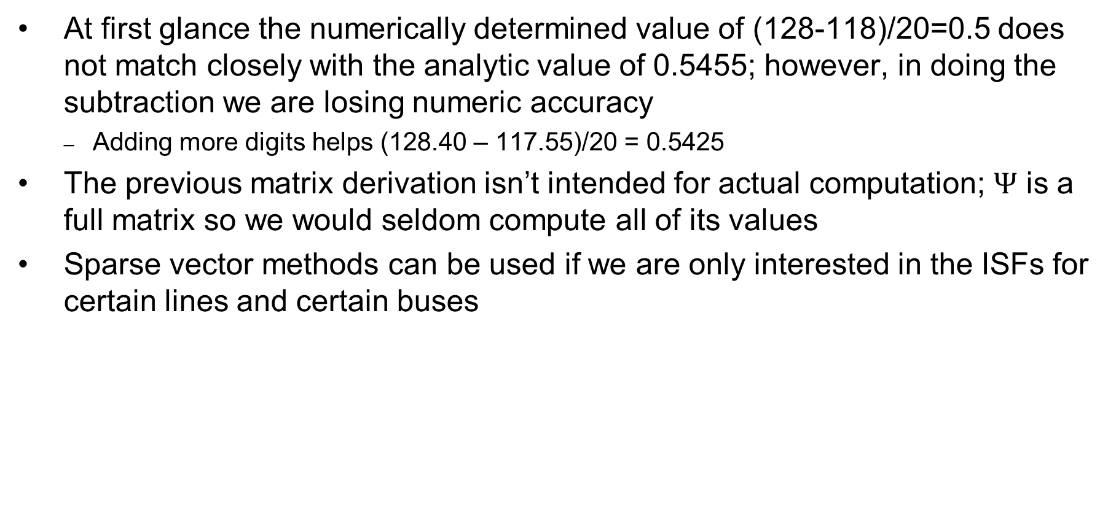
Five Bus Example Comments
At first glance the numerically determined value of (128-118)/20=0.5 does not match closely with the analytic value of 0.5455; however, in doing the subtraction we are losing numeric accuracy
  Adding more digits helps (128.40 – 117.55)/20 = 0.5425
The previous matrix derivation isn’t intended for actual computation; $Ψ$ is a full matrix so we would seldom compute all of its values
Sparse vector methods can be used if we are only interested in the ISFs for certain lines and certain buses

Slide 39
Distribution Factors
Various additional distribution factors may be defined
  power transfer distribution factor (PTDF)
  line outage distribution factor (LODF)
  line closure distribution factor (LCDF)
  outage transfer distribution factor (OTDF)
These factors may be derived from the ISFs making judicious use of the superposition principle

Slide 40
Definition: Basic Transaction
A basic transaction involves the transfer of a specified amount of power t from an injection node m to a withdrawal node n

Slide 41
Definition: Basic Transaction
We use the notation
to denote a basic transaction
injection node
withdrawal node
quantity

Slide 42
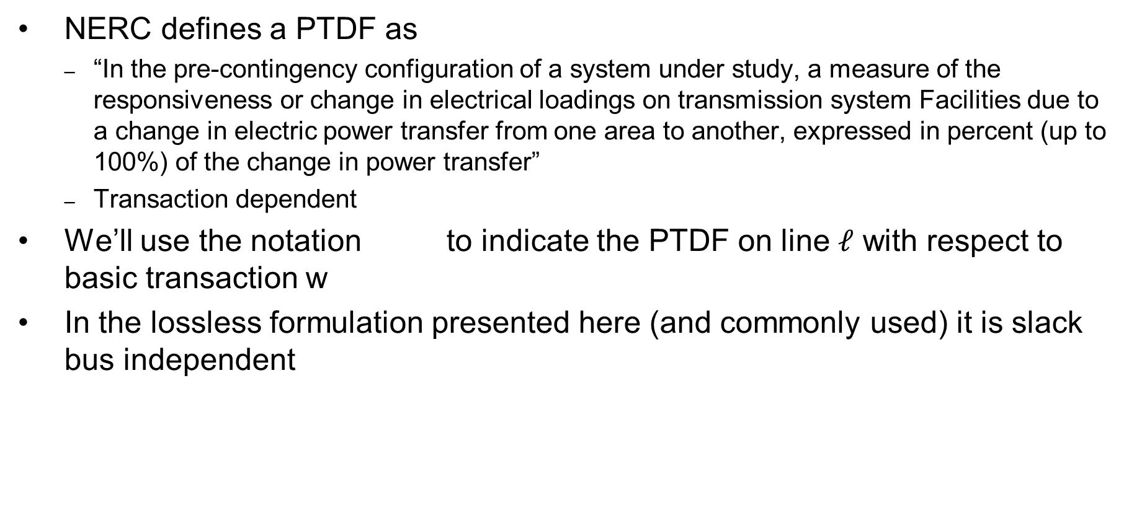
Definition: PTDF
NERC defines a PTDF as
  “In the pre-contingency configuration of a system under study, a measure of the responsiveness or change in electrical loadings on transmission system Facilities due to a change in electric power transfer from one area to another, expressed in percent (up to 100%) of the change in power transfer”
  Transaction dependent
We’ll use the notation to indicate the PTDF on line $ℓ$ with respect to basic transaction w
In the lossless formulation presented here (and commonly used) it is slack bus independent

Slide 43
PTDFs
Note, the PTDF is independent of the amount t; which is often expressed as a percent

Slide 44
PTDF Evaluation in Two Parts
=
+

Slide 45
PTDF Evaluation

Slide 46
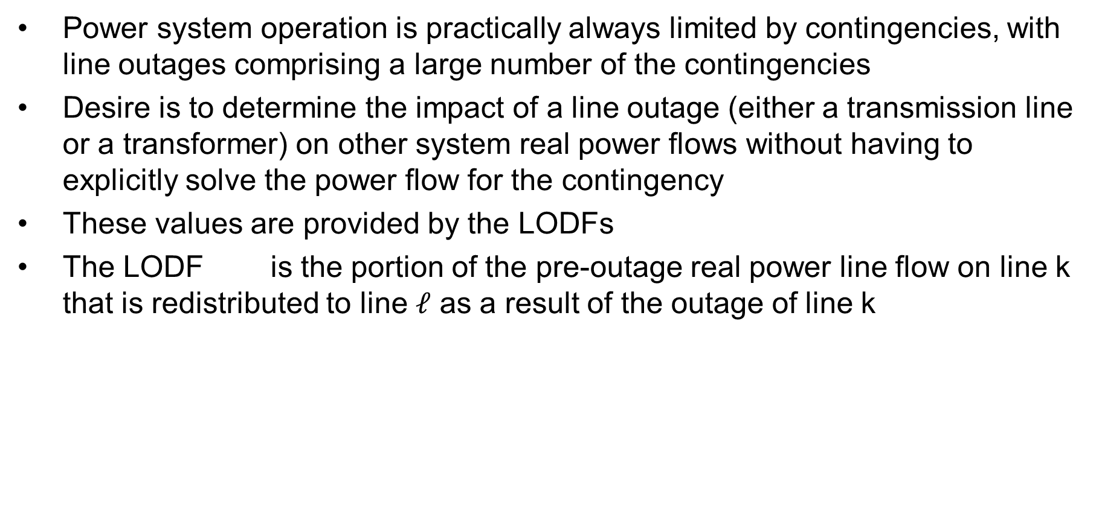
Line Outage Distribution Factors (LODFs)
Power system operation is practically always limited by contingencies, with line outages comprising a large number of the contingencies
Desire is to determine the impact of a line outage (either a transmission line or a transformer) on other system real power flows without having to explicitly solve the power flow for the contingency
These values are provided by the LODFs
The LODF is the portion of the pre-outage real power line flow on line k that is redistributed to line $ℓ$ as a result of the outage of line k

Slide 47
LODFs
outaged
base case
outage case
Best reference is Chapter 7 of the course book

Slide 48
LODF Evaluation
We simulate the impact of the outage of line k by adding the basic transaction
and selecting Δt_{k} in such a way that the flows on the dashed lines become exactly zero
In general this Δt_{k} is not
equal to the original line
flow

Slide 49
LODF Evaluation
We select Δtk to be such that
where Δƒ k is the active power flow change on the line k due to the transaction wk
The line k flow from wk depends on its PTDF
it follows that

Slide 50
LODF Evaluation
For the rest of the network, the impacts of the outage of line k are the same as the impacts of the additional basic transaction wk
Therefore, by definition the LODF is

Slide 51
Five Bus Example
Assume we wish to calculate the values for the outage of line 4 (between buses 2 and 3); this is line k
Say we wish
to know the change in flow
on the line
3 (Buses 3 to 4). PTDFs for
a transaction
from 2 to 3
are 0.7273
on line 4
and 0.0909
on line 3

Slide 52
Five Bus Example
Hence we get

Slide 53
Five Bus Example Compensated
Here is the
system with the
compensation
added to bus
2 and removed
at bus 3; we
are canceling
the impact of
the line 4 flow
for the reset
of the network.

Slide 54
Five Bus Example
Below we see the network with the line actually outaged
The line 3
flow changed
from 63 MW
to 106 MW,
an increase
of 43 MW,
matching the
LODF
value

Slide 55
Developing a Critical Eye
In looking at the below formula you need to be thinking about what conditions will cause the formula to fail
Here the obvious situation is when the denominator is zero
That corresponds to a situation in which the contingency causes system islanding
  An example is line 6 (between buses 4 and 5)
  Impact modeled by injections at the buses within each viable island

Slide 56
Line Closure Distribution Factors (LCDFs)
Closed line
base case
line k addition case

Slide 57
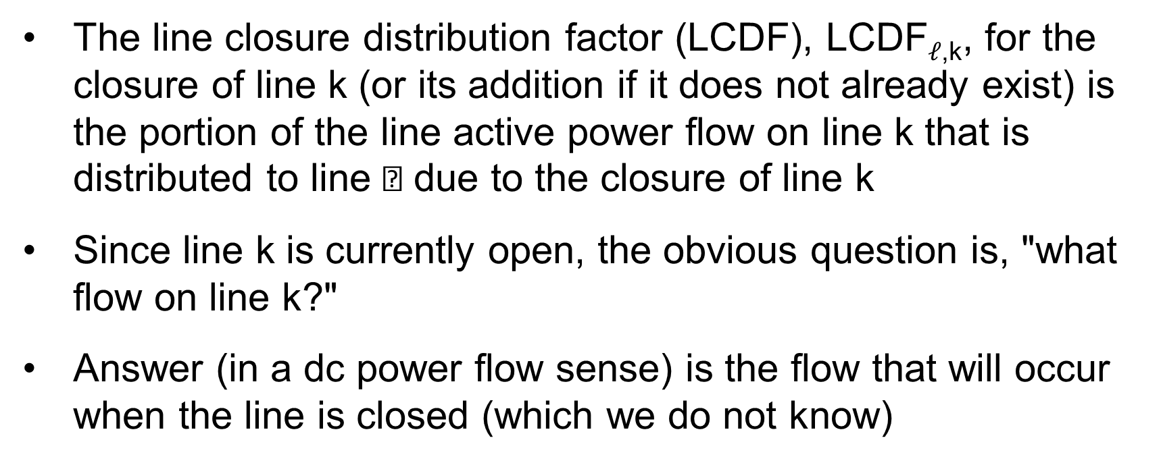
LCDF Definition
The line closure distribution factor (LCDF), LCDF$ℓ$_{,k}, for the closure of line k (or its addition if it does not already exist) is the portion of the line active power flow on line k that is distributed to line  due to the closure of line k
Since line k is currently open, the obvious question is, "what flow on line k?"
Answer (in a dc power flow sense) is the flow that will occur when the line is closed (which we do not know)

Slide 58
LCDF Evaluation
We simulate the impact of the closure of line k by imposing the additional basic transaction
on the base case network and we select Δt_{k} so that

Slide 59
LCDF Evaluation
For the other parts of the network, the impacts of the addition of line k are the same as the impacts of adding the basic transaction wk
Therefore, the definition is
The post-closure flow ƒk is determined (in a dc power flow sense) as the flow that would occur from the angle difference divided by (1 + )

Slide 60
Outage Transfer Distribution Factor
The outage transfer distribution factor (OTDF) is defined as the PTDF with the line k outaged
The OTDF applies only to the post-contingency configuration of the system since its evaluation explicitly considers the line k outage
This is a quite important value since power system operation is usually contingency constrained

Slide 61
Outage Transfer Distribution Factor (OTDF)
outaged
line

Slide 62
OTDF Evaluation
=
+

Slide 63
OTDF Evaluation
Since
and
then
so that

Slide 64
Five Bus Example
Say we would like to know the PTDF on line 1 for a transaction between buses 2 and 3 with line 2 out

Slide 65
Five Bus Example
Hence we want to calculate these values without having to explicitly outage line 2
Hence the
value we
are looking
for is 0.2
(20%)

Slide 66
Five Bus Example
Evaluating: the PTDF for the bus 2 to 3 transaction on line 1 is 0.2727; it is 0.1818 on line 2 (from buses 1 to 3); the LODF is on line 1 for the outage of line 2 is -0.4
Hence
For line 4 (buses 2 to 3) the value is

Slide 67
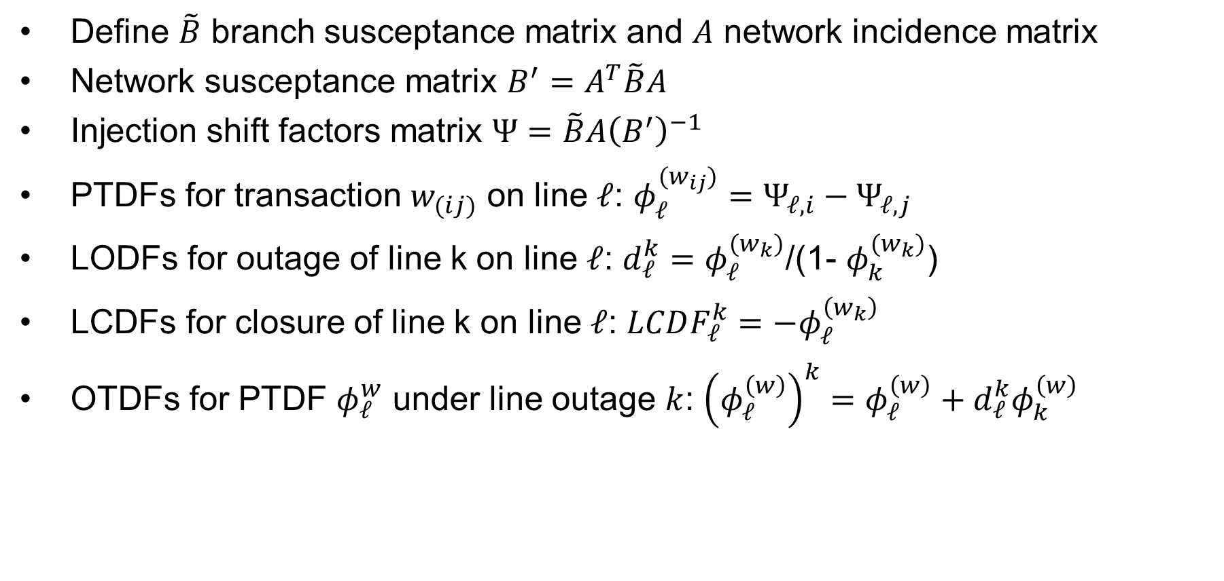
Summary of Sensitivity Calculations
Define $\tilde{B}$ branch susceptance matrix and $A$ network incidence matrix
Network susceptance matrix $B^{′}=A^{T}\tilde{B}A$
Injection shift factors matrix $Ψ=\tilde{B}A{\left(B^{′}\right)}^{−1}$
PTDFs for transaction $w_{(ij)}$ on line $ℓ$: $φ_{ℓ}^{(w_{ij})}=Ψ_{ℓ,i}−Ψ_{ℓ,j}$
LODFs for outage of line k on line $ℓ$: $d_{ℓ}^{k}=$ $φ_{ℓ}^{(w_{k})}$/(1- $φ_{k}^{(w_{k})}$)
LCDFs for closure of line k on line $ℓ$: $LCDF_{ℓ}^{k}=−φ_{ℓ}^{\left(w_{k}\right)}$
OTDFs for PTDF $φ_{ℓ}^{w}$ under line outage $k$: ${\left(φ_{ℓ}^{\left(w\right)}\right)}^{k}=φ_{ℓ}^{\left(w\right)}+d_{ℓ}^{k}φ_{k}^{\left(w\right)}$

Slide 68
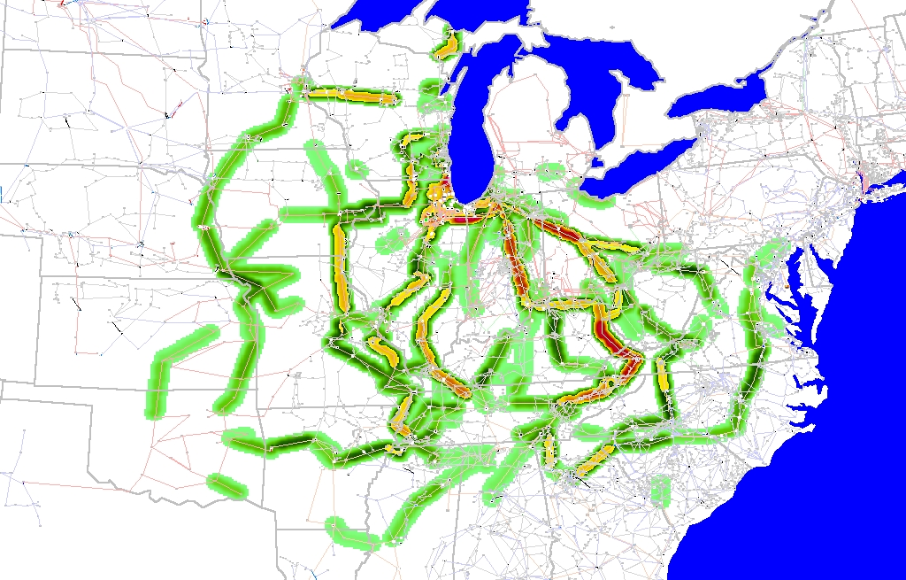
Eastern Interconnect Example: Wisconsin Utility to TVA PTDFs
In this
example
multiple
generators
contribute
for both
the seller
and the
buyer
Contours show lines that would carry at least 2% of a power transfer from Wisconsin to TVA

Slide 69
Additional Comments
Distribution factors are defined as small signal sensitivities, but in practice, they are also used for simulating large signal cases
Distribution factors are widely used in the operation of the electricity markets where the rapid evaluation of the impacts of each transaction on the line flows is required
Applications to actual system show that the distribution factors provide satisfactory results in terms of accuracy
For multiple applications that require fast turn around time, distribution factors are used very widely, particularly, in the market environment
They do not work well with reactive power!

Slide 70

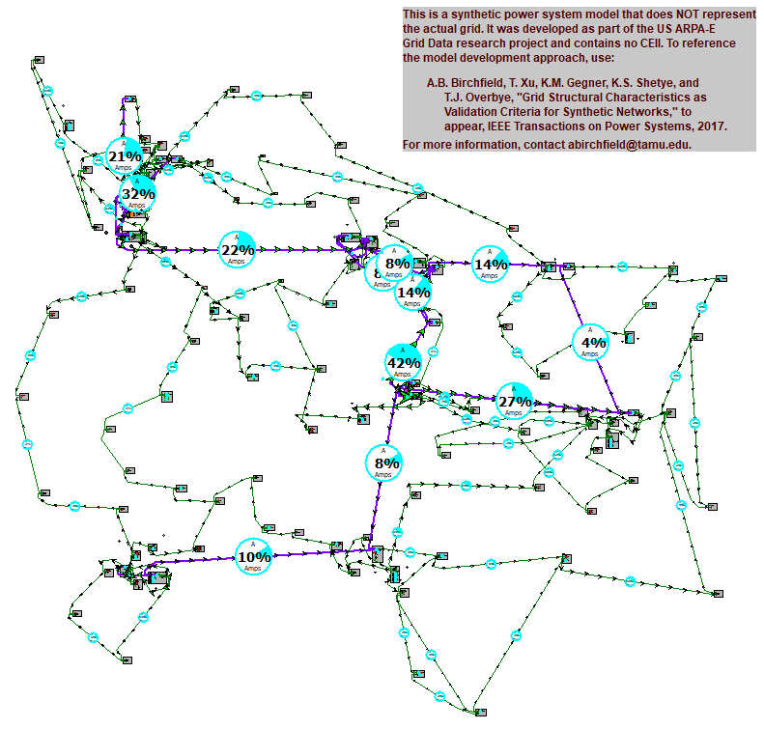
Assignment 4

