Slide 1
ECEN 615, Fall 2023
Methods of Electric Power System Analysis
Class 8: Power Flow Computational Techniques and Approximations, Part 2
Prof. Adam Birchfield
Dept. of Electrical and Computer Engineering
Texas A&M University
abirchfield@tamu.edu

Slide 2
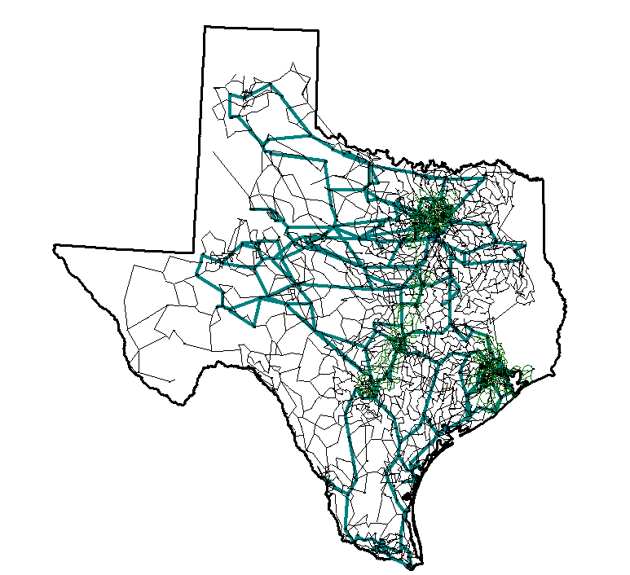
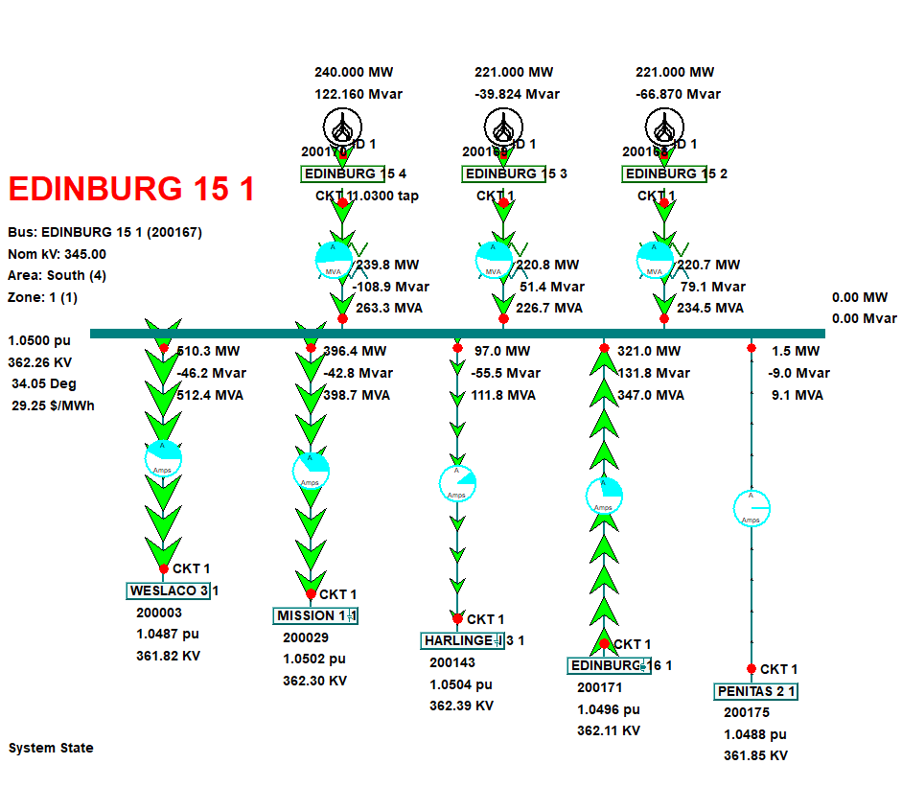
Exercise: Assignment 2 Part 2

Slide 3
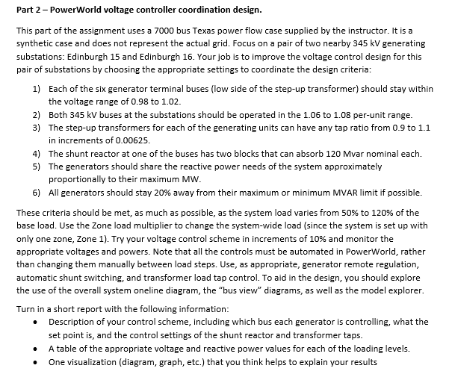
Advanced: Contingency analysis

Slide 4
Power Flow Optimal Multiplier
Classic reference on power flow optimal multiplier is S. Iwamoto, Y. Tamura, “A Load Flow Calculation Method for Ill-Conditioned Power Systems,” IEEE Trans. Power App. and Syst., April 1981
Another paper is J.E. Tate, T.J. Overbye, “A Comparison of the Optimal Multiplier in Power and Rectangular Coordinates,” IEEE Trans. Power Systems, Nov. 2005
Key idea is once NR method has selected a direction, we can analytically determine the distance to move in that direction to minimize the norm of the mismatch
  Goal is to help with stressed power systems

Slide 5
Power Flow with Optimal Multiplier
Consider an n bus power system with f(x) = S where S is the vector of the constant real and reactive power load minus generation at all buses except the slack, x is the vector of the bus voltages in rectangular coordinates: Vi = ei + jfi, and f is the function of the power balance constraints

Slide 6
Power Flow with Optimal Multiplier
With a standard NR approach, we would get
If we are close enough to the solution the iteration converges quickly, but if the system is heavily loaded it can diverge

Slide 7
Power Flow with Optimal Multiplier
Optimal multiplier approach modifies the iteration as
Scalar m is chosen to minimize the norm of the mismatch F in direction Δx
Paper by Iwamoto, Y. Tamura from 1981 shows m can be computed analytically with little additional calculation when rectangular voltages are used

Slide 8
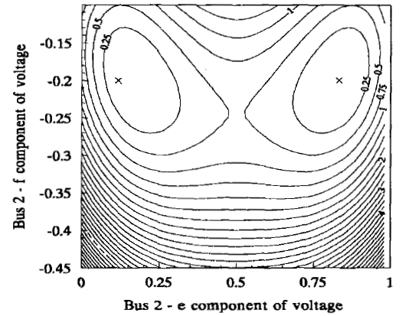
Power Flow with Optimal Multiplier
Determination of m involves solving a cubic equation, which gives either three real solutions, or one real and two imaginary solutions
1989 PICA paper by Iba
(“A Method for Finding a
Pair of Multiple Load
Flow Solutions in Bulk
Power Systems”) showed
that NR tends to converge
along line joining the high
and a low voltage solution
However, there are some model restrictions

Slide 9
Sparse Matrix Methods
The crucial part of the computation of the power flow deals with the matrix algebra, building and factoring the Jacobian
The Jacobian is very sparse, that is, most entries are zero. For large systems, well over 99% of the entries are zero.
A lot of key computational techniques take advantage of this sparsity.
We'll be looking at these methods in more detail after the first exam.

Slide 10
Quasi-Newton Power Flow Methods
First we consider some modified versions of the Newton power flow (NPF)
Since most of the computation in the NPF is associated with building and factoring the Jacobian matrix, J, the focus is on trying to reduce this computation
In a pure NPF J is build and factored each iteration
Over the years pretty much every variation of the NPF has been tried; here we just touch on the most common
Whether a method is effective can be application dependent
  For example, in contingency analysis we are usually just resolving a solved case with an often small perturbation

Slide 11
Quasi-Newton Power Flow Methods
The simplest modification of the NPF results when J is kept constant for a number of iterations, say k iterations
  Sometimes known as the Dishonest Newton
The approach balances increased speed per iteration, with potentially more iterations to perform
There is also an increased possibility for divergence
Since the mismatch equations are not modified, if it converges it should converge to the same solution as the NPF
These methods are not commonly used, except in very short duration, sequential power flows with small mismatches

Slide 12
Dishonest N-R Example
We pay a price
in increased
iterations, but
with decreased
computation
per iteration; that
price is too high
in this example

Slide 13
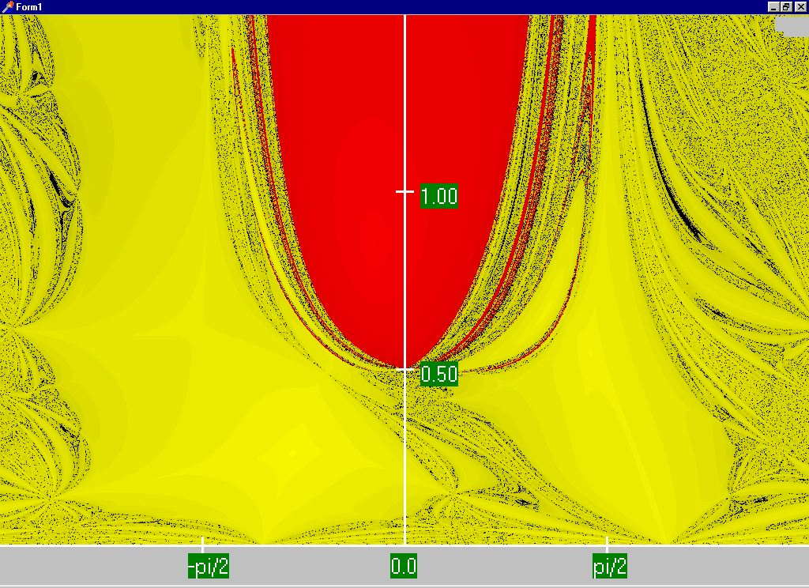
NPF (Honest) Region of for Two Bus Example Convergence
Red region converges to the high voltage solution, while the yellow region converges to the low voltage solution
Maximum
of 15 iterations

Slide 14
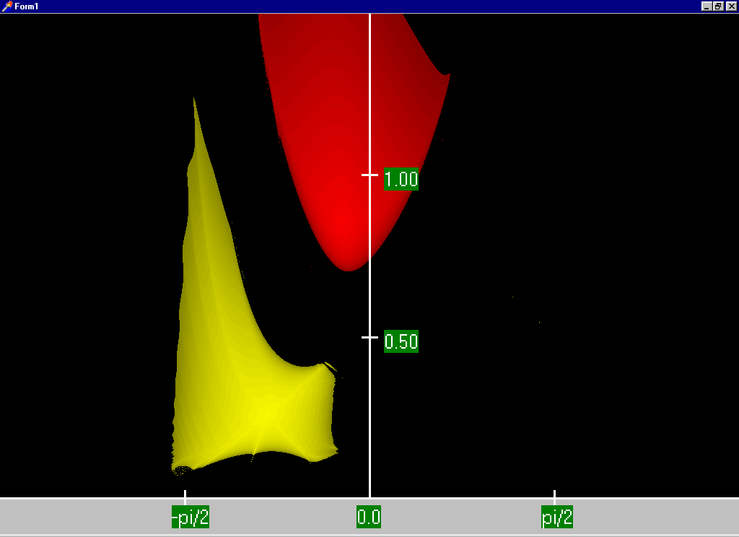
Two Bus Dishonest ROC
In this case being honest pays! At least with respect to the region of convergence (ROC)

Slide 15
Quasi-Newton Power Flow Methods
A second modification is to modify the step size in the direction given by the NPF
  This is one we’ve already considered with the optimal multiplier approach
The generalized approach is to solve what is known as the line search (i.e., a one-dimensional optimization) to determine μ

Slide 16
The Single Dimensional ψ (l)
0

Slide 17
Line Search
We need a cost function, which is usually the Euclidean norm of the mismatch vector
The line search is a general optimization problem for which there are many potential solution approaches
  Determines a local optimum within some search boundaries
  Approaches depend on whether there is gradient information available
Aside from the optimal multiplier approach, which can be quite helpful with little additional computation, the convergence gain from determining the “optimal” μ is usually more than offset by the line search computation

Slide 18
Decoupled Power Flow
Rather than not updating the Jacobian, the decoupled power flow takes advantage of characteristics of the power grid in order to decouple the real and reactive power balance equations
  There is a strong coupling between real power and voltage angle, and reactive power and voltage magnitude
  There is a much weaker coupling between real power and voltage angle, and reactive power and voltage angle
Key reference is B. Stott, “Decoupled Newton Load Flow,” IEEE Trans. Power. App and Syst., Sept/Oct. 1972, pp. 1955-1959

Slide 19
Decoupled Power Flow Formulation

Slide 20
Decoupling Approximation

Slide 21
Off-diagonal Jacobian Terms
By assuming ½ the elements are zero, we only have to do
½ the computations

Slide 22
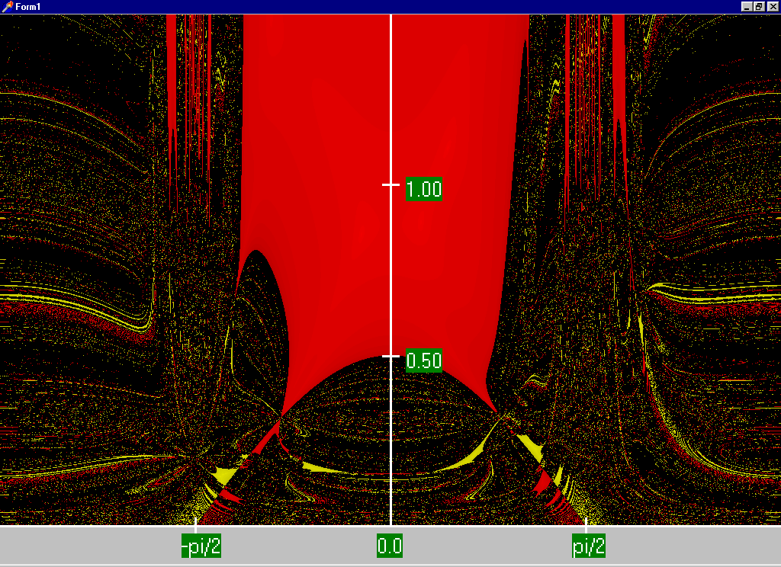
Decoupled N-R Region of Convergence
The high solution ROC is actually larger than with the standard NPF. Obviously this is not a good a way to get the low solution

Slide 23
Fast Decoupled Power Flow
By continuing with our Jacobian approximations we can actually obtain a reasonable approximation that is independent of the voltage magnitudes/angles.
This means the Jacobian need only be built/inverted once per power flow solution
This approach is known as the fast decoupled power flow (FDPF)

Slide 24
Fast Decoupled Power Flow, cont.
FDPF uses the same mismatch equations as standard power flow (just scaled) so it should have same solution
The FDPF is widely used, though usually only when we only need an approximate solution
Key fast decoupled power flow reference is B. Stott, O. Alsac, “Fast Decoupled Load Flow,” IEEE Trans. Power App. and Syst., May 1974, pp. 859-869
Modified versions also exist, such as D. Jajicic and A. Bose, “A Modification to the Fast Decoupled Power Flow for Networks with High R/X Ratios, “IEEE Transactions on Power Sys., May 1988, pp. 743-746

Slide 25
FDPF Approximations
To see the impact on the real power equations recall

Slide 26
FDPF Approximations
With the approximations for the diagonal term we get
Hence the Jacobian for the real equations can be approximated as –B

Slide 27
FDPF Approximations
For the reactive power equations we also scale by Vi
For the Jacobian off-diagonals we get

Slide 28
FDPF Approximations
And for the reactive power Jacobian diagonal we get
As derived the real and reactive equations have a constant Jacobian equal to –B
  Usually modifications are made to omit from the real power matrix elements that affect reactive flow (like shunts) and from the reactive power matrix elements that affect real power flow, like phase shifters
  We’ll call the real power matrix B’ and the reactive B”

Slide 29
FDPF Three Bus Example
Use the FDPF to solve the following three bus system

Slide 30
FDPF Three Bus Example, cont’d

Slide 31
FDPF Three Bus Example, cont’d

Slide 32
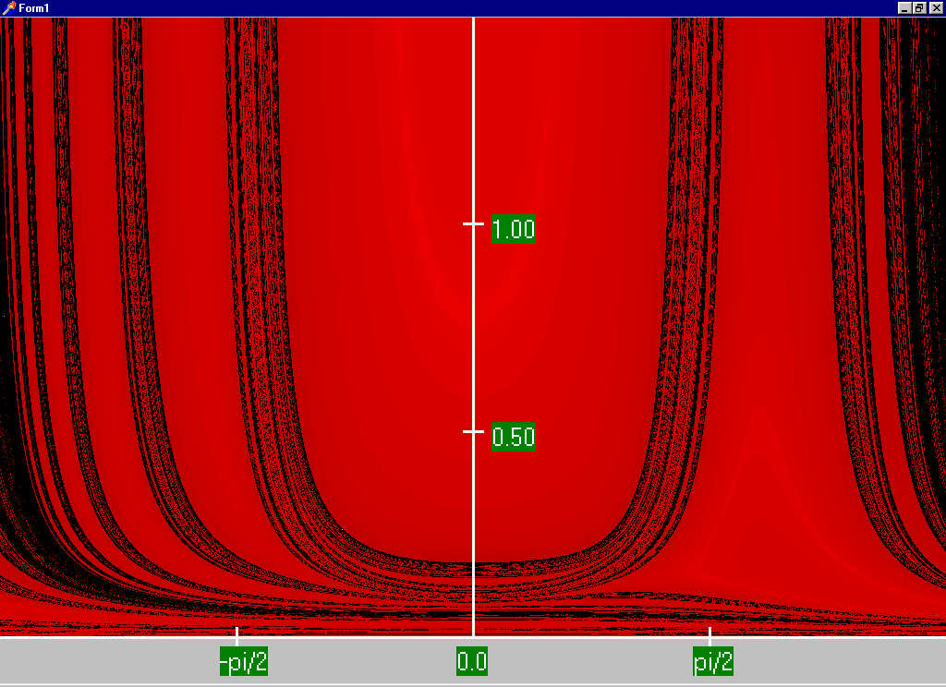
FDPF Region of Convergence

Slide 33
FDPF Cautions
The FDPF works well as long as the previous approximations hold for the entire system
With the movement towards modeling larger systems, with more of the lower voltage portions of the system represented (for which r/x ratios are higher) it is quite common for the FDPF to get stuck because small portions of the system are ill-behaved
The FDPF is sometimes used to provide an initial guess of the solution or for contingency analysis

Slide 34
DC Power Flow
The “DC” power flow makes the most severe approximations:
  completely ignore reactive power, assume all the voltages are always 1.0 per unit, ignore line conductance
This makes the power flow a linear set of equations, which can be solved directly
The term dc power flow actually dates from the time of the old network analyzers (going back into the 1930’s)
Not to be confused with the inclusion of HVDC lines in the standard NPF
P sign convention is generation is positive

Slide 35
DC Power Flow References
I don’t think a classic dc power flow paper exists; a nice formulation is given in our book Power Generation and Control book by Wood, Wollenberg and Sheble
The August 2009 paper in IEEE Transactions on Power Systems, “DC Power Flow Revisited” (by Stott, Jardim and Alsac) provides good coverage
T. J. Overbye, X. Cheng, and Y. Sun, “A comparison of the AC and DC power flow models for LMP Calculations,” in Proc. 37th Hawaii Int. Conf. System Sciences, 2004, compares the accuracy of the approach

Slide 36
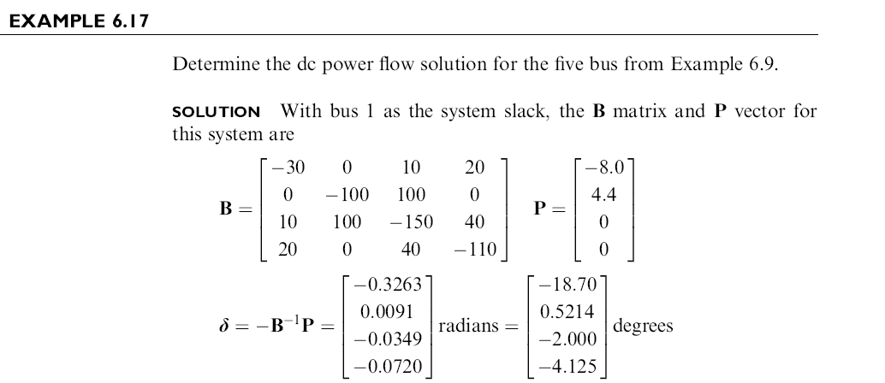
DC Power Flow Example
Example from Power System Analysis and Design, by Glover, Overbye, Sarma, 6th Edition

Slide 37
DC Power Flow in PowerWorld
PowerWorld allows for easy switching between the dc and ac power flows (case Aggieland37)
To use the dc approach
in PowerWorld select Tools, Solve, DC Power Flow
Notice there are no losses

